Slide 1

Computer as a modern means of communication
With the help of computers the Internet has entered into our life. It became an integral part of a life of each person. Now people cannot live without checking of mail and visiting their favourite sites.
Учитель английского языка Яньшина А.А.
Учитель информатики Комкова Г.В.

Slide 2
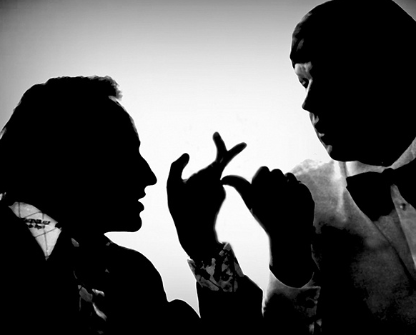
Dialogue vocabulary
In my opinion…
Oh, I see!
I never thought about it that way before.
I’m afraid I can’t agree…
I don’t agree that…
May I have a word?
Excuse me for interrupting…
What do you think about it?
To my mind…
I feel strongly against it.

Slide 3
Listen to four people speaking about the role of computers in their lives and decide whether these statements are true (T) or false (F) .
A 1. Her job is to assess and repair computers.
2. She often wonders how people managed without computers.
B 1. He uses the computer every day.
2. He never writes to his relatives.
C 1. She believes that life would be easiest without computers.
2. She knows that there are many people who don’t use computers.
D 1. He is worried that people depend on computers too much.
2. He thinks that computers can help people develop their skills.

Slide 4

Pair work
Work in pairs. Discuss the following questions and report the results back to the class.
How is your life dependent on technology?
Do you think people depend on computers too much?
What do you think the world would be like without computers?

Slide 5
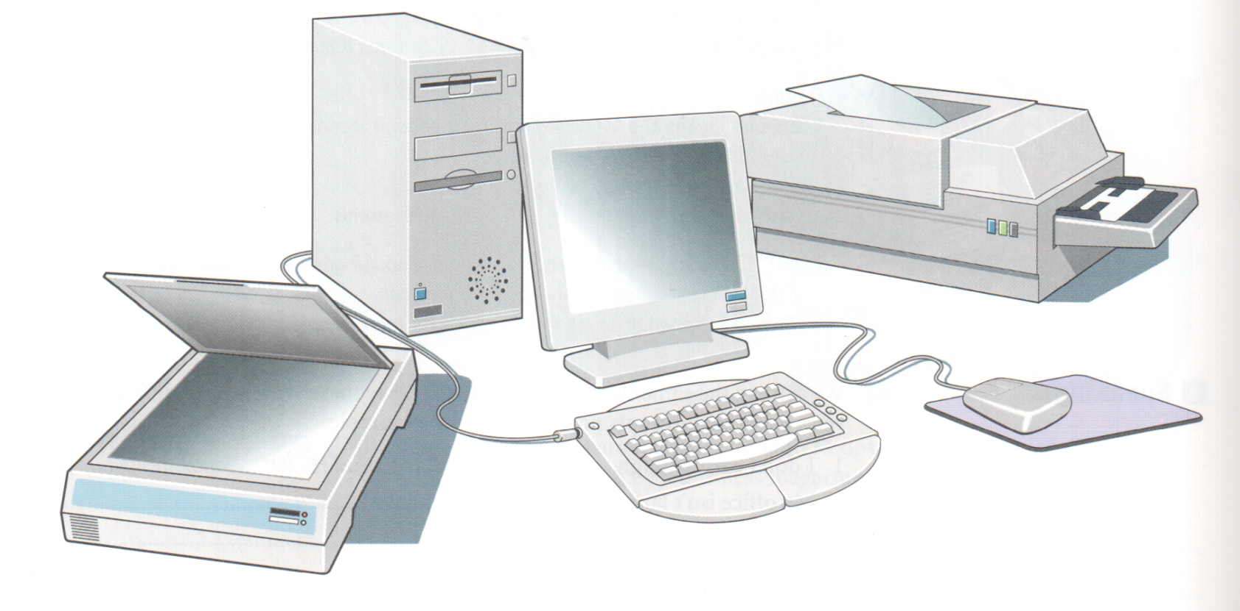
Label the picture
Keyboard, scanner, printer, socket, central unit, mouse mat, screen, mouse
1.
6.
4.
3.
7.
5.
8.
2.

Slide 6
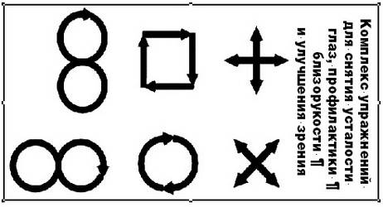
Ease your eyes

Slide 7
Reading task
Open Microsoft Word, read the text “The benefits of Modern Technology”, do the tasks.
True or False?
1. The author is annoyed about those who still don’t know what the “e” in e-mail stands for.
2. It is cheaper to send an e-mail than an ordinary letter.
3. It takes several days to send an e-mail.
4. The computer you need should be fairly powerful.

Slide 8

E-mail message
Rebecca has to write a weekly article, and then send it to her editor with an e-mail message. Complete this flow chart using the expressions below.
Send to editor
Shut down
Check spelling
Write e-mail message
Connect modem
Attach article
Write article
Disconnect modem
Save any changes
Save document
Open application
Switch on computer

Slide 9

Emoticons and abbreviations.
When people send informal e-mails or text messages, they sometimes use emoticons ( symbols) or abbreviations. Look through the list and match the items 1-9 with the meaning a-i.
I-O a) I’m angry
CUL8R b) I’m frowning
:-O c) by the way
BTW d) Are you OK?
:-C e) I’m yawning
TYVM f) I’m sad
:( g) Thank you very much
RUOK h) see you later
:-II i) Wow!

Slide 10
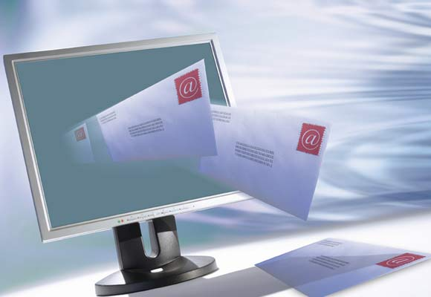
Writing an e-mail
Write an e-mail message to
your classmates.
Their addresses:
ta96q@yandex.ru
marina95p@yandex.ru
karabey2009@yandex.ru

Slide 11




Rounding off
Open Paint and draw a face according to your mood:
“OK”
“Bad”
“Good”
“So-so”

Slide 12
You can learn some more information in these books:
Matrix. Kathy Gude, Michael Duckworth. Oxford University Press.-2002.
Business Basics. David Grant and Robert McLarty. Oxford University Press.-2003.
“Enjoy English” 10 класс. М.З. Биболетова .
Универсальные материалы для подготовки учащихся к ЕГЭ по английскому языку. «Интеллект-центр»-2010.

