Slide 1
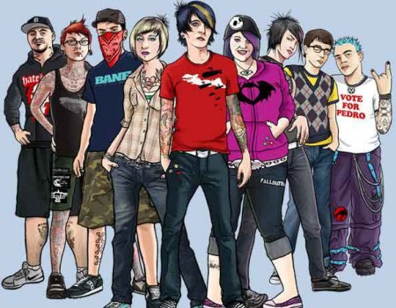
Обобщающий урок в 10 классе по теме
«Молодежные субкультуры»
Учитель МБОУ «Гимназия №3»
Зинченко О. С.

Slide 2


Slide 3
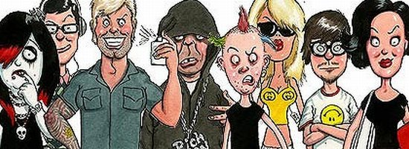
Subcultures

Slide 4
Our tasks:
revise the material
on Subcultures
doing different kinds of work

Slide 5
Choose the right characteristics of a subculture.
1. a way of life.
2. a way for teenagers to express their individuality.
3. the total of the inherited (унаследованный) ideas, beliefs, values and knowledge.
4. any group within a larger complex culture which has interests that vary from those of the mainstream culture.
5. the total range of activities and ideas of a group of people with shared traditions, which are transmitted and reinforced by the members of the group.
6. a group with distinct styles, behaviors and interests.

Slide 6
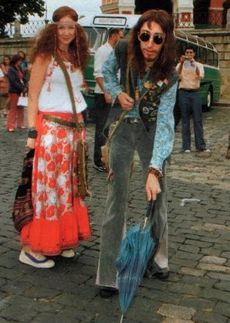
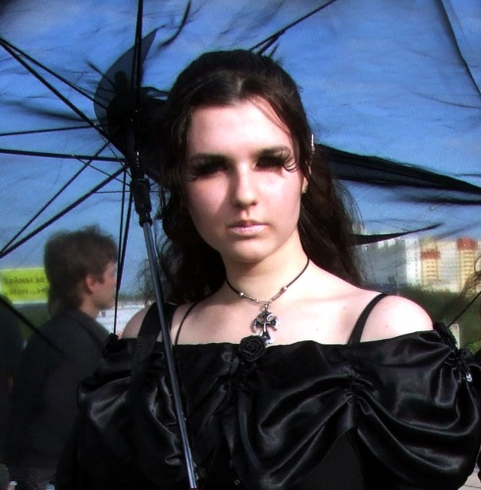
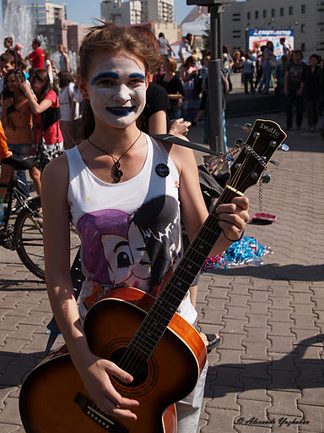
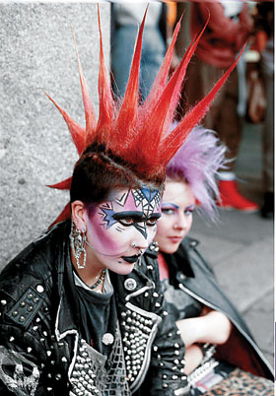
Main features of subcultures
image
music
ideas
lifestyle

Slide 7
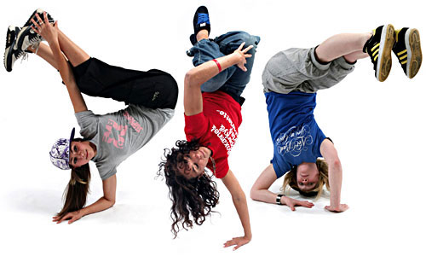
Name members of subcultures

Slide 8
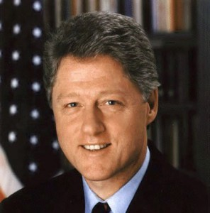
Bill (William Jefferson) Clinton
the American ex-president

Slide 9
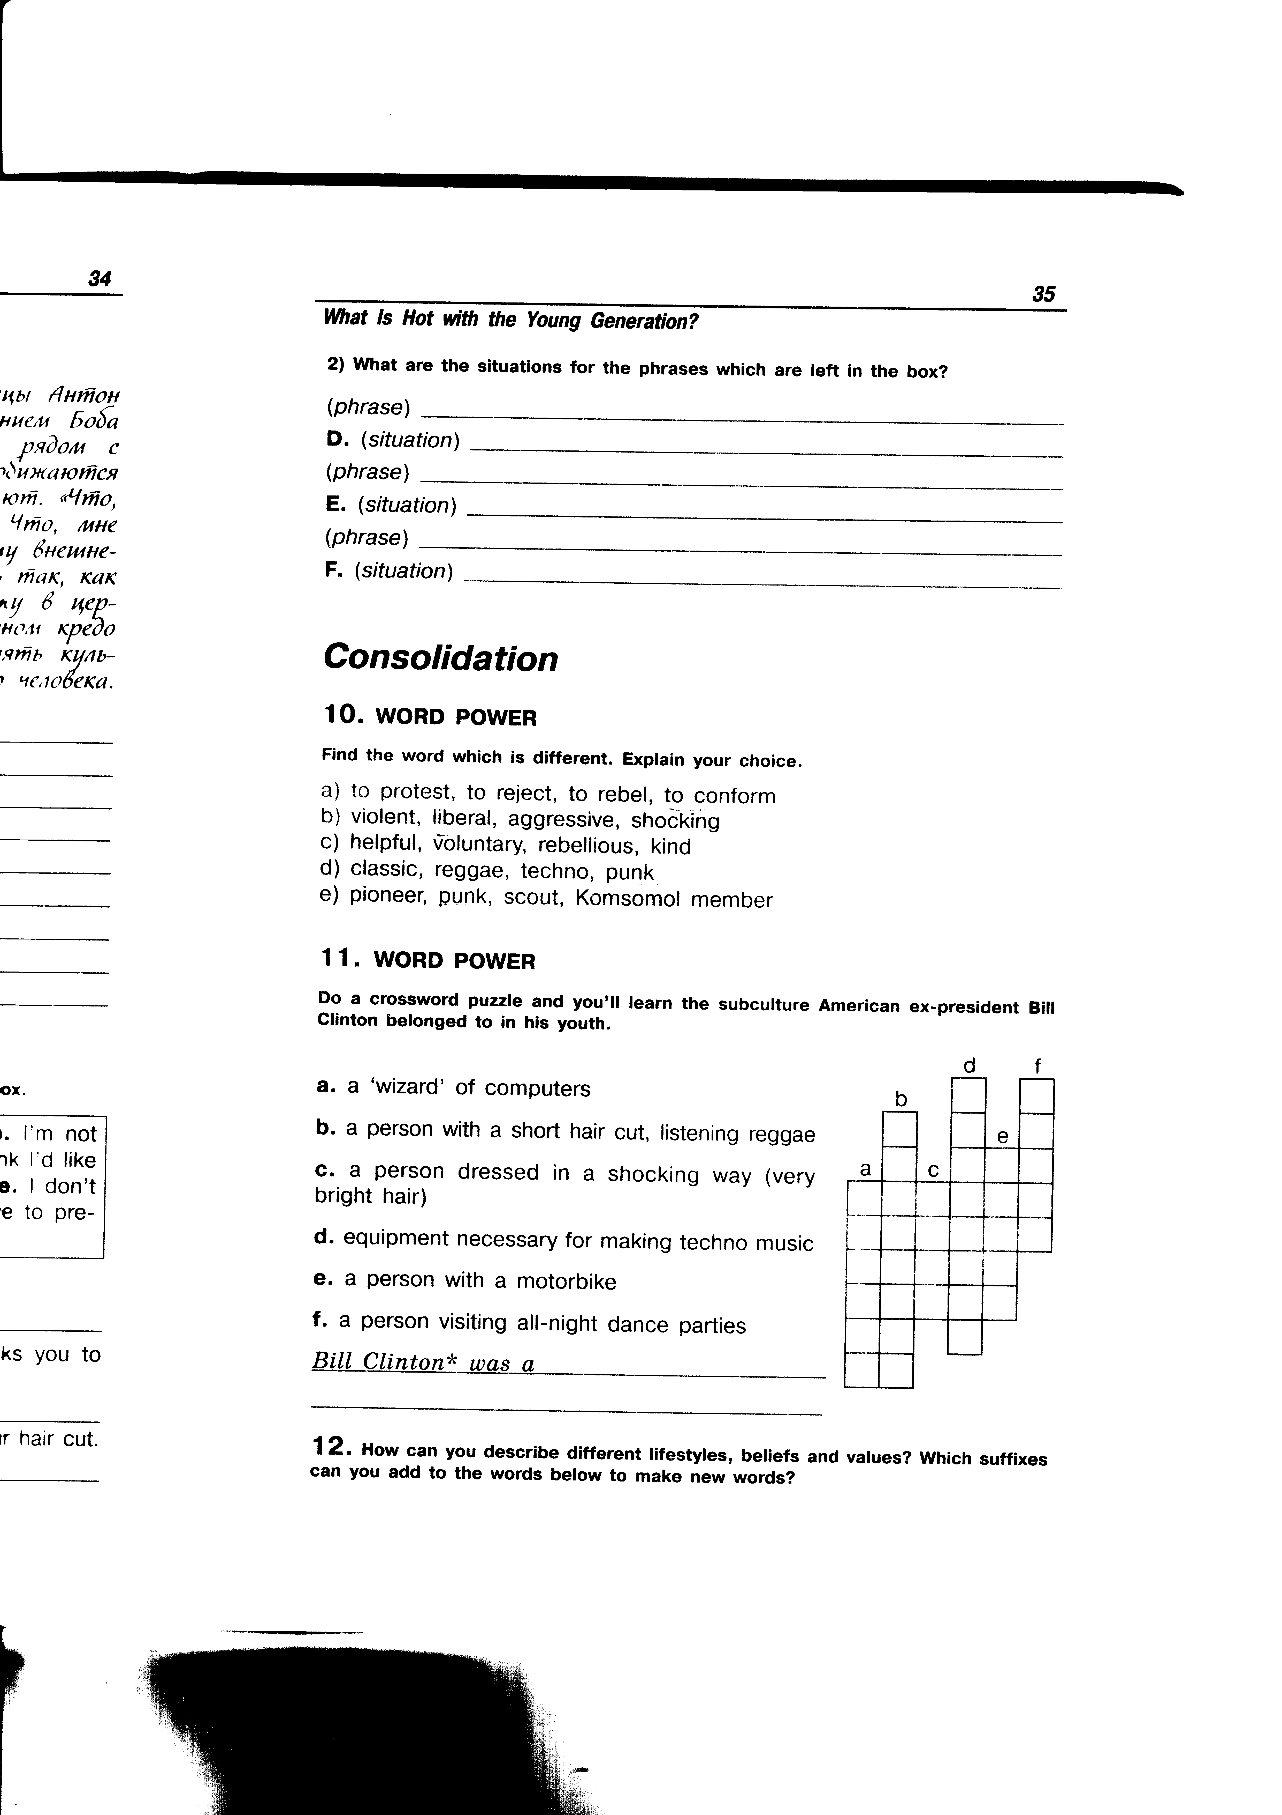
Do a crossword puzzle.

Slide 10
Find the answer to the questions.
In which text can you find the description of the: goth? mod? skinhead? raver? hacker? | A He is a wizard of the computer community, he knows how his computer works. He can do things with it that seem “magical”. | B He is one of a gang of white boys characterized by closely cropped hair, heavy boots, and braces and a nationalist and racist agenda.
 | C He is a person who leads a wild or uninhibited social life, especially attending “Rave” parties. | D Elements of the lifestyle include music, clothes (often tailor-made), dancing and motor scooters.
 | E He is characterized by black clothes and deathly white make-up. | F He is a member of a motorcycle gang.

Slide 11
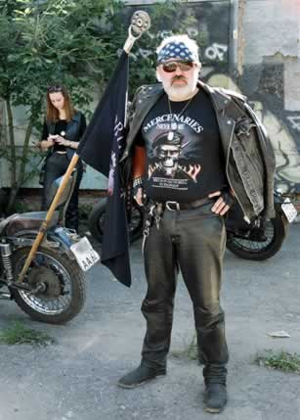
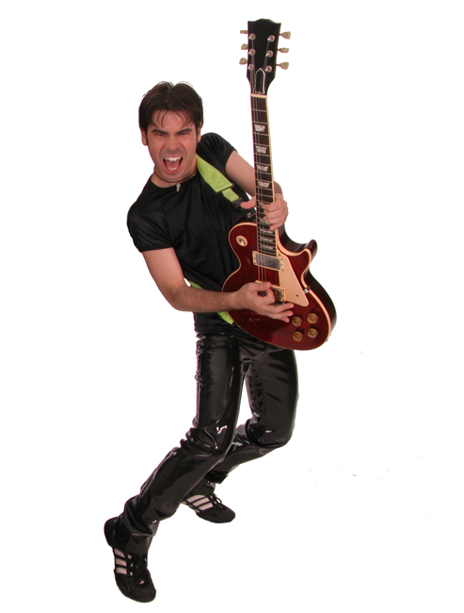
Describe the members of subcultures.

Slide 12
Use the words from the right column in the correct form.
I have never supposed that there are so many music styles and so many 1) _____ around us. I have only known something about 2) ____, they are the people who like to wear the 3) ____ black and lots of silver jewellery. It seems to me, that I begin to 4) ____ why this subculture is so 5) _____ among teenagers and young people. They start to analyze their 6) ___ and become 7) _______ with it. | culture gothical black misunderstand popularity live satisfy

Slide 13

match the attitudes (1-5) with the statements (A-F).
Which speaker says that …
A. the teens want to change the world?
B. when you are a teen, you what to know who you are?
C. some people know where they are going, but most teens don’t have any idea?
D. It seems to the teens that the parents are always against?
E. a subculture is a way of life, a real life?
F. all subcultures are awful?

Slide 14

Give a talk about a subculture.
Remember:
to tell what a subculture is;
to tell what subculture you belong to;
to explain why you like your subculture.

Slide 15

Hometask
write about your
own attitude to any subculture

Slide 16


