Slide 1
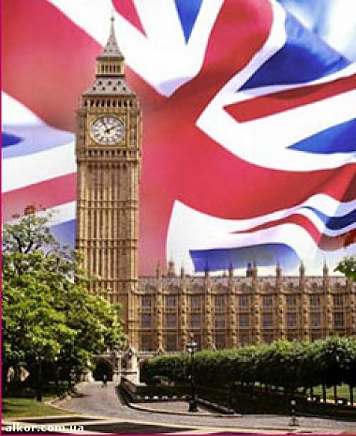
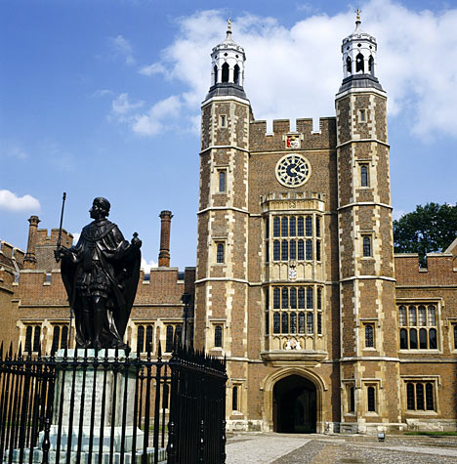
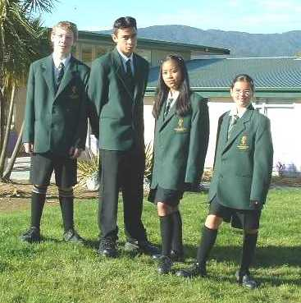

Schools

Slide 2
Conversation bricks
As a rule
But what about
In general
The exception is
Но как же насчет
Как правило
Исключением является
В общем

Slide 3
Conversation bricks
As a rule
But what about
In general
The exception is
Как правило
Но как же насчет
В общем
Исключением является

Slide 4
ABBYY Lingvo
public school
1) привилегированная частная средняя школа (закрытая; чаще школа- интернат для мальчиков) (в Англии)
2) (бесплатная) средняя школа (в США )
public school
1) (in England and Wales) a private independent fee-paying secondary school
2) (in the US) any school that is part of a free local educational system

Slide 5
Types of schools
Russian | English | American
Государственная школа | State school | Public school
Частная школа | Public school | Private schools

Slide 6
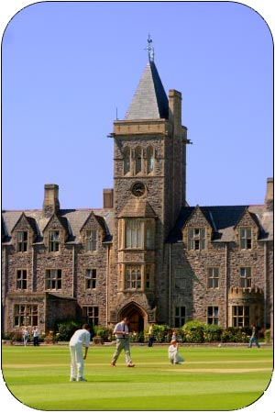
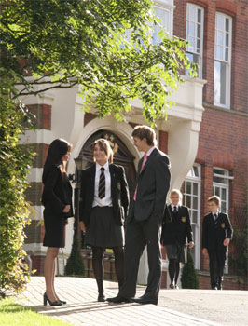
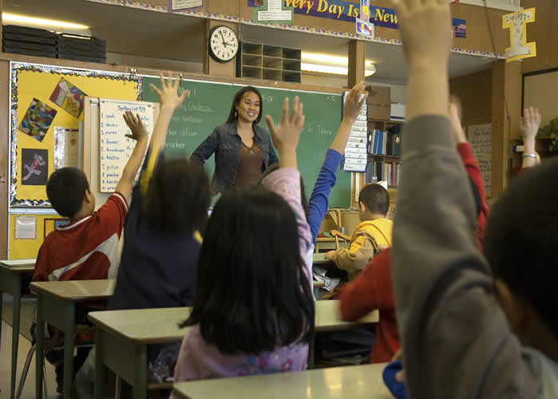
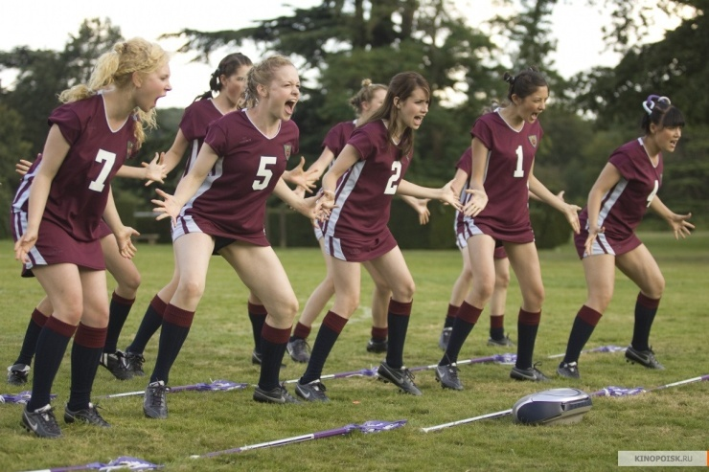
English schools

Slide 7
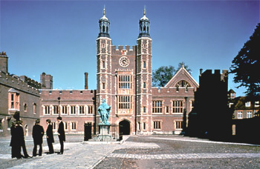
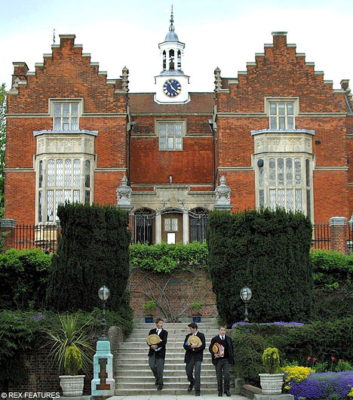
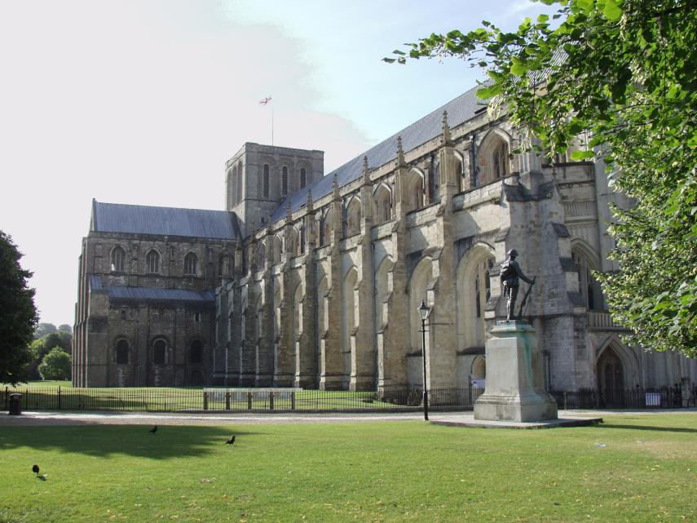
Famous public schools
Eton College
Harrow
Winchester

Slide 8
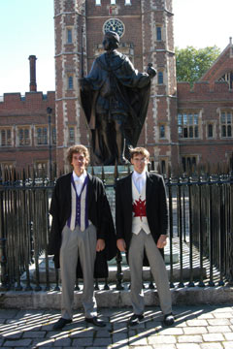
Eton College
Eton is one of England’s prestigious schools.
It is an all-boys school.

Slide 9
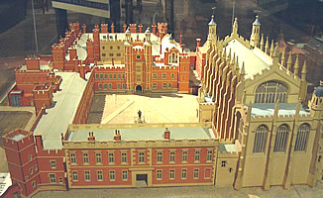
Eton College
A model of Eton College

Slide 10
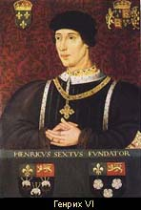
Eton College
Eton College
was founded
in 1440
by Henry VI
Henry VI

Slide 11

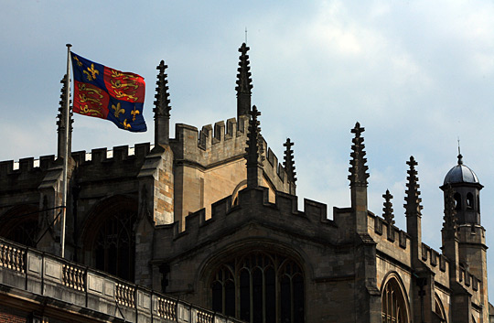
Eton College
The flag of Eton College and
the coat of arms

Slide 12
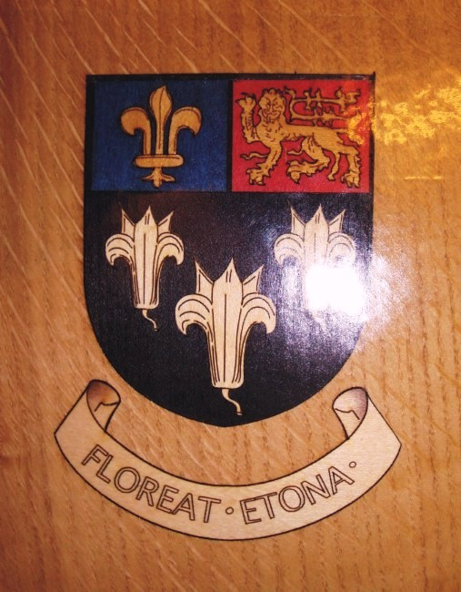
Eton College
Eton’s motto is
“Floreat Etona”
Девиз колледжа
«Да процветает Итон»

Slide 13
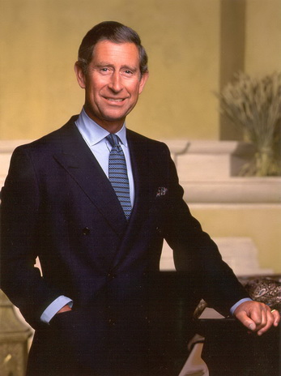
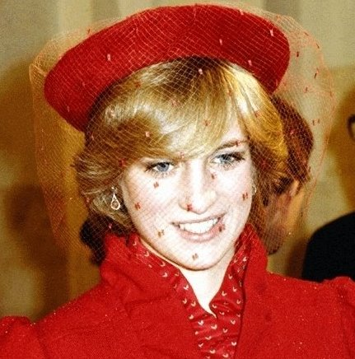
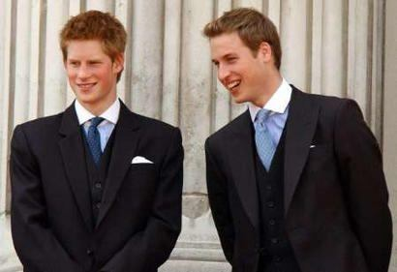
Eton College
Diana
Charles
Harry and William
The sons of Prince Charles and Princess Diana
studied at Eton.

Slide 14
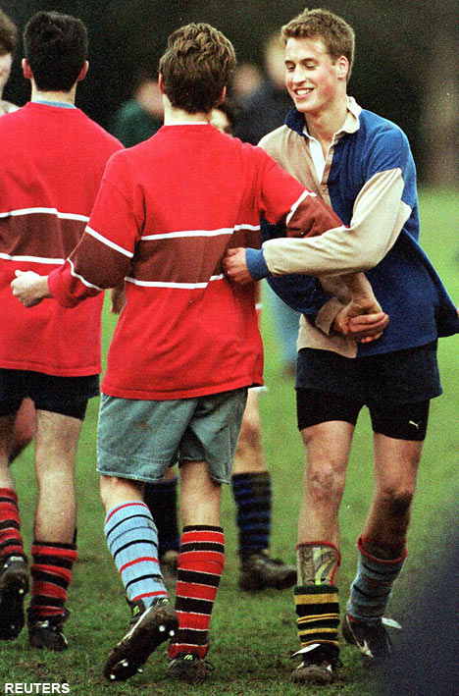
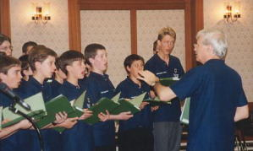
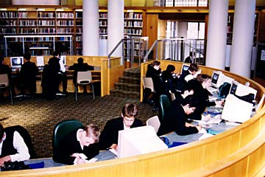
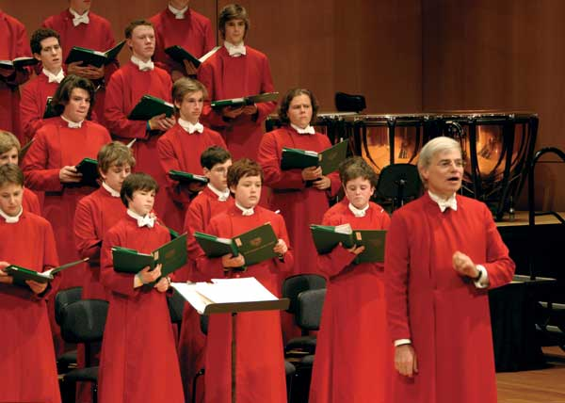
Eton College
There are
1,309 boys between the ages of 13 and 18 in Eton.

Slide 15
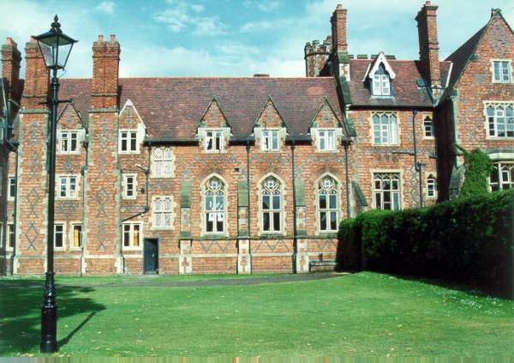
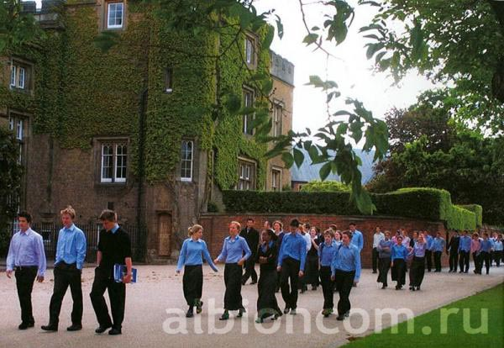
Rugby School
Страна:Англия
Город:Регби
Тип обучения:Совместное обучение
Возраст:13-18 лет
Количество:781 студентов.
Рейтинги:Лучшие частные школы Великобритании 2009 г. по версии
The Daily Telegraph - 38

Slide 16
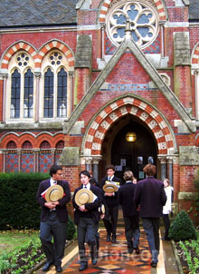
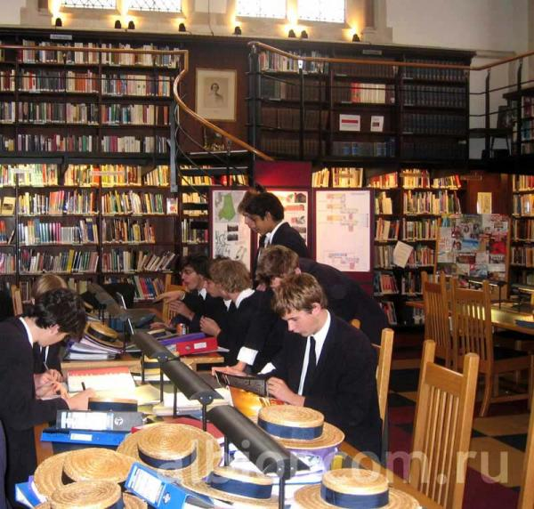
Winchester College
Страна: Англия
Город: Винчестер
Тип обучения: Для мальчиков
Возраст: 13-18 лет
Количество: 692 студентов.
Рейтинги: Лучшие частные школы Великобритании за 2006 г. по версии:
The Sunday Times - 29

Slide 17
Quiz
1. Eton is…
the home of Prince William.
an all- boys school.
a famous state school.

Slide 18
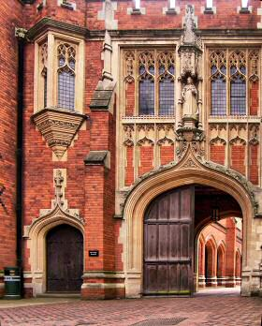
Quiz
2. When was Eton founded?
in 1440
in 1540
in 1640
in 1740

Slide 19
Quiz
3. What does “Floreat Etona” mean?
Да процветает Итон.
b) Пусть всегда будет Итон.
c) Да здравствует Итон.

Slide 20
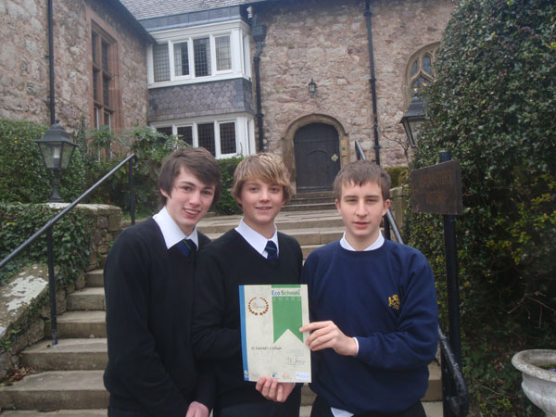
Quiz
4. Who can study at Eton?
the rich
b) the poor
c) only the children
of kings and queens

Slide 21
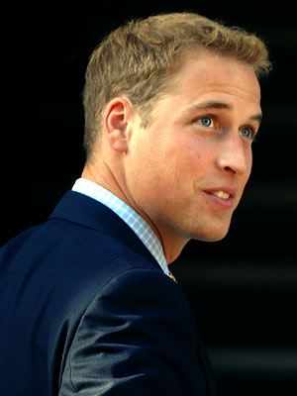
Quiz
5. Prince William…
lives in Eton now.
b) studies at Eton.
c) studied at Eton.

Slide 22
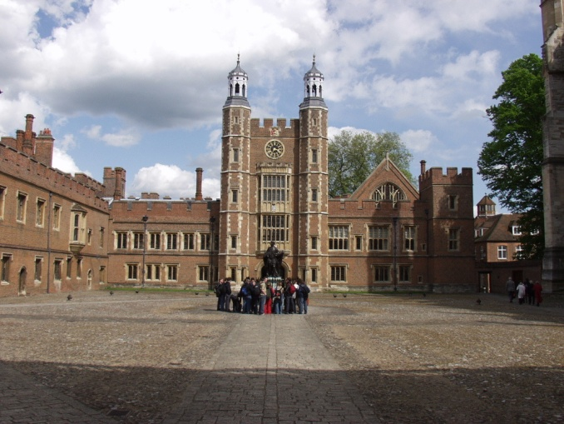
Quiz
6. Public school means that…
the school is private.
b) the school is for
everybody.

Slide 23
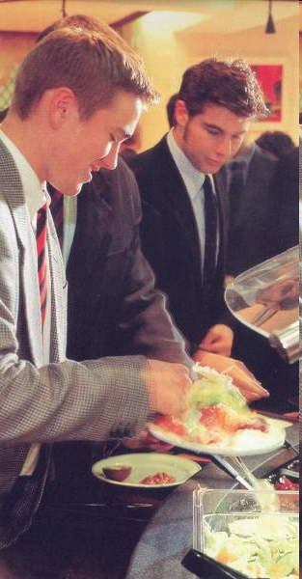
Quiz
7. Boarding school means that…
students live there.
b)it is abroad.
c)there are only boys there

Slide 24
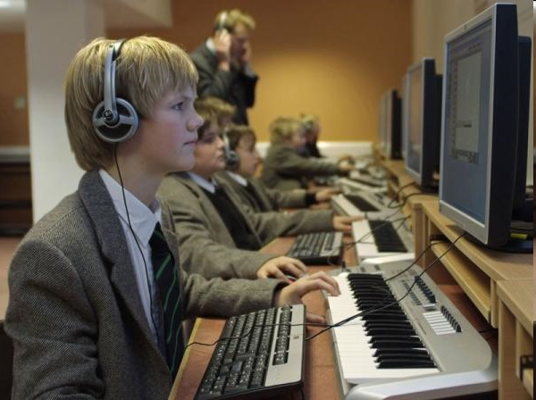
Quiz
8. If you get a scholarship it means that…
the school will pay you money
b)you`ll have to take extra exams
c)You don`t have to pay for the school

Slide 25
Conversation bricks
Обобщение
Конкретизация
As a rule
In general
But what about
The exception is

Slide 26
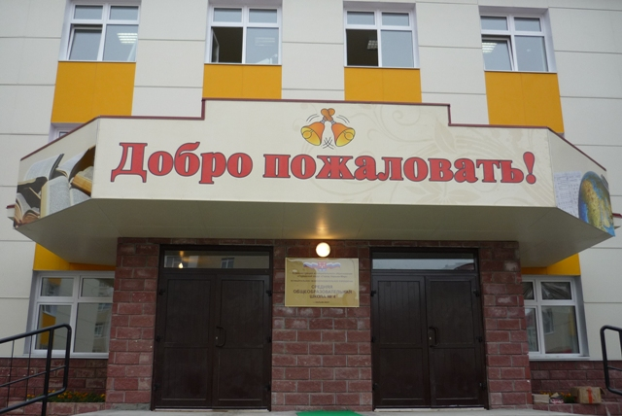
Homework
Ex.9, 10 p. 115

Slide 27
Использованные источники
Слайды из презентации Кашпаровой Гульнары, 2010г.

