Slide 1
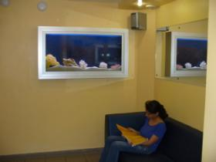

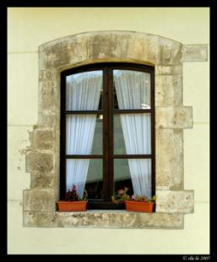
“home, SWEET HOME”
Парасоцкая О.Н., учитель английского языка
II квалификационной категории
МОУ Куриловской школы
Подольского района
Московской области

Slide 2



Slide 3
Найти русский эквивалент пословице
“East or west home is best”
Где бы я не находился, дом – лучшее место
Запад, восток, дом- лучшее место
В гостях хорошо, а дома лучше!

Slide 4
[O:]
[b]
[I]
[R]
floor
armchair
table
bathroom
living room
lamp
hall
bedroom
kitchen

Slide 5

There is a … . There are …
a chair
a computer
a bed
a lamp
a carpet
a desk
books
a picture

Slide 6
There is a bed in the …. .
There is a red … on the floor in my room.
There are two big … in my flat.
We have got a carpet on the … .
There is a … on the desk.
We can draw a … .
I like to sit in my … .
My mother cook breakfast in the … .
I like my … .
Fill the crossword and
you’ll read another word
in the marked squires.

Slide 7

Where is the bear?
in
above
behind
between
under
In the middle of
In the left corner

Slide 8
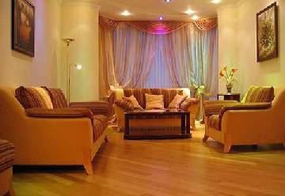
Is there a (an) … ? Are there … ?
Have you got a (an) … ?
a table
a lamp
a shelf
a sofa
a chair
an armchair
a carpet
a picture
a window
a fireplace
a computer

Slide 9
Let’s have a fun!
Sing a song!

Slide 10

Listen to the text and
do some tasks

Slide 11




Speak about your room
Estate Agency
“The room of your Dream”

Slide 12

You are right!

Slide 13

Try again!

