Slide 1
Animals In Our Life

Slide 2
[s], [d], [t], [f], [v], [e], [ei], [a:], [ai].

Slide 3
for, no, five, wet, pet, arm, ham, pale, bed, red, fine, my

Slide 4


TH
5
4
6
7
8
3
9
2
10
1

Slide 5
the fourth
the fifth
the sixth
the seventh
the eight
the ninth
the tenth
the eleventh
the twelfth
the first
the second
the third

Slide 6

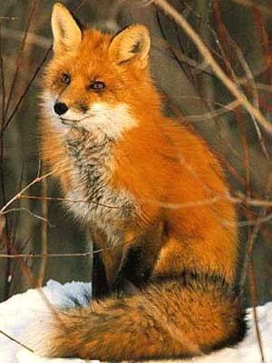

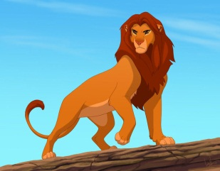
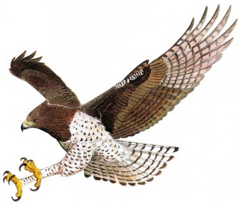
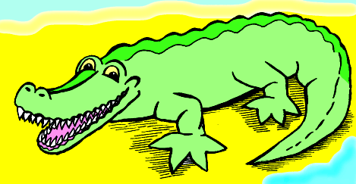
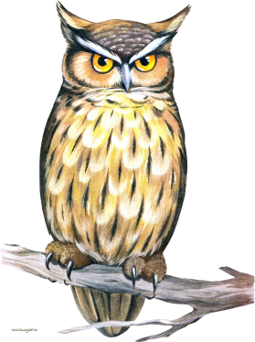
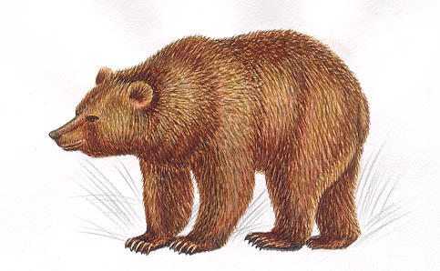
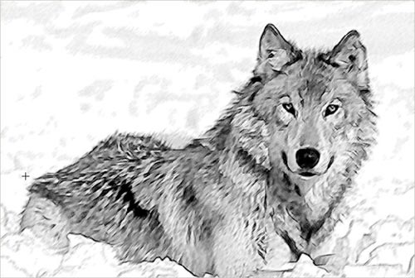
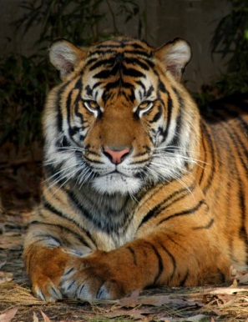
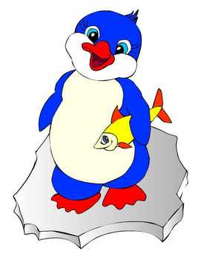
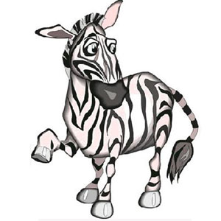
Match the words to the pictures
Elephant
Zebra
Lion
Crocodile
Snake
Tiger
Fox
Bear
Wolf
Eagle
Penguin
Owl

Slide 7
Questions to the text
Has Mike got a pet?
What pet has he got?
Does his pet answer to his (her) name?
What colour is his pet?
What does he teach his pet to do?
What can his pet do?
What does his pet eat and drink?

Slide 8
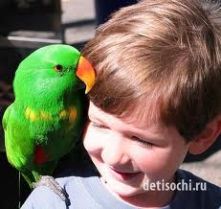
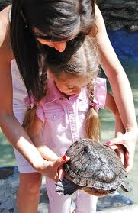
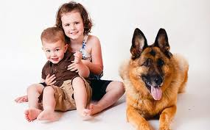
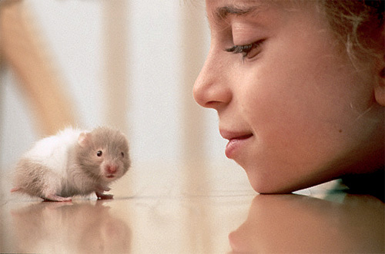
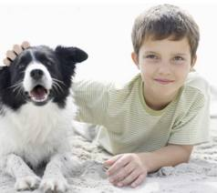
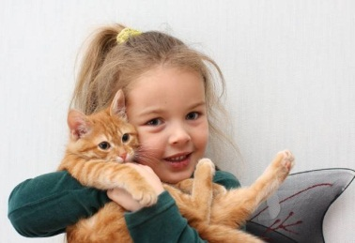
Our Pets

Slide 9
For example:
This is Ben.
He is seven.
He has got a pet.
It is a dog.
His dog’s name is Rex.
Rex is black and white.
Ben likes to play and to walk with his dog.

Slide 10
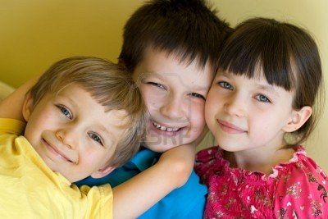
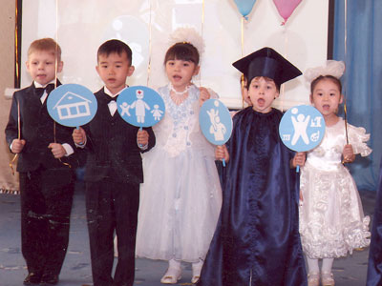
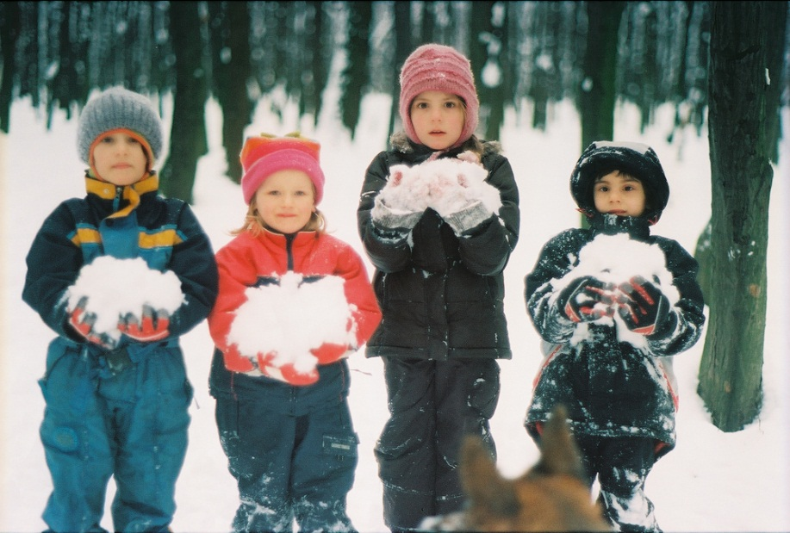

Slide 11
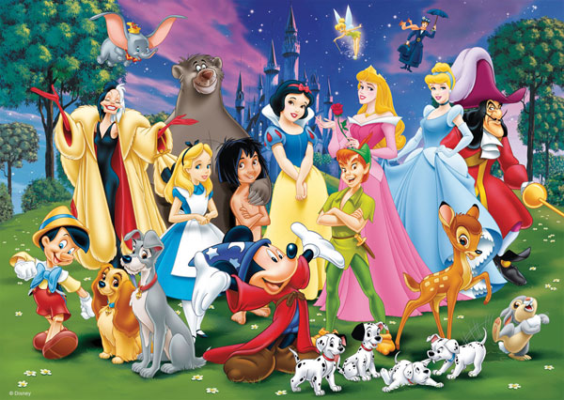

Slide 12
Thank you for attention!

