Slide 1
Презентация к уроку “Знакомство с Англией”
Презентацию подготовила Баянова А. А.
Учитель английского языка ГБОУ СОШ №438 г. Москвы

Slide 2
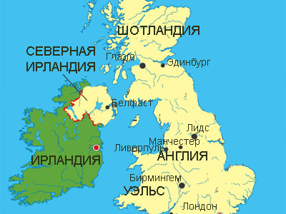
There are four countries in the United Kingdom. They are: England, Scotland, Wales and Northern Ireland.

Slide 3

The symbol of England is a red rose. English people are fond of gardening.

Slide 4
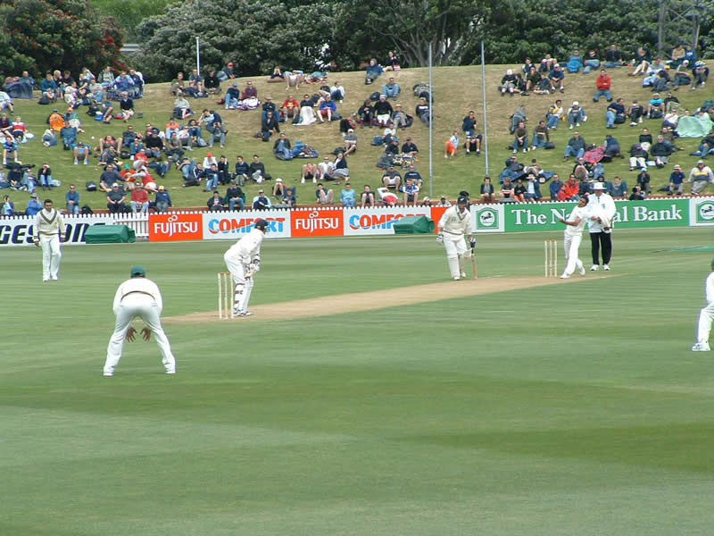
English football is famous of course, but there is another national sport – cricket.

Slide 5

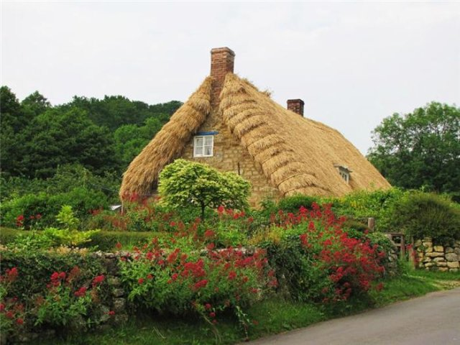
In the south of England you will find a lot of beautiful villages. Some of the houses have thatched roofs.

Slide 6
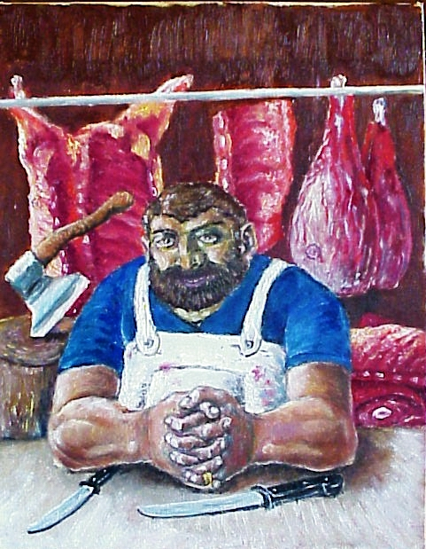
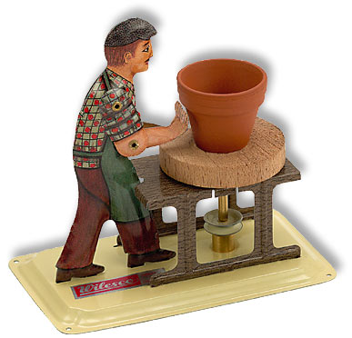
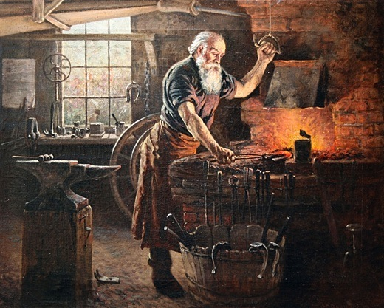
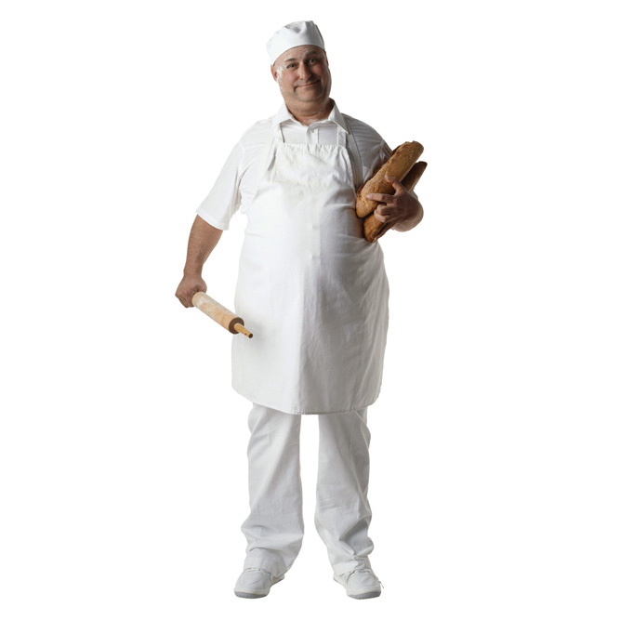
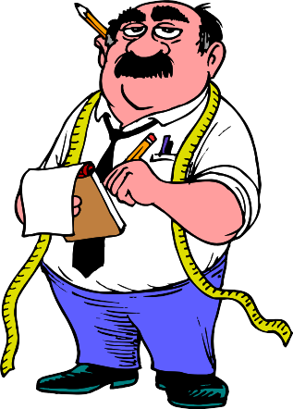
Many English surnames are the names of jobs, for example Butcher, Baker, Potter, Tailor.

Slide 7
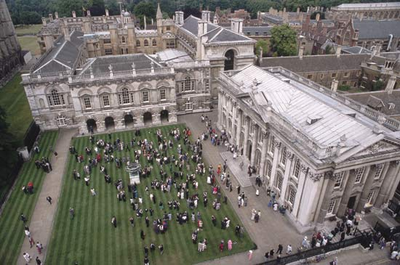
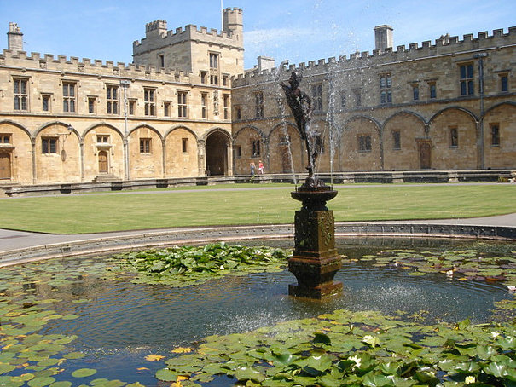
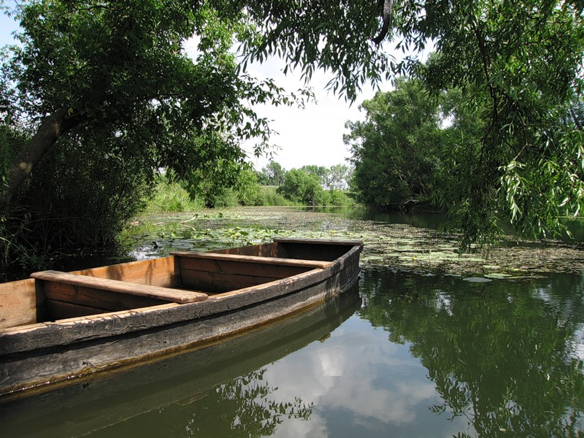
The two oldest and most famous universities in England are in Oxford and Cambridge. If you visit these cities, you will see very many interesting things and among them – punts.

Slide 8
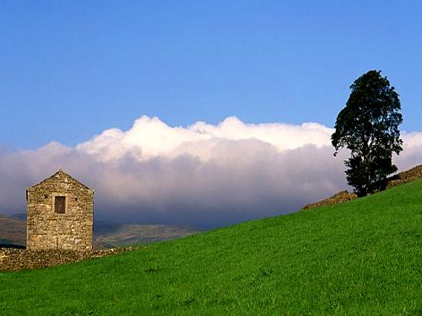
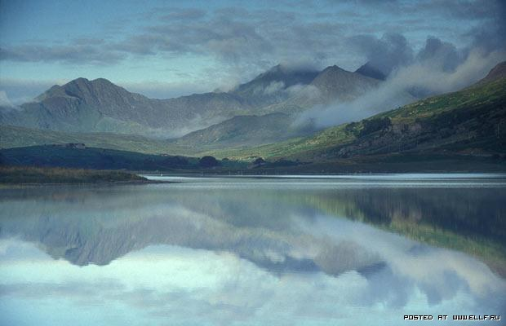
Some of the wildest and most beautiful countryside in England is in the north. It is very popular with walkers and campers.

Slide 9
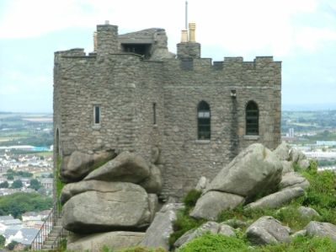
Cornwall is full of mystery and magic. There are lots of fascinating places.

Slide 10
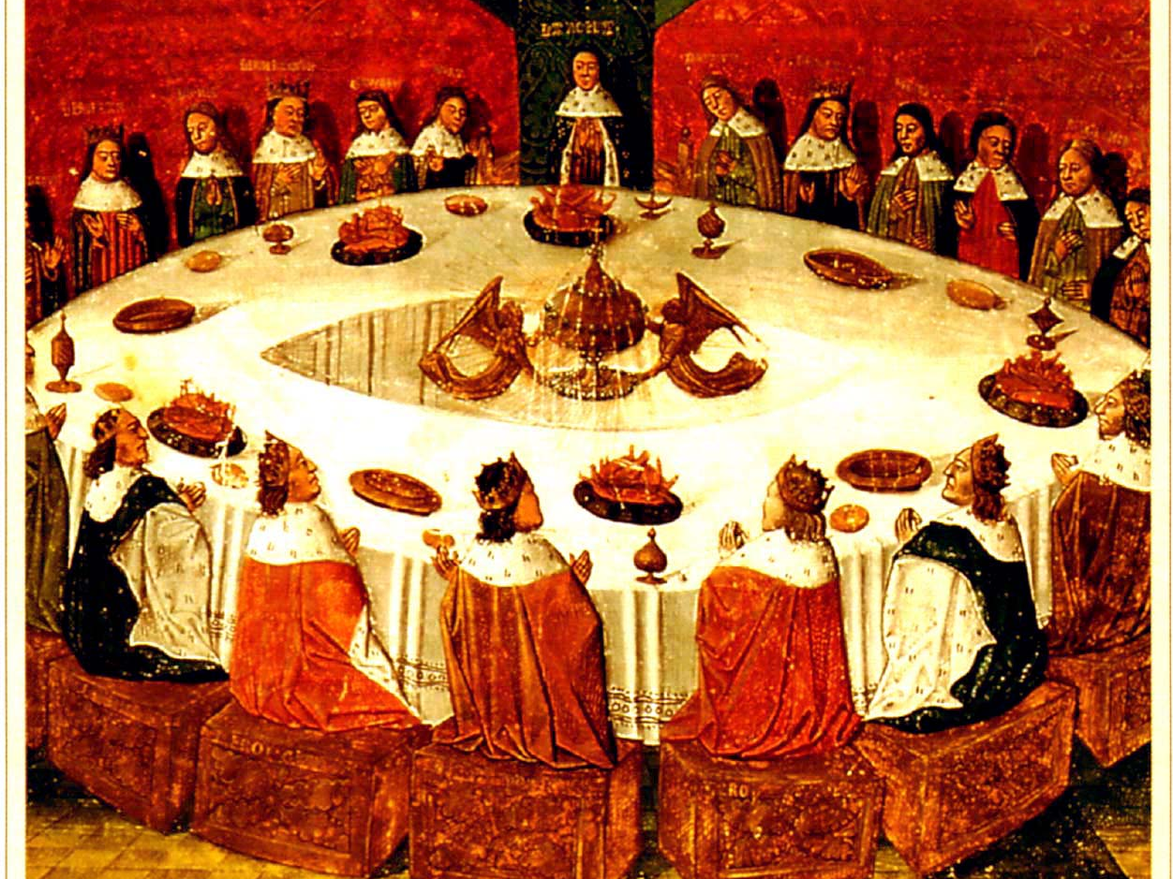
King Arthur is a fabled Celtic warrior of the sixth century. There are a lot of old stories about him, his beautiful wife Guinevere, Merlin, the magician and the Knights of the Round Table.

Slide 11

Thank you for your attention! ☺

