Slide 1


Pass
the
Ball

Slide 2
INSTRUCTIONS:
When the music plays, the students pass the ball. They stop passing, when the music stops. The students without the ball ask “what’s that?” The student with the ball, answers according the picture on screen.
Alternative: The student with the ball asks “what’s that?” and the other students answer according to the picture.
You may also print out the slides as flashcards and play various language games.

Slide 3
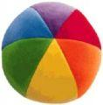

Pass the ball.
Notes:
When this slide is shown, the music will play and the students pass the ball until you click on the screen to stop.

Slide 4
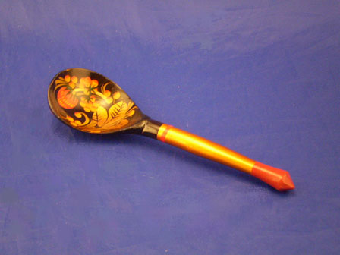
Notes:
After you click the previous screen to stop the music, this next slide will be shown. The student (or students) should say: “I have a toothache.”

Slide 5
Pass the ball.
Notes:
When this slide is shown, the music will play and the students pass the ball until you click on the screen to stop.

Slide 6


Slide 7
Pass the ball.
Notes:
When this slide is shown, the music will play and the students pass the ball until you click on the screen to stop.

Slide 8


Slide 9
Pass the ball.
Notes:
When this slide is shown, the music will play and the students pass the ball until you click on the screen to stop.

Slide 10


Slide 11
Pass the ball.
Notes:
When this slide is shown, the music will play and the students pass the ball until you click on the screen to stop.

Slide 12
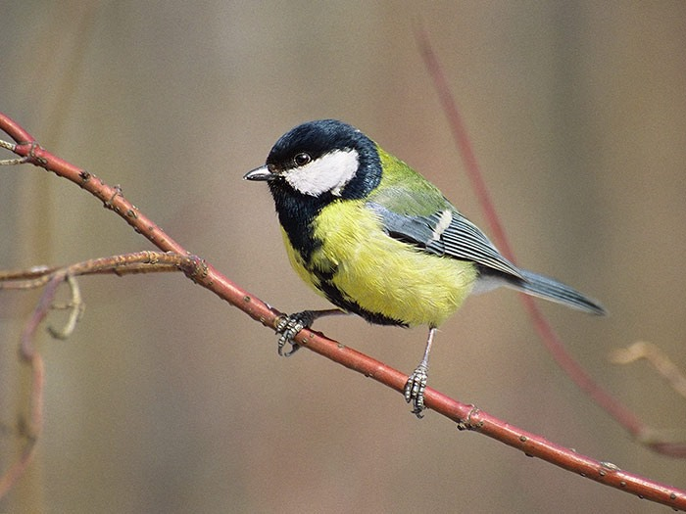

Slide 13
Pass the ball.
Notes:
When this slide is shown, the music will play and the students pass the ball until you click on the screen to stop.

Slide 14
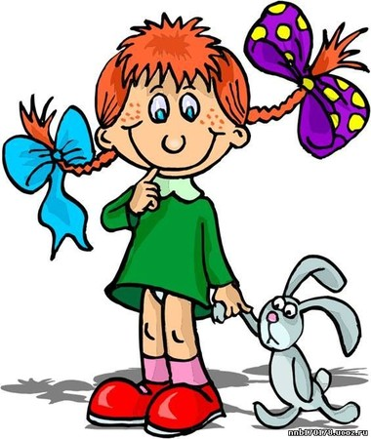

Slide 15
Pass the ball.
Notes:
When this slide is shown, the music will play and the students pass the ball until you click on the screen to stop.

Slide 16
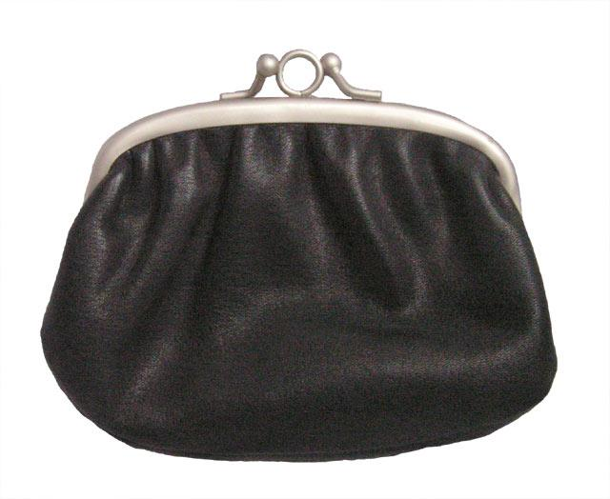

Slide 17
Pass the ball.
Notes:
When this slide is shown, the music will play and the students pass the ball until you click on the screen to stop.

Slide 18


Slide 19
Pass the ball.
Notes:
When this slide is shown, the music will play and the students pass the ball until you click on the screen to stop.

Slide 20


Slide 21
Well done.
The End
Notes:
When this slide is shown, the music will play and the students pass the ball until you click on the screen to stop.

