Slide 1
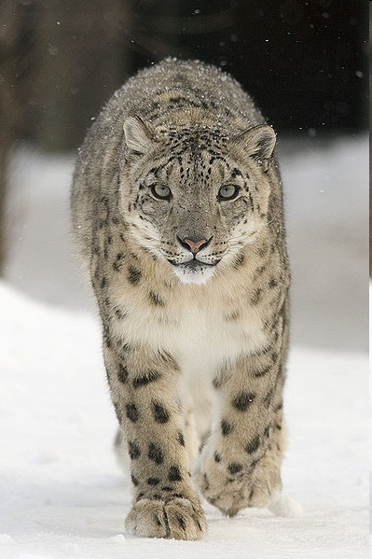
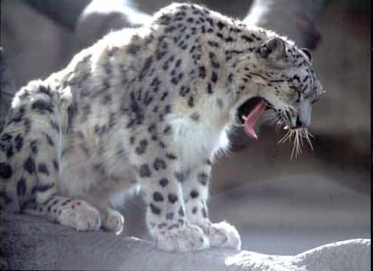
Wild snow leopard

Slide 2
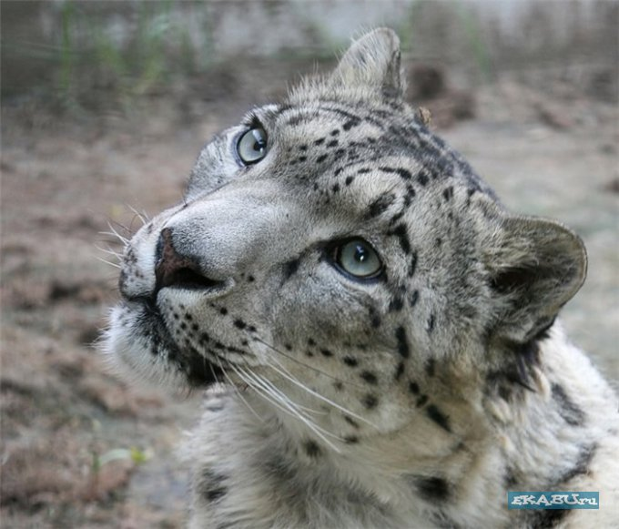
The Snow Leopard lives in Central Asia. It is found in the following countries: Russia, Mongolia, Tibet, China, India, Pakistan, and Afghanistan.

Slide 3
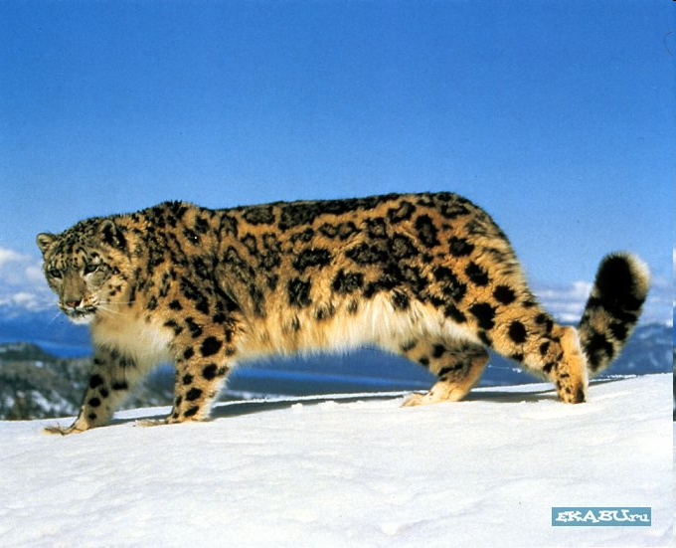
In the day time it lives in caves. It hunts at night . It can jump very well. The snow leopard can see and hear perfectly.

Slide 4
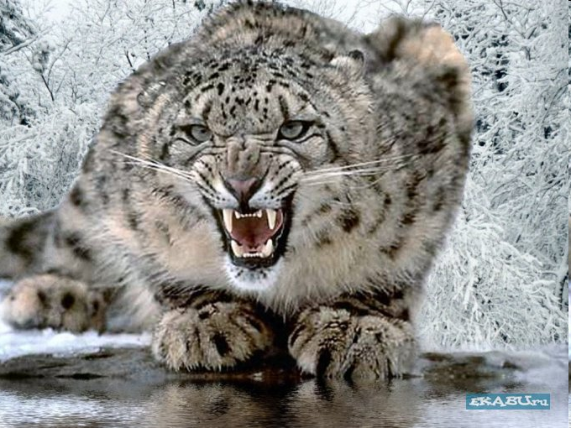
It likes to play with snow. The snow leopard is a good hunter. Every 10-15 days it kills a large animal and eats it about 4 days.

Slide 5
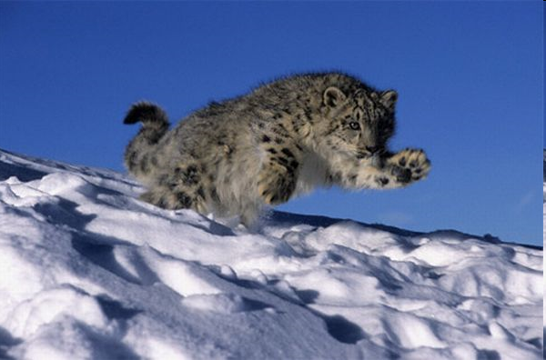
If it sees a man, it escapes and hides. The fur coat of the snow leopard is of great value. That is why hunters kill it very often. A fur coat made of its skin costs 60 thus dollars.

Slide 6
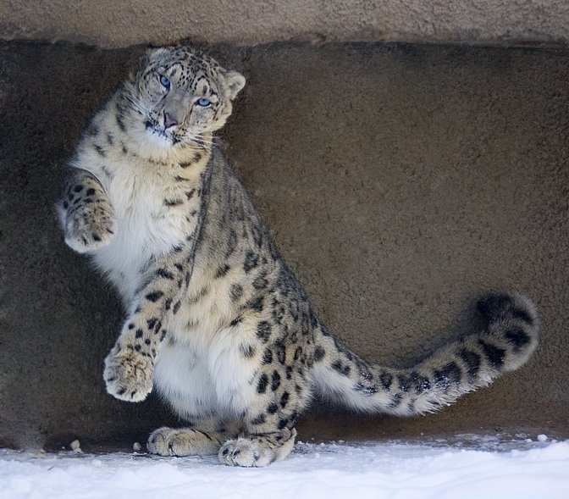
Please, don't kill this beautiful animal!!! Save it for the Earth and our nature.

