Slide 1
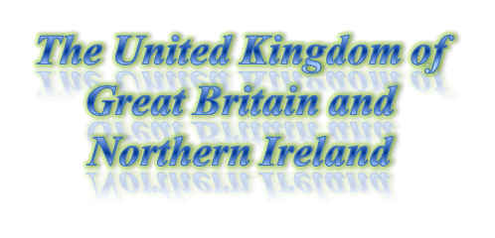
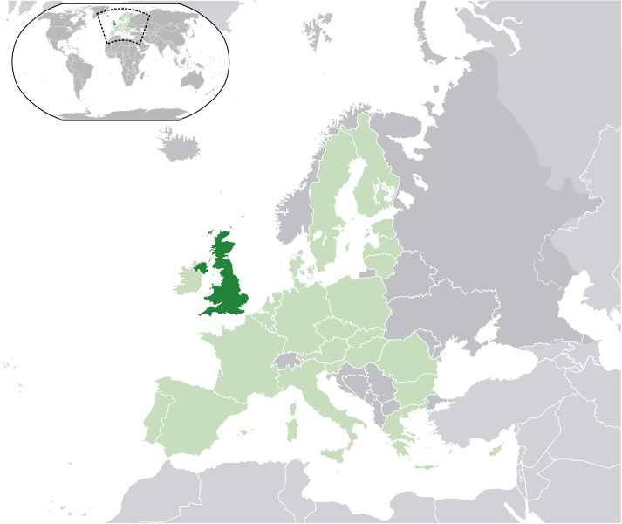





Capital (and largest city) | London 51°30′N 0°7′W
Official languages | English
Area: Total Water (%) | 243,610 km2 (80th) 94,060 sq mi 1.34
Population: Mid-2010 estimate 2001 census Density | 62,262,000 58,789,194 255.6/km2 661.9/sq mi
Currency | Pound sterling (GBP)
Time zone Summer (DST) | GMT (UTC+0) BST (UTC+1)
Calling code | 44

Slide 2
The United Kingdom of Great Britain and Northern Ireland (commonly known as the United Kingdom, the UK or Britain) is a sovereign state located off the north-western coast of continental Europe. The country includes the island of Great Britain, the north-eastern part of the island of Ireland and many smaller islands. Northern Ireland is the only part of the UK that shares a land border with another sovereign state—the Republic of Ireland. Apart from this land border the UK is surrounded by the Atlantic Ocean, the North Sea, the English Channel and the Irish Sea.
The United Kingdom is a unitary state governed under a constitutional monarchy and a parliamentary system, with its seat of government in the capital city of London. It is a country in its own right and consists of four countries: England, Northern Ireland, Scotland and Wales. There are three devolved national administrations, each with varying powers, situated in Belfast, Cardiff and Edinburgh; the capitals of Northern Ireland, Wales and Scotland respectively. Associated with the UK, but not constitutionally part of it, are three Crown Dependencies and fourteen overseas territories. These are remnants of the British Empire which, at its height in 1922, encompassed almost a quarter of the world's land surface and was the largest empire in history. British influence can still be observed in the language, culture and legal systems of many of its former territories.
The UK is a developed country and has the world's sixth-largest economy by nominal GDP and seventh-largest economy by purchasing power parity. It was the world's first industrialised country and the world's foremost power during the 19th and early 20th centuries. The UK remains a great power with leading economic, cultural, military, scientific and political influence. It is a recognised nuclear weapons state and its military expenditure ranks third or fourth in the world. The UK has been a permanent member of the United Nations Security Council since its first session in 1946; it is also a member of the Commonwealth of Nations, the Council of Europe, the European Union, the G7, the G8, the G20, NATO, the OECD, and the World Trade Organization.
God save our gracious Queen, Long live our noble Queen, God save the Queen: Send her victorious, Happy and glorious, Long to reign over us: God save the Queen. O Lord, our God, arise, Scatter her enemies, And make them fall. Confound their politics, Frustrate their knavish tricks, On Thee our hopes we fix, God save us all. Thy choicest gifts in store, On her be pleased to pour; Long may she reign: May she defend our laws, And ever give us cause To sing with heart and voice God save the our Queen.
"God Save the Queen" (alternatively "God Save the King") is an anthem used in a number of Commonwealth realms and British Crown Dependencies. The words of the song, like its title, are adapted to the gender of the current monarch, with "King" replacing "Queen", "he" replacing "she", and so forth, when a king reigns. It is the de facto British national anthem and of some British territories; one of the two national anthems of New Zealand (since 1977) and those of Britain's territories that have their own additional local anthem; and the royal anthem of Australia (since 1984), Canada (since 1980), Barbados, Jamaica, and Tuvalu, as well as Gibraltar and the Isle of Man. In countries not previously part of the British Empire, the tune of "God Save the Queen" has also been used as the basis for different patriotic songs, though still generally connected with royal ceremony.
The authorship of the song is unknown, and beyond its first verse, which is consistent, it has many historic and extant versions: Since its first publication, different verses have been added and taken away and, even today, different publications include various selections of verses in various orders. In general only one verse is sung; sometimes two verses are sung, and on rare occasions three.
The sovereign and his or her consort are saluted with the entire anthem, while other members of the royal family who are entitled to royal salute (such as the Prince of Wales) receive just the first six bars. The first six bars also form all or part of the Vice Regal Salute in some Commonwealth realms outside the UK (e.g., in Canada, governors general and lieutenant governors at official events are saluted with the first six bars of "God Save the Queen" followed by the first four and last four bars of "O Canada"), as well as the salute given to governors of British overseas territories.

Slide 3
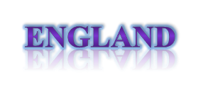
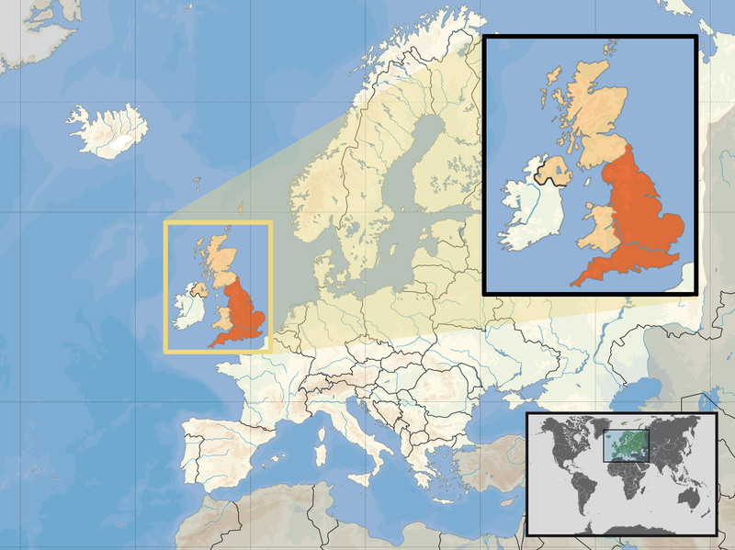

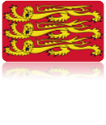



Capital (and largest city) | London 51°30′N 0°7′W
Official languages | English
Area: Total | 130,395 km2 50,346 sq mi
Population: 2008 estimate 2001 census Density | 51,446,000 49,138,831 395/km2
Currency | Pound sterling (GBP)
Time zone Summer (DST) | GMT (UTC+0) BST (UTC+1)
Calling code | 44
Date formats | dd/mm/yyyy

Slide 4

England is a country that is part of the United Kingdom. It shares land borders with Scotland to the north and Wales to the west; the Irish Sea is to the north west, the Celtic Sea to the south west, with the North Sea to the east and the English Channel to the south separating it from continental Europe. Most of England comprises the central and southern part of the island of Great Britain in the North Atlantic. The country also includes over 100 smaller islands such as the Isles of Scilly and the Isle of Wight.
The area now called England was first inhabited by modern humans during the Upper Palaeolithic period, but it takes its name from the Angles, one of the Germanic tribes who settled during the 5th and 6th centuries. England became a unified state in AD 927, and since the Age of Discovery, which began during the 15th century, has had a significant cultural and legal impact on the wider world. The English language, the Anglican Church, and English law—the basis for the common law legal systems of many other countries around the world—developed in England, and the country's parliamentary system of government has been widely adopted by other nations. The Industrial Revolution began in 18th-century England, transforming its society into the world's first industrialised nation. England's Royal Society laid the foundations of modern experimental science.
England's terrain mostly comprises low hills and plains, especially in central and southern England. However, there are uplands in the north (for example, the mountainous Lake District, Pennines, and Yorkshire Dales) and in the south west (for example, Dartmoor and the Cotswolds). London, England's capital, is the largest metropolitan area in the United Kingdom and the largest urban zone in the European Union by most measures. England's population is about 51 million, around 84% of the population of the United Kingdom, and is largely concentrated in London, the South East and conurbations in the Midlands, the North West, the North East and Yorkshire, which each developed as major industrial regions during the 19th century. Meadowlands and pastures are found beyond the major cities.
The Kingdom of England—which after 1284 included Wales—was a sovereign state until 1 May 1707, when the Acts of Union put into effect the terms agreed in the Treaty of Union the previous year, resulting in a political union with the Kingdom of Scotland to create the new Kingdom of Great Britain. In 1801, Great Britain was united with the Kingdom of Ireland through another Act of Union to become the United Kingdom of Great Britain and Ireland. In 1922, the Irish Free State was established as a separate dominion, but the Royal and Parliamentary Titles Act 1927 reincorporated into the kingdom six Irish counties to officially create the current United Kingdom of Great Britain and Northern Ireland.
God save our gracious Queen, Long live our noble Queen, God save the Queen: Send her victorious, Happy and glorious, Long to reign over us: God save the Queen. O Lord, our God, arise, Scatter her enemies, And make them fall. Confound their politics, Frustrate their knavish tricks, On Thee our hopes we fix, God save us all. Thy choicest gifts in store, On her be pleased to pour; Long may she reign: May she defend our laws, And ever give us cause To sing with heart and voice God save the our Queen.
"God Save the Queen" (alternatively "God Save the King") is an anthem used in a number of Commonwealth realms and British Crown Dependencies. The words of the song, like its title, are adapted to the gender of the current monarch, with "King" replacing "Queen", "he" replacing "she", and so forth, when a king reigns. It is the de facto British national anthem and of some British territories; one of the two national anthems of New Zealand (since 1977) and those of Britain's territories that have their own additional local anthem; and the royal anthem of Australia (since 1984), Canada (since 1980), Barbados, Jamaica, and Tuvalu, as well as Gibraltar and the Isle of Man. In countries not previously part of the British Empire, the tune of "God Save the Queen" has also been used as the basis for different patriotic songs, though still generally connected with royal ceremony.
The authorship of the song is unknown, and beyond its first verse, which is consistent, it has many historic and extant versions: Since its first publication, different verses have been added and taken away and, even today, different publications include various selections of verses in various orders. In general only one verse is sung; sometimes two verses are sung, and on rare occasions three.
The sovereign and his or her consort are saluted with the entire anthem, while other members of the royal family who are entitled to royal salute (such as the Prince of Wales) receive just the first six bars. The first six bars also form all or part of the Vice Regal Salute in some Commonwealth realms outside the UK (e.g., in Canada, governors general and lieutenant governors at official events are saluted with the first six bars of "God Save the Queen" followed by the first four and last four bars of "O Canada"), as well as the salute given to governors of British overseas territories.

Slide 5
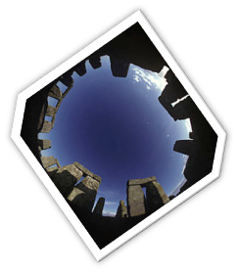
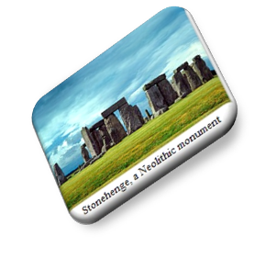


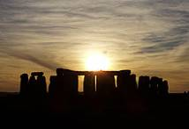
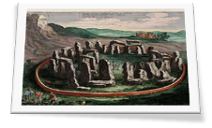
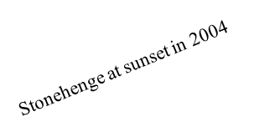

Stonehenge is a prehistoric monument located in the English county of Wiltshire, about 2.0 miles (3.2 km) west of Amesbury and 8 miles (13 km) north of Salisbury. One of the most famous sites in the world, Stonehenge is composed of earthworks surrounding a circular setting of large standing stones. It is at the centre of the most dense complex of Neolithic and Bronze Age monuments in England, including several hundred burial mounds.
Archaeologists have believed that the iconic stone monument was erected around 2500 BC, as described in the chronology below. One recent theory however, has suggested that the first stones were not erected until 2400–2200 BC, whilst another suggests that bluestones may have been erected at the site as early as 3000 BC (see phase 1 below).
The surrounding circular earth bank and ditch, which constitute the earliest phase of the monument, have been dated to about 3100 BC. The site and its surroundings were added to the UNESCO's list of World Heritage Sites in 1986 in a co-listing with Avebury Henge monument. It is a national legally protected Scheduled Ancient Monument. Stonehenge is owned by the Crown and managed by English Heritage, while the surrounding land is owned by the National Trust.
Archaeological evidence found by the Stonehenge Riverside Project in 2008 indicates that Stonehenge could possibly have served as a burial ground from its earliest beginnings. The dating of cremated remains found on the site indicate that deposits contain human bone material from as early as 3000 BC, when the initial ditch and bank were first dug. Such deposits continued at Stonehenge for at least another 500 years.

Slide 6
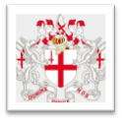


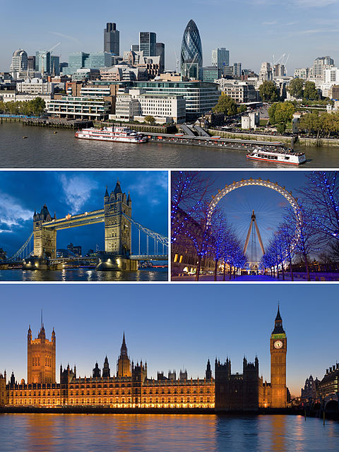

London
Sovereign state Constituent country Region Ceremonial counties Districts | United Kingdom England London City and Greater London City and 32 boroughs
Area: Total | 1,572.1 km2 (607 sq mi)
Population: London Density Urban Metro Demonym Ethnicity | 7,825,200 4,978/km2 8,278,251 13,945,000 Londoner Ethnic groups
Time zone Summer (DST) | GMT (UTC±0) BST (UTC+1)
Website | london.gov.uk
Elevation | 24 m

Slide 7

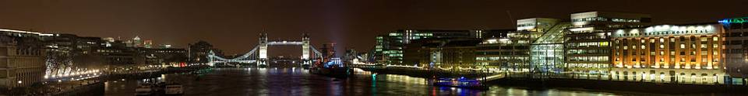
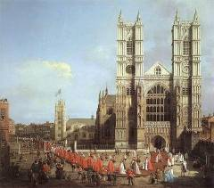
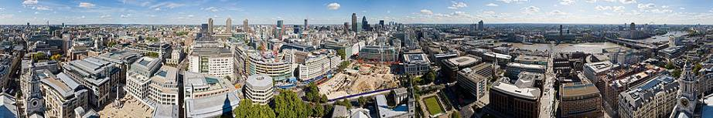
London is the capital city of England and the United Kingdom, the largest metropolitan area in the United Kingdom, and the largest urban zone in the European Union by most measures. Located on the River Thames, London has been a major settlement for two millennia, its history going back to its founding by the Romans, who called it Londinium. London's ancient core, the City of London, largely retains its square-mile medieval boundaries. Since at least the 19th century, the name London has also referred to the metropolis developed around this core. The bulk of this conurbation forms the London region and the Greater London administrative area, governed by the elected Mayor of London and the London Assembly.
London is a leading global city, with strengths in the arts, commerce, education, entertainment, fashion, finance, healthcare, media, professional services, research and development, tourism and transport all contributing to its prominence. It is the world's largest financial centre alongside New York City and has the largest city GDP in Europe.It has the most international visitors of any city in the world and London Heathrow is the world's busiest airport by number of international passengers. London's 43 universities form the largest concentration of higher education in Europe. In 2012 London will become the first city to host the modern Summer Olympic Games three times.
London has a diverse range of peoples, cultures and religions and more than 300 languages are spoken within its boundaries. In July 2010 Greater London had an official population of 7,825,200, making it the most populous municipality in the European Union. The Greater London Urban Area is the second-largest in the EU with a population of 8,278,251, while London's metropolitan area is the largest in the EU with an estimated total population of between 12 million and 14 million. London had the largest population of any city in the world from around 1831 to 1925.
London contains four World Heritage Sites: the Tower of London; Kew Gardens; the site comprising the Palace of Westminster, Westminster Abbey, and St Margaret's Church; and the historic settlement of Greenwich (in which the Royal Observatory marks the Prime Meridian (0° longitude) and GMT). Other famous landmarks include Buckingham Palace, the London Eye, Piccadilly Circus, 30 St Mary Axe ("The Gherkin"), St Paul's Cathedral, Tower Bridge, Trafalgar Square and Wembley Stadium. London is home to numerous museums, galleries, libraries, sporting events and other cultural institutions, including the British Museum, National Gallery, British Library, Wimbledon and 40 theatres. London's Chinatown is the largest in Europe. The London Underground network is the oldest underground railway network in the world, and the second-most extensive, after the Shanghai Metro.

Slide 8
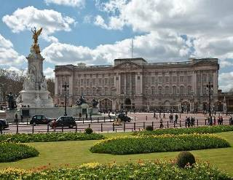


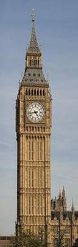
Buckingham Palace is the London home and primary residence of the British monarch. Located in the City of Westminster, the palace is a setting for state occasions and royal hospitality. It has been a focus for the British people at times of national rejoicing and crisis.
Originally known as Buckingham House, the building which forms the core of today's palace was a large townhouse built for the Duke of Buckingham in 1705 on a site which had been in private ownership for at least 150 years. It was subsequently acquired by George III in 1761 as a private residence for Queen Charlotte, and known as "The Queen's House". During the 19th century it was enlarged, principally by architects John Nash and Edward Blore, forming three wings around a central courtyard. Buckingham Palace finally became the official royal palace of the British monarch on the accession of Queen Victoria in 1837. The last major structural additions were made in the late 19th and early 20th centuries, including the East front which contains the well-known balcony on which the Royal Family traditionally congregate to greet crowds outside. However, the palace chapel was
destroyed by a German bomb in World War II; the Queen's Gallery was built on the site and opened to the public in 1962 to exhibit works of art from the Royal Collection.
The original early 19th-century interior designs, many of which still survive, included widespread use of brightly coloured scagliola and blue and pink lapis, on the advice of Sir Charles Long. King Edward VII oversaw a partial redecoration in a Belle Époque cream and gold colour scheme. Many smaller reception rooms are furnished in the Chinese regency style with furniture and fittings brought from the Royal Pavilion at Brighton and from Carlton House. The Buckingham Palace Garden is the largest private garden in London.
The state rooms, used for official and state entertaining, are open to the public each year for most of August and September, as part of the Palace's Summer Opening.
The present Clock Tower was raised as a part of Charles Barry's design for a new palace, after the old Palace of Westminster was largely destroyed by fire on the night of 16 October 1834.The new Parliament was built in a Neo-gothic style. Although Barry was the chief architect of the Palace, he turned to Augustus Pugin for the design of the Clock Tower, which resembles earlier Pugin designs, including one for Scarisbrick Hall. The design for the Clock Tower was Pugin's last design before his final descent into madness and death, and Pugin himself wrote, at the time of Barry's last visit to him to collect the drawings: "I never worked so hard in my life for Mr Barry for tomorrow I render all the designs for finishing his bell tower & it is beautiful." The tower is designed in Pugin's celebrated Gothic Revival style, and is 96.3 metres high.
The bottom 61 metres of the Clock Tower's structure consists of brickwork with sand coloured Anston limestone cladding. The remainder of the tower's height is a framed spire of cast iron. The tower is founded on a 15-metre square raft, made of 3-metre thick concrete, at a depth of 4 metres below ground level. The four clock dials are 55 metres above ground. The interior volume of the tower is 4,650 cubic metres.
Despite being one of the world's most famous tourist attractions, the interior of the tower is not open to overseas visitors, though United Kingdom residents are able to arrange tours through their Member of Parliament. However, the tower has no lift, so those escorted must climb the 334 limestone stairs to the top.
Because of changes in ground conditions since construction, the tower leans slightly to the north-west, by roughly 220 millimetres at the clock dials, giving an inclination of approximately 1/250. Due to thermal effects it oscillates annually by a few millimetres east and west.

Slide 9

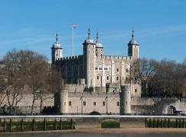
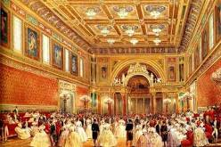
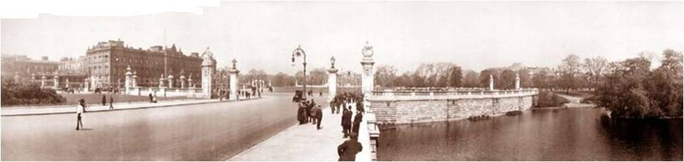
Buckingham Palace is the London home and primary residence of the British monarch. Located in the City of Westminster, the palace is a setting for state occasions and royal hospitality. It has been a focus for the British people at times of national rejoicing and crisis.
Originally known as Buckingham House, the building which forms the core of today's palace was a large townhouse built for the Duke of Buckingham in 1705 on a site which had been in private ownership for at least 150 years. It was subsequently acquired by George III
in 1761 as a private residence for Queen Charlotte, and known as "The Queen's House". During the 19th century it was enlarged, principally by architects John Nash and Edward Blore, forming three wings around a central courtyard. Buckingham Palace finally became the official royal palace of the British monarch on the accession of Queen
Victoria in 1837. The last major structural additions were made in the late 19th and early 20th centuries, including the East front which contains the well-known balcony on which the Royal Family traditionally congregate to greet crowds outside. However, the palace chapel was destroyed by a German bomb in World War II; the Queen's Gallery was built on the site and opened to the public in 1962 to exhibit works of art from the Royal Collection.
The original early 19th-century interior designs, many of which still survive, included widespread use of brightly coloured scagliola and blue and pink lapis, on the advice of Sir
Charles Long. King Edward VII oversaw a partial redecoration in a Belle Époque cream and
gold colour scheme. Many smaller reception rooms are furnished in the Chinese regency style with furniture and fittings brought from the Royal Pavilion at Brighton and from Carlton House. The Buckingham Palace Garden is the largest private garden in London.
The state rooms, used for official and state entertaining, are open to the public each year for most of August and September, as part of the Palace's Summer Opening.

Slide 10
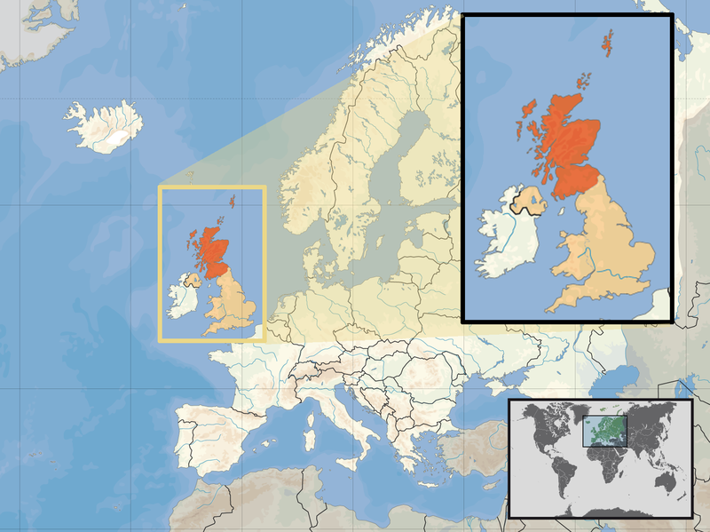






Capital (and largest city) | Edinburgh 55°57′N 3°12′W
Official languages | English, Scottish Gaelic
Area: Total | 78,772 km2 30,414 sq mi
Population: mid-2010 estimate 2001 census Density | 5,222,100 5,062,011 65.9/km2
Currency | Pound sterling (GBP)
Time zone Summer (DST) | GMT (UTC+0) BST (UTC+1)
Calling code | 44
Date formats | dd/mm/yyyy

Slide 11
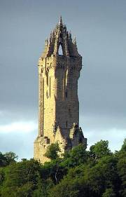

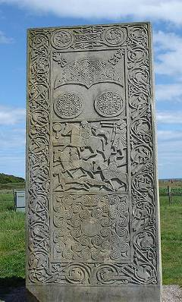
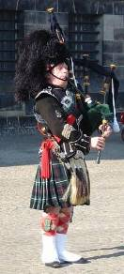

Scotland is a country that is part of the United Kingdom. Occupying the northern third of the island of Great Britain, it shares a border with England to the south and is bounded by the North Sea to the east, the Atlantic Ocean to the north and west, and the North Channel and Irish Sea to the southwest. In addition to the mainland, Scotland includes over 790 islands including the Northern Isles and the Hebrides.
Edinburgh, the country's capital and second largest city, is one of Europe's largest financial centres. Edinburgh was the hub of the Scottish Enlightenment of the 18th century, which transformed Scotland into one of the commercial, intellectual and industrial powerhouses of Europe. Glasgow, Scotland's largest city, was once one of the world's leading industrial cities and now lies at the centre of the Greater Glasgow conurbation. Scottish waters consist of a large sector of the North Atlantic and the North Sea, containing the largest oil reserves in the European Union. This has given Aberdeen, the third largest city in Scotland, the title of Europe's oil capital.
The Wallace Monument commemorates William Wallace, the 13th-century Scottish hero.
The Kingdom of Scotland emerged as an independent sovereign state in the Early Middle Ages and continued to exist until 1707, although it had been in a personal union with the kingdoms of England and Ireland since James VI of Scotland succeeded to the English and Irish thrones in 1603. On 1 May 1707, Scotland entered into an
incorporating political union with England to create the united Kingdom of Great Britain. This union resulted from the Treaty of Union agreed in 1706 and enacted by the twin Acts of Union passed by the Parliaments of both countries, despite widespread protest across Scotland. Scotland's legal system continues to be separate from those of England and Wales and Northern Ireland, and Scotland constitutes a distinct jurisdiction in public and in private law.
The continued existence of legal, educational and religious institutions distinct from those in the remainder of the UK have all contributed to the continuation of Scottish culture and national identity since the Union. In 1999, a devolved legislature, the Scottish Parliament, was founded with authority over many areas of home affairs following a successful referendum in 1997. In 2011 the Scottish National Party (SNP) won an overall majority in the parliament and intend to hold a referendum on independence from the United Kingdom sometime in the current parliamentary term.
A Pipe Major playing the Great Highland Bagpipe
A replica of the Pictish Hilton of Cadboll Stone.

Slide 12

National anthem of Scotland
Flower of Scotland
Scotland the Brave
1. O Flower of Scotland,
When will we see your like again
That fought and died for
Your wee bit hill and glen.
And stood against him,
Proud Edward's army,
And sent him homeward
To think again.
2. The hills are bare now,
And autumn leaves lie thick and still
O'er land that is lost now,
Which those so dearly held
That stood against him,
Proud Edward's army
And sent him homeward
To think again.
3. Those days are past now
And in the past they must remain
But we can still rise now
And be the nation again!
That stood against him
Proud Edward's army
And sent him homeward
To think again.
4. O Flower of Scotland,
When will we see your like again
That fought and died for
Your wee bit hill and glen.
And stood against him,
Proud Edward's army,
And sent him homeward
To think again.
There is no official national anthem of Scotland. However, a number of songs are used as de facto Scottish anthems, most notably Flower of Scotland and Scotland the Brave. God Save the Queen is the national anthem for the United Kingdom as a whole and is used in Scotland in that context.
In 2004, lawyers for the devolved Scottish Parliament advised that it was within the legal competence of the Scottish Parliament to choose a national anthem for Scotland, countering the suggestion that it would be a matter reserved to the Parliament of the United Kingdom. This ruling prompted some interest in the idea, and a petition to the Scottish Parliament's petitions committee supported by the Scottish Green Party was referred without recommendation to the Scottish Executive who chose to take no action, considering the issue not to be a political priority. There have been subsequent attempts to re-open the debate on a national anthem for Scotland.
1.Hark when the night is falling
Hear! hear the pipes are calling,
Loudly and proudly calling,
Down thro' the glen.
There where the hills are sleeping,
Now feel the blood a-leaping,
High as the spirits
of the old Highland men.
3.Towering in gallant fame,
Scotland my mountain hame,
High may your proud
standard gloriously wave,
Land of my high endeavour,
Land of the shining rivers,
Land of my heart for ever,
Scotland the brave.
2.High in the misty Highlands,
Out by the purple islands,
Brave are the hearts that beat
Beneath Scottish skies.
Wild are the winds to meet you,
Staunch are the friends that greet you,
Kind as the love that shines
from fair maidens' eyes.
1.Far off in sunlit places,
Sad are the Scottish faces,
Yearning to feel the kiss
Of sweet Scottish rain.
Where tropic skies are beaming,
Love sets the heart a-dreaming,
Longing and dreaming for the homeland again.

Slide 13
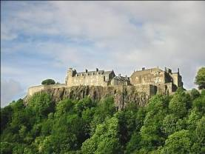


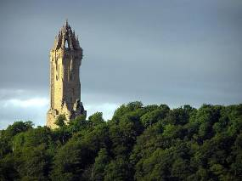
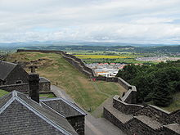
Attractions
Stirling Castle, located in Stirling, is one of the largest and most important castles, both historically and architecturally, in Scotland. The castle sits atop Castle Hill, an intrusive crag, which forms part of the Stirling Sill geological formation. It is surrounded on three sides by steep cliffs, giving it a strong defensive position. Its strategic location, guarding what was, until the 1890s, the farthest downstream crossing of the River Forth, has made it an important fortification from the earliest times. Most of the principal buildings of the castle date from the fifteenth and sixteenth centuries. A few structures of the fourteenth century remain, while the outer defences fronting the town date from the early eighteenth century. Several Scottish Kings and Queens have been crowned at Stirling, including Mary, Queen of Scots, in 1543. There have been at
least eight sieges of Stirling Castle, including several during the Wars of Scottish Independence, with the last being in 1746, when Bonnie Prince Charlie unsuccessfully tried to take the castle. Stirling Castle is a Scheduled Ancient Monument, and is now a tourist attraction managed by Historic Scotland.
The National Wallace Monument (generally known as the Wallace Monument) is a tower standing on the summit of Abbey Craig, a hilltop near Stirling in Scotland. It commemorates Sir William Wallace, the 13th century Scottish hero.
The tower was constructed following a fundraising campaign which accompanied a resurgence of Scottish national identity in the 19th century. In addition to public subscription, it was partially funded by contributions from a number of foreign donors, including Italian national leader Giuseppe Garibaldi. Completed in 1869 to the designs of architect John Thomas Rochead at a cost of £18,000, the monument is a 67-metre (220 ft) sandstone tower, built in the Victorian Gothic style. It stands on the Abbey Craig, a volcanic crag above Cambuskenneth Abbey, from which Wallace was said to have watched the gathering of the army of English king Edward I, just before the Battle of Stirling Bridge.
The monument is open to the general public. Visitors climb the 246 step spiral staircase to the viewing gallery inside the monument's crown, which provides expansive views of the Ochil Hills and the Forth Valley.
A number of artifacts believed to belong to Wallace are on display inside the monument, including the Wallace Sword, and a 1.68-metre (5 ft, 6 in) long claymore. Inside is also a Hall of Heroes, a series of busts of famous Scots, effectively a small national Hall of Fame.

Slide 14

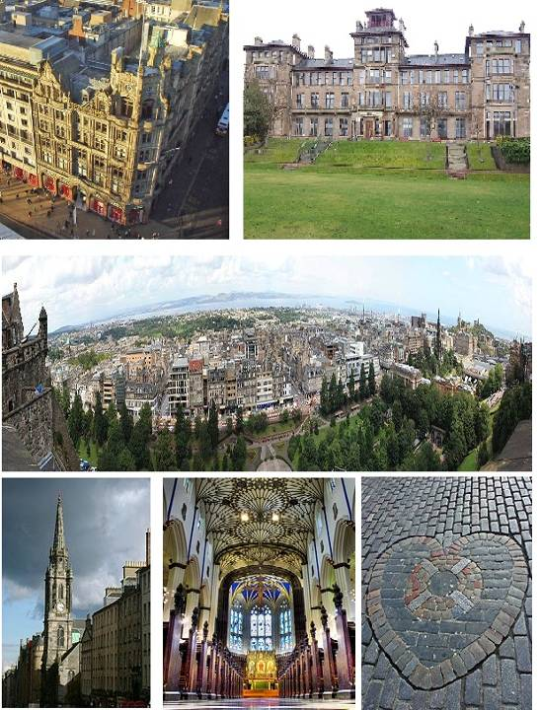
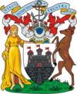

Sovereign state Constituent country Council area Lieutenancy area | United Kingdom Scotland City of Edinburgh Edinburgh
Area: Total | 259 km2(100.00 sq mi)
Population: Total Urban density | 486,120 1,844/km2(4,776/sq mi )
Time zone Summer (DST) | GMT (UTC±0) BST (UTC+1)
Website | www.edinburgh.gov.uk

Slide 15

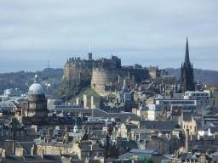
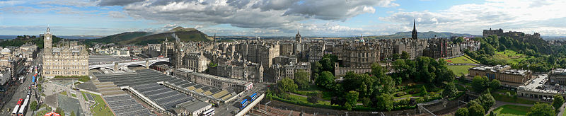
Edinburgh is the capital city of Scotland, the second largest city in Scotland, and the seventh-most populous in the United Kingdom. The City of Edinburgh Council is one of Scotland's 32 local government council areas. The council area includes urban Edinburgh and a 30-square-mile rural area. Located in the south-east of Scotland, Edinburgh lies on the east coast of the Central Belt, along the Firth of Forth, near the North Sea.
Edinburgh is the seat of the Scottish Parliament. The city was one of the major centres of the Enlightenment, led by the University of Edinburgh, helping to earn it the nickname Athens of the North. The Old Town and New Town districts of Edinburgh were listed as a UNESCO World Heritage Site in 1995. There are over 4,500 listed buildings within the city. In May 2010, it had a total of 40 conservation areas covering 23% of the building stock and 23% of the population, the highest such ratios of any major city in the UK. In the 2010 mid-year population estimates, Edinburgh had a total resident population of 486,120.
The city is well known for the annual Edinburgh Festival, a collection of official and independent festivals held annually over about four weeks from early August. The number of visitors attracted to Edinburgh for the Festival is roughly equal to the settled population of the city. The most famous of these events are the Edinburgh Fringe (the largest performing arts festival in the world), the Edinburgh International Festival, the Edinburgh Military Tattoo, and the Edinburgh International Book Festival. Other events include the Hogmanay street party, Burns Night and the Beltane Fire Festival. Edinburgh attracts 1 million overseas visitors a year, making it the most visited tourist destination in the United Kingdom, after London.

Slide 16
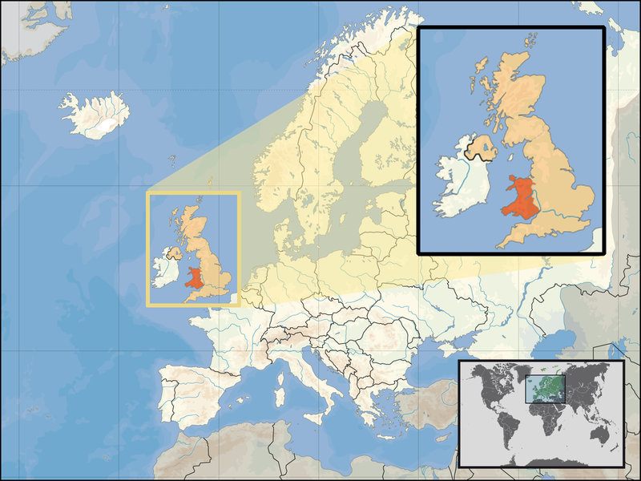






Capital (and largest city) | Cardiff (Caerdydd) 51°29′N 3°11′W
Official languages | Welsh, English
Area: Total | 20,779 km2 8,022 sq mi
Population: mid-2010 estimate 2001 census Density | 3,006,400 2,903,085 140/km2
Currency | Pound sterling (GBP)
Time zone Summer (DST) | GMT (UTC+0) BST (UTC+1)
Calling code | 44
Date formats | dd/mm/yyyy

Slide 17
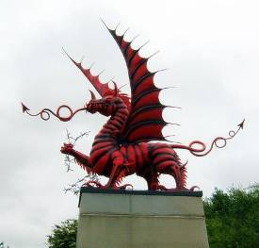
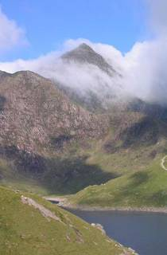
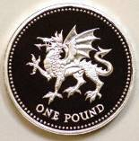
Wales, Welsh: Cymru; pronounced is a country that is part of the United Kingdom and the island of Great Britain, bordered by England to its east and the Atlantic Ocean and Irish Sea to its west. It has a population of three million, and a total area of 20,779 km² . Wales has over 1,200 km of coastline, including its offshore islands; the largest, Anglesey , is also the largest island in the Irish Sea. Generally mountainous, its highest mountains are in the north and central areas, especially in Snowdonia , which contains Snowdon , its highest peak.
During the Iron Age and early medieval period, Wales was inhabited by the Celtic Britons. A distinct Welsh national identity emerged in the centuries after the Roman withdrawal from Britain in the 5th century, and Wales is regarded as one of the modern Celtic nations today. Gruffydd ap Llywelyn was recognised as king of Wales in 1057. Llywelyn ap Gruffydd's death in 1282 marked the completion of Edward I of England's conquest of Wales. The castles and town walls erected to ensure its permanence are now UNESCO World Heritage Sites. Owain Glyndŵr briefly restored independence to what was to become modern Wales, in the early 15th century. Wales was subsequently annexed by England under the Laws in Wales Acts 1535–1542 since when, excluding those matters now devolved to Wales, English law has been the legal system of Wales and England. Distinctive
Welsh politics developed in the 19th century. Welsh Liberalism, exemplified in the early 20th century by Lloyd George, was displaced by the growth of socialism and the Labour Party. Welsh national feeling grew over the century; Plaid Cymru was formed in 1925 and Cymdeithas yr Iaith Gymraeg (The Welsh Language Society) in 1962. The National Assembly for Wales, created in 1999 following a referendum, holds responsibility for a range of devolved policy matters.
Wales lies within the north temperate zone, its changeable, maritime climate making it one of the wettest countries in Europe. It was an agricultural society for most of its early history, the country's terrain making arable farming secondary to pastoral farming, the primary source of Wales' wealth. In the 18th century, the introduction of the slate and metallurgical industries, at the dawn of the Industrial Revolution, began to transform the country into an industrial nation; the UNESCO World Heritage Sites Pontcysyllte Aqueduct and the Blaenavon Industrial Landscape date from that period.
The south Wales coalfield's exploitation in the Victorian era caused a rapid expansion of the Welsh population. Two-thirds of Wales' three million population live in south Wales, mainly in and around the cities of Cardiff (Caerdydd), Swansea (Abertawe) and Newport (Casnewydd), and in the nearby valleys. Another concentration live in eastern north Wales. Cardiff, Wales' capital, is the country's most populous city, with 317,500 residents, and for a period was the biggest coal port in the world. Today, with the country's traditional heavy industries (coal, steel, copper, tinplate and slate) either gone or in decline, Wales' economy depends on the public sector, light and service industries, and tourism.
Although Wales shares a close political and social history with the rest of Great Britain, it has retained a distinct cultural identity. Wales is officially bilingual, the Welsh and English
languages having equal status. The Welsh language is an important element of Welsh culture, and its use is supported by national policy. Over 580,000 Welsh speakers live in Wales, more than 20% of the population. From the late 19th century onwards, Wales acquired its popular image as the "land of song," attributable in part to the revival of the eisteddfod tradition. At international sporting events, such as the FIFA World Cup, Rugby World Cup and the Commonwealth Games, Wales is represented by national teams regulated and organised by over fifty national governing bodies of sports in Wales. At the Olympic Games, Welsh athletes compete as part of a Great Britain team. Although football has traditionally been the more popular sport in north Wales, rugby union is seen as a symbol of Welsh identity and an expression of national consciousness.

Slide 18

Hen Wlad Fy Nhadau
Hen Wlad Fy Nhadau (Welsh pronunciation: is the national anthem of Wales. The title – taken from the first words of the song – means "Old Land of My Fathers", usually rendered in English as simply "Land of My Fathers". The words were written by Evan James and the tune composed by his son, James James, both residents of Pontypridd, Glamorgan, in January 1856. The earliest written copy survives and is part of the collections of the National Library of Wales.
The land of my fathers is dear unto me,
Old land where the minstrels are honored and free;
Its warring defenders so gallant and brave,
For freedom their life’s blood they gave.
Home, home, true am I to home
While seas secure the land so pure
O may the old language endure.
Old land of the mountains, the Eden of bards
Each gorge and each valley a loveliness guards
Through love of my country, charmed voices will be
Its streams, and its rivers, to me.
Home, home, true am I to home
While seas secure the land so pure
O may the old language endure.
Though foemen have trampled my land 'neath their feet
The language of Cambria still knows no retreat
The muse is not vanquished by traitor’s fell hand
Nor silenced the harp of my land.

Slide 19
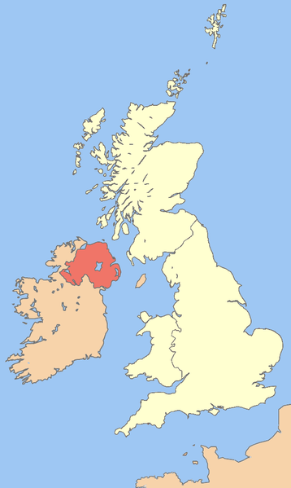


Northern Ireland
Capital (and largest city) | Belfast 54°35.456′N 5°50.4′W
Official languages | English Irish Ulster Scots
Area: Total | 13,843 km2 5,345 sq mi
Population: 2009 estimate 2001 census Density | 1,789,000 1,685,267 122/km2 315/sq mi
Currency | Pound sterling (GBP)
Time zone Summer (DST) | GMT (UTC+0) BST (UTC+1)
Calling code | 44
Date formats | dd/mm/yyyy

Slide 20
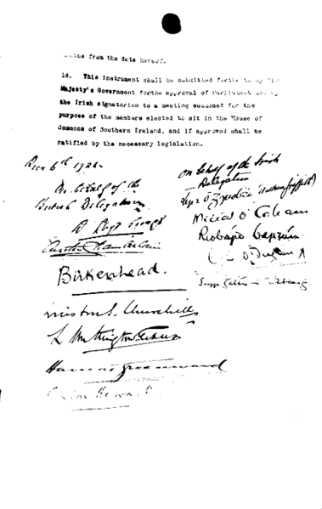

Northern Ireland is one of the four countries of the United Kingdom. Situated in the north-east of the island of Ireland, it shares a border with the Republic of Ireland to the south and west. At the time of the 2001 UK Census, its population was 1,685,000, constituting about 30% of the island's total population and about 3% of the population of the United Kingdom.
Northern Ireland consists of six of the nine counties of the Irish province of Ulster. It was created as a distinct division of the
United Kingdom on 3 May 1921 under the Government of Ireland Act 1920, though its constitutional roots lie in the 1800 Act of Union between Great Britain and Ireland. For over 50 years it had its own devolved government and parliament. These institutions were suspended in 1972 and abolished in 1973. Repeated attempts to restore self-government finally resulted in the establishment in 1998 of the present-day Northern Ireland Executive and Northern Ireland Assembly. The Assembly operates on consociational democracy principles requiring cross-community support.
Northern Ireland was for many years the site of a violent and bitter ethno-political conflict—the Troubles—which was caused by divisions between nationalists, who are predominantly Roman Catholic, and unionists, who are predominantly Protestant, which has been the most prevalent religion. Unionists want Northern Ireland to remain as a part of the United Kingdom, while nationalists wish for it to be politically united with the rest of Ireland, independent of British rule. Since the signing of the "Good Friday Agreement" in 1998, most of the paramilitary groups involved in the Troubles have ceased their armed campaigns.
Owing to its unique history, the issue of the symbolism, name and description of Northern Ireland is complex, as is the issue of citizenship and identity. In general, unionists consider themselves British and nationalists see themselves as Irish, though these identities are not necessarily mutually exclusive. Additionally, many people from both sides of the community consider themselves as Northern Irish.

Slide 21

Footballers:
David Robert Joseph Beckham (England)
Wayne Mark Rooney (England)
George Best (Northern Ireland)
Henry Gregg (Northern Ireland)
Tennis player:
Timothy Henry "Tim" Henman (England)
Andrew "Andy" Murray (England)
Basketball:
Ben Gordon (England)
Nana Papa Yaw Dwene "Pops" Mensah-Bonsu (England)
Athletes:
Phillips Olaosebikan Idowu
Roger Gilbert Bannister

Slide 22

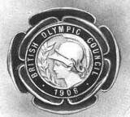
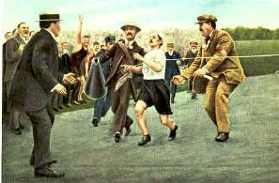
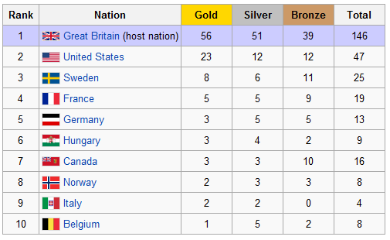
The 1908 Summer Olympics, officially the Games of the IV Olympiad, were an international multi-sport event which was held in 1908 in London. These games were originally scheduled to be held in Rome. At the time they were the fifth modern Olympic games. However, the Athens Games of 1906 have since been downgraded by the International Olympic Committee and the 1908 Games are seen as the start of the Fourth Olympiad, in keeping with the now-accepted four-year cycle. The IOC president for these Games was Baron Pierre de Coubertin.
The medal of the 1908 British Olympic Council.
Dorando Pietri finishes the marathon.
Host city | London, England, United Kingdom
Athletes participating | 2,008 (1,971 men, 37 women,)
Events | 110 in 22 sports
Opening ceremony | April 27
Closing ceremony | October 31
Stadium | White City Stadium

Slide 23
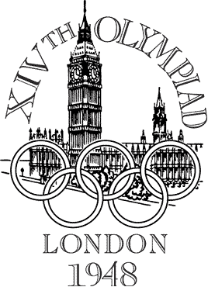

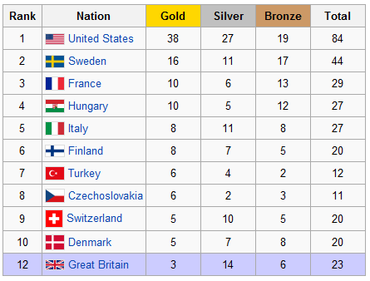
The 1948 Summer Olympics, officially known as the Games of the XIV Olympiad, were an international multi-sport event which was held in London, United Kingdom. After a 12-year hiatus because of World War II, these were the first Summer Olympics since the 1936 Games in Berlin. The 1940 Games had been scheduled for Tokyo, and then Helsinki; the 1944 Games had been provisionally planned for London. This was the second occasion that London had hosted the Olympic Games, the city had previously been the venue in 1908. The Olympics are scheduled to return to London in 2012.
The event came to be known as the Austerity Games due to the economic climate and post-war rationing. No new venues were built for the games and athletes were housed in existing accommodation instead of an Olympic Village. A record 59 nations were represented by 4,104 athletes, 3,714 men and 390 women, in 19 sport disciplines. Because of their roles as aggressors in World War II Germany and Japan were not invited to participate; the USSR were invited but chose not to send any athletes. The United States team won the most total medals, 84, and the most gold medals, 38. The host nation won 23 medals, three of them gold.
One of the star performers at the Games was Dutch sprinter Fanny Blankers-Koen. Nicknamed "The Flying Housewife" the 30-year old mother of three children won four gold medals in athletics. In the decathlon American Bob Mathias became the youngest male ever to win an Olympic gold medal at the age of 17. The most individual medals were won by Veikko Huhtanen of Finland who took three golds, a silver and a bronze in men's gymnastics.
Host city | London, England, United Kingdom
Athletes participating | 4,104 (3,714 men, 390 women)
Events | 136 in 17 sports
Opening ceremony | 29 July
Closing ceremony | 14 August
Stadium | Wembley Stadium

Slide 24
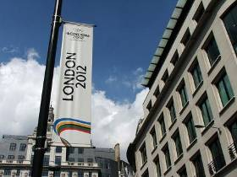

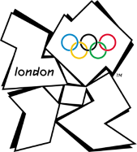
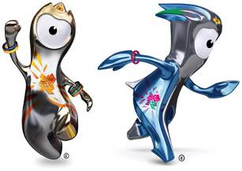

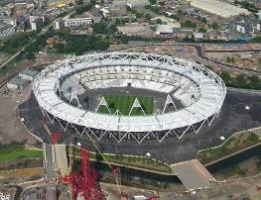
The 2012 Summer Olympic Games, officially known as the Games of the XXX Olympiad, are scheduled to take place in London, England, United Kingdom, from 27 July to 12 August 2012. London will become the first city to officially host the modern Olympic Games three times, having previously done so in 1908 and in 1948.
London was elected as the host city on 6 July 2005 during the 117th
Host city | London, England, United Kingdom
Nations participating | 131 (qualified) 204 (estimated)
Athletes participating | 10,500 (estimated)
Events | 302 in 26 sports
Opening ceremony | 27 July
Closing ceremony | 12 August
Stadium | Olympic Stadium
IOC Session in Singapore, defeating Moscow, New York City, Madrid and Paris after four rounds of voting. The successful bid was headed by former Olympic champion Sebastian Coe.
The Olympics prompted a redevelopment of many of the areas of London in which the games are to be held – particularly themed towards sustainability. While the budgetary considerations have generated some criticism, the Games will make use of many venues which were already in place before the bid, including Wembley Stadium, Wembley arena, Wimbledon All England Club, Lord's Cricket Ground, The O2 Arena, Earls Court Exhibition Centre, Weymouth and Portland National Sailing Academy, and the Excel Centre.
The official mascots for the 2012 Summer Olympic and Paralympic Games were unveiled on 19 May 2010; this marks the second time (after Vancouver) that both
Olympic and Paralympic mascots were unveiled at the same time. Wenlock and Mandeville are animations depicting two drops of steel from a steelworks in Bolton. They are named Wenlock, after the Shropshire town of Much Wenlock, which held a forerunner of the current Olympic Games which held a forerunner of the current which
Mandeville
held a forerunner of the current Olympic Games, and Mandeville, after Stoke Mandeville, a village in
Wenlock
Buckinghamshire where a forerunner to the Paralympic Games were first held. The writer Michael Morpurgo wrote the story concept to the mascots, and an animation was produced; it is intended that thiswill form part of an ongoing series concerning the mascots in the run-up to the Games in 2012. Two stories have been created about the mascots: Out Of A Rainbow, the story of how Wenlock and Mandeville came to be, and Adventures On A Rainbow, which features the children from Out Of A Rainbow meeting the mascots and trying out many different Olympic and Paralympic sports.

Slide 25

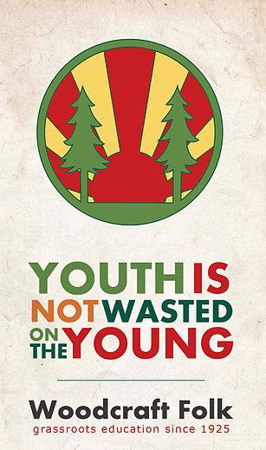

The Scout Association
Girl Scouts’ Association
The Woodcraft folk

Slide 26

The Scout Association is the World Organization of the Scout Movement recognised Scouting association in the United Kingdom. Scouting began in 1907 through the efforts of Robert Baden-Powell. The Scout Association was formed under its previous name, The Boy Scout Association, in 1910 by the grant of a charter by the Parliament of the United Kingdom. The Boy Scout Association was re-named as The Scout Association in 1967.
The stated aim of The Scout Association is to "promote the development of young people in achieving their full physical, intellectual, social and spiritual potential, as individuals, as responsible citizens and as members of their local, national and international communities“. The Scout Association provides a Programme to help achieve this aim for young people from the age of 6 to 25 The latest census shows that over 390,000 people aged 6–25 are members of The Scout Association. Thanks to this work, The Scout Association is a member of The National Council for Voluntary Youth Services (NCVYS).
Girls were first admitted in 1976 to the Venture Scouts, and the rest of Sections on an optional basis in 1991. Since 2007 all Scout Groups in the UK must accept girls as well as boys, although religious preferences can be accommodated.
a
Scouting in the UK is open to all faiths and variations to the Scout Promise are allowed in order to accommodate those of different religious obligations or national allegiances. The Scout Association does not permit an atheist version of the Promise, or a lack of any sort of faith or religion in the programme, and this has attracted criticism from the National Secular Society (NSS) and the British Humanist Association.
The Scout Association
Headquarters | Gilwell Park
Location | Chingford
Country | United Kingdom
Founded | 1910, incorporated 1912
Founder | Baden-Powell
Membership | 390,901 youth 91,545 adults (2009)
Chief Scout | Bear Grylls
Chief Executive | Derek Twine
Affiliation | World Organization of the Scout Movement
Website http://www.scouts.org.uk/

Slide 27

Motto Education for Social Change; Span the World with Friendship
Founder | Leslie Paul
Type | Educational Charity No. 1073665
Founded | 1925
Location | Units 9/10, 83 Crampton Street, London, SE17 3BF, UK
Origins | Kindred of the Kibbo Kift, Scouting and Cooperative movement
Key people | Chair of General Council: Lloyd Russell-Moyle General Secretary: Jon Nott
Area served | United Kingdom
Focus | Environmentalism, Internationalism, Children's Rights, Cooperation and Peace
Method | Popular education and Scouting
Members | c. 25,000
Website www.woodcraft.org.uk
The Woodcraft Folk is a UK-based educational movement for children and young people, and registered charity no. 1073665. The constitutional object of this youth organisation is "to educate and empower young people to be able to participate actively in society, improving their lives and others' through active citizenship."
Whilst sharing many of the same historical roots as the Scouting movement, The Woodcraft Folk's direct antecedent was the Kindred of the Kibbo Kift, an organisation led by ex-Scout Commissioner for Woodcraft and Camping John Hargrave, who had broken with what he considered to be the Scouts' militaristic approach in the years immediately after the First World War. The Woodcraft Folk was established by Leslie Paul in 1925 after the south London co-operative groups challenged Hargrave's authoritarian tendencies over his refusal to recognise a local group called "The Brockley Thing" and broke away from the Kindred. In its early days it was very similar to the Kibbo Kift, with a strong pagan and anti-capitalist emphasis, but gradually developed its own distinct ethos.
The name 'Woodcraft' was used by the influential writer and naturalist Ernest Thompson Seton at the turn of the 20th century when setting up the American proto-Scouting organisation Woodcraft Indians, and in this context meant the skill of living in the open air, close to nature.
In 2000 The Woodcraft Folk developed a birthday logo. There was much argument about which logo should be used on official publications, with the new square logo favoured for a long time by the Head Office. In 2008 Annual Conference the Woodcraft Folk voted to stop using the 75th logo and resort only to the round logo on official publications.
Woodcraft Folk Logo used in the late 1980s to early 2000s and between 2008-2010
50th Anniversary Logo used in 1975
The history within the labour movement can be seen in the book produced by the Woodcraft Folk called Fashioning a New World which it commissioned for its 75th birthday. Other historical references exist, Cooperative Banners a book available from the Rochdale Pioneers museum contains banners of the Woodcraft Folk. The Woodcraft Folk historical records are held at the London School of Economics. Much of these archives can be viewed on-line including resources on how to use them for young peoples groups.

