Slide 1
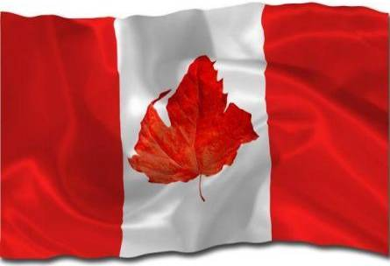


Slide 2
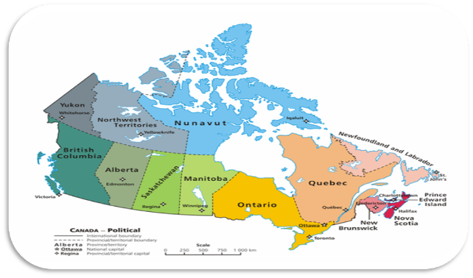
Canada is a federation composed of ten provinces and three territories. In turn, these may be grouped into regions: Western Canada, Central Canada, Atlantic Canada, and Northern Canada (Eastern Canada refers to Central Canada and Atlantic Canada together). Provinces have more autonomy than territories. The provinces are responsible for most of Canada's social programs (such as health care, education, and welfare) and together collect more revenue than the federal government, an almost unique structure among federations in the world. Using its spending powers, the federal government can initiate national policies in provincial areas, such as the Canada Health Act; the provinces can opt out of these, but rarely do so in practice. Equalization payments are made by the federal government to ensure that reasonably uniform standards of services and taxation are kept between the richer and poorer provinces

Slide 3
Canada is one of the world's wealthiest nations, with a high per-capita income. It is a member of the Organisation for Economic Co-operation and Development (OECD) and the G8, and is one of the world's top ten trading nations. Canada is a mixed economy, ranking above the US and most western European nations on the Heritage Foundation's index of economic freedom.The largest foreign importers of Canadian goods are the United States, the United Kingdom, and Japan. Canada's two official languages are English and French.

Slide 4
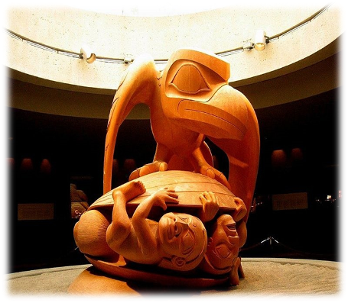
Canada has a diverse makeup of nationalities and cultures, and has constitutional protection for policies that promote multiculturalis In Quebec, cultural identity is strong, and many French-speaking commentators speak of a culture of Quebec as distinguished from English Canadian culture however, as a whole Canada is a cultural mosaic – a collection of several regional, aboriginal, and ethnic subcultures. Historically Canada has been influenced by British, French, and aboriginal cultures and traditions.

Slide 5
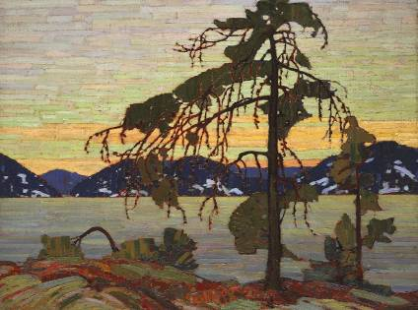
Through their culture, language, art and music, aboriginals continue to influence the Canadian identity. Many Canadians value multiculturalism and see Canada as being inherently multicultural.

Slide 6

Canada's official national sports are ice hockey and lacrosse. Hockey is a national pastime and the most popular spectator sport in the country. It is also the sport most played by Canadians. Seven of Canada's eight largest metropolitan areas – Toronto, Montreal, Vancouver, Ottawa, Calgary, Edmonton and Winnipeg – have franchises in the National Hockey League (NHL), and there are more Canadian players in the NHL than from all other countries combined.

Slide 7

Other popular spectator sports include curling and football; the latter is played professionally in the Canadian Football League (CFL). Golf, baseball, skiing, soccer, cricket, volleyball, and basketball are widely played at youth and amateur levels, but professional leagues and franchises are not widespread.

Slide 8
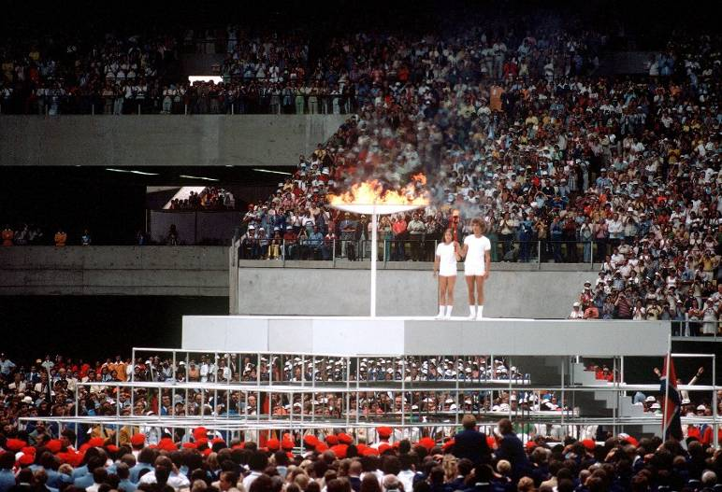
Olympic flame in Montreal

Slide 9
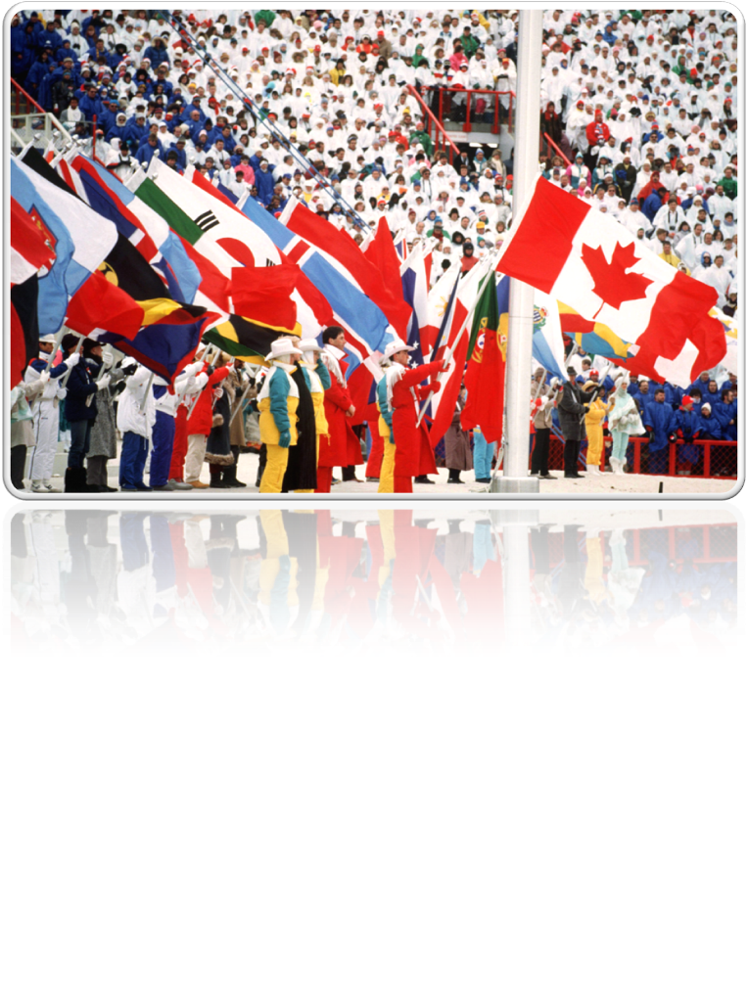
Winter games in Calgary

Slide 10
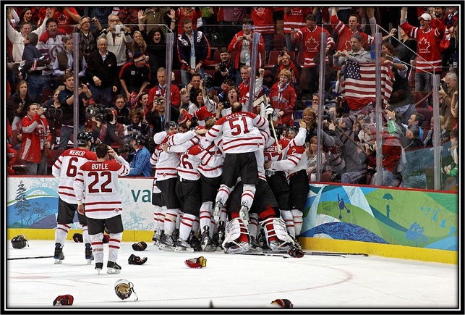
Canada has hosted several high-profile international sporting events, including the 1976 Summer Olympics in Montreal, the 1988 Winter Olympics in Calgary, and the 2007 FIFA U-20 World Cup. Canada was the host nation for the 2010 Winter Olympics in Vancouver and Whistler, British Columbia.

Slide 11
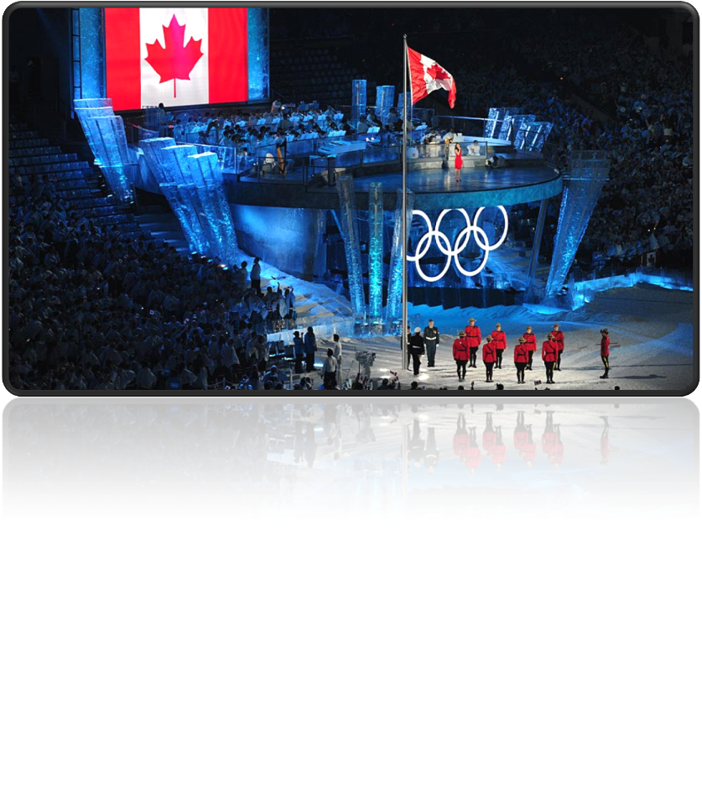
Vancouver

Slide 12
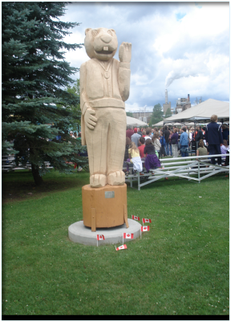
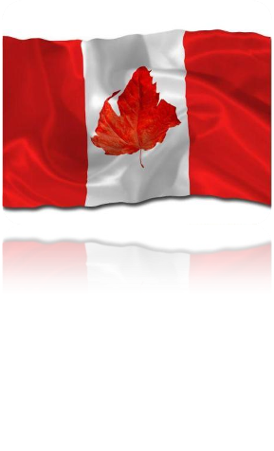
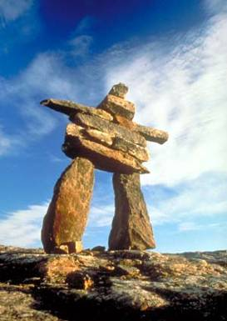
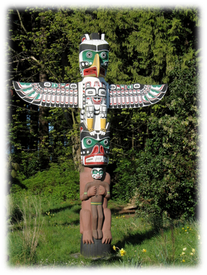
Canada's national symbols are influenced by natural, historical, and Aboriginal sources. The use of the maple leaf as a Canadian symbol dates to the early 18th century. The maple leaf is depicted on Canada's current and previous flags, on the penny, and on the Arms of Canada. Other prominent symbols include the beaver, Canada Goose, Common Loon, the Crown, the Royal Canadian Mounted Police, and more recently, the totem pole and Inuksuk.

