Slide 1
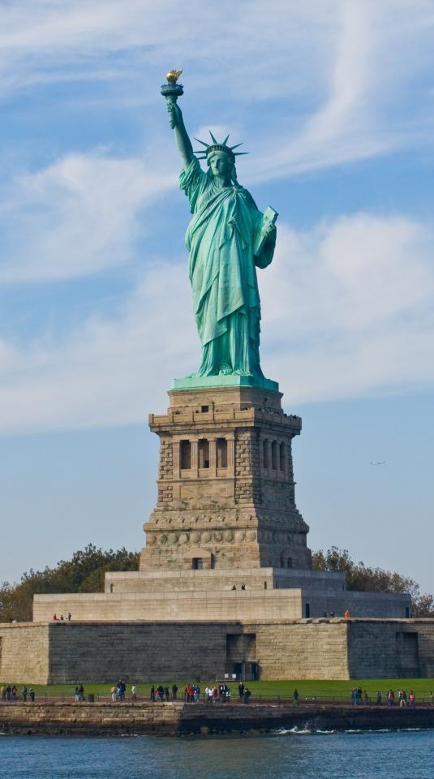
The United States of America

Slide 2
The United States of America (also called the United States, the States, the U.S., the USA, and America) is a federal constitutional republic comprising fifty states and a federal district. The country is situated mostly in central North America, where its forty-eight contiguous states and Washington, D.C., the capital district, lie between the Pacific and Atlantic Oceans, bordered by Canada to the north and Mexico to the south. The state of Alaska is in the northwest of the continent, with Canada to the east and Russia to the west across the Bering Strait. The state of Hawaii is an archipelago in the mid-Pacific. The country also possesses several territories in the Pacific and Caribbean.
At 3.79 million square miles and with over 312 million people, the United States is the third or fourth largest country by total area, and the third largest by both land area and population. It is one of the world's most ethnically diverse and multicultural nations, the product of large-scale immigration from many countries. The U.S. economy is the world's largest national economy, with an estimated 2010 GDP of $14.53 trillion.

Slide 3
Population
The population of the USA is 276 millions:
29% from Britain and Ireland
8% from Germany
5% from Italy
3% from Poland
3% from Scandinavia
12% African Americans
8% Hispanics
3% Asian and Pacific Islanders

Slide 4
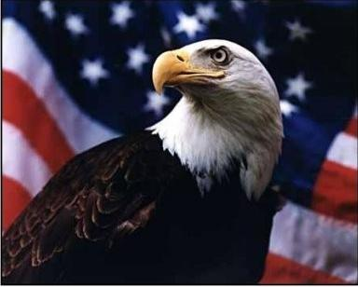
Indigenous peoples descended from forebears who migrated from Asia have inhabited what is now the mainland United States for many thousands of years. This Native American population was greatly reduced by disease and warfare after European contact. The United States was founded by thirteen British colonies located along the Atlantic seaboard.

Slide 5
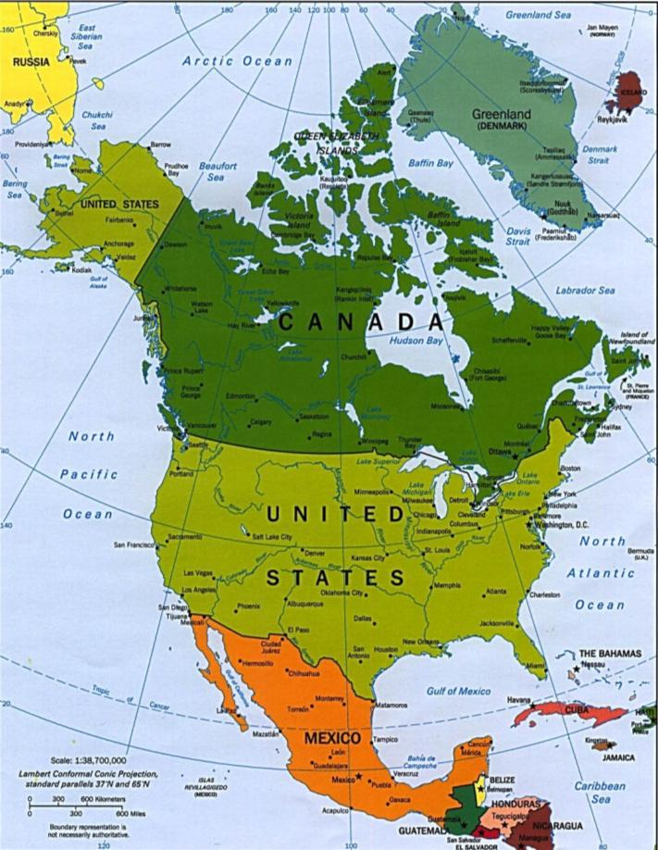
Geography

Slide 6
The land area of the contiguous United States is approximately 1,900 million acres. Alaska, separated from the contiguous United States by Canada, is the largest state at 365 million acres. Hawaii, occupying an archipelago in the central Pacific, southwest of North America, has just over 4 million acres. The United States is the world's third or fourth largest nation by total area, ranking behind Russia and Canada and just above or below China. The ranking varies depending on how two territories disputed by China and India are counted and how the total size of the United States is measured: calculations range from 3,676,486 square miles to 3,717,813 square miles to 3,794,101 square miles. Including only land area, the United States is third in size behind Russia and China, just ahead of Canada.

Slide 7
Political system
The United States has operated under a two-party system for most of its history. For elective offices at most levels, state-administered primary elections choose the major party nominees for subsequent general elections. Since the general election of 1856, the major parties have been the Democratic Party, founded in 1824, and the Republican Party, founded in 1854. Since the Civil War, only one third-party presidential candidate—former president Theodore Roosevelt, running as a Progressive in 1912—has won as much as 20% of the popular vote.
Within American political culture, the Republican Party is considered center-right or conservative and the Democratic Party is considered center-left or liberal. The states of the Northeast and West Coast and some of the Great Lakes states, known as "blue states", are relatively liberal. The "red states" of the South and parts of the Great Plains and Rocky Mountains are relatively conservative.

Slide 8
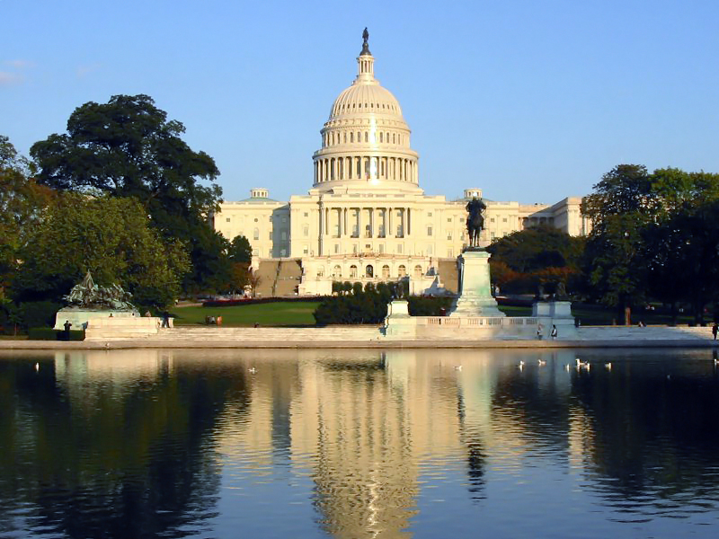

Slide 9
The winner of the 2008 presidential election, Democrat Barack Obama, is the 44th U.S. president. The 2010 midterm elections saw the Republican Party take control of the House and make gains in the Senate, where the Democrats retain the majority. In the 112th United States Congress, the Senate comprises 51 Democrats, two independents who caucus with the Democrats, and 47 Republicans; the House comprises 240 Republicans and 192 Democrats—three seats are vacant. There are 29 Republican and 20 Democratic state governors, as well as one independent.

Slide 10
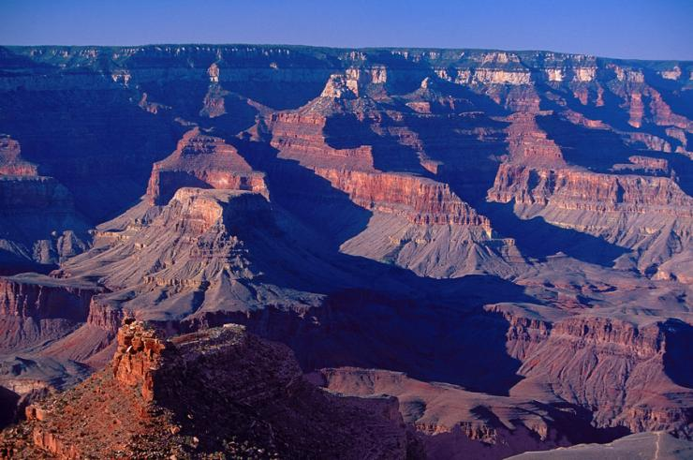
Grand Canyon
The Grand Canyon is a steep-sided canyon carved by the Colorado River in the United States in the state of Arizona. It is largely contained within the Grand Canyon National Park, the 15th national park in the United States. President Theodore Roosevelt was a major proponent of preservation of the Grand Canyon area, and visited it on numerous occasions to hunt and enjoy the scenery. It is considered a Wonder of the Natural World

Slide 11
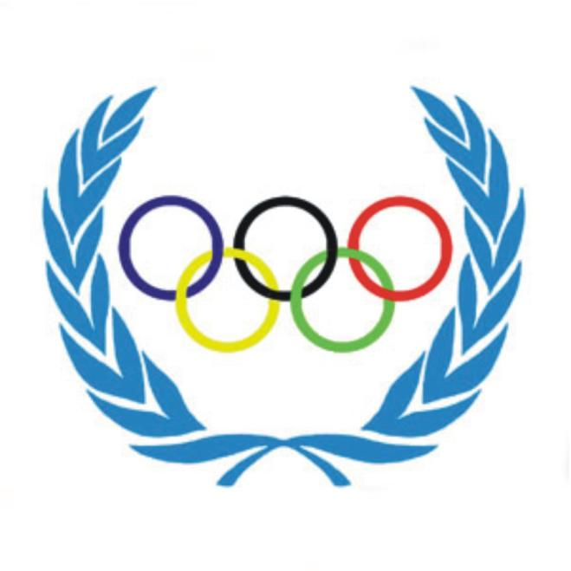
Olympic games

Slide 12
The city of Chicago, Illinois, had won the original bid to host the 1904 Summer Olympics, but the organizers of the Louisiana Purchase Exposition in St. Louis would not accept another international event in the same time frame.
St. Louis organizers repeated the mistakes made at the 1900 Summer Olympics in Paris.
Officially, the games lasted for four and a half months; in fact, James Edward Sullivan tried to hold an event every day for the duration of the fair. The Olympic caliber events were again mixed with other sporting events, but whereas Paris hardly ever mentioned them, Sullivan called all his sports events "Olympic." The IOC later declared that 94 of these events were Olympic.

Slide 13
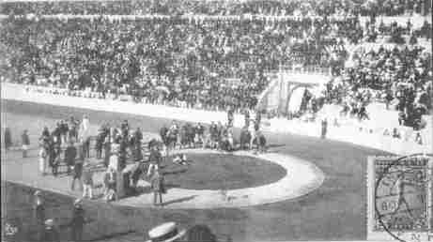
The participants totaled 651 athletes - 645 men and 6 women representing 12 countries. However, only 42 events (less than half) actually included athletes who were not from the United States. The actual athletics events that formed the bulk of the recognized Olympic sports were held from Monday, August 29 to Saturday, September 3.

Slide 14
Outstanding American sportsmen
One of the most remarkable athletes was the American gymnast George Eyser, who won six medals even though his left leg was made of wood. Frank Kugler won four medals in freestyle wrestling, weightlifting and tug of war, making him the only competitor to win a medal in three different sports at the same Olympic Games. Chicago runner James Lightbody won the steeplechase and the 800 m and then set a world record in the 1500 m. Harry Hillman won both the 200 m and 400 m hurdles and also the flat 400 m. Sprinter Archie Hahn was champion in the 60 m, 100 m and 200 m. In this last race, he set an Olympic record in 21.6, a record that stood for 28 years. In the discus, after American Martin Sheridan had thrown exactly the same distance as his compatriot, Ralph Rose (39.28 m), the judges gave them both an extra throw to decide the winner. Sheridan won the decider and claimed the gold medal. Ray Ewry again won all three standing jumps.
The team representing Great Britain was awarded a total of two medals, both won by Irish athletes. The top non-USA athlete was Emil Rausch of Germany, who won three swimming events. Zoltan Halmay of Hungary and Charles Daniels of the United States each won two swimming gold medals. Galt Football Club from Canada won the gold medal in football.

Slide 15
Kinds of sport
Aquatics: Diving
Aquatics: Swimming
Aquatics: Water polo
Archery
Athletics
Boxing
Cycling
Fencing
Football (Soccer)
Golf
Lacrosse
Roque
Rowing
Tennis
Tug of war
Weightlifting
Wrestling
Basketball was featured as a demonstration sport.
Baseball was featured as a demonstration sport.

Slide 16


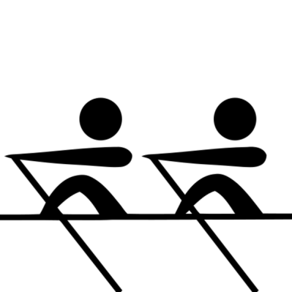


Symbol of Olympic games

