Slide 1

THE FINAL LESSON
UNIT I
“THE WORLD OF JOBS”
Составители: учителя английского языка ГБОУ ЦО №1862
Рынденкова О.К. и Рыжичкин М.О.

Slide 2

The Objectives of the lesson
Training:
Enhancing and consolidating of Vocabulary on the topic; reading and listening skills in the State Final Attestation format
Developing:
Listening and reading skills development skills to use acquired knowledge in practice;
Educational:
The development of critical thinking, assistance in establishing and nurturing a sense of responsibility to the choice of profession.
The tasks of the lesson
Learning:
To intensify the use of Lexico-grammatical structures to form and to improve the communicative competence of students.
Educational:
To facilitate vocational guidance for students to develop the correct self-assessment of their abilities and interests.

Slide 3
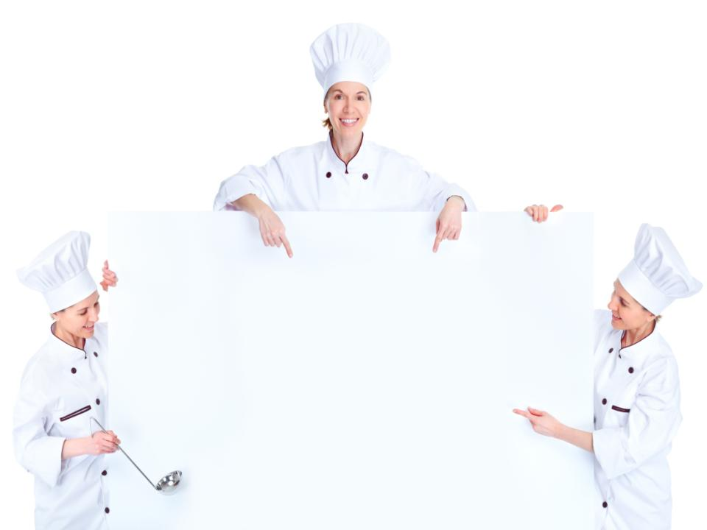
INTRODUCTORY
NOTE
Highly respected colleagues, I am working in the classes from the 6th to the 9th at the school curriculum based of the English course books by Afanas’eva and Micheeva. I am aware that nowadays lots of authors work at high pressure to issue various teacher friendly tests and I am grateful to them. But for me as a creative teacher these tests are not enough and I try my hand in completing my own ones and today I want you to see the way I usually make up the tests and now in detail.
The student’s book for the 8th grade consists of 6 Units. After covering one of them I check how well the pupils digested the material given at the lessons. This is the reason I comprise the final tests for each Unit. I am in the habit of making them up on one and the same pattern: the checking of the vocabulary, grammar, reading and listening, the recording is always authentic. As a home assignment I suggest the pupils solving the crossword puzzle thought up by myself which the pupils solve at home most willingly. Thus, broadening their outlook and vocabulary. And now let’s have a look at the tasks themselves. Task I is directed to the checking of the vocabulary studied. Taking the words given by the authors for learning I think up a story with some plot. The words that the pupils should fill the gaps with all the letters except the first one are missing. The pupils ‘task is to rack their brains and recollect the required word without making a mistake. Task II is directed to the checking of grammar. I use the new words of the Unit to think up sentences on all the grammar material studied in the Unit –the tasks are accomplished in the way of multiple choice. Task III is centered on reading. A text is selected on the topic in question. The tasks to the text are compiled in the format of the State Final Certification-such as the tasks on True, False, Not Stated statements; Multiple Choice Task IV is aimed at listening. A text read by the native speaker is selected. The task on understanding can be various: the answers to the questions, putting the sentences in the proper order, rewriting the text in the Reported Speech if the text is given in the way of the dialogue, putting five types of the essential questions to the text, and Multiple Choice. Talking about homework I usually offer a crossword puzzle to solve and at the next lesson we check it together.

Slide 4

VOCABULARY CHECKING
John Smith appears to be my classmate. He is the 1) s------- of us all and it is no wonder that everyone and each calls him “a mine of knowledge”. John is considered to be an honorable pupil and always finds himself at the 2) t-- of our class. This boy is a decent person for he never 3) s---- his knowledge o-- for the whole world to see, moreover, he never 4) f---- j------ of his classmates’ success. John, I must say, is a 5) t------ boy as he never reads 6) r----- books, &when it comes to going to the pictures and seeing some r----- films he refuses point blank as well. He is sure that the books & films like these affect people enormously and it stand to reason that they 7) d- more h--- than g---. My classmate is very 8)k--- h------. Everyone knows that his next door neighbour Mrs. Evans is 9) d--- & d--- from birth. John tries to find some time to 10)t--- c--- of her. He is a good hand at creating things of empyreal beauty &it’s a piece of cake for him to 11) f—a lamp or a shelf if she asks him about it. Mrs. Evans in her turn likes to treat him to her home-made jam with a cherry12) f------. They are very happy to be13) h------ to each other. But every time I remember my classmate Bob Brown it gives me13) c-----. You can’t even imagine how 14) s---- she is. He pretended being 15) d--- & d--- when his teachers want him to answer. He is always 16) c------ at the exams. He doesn’t 17) c--- for studying, but he feels 18) j------ of his 19) s---- classmates who are at the 20) t--- of our class. He is a 21) r----- little snob, capable for nothing but 22) s------off. But this is another story……….

Slide 5
ANSWER KEY
Smartest
Top
Shows off
Feels jealous
Terrific
Rotten
Do more harm than good
Kind hearted
Deaf & dumb
Take care
Fix
Flavor
Helpful
Silly
Deaf & dumb
Cheating
Care
Jealous
Smart
Top
Rotten
Showing off

Slide 6

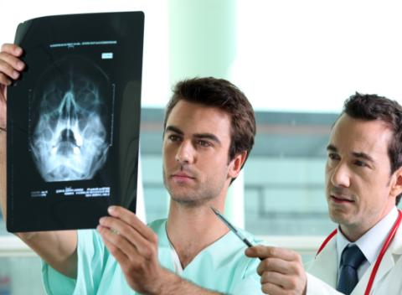
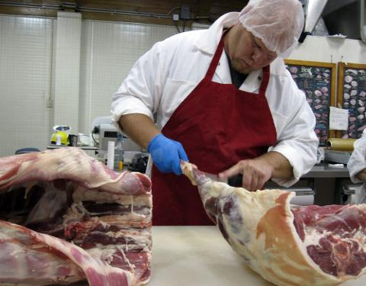
READING
Derek was a clever boy, but his parents were so poor that they could hardly keep their bodies and souls together, so he had to work in his spare time & during his holidays to pay for his education. In spite of this, he managed to enter the University, but he was alive to the fact that studying in it will be money consuming and after weighing all pros and cons he adopted a decision to try his hand in moonlighting two jobs simultaneously and the idea to work odd jobs now and then throughout the holidays did not frighten him at all as to earn enough money to pay for his studies was his long-life dream. Once in summer strolling along a street absorbed in thoughts he noticed an ad stuck on the shop window that ran as follows – “An assistant for the butcher WANTED”. He popped in the shop had a word or two with the owner and to his luck got the position at once. He should be at work during the day time. While staying in the queue he overheard that the local hospital needed nurses and male nurses and applied for the vacancy most willingly as he had to work at hospital at nights that suited him greatly. Working in the shop he was in agony of utter delight to follow the butcher’s suit in everything. Time went by and soon enough he learnt to cut meat up quite nicely, so the butcher seeing how nice the boy could handle the things about the shop did not think twice about leaving him all alone to take over the shop and run business as to do all the serving in his stead while he went into the room behind the shop to do the accounts. In hospital he was not burden with any serious errands that appeared to be the matter of life and death for the patients, just the other way round, frankly speaking, he was only allowed to do only the simplest jobs, like helping to lift people and carry them from one part of the hospital to another. It was a must for Derek to be dressed in white both at the butcher’s shop & at the hospital. One evening at the hospital Derek was called to give a hand to carry a woman from her bed to the place where she was to undergo an operation. When Derek appeared in the doorway he noticed the woman trembling all over he was aware that the thought of the forthcoming operation frightened her so much that she was on the edge of collapsing. He kept on standing till the moment the woman threw a glance at him-one should have seen the expression of her face at that moment. Being scared out of her wits she yielded at the top of her voice “No! No!” she cried.“Not my butcher! I won’t be operated on by my butcher!”
Derek worked hard because he wanted to earn much pocket money.
Derek’s parents were happy when their son managed to find the jobs.
The butcher was pleased with Derek’s work & due to it he let Derek to take over l the shop & to run business in his stead while he was busy with calculating profits in the ware house.
Derek’s work at the hospital compared to his job at the butcher’s wasn’t so challenging & he didn’t take much pain to cope up with responsibility assumed on him.
The lady was overjoyed when she saw Derek; she wanted him to operate on her.
The boy had to wear white clothes in the hospital & at the butcher’s.
In some years Derek’s name was known to everyone in his country. He has become a skillful plastic surgeon.
Derek’s parents were very poor to give their son good education.
F
NS
T
T
F
T
NS
T

Slide 7
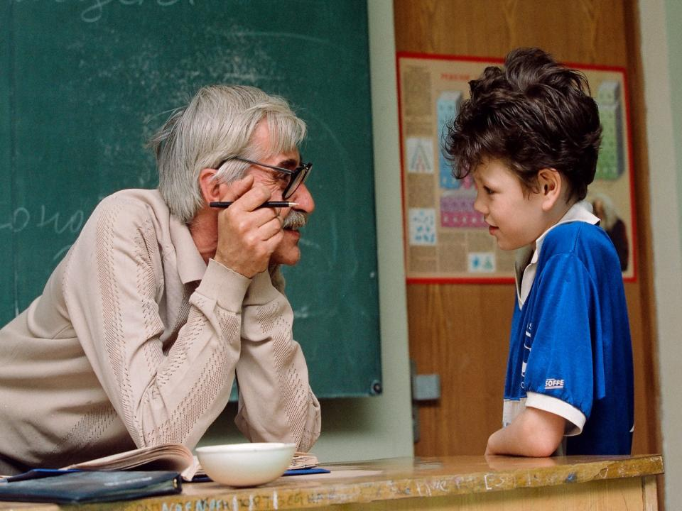
1) No wonder why Mr. Gregory is a good Geography teacher. He … almost all the countries in the world.
Visited
had visited
has visited
GRAMMAR REVISION.
CHOOSE THE RIGHT ITEM

Slide 8

2) My uncle … as a surgeon since 1983.
Works
has been working
has worked

Slide 9
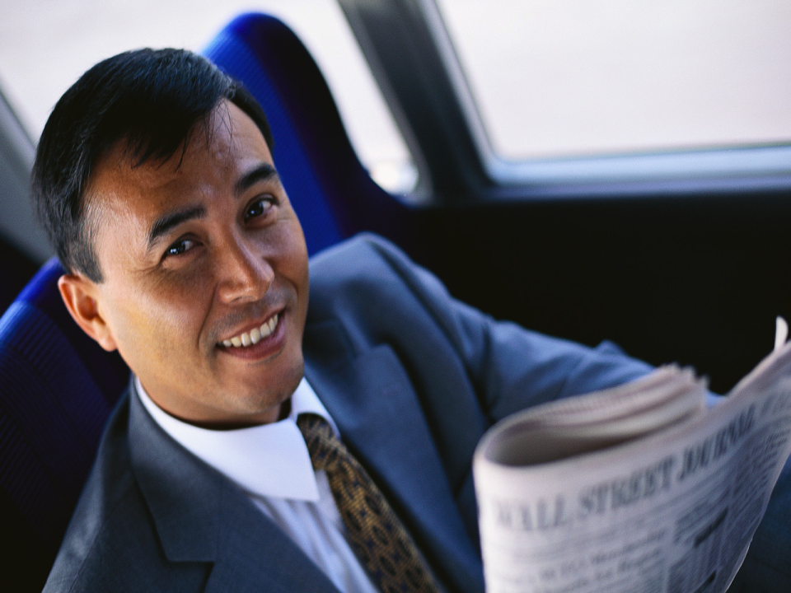
3) When … Mr. Smith … his business?
Has begun
Did begin
had begun

Slide 10
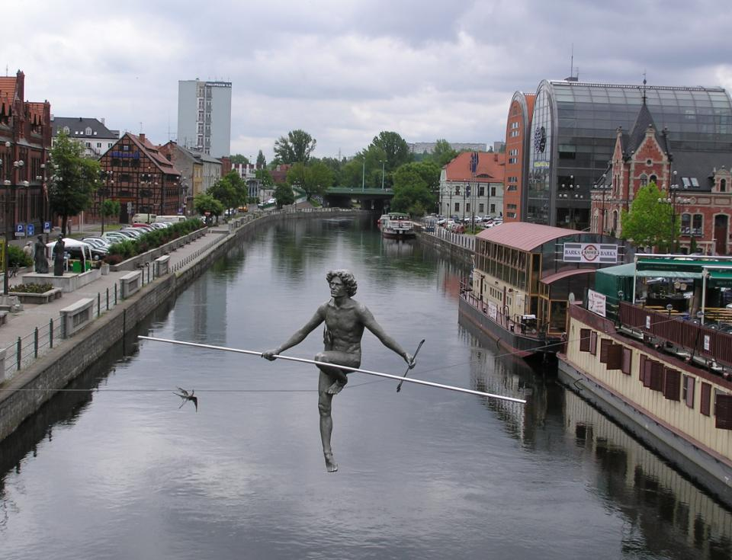
4) Mary’s parents didn’t expect their daughter … a trapeze-acrobat
To become
become
became

Slide 11

5) I want my children … the right profession
Choose
to choose
will choose

Slide 12
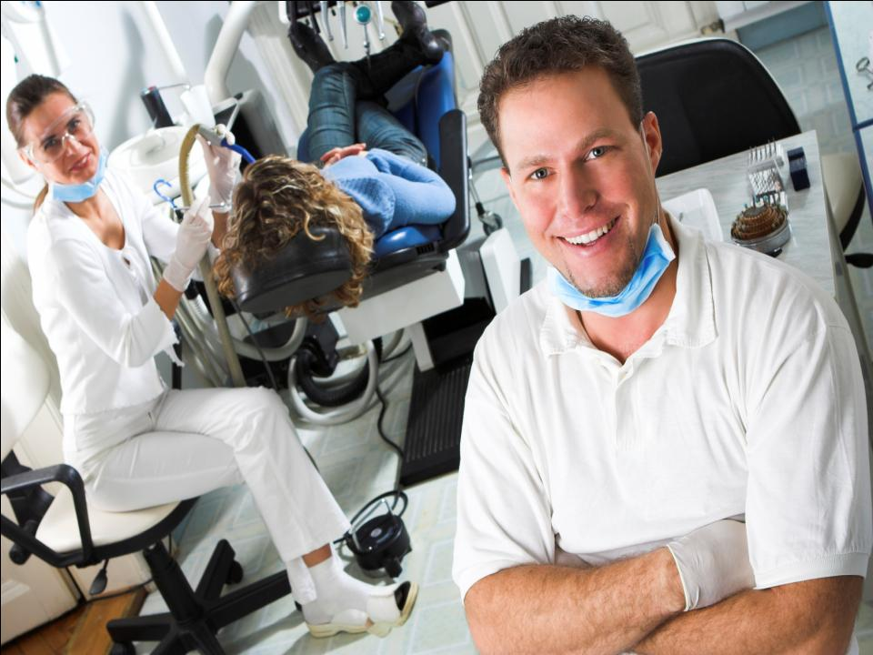
6) The profession of the dentist … already in the 15th century
Has been known
was known
had been known

Slide 13
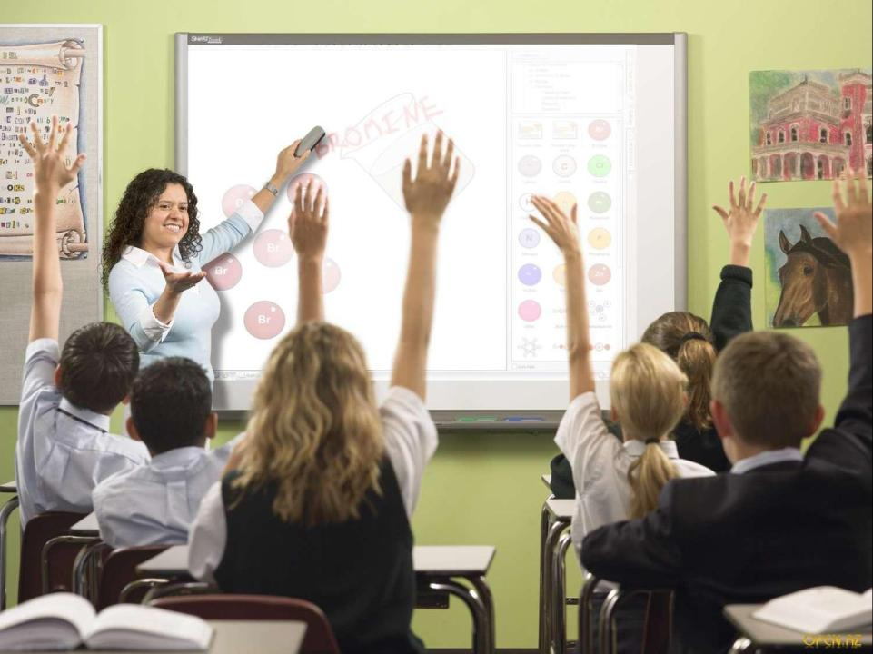
7) If Cecil … more patient she … a very good teacher, but unfortunately she isn’t.
were/would be
had been/would have been
is/will be

Slide 14
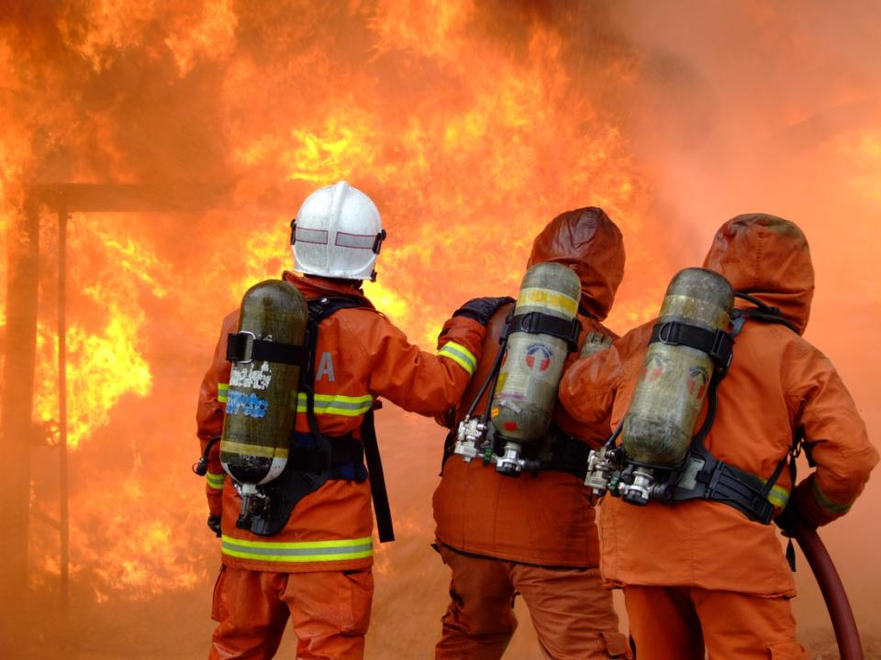
8) How long Mr. McGregor … as a firefighter?
has been working
works
has worked

Slide 15
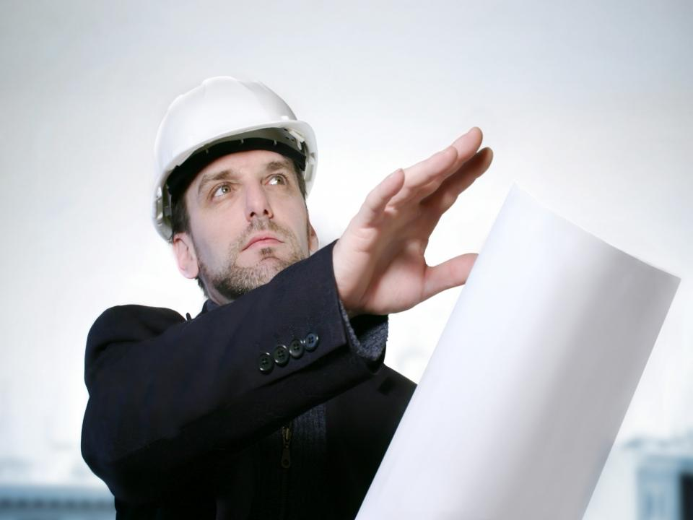
9) If 20 years ago my parents … me to choose the right career now I … a good architect, I was good at drawing in my childhood & youth.
Helped/would be
had helped/would have been
had helped/would be

Slide 16
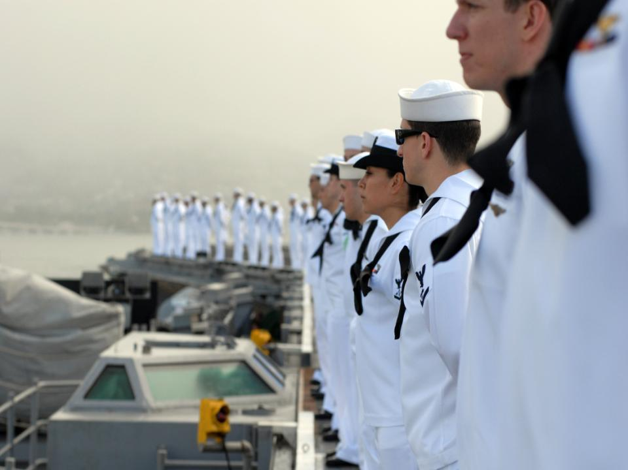
10) But for my cousin’s advice
I … become a sailor … so many countries of the world.
Wouldn’t have/wouldn’t have visited
Wouldn’t /wouldn’t visit
Didn’t/didn’t visit

Slide 17
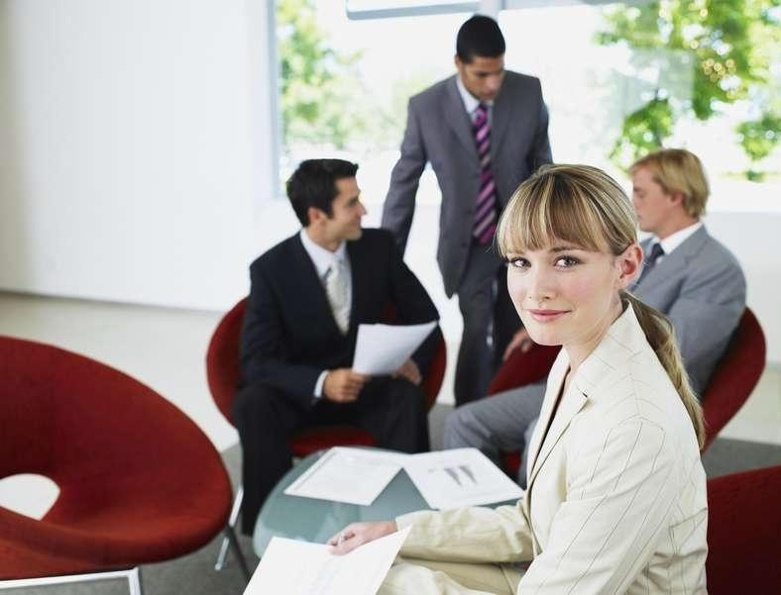
LISTENING
Listen to the dialogue &
put TRUE,FALSE or NOT STATED
to the statements.
Make sure you know these
words & and expressions:
employer - работодатель
marketing - маркетинг
challenging - трудный
to be very good at motivating people –уметь смотивировать людей
conglomerate - конгломерат
a new acting CEO - новый исполняющий обязанности генерального директора
STATEMENTS:
Petra was working in logistic company.
The girl was satisfied with the job offered to her by the employer.
Petra is very organized& has good experience in sales.
Petra is very busy she can’t afford to have a hobby for herself.
The company was recently bought out by a Japanese conglomerate.
The girl has been working in marketing more than 4 years.
Everybody knows that the new acting CEO is Jane Mayers.
The employer asks the girl to call him at the end of the week.
F
F
T
NS
F
NS
F
T

Slide 18
WORDSEARCH
1. A student who is doing temporary work in the office in order to get work experience = an in____.
2. The person who is employed to do office work, including typing letters and answering phone calls = the se____.
8. The person who spreads stories about other people’s private lives = the office gos____.
3. The person who does administrative work for one particular person, usually an office manager or a boss = a personal a____ (also known as a P.A.).
4. The person in charge of the office = the b____.
5. The person who likes to play jokes on other people or do funny things = the office jo____.
7. Someone who seems to be very kind but who will report you for arriving late or for not doing your work properly = the backst____.
9. The person who tells stories that no one else is interested in = the office bo____.
10. The person who likes to get things finished as quickly as possible, and whose standard of work is usually poor = the slop____ worker.
17. Someone who will never break any rules or regulations, even if it is the sensible thing to do = a jobs________.
6. Someone who loves to ridicule or threaten others = the office bu____.
11 . Someone who will do anything for attention at work = the attention se____.
12. The newest employee = the new b____.
13. Someone who deliberately causes trouble at work = the office sab____.
14. A man who is constantly flirting with female employees = the office le____.
15. The person who always defends the boss = the boss’ p_______.
16. The person who is given all the worst jobs in the office = the office dog_______.
D | R | J | P | H | Y | R | S | H | C | T | E | L | B
W | E | O | Y | R | A | T | E | R | C | E | S | E | O
G | K | K | U | B | Z | K | C | D | J | T | E | P | Y
O | E | E | S | I | E | E | Q | B | M | O | X | E | M
S | E | R | Z | Y | S | U | C | F | Z | Q | H | H | S
S | S | S | H | S | E | W | S | S | O | B | P | T | A
I | P | Y | O | J | U | Z | M | N | C | F | U | R | B
P | R | E | B | B | A | T | S | K | C | A | B | O | O
Y | C | J | J | O | V | P | Y | A | N | F | I | W | T
P | Y | D | O | B | S | G | O | D | K | Y | N | S | E
P | X | H | C | E | R | O | B | D | V | E | T | B | U
O | B | U | L | L | Y | A | Y | L | P | D | E | O | R
L | U | A | S | S | I | S | T | A | N | T | R | J | Y
S | K | X | I | E | X | O | A | T | P | B | N | E | D

