Slide 1
Welcome to our zoo!
Презентация выполнена учителем МБОУ СОШ № 27 г. Мытищи Московской области
Копташкиной Н.В.

Slide 2
Pronunciation of Final -S/-ES
[s] [z] [iz]
после глухих после гласных и звонких после шипящих и свистящих
согласных согласных
a cat – cats a bird – birds a fox- foxes
a duck – ducks an animal- animals an ostrich -
a parrot- parrots a dog- dogs ostriches
a pet- pets a whale- whales a box- boxes
an elephant – a lion- lions a glass- glasses
elephants an owl- owls a peach- peaches
a bat- bats a reptile- reptiles

Slide 3
Guess the animal !
Is it big / small / dangerous / kind / green / white….?
Yes, it is. No, it isn’t.
Has it got a tail / four legs / wings ….?
Yes, it has. No, it hasn’t.
Can it fly / jump / swim…?
Yes, it can. No, it can’t.

Slide 4
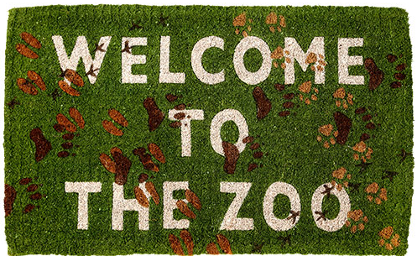

Slide 5
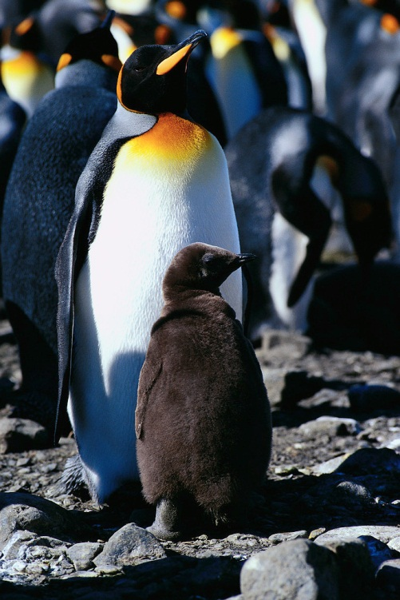
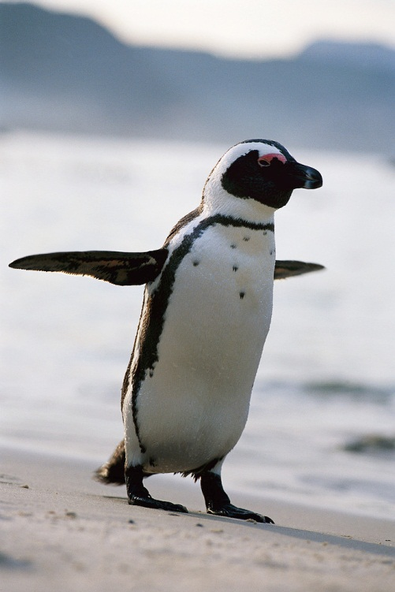
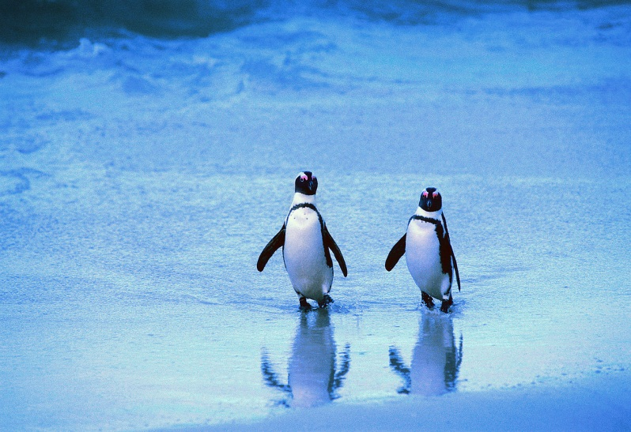
Penguins
Ten little penguins,
Standing on the ice.
All of them are smiling,
They seem to be so nice.
They play out in the snow,
All the winter long,
They eat a lot of fish,
Which makes them big and strong.

Slide 6
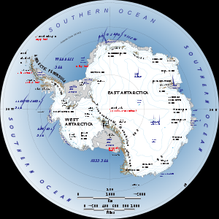

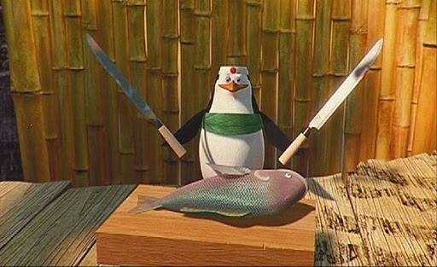
Check your answers
Animals | Number | They are from | They are | They like eating
penguins | 7 | Antarctica | kind and funny | fish

Slide 7
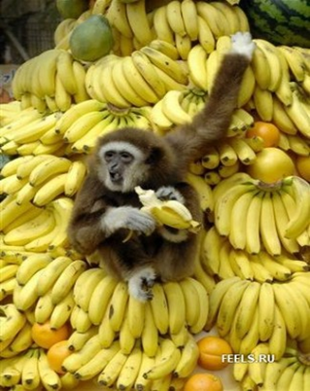
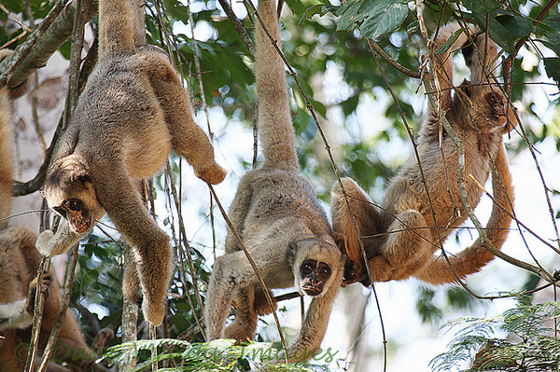
monkeys
Monkeys are cute
And look like us.
They jump very high
And play on the grass.

Slide 8
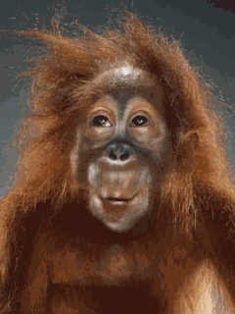
Check your answers
Animals | Number | They are from | They are | They like eating
monkeys | 21 | Africa | fast and funny | bananas, apples, cookies

Slide 9
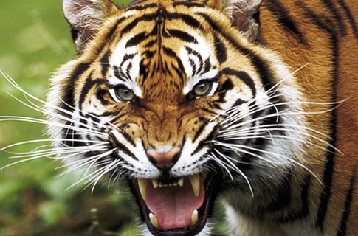
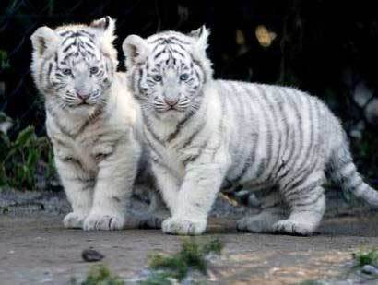
tigers
Tigers are orange
With black stripes.
They сan be dangerous,
They can be nice.

Slide 10
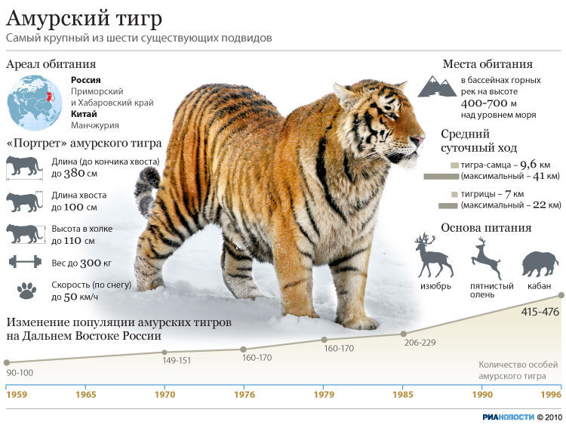
Check your answers
Animals | Number | They are from | They are | They like eating
Amur (siberian) tigers | 9 | Russia | fast, dangerous, very big | meat

Slide 11
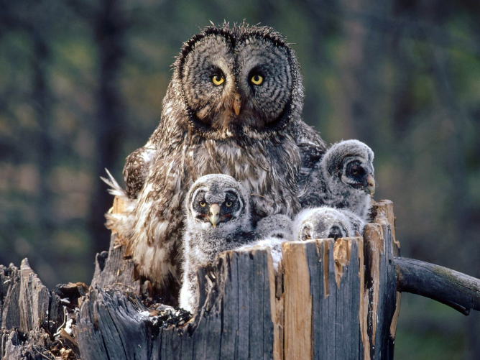
owls
Five little owls in an old tree,
Fluffy and puffy as owls could be.
As I walked , I could hear one say,
"There'll be mouse for dinner today!"
Then all of them hooted "Tu -whit, Tu-whoo!"
Yes, mouse for dinner, Hoo hoo, Hoo hoo!"

Slide 12
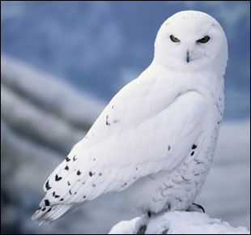
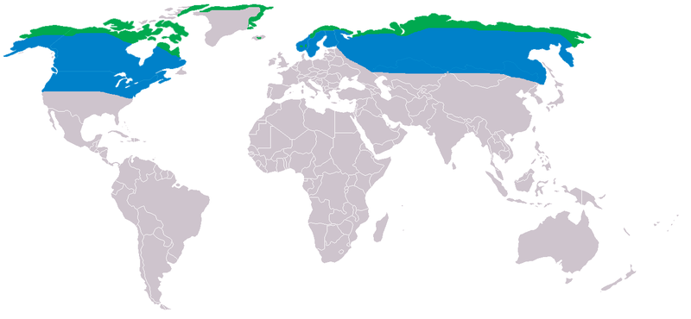
Check your answers
Animals | Number | They are from | They are | They like eating
Snowy owls | 11 | Russia | clever, dangerous, beautiful | lemmings, mice, birds

Slide 13
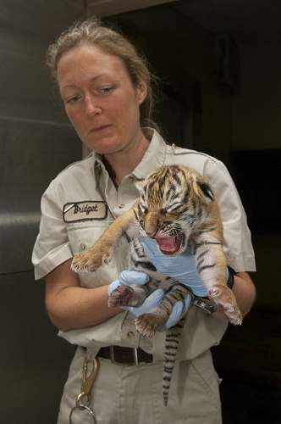
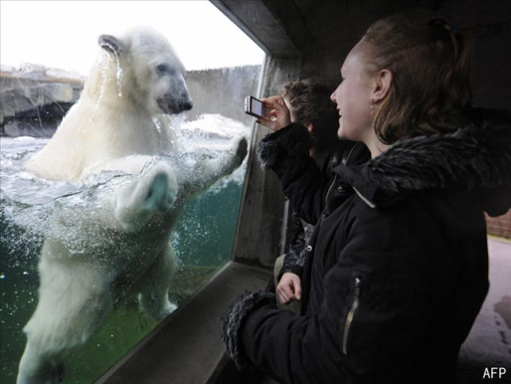
Learn a dialogue
Zoo keeper: Hello, can I help you?
Visitor: Hello. I’d like to know about tigers. Where are they from?
Zoo keeper: Our tigers are from Russia. They are very big and dangerous.
Visitor: And what do they like eating?
Zoo keeper: They like eating meat.
Visitor: Oh, I see. Thank you. Bye!
Zoo keeper: You are welcome!

Slide 14
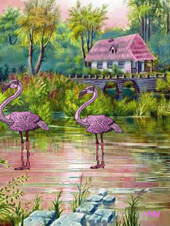
Thank you for your kind attention!

Slide 15
В презентации использованы электронные ресурсы
http://animalpicture.ru/wp-content/uploads/2009/10/178.jpg - тигрята
http://best-gif.narod.ru/images пингвины
http://www.trt.net.tr/medya/resim/2009/01/26/c57dc7a6-bbe0-4c03-8058-465bdee66574-galeri.jpg zoo visitor
http://www.segodnya.ua/img/forall/a/140592/70.jpg тигр
http://upload.wikimedia.org/wikipedia/commons/thumb/e/ec/Panthera_tigris_altaica_world.png/250px-Panthera_tigris_altaica_world.png ареал обитания тигра
http://img.beta.rian.ru/images/20730/19/207301933.jpg амурский тигр
http://www.gandex.ru/upl/oboi/u26_6062_sova.jpg сова
http://upload.wikimedia.org/wikipedia/commons/4/4e/Nyctea_scandiaca_dis.png сова ареал
http://www.owl-pictures.com/snowy_owl.jpg белая сова
http://1.bp.blogspot.com/_qm4HVkF5dxY/S_82S8AEi-I/AAAAAAAADPA/ayZ3BS2GgTE/s1600/zoo+doormat.png welcome to the zoo
http://lh4.ggpht.com/_EqcZ5qeoMT4/TS97PeYvdgI/AAAAAAAAAxg/W1SN6VF9cA8/%D0%91%D0%B5%D0%B7%D1%8B%D0%BC%D1%8F%D0%BD%D0%BD%D1%8B%D0%B96.jpg пингвин с рыбой
http://photos.signonsandiego.com/albums/animals/tigercub.jpg zoo keeper with a tiger
http://proza.ru/pics/2011/23/03/1051.jpg - обезьяна с бананами
http://science.compulenta.ru обезьяны
http://upload.wikimedia.org. Антарктида

Slide 16
Стихотворения про пингвинов и сов взяты с сайта www.readinglady.com
Стихотворения про тигров и обезьян придуманы ученицей 5б класса МБОУ СОШ № 27 г. Мытищи Копташкиной Таней

