Slide 1




How to be healthy

Slide 2
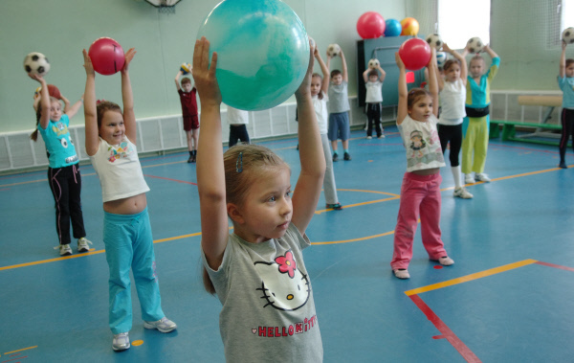
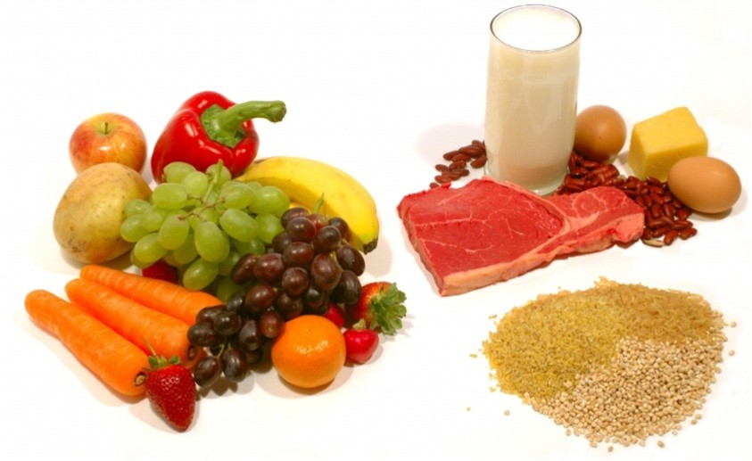

What should we do to be healthy?

Slide 3
Answer the questions:
When should people get up and go to bed?
How many times a day should people clean their teeth?
What should people do before eating?
What healthy food should people eat?
What should people do if they have a cold?
What should people do if they have a toothache?
Should we do morning exercises?

Slide 4

We should
Get up early and go to bed early
Wash your hands before eating
Go in for sports
Sleep enough
Take a cold shower
Air the room

Slide 5
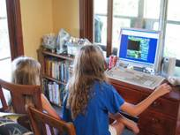
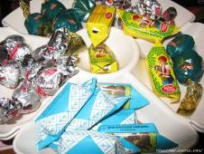

We shouldn’t
Watch TV too long
Clean your teeth once a day
Eat too many sweets
Spend much time indoors
Eat between meals

Slide 6
Match the words to make the word-combinations.
1) to visit a) a patient 2) to take b) a doctor 3) examine c)medicine 4) to have d) healthy 5) to feel e) a headache

Slide 7
Put the words of the proverbs about health in a logical order
wealth is good above health
a day apple an away keeps doctor a
to and healthy bed wise makes a rise man early and early to wealthy
a mind sound in body a sound

Slide 8

Proverbs about health
Good health is above wealth.
An apple a day keeps a doctor away.
Early to bed and early to rise makes a man. healthy, wealthy and wise.
A sound mind in a sound body.

Slide 9
Find the Russian equivalents for these English proverbs
Good health is above wealth.
Кто рано ложится и рано встаёт, здоровье, богатство и ум наживёт.
An apple a day keeps a doctor away.
В здоровом теле – здоровый дух.
Early to bed and early to rise makes a man healthy, wealthy and wise.
Кушай по яблоку в день, и доктор не понадобится.
A sound mind in a sound body.
Здоровье дороже богатства.

