Slide 1
The Impact of Social Media on Youth Culture

Slide 2
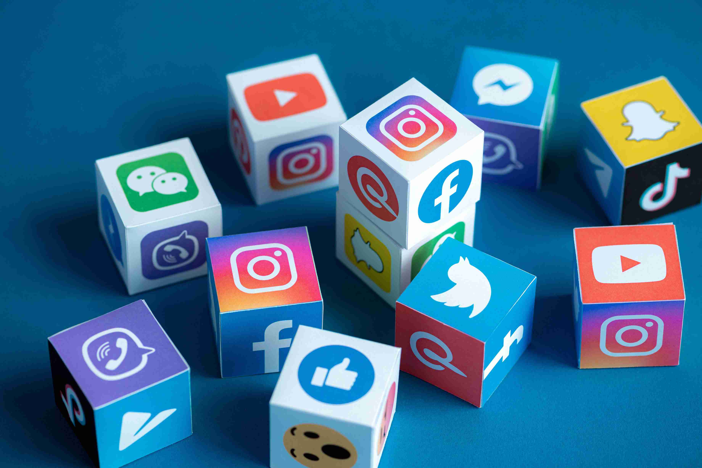
Social Media: A Double-Edged Sword?
Social media has become an integral part of modern life, especially for young people.
However, it’s important to consider the impact it has on youth culture.
Notes:
Social media has become an integral part of modern life, especially for young people. It offers countless opportunities for connection, information, and entertainment. However, it’s important to consider the impact it has on youth culture.

Slide 3

Watch a quick news report

Slide 4
Discuss in groups
In your opinion, what are the pros and cons of social media?
Notes:
Social media has become an integral part of modern life, especially for young people. It offers countless opportunities for connection, information, and entertainment. However, it’s important to consider the impact it has on youth culture.

Slide 5
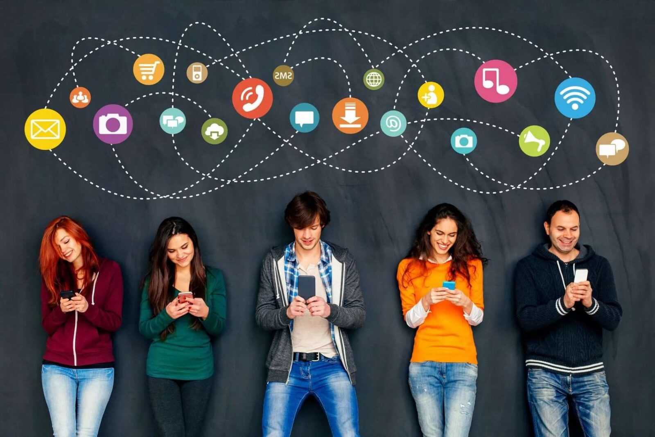
The Benefits of Social Media
Communication: Social media platforms connect people across geographical boundaries, enabling instant communication and fostering friendships.

Slide 6

The Benefits of Social Media
Information: Social media provides access to a vast amount of information, helping young people stay updated on current events, learn new skills, and explore different perspectives.

Slide 7

The Benefits of Social Media
Inspiration: Social media can inspire young people through motivational content, creative projects, and stories of resilience.

Slide 8
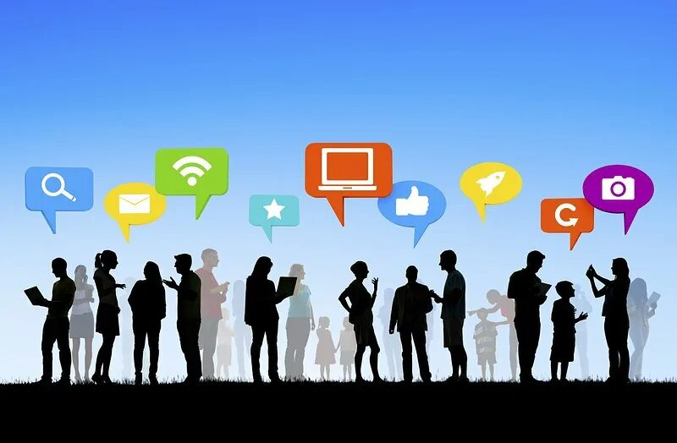
The Benefits of Social Media
Community: Social media platforms can create online communities, providing a sense of belonging and support for young people with shared interests.

Slide 9

The Challenges of Social Media
Cyberbullying: The anonymity and reach of social media can fuel cyberbullying, leading to emotional distress and mental health issues.

Slide 10

The Challenges of Social Media
Addiction: The constant notifications and social pressure can lead to excessive social media usage, potentially affecting academics, relationships, and overall well-being.

Slide 11
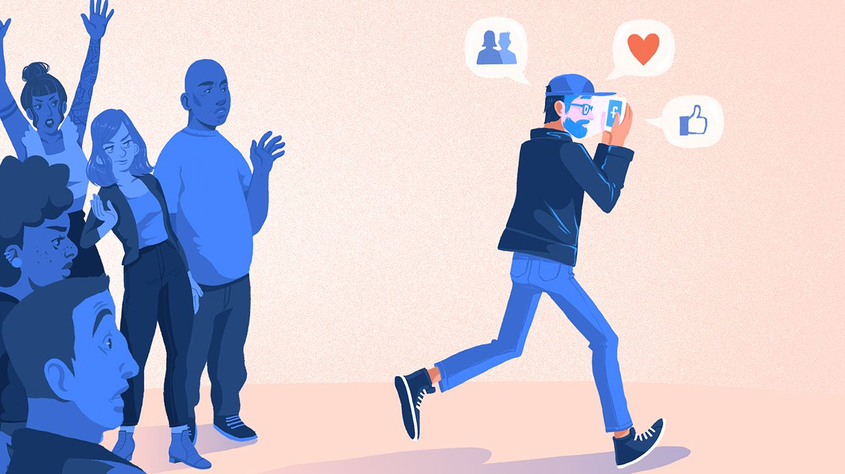
The Challenges of Social Media
Social Isolation: While social media connects people, it can also lead to social isolation, as people spend less time in real-world interactions.

Slide 12
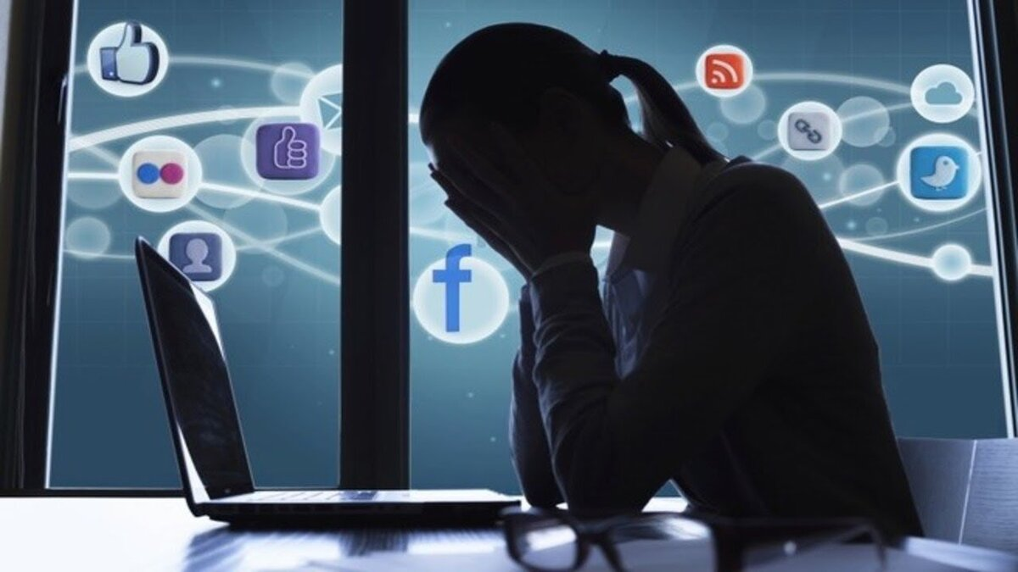
The Challenges of Social Media
Identity Crisis: Social media can influence young people’s self-perception and body image, leading to insecurity and a desire to conform to unrealistic standards.

Slide 13
What’s Your Take?
Homework:
Group Project
Prepare a presentation about social media and its impact on young generation
You can talk about the things we discussed today:
Positive Impact: Communication, information, inspiration, community
Negative Impact: Cyberbullying, addiction, social isolation, identity crisis
Other: Social media trends, influencers, the future of social media.

Slide 14
Project’s plan
Theme Selection
Task Distribution and Research Plan (role assignment, research plan development)
Research and Information Gathering (gathering information, organizing findings)
Presentation Development
Presentation Delivery

Slide 15

Discuss in groups
Your group project’s theme
Task distribution and research plan
Sources of information
Predentation development

