Slide 1

Ways of cooking

Slide 2
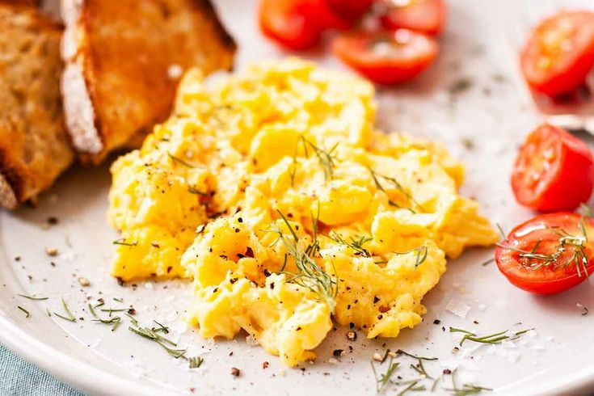
Scrambled eggs |ˈskræmbəld||eɡz|

Slide 3
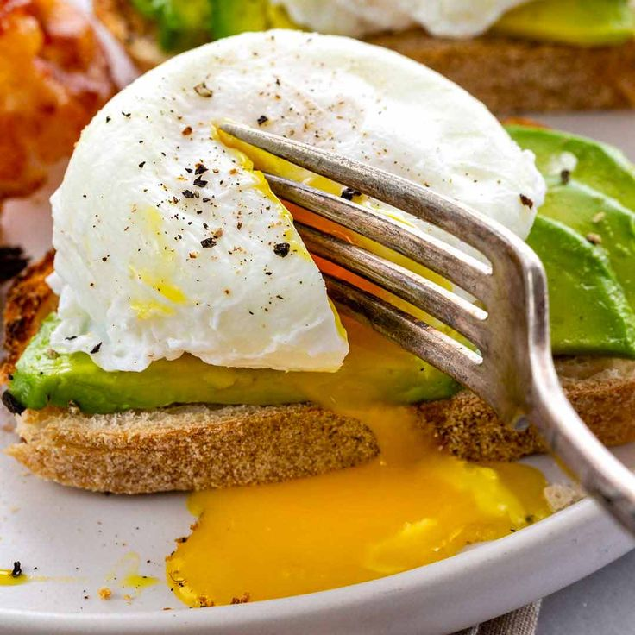
Poached eggs |pəʊtʃt| |eɡz|

Slide 4
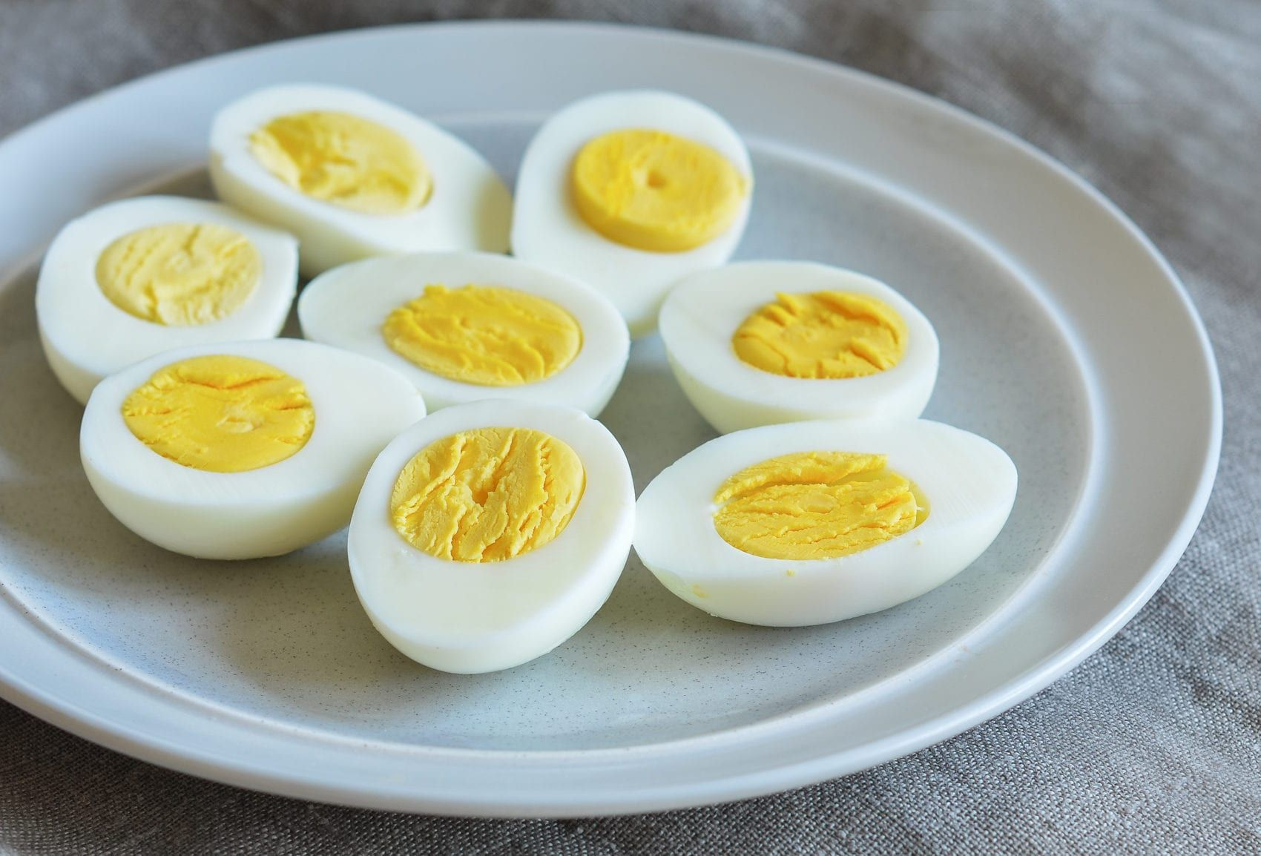
Boiled eggs |bɔɪld| |eɡz|

Slide 5
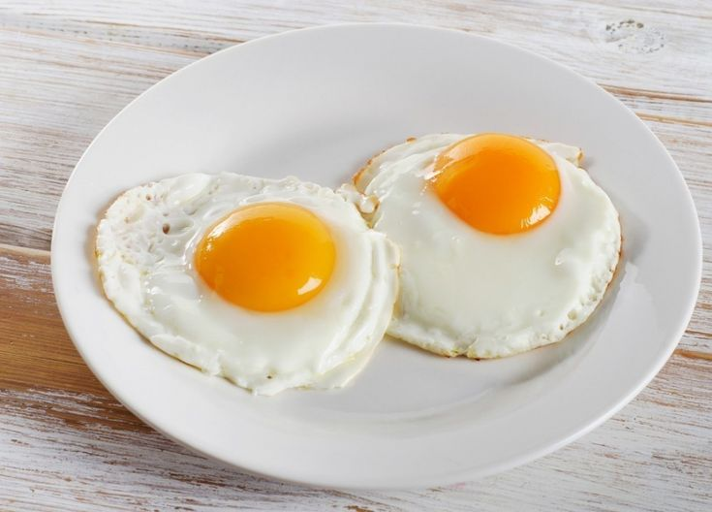
Fried eggs |fraɪd| |eɡz|

Slide 6
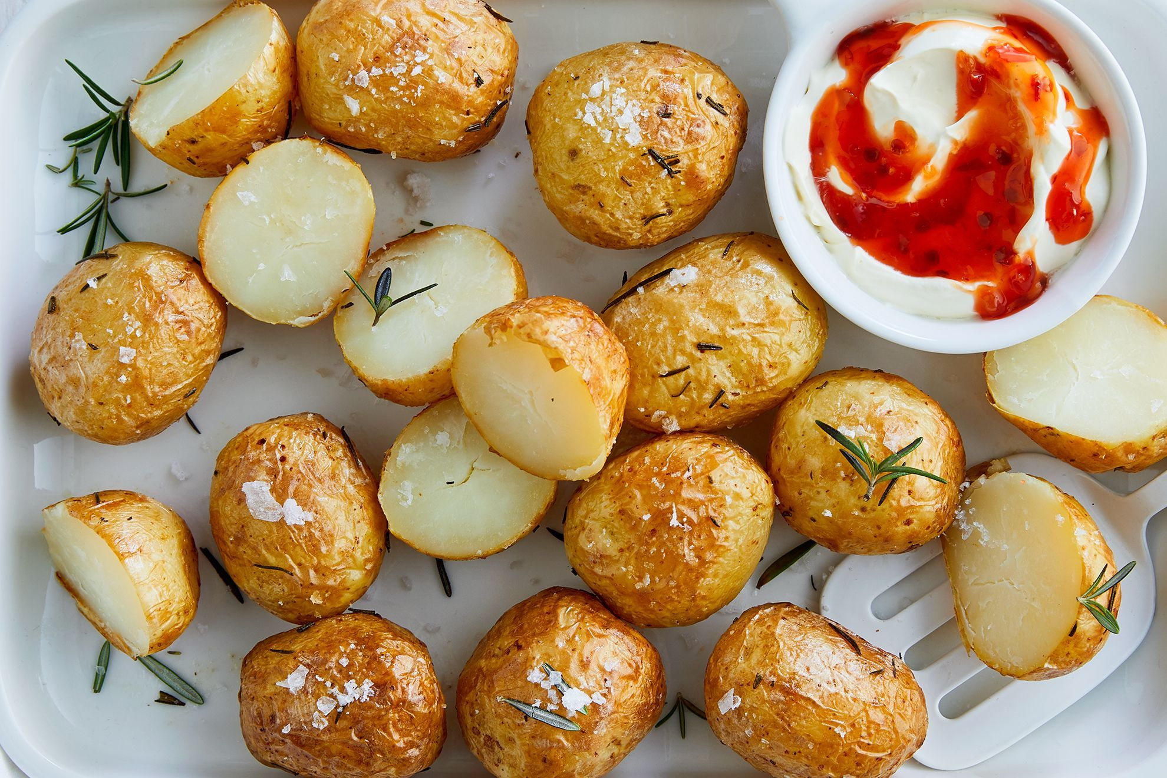
Baked potatoes |ˈbeɪkt||pəˈteɪtəʊz|

Slide 7
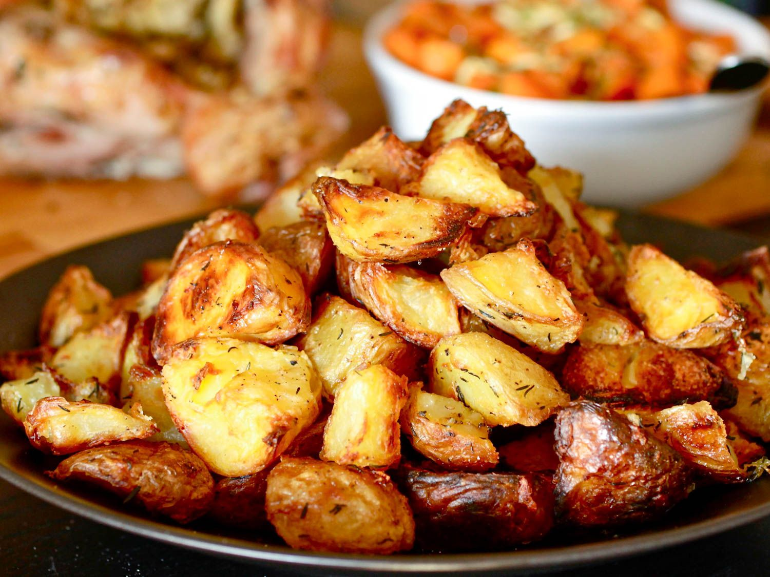
Roast potatoes |rəʊst| |pəˈteɪtəʊz|

Slide 8
roast potatoes vs baked potatoes
Baked potatoes are potatoes cooked whole and unpeeled without fat in the oven.
Roast potatoes are potatoes peeled, cut up, partially boiled, then cooked in fat in the oven.

Slide 9
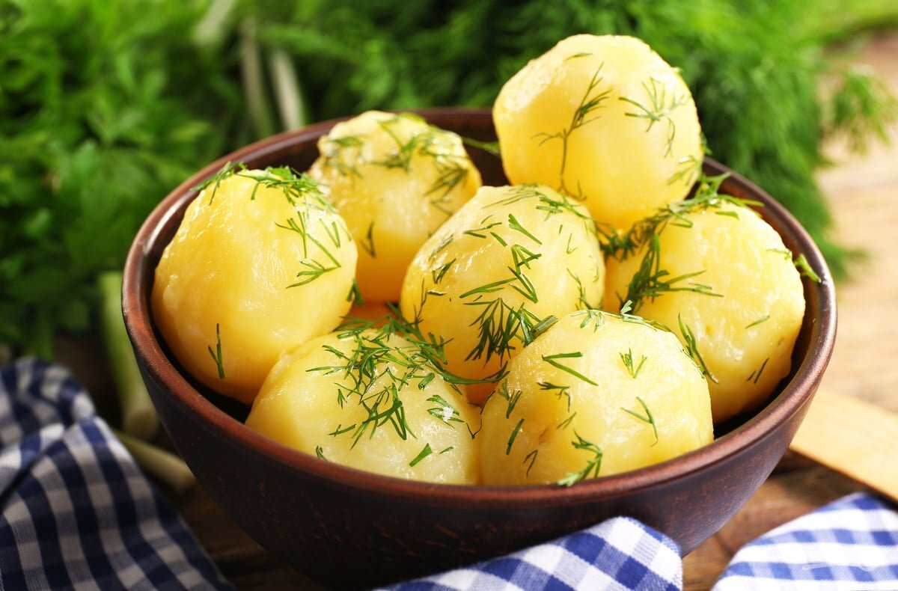
Boiled potatoes |bɔɪld||pəˈteɪtəʊz|

Slide 10
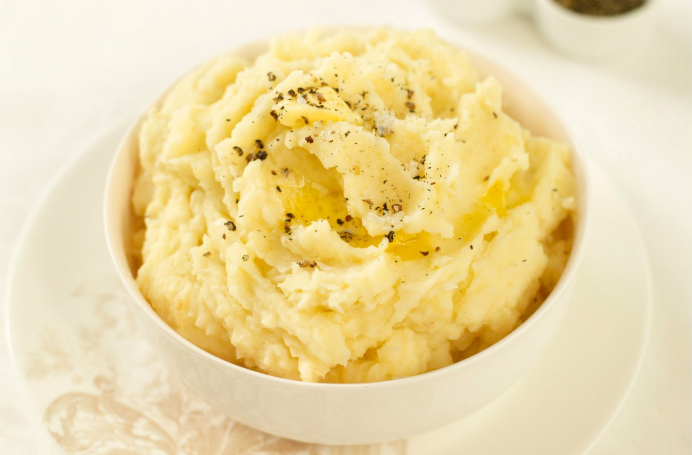
Mashed potatoes |mæʃt| |pəˈteɪtəʊz|

Slide 11
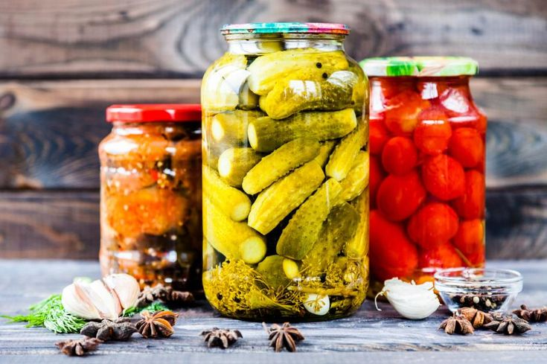
pickled vegetables |ˈpɪk(ə)ld| |ˈvedʒɪtəbəlz|

Slide 12
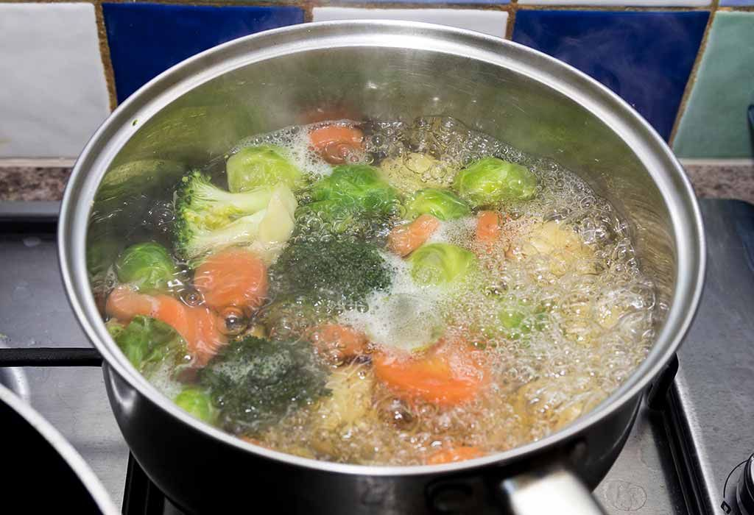
boiled vegetables |bɔɪld| |ˈvedʒɪtəbəlz|

Slide 13
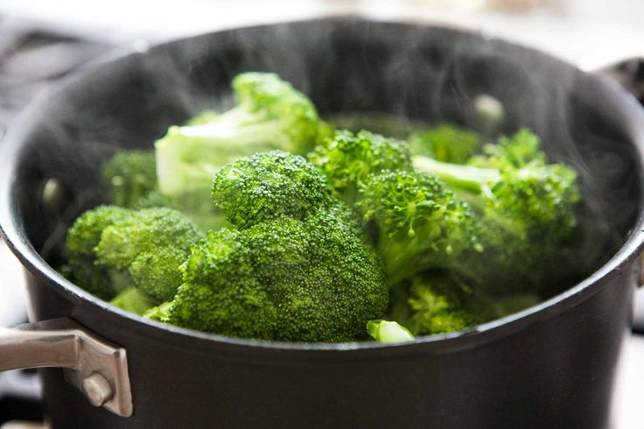
steamed vegetables |stiːmd| |ˈvedʒɪtəbəlz|

Slide 14
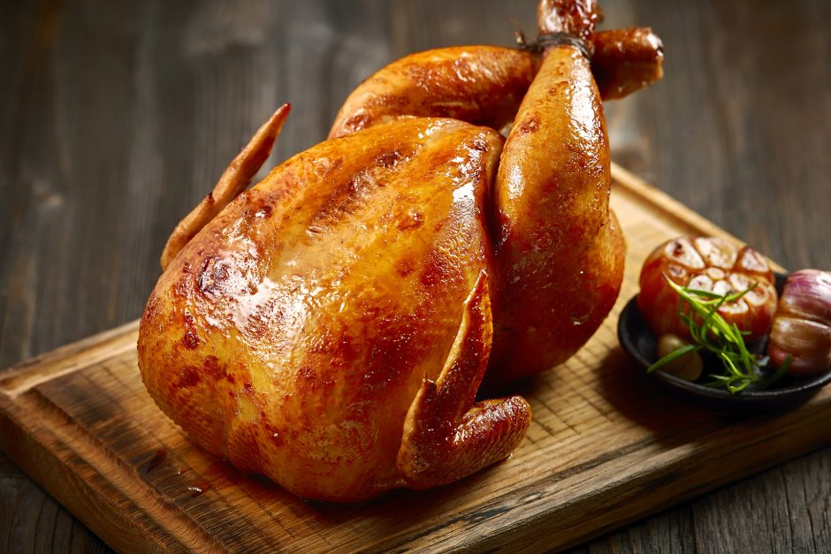
Roast chicken |rəʊst||ˈtʃɪkɪn|

Slide 15
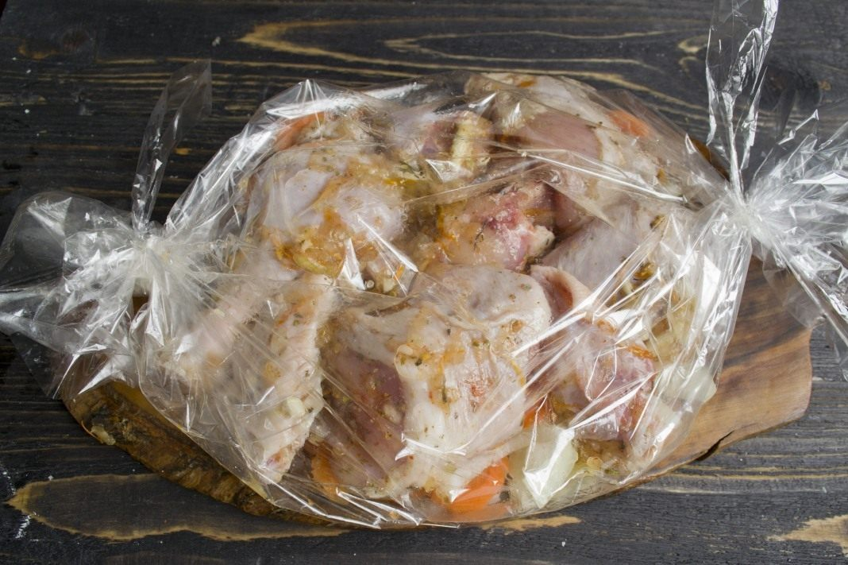
Baked chicken |ˈbeɪkt||ˈtʃɪkɪn|

Slide 16
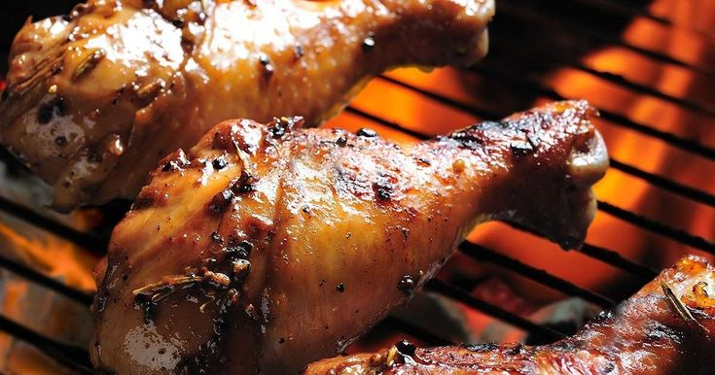
grilled chicken |ɡrɪld||ˈtʃɪkɪn|

Slide 17
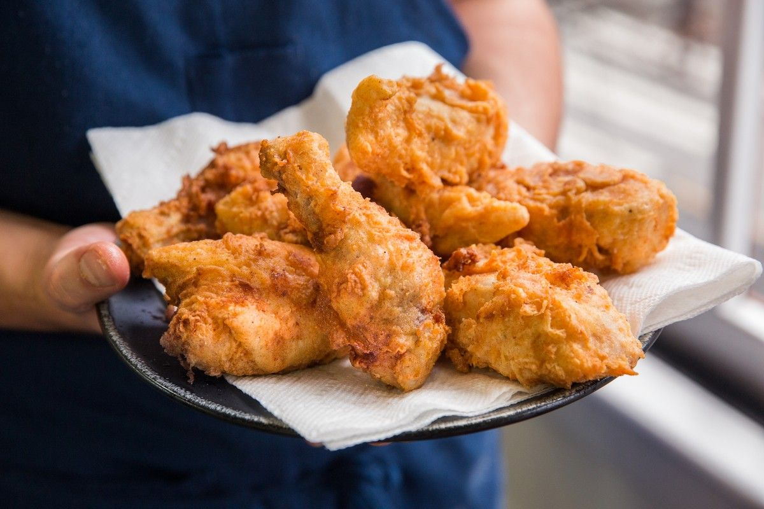
fried chicken |fraɪd| |ˈtʃɪkɪn|

Slide 18
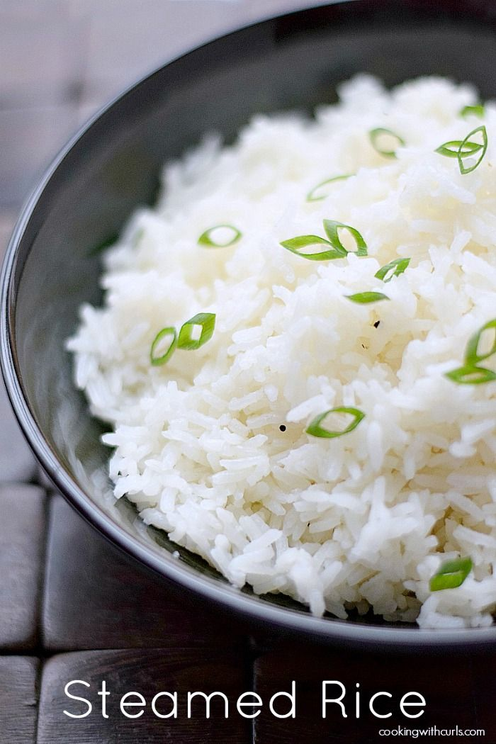
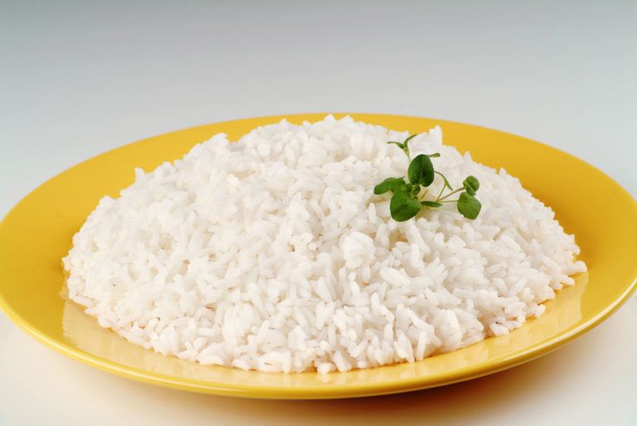
boiled rice |bɔɪld| |raɪs|

Slide 19
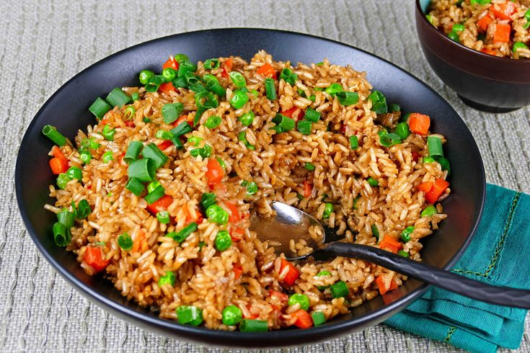
fried rice |fraɪd| |raɪs|

Slide 20
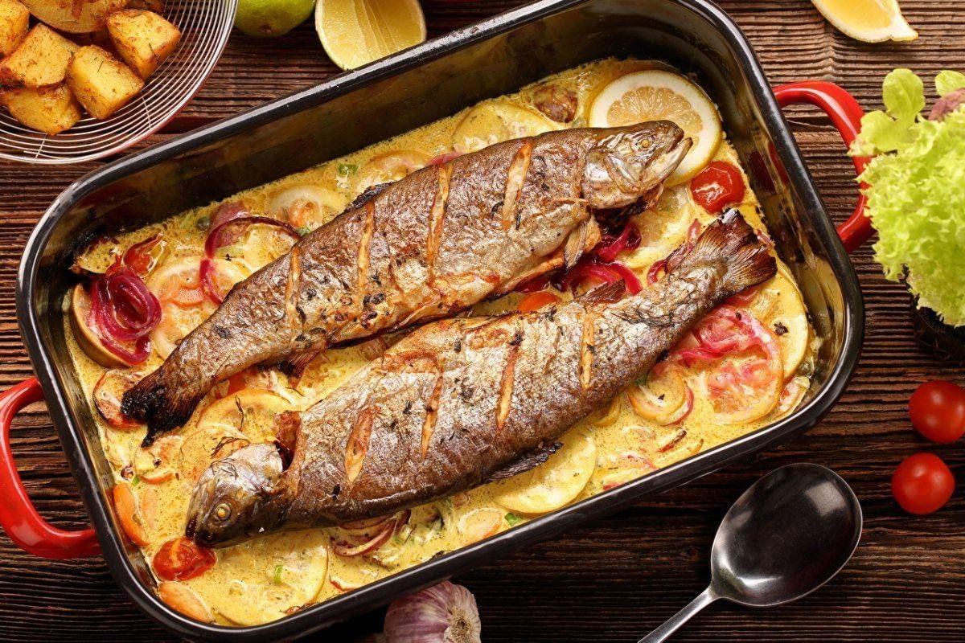
baked fish |ˈbeɪkt||fɪʃ|

Slide 21
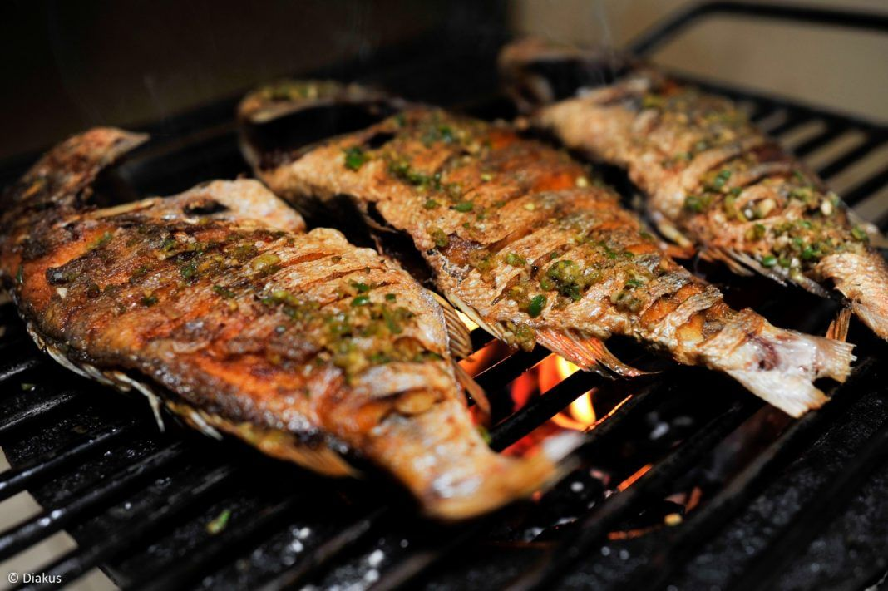
grilled fish |ɡrɪld| |fɪʃ|

Slide 22
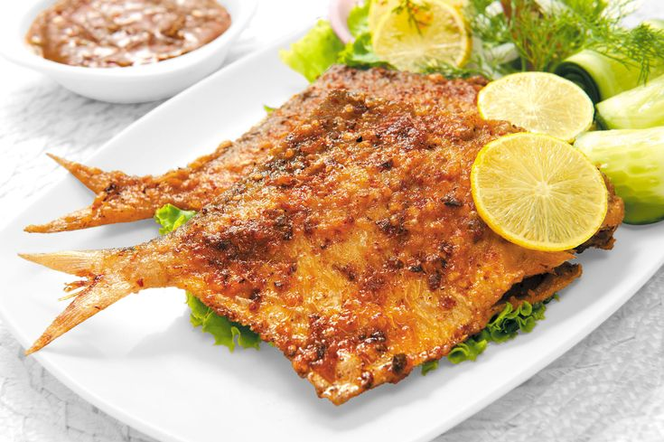
fried fish |fraɪd||fɪʃ|

Slide 23
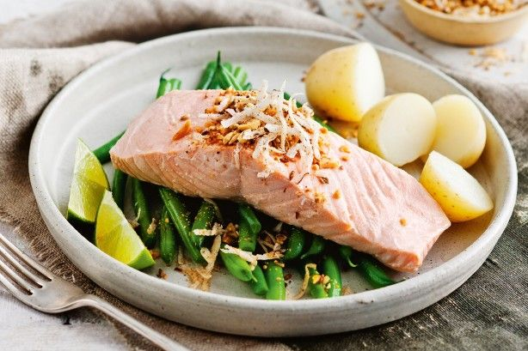
Poached fish |pəʊtʃt||fɪʃ|

