Slide 1
The role of the teacher in Human life
Student: Gilyazova Sofie
Teacher: Trymbovetskaia
Galina Vladimirovna

Slide 2
Aim and tasks
Project aim: to find out and evaluate the role of the teacher, S.A. Rachinskiy, in the person’s life.
Project tasks: to analyze and describe the pedagogical activity of S.A. Rachinskiy, its impact on development of the student’s personality.

Slide 3
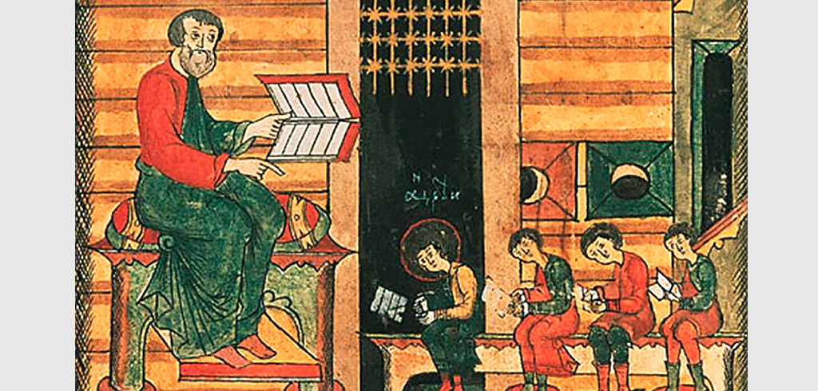

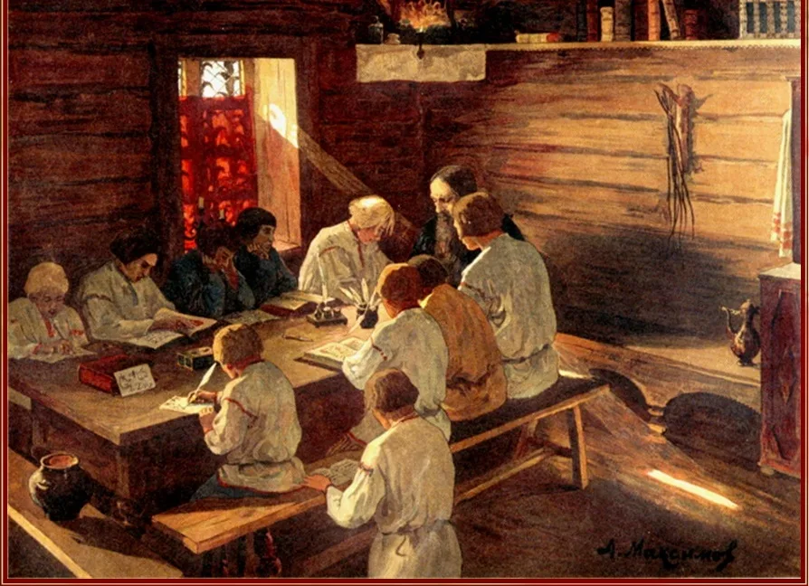
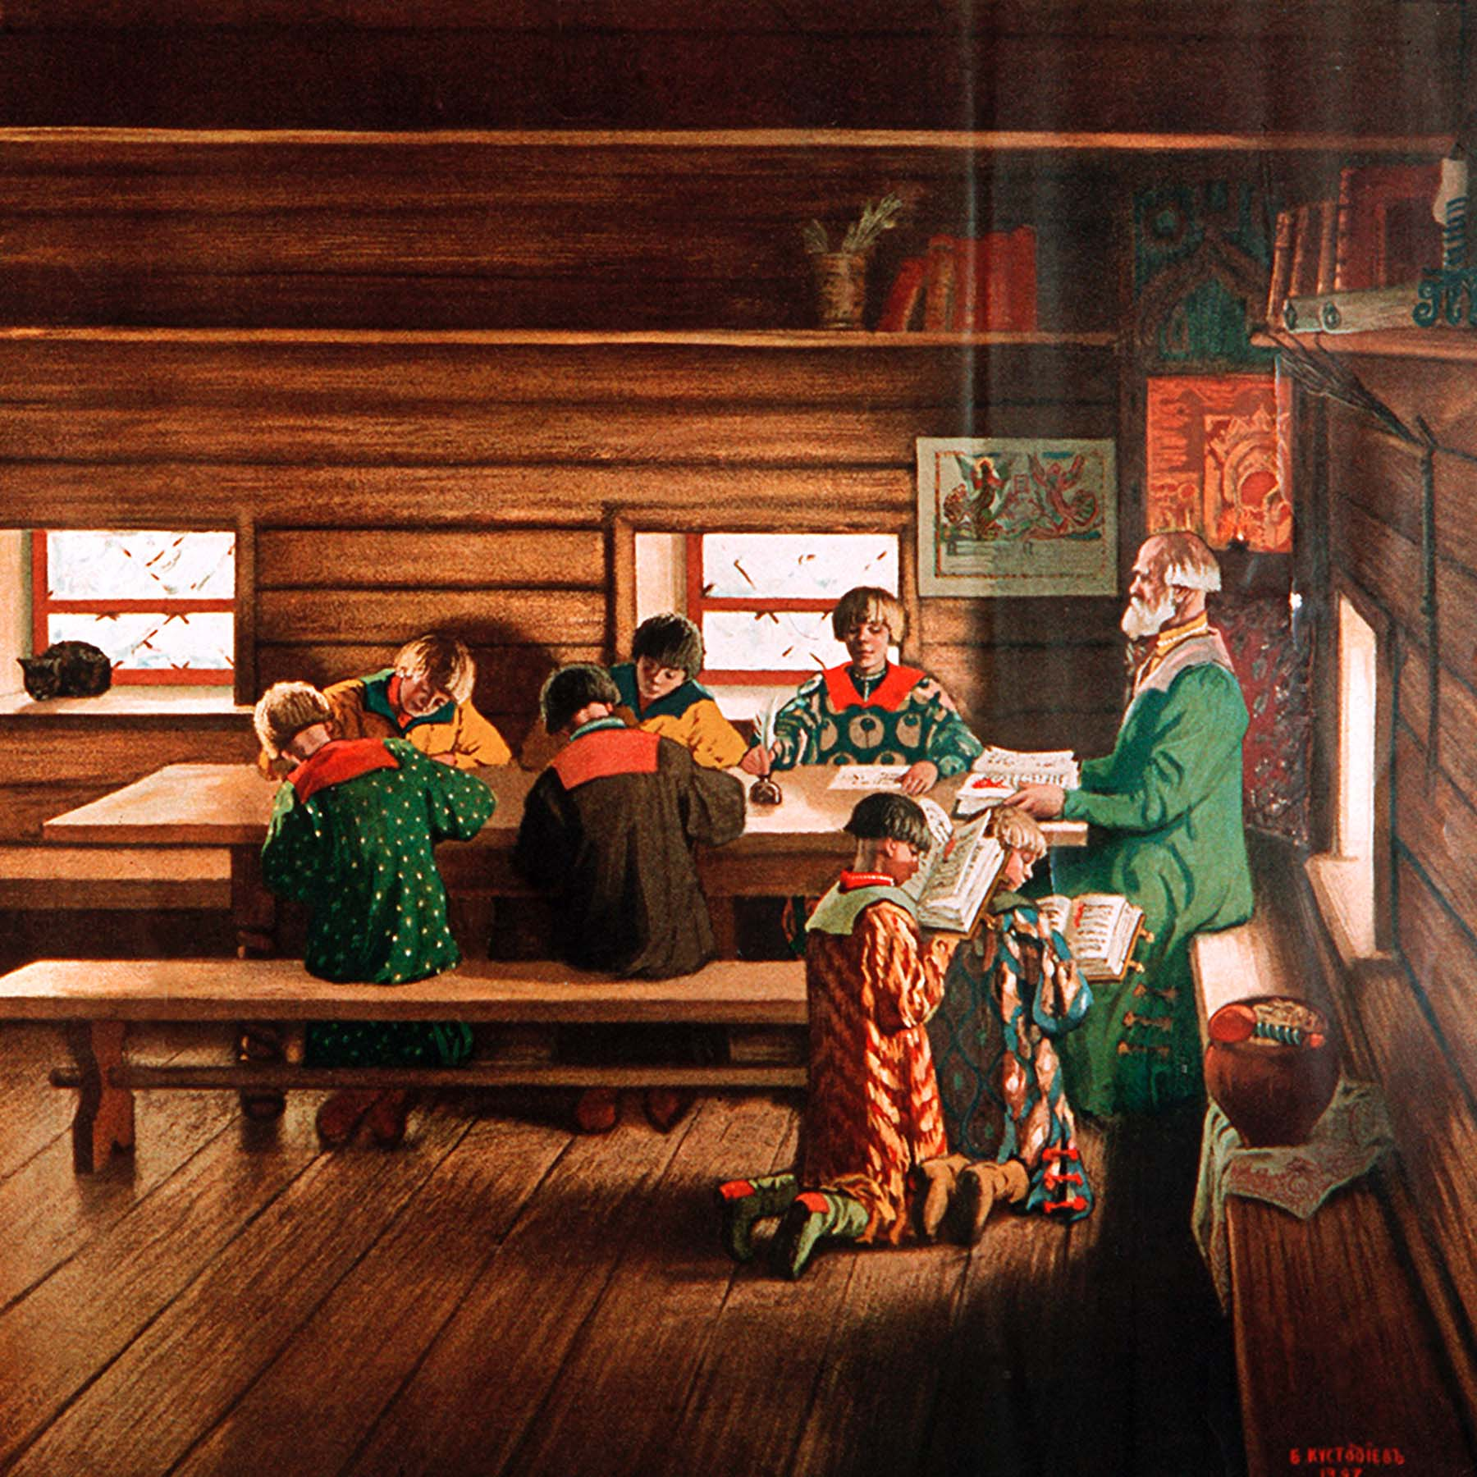

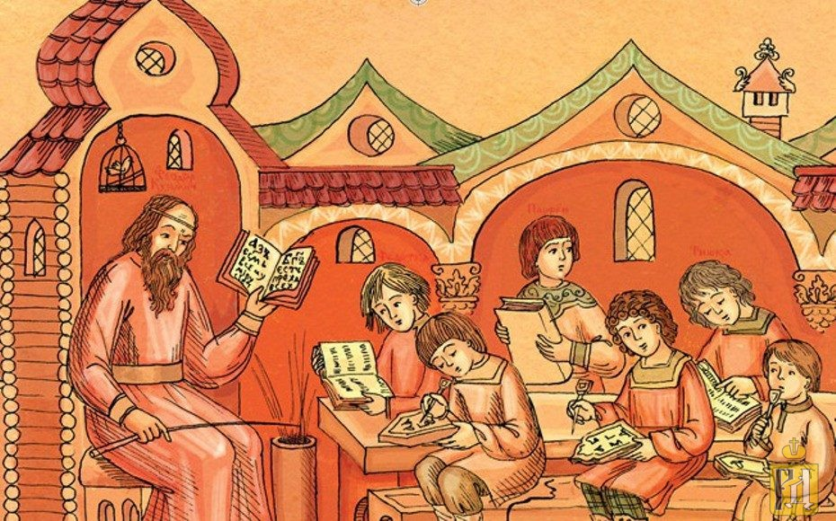
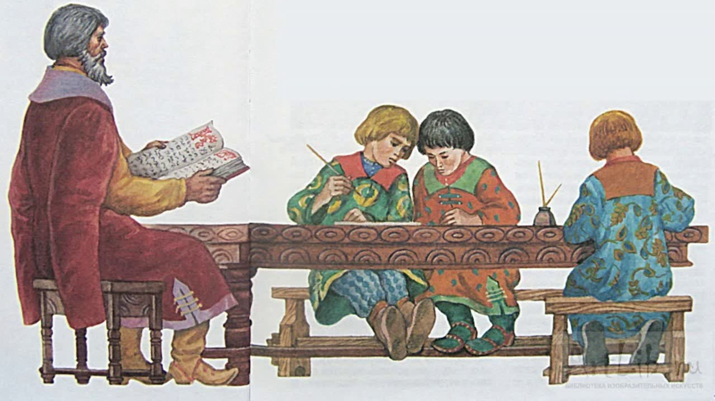

Slide 4
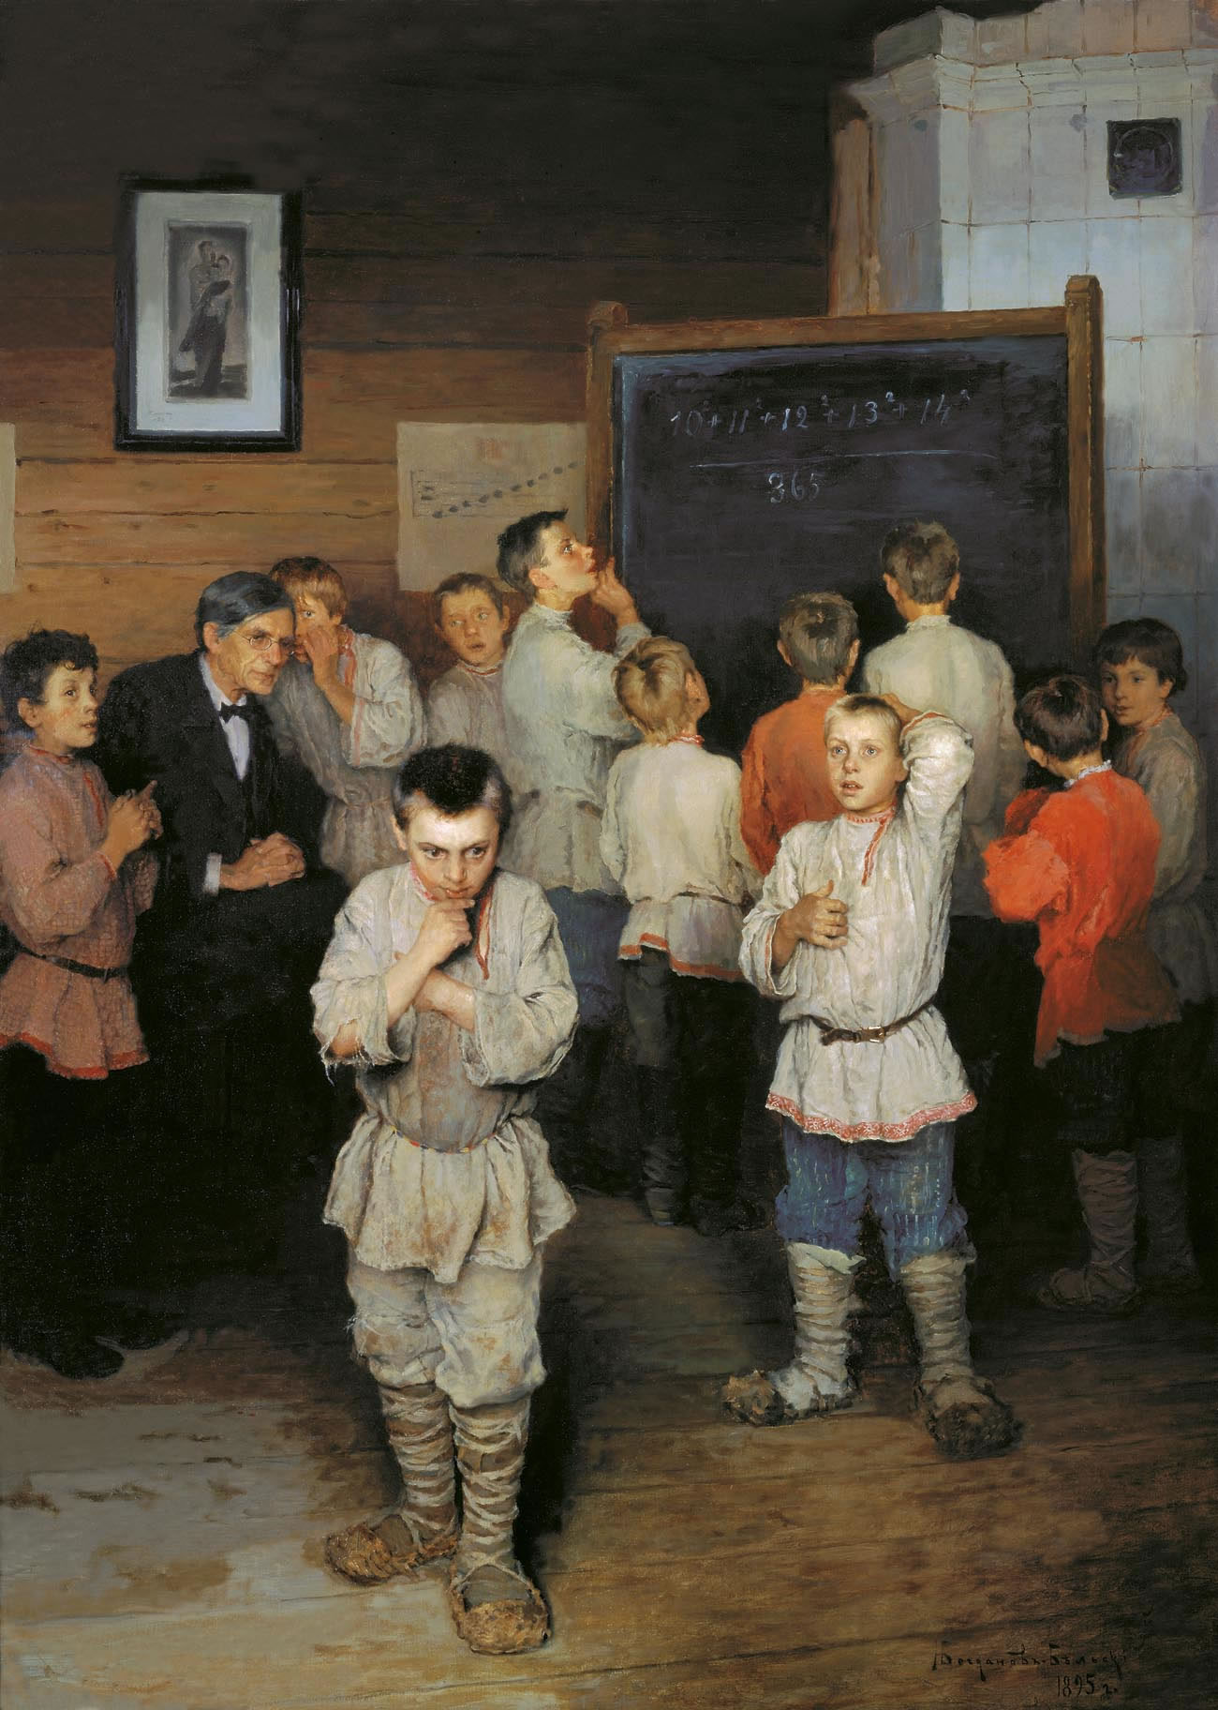
Mental arithmetic /Устный счет
1895
Bogdanov – Belskiy N.P.
State Tretyakov Gallery

Slide 5
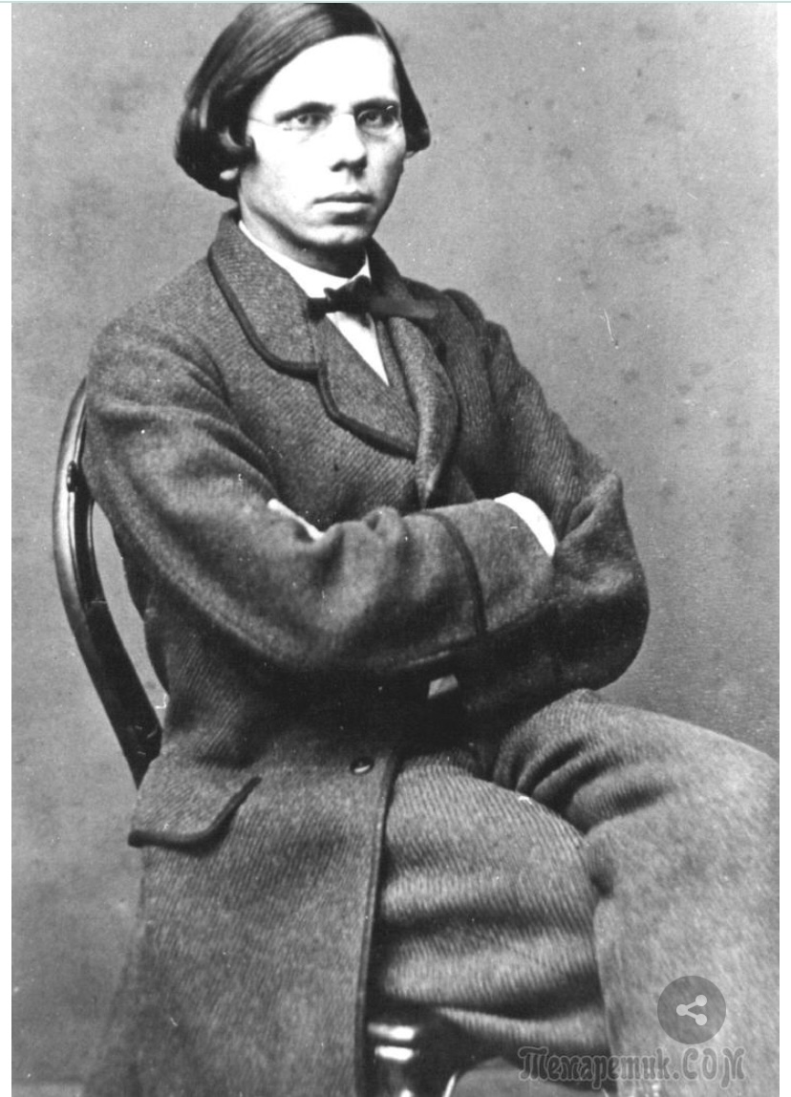
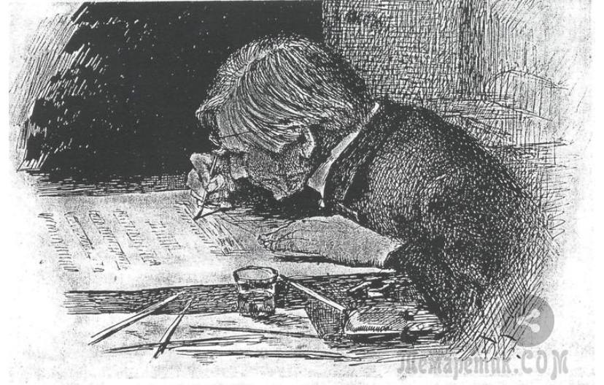
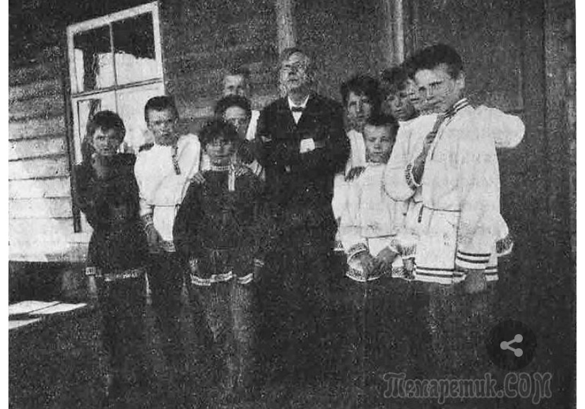
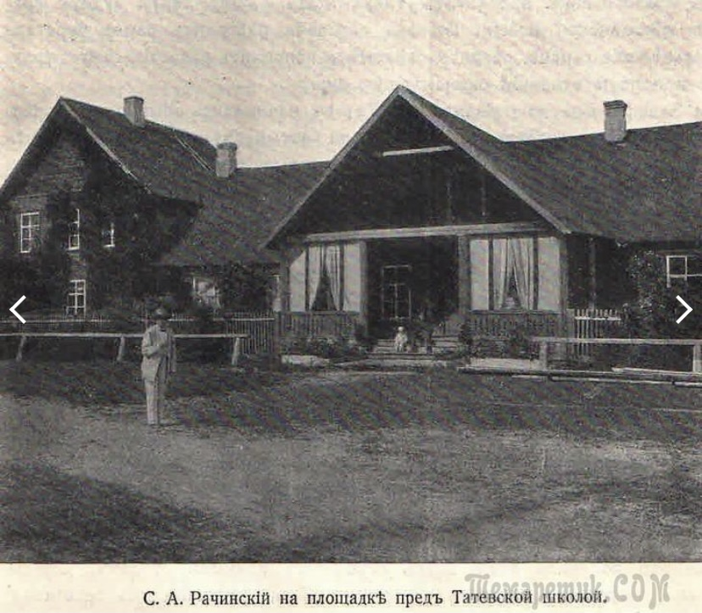
Rachinsky S.A.
Professor of botany at the
Moscow State University
Rachinsky S.A.
picture by
Bogdanov-Belsky
S.A. Rachinsky in front of the school in Tatevo,
Belskiy district, Smolensk gubernia
S.A. Rachinsky with students at the school door.
June 1891

Slide 6
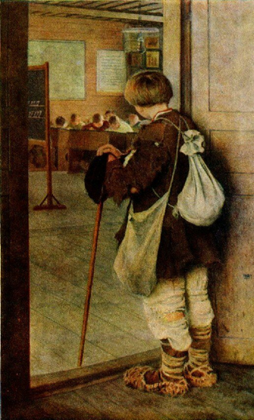
At the school doors /У дверей школы
1897
Bogdanov – Belskiy N.P.
State Russian Museum
St. Petersburg

Slide 7
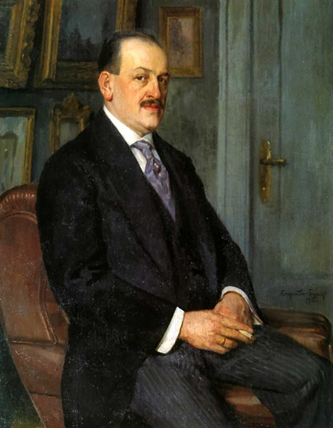
Self-portrait /Автопортрет
1915
Bogdanov – Belskiy N.P.
Lugansk Art Museum

Slide 8
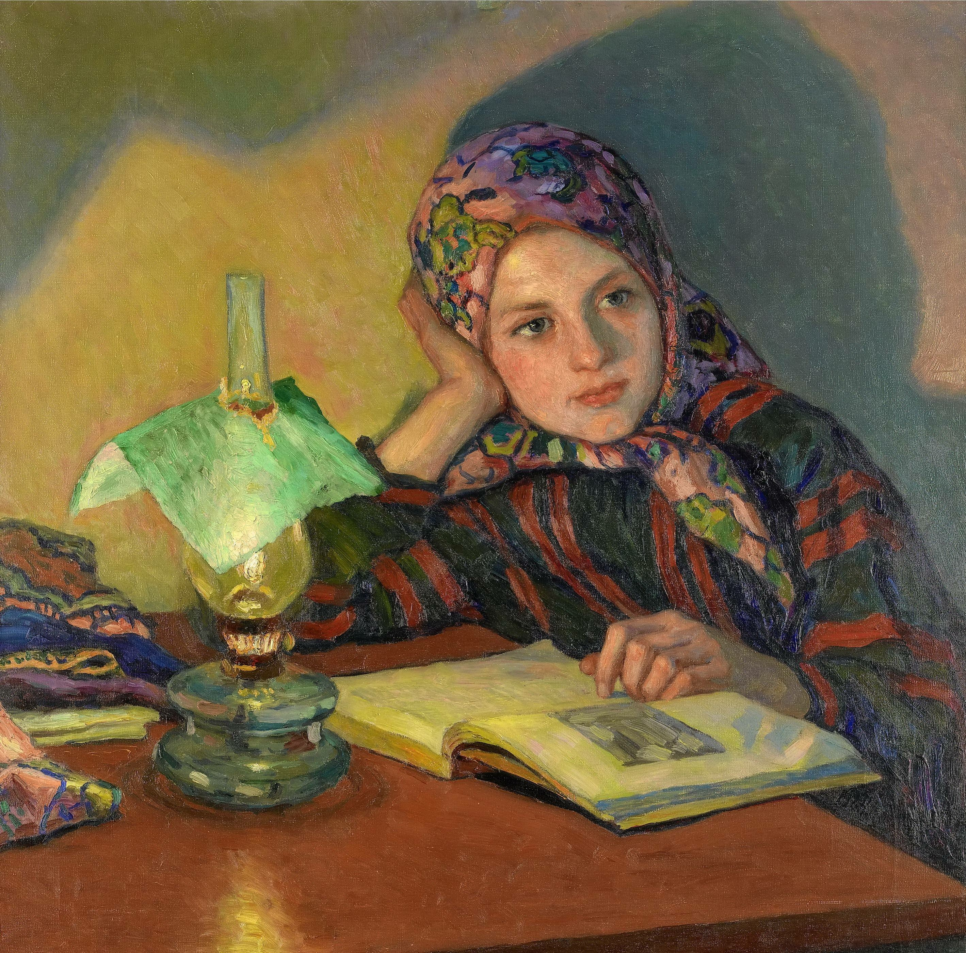
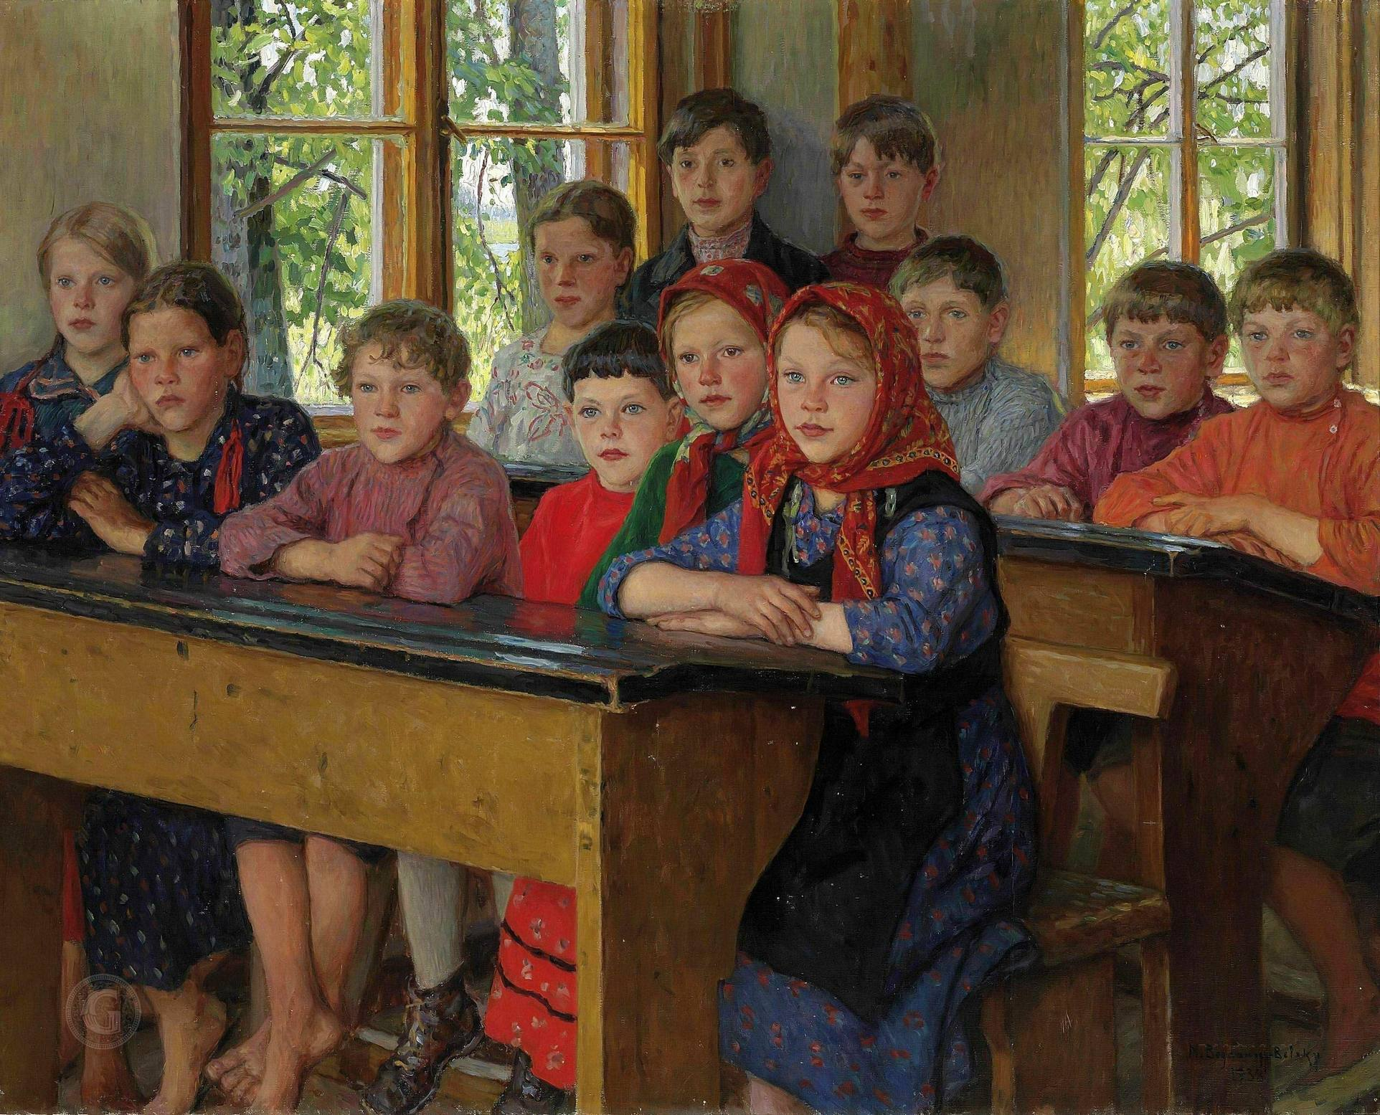
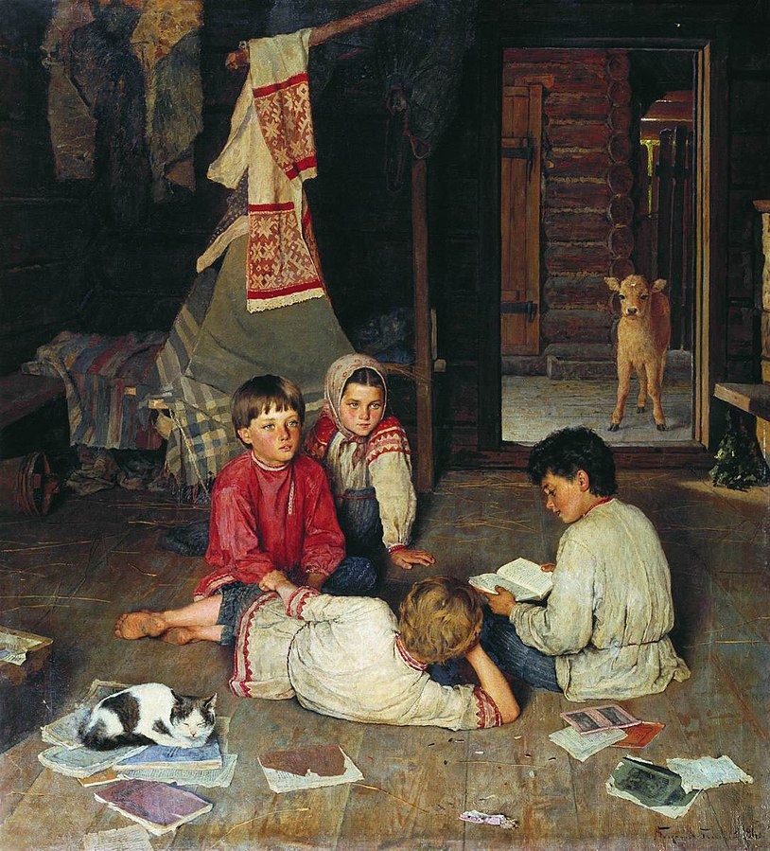
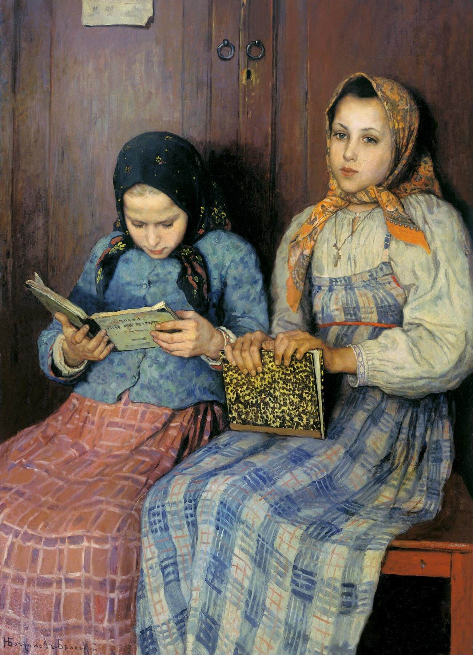
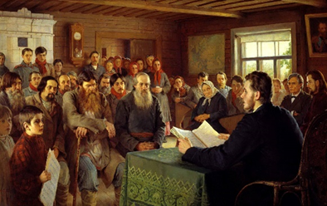
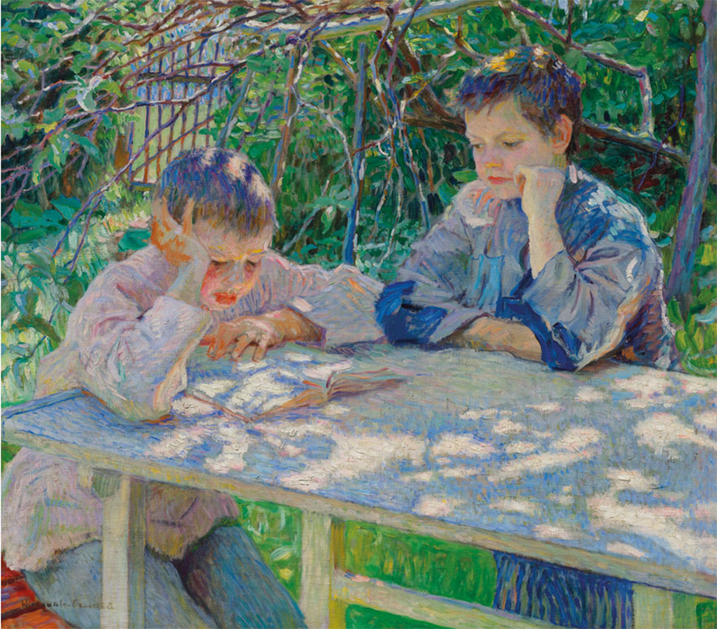
Inspiration / Вдохновение
In classroom / В классе
1938
Новая сказка / New fairytale
1891
Ученицы / Students
1901
Воскресное чтение в сельской школе/
Sunday reading in a village school
1895
Learning is light/ Ученье – свет
1920

Slide 9
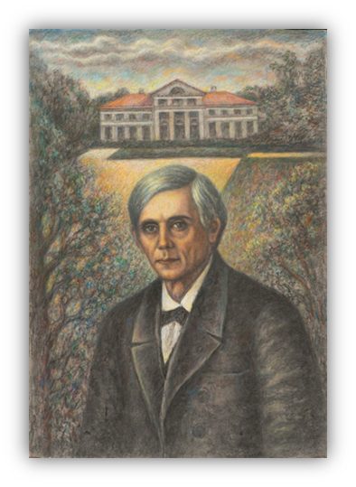
Rachinsky S.A.
«An amazing person, a teacher of life.
I owe him everything, everything…»
N.P. Bogdanov-Belsky

Slide 10
Thank you for attention!

