Slide 1
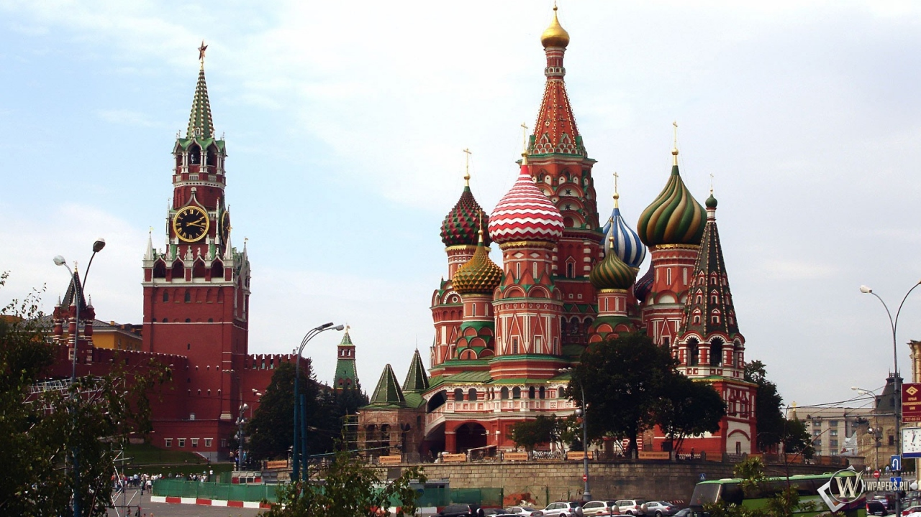
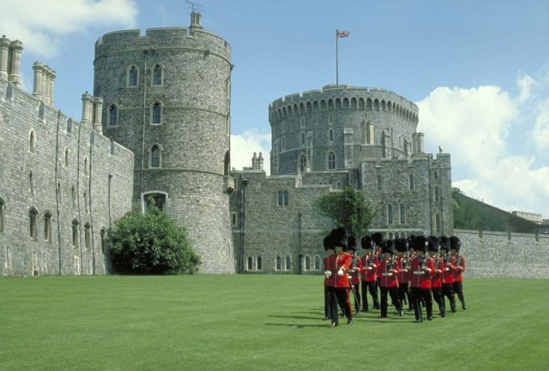
Icons of Britain and Russia
7th form

Slide 2
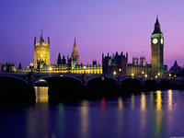
Icons are symbolic – they represent something
in one culture, history or the way of life
Icons of Britain and Russia

Slide 3
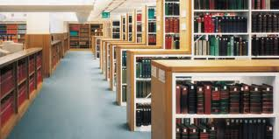

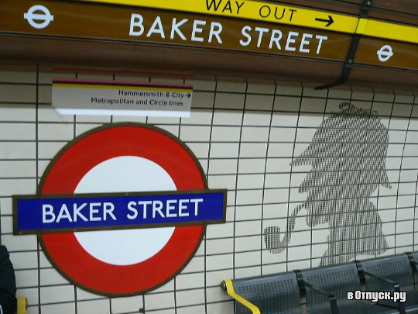
… votes for …
He/she thinks it’s best because…
He/she also…
Besides…

Slide 4
Match the words with their translations:
1. Item
a) характер, персонаж
2. to recognize
б) представлять
3. to pack
c) признавать
4. to be around
d) значимый
5. to include
e) заполнять
6. significant
f) предмет
7. to represent
g) существовать
8. a character
h) включать, содержать

Slide 5
Fill in the gaps:
To be around, a character, to include, an item, to pack, to recognize, to represent, significant
1. St Petersburg _____________as the second capital of Russia.
is recognized
significant
2. Red Square is one of the most ___________ icons of Russia.
3. Red Square best ___________ Russia because it makes everyone fell the past and the
present of this country.
represents
4. Each day the Obraztsov Puppet Theatre __________ with people who come to see its performances.
is packed
5. The Obraztsov Puppet Theatre clock is decorated with folk tale _________
characters
6. The circus artist school in Russia __________________ for hundred of years.
has been around
7. The Pushkin Museum of Fine Arts ________ wonderful collections of items from different countries.
includes
8. The Museum of the History of Moscow has more than one million _______ : documents,maps, rare books, manuscripts and other publications.
items

Slide 6
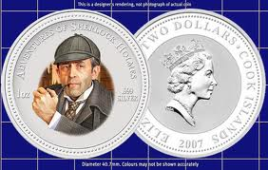
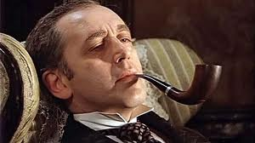
Vasili
Livanov

Slide 7
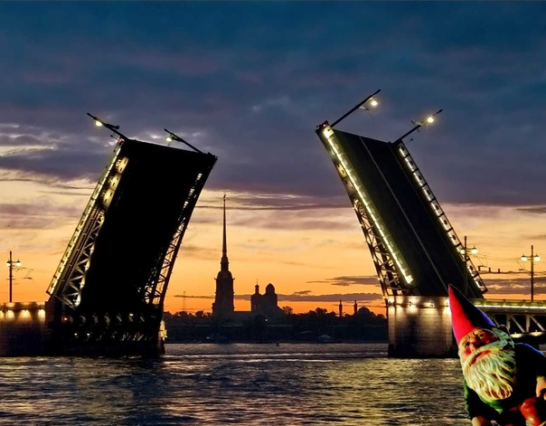
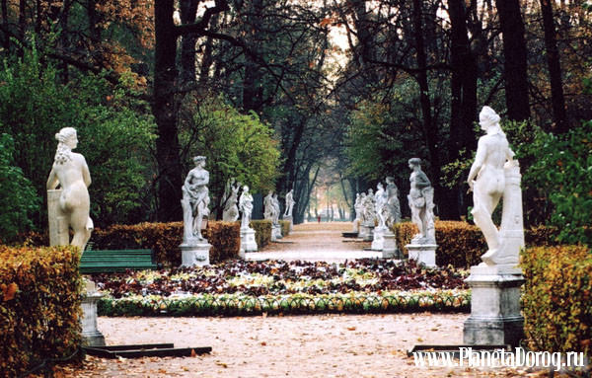
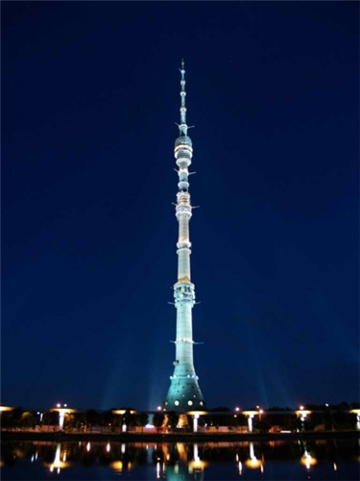
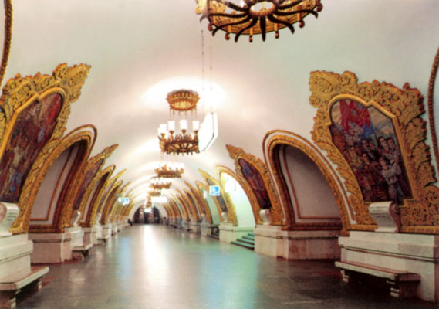
ST Petersburg
Bridges
Summer garden
Ostankino tower
Moscow metro

Slide 8
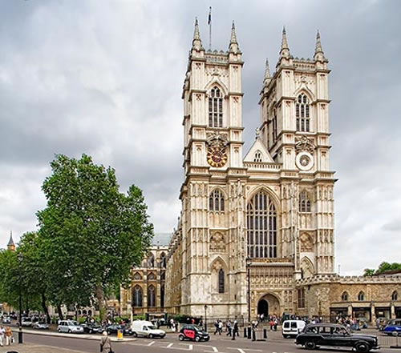
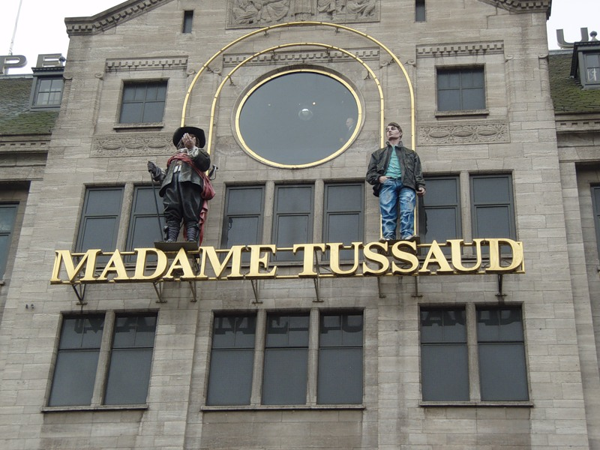
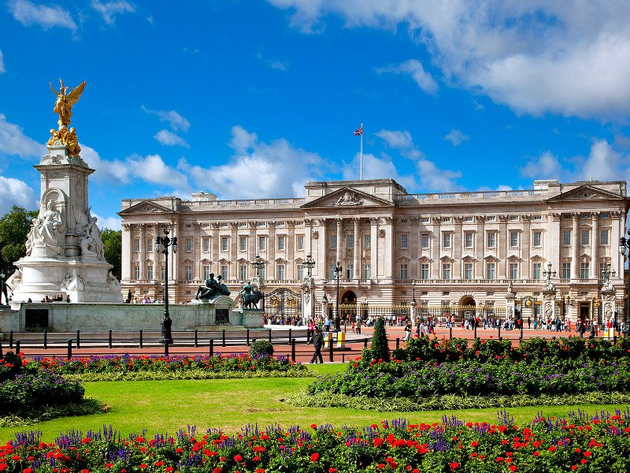
Westminster Abbey
Museum
Buckingham Palace

Slide 9
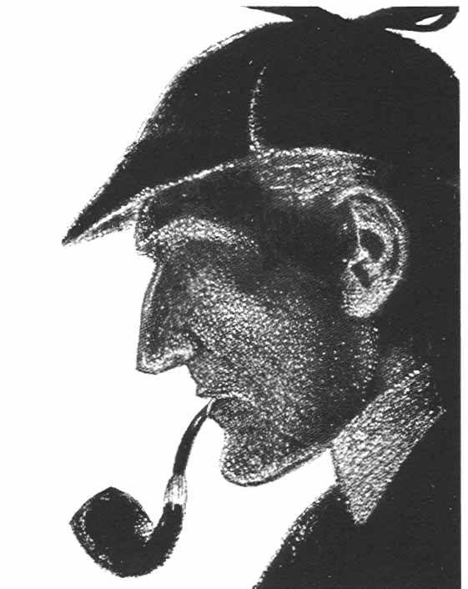
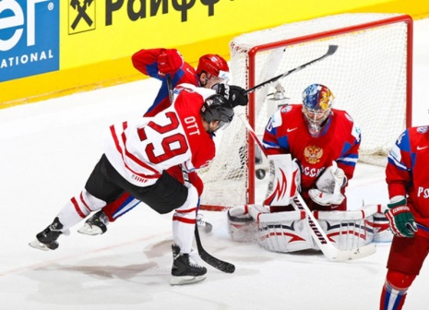
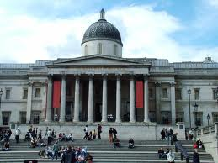
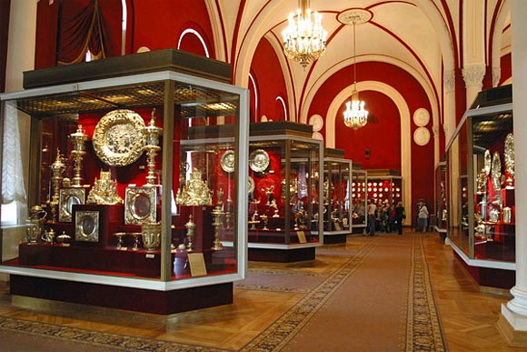
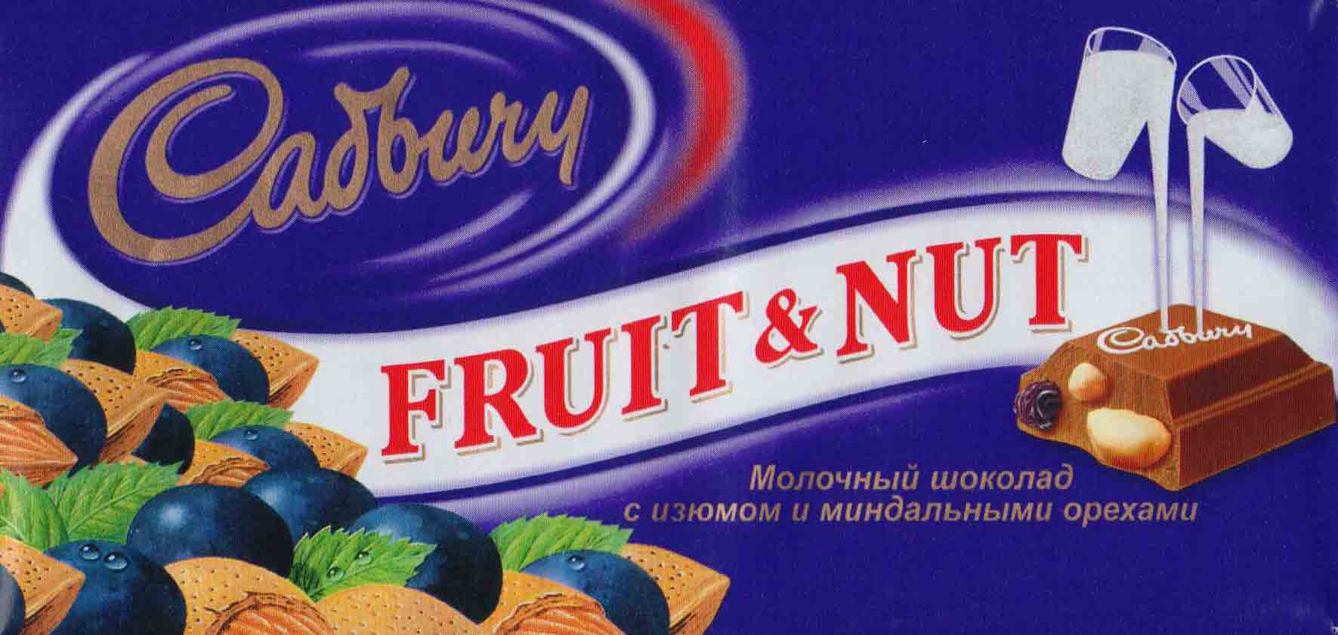
ICE HOCKEY
CADBURY CHOCOLATE
ORUZHEINAYA PALATA
NATIONAL GALLERY
SHERLOCK HOLMES

Slide 10
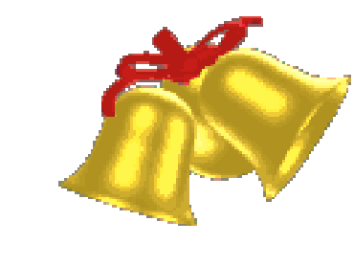
Home task:
to do the project
“National symbols” and
prepare the presentation

