Slide 1

Heroism of Women in the Great Patriotic War
Made by English teachers:
Petrova Y.V., Nasybullina A.A., Glukhikh A.D.

Slide 2

Watch the video and answer the questions.
1.What holiday are we going to celebrate soon?
2.Why is this holiday special for our country?
3.What is the topic of our lesson today?

Slide 3

Answer the questions to remember some linking words
To my mind (по-моему)
I think (я думаю)
I am convinced (я убеждён)
I suppose (я предполагаю)
It seems to me (мне кажется)
From my point of view (с моей точки зрения)
I guess (я полагаю)
In my opinion (по моему мнению)
I believe (я верю)
1.What holiday are we going to celebrate soon?
2.Why is this holiday special for our country?
3.What is the topic of our lesson today?

Slide 4

Match the word combinations
1.The Great Patriotic War
2. the Soviet nurses
3. on an attack or on reconnaissance.
4. enemy bombers
5. give medical aid
6. the Nazis heavy fire
7. the wounded soldiers
8. a sense of duty
9. a desire to “do their bit”.
10. difficult conditions.
11. to be badly hurt
12. to be returned to the Red Army.
13. to continue for many hours, days and nights.
a.советские медсестры
b. вражеские бомбардировщики
c. оказывать медицинскую помощь
d. нацистские обстрелы
e. вернуться в Красную Армию
f. раненые солдаты
g. чувства долга
h. в атаке или на разведке.
i. желания “внести свою лепту”
j. тяжелые условия
k. быть тяжело раненным
l. Великая Отечественная война
m. продолжаться много часов, дней и ночей

Slide 5

Check the word combinations
1.The Great Patriotic War
2. the Soviet nurses
3. on an attack or on reconnaissance.
4. enemy bombers
5. give medical aid
6. the Nazis heavy fire
7. the wounded soldiers
8. a sense of duty
9. desire to “do their bit”.
10. difficult conditions.
11. to be badly hurt
12. to be returned to the Red Army.
13. to continue for many hours, days and nights.
l. Великая Отечественная война
a. советские медсестры
h. в атаке или на разведке.
b. вражеские бомбардировщики
c. оказывать медицинскую помощь
d. нацистские обстрелы
f. раненые солдаты
g. чувства долга
i. желания “внести свою лепту”
j. тяжелые условия
k. быть тяжело раненным
e. вернуться в Красную Армию
m. продолжаться много часов, дней и ночей

Slide 6

Grammar Activity. Use the words in the correct forms
June 22, 1941, the day of the sudden invasion of the territory of the USSR by German troops, The Great Patriotic War 1. (be) a difficult time for Russia. The country was under constant attack, facing numerous attacks from its 2. (enemy). The soldiers 3. (fight) bravely, defending the Motherland, and they fought hard to win the battles. Women 4. (play) a vital role in the war, serving as nurses and caring for the wounded soldiers. During the Great Patriotic War many 5. (woman) in the Soviet Union fought bravely for their country. They 6. (help) in many ways, including working in factories, driving trains. Many women also 7. (join) the military. They 8. (serve) as nurses, doctors and pilots. Some women even 9. (become) snipers and tank crew members. They faced numerous challenges, including harsh conditions, and heavy loss. Despite these obstacles, the women 10. (show) strength and heroism.
Nowadays many 11. (Russian) celebrate Victory Day on May 9. Victory Day in Russia 12. (mark) the end of the Great Patriotic War in 1945. Victory Day is the 13. (important) national holiday in Russia. A lot of people attend local military 14. (parade) and watch the firework displays at night on Victory Day. The 13. (big) parade is in Moscow’s Red Square. 15. (Person) lay wreaths at the war memorials and monuments. Many Russians wear St. George 16. (ribbon) and honor veterans. Veterans wear their 17. (medal) and get red carnations. Families gather around the dinner table and watch the 18. (favourite) films about The Great Patriotic War.

Slide 7
Grammar Activity Check the answers
1. was
2. enemies
3. fought
4. played
5. women
6. helped
7. joined
8. served
9. became
10. showed
11. Russians
12. marks
13. parades
14. biggest
15. people
16. ribbons
17. medals
18. most favourite

Slide 8

Reading activity. Answer the questions
1. When did the Great Patriotic War start?
2. Were those years of war tragic for Russia? Why?
3. What role did women play during the Great
Patriotic War?
4. What was the date when the war ended?
5. What is the main symbol of Victory day?
6. How do Russians celebrate this holiday?

Slide 9

Pair Work /Speaking Activities Check the answer
A: Hi. What do you think about The Great Patriotic War?
B: It was the most terrible war. Soviet soldiers, nurses and doctors heroically defended their homeland from Nazis heavy attack.
A: Were there a lot of female medical workers?
B: Of course, the female Soviet nurses and doctors worked under the Nazis heavy fire in the tent hospitals and battlefields.
A: Was their exhausting work connected with risk?
B: Sure. A lot of them lost their lives or were badly hurt when their hospitals came under the Nazis heavy fire.
A: Did your great-grandma work as a nurse or a doctor during the Great Patriotic War?
B: My great-grandma worked as a nurse in the military hospital in the war. She treated and took care of the wounded Soviet soldiers. She did everything to save their lives and to serve our Motherland.
A: We must remember the heroism of The Great Patriotic War veterans.

Slide 10

Speaking Activity Use the plan
Начать описание следует с фразы: «I’d like to describe picture (number)»
(Я бы хотел описать картинку (номер).
The place (место, где был сделан снимок).Для начала нужно указать, кто изображён на картинке: «The picture shows us...» (На картинке изображена...) Затем следует предположить, где был сделан снимок: «The photo was (probably) taken inside/outside» (Фотография (возможно) была сделана внутри/на улице).
The action (действие, происходящее на снимке). Предложение с описанием действия нужно строить в Present Continuous.
The person's appearance (внешность людей, изображённых на снимке). Например: «The girl/boy looks like she/he is about ... years old» (Девочке/мальчику около ... лет). Можно описать внешность: «She/he has (colour) eyes and dark/fair hair» (У неё/него (цвет) глаза и тёмные/светлые волосы). Также стоит упомянуть одежду: «The girl/boy is wearing …»
Whether you like the picture or not. Например: «I like the picture, because the atmosphere is … » (Мне нравится эта картинка, потому что атмосфера на ней …
Why. Например: «I like this picture as it is bright and colorful, full of positive emotions and it makes me think of ….» (Мне нравится эта картина, потому что она яркая и красочная, полна положительных эмоций и напоминает мне о ...

Slide 11
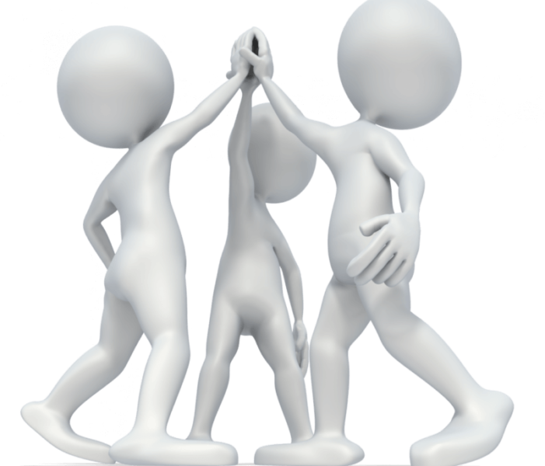
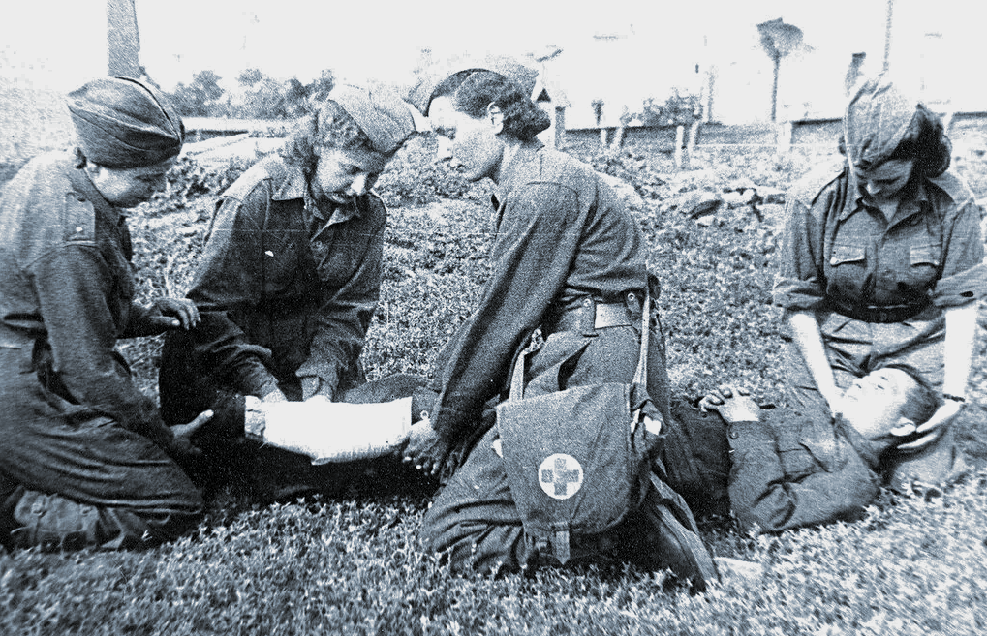
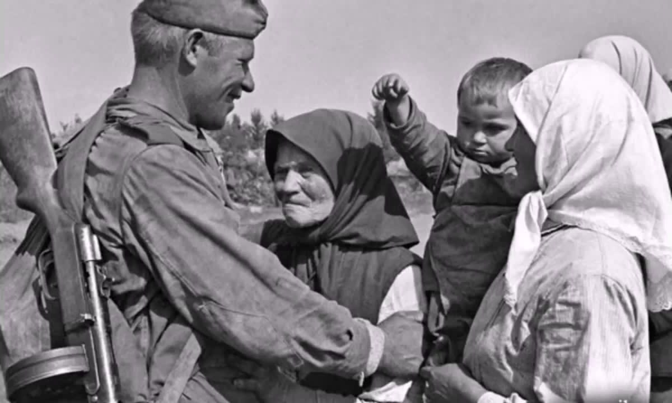
Speaking Activity
PHOTO 1
PHOTO 2
TEAM 1

Slide 12
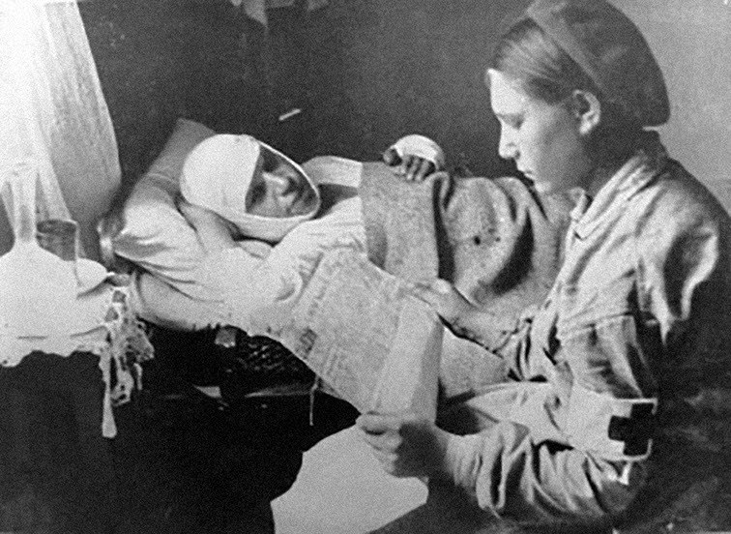
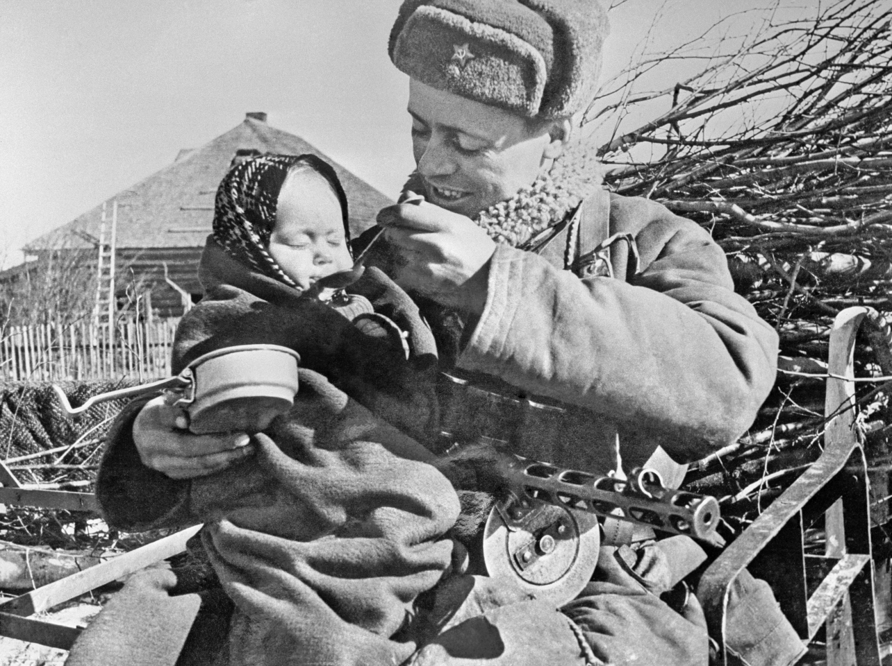
Speaking Activity
PHOTO 1
PHOTO 2
TEAM 2

Slide 13

Homework instructions
Fill the fact file about your relative (120-140 words)
Full name
Was from
Date of birth
Actions during the war
Interesting facts
Peace time action
Date of death

Slide 14

Now I know :
Complete this phrase: “Now I know how to…”
speak about...
understand the information...
explain the problem...
exchanged views with classmates on the topic...
give arguments...
find necessary information...

Slide 15


Well done!
THE END
Thank you for the lesson.

