Slide 2
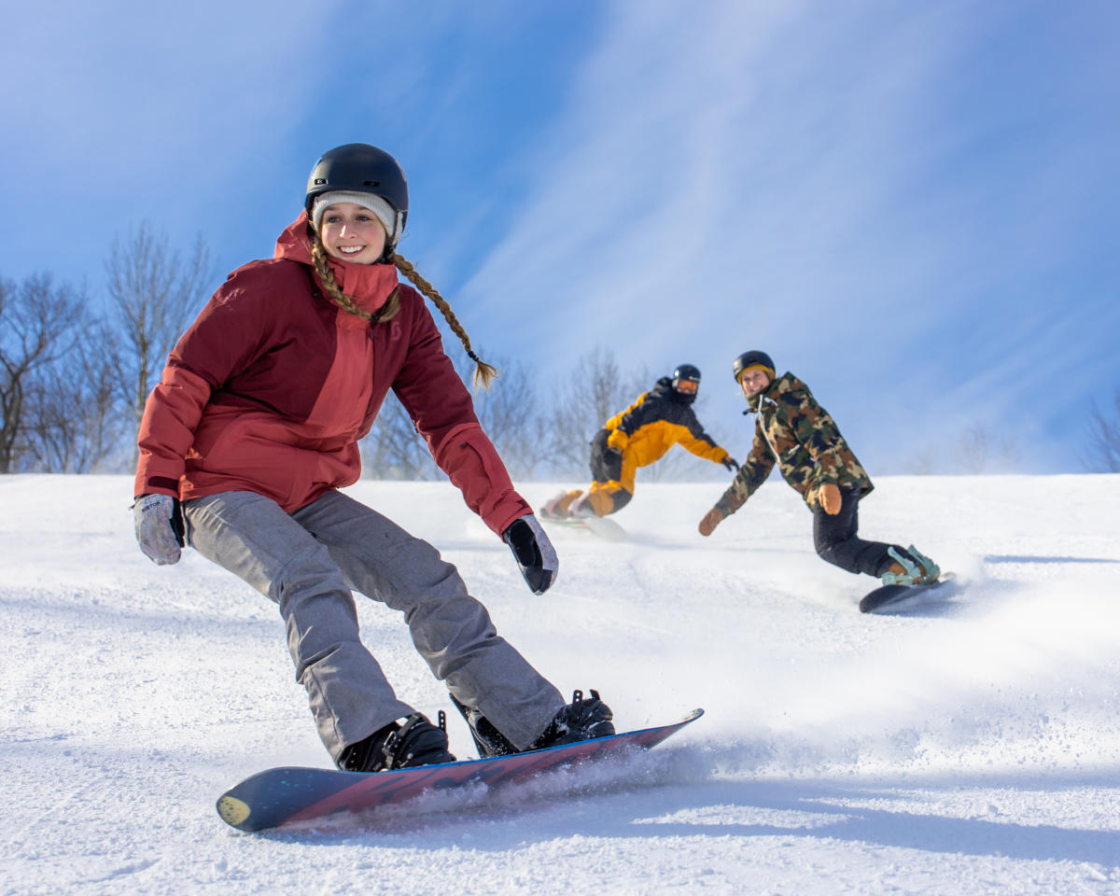
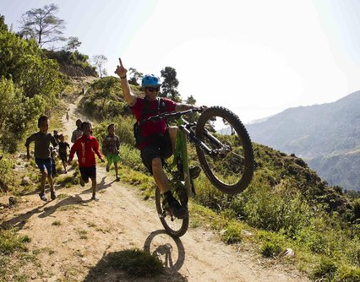
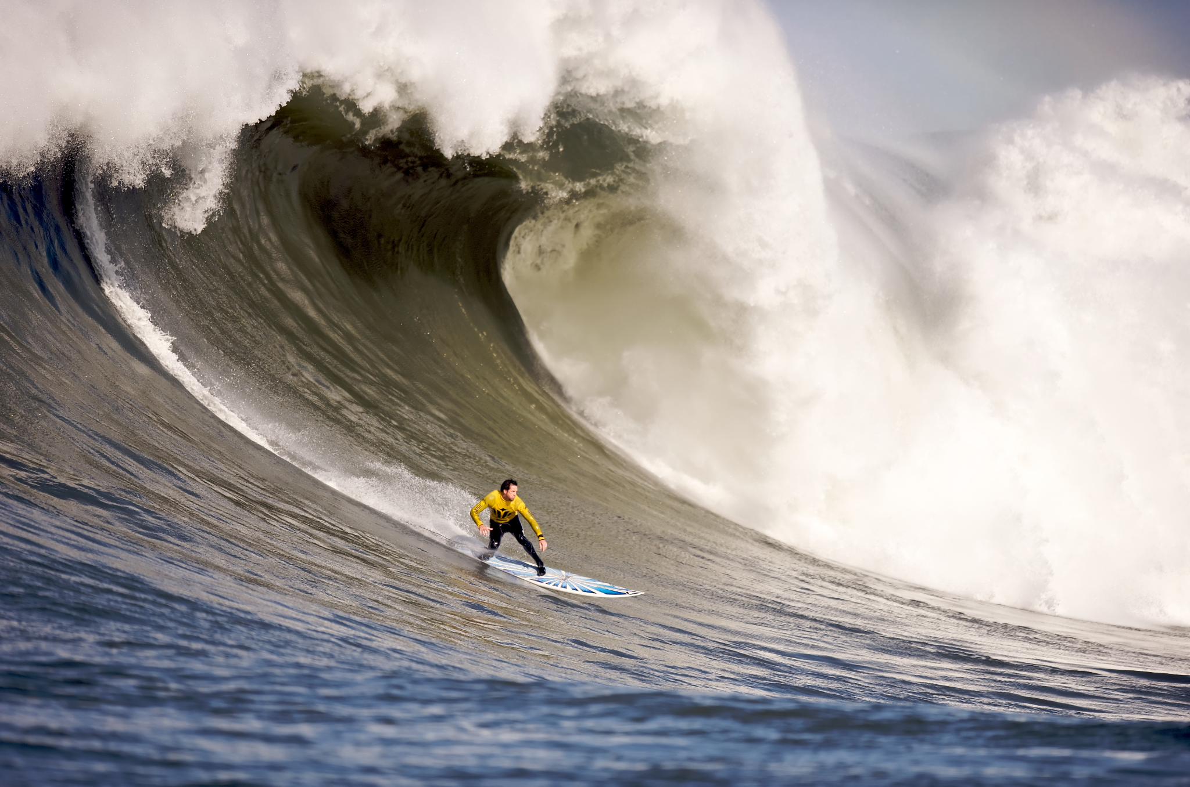
What are these activities?
Have you ever tried them?
Which of them would you like to try?

Slide 3
OUTDOOR ACTIVITIES

Slide 4
Today we are going to…
01
03
02
Learn some new words
Talk about outdoor activities
Practice some words that you already know

Slide 5
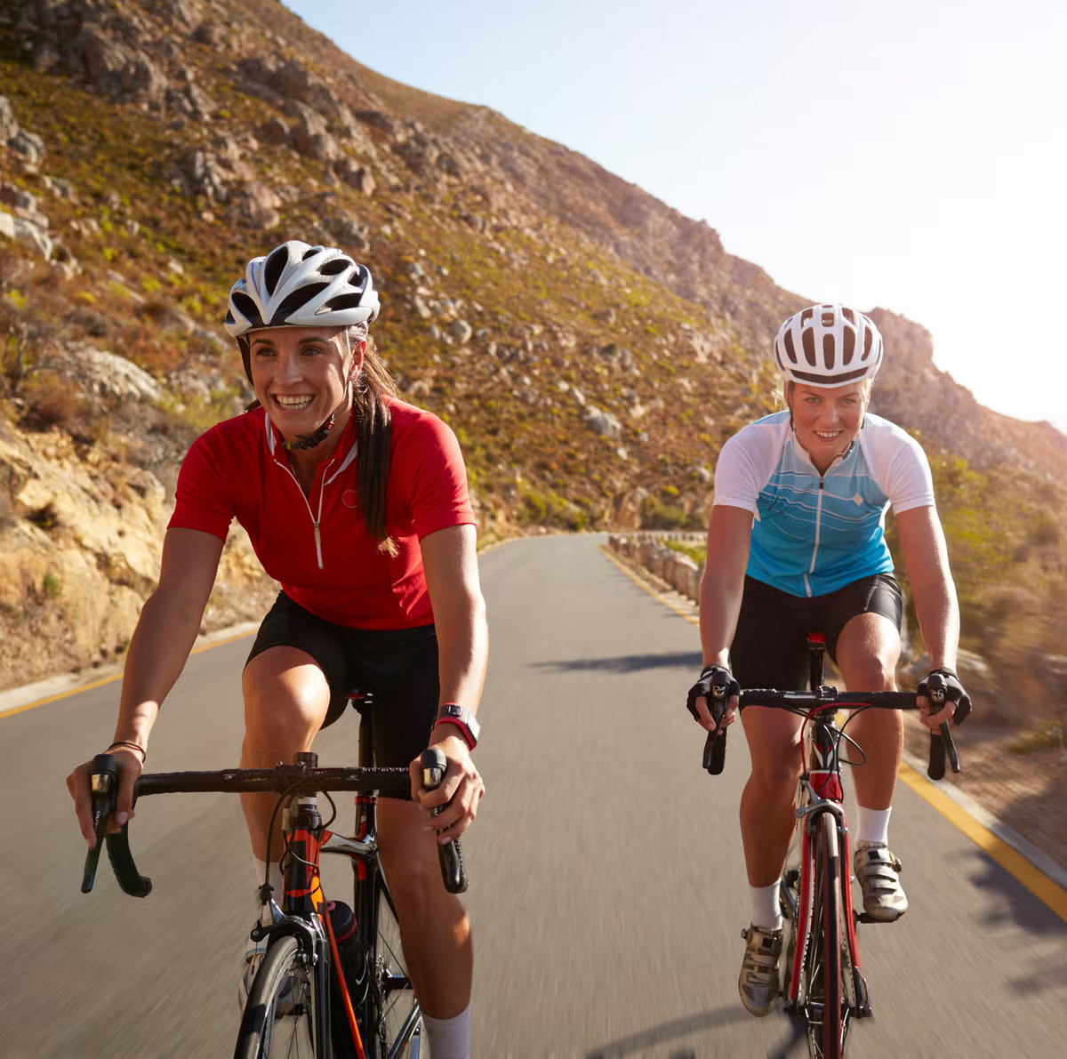
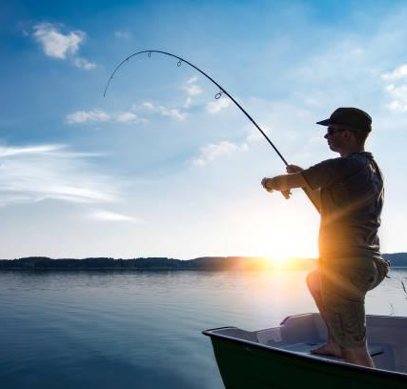
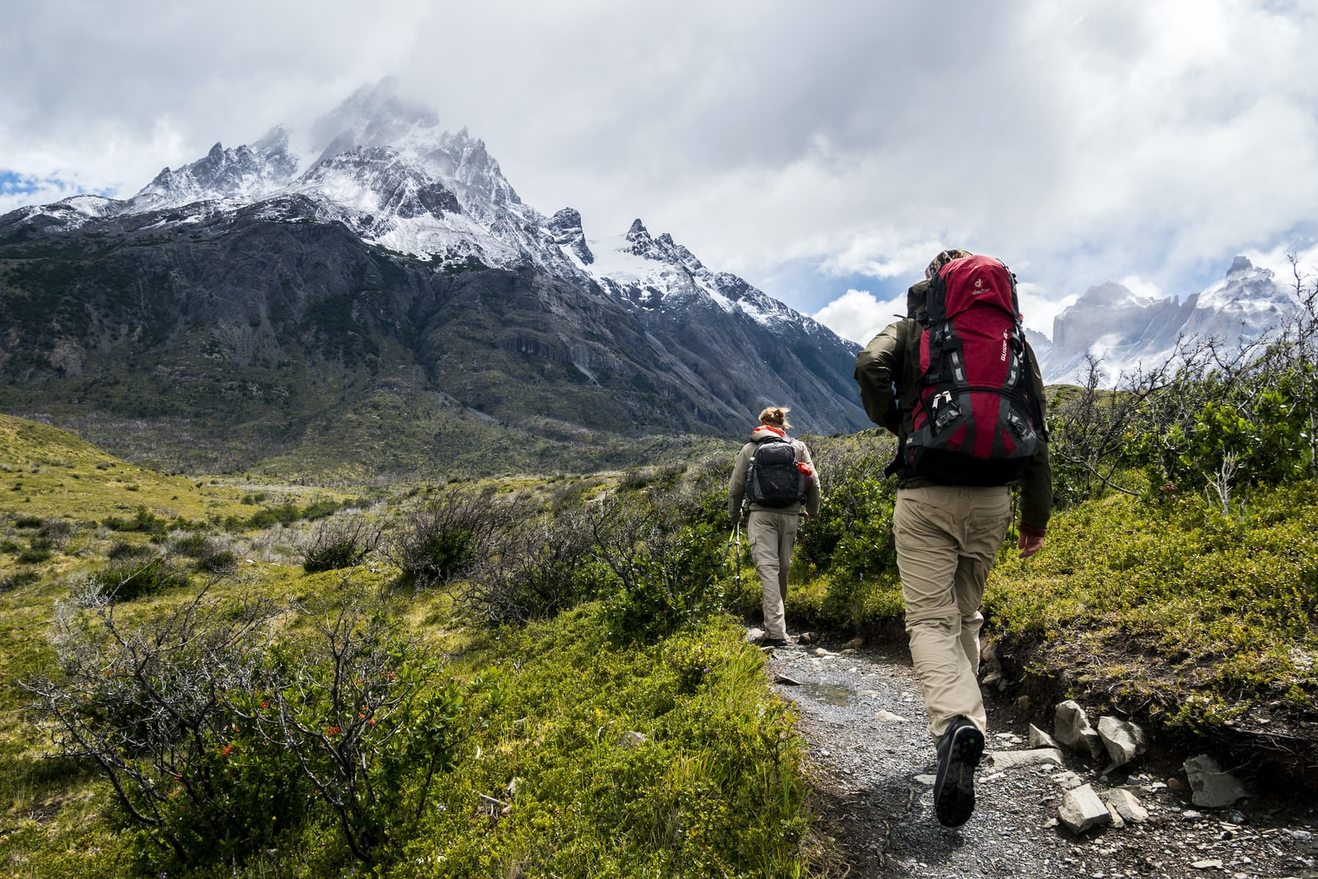
Outdoor activities
Cycling
Fishing
Hiking

Slide 6
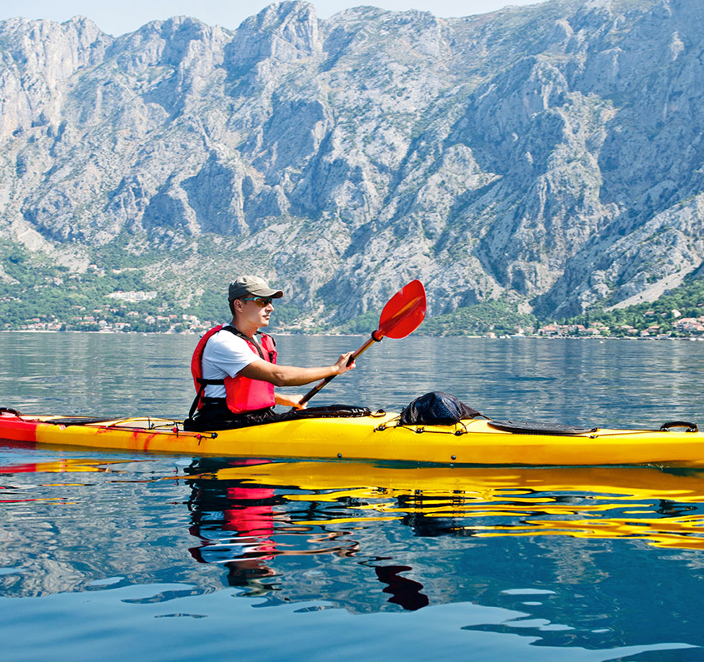
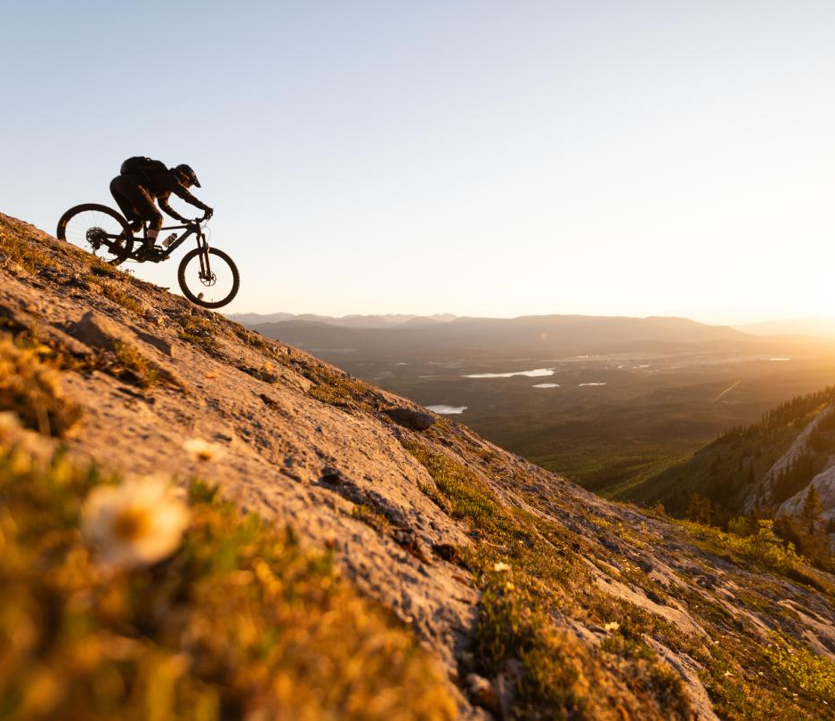
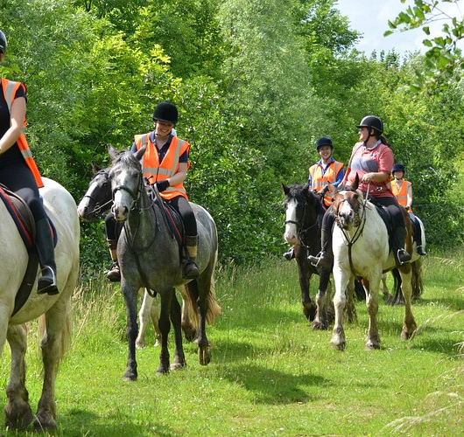
Outdoor activities
Kayaking
Mountain biking
Pony trekking

Slide 7
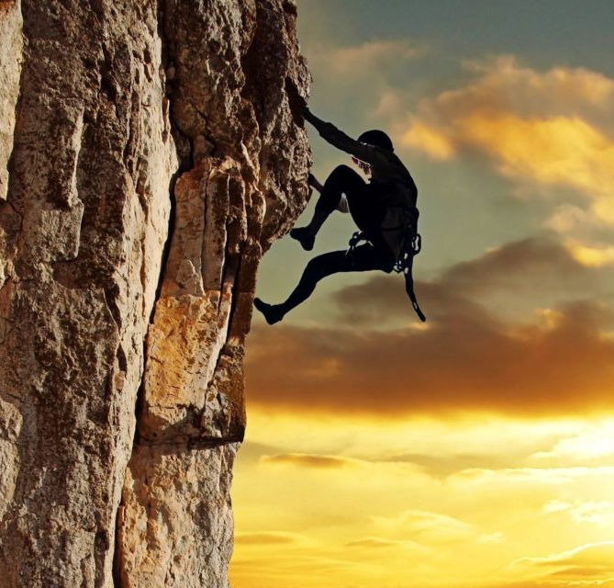
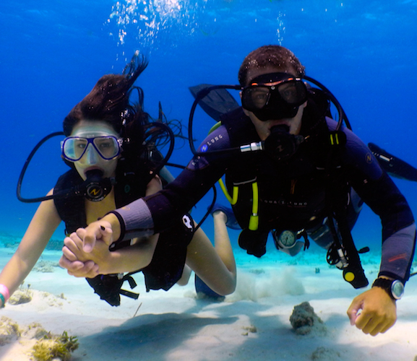
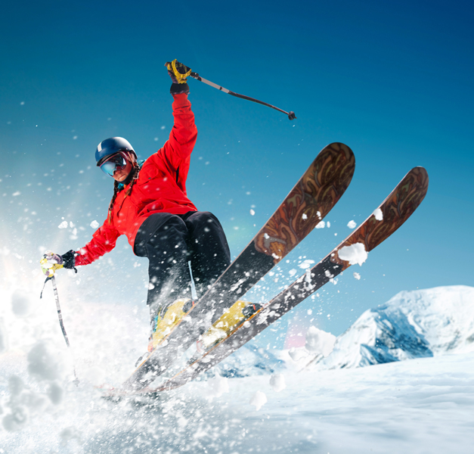
Outdoor activities
Rock climbing
Scuba diving
Skiing

Slide 8
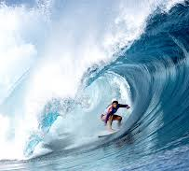
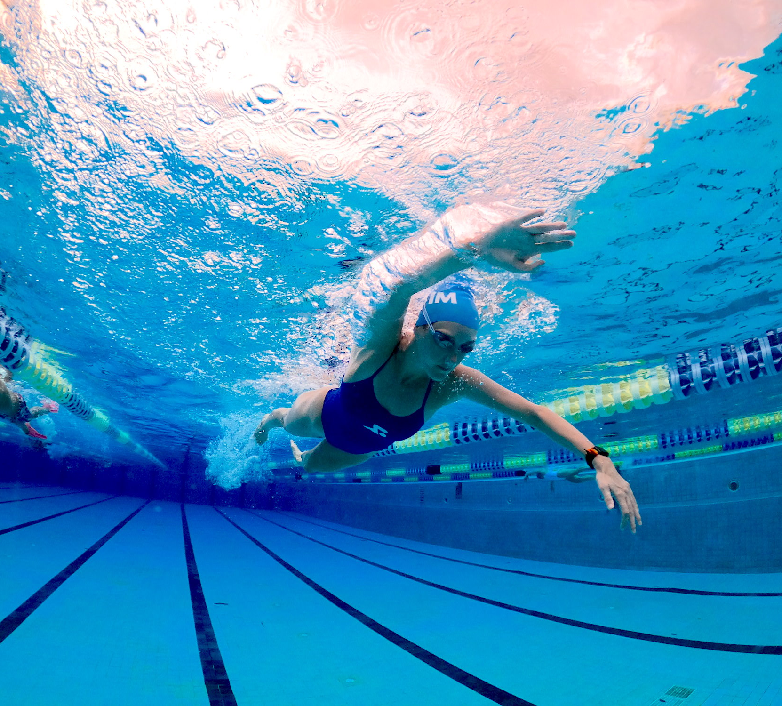
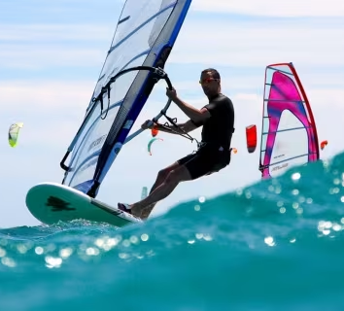
Outdoor activities
Snowboarding
Swimming
Surfing
Windsurfing

Slide 9
Put activities in
two categories:
Land activities:
Water activities:
Cycling…
Hiking,
Mountain biking,
Pony trekking,
Rock climbing,
Skiing,
Snowboarding
Fishing…
Kayaking,
Scuba diving,
Surfing,
Swimming,
Windsurfing

Slide 10
+
Yes, I have.
–
No, I haven’t.
Have you ever tried _________?
pony trekking

Slide 11

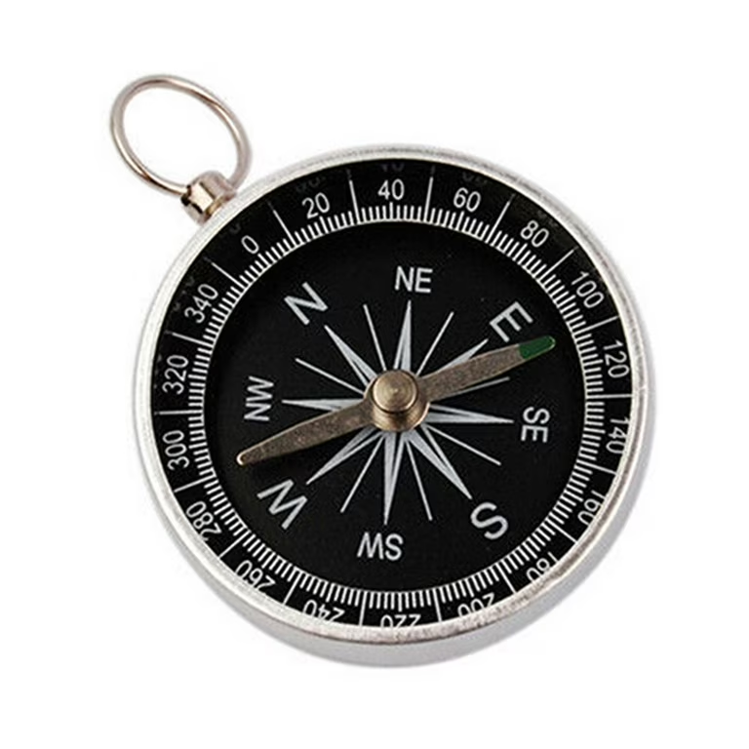
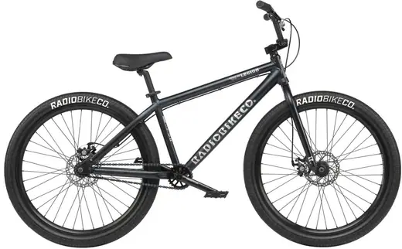
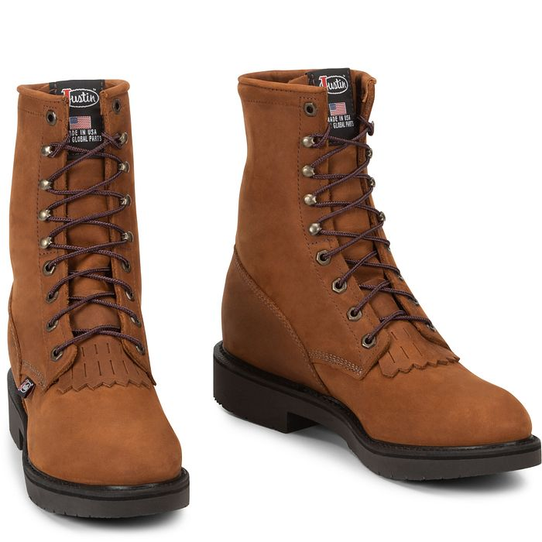
Sporting equipment
Boots
Bike
Compass

Slide 12
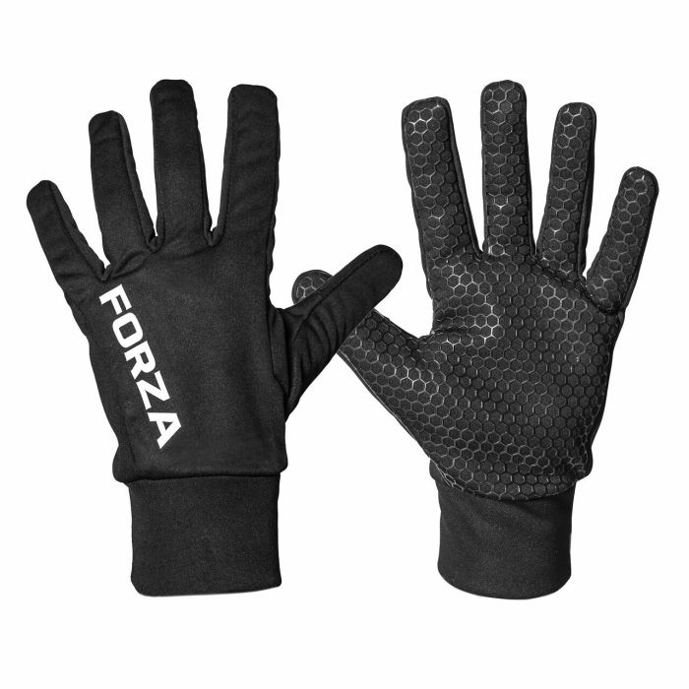
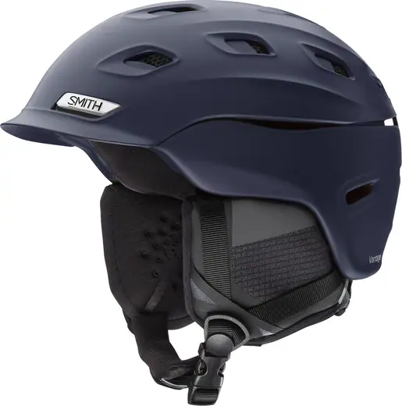
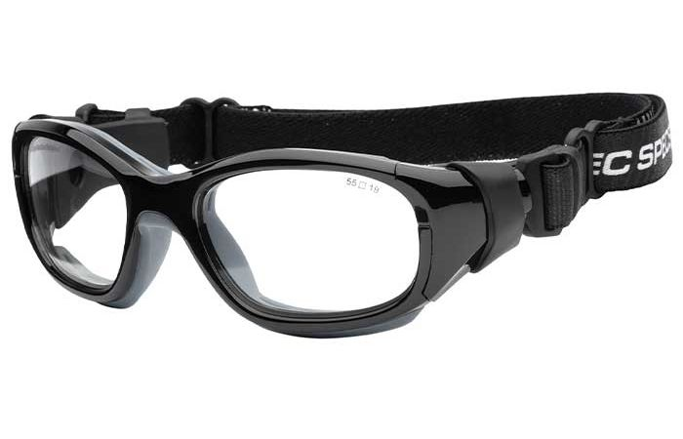
Sporting equipment
Goggles
Gloves
Helmet

Slide 13
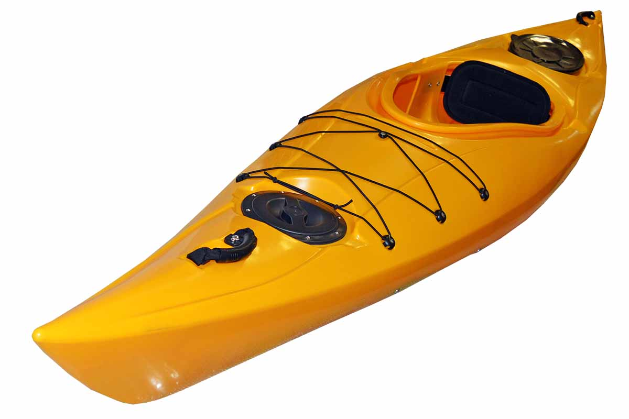
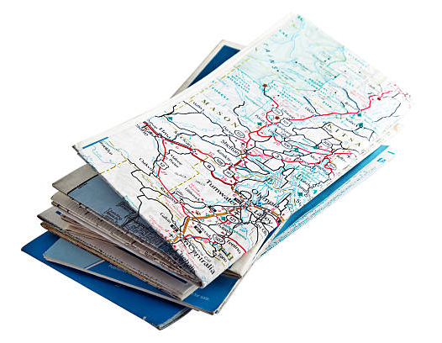
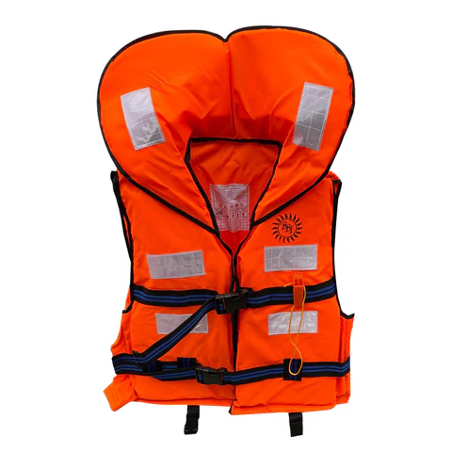
Sporting equipment
Life jacket
Kayak
Map

Slide 14
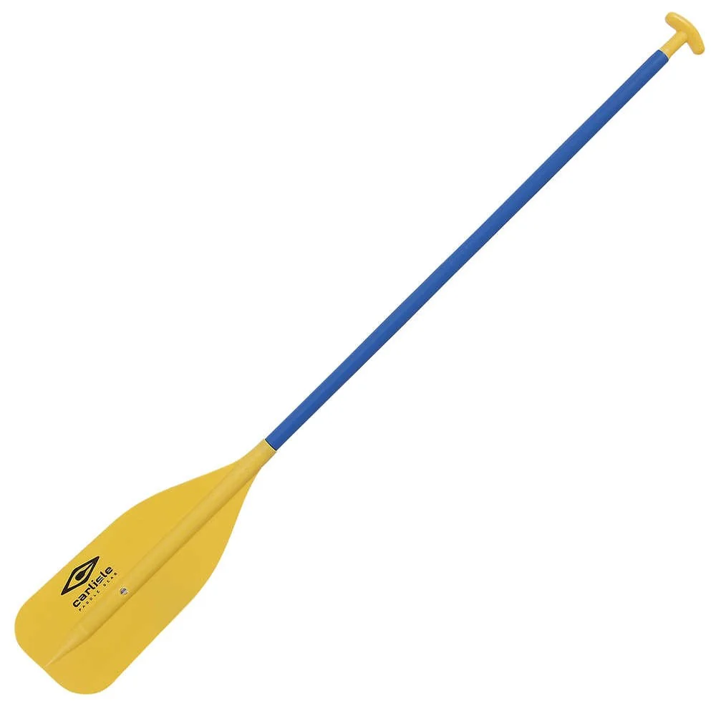
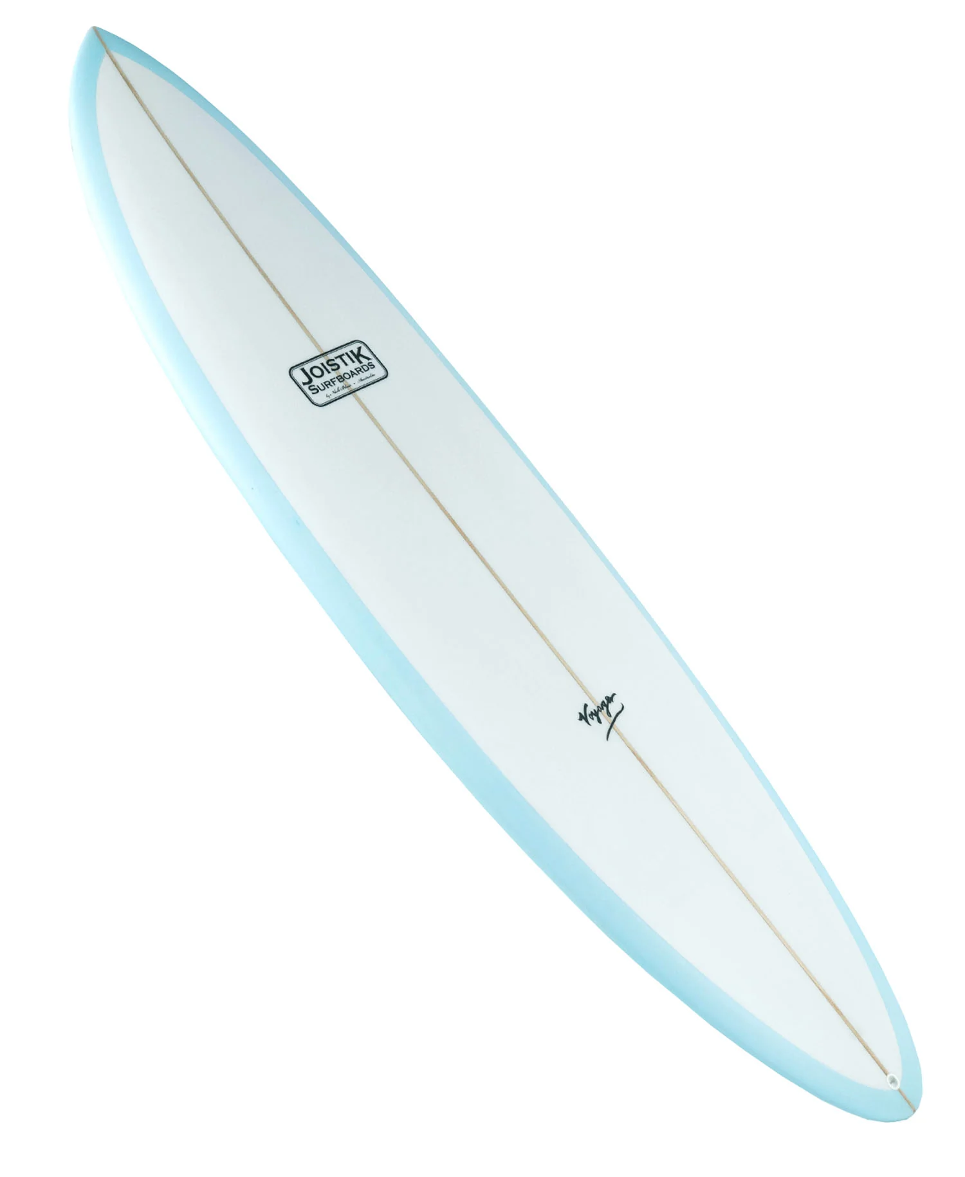
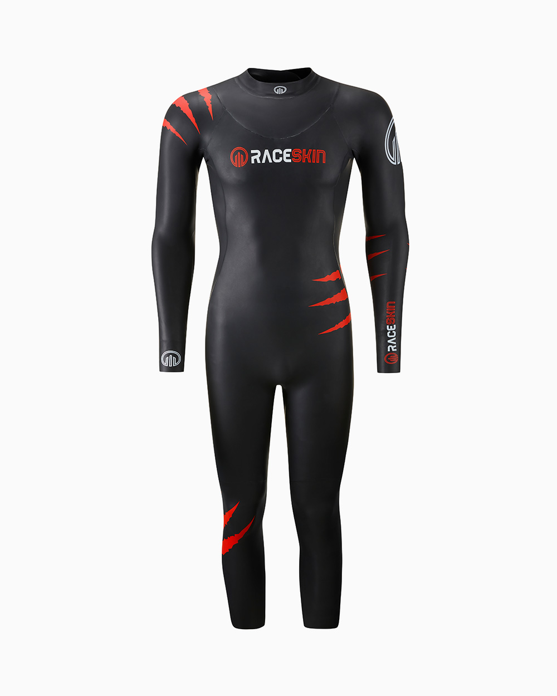
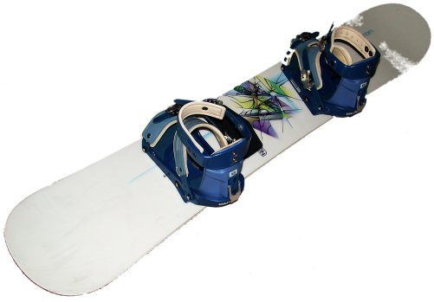
Paddle
Surfboard
Snowboard
Wetsuit

Slide 15
Guess the sporting equipment:
Helmet
Paddle
Wetsuit
You wear this on your head for protection
You use these wooden things to move a boat in water
You wear this to keep warm in water
Gloves
Boots
Goggles
You wear these on your hands
You wear these on your feet when you’re climbing
You wear these to protect your eyes

Slide 16
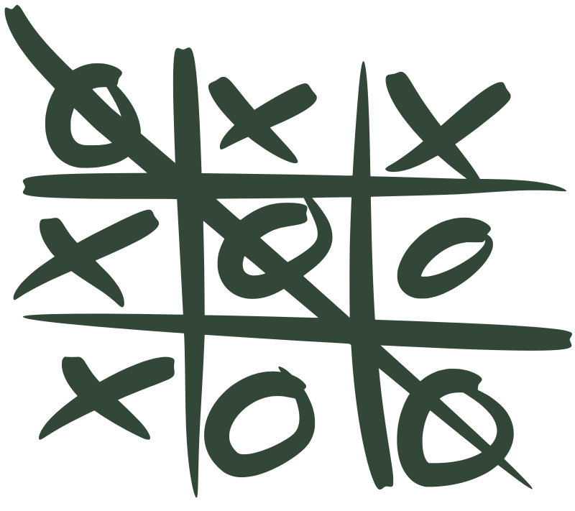
Now let’s play tic-tac-toe!
!
BUT!
Before you put your sign (cross ‘X’ or circle ‘O’), say the thing out loud in English.

Slide 17
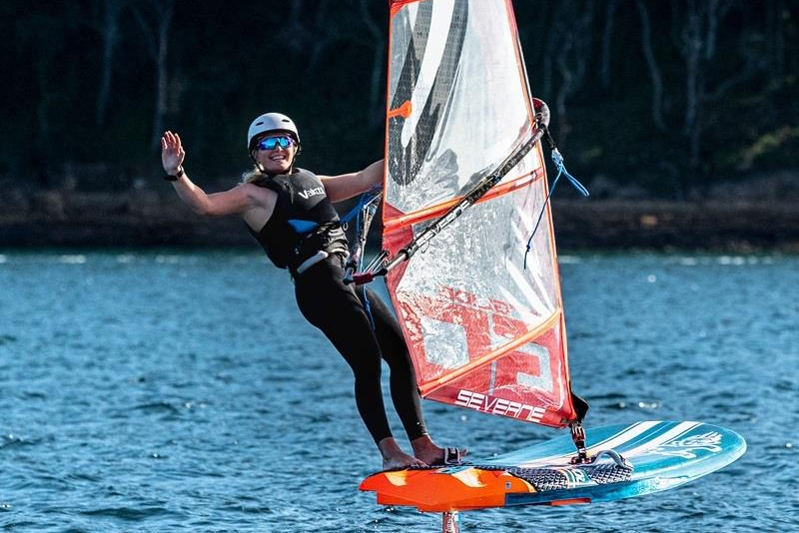
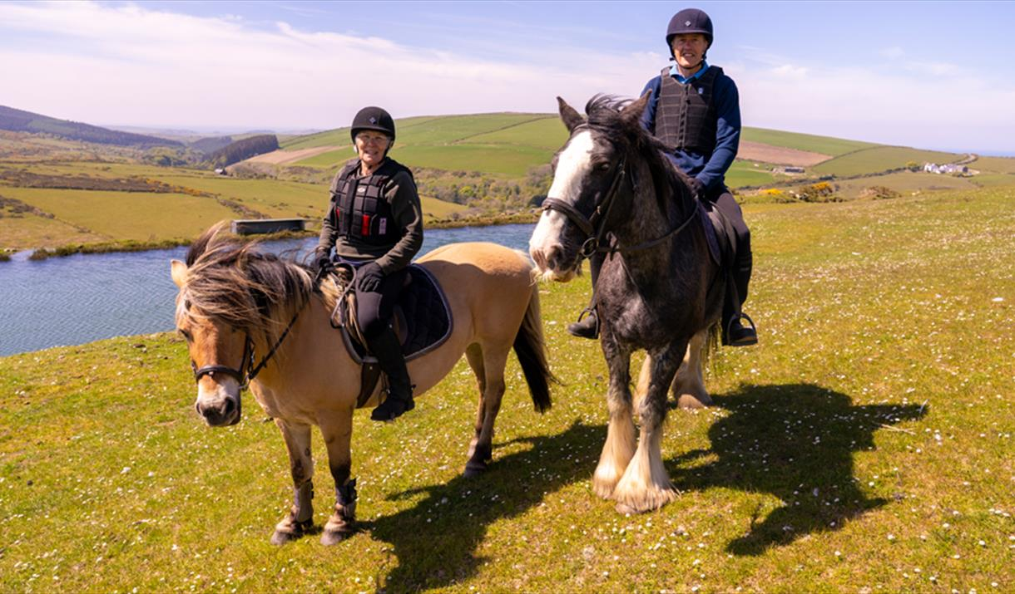
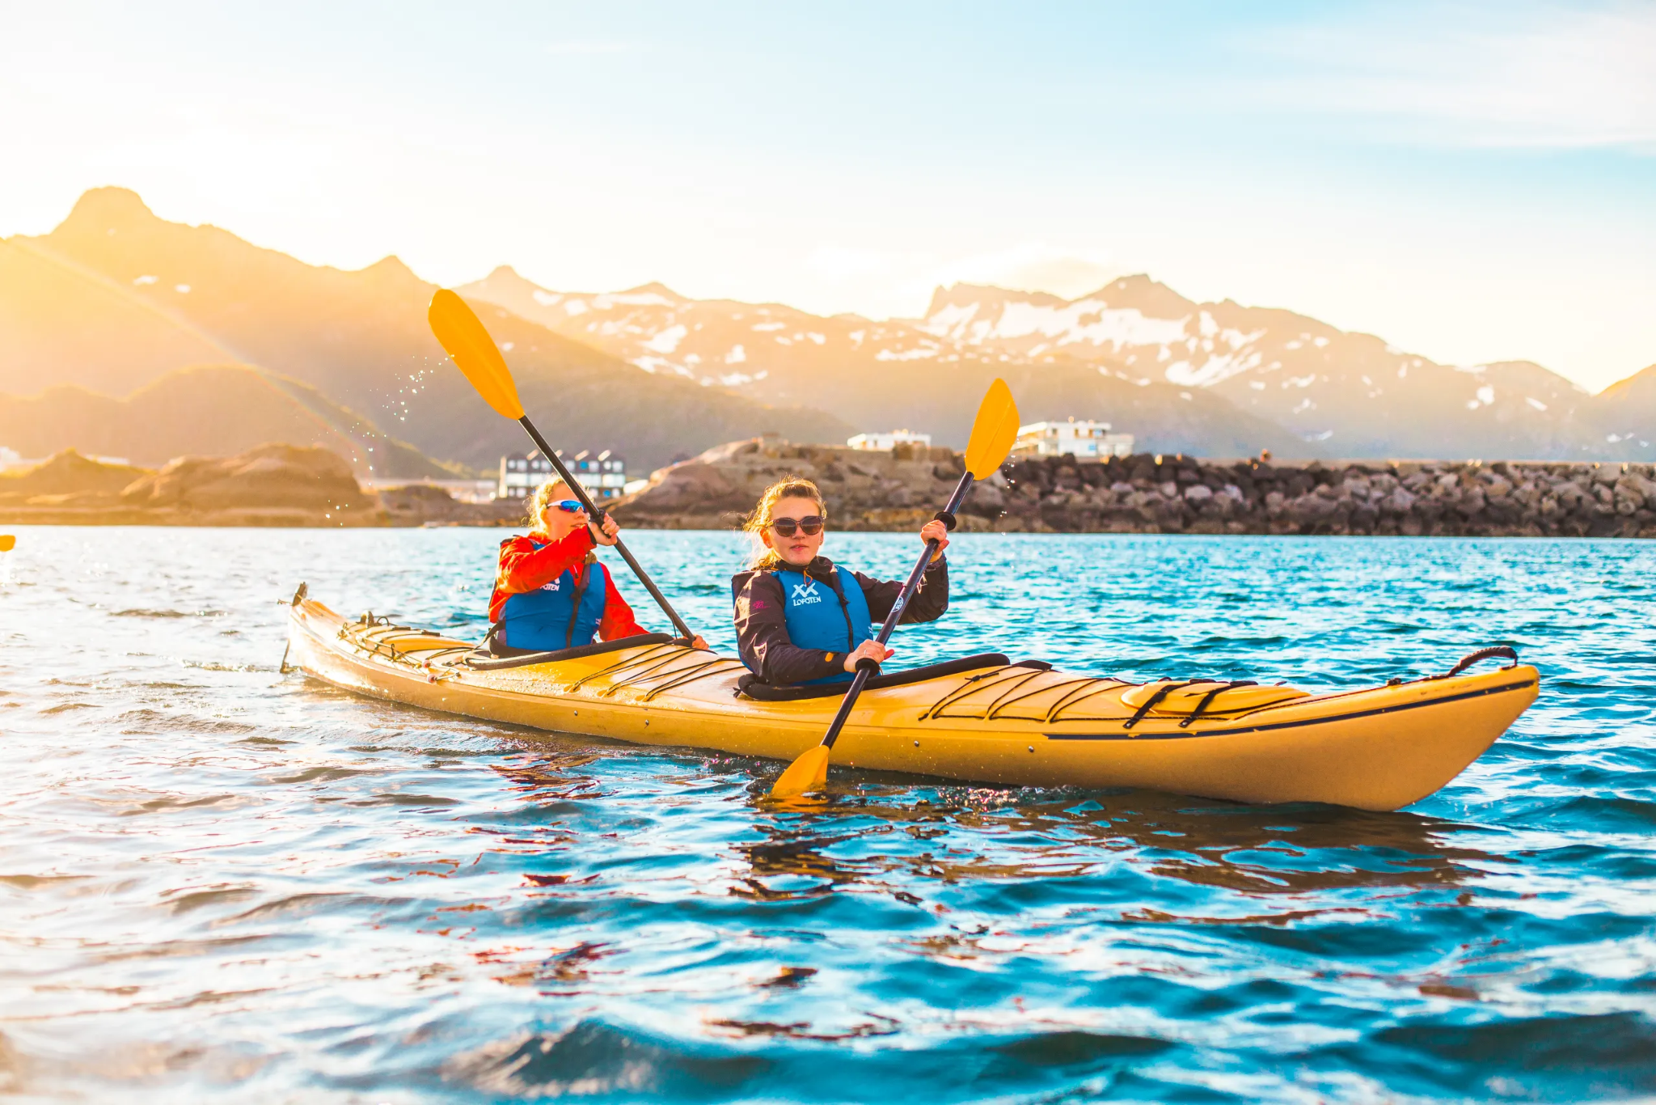
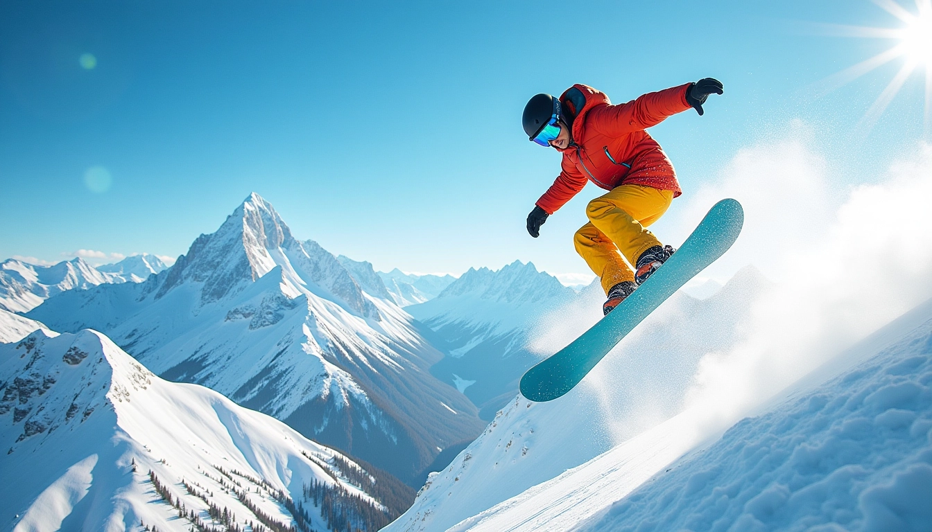
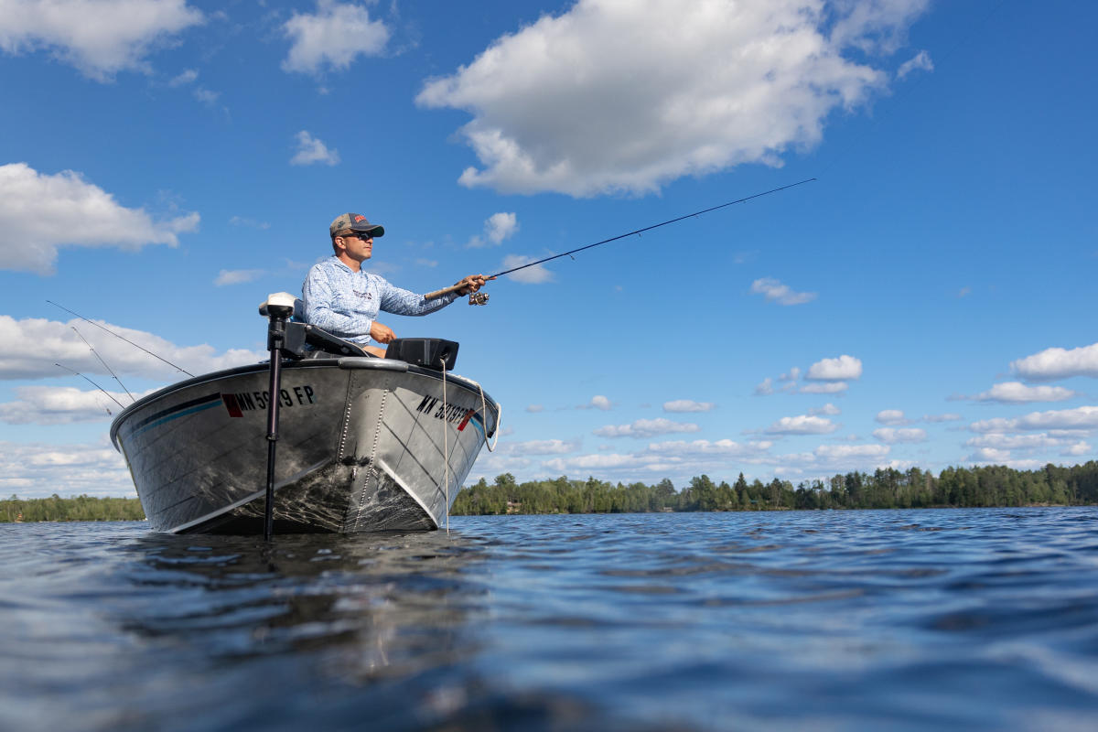
What activity did the group talk about?
What equipment do you need?
A
B
C
D
E
F

Slide 18

Thank you! See you soon…

