Slide 1
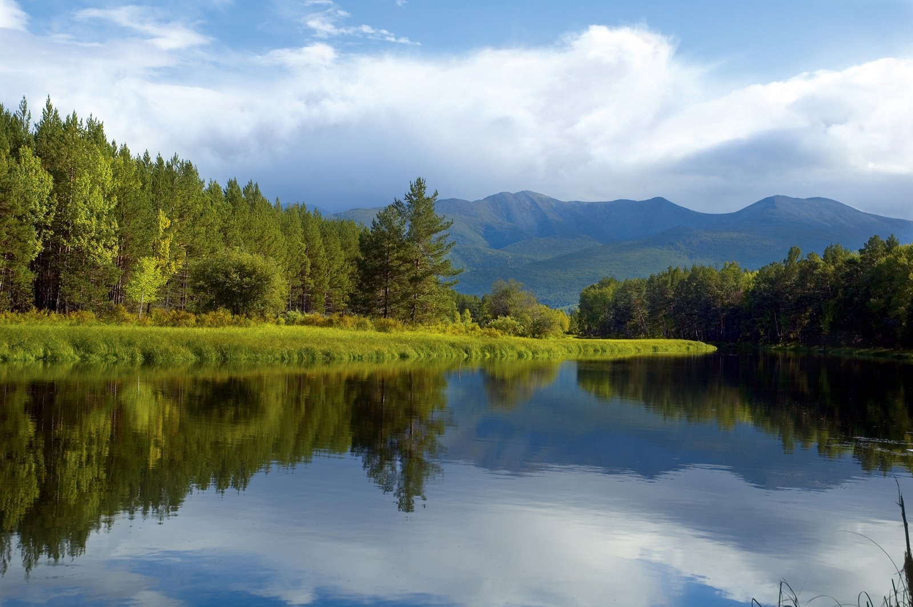
Russian nature reserves
FACT or FICTION?

Slide 2
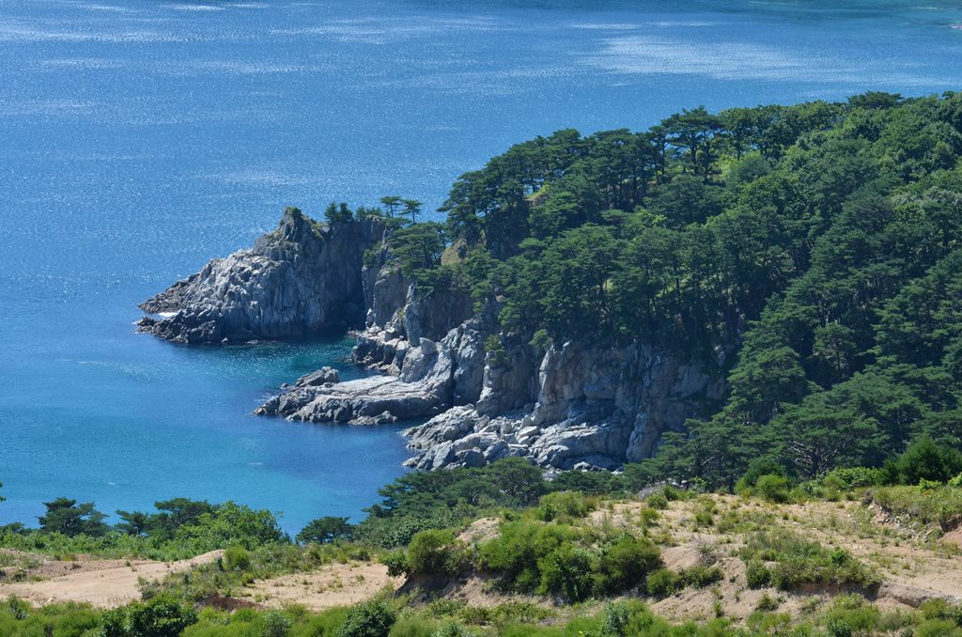
The Far Eastern Marine Reserve consists of over 50% of the water area.
True

Slide 3
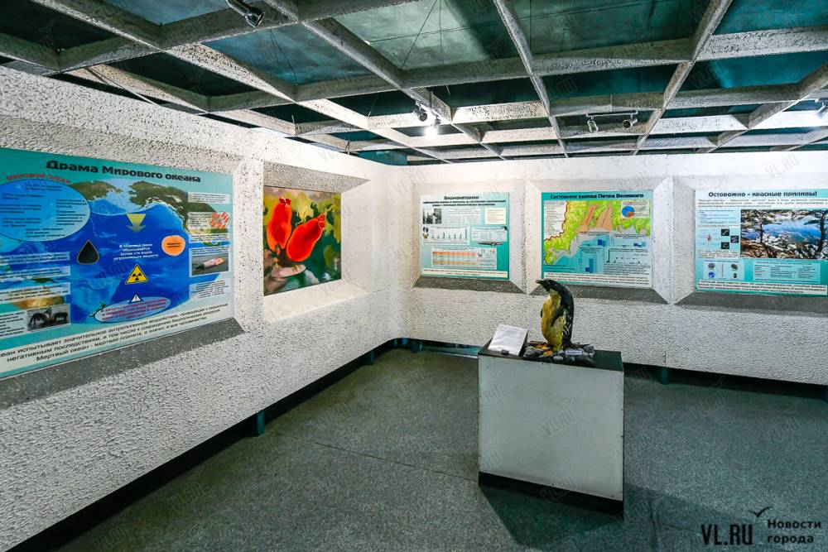
The museum “Nature of the sea and its protection“ is the only museum in Russia located on an island.
True

Slide 4
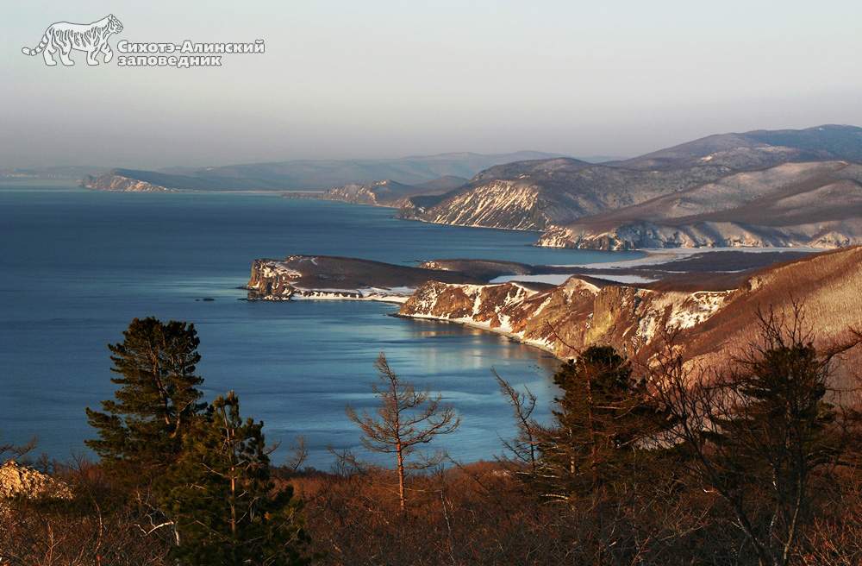
From 1939 to 1951 The Sikhote-Alin Nature Reserve was the largest nature reserve not only in the
USSR but also in the world.
True

Slide 5
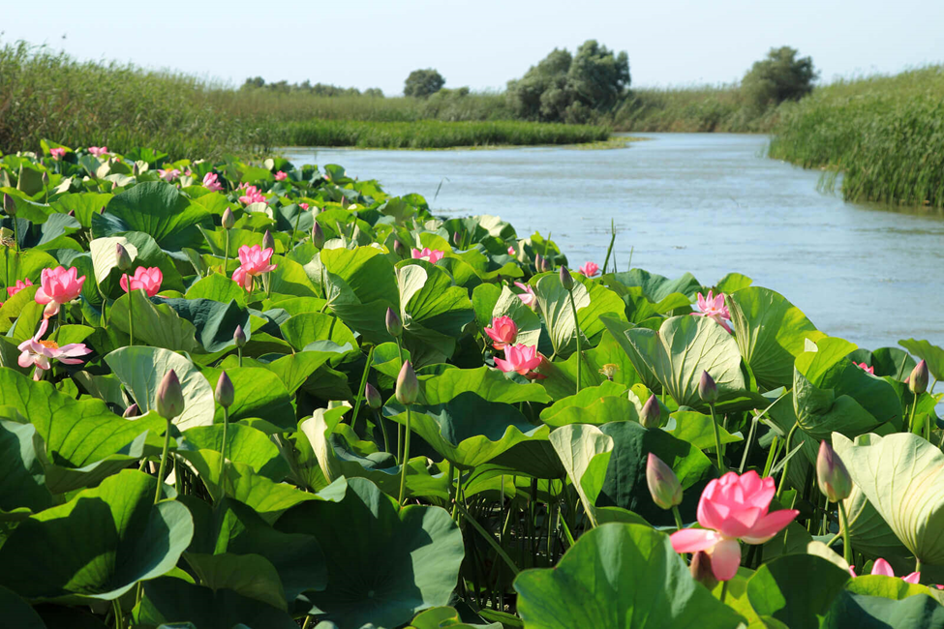
The Astrakhan Nature Reserve is the only place in the world where you can find lotus flowers.
False

Slide 6
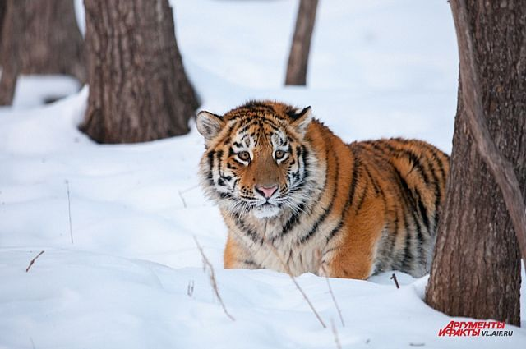
The Ussurisky Nature Reserve is featured in the natural film ”Operation Snow Tiger” by the BBC.
True

Slide 7
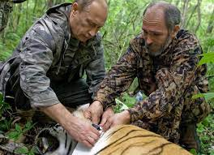
In 2008 the President of Russia V. Putin participated in temporary immobilization of a tigress.
He measured its height, weight and pressure. He also fitted a satellite collar on it.
True

Slide 8
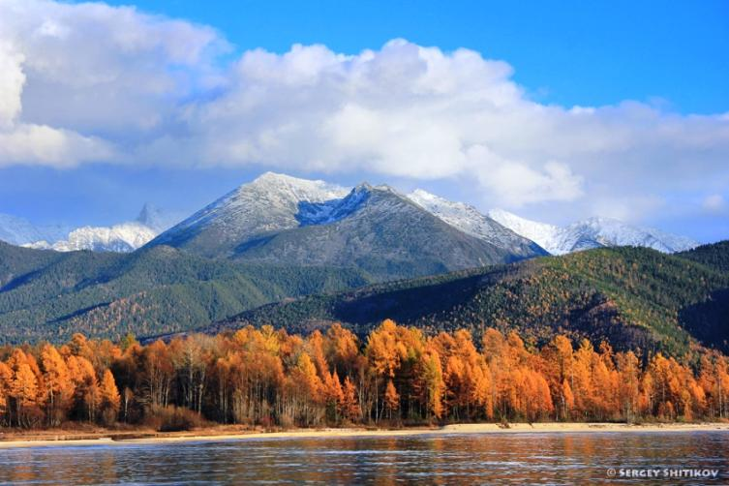
The Barguzinsky Nature Reserve located in Buryatia is the oldest in the world.
False

Slide 9
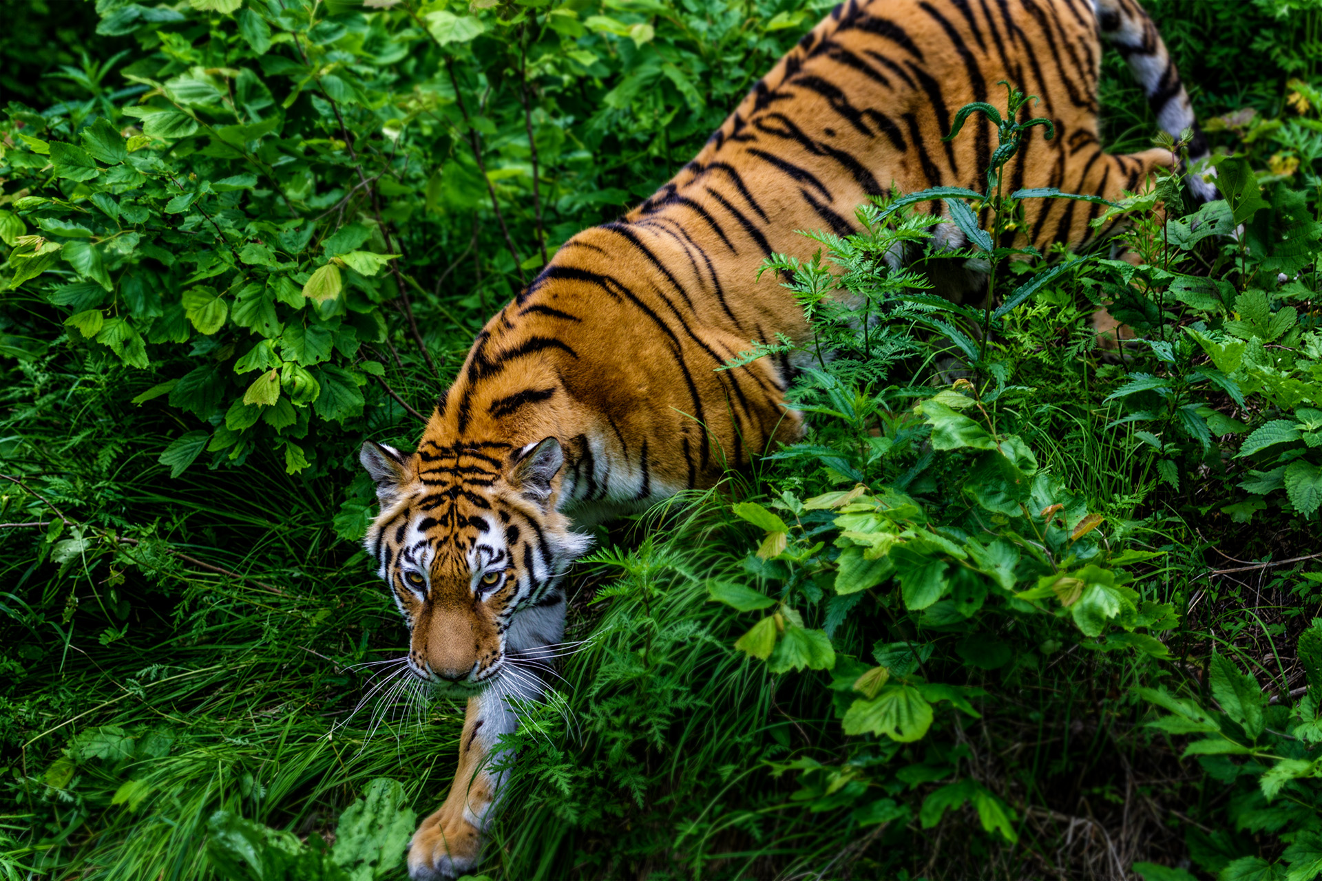
The Sikhote-Alin Reserve, the only one in Russia and the second in the world, received a CATS certificate proving the importance of this territory for the preservation of the rarest cat on the planet - the Amur tiger.
True

