Slide 1
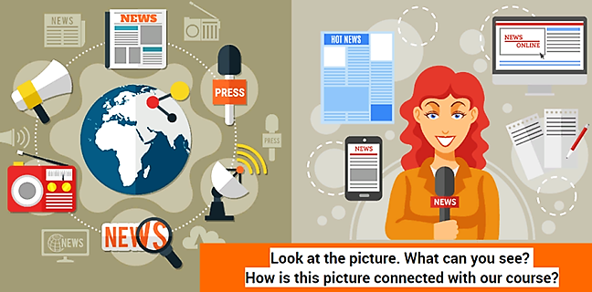
English for Journalists.

Slide 2
"Journalism largely consists of saying 'Lord Jones is Dead' to people who never knew that Lord Jones was alive." - Gilbert K. Chesterton
Let’s discuss the following questions:
What is the job of a journalist?
How do reporters investigate stories?
How do journalists use social media to gather and report news?

Slide 3
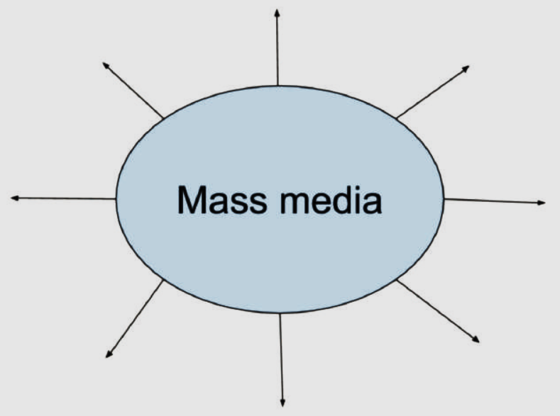
Fill in:

Slide 4
Print Media: Newspapers, Banners, Billboards, Brochures, Flyers, Magazines;
Broadcast Media: Television , Radio;
Internet (Online) Media: Social networks or websites (Vkontakte, Telegram, Dzen, Odnoklassniki (OK.ru), RUTUBE, Yappy, etc), Online forums, Podcasts, AI content (Artificial Intelligence tools like ChatGPT).

Slide 5
Now imagine you are journalists. You want to interview someone for a school magazine. Work in pairs. Prepare your questions and interview each other.
Examples of questions:
You
What’s your name?
How old are you?
Do you go to school?
How long have you been_____________?
Family
Is your family big or small?
Do you have any sisters or brothers?
Home
Where do you live?
How long have you lived in______?
What is your hobby?

Slide 6
