Slide 1
GOING SHOPPING

Slide 2
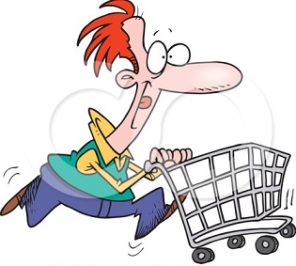
Going shopping
Do you often go shopping?
Do you like it? What shops do you prefer to go to?

Slide 3
Our aims for today
To learn some new names of the shops
To remember the verb “to be” in the Past Simple

Slide 4
Remember!
Chemist’s- аптека
Newsagent’s- газетный киоск
Record shop- музыкальный магазин
Shopping centre/ mall- торговый центр
Fast food restaurant- ресторан быстрого приготовления
Florist’s- цветочный магазин

Slide 5
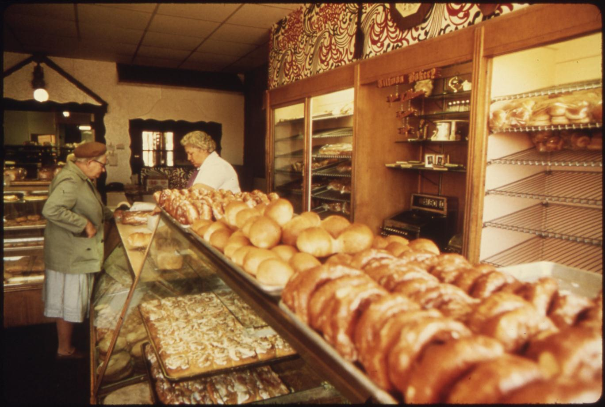
bakery

Slide 6
florists’s

Slide 7
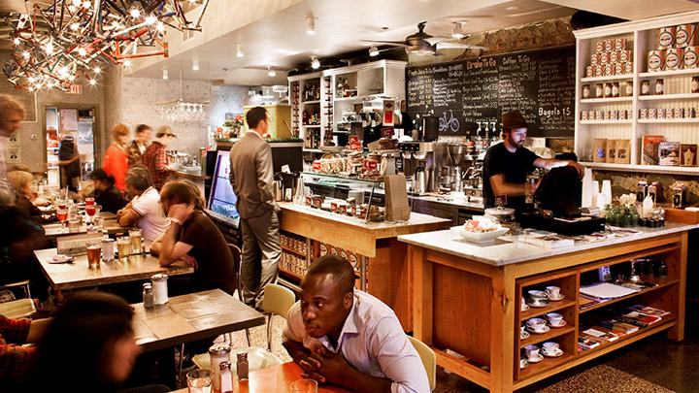
cafe

Slide 8
shoe shop

Slide 9
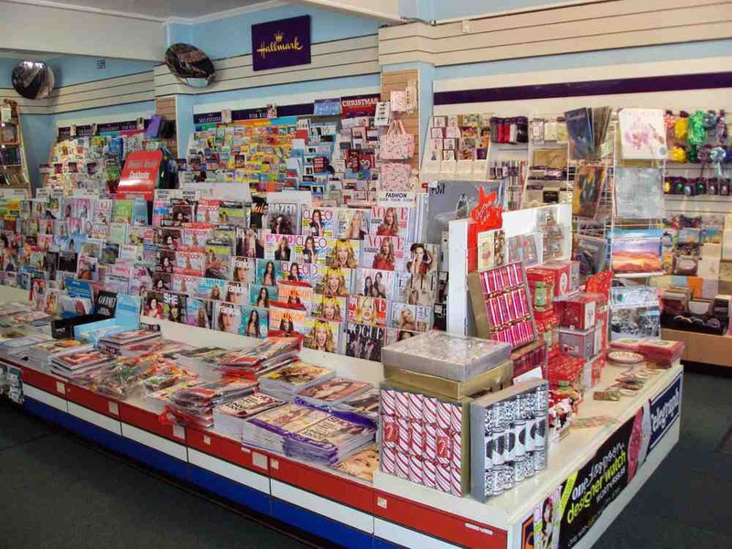
newsagent’s

Slide 10
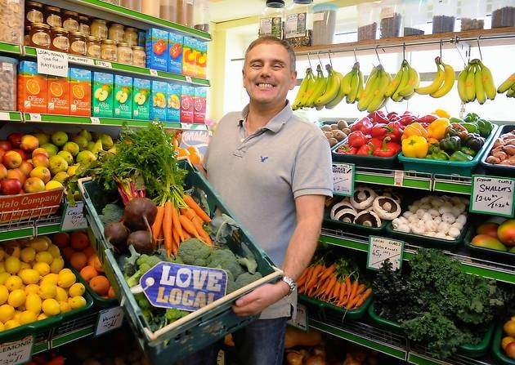
greengrocer’s

Slide 11
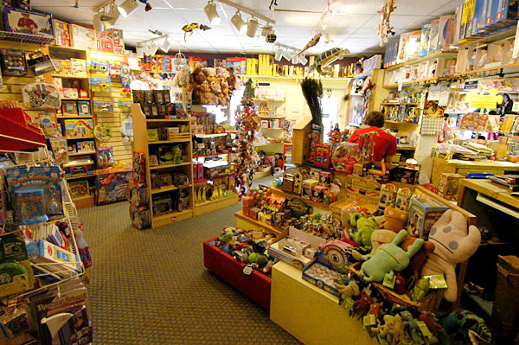
toy shop

Slide 12
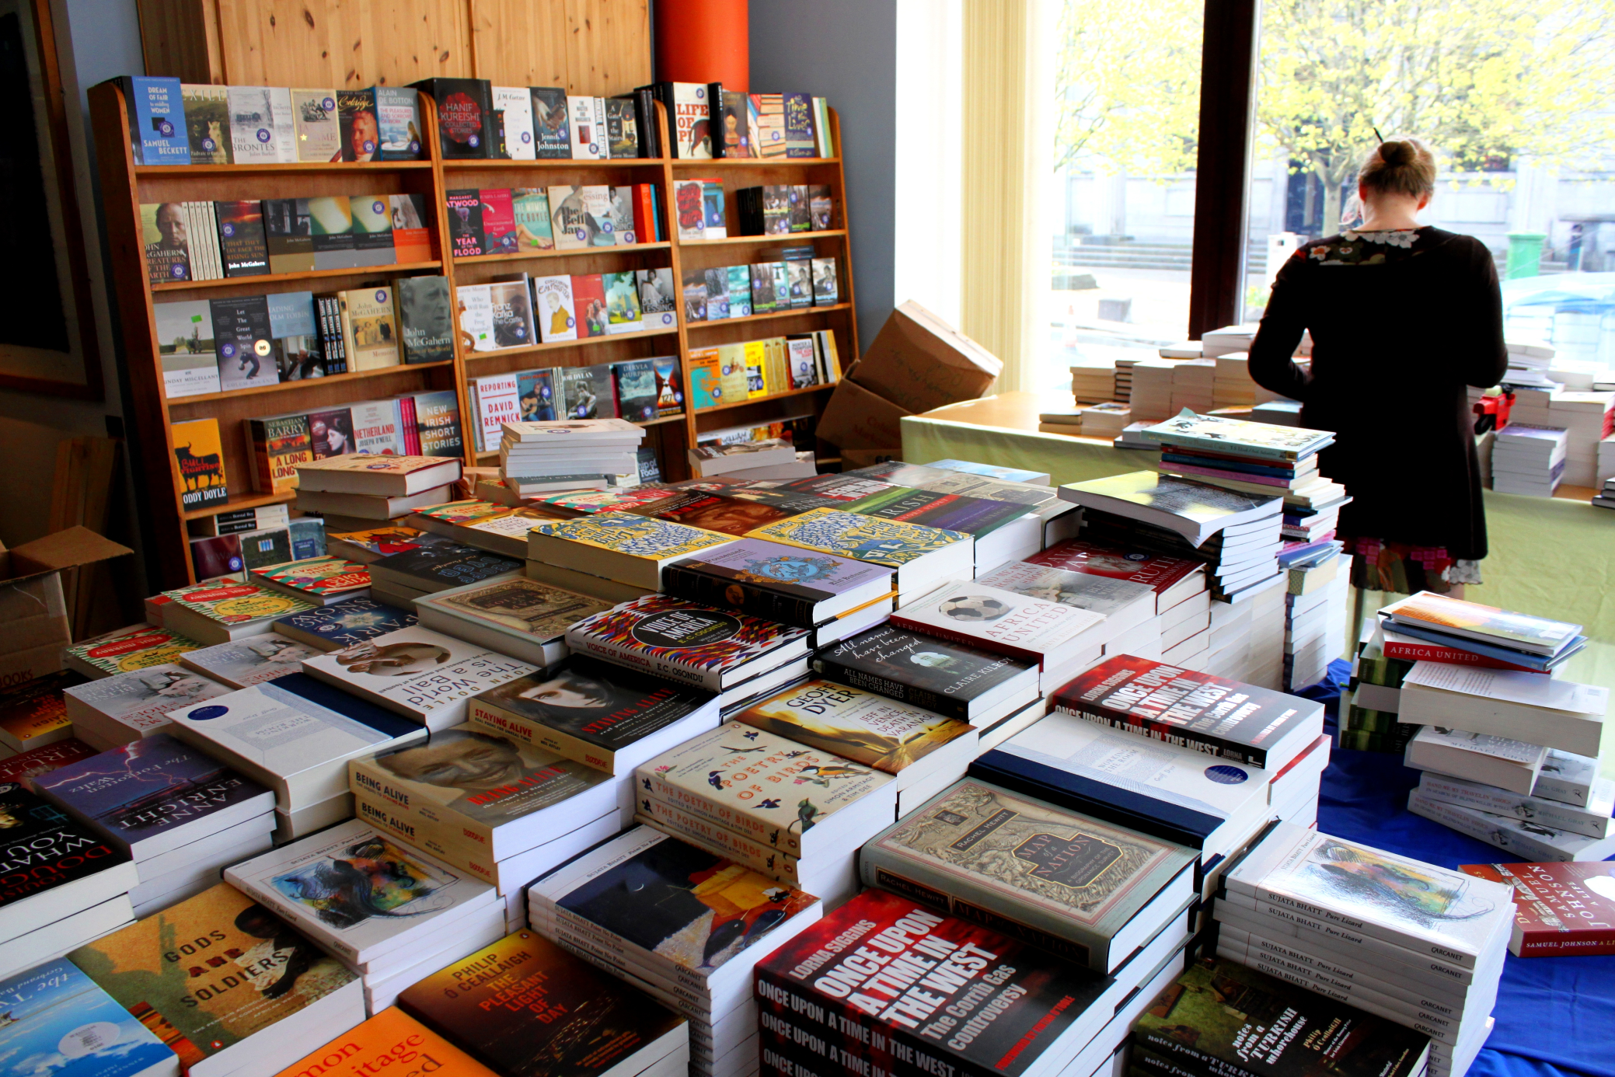
bookshop

Slide 13
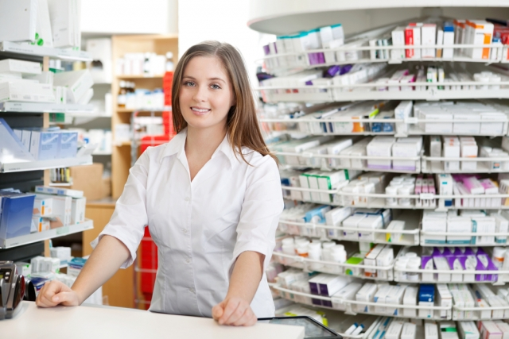
chemist’s

Slide 14
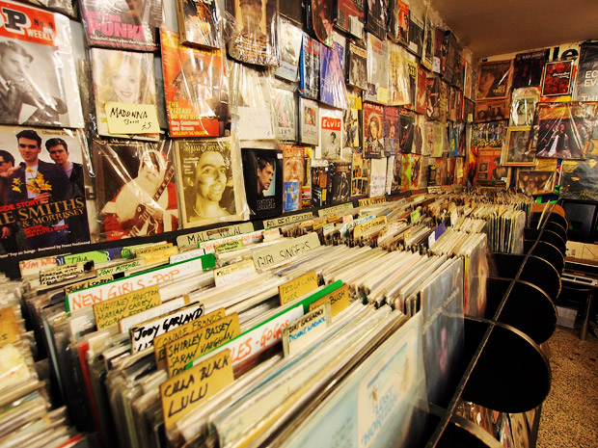
record shop

Slide 15
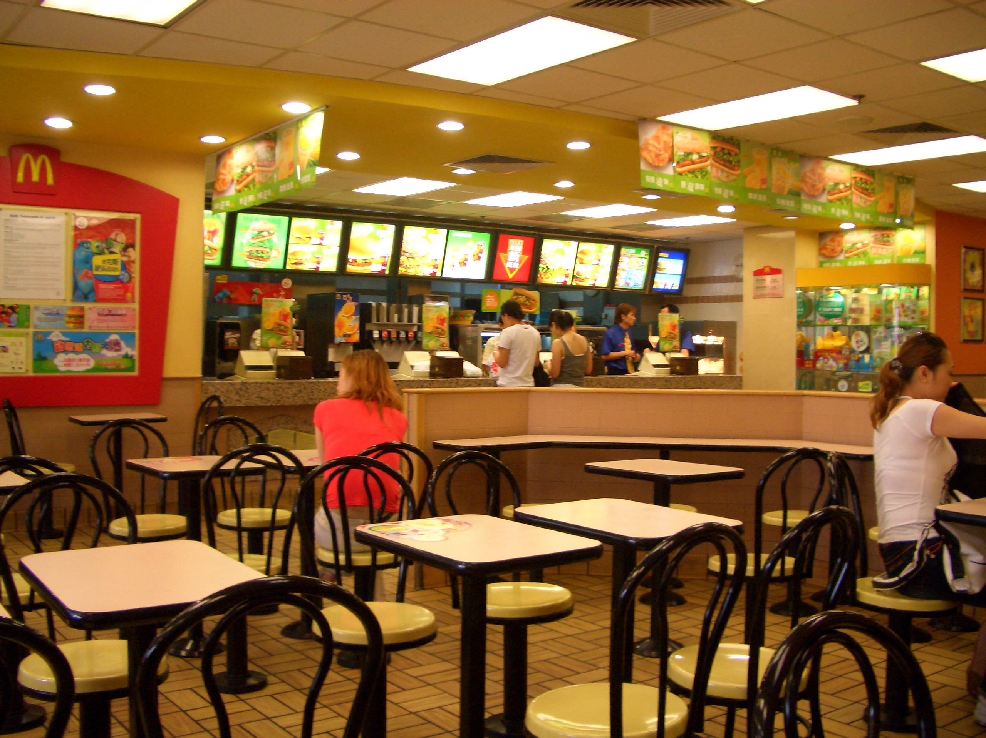
fast food restaurant

Slide 16
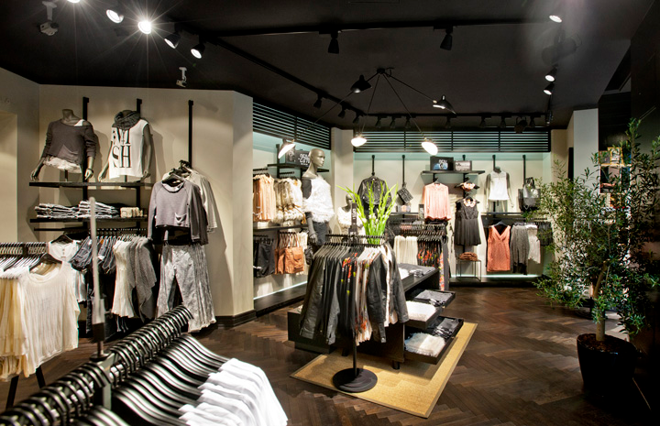
clothes shop

Slide 17
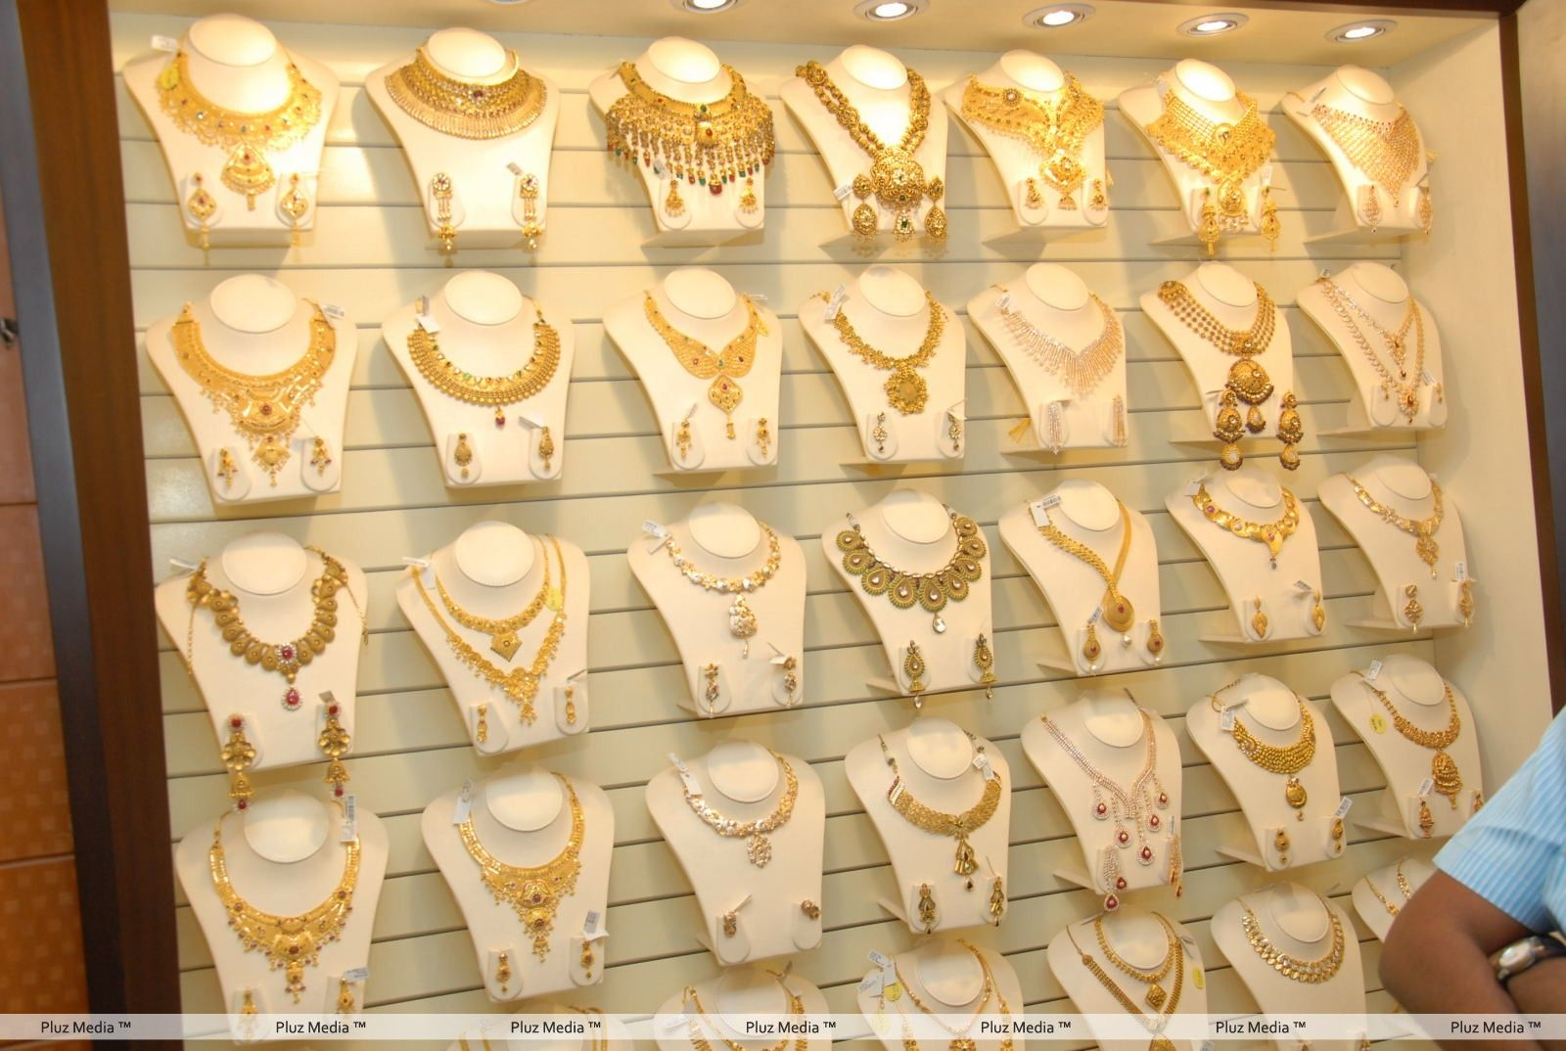
jeweller’s

Slide 18
Which shops can you see in the shopping centre?
I can see a florist shop called Laura’s.

Slide 19
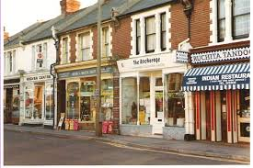
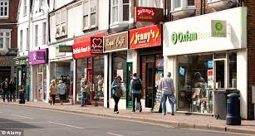
Where is the shoe shop?
Florist’s
Toy shop
Shoe shop

Slide 20
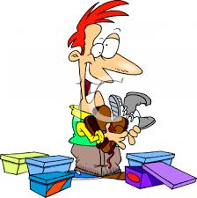
You’re at the shopping centre.
A: So, what do you want to buy?
B: A pair of shoes.
A: Let’s go to the shoe shop.
B: Where is it?
A: On the first floor.

Slide 21
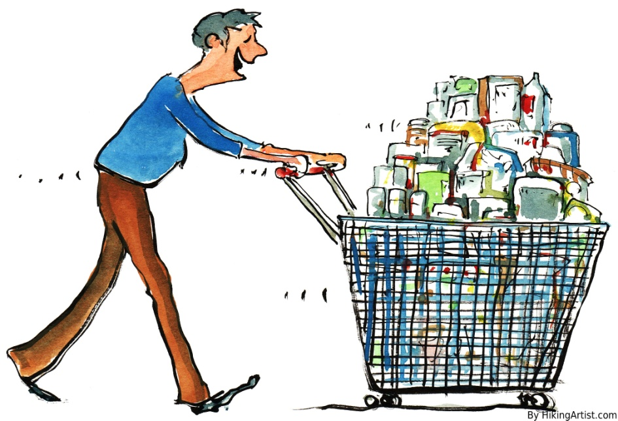
Make a dialogue
A: So, what do you want to buy?
B: … .
A: Let’s go to … .
B: Where is it?
A: On the … floor.

Slide 22
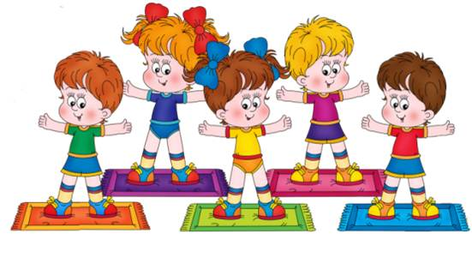
☺ Let’s have a break ☺
Stand up and look around
Shake your head and turn around
Stamp your feet upon the ground
Clap your hands and then sit down

Slide 23
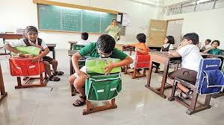
Where were you last Monday morning?
I was at school.

Slide 24
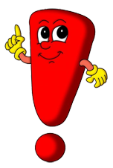
Was/were
Past Simple
Notes:
https://yandex.ru/video/search?filmId=9380080792886658205&text=to%20be%20in%20the%20past%20simple%20for%20kids&noreask=1&path=wizard
https://e.mail.ru/thread/1:bcc0e05f25b14b95:0/

Slide 25
«To be» in the Past Simple
I/He/She/It was … .
We/You/They were … .
I/He/She/It wasn’t … .
We/You/They weren’t … .
Was I/he/she/it …?
Were we/you/they …?

Slide 26
Home task.
SB p.107,ex.6
WB p. 65, ex. 1-4

Slide 27
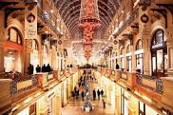
Example
My favorite shop is Gum. It is in the centre of Moscow. It’s more than 110 years old. The building is beautiful. It’s like a museum.
There are more than 150 shops. You can buy everything there : clothes, shoes, food. Around 30000 people visit Gum every day.
I was there last Saturday with my Mum. We were there to buy a present for my grandmother.

Slide 28
THANK YOU FOR YOUR WORK!

