Slide 1

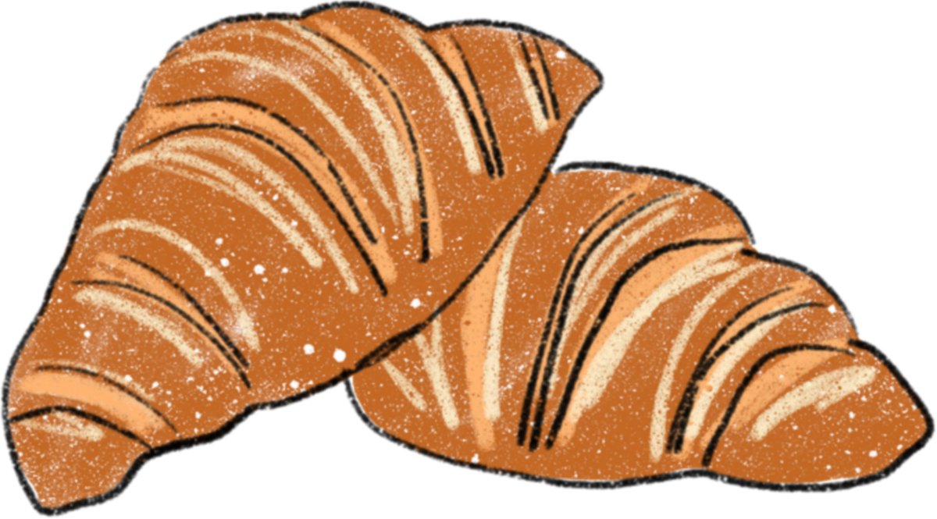

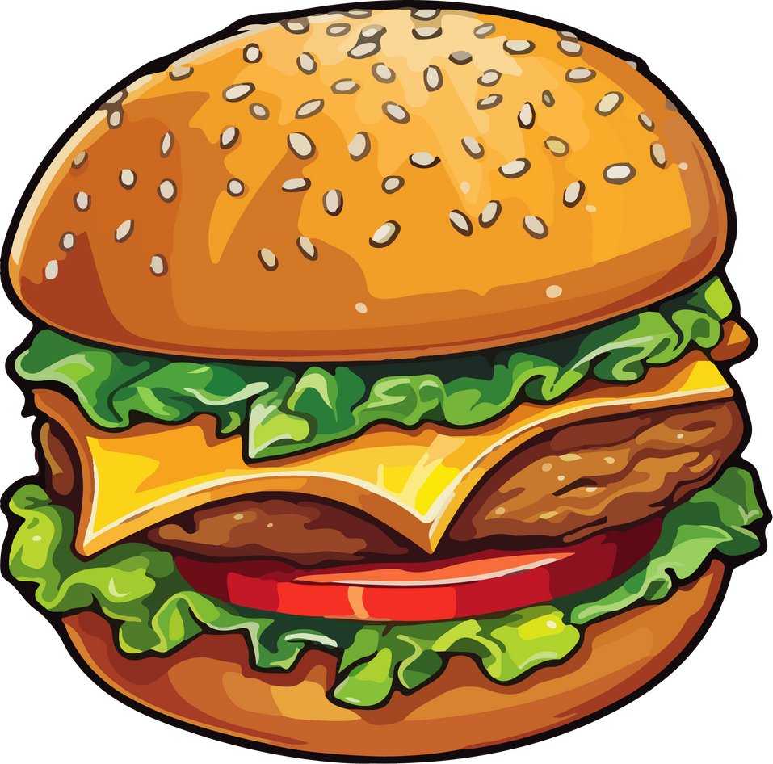
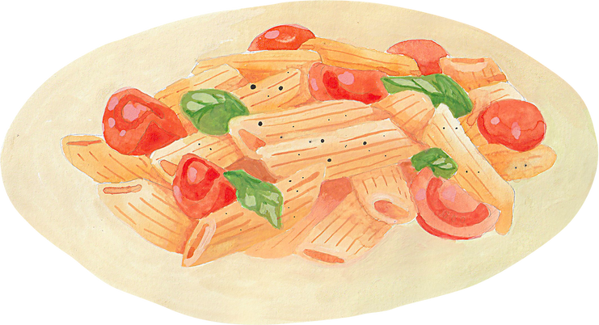
Food from around the world

Slide 2



In today’s lesson
  review food items
  learn new food vocabulary
  watch a video
  discover new recipes
  play

Slide 3




Introduction
Many traditional foods of different cultures have become staple foods that we eat in Russia today.
There is a great variety of cookbooks, food magazines and cookery programmes which cover a wide range of topics from recipes to food preparation.

Slide 4




Guess a popular dish
?
?
?
This is a rice dish cooked in a big pan. Different types of it include vegetarian, seafood and mixed. All types use olive oil.
This is a noodle dish of various shapes
cooked by boiling and served with sauces like pesto, tomato sauce.
This salad is made with pieces of tomatoes, sliced cucumbers, onions, feta cheese and olives. It’s dressed with olive oil.

Slide 5

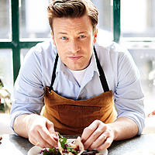
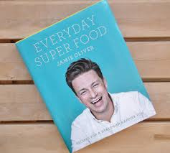
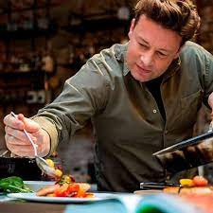
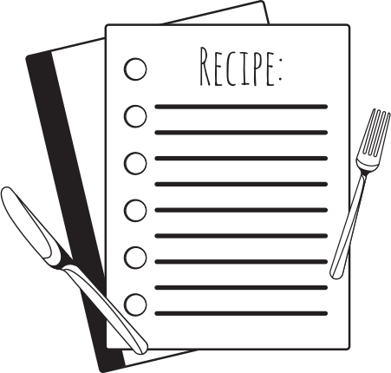
Use notes below to talk about one of the best chefs in the world
Jamie Oliver: chef profile
  Personal life
  Career
  Books and Media
Charity
and campaigning
Full name: Jamie Trevor Oliver
Birthplace: Essex, England
Family: married, 5 children
Early life: practised cooking in his parents’ pub
Job: celebrity chef, cookbook author
1st job as pastry chef, sous-chef at The River Cafe, London,
1999 his BBC show appeared on TV and his book became a bestseller,
2008 opened his restaurant
the best-selling British non-fiction author,
2nd best-selling British author behind J.K.Rowling,
sold more than 14 million books,
appeared in many TV shows
made efforts to improve school lunches, food education and healthy eating,
established the charity restaurant where trained young people

Slide 6



Vocabulary
  poached egg - cooked outside the shell by poaching
  smash - break into pieces
  crack - break
  vinegar - sour-tasting liquid
  gently - softly
  simmer - boil gently, softly
  sprinkle - cover/powder with small drops of something

Slide 7


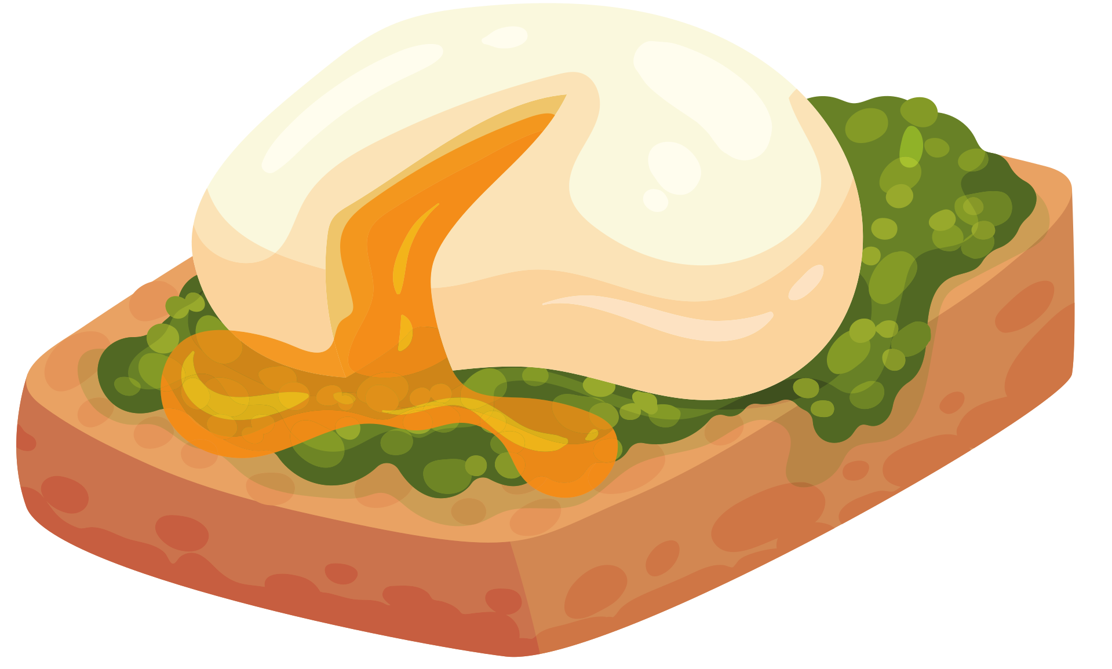
Choose the right tips for perfect poached eggs
  Use fresh eggs.
  Simmer gently. Don’t boil.
  Use a bowl to drop the egg into the saucepan.
  Cook over a high heat.
  Cook over a low heat.
  Simmer slightly for 3 min.
  Spin the water to help hold the egg together.

Slide 8





Order the instructions for food preparation
A
B
C
D
Crack an egg into a cup and gently pour it into the water.
Bring your water to the boil. Simmer the water gently.
When it’s ready, remove it to some kitchen paper to dry off and serve with buttered toast and a sprinkle of sea salt and pepper.
Simmer for about 3 min.

Slide 9
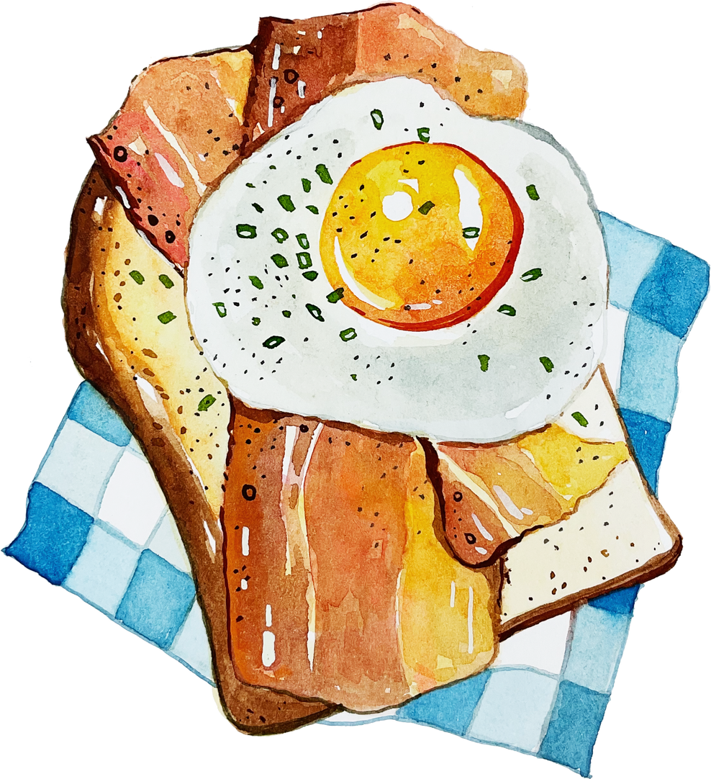
Thanks For Watching

