Slide 1
Tsaritsyno -my love!
Peformer:
Pryskalina Pouline
Class 8N
Tsaritsyno - my love!
Superviser:
Lozneva Natalia
Teacher of English

Slide 2
Practical significance of the work
Changing of the role and significance of institutions in the socio-cultural sphere at the age of high technologies:
1. They perform the functions of cultural and educational services to the population.
2. They perform the role of regional educational and scientific centers.
3. They are developed as tourist centers.
The Tsaritsyno Museum-Reserve is a unique ensemble of architectural structures that reflect the history and culture of Moscow of the XVIII–XIX centuries the study of which has great educational and educational value.

Slide 3
Class survey

Slide 4
Research methodology
Problem
Object
Subject
Most schoolchildren lack information about
the history of the park
and do not have a clear
idea of what its official
name means.
Final product
Historical sites of
Tsaritsyno Park
and their
background
The origin and
meaning of its
modern name
Tourist brochure
“A Visit to Tsaritsyno”
Reasearch methods: historical method, theoretical analysis of literature, questionnaire, survey, induction, analysis of the data obtained

Slide 5
The main aim and objectives of the project
find evidence confirming that Tsaritsyno is a museum-reserve and to introduce our classmates to the history and evelopment of Tsaritsyno Park as a cultural heritage
To conduct a survey among our classmates and find out if they know the exact name of Tsaritsyno Park
To study literature connected with the topic
To define what a museum-reserve is and highlight its distinctive features
To issue a tourist brochure “A Visit to Tsaritsyno

Slide 6
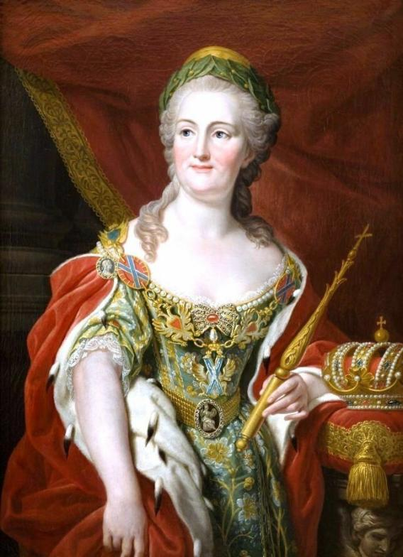
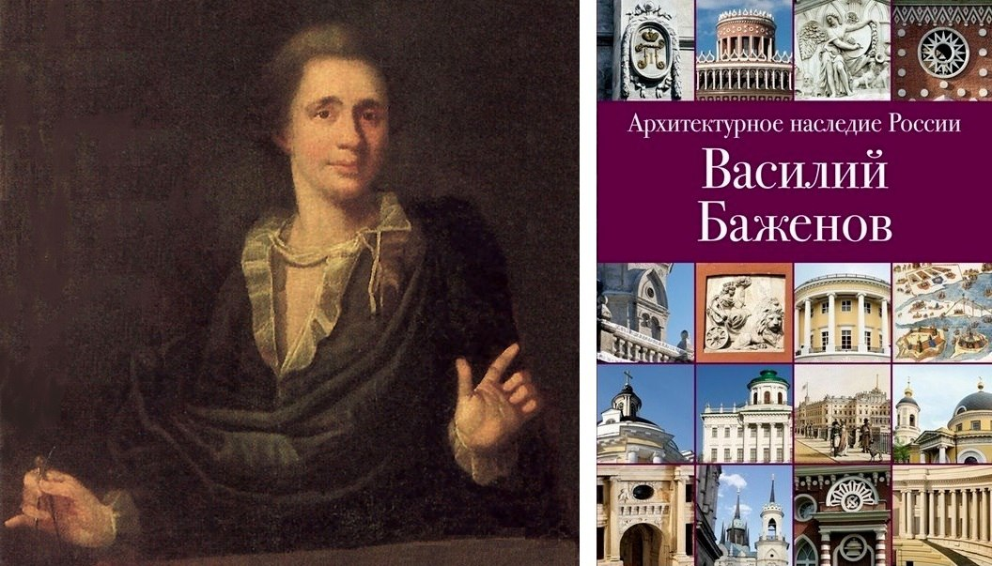
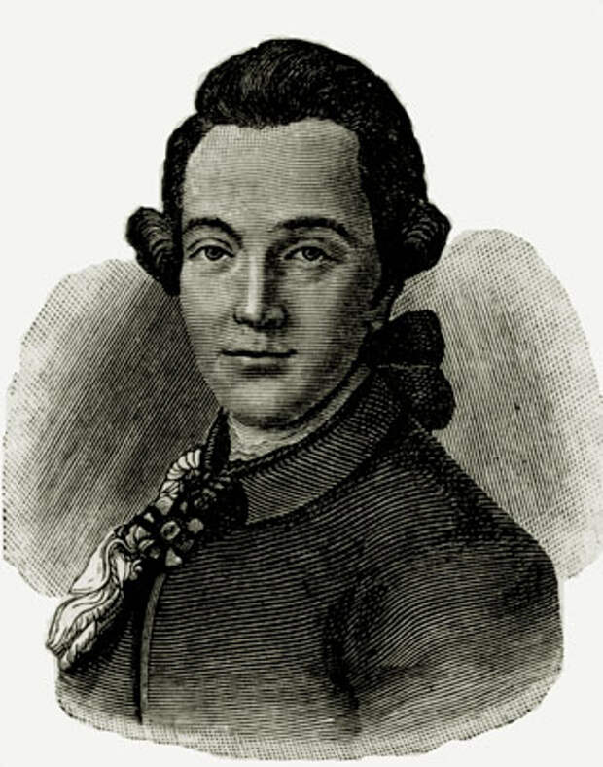
From the origins to present

Slide 7
Tsaritsyno in the 19th century
A centre of walks and recreation.
It is favored by cultural figures: artists, composers, artists. By the end of the XIX century, it has become a prestigious suburban area.

Slide 8
The beginning of changes. The first museum
1927 -the Tsaritsyn Museum of History, Art and Local Lore and began work in the Third Cavalier Corps.

Slide 9
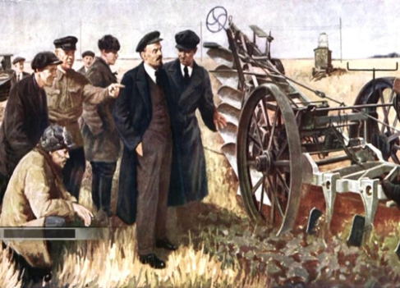
"Leninsky Museum of Local Lore of the Horticultural District"
New expositions

Slide 10
From the 40-s to these days
The Great Patriotic War left its mark on the park.

Slide 11
Tsaritsyno 1940-1950s
Archival photographs from private collections.

Slide 12
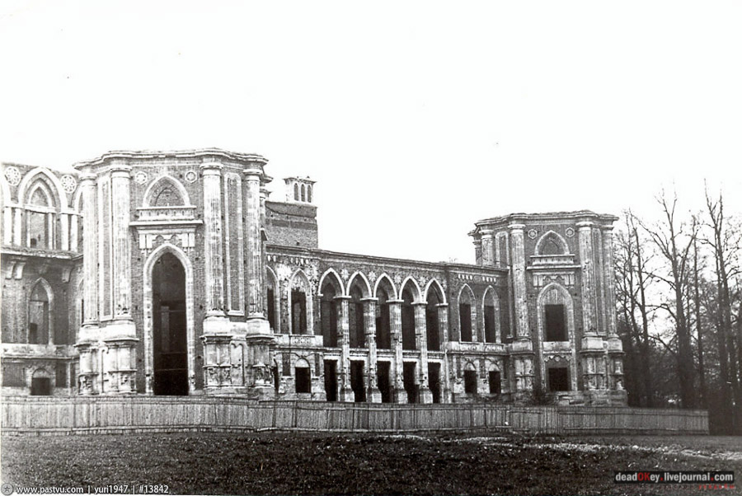
Tsaritsyno in 1970 -1990s

Slide 13
1940s - 1950s
reconstruction projects
1979
the status of a monument of landscape art
1984
the State Museum of Decorative and Applied Arts of the Peoples of the USSR
1992
the Tsaritsyno State Historical, Architectural, Art and Landscape Museum-Reserve
PastPast
Past
Future
A 50 year long road
From the “whim of the Empress” to the State Historical, Architectural, Art and Landscape Museum-Reserve

Slide 14
Museum, reserve, museum-reserve
A museum-reserve is a kind of open—air museum, which, in addition to expositions, includes architectural, historical and natural monuments important for preserving the historical, cultural and natural heritage of a country or region.
Mikhailovskoye Museum-Reserve

Slide 15
Special
status
 | National park | Nature Reserve | State Museum-Reserve
status is defined in federal legislation | + | + | +
economic activity | - | - | +
state budget | + | + | +
protection of ecological, historical and cultural objects of the state | - | - | +
protection of rare species of animals and plants | + | + | - +
open for people to visit | + | - | +
 | National park | Nature Reserve | State Museum-Reserve
status is defined in federal legislation | + | + | +
economic activity | - | - | +
state budget | + | + | +
protection of ecological, historical and cultural objects of the state | - | - | +
protection of rare species of animals and plants | + | + | - +
open for people to visit | + | - | +
 | National park | Nature Reserve | State Museum-Reserve
status is defined in federal legislation | + | + | +
economic activity | - | - | +
state budget | + | + | +
protection of ecological, historical and cultural objects of the state | + | + | +
protection of rare species of animals and plants | + | + | +
open for people to visit | + | - | +

Slide 16
More evidence
Государственный историко-культурный Кремль
музей - заповедник "Московский Кремль"
Государственный исторический Красная пл., 1/2
музей
(музейный комплекс)
Государственный художественный Андропова пр., 39
историко-архитектурный и
природно-ландшафтный музей - заповедник
"Коломенское"
Государственный Дольская ул., 1
историко-архитектурный и ландшафтный
музей - заповедник "Царицыно"
Указ Президента РФ от 20.02.1995 N 176 Об утверждении Перечня объектов исторического и культурного наследия федерального (общероссийского) значения

Slide 17
Постановление Правительства Москвы № 63-ПП от 18 февраля 2014 года
О
Об утверждениОб утверждении границы территории объекта культурного наследия (памятника садово-паркового искусства) регионального значения «Усадьба „Царицыно“, границы охранной зоны объекта культурного наследия федерального значения „Ансамбль усадьбы Царицыно, XVIII в.“, режимов использования земель и градостроительных регламентов в границах ее территории»и градостроительных регламентов в границах ее территории»
Приказ Минкультуры России от 10.10.2022 N 1886 "О включении выявленных объектов культурного наследия в единый государственный реестр объектов культурного наследия (памятников истории и культуры) народов Российской Федерации в качестве объектов культурного наследия федерального значения в составе объекта культурного наследия федерального значения "Ансамбль усадьбы Царицыно", конец XVII - начало XIX вв. (г. Москва, Дольская ул., д. 1, д. 1, стр. 2, 3, 4, 5, 6, 7, 13, 16, 17, д. 2, стр. 1) и утверждении границ их территории" (Зарегистрировано в Минюсте России 21.11.2022 N 71035)

Slide 18
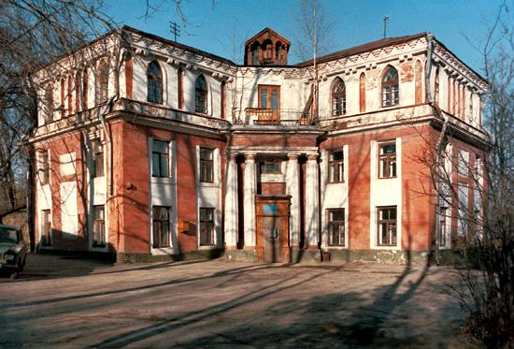
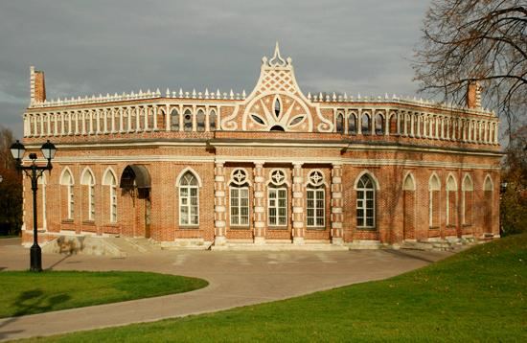
Specially protected objects under the patronage of the state
First Cavalry Building
Second Cavalry Building
The Church Life-Giving Spring

Slide 19
Conclusion
We hope that we have achieved the goal of our work, reviewed the history of the Tsaritsyno Museum-Reserve, explained the meaning of its name and convinced our listeners. that Tsaritsyno is not just a recreation park, but an object of national heritage, protected by the state for future generations, so that they can better understand the history of our beloved Homeland.

Slide 20
Thank you for your attention!

