Slide 1
Внеклассное мероприятие по английскому языку для обучающихся 4 классов «Новогодние приключения»
Лях Наталья Валерьевна, учитель английского языка МАОУ «Школа № 16 им. Героя Советского союза летчика- космонавта А.А. Леонова»

Slide 2
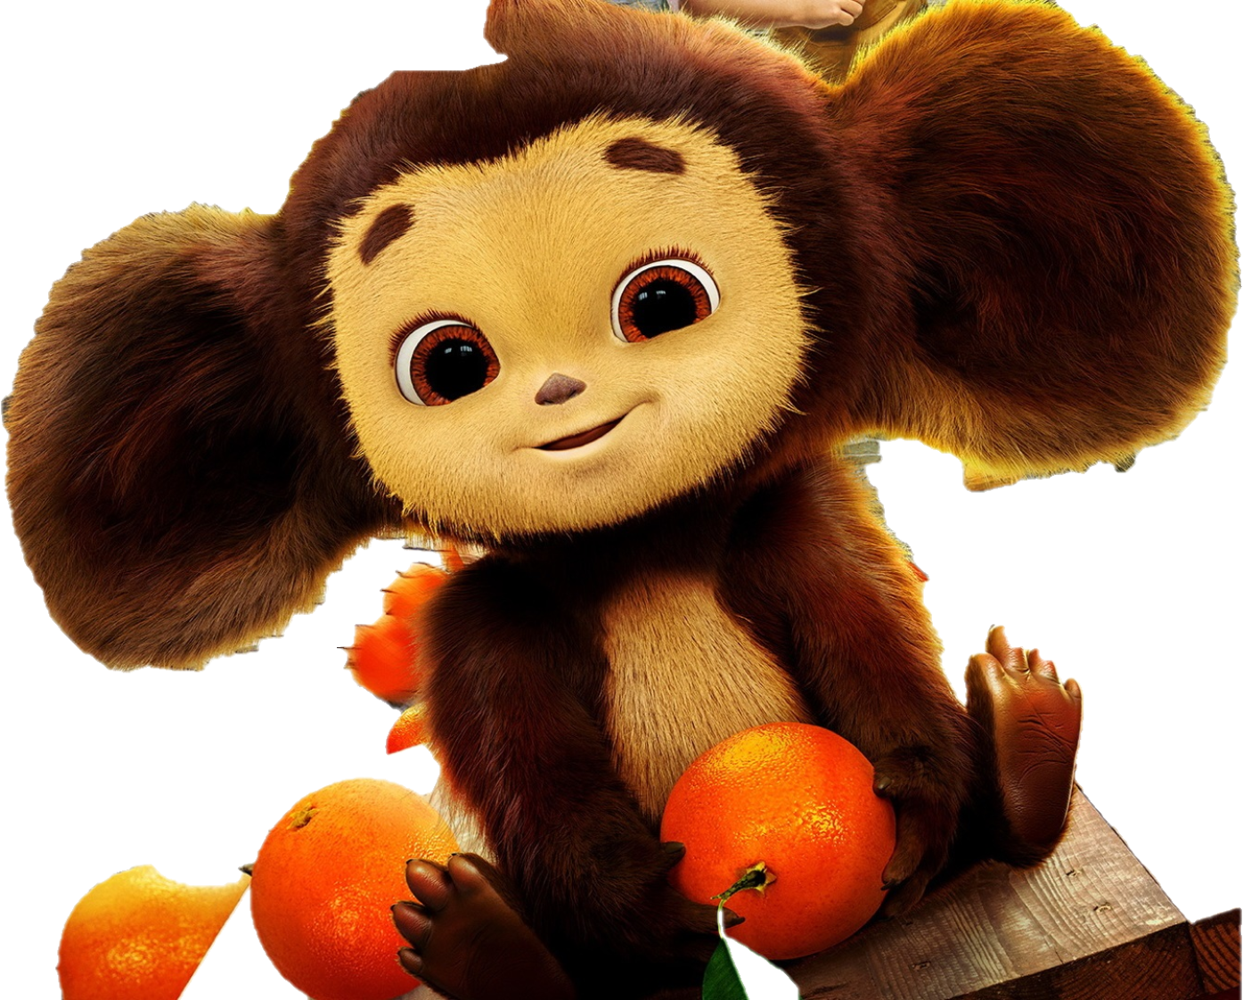
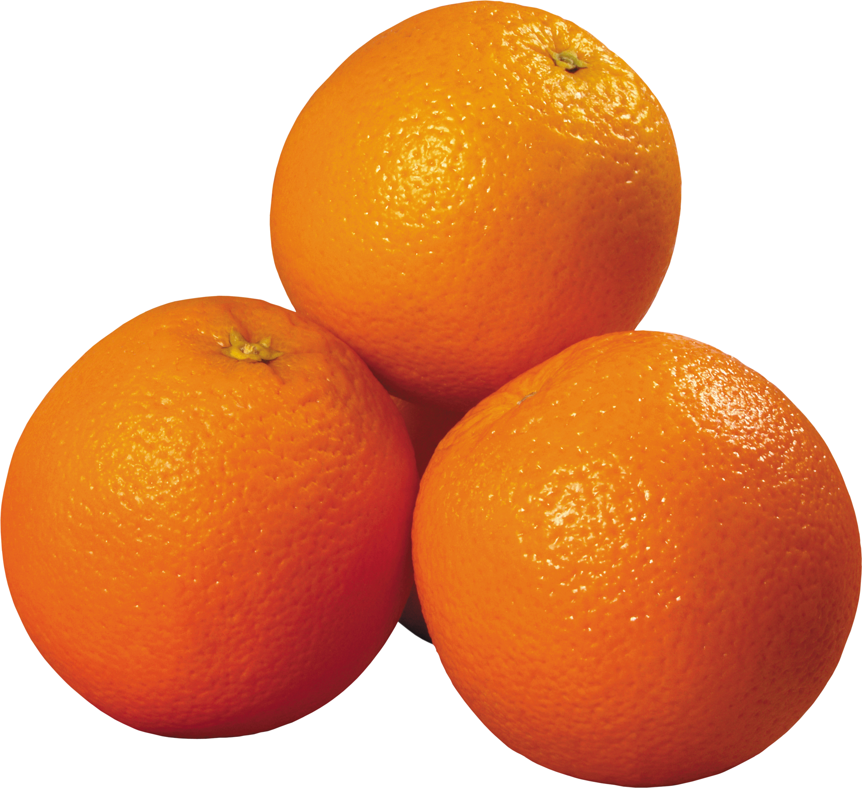
Children, I received a letter yesterday.
Please, help me to read this letter.
I am
I am 11.
I am from
I
I have a friend.

Slide 3
Who is knocking? Oh, this is a box. And what is there in the box? Do you want to know? Listen.

Slide 4
Tell me about yourself
My name is…
I am…

Slide 5
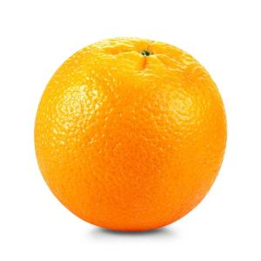
What words do you see? What tense are we going to talk about today?
had
was
went
played
blew
met
saw
flew

Slide 6
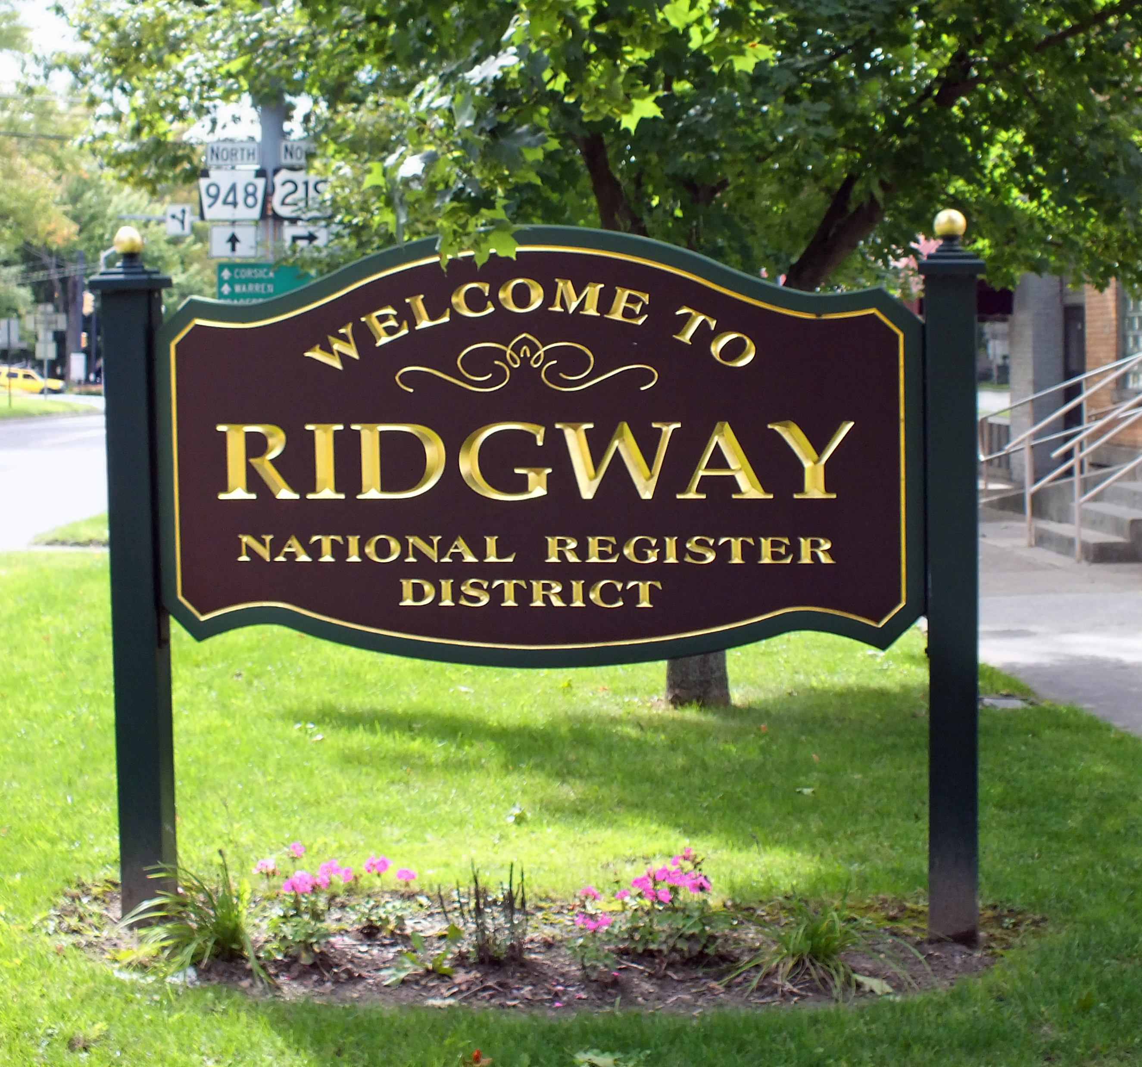
Past Simple Tense

Slide 7
Let’s repeat the words
be-was\were
go-went
have-had
play-played
blow-blew
meet-met
see-saw
fly-flew

Slide 8
What grammar tense we should use?
How do we form this tense?
Verb + ed
V2
We use the past simple to talk about actions at a point of time in the past \ present?
We add –ing \ -ed to verb to make past simple?

Slide 9
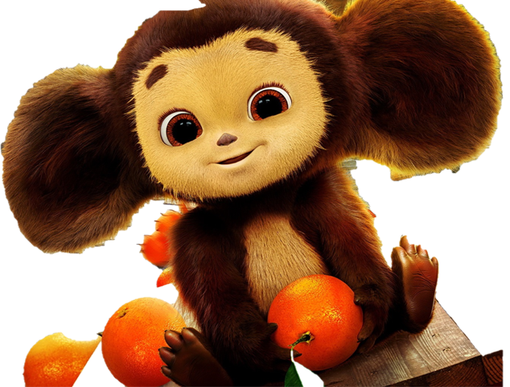
Listening
How did it spend last weekend?
My weekend was…
very good
not very good
very bad
2. On Saturday morning I went to…
school
the shops
the sport club
3. I had lunch …
at home
at school
at the café

Slide 10
4. For lunch I had …
soup
fish
oranges
5. Then I….
a)met my friends
b) went out with my friends
c) helped my friends
6. In the evening I..
watched TV
read a good book
played computer games

Slide 11
7. I ________ like my weekends.
a)usually
b) always
c) sometimes
d) never

Slide 12
PAST SIMPLE QUESTIONS
Did
I
he, she, it
we, you
they
verb
?

Slide 13
Make up the sentences.
https://view.genial.ly/638bf686fcaa15001802cc4f

Slide 14
PAST SIMPLE NEGATIVE
I
he, she, it
we, you
they
didn’t
verb
.

Slide 15
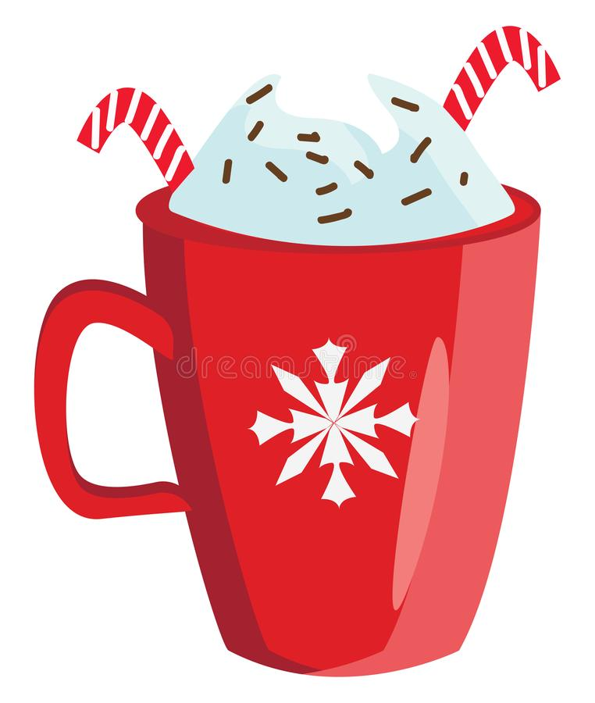
I
read a book
We
go to the cinema
They
get up in the morning
didn’t
Tom
visit his granny
Kate
make breakfast

Slide 16
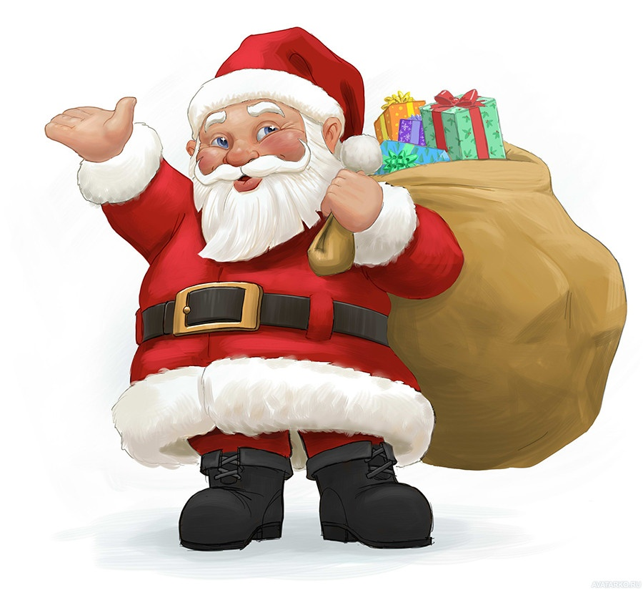
QUIZ.
SANTA’S FRIEND
Let’s solve the quiz. Santa’s friend.
https://view.genial.ly/63df521b36a19a0019e400c4/interactive-content-santas-helpers-quiz

Slide 17
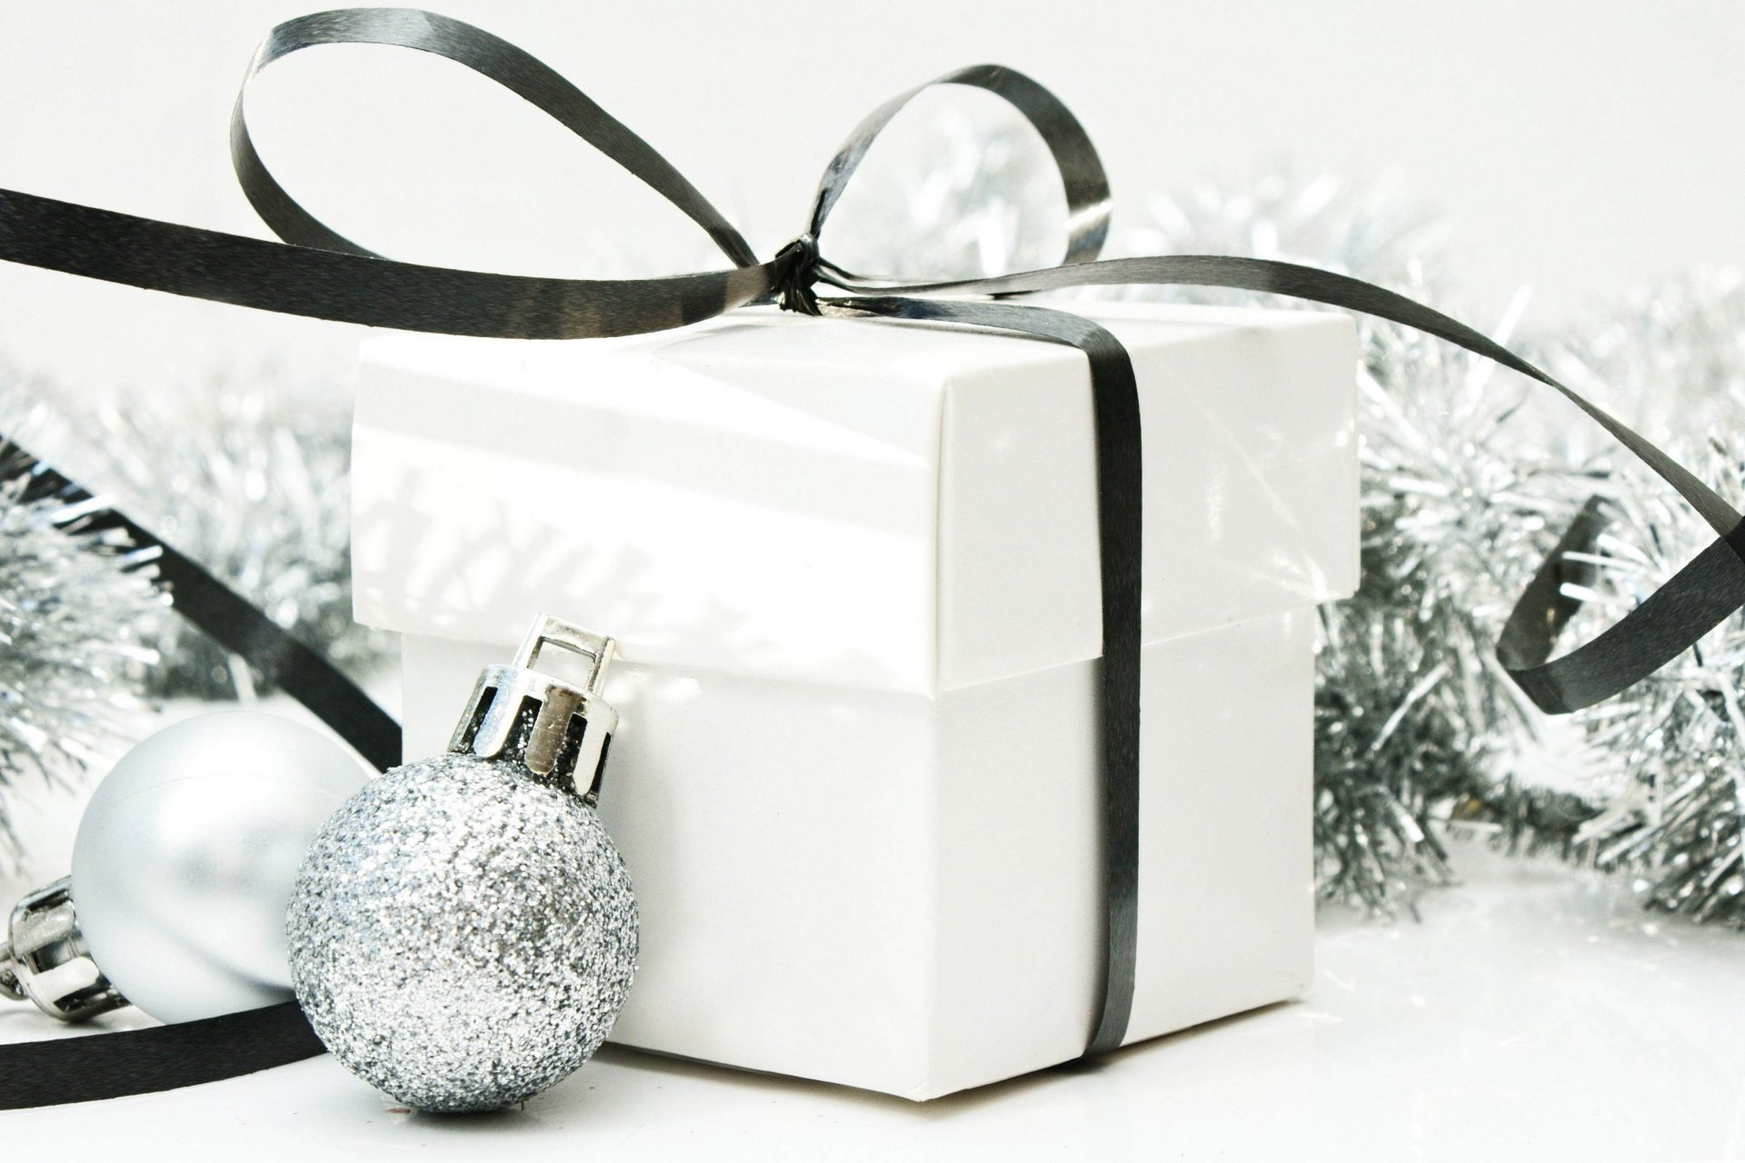
Santa Claus will be able to deliver all the presents in time. He brought some presents for you. Take them.

