Slide 1



Memory of the generations: the 80th anniversary of the Great Victory
Учитель: Афанасьева Ольга Михайловна, ГБОУ Школа № 1558 имени Росалии де Кастро, г. Москва

Slide 2
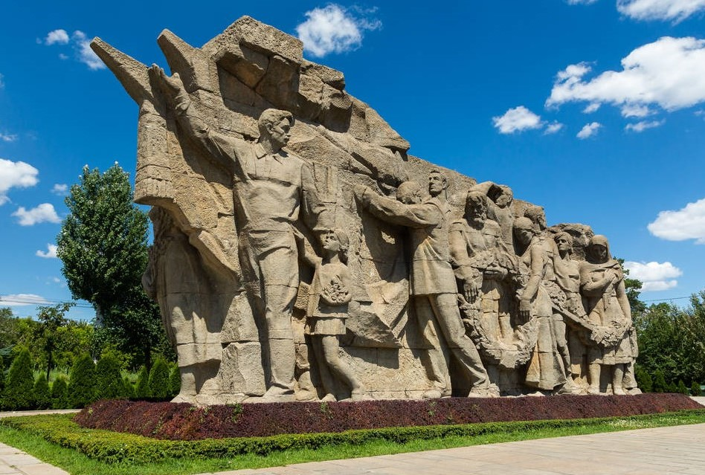
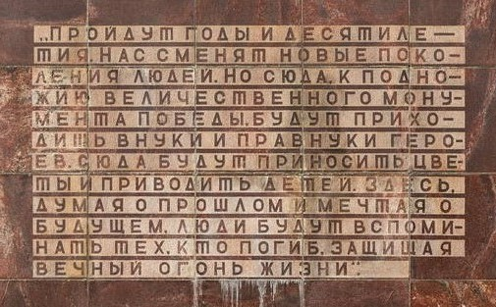

"Memory of the Generations"
"Years and decades will pass. New generations of people will replace us. However, grandchildren and great-grandchildren of the heroes will come here to the foot of the triumph memorial of Victory. They will bring flowers and children. While reflecting on the past and dreaming of the future, people will remember those who lost their lives while defending the eternal fire of life."

Slide 3
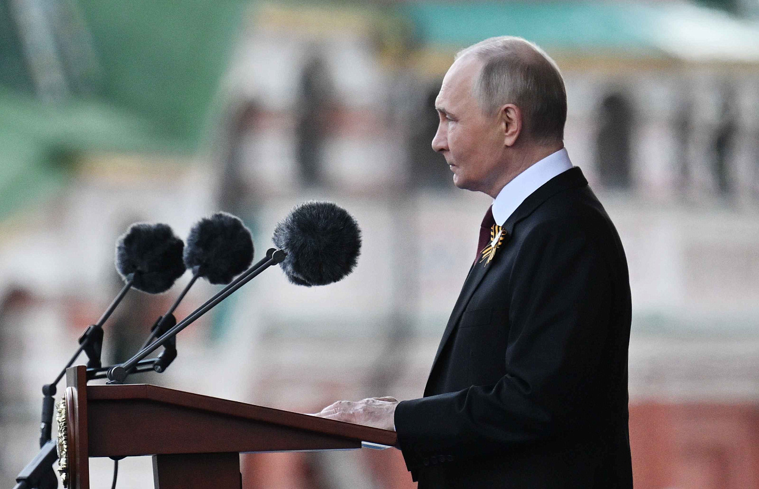
Vladimir Putin’s address at the military parade commemorating the 80th anniversary of the Great Victory
“…Today, we are all joined by feelings of joy and sorrow, pride and gratitude, and admiration for the generation that defeated Nazism and, at the cost of millions of lives, won freedom and peace for all humanity.
We faithfully preserve the memory of these historic and triumphant events. As the heirs of the victors, we celebrate the holiday of May 9 as our own, as the most significant one for the country, for the entire nation, for each family, and for each of us.
Our fathers, grandfathers and great-grandfathers saved the Fatherland. And they entrusted us to defend the Motherland, to remain united and strongly defend our national interests, our thousand-year history, culture and traditional values, and everything else that is dear and sacred to us.
We remember the lessons of World War II, and we will never agree with the distortion of its events or with attempts to justify the executioners and slander the true victors.
Our duty is to defend the honour of the soldiers and commanders of the Red Army, the great feat performed by representatives of different nationalities, who will be remembered as Russian soldiers throughout history.” (Vladimir Putin)

Slide 4
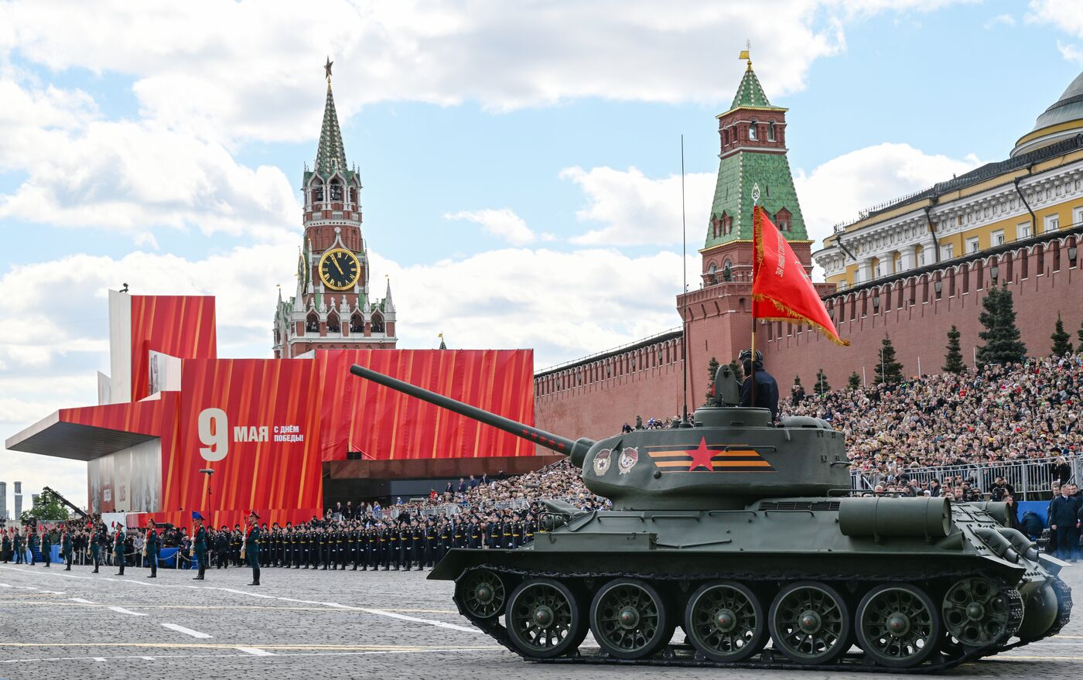
"Without knowing the past, it is impossible to understand the true meaning of the present and the goals of the future.“
A. M. Gorky
Let's Discuss
What does Victory Day mean to you personally?
Do you have any family members who are war veterans?
How do people usually honor war veterans on Victory Day?
How do you and your family celebrate Victory Day?
Have you ever visited any historical sights related to WWII? If so, what sights did you visit?
Why is it important to remember and commemorate historic events like Victory Day?
Do you think younger generations understand the importance of days like Victory Day?
How do we make sure that future generations appreciate their history?

Slide 5
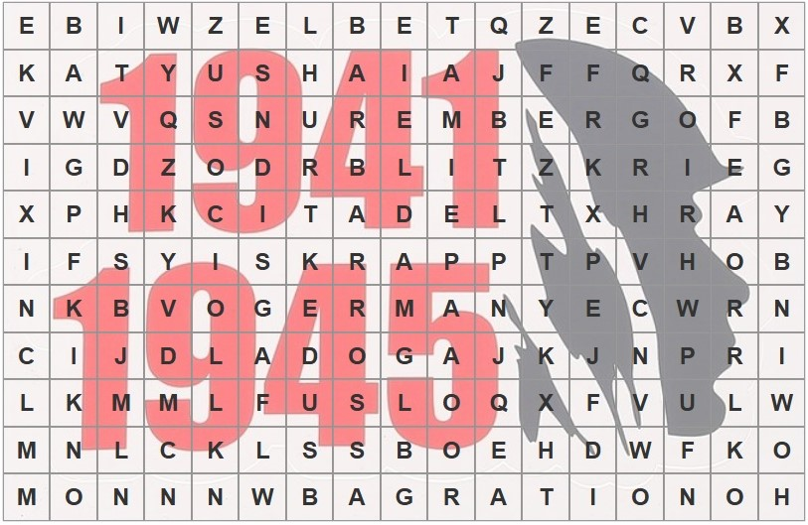
Quiz
The Great Patriotic War
1941-1945
Find the words that refer to the historical events of the Great Patriotic War 1941–1945.
1. the country that declared war on the Soviet Union in 1941
2. the code name of the operation for the Axis invasion of the USSR
3. the lake well-known as "The Road of Life"
4. the city hosted a series of military tribunals against representatives of the defeated Nazi Germany after WWII
5. the river where Soviet and American troops met on April 25, 1945

Slide 6
Quiz
The Great Patriotic War
1941-1945
Find the words that refer to the historical events of the Great Patriotic War 1941–1945.
6. the code name of the German offensive operation in July 1943 against the Soviet forces in Kursk
7. the name of the well-known multiple rocket launcher and song
8. a military tactic called 'Lightning War‘
9. the code name of the Red Army operation for breaking the Leningrad Siege in January 1943
10. the code name of the large-scale Soviet offensive operation against Nazi Germany from June 23 to August 19, 1944 on the Eastern Front

Slide 7
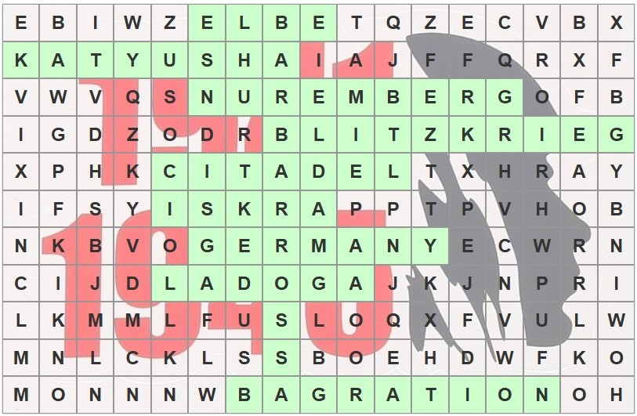
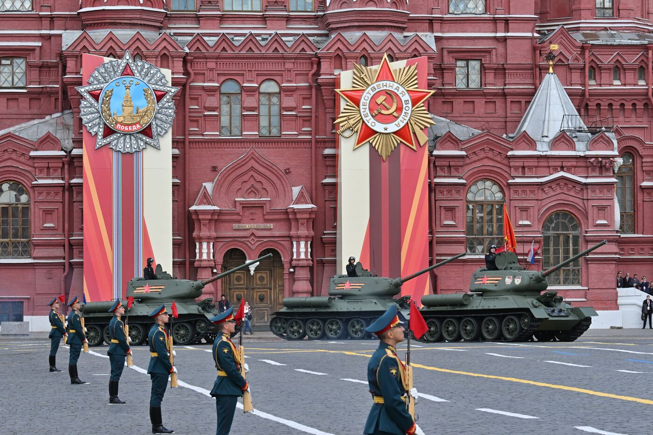
Quiz
The Great Patriotic War
1941-1945

Slide 8

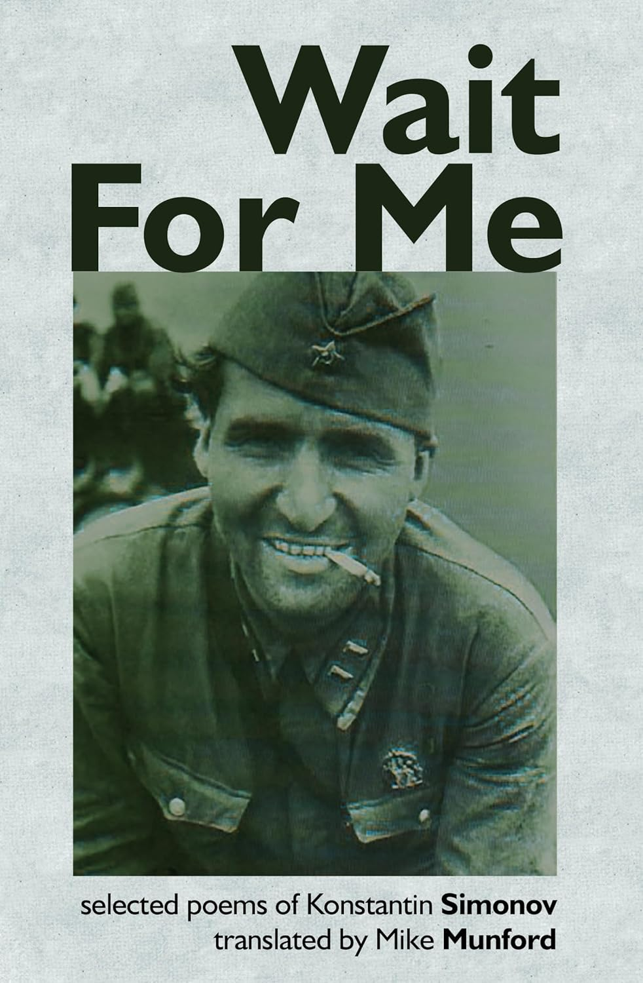
Poem “Wait for me”
Konstantin Simonov
Translated by Mike Munford
Wait for me and I'll come back!
Wait with all your might!
Wait when dreary yellow rains
Tell you nothing's right;
Wait when snow is falling fast;
Wait when summer's hot;
When no one waits for other men
And all the past's forgot!
Wait when those that wait with you
Are bored and tired and glum,
And when it seems, from far away,
No letters ever come!
Wait for me and I'll come back!
Wait in patience yet
When they tell you off by heart
That you should forget;
And when my mother and my son
Give up on me at last
And friends sit sadly round the fire
And talk about the past
And drink a bitter glass of wine
In memory of me –
Wait! No rush to drink with them!
Tell them to wait and see!
Wait for me and I'll come back,
Escaping every fate!
‘Just a lot of luck!’ they'll say,
Those that didn't wait.
They will never understand
How, amidst the strife,
By your waiting for me, dear,
You had saved my life!
Only you and I will know
How you got me through!
Simply – you knew how to wait!
No one else but you!

Slide 9
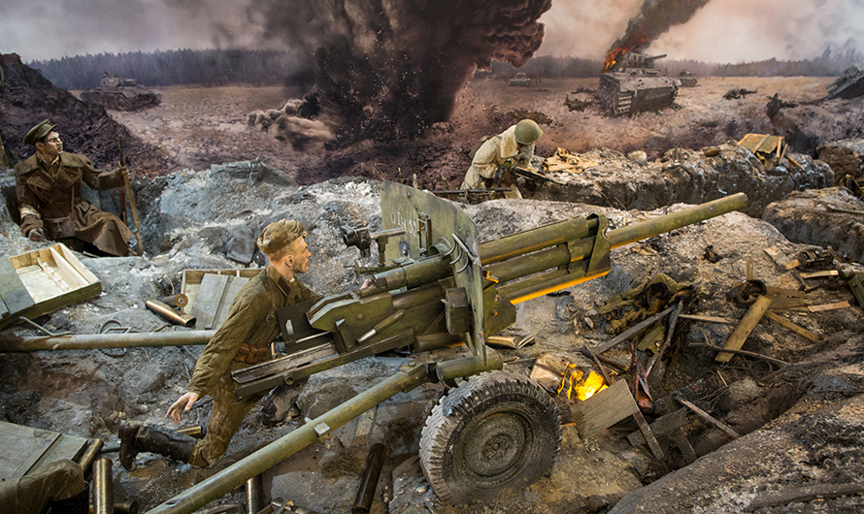
The Battle of Moscow
The Battle of Moscow took place on the Eastern Front against the forces of Nazi Germany during World War II. It lasted from October 1941 to January 1942. The battle included a defensive period, from 30 September to 5 December 1941, and the offensive period. The latter consisted of the counteroffensive from 6 December 1941 to 7 January 1942 and the all-out Soviet offensive, which took place from 8 January to 20 April 1942.
Adolf Hitler believed that the German Army could capture Moscow within three or four months. For Hitler, Moscow was the most important military and political target, as he anticipated that the city's surrender would shortly afterwards lead to the general collapse of the Soviet Union.
However, the original blitzkrieg invasion plan, which the Germans called “Operation Barbarossa,” failed. The advance of Hitler’s troops was slowed by Soviet defenders at the Battle of Smolensk, which lasted from July until September 1941. It delayed the German offensive towards Moscow for two months. Later, a new battle took place. In the Nazi generals’ view, it was only the bad weather that stopped the Mozhaisk defensive line from being taken quickly.
By early December, the lead German Panzer Groups stood less than 30 kilometres from the Kremlin, and Wehrmacht officers were able to see some of Moscow's buildings with binoculars, but the German forces were unable to make further advances.

Slide 10
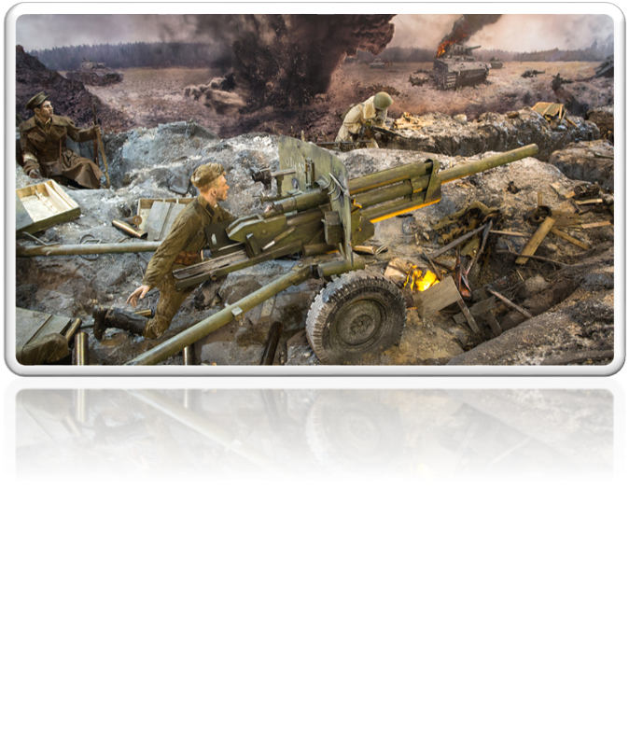
The Battle of Moscow
On 5 December, 1941, Soviet troops attacked the German forces outside Moscow, and by January 1942, the Wehrmacht had been driven back 100 to 250 kilometres, ending the threat to Moscow.
The Soviet military commander Georgy Konstantinovich Zhukov, who took charge of Moscow's defence, wrote, “Nazis did not expect Soviet resistance to be so strong. The deeper they moved into the country's territory, the more fierce it became. When Hitler's armies approached Moscow, every man and woman here thought it was imperative to resist the enemy. And that resistance grew day by day. The enemy was sustaining heavy losses, one after another. In fact, Hitler's best troops perished here. Nazis believed the Red Army was not capable of defending Moscow, but their plans failed.”
Military historians firmly believe that the Battle of Moscow marked a turning point in the war, as it was the first time since the Wehrmacht began its conquests in 1939 that it had been forced into a major retreat.
“The whole world was excited by the unexpected turn of events. Foreign newspapers were in complete perplexity. The “invincible” German army, which was constantly attacking, finally reached almost the very gates of Moscow and suddenly ran back. Foreign newspapers could not explain it and wrote about the “miracle near Moscow,” reported Evgeny Aleksandrovich Shilovsky in his book “The defeat of the German troops near Moscow”.

Slide 11
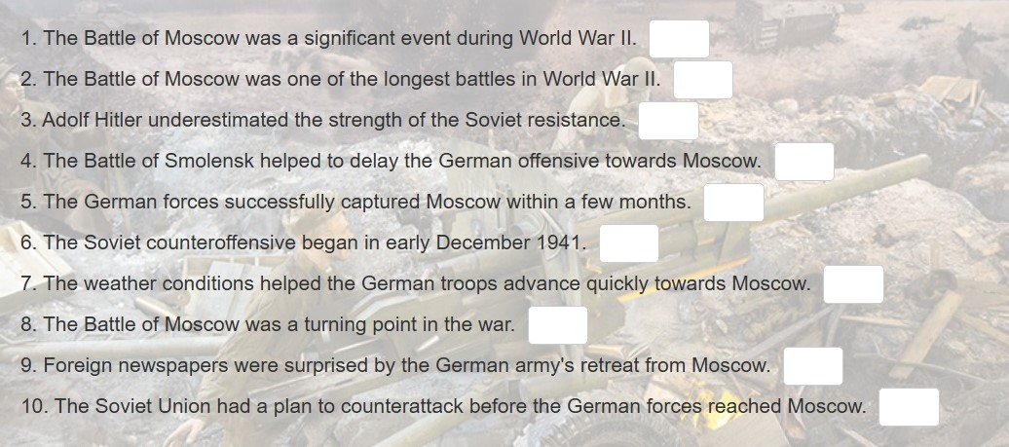

The Battle of Moscow
Read the text “The Battle of Moscow" and mark the statements as TRUE, FALSE, or NOT STATED.

Slide 12
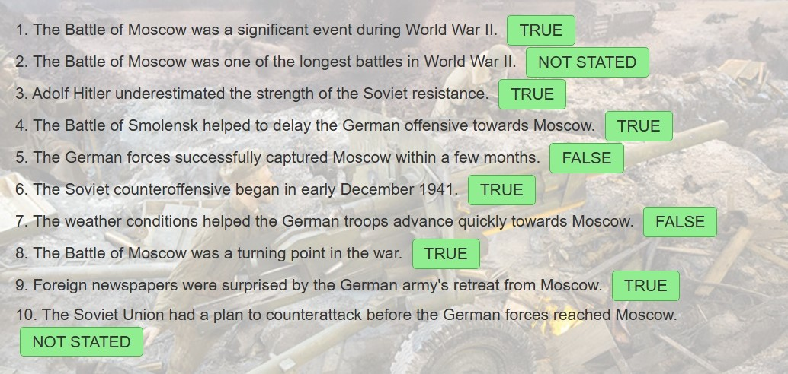
The Battle of Moscow
Read the text "Battle of Moscow" and mark the statements as TRUE, FALSE, or NOT STATED.

Slide 13
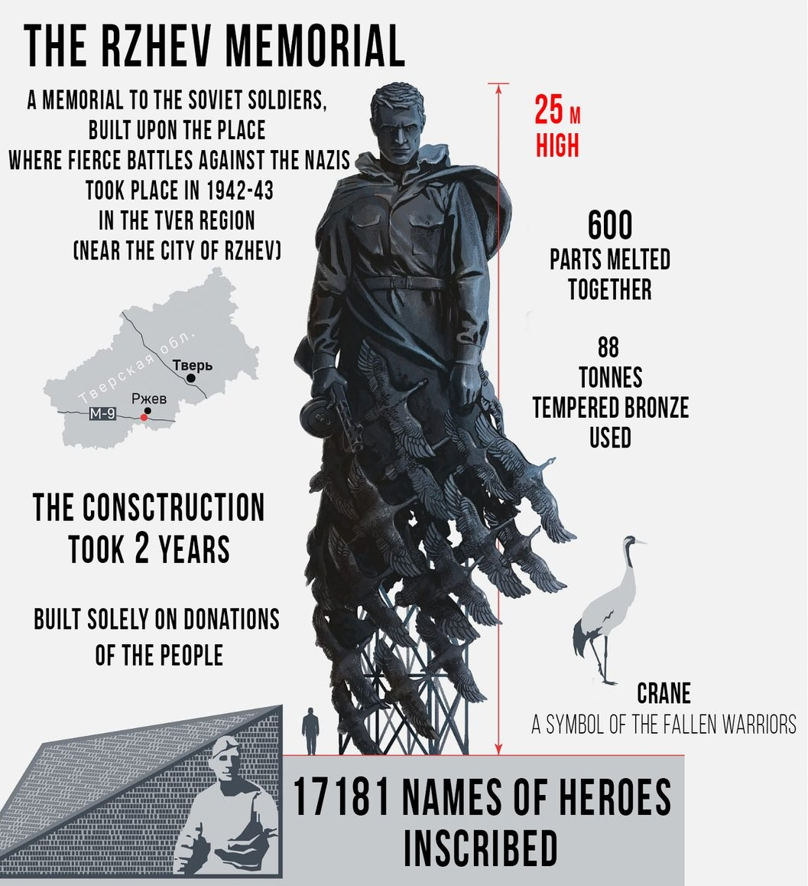
Rzhev Memorial to the Soviet Soldier
Read the information in the poster and answer the questions.
1. How high is the statue of the Soviet soldier?
2. What material is the statue of the Soviet soldier made of?
3. How many names of soldiers who died in the Battle of Rzhev are listed on the panels?
4. How many pieces does the statue consist of?
5. How long did it take to erect the statue?
6. What does a flock of cranes symbolize?

Slide 14
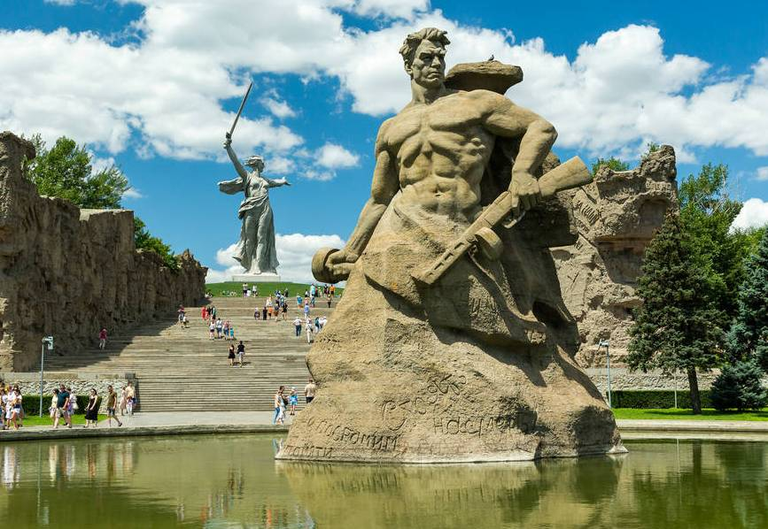
Memorial complexes
Let's Discuss
Memorial complexes hold significant importance by serving as communal spaces for remembrance, fostering empathy and reflection, and educating future generations about the past. They provide a tangible way to honor individuals, events, or movements, offering a place for grief, healing, and shared understanding. Furthermore, they act as cultural hubs, preserving history and ensuring the legacy of those commemorated for generations to come.
How important is it to remember historical events like wars through memorials?
Can you name any specific memorials built after World War II to honour those who fought or died during this conflict?
Are digital memorials effective compared to traditional stone/brick memorials?
Which memorial(s) related to World War II have you visited personally? What did you feel there?

Slide 15
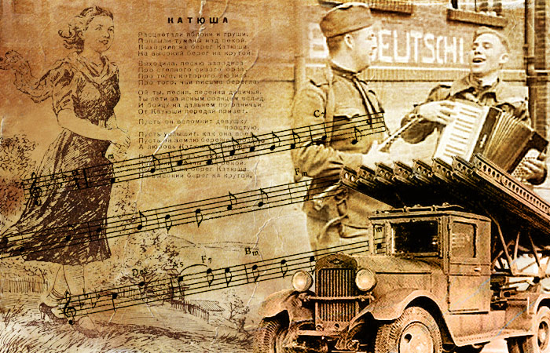
Song “Katyusha” lyrics: Matvey Isakovsky music: Mikhail Blanter translation: Vyacheslav Chistyakov
All the apple and pear trees are in blossom,
Morning fogs along the river creep,
And the girl, Katyusha, young and lovesome,
Comes the river bank that’s high and steep.
She walks out and starts a song about
Her brave boy - a steppe dove-colored eagle,
How she waits for him, without doubt
To his letters glad she's been and will.
Let you, song, according to her order
Fly to heights, and follow the Earth,
To the soldier at the country’s border
From Katyusha bring the greeting warmth.
Let him hear the song true and sincere,
By the honest girl sent as a dove.
Let him keep safe earth beloved, dear,
And Katyusha will take care of love.

Slide 16
Song “Katyusha”
Let's Discuss
"Katyusha" is a wartime song composed in 1938 by Matvey Blanter with lyrics written by Mikhail Isakovsky. It gained popularity during the Great Patriotic War as an inspiration to defend Motherland from the enemy. This wonderful song represented hope, love, and faith for the safe return of Russian soldiers battling against fascist invaders.
Have you ever listened to a wartime song?
What emotions do you think music can evoke during difficult times like war?
Do you believe that music can help maintain hope and morale among soldiers?
Why do you think some songs become symbols of resilience and strength?
How can music be used to remember and honour those who have fought in wars?

Slide 17
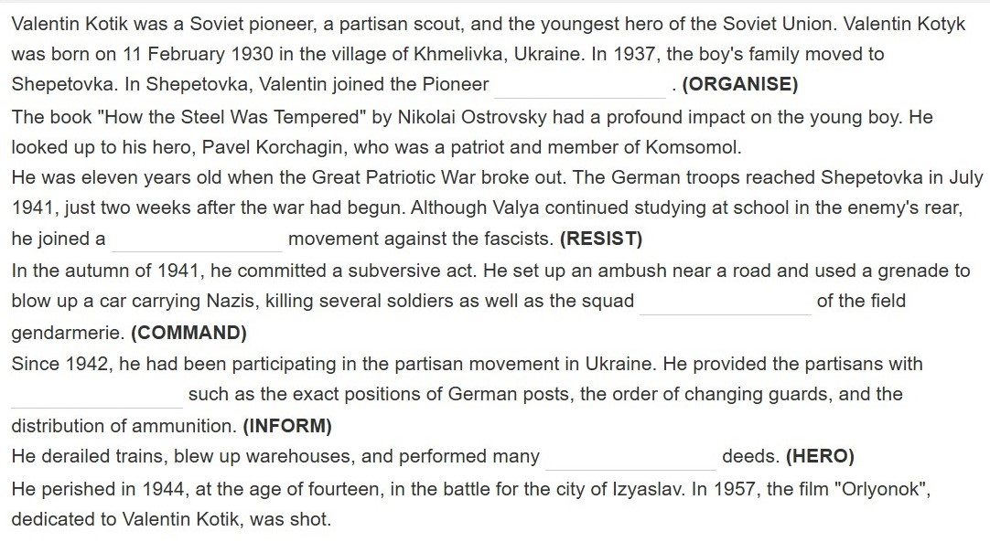
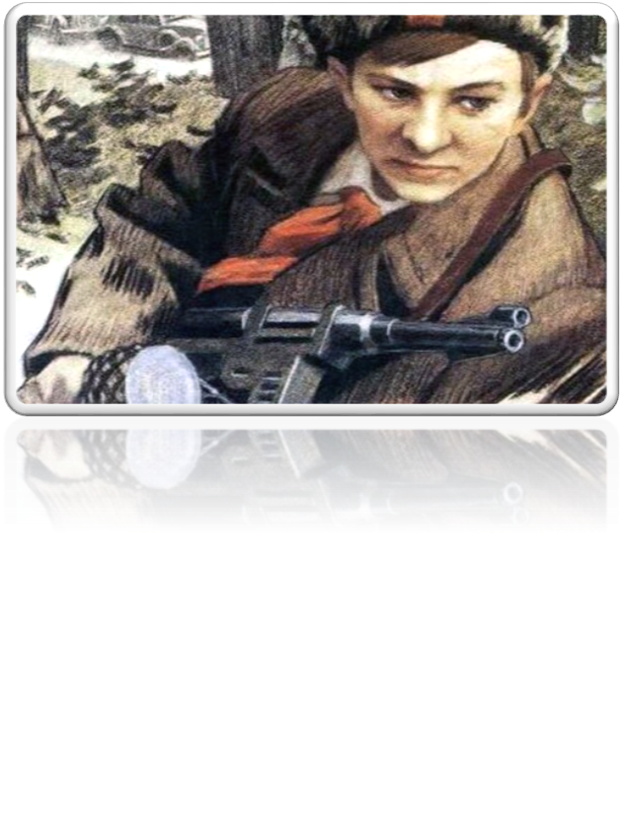
Young Heroes of the Great Patriotic War
Valentin (Valya) Kotik
Read the text and fill in the gaps transforming the capitalized words.

Slide 18
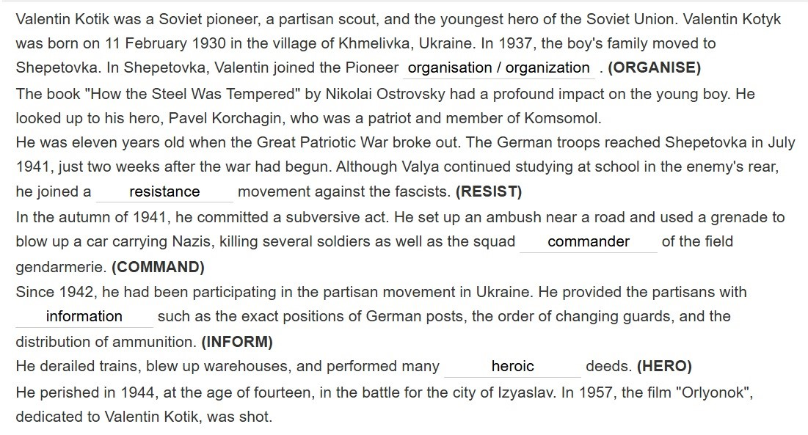
Young Heroes of the Great Patriotic War
Valentin (Valya) Kotik

Slide 19
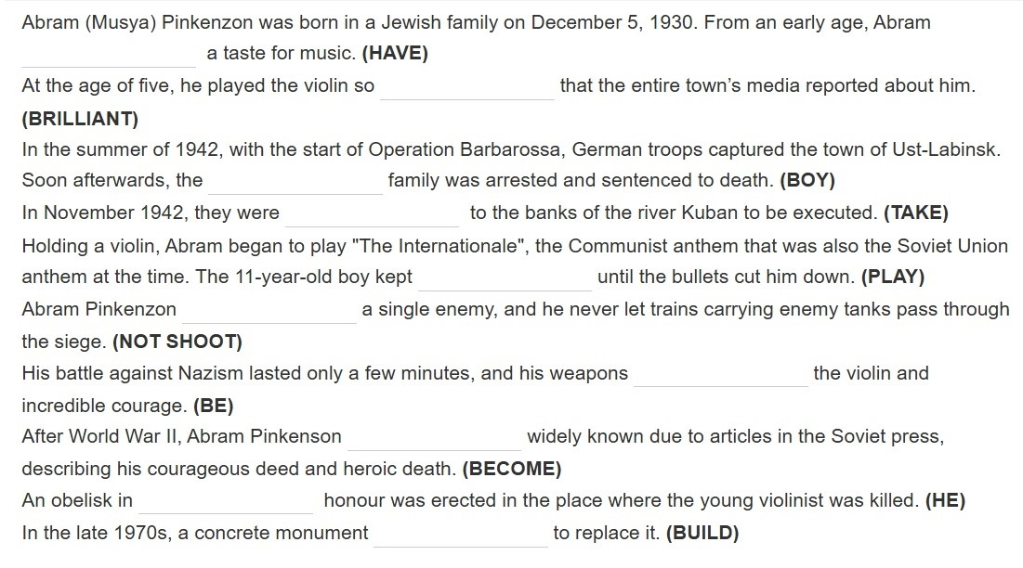
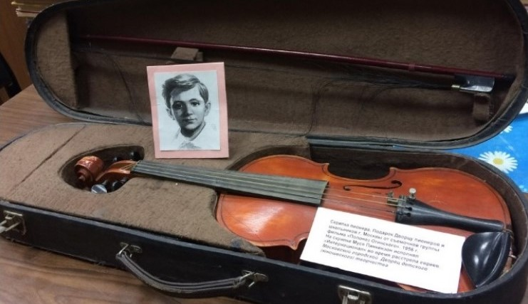
Young Heroes of the Great Patriotic War
Abram (Musya) Pinkenzon
Read the text and fill in the gaps
with the proper grammatical form of the capitalized words.

Slide 20
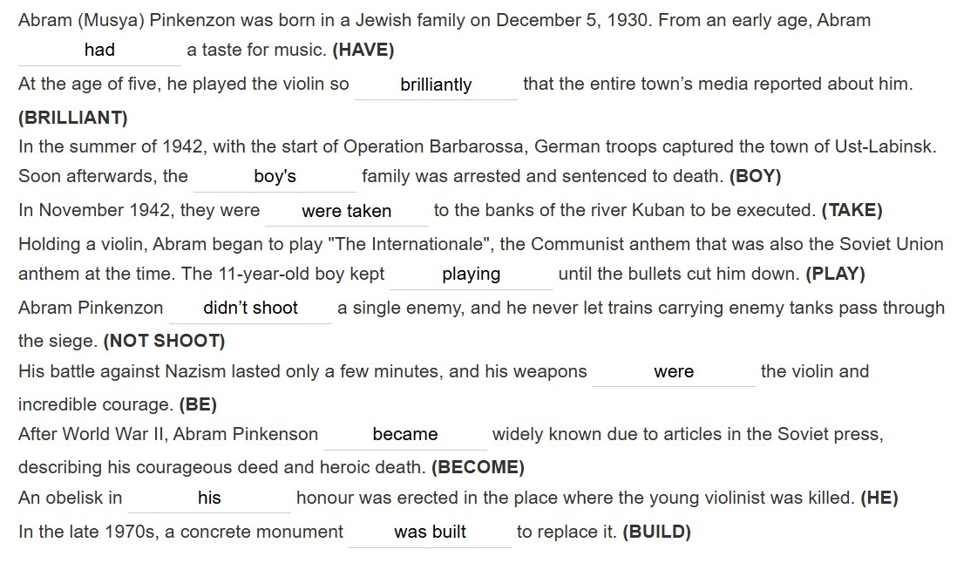

Young Heroes of the Great Patriotic War
Abram (Musya) Pinkenzon

Slide 21
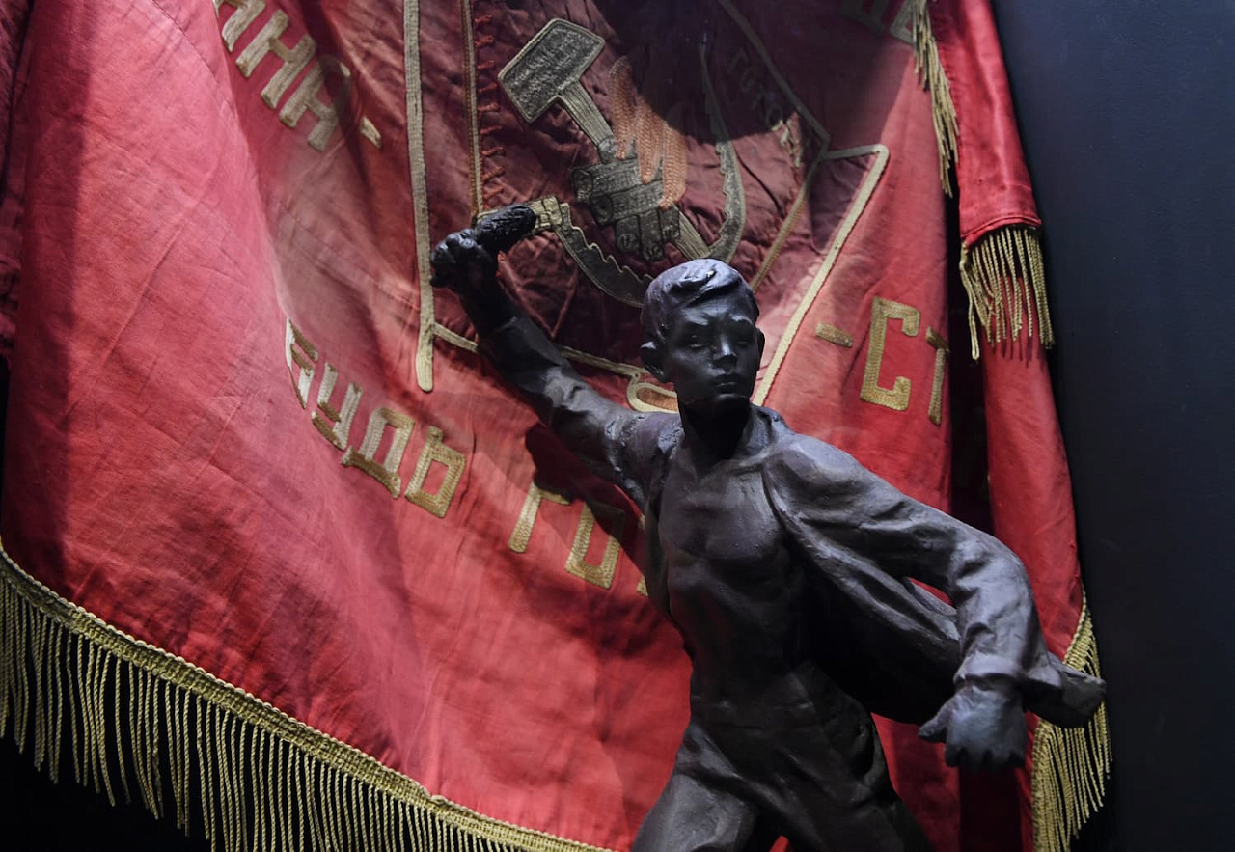

Young Heroes of the Great Patriotic War
Let's Discuss
How important is it for children to learn about history and the sacrifices made by others?
Have you ever looked up to someone as a hero? Who were they and why did you admire them?
In your opinion, what qualities make someone a hero?
How can stories of bravery during difficult times inspire future generations?
How do you feel when you hear about acts of courage from young people in history?
How can films and books help us understand historical events better?

Slide 22

Young Heroes of the Great Patriotic War
Project
Work in teams of three to four people. Find information about one or more child heroes of the Great Patriotic War. Use reliable sources like history textbooks or library resources. Prepare a short presentation (about 5 minutes).
Focus on
Background : Who were they, and how did they live before the war?
Key actions: What were their most significant contributions during the war?
Challenges: What difficulties did they have to overcome, and how did they do it?
Impact: Did they receive recognition for their contributions, and what impact does their story have on understanding the lives of children in wartime?
Each member of the group should be in charge of one part of the presentation. Use visual aids (slides, posters or infographics) to emphasise important information.

Slide 23

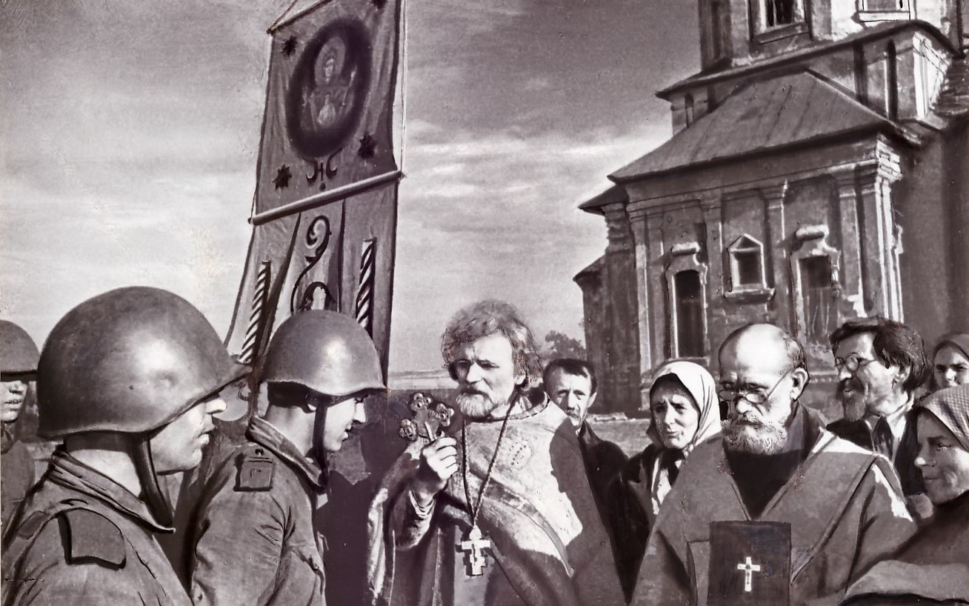
Russian Orthodox Church
1941-1945
The Russian Orthodox Church made a significant contribution to the 1) _______ of Hitler's Germany.
Sergius, the Patriarch of Moscow and Kolomna and a real Russian 2) _______, called upon all religious believers to unite in their 3) _________ against Nazi Germany. Inspired by his words, people raised more than 300 million roubles, and the Dmitry Donskoy tank 4) _________ was formed using money donated by the Church.
Apart from money, religious believers 5) ________ warm clothes for soldiers. In the occupied territories, priests helped the 6) ________; they sheltered people from the oppression of the Nazi 7) _______, and in their sermons expressed their strong belief in the eventual 8) _________of the Soviet Army.
In 1944, several deans of Moscow churches were 9) ________ the 10) _________ of Moscow medal.
Read the text and fill in the gaps (1-10) with the appropriate words.
awarded /collected /defeat /defence /division fight /invaders /partisans /patriot / victory

Slide 24
Russian Orthodox Church
1941-1945
The Russian Orthodox Church made a significant contribution to the 1) defeat of Hitler's Germany.
Sergius, the Patriarch of Moscow and Kolomna and a real Russian 2) patriot, called upon all religious believers to unite in their 3) fight against Nazi Germany. Inspired by his words, people raised more than 300 million roubles, and the Dmitry Donskoy tank 4) division was formed using money donated by the Church.
Apart from money, religious believers 5) collected warm clothes for soldiers. In the occupied territories, priests helped the 6) partisans; they sheltered people from the oppression of the Nazi 7) invaders, and in their sermons expressed their strong belief in the eventual 8) victory of the Soviet Army.
In 1944, several deans of Moscow churches were 9) awarded the 10) Defence of Moscow medal.

Slide 25
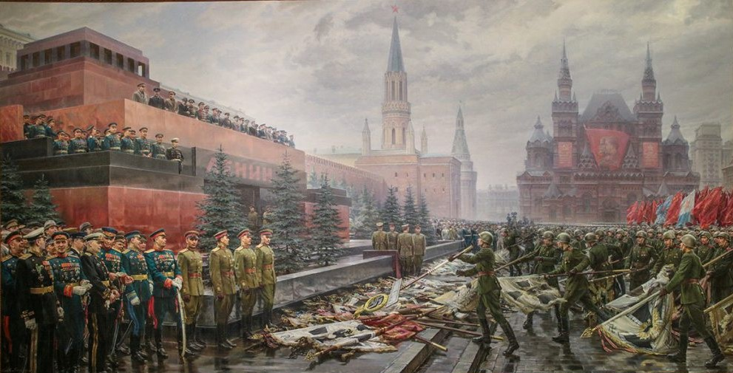
Victory Parade 1945
The first parade commemorating the victory over Germany in the Great Patriotic War was held in Red Square at 10:00 a.m. on June 24, 1945. The procession took place a month after 9 May, the day Nazi Germany surrendered.
The procession was commanded by Marshals of the Soviet Union Georgy Zhukov and Konstantin Rokossovsky. They rode black and white horses around the parade ground.
The historic Victory parade lasted two hours. It was the longest and largest military parade ever held in Red Square, with 40,000 Red Army soldiers, 1,850 military vehicles, and other military equipment.
Twelve combined regiments were formed to take part in the parade. The combined regiments of the Soviet Army and the Navy, including the Heroes of the Soviet Union and Cavaliers of the Order of Glory, marched across Red Square. The commanders of fronts and armies marched in front of the regiments.
At the end of the parade, a column of soldiers marched solemnly, carrying 200 lowered banners of the defeated enemy’s troops. The banners were dropped on the ground near Lenin’s Mausoleum to symbolize a complete enemy capitulation. The soldiers carrying them wore gloves to demonstrate their hate for Nazi Germany.
The Victory parade included not just people but also bomb-sniffing dogs. Dzhulbars, a shepherd dog, successfully detected 7,500 mines and 150 bomb shells. The dog was awarded the "For Battle Merit" medal.

Slide 26
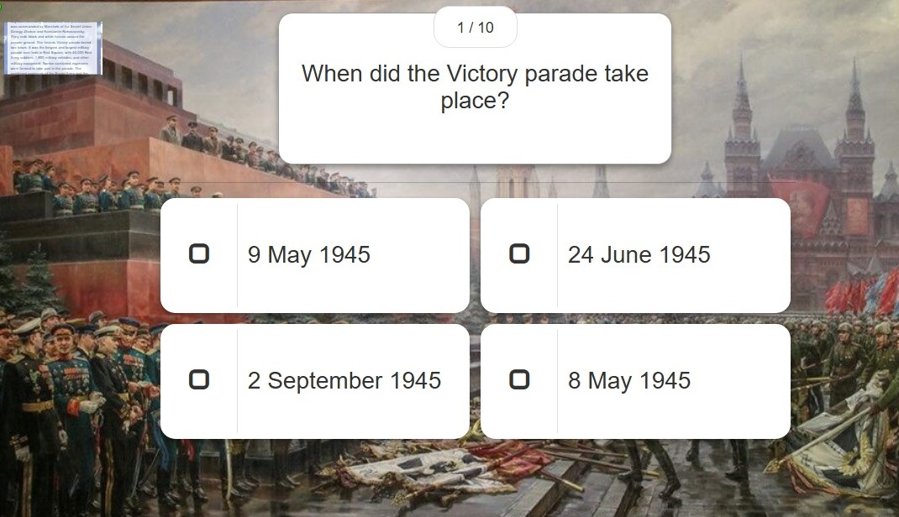
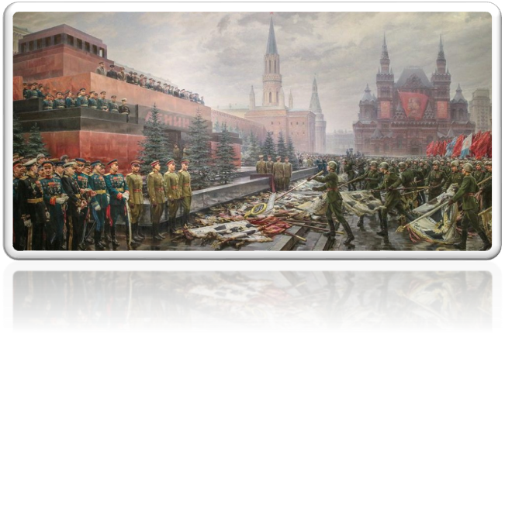
Victory Parade 1945

Slide 27
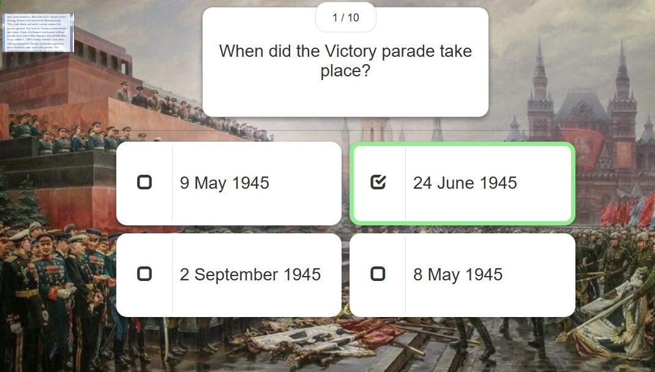
Victory Parade 1945

Slide 28
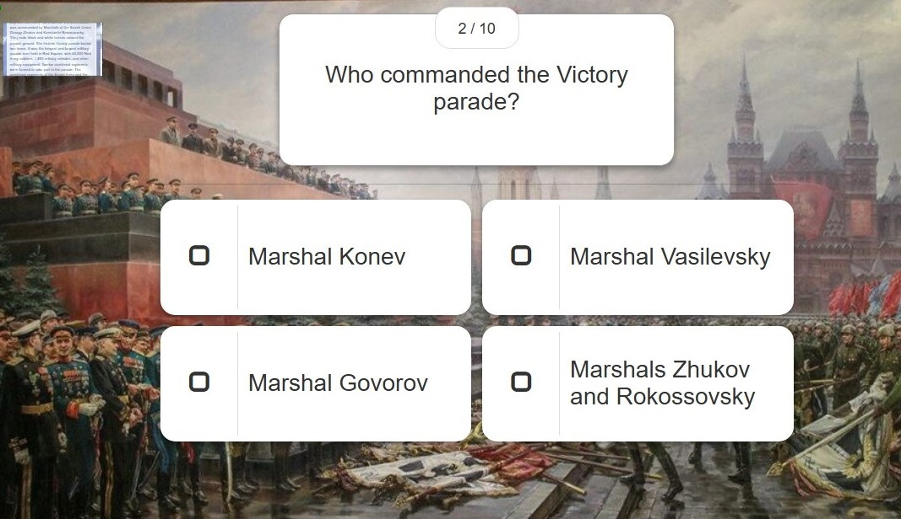
Victory Parade 1945

Slide 29
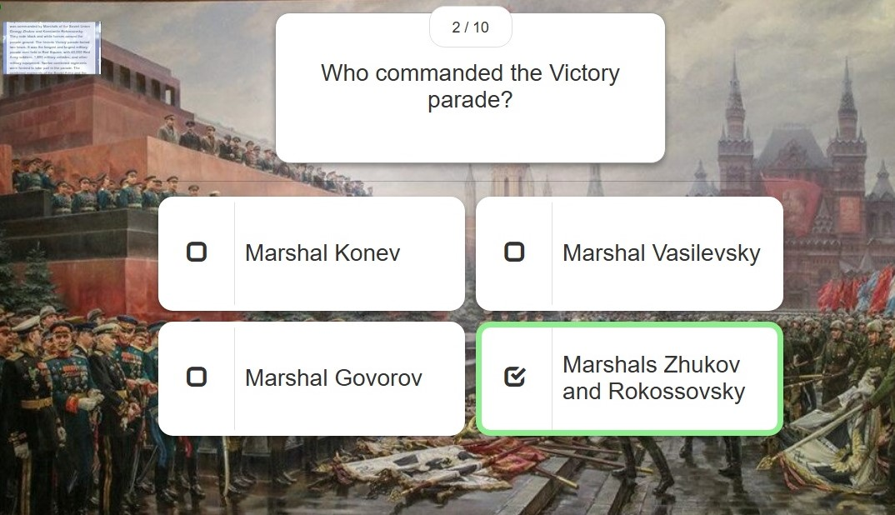
Victory Parade 1945

Slide 30
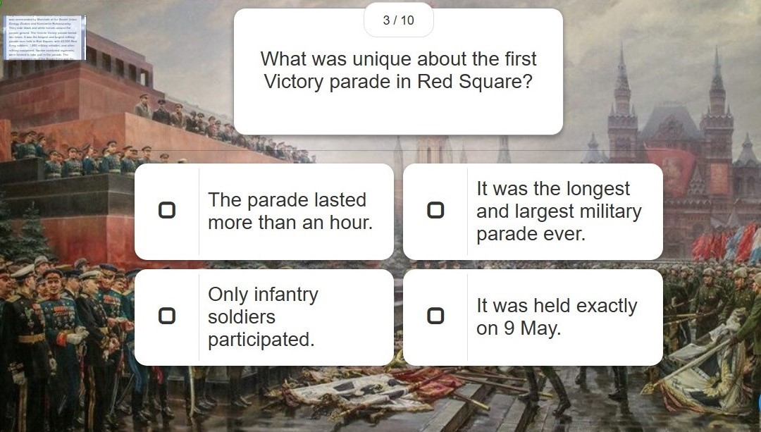
Victory Parade 1945

Slide 31
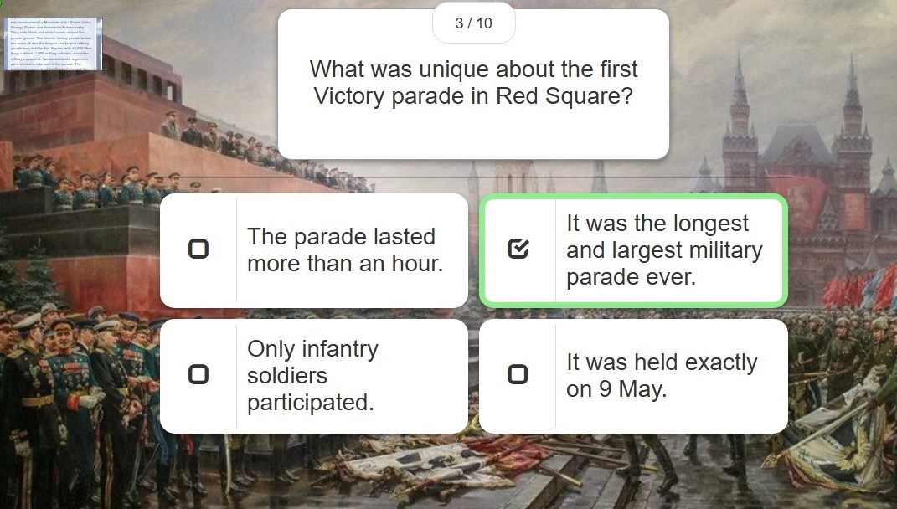
Victory Parade 1945

Slide 32
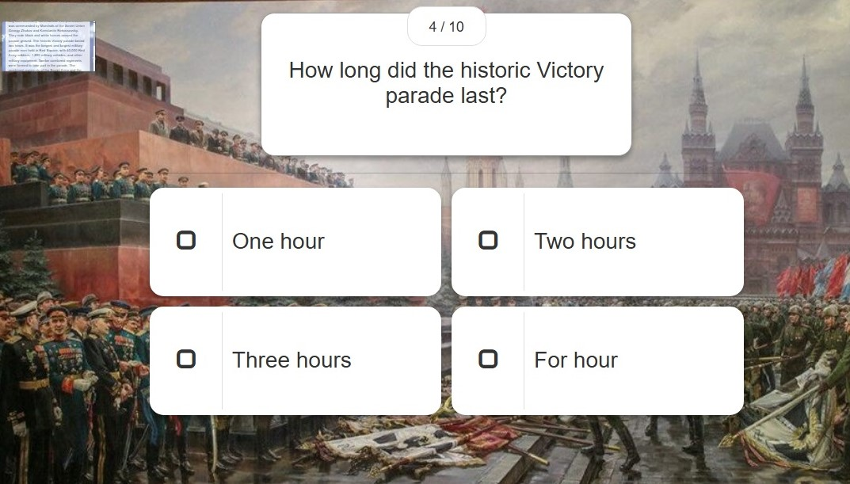
Victory Parade 1945

Slide 33
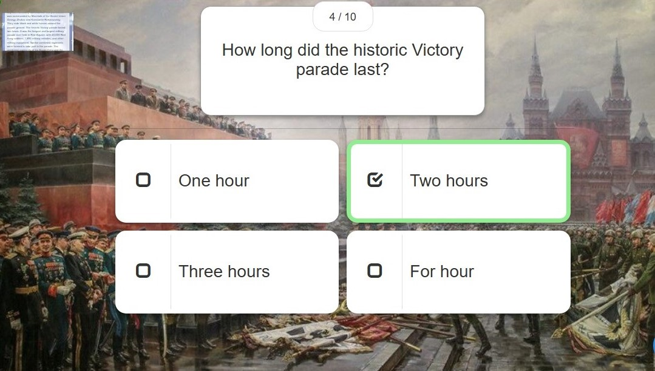
Victory Parade 1945

Slide 34
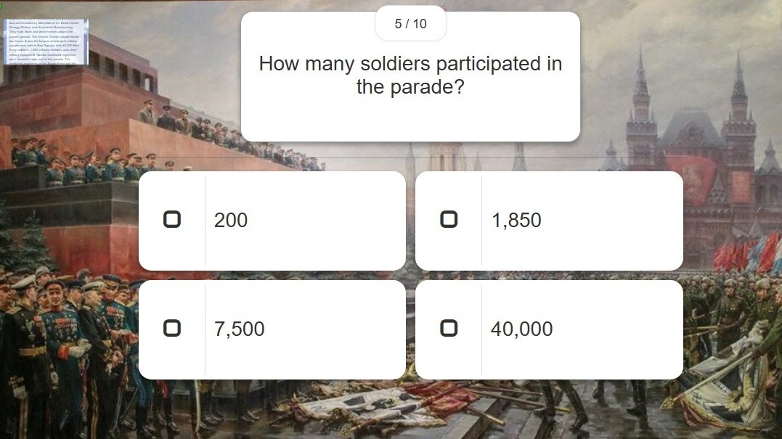
Victory Parade 1945

Slide 35
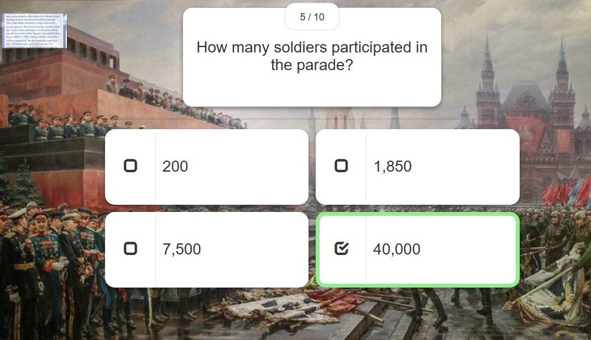
Victory Parade 1945

Slide 36
Victory Parade 1945

Slide 37
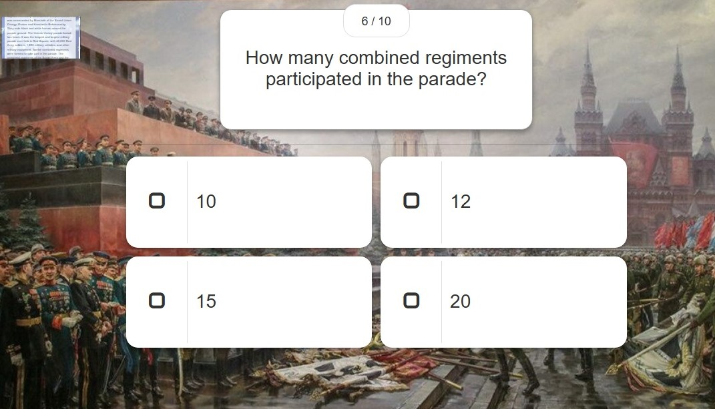
Victory Parade 1945

Slide 38
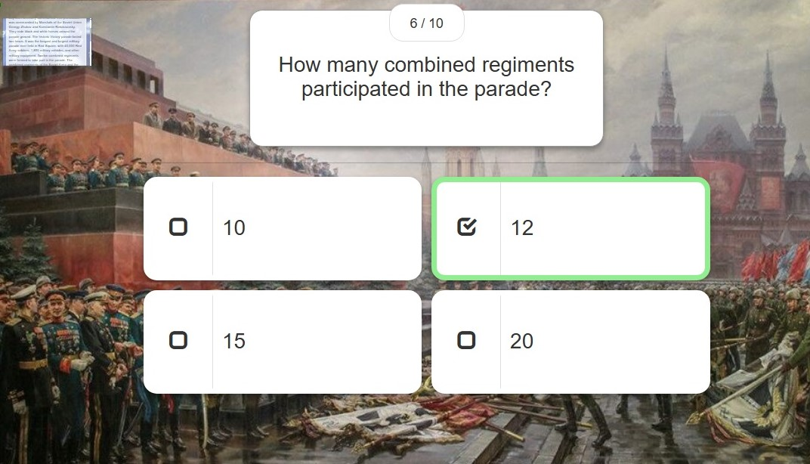
Victory Parade 1945

Slide 39
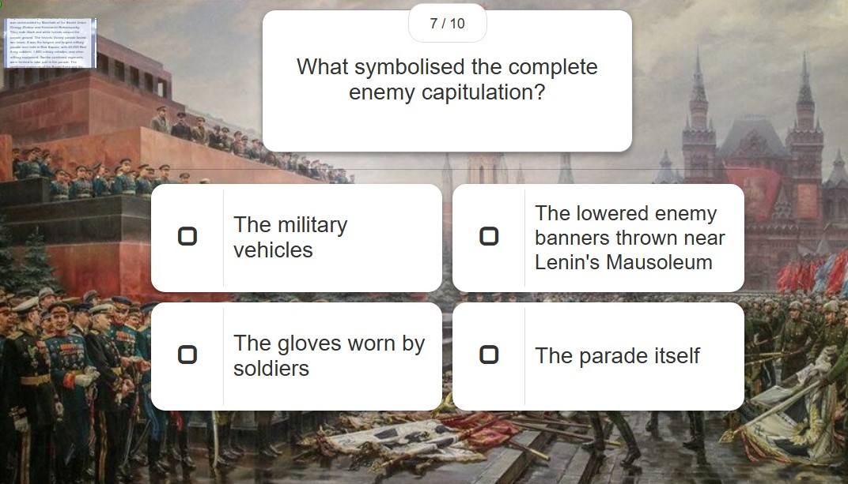
Victory Parade 1945

Slide 40
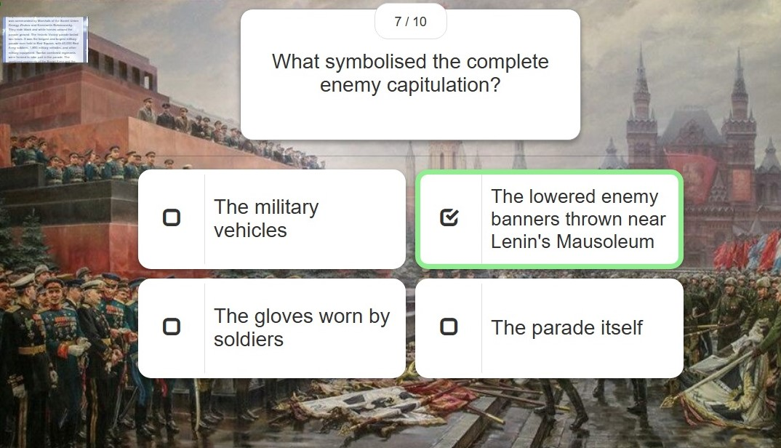
Victory Parade 1945

Slide 41
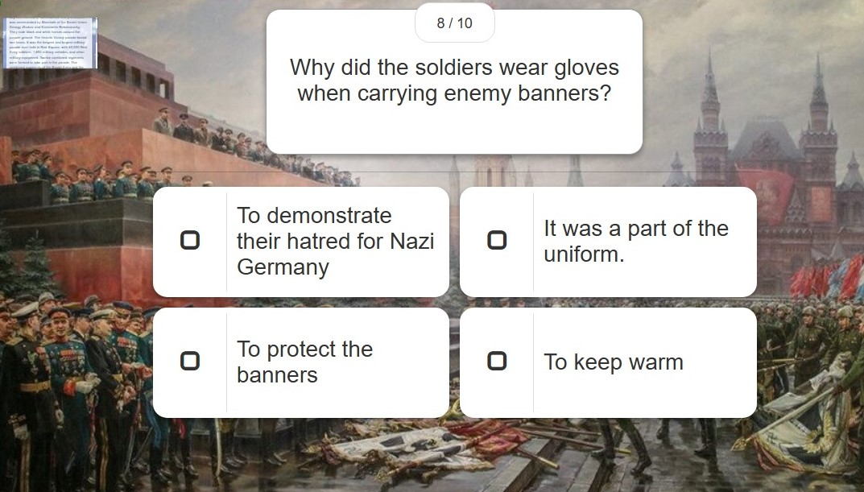
Victory Parade 1945

Slide 42
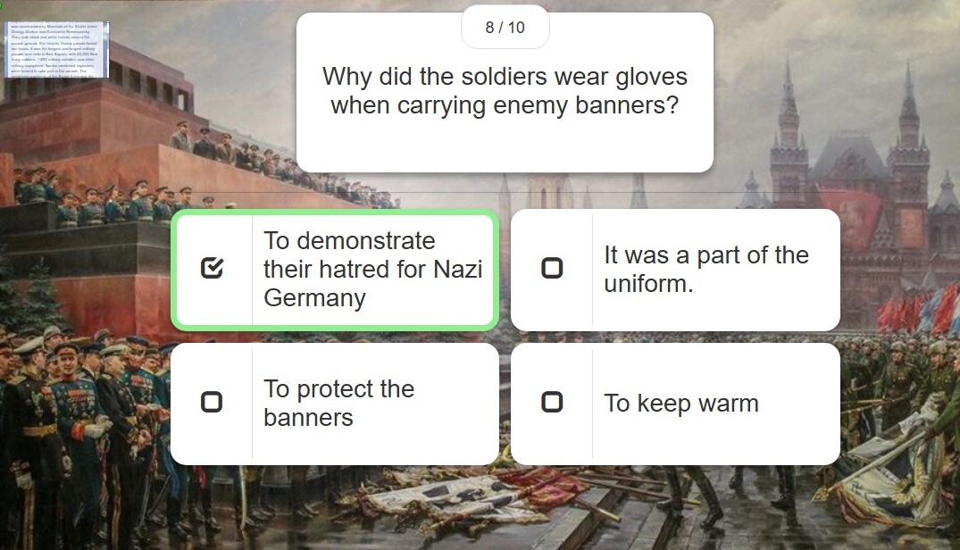
Victory Parade 1945

Slide 43
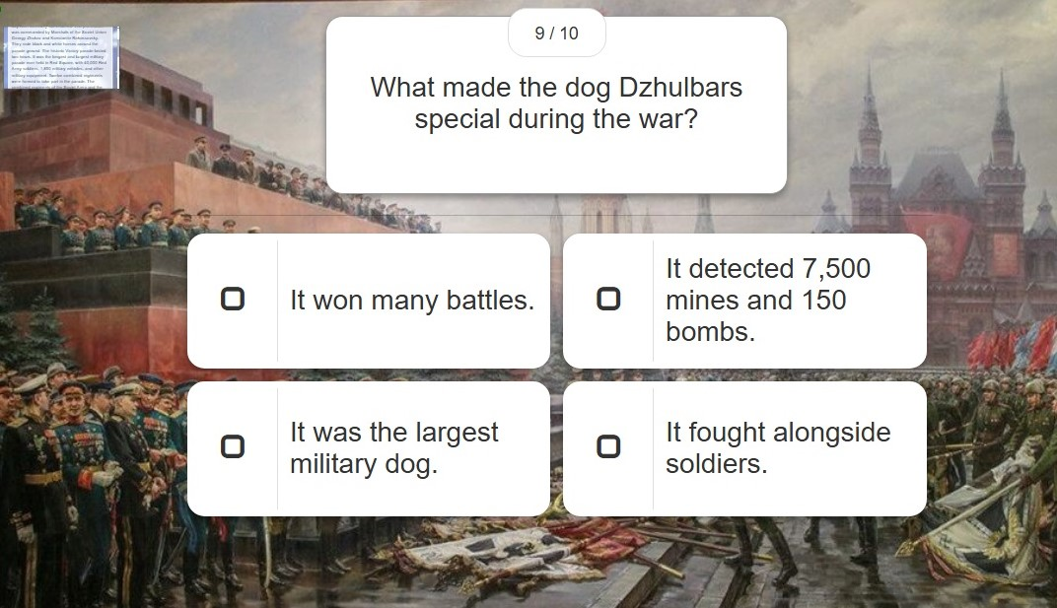
Victory Parade 1945

Slide 44
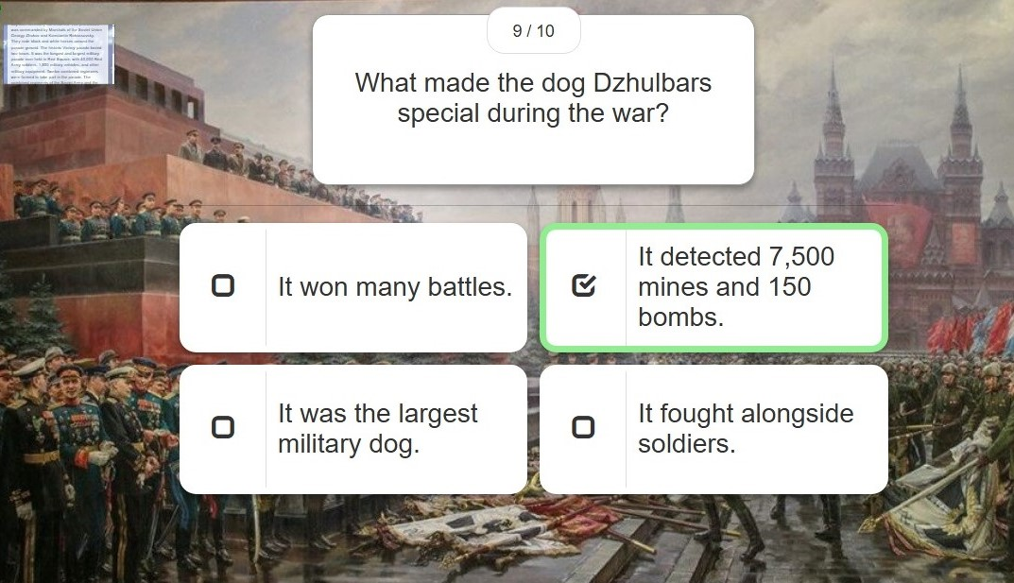
Victory Parade 1945

Slide 45
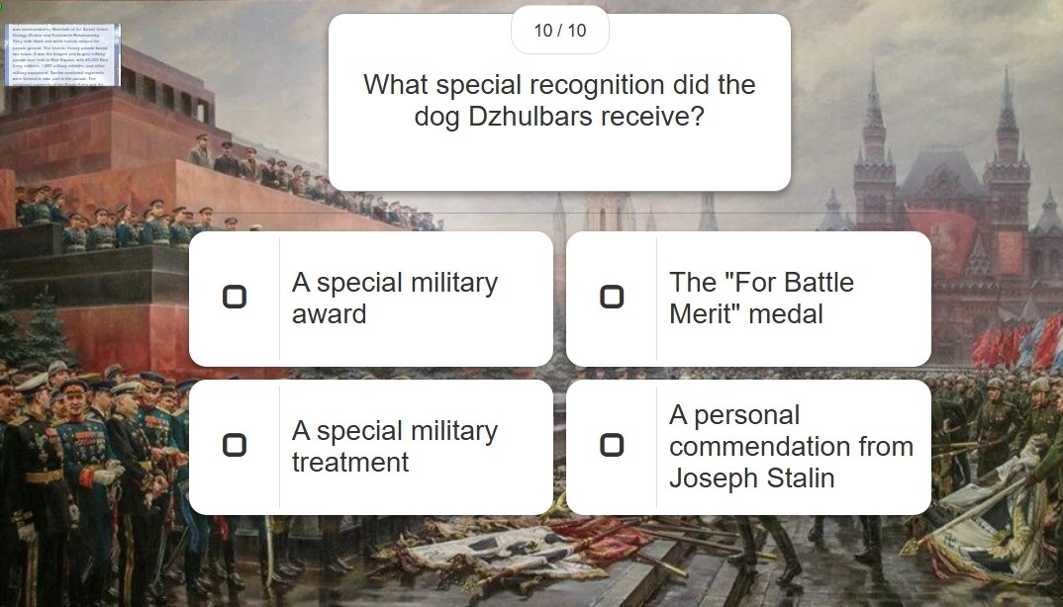
Victory Parade 1945

Slide 46
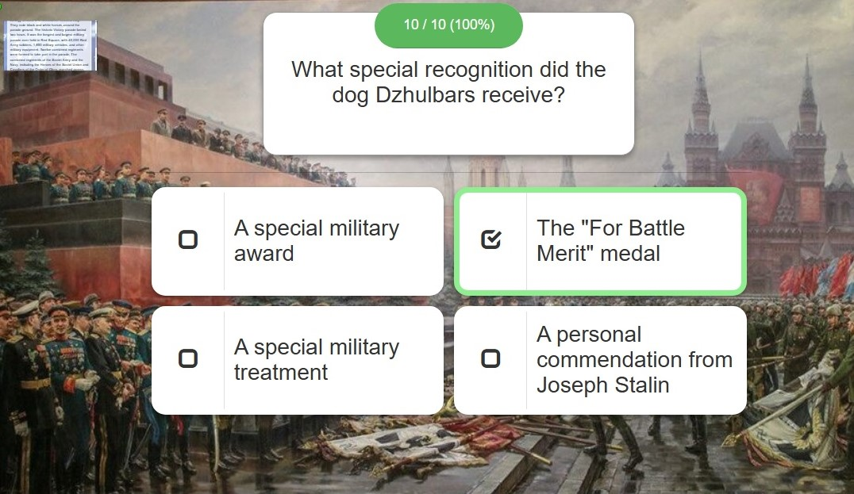
Victory Parade 1945

Slide 47
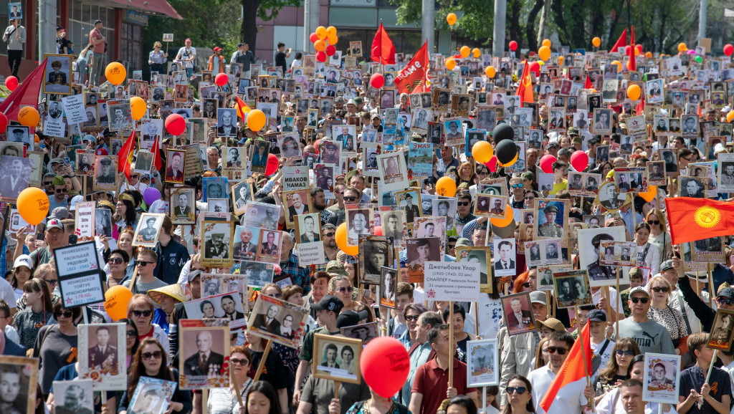
Poem “Requiem”
Robert Rozhdestvensky
Translated by Archie Johnstone

Slide 48
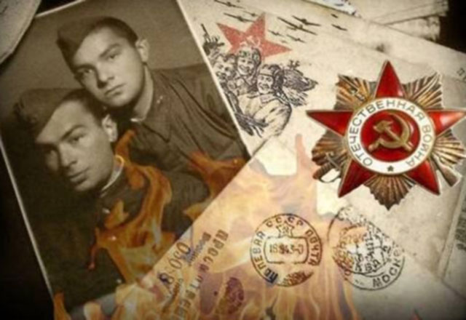
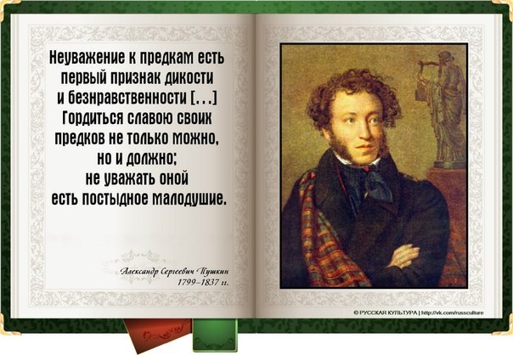

Essay
Comment on the following quotation.
To be proud of the glory of one's ancestors is not only possible, but also a must; not to respect it is shameful cowardice.
A. S. Pushkin
Write 200–250 words.
Use the following plan:
make an introduction, explaining how you understand the author’s point of view;
express your personal opinion and give reasons to support it;
give examples from literature or history to illustrate your reasons;
make a conclusion restating your position.

Slide 49
Электронные ресурсы
https://may9.ru/
https://photo.may9.ru/ru/story/list_370895817/
https://may9.ru/news/2875/
https://may9.ru/en/news/20059/
http://www.kremlin.ru/events/president/news/76879
https://simonov.co.uk/waitforme
https://pskovgo.narod.ru/poems/rozhdest.htm
https://stihi.ru/2014/05/11/9553
https://mamaev-hill.ru/memorial/vkhodnaya-ploschad
https://www.mos.ru/en/news/item/18652073/
https://www.reddit.com/r/europe/comments/hin04h/today_russia_unveiled_a_spectacular_monument/#lightbox

