Slide 1



Welcome to
FAIRY
GARDEN

Slide 2

Complete the months
1. J_n_ _ r _ 5. M _ _ 9. S _ pt _ mb _ r
2. F _br _ _ r _ 6. J _ n _ 10. _ ct _ b _ r
3. M _ rch 7. J _ l _ 11. N _ v _ mb _r
4. _ pr _ l 8. _ _ g _ s t 12. D _ c _ mb _r

Slide 3
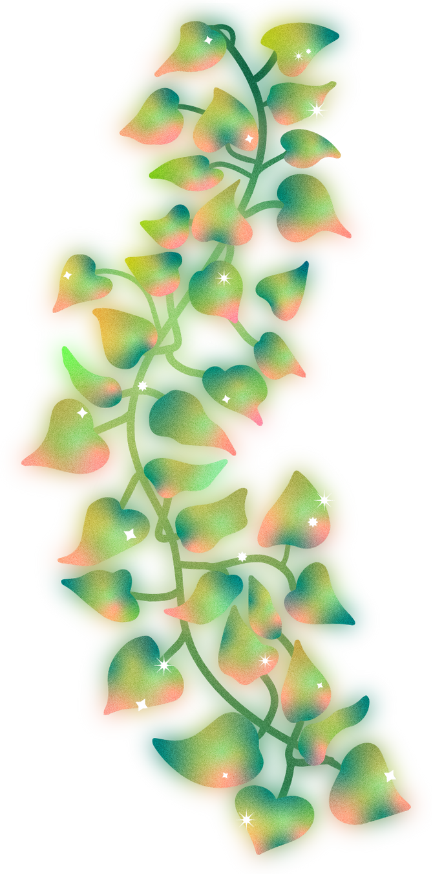

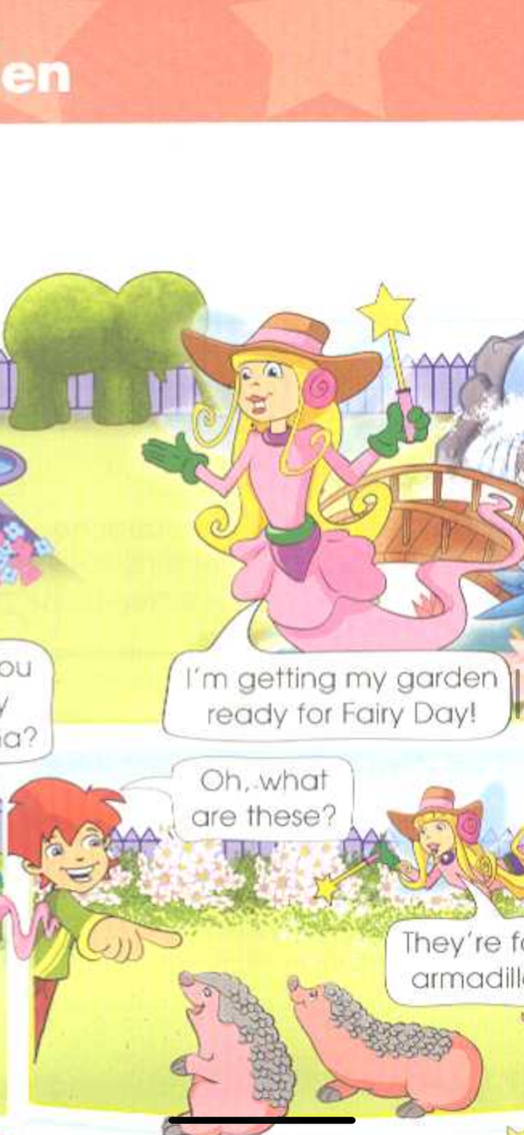
Dear friends,
Please come ….

Slide 4
Dear friends,
Please come and help me in my Fairy Garden!
Love,
Erlina

Slide 5
FUTURE SIMPLE
Указание на простое действие в будущем
При перечислении последовательности действий в будущем
Регулярные, повторяющиеся действия в будущем
We'll return in 4 hours.
I promise I'll visit you every day.
Iwill go to the river, swim and fishevery day.

Slide 6
tomorrow – завтра
next year – в следующем году
in five years – через пять лет
in 2095 – в 2095 году

Slide 7
Утвердительные предложения
I will play We will play
You will play You will play
He / she / it will play They will play

Slide 8
Отрицательные предложения:
I will not play We will not play
You will not play. You will not play
He / she / it will not play They will not play

Slide 9
Вопросительные предложения:
Will I play? Will we play
Will you play? Will you play?
Will he / she / it play? Will they play?

Slide 10
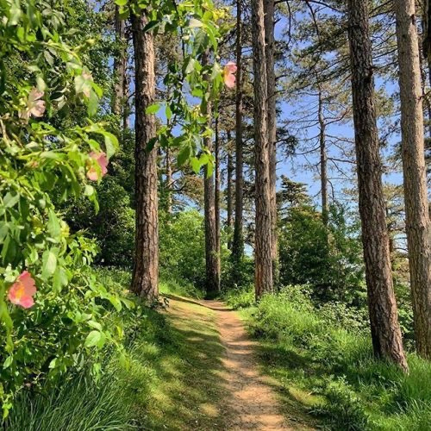

July
July
February
April
April
March
September
October
June
January
May
November
August
December

Slide 11
July
July
February
April
April
March
September
October
June
May
November
August
December

Slide 12
July
July
April
April
March
September
October
June
May
November
August
December

Slide 13
July
July
April
April
September
October
June
May
November
August
December

Slide 14
July
July
April
September
October
June
May
November
August
December

Slide 15
July
July
April
September
October
June
November
August
December

Slide 16
July
July
April
September
October
November
August
December

Slide 17
July
April
September
October
November
August
December

Slide 18
July
April
September
October
November
December

Slide 19
July
April
October
November
December

Slide 20
July
April
November
December

Slide 21
July
April
December

Slide 22
July
April

Slide 23


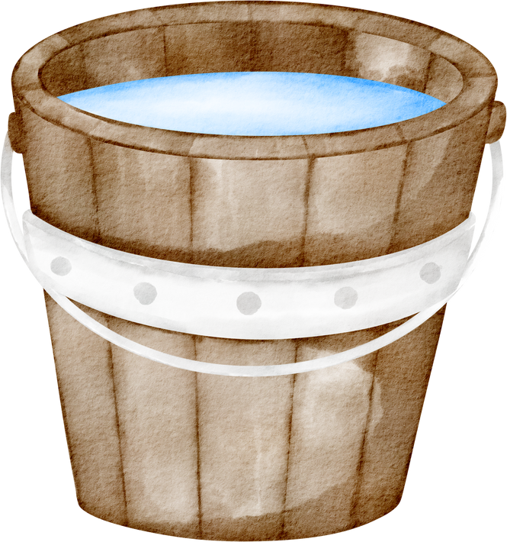
Fourth
First
Third
Second

Slide 24
Fourth
Third
Second
First

Slide 25
Fourth
Third
First
Second

Slide 26
Fourth
First
Second
Third

Slide 27
First
Second
Third
Fourth

Slide 28

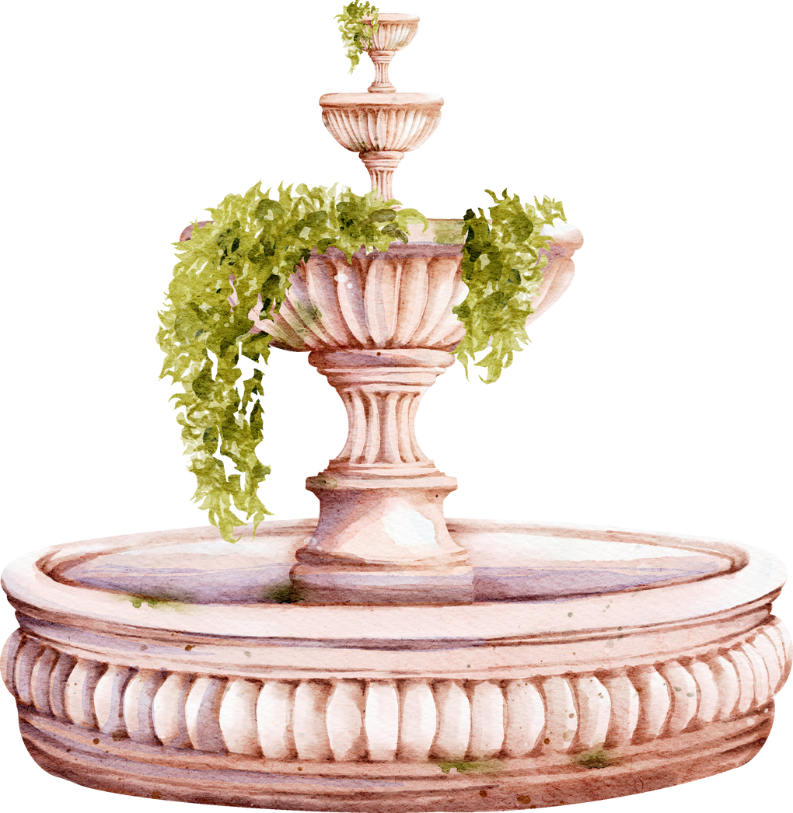
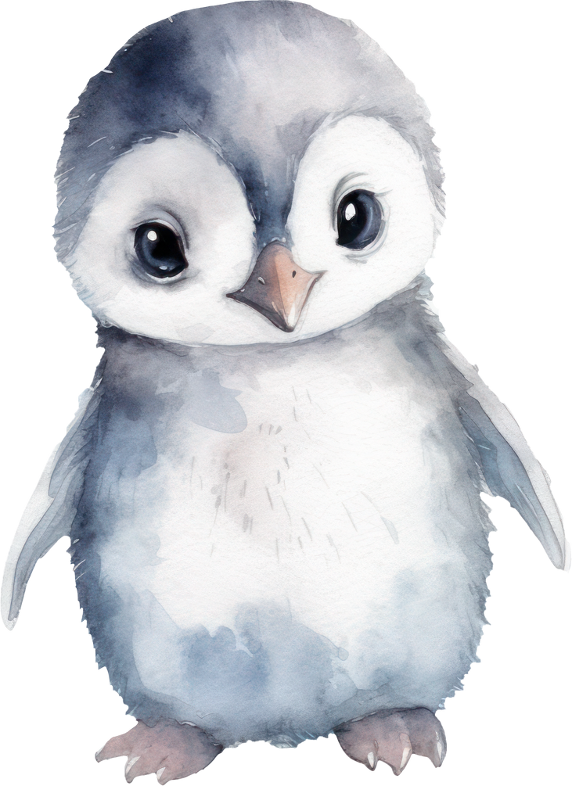
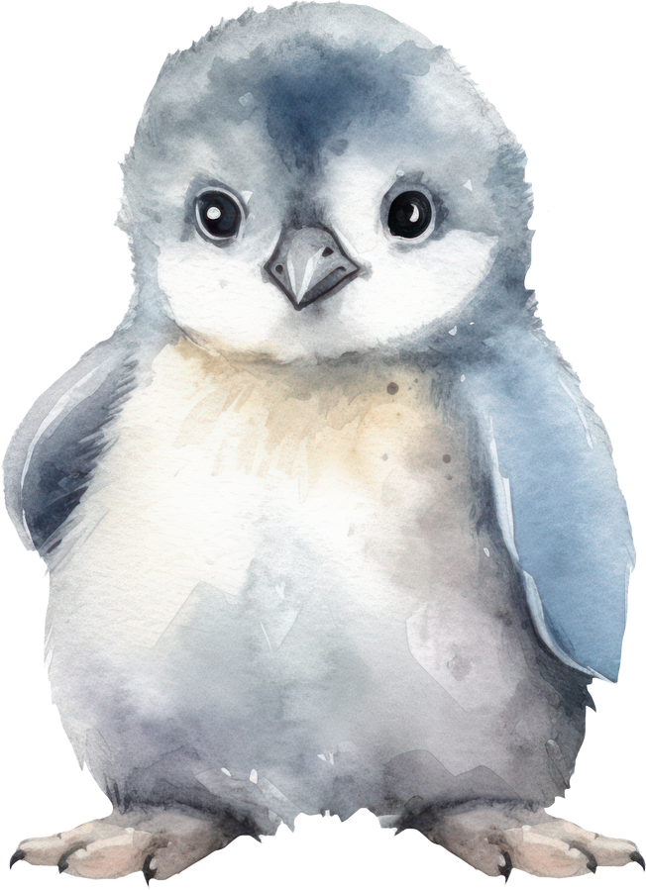
I (to do) morning exercises.

Slide 29
Will I do morning exercises?

Slide 30
She (to sleep) after dinner.

Slide 31
Will she sleep after dinner?

Slide 32
We (to work) part-time.

Slide 33
Will we work part-time?

Slide 34
They (to drink) tea every day.

Slide 35
Will they drink tea every day?

Slide 36
He (to work) at a factory.

Slide 37
Will he work at a factory.

Slide 38
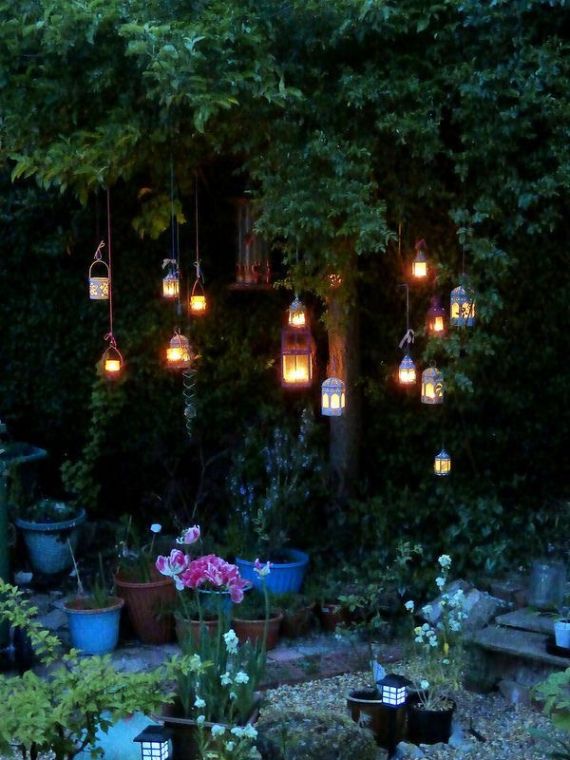

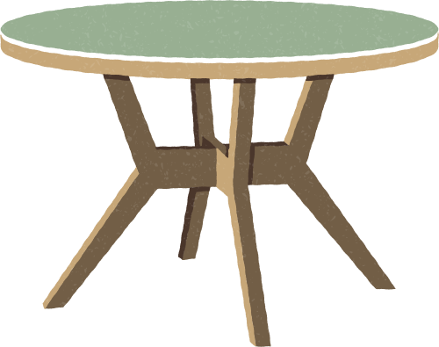
will
party
to
She
go

Slide 39

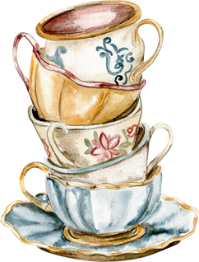
She will go to the party

Slide 40
They
visit
grandparents
will

Slide 41
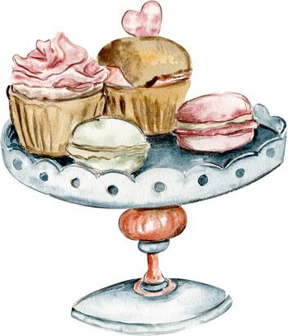
They will visit grandparents

Slide 42
will
we
this
watch
film

Slide 43
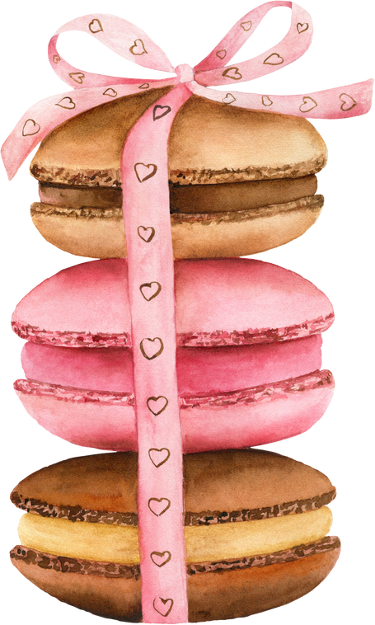
We will watch this film

Slide 44
My
mother
cook
will
dinner

Slide 45
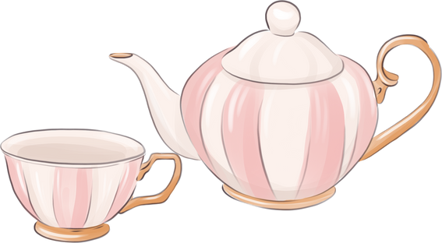
My mother will cook dinner

Slide 46
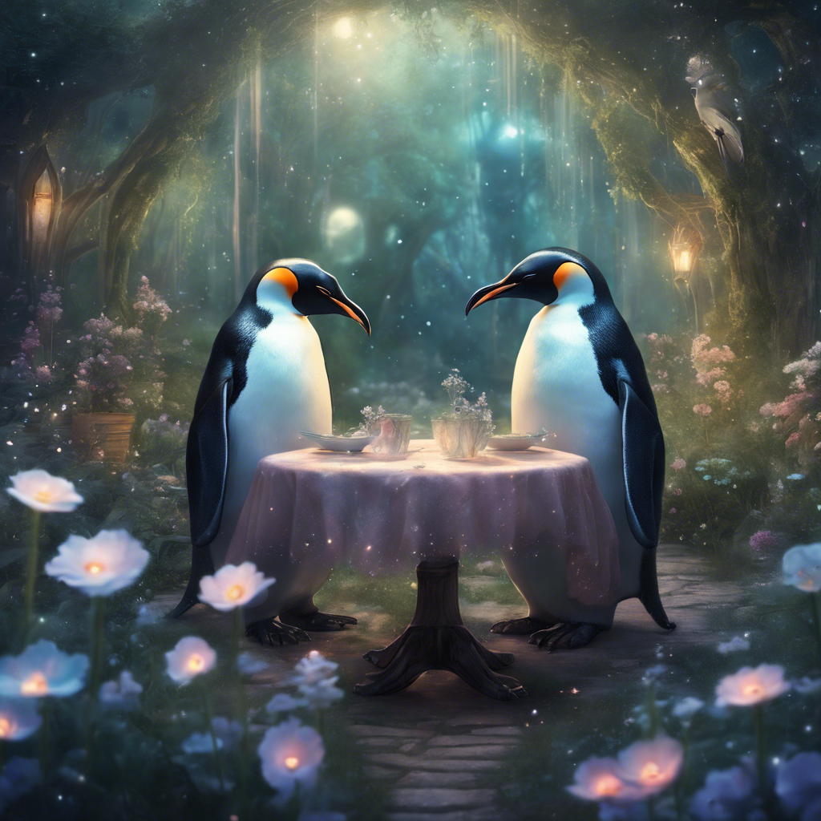

Slide 47

GOOD BYE
love love

