Slide 1
Which is faster?

Slide 2
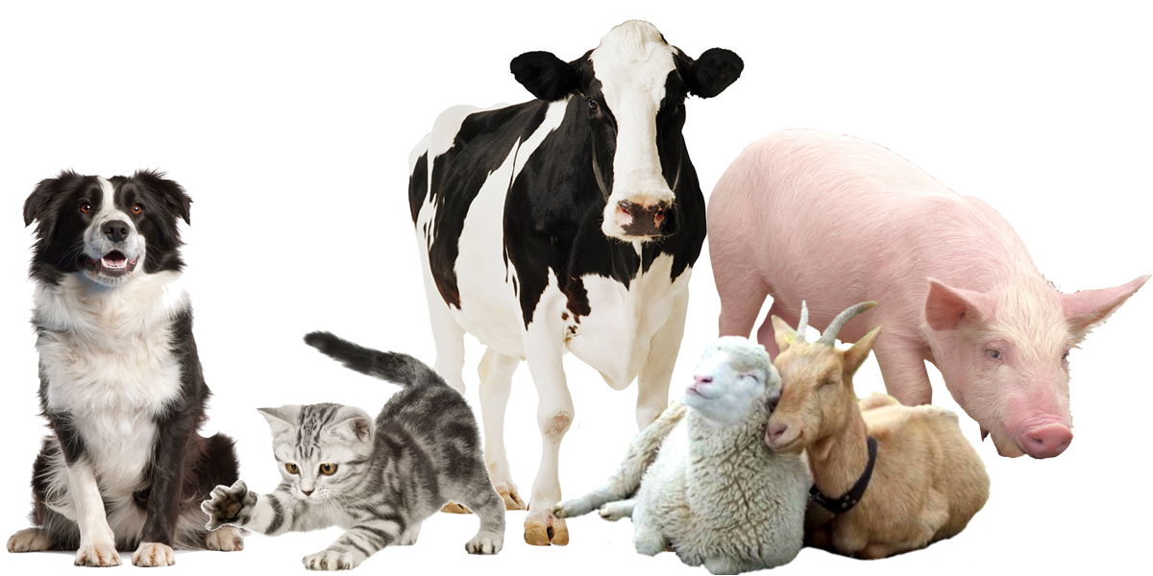
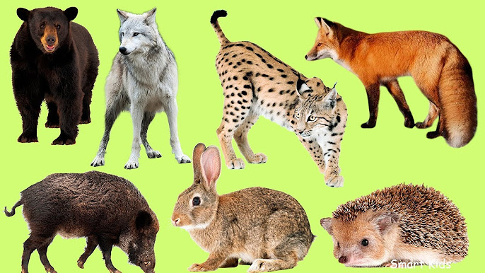
Domestic and wild animals
Domestic Wild

Slide 3
Wild animals
Our aim is to meet and practise vocabulary related to wild animals.

Slide 4
Exercise 1
Deer –d mosquito -j
Tortoise –b chimpanzee -n
Cheetah –c bear - r
Camel – q buffalo -s
Owl – m elephant - t
Dolphin –o snail -a
Cobra –f ant -h
Scorpion – g
Fly - i

Slide 5
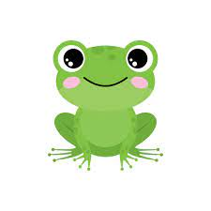
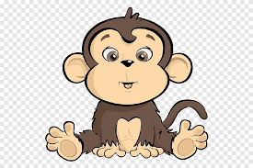
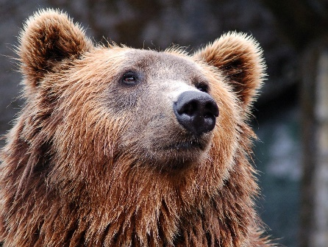
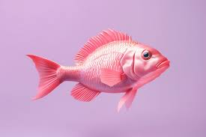
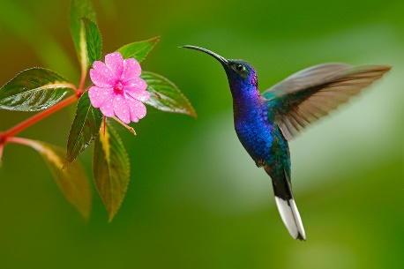
Let’s have a rest
Jump like a frog
Climb like a monkey
Go like a bear
Swim like a fish
Fly like a bird

Slide 6
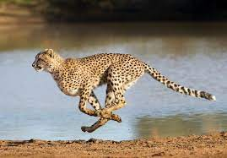
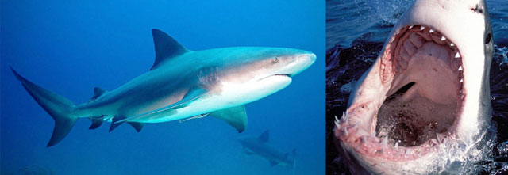
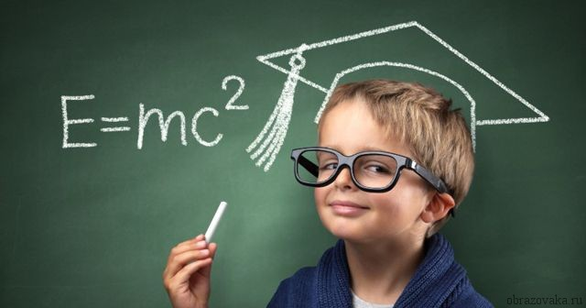
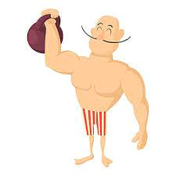
Adjectives
1.Fast [fa:st] 1.
2.Dangerous [‘deindзeres] 2.
3.Intelligent [in’telidз(e)nt]3.
4.Strong [stron] 4.

Slide 7
Exercise 3
A tortoise is faster than a snail.
A cheetah is the fastest animal.
A cobra is more dangerous than a scorpion.
A mosquito is the most dangerous insect.
A dog is more intelligent than a mouse.
A chimpanzee is the most intelligent animal.
A camel is stronger than a horse.
An elephant is the strongest animal.

Slide 8
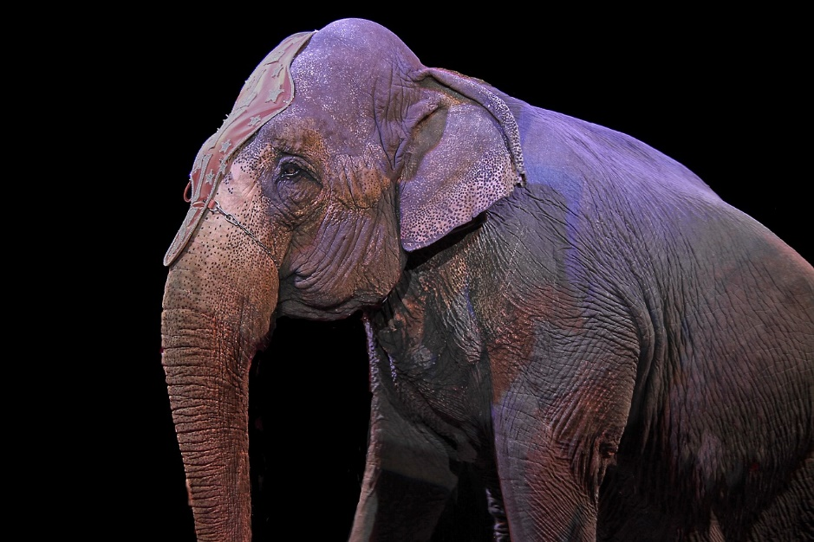
Riddles
It’s big. It has got a very long nose. It’s grey. It’s the strongest animal.

Slide 9
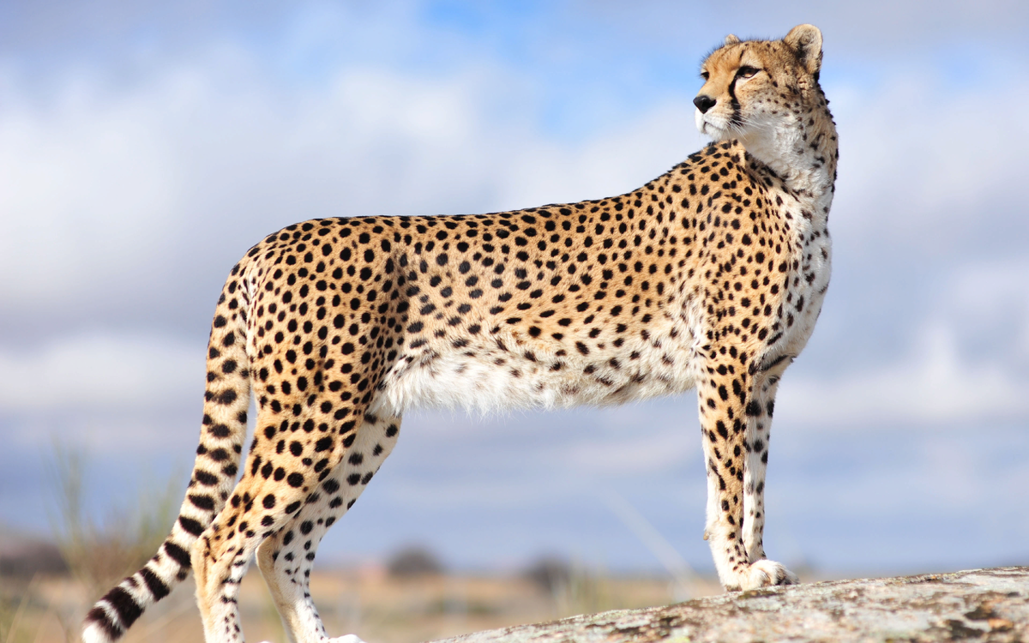
Riddles
It’s not big not small. It’s the fastest animal.

Slide 10
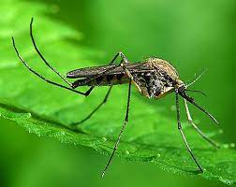
Riddles
It’s small. It’s an insect. It’s the most dangerous insect.

Slide 11
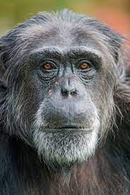
Riddles
It’s small. It’s brown. It’s the most intelligent animal.

Slide 12
Marks
30-28 “5”
27- 22 “4”
21-16 “3”

