Slide 1
Present Progressive/Continuous
Настоящее Продолженное/Длительное время
to be
Ving
Слова-«сигналы»:
now (сейчас), at the/this moment ( в данный/этот момент),
Look (смотри), Listen ((по)слушай)

Slide 2
am
is
are
doing

Slide 3
to be (am/is/are) Ving
I
am
play
ing
He/She
is
play
ing
We/You/They
are
play
ing

Slide 4
+
The girl is singing now.
We are doing morning exercises, look!

Slide 5
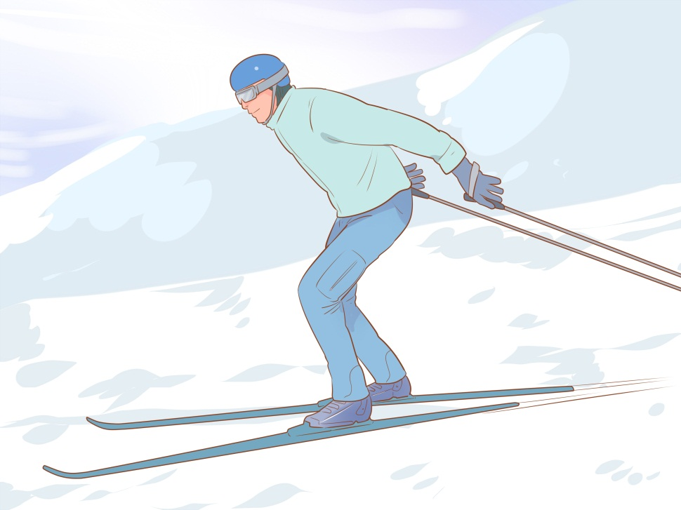
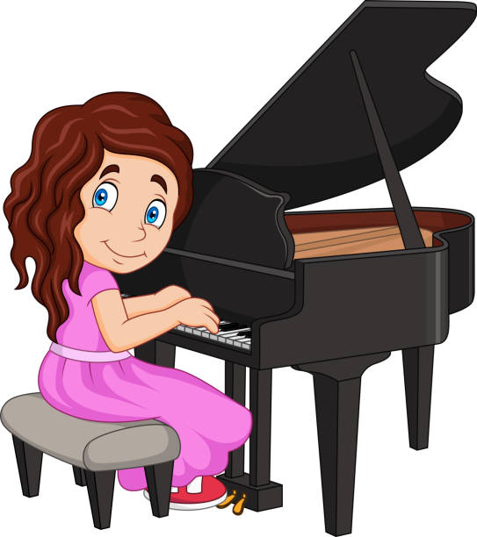
My brother is skiing
at the moment.
He is not at home.
I am playing the piano, listen to me!

Slide 6
-
Look at me, I am not doing my homework.
I am not riding a bike, look!

Slide 7
Max is not writing now.
Look at them!
They are not
sleeping!They
are running!

Slide 8
?
Are you singing? – No, I am not.
What are you doing now?
- I am reading.

Slide 9
What are Billy and Maria doing?
Are they having lunch?
No, they are not.
They are swimming, look!

Slide 10
What is Kevin doing?
Is he playing with
his toys?
- No, he is not.
He is sleeping in his bed.

Slide 11
LET’S PRACTICE

Slide 12
AM/IS/ARE?
are
We _______ playing tennis. Let’s play with us!
I _______ not doing my homework now.
My friend ________ having lunch, he cannot play volleyball.
His brothers _______ going to school now.
Helen ________ sleeping, she is ill.
I ________ watching TV, I don’t want to play.
am
is
are
is
am

Slide 13
Open the brackets using the Present Progressive
are going
We _______________ (to go) home now.
Teddy and Mike _______________ (to sleep), sh!
Look, Mary _____________ (to cry)!
I ______________ (to read) an interesting book, I don’t want to watch TV.
Her mum ______________(to cook) dinner at the moment.
I _____________ (to listen) to music.
are sleeping
is crying
am reading
is cooking
am listening

