Slide 1
“What are you wearing?”

Slide 2
Tongue Twister

Slide 3
READ IT!
a book
a ruler
a rubber
a pen
a pencil case
green
red
black
yellow
blue
white
a shirt
a T-shirt
a dress
a jacket
shorts
trousers
I have got …
I’m wearing…
My … is / are . . .

Slide 4
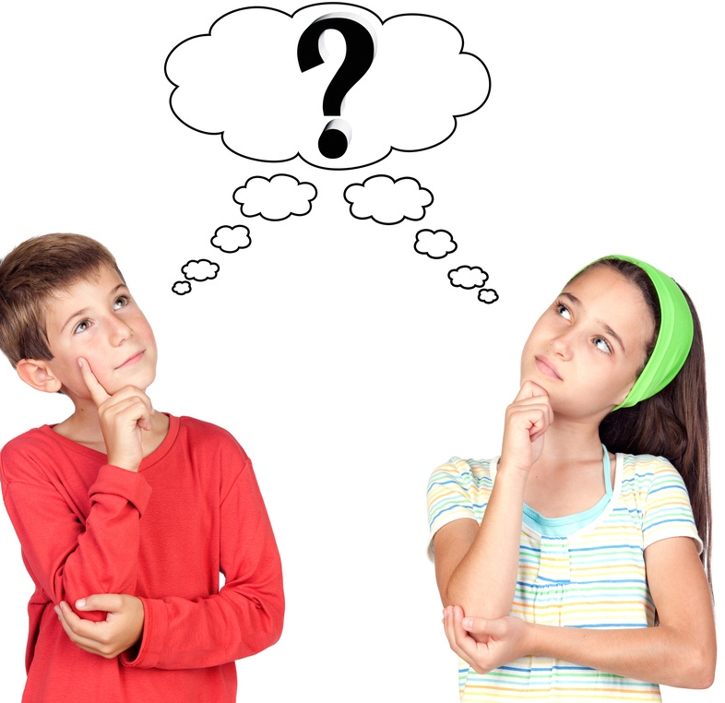
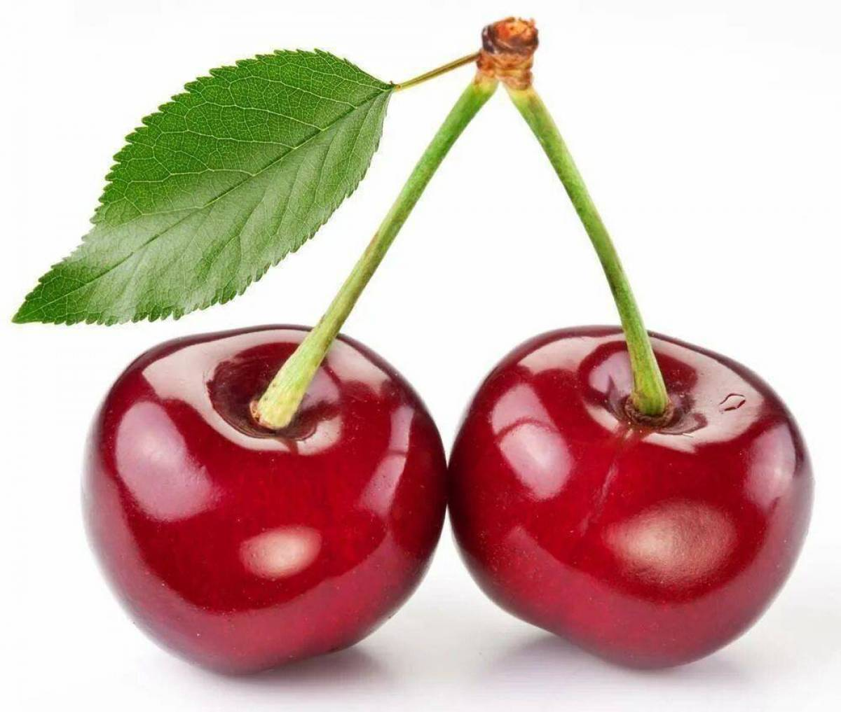
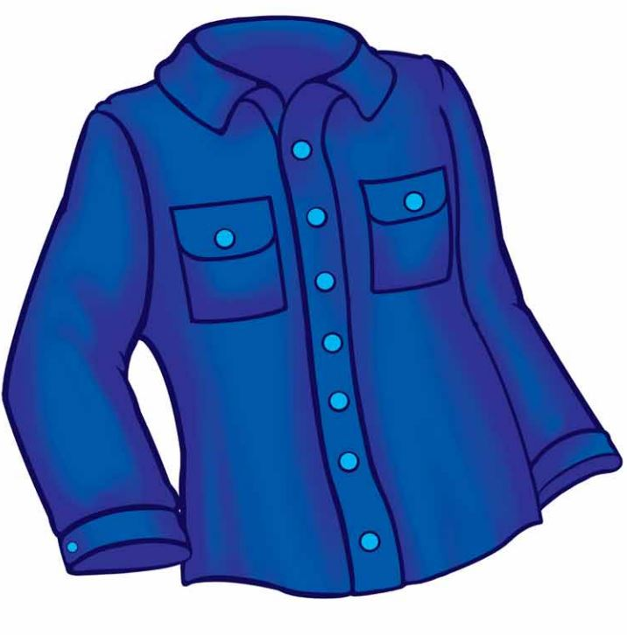
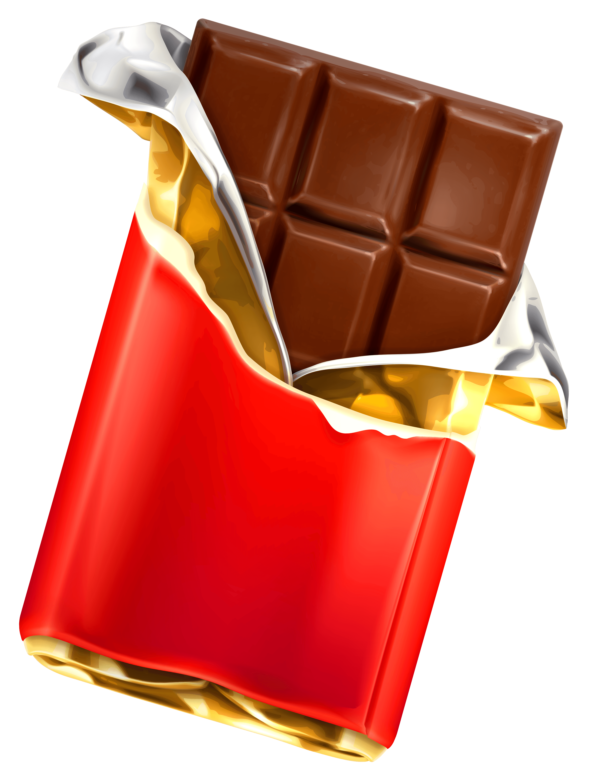
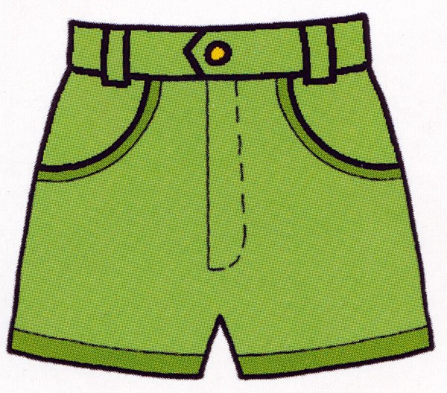
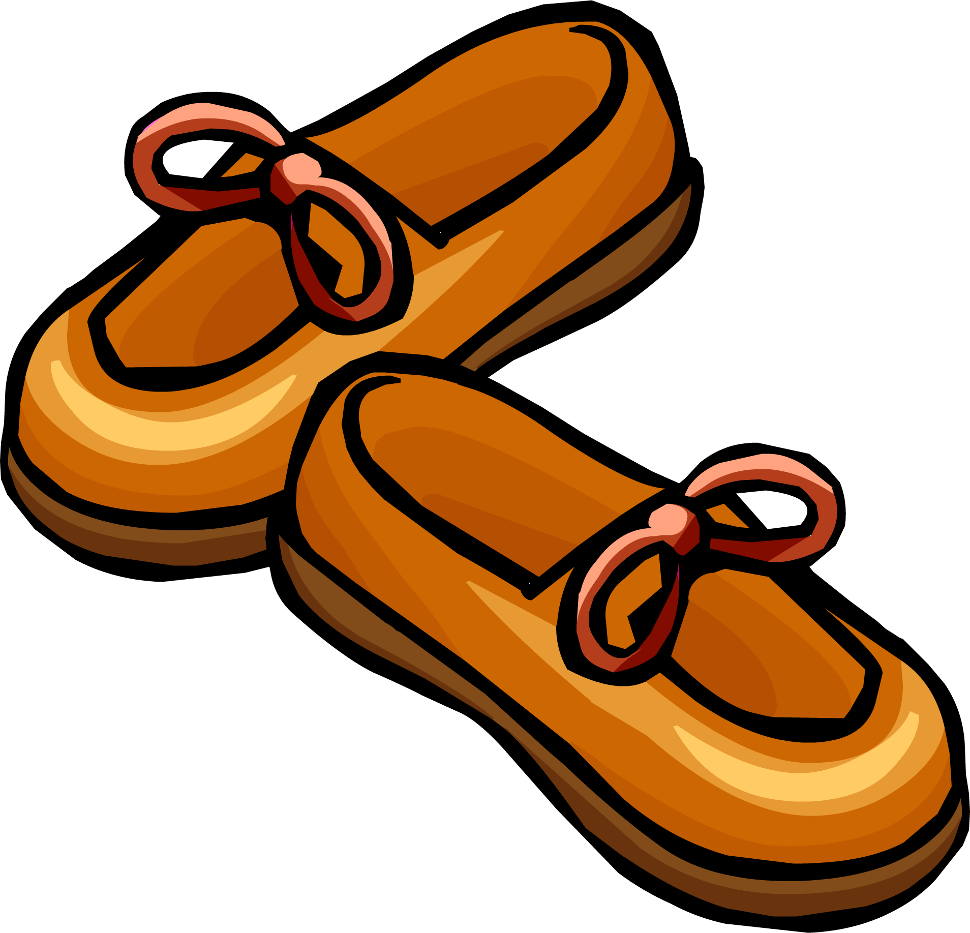
Be a Star!
sh
ch
th
shirt
shorts
shoes
cherry
child
chocolate
think
three

Slide 5
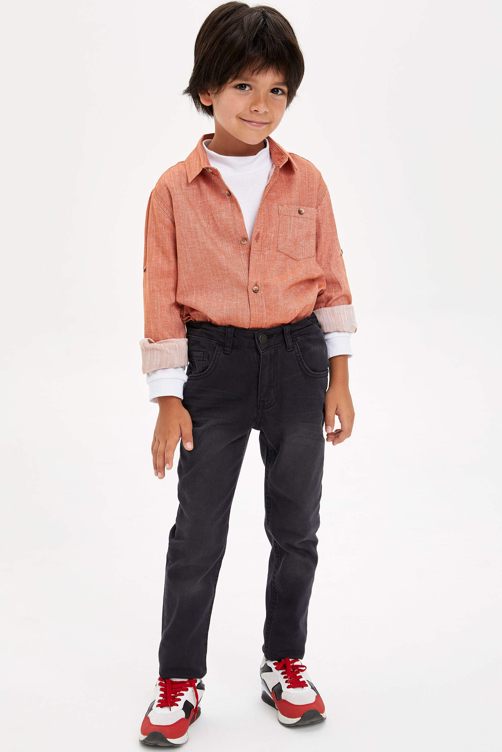
At!
I am wearing shorts .
I am wearing trousers.
I am wearing a dress.
I am wearing a T-shirt.

Slide 6
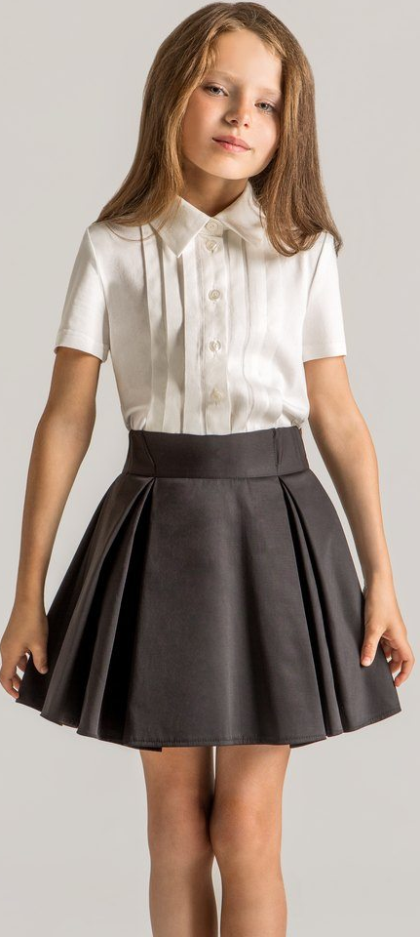
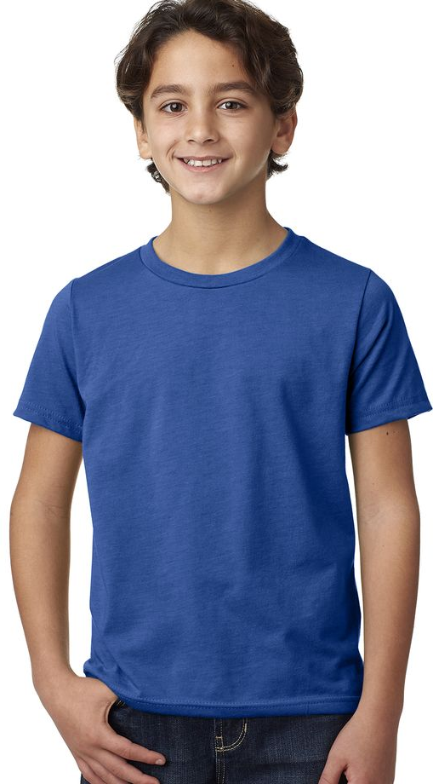
I am wearing a jacket.
I am wearing a skirt.
I am wearing a hat.
I am wearing a T-shirt.

Slide 7
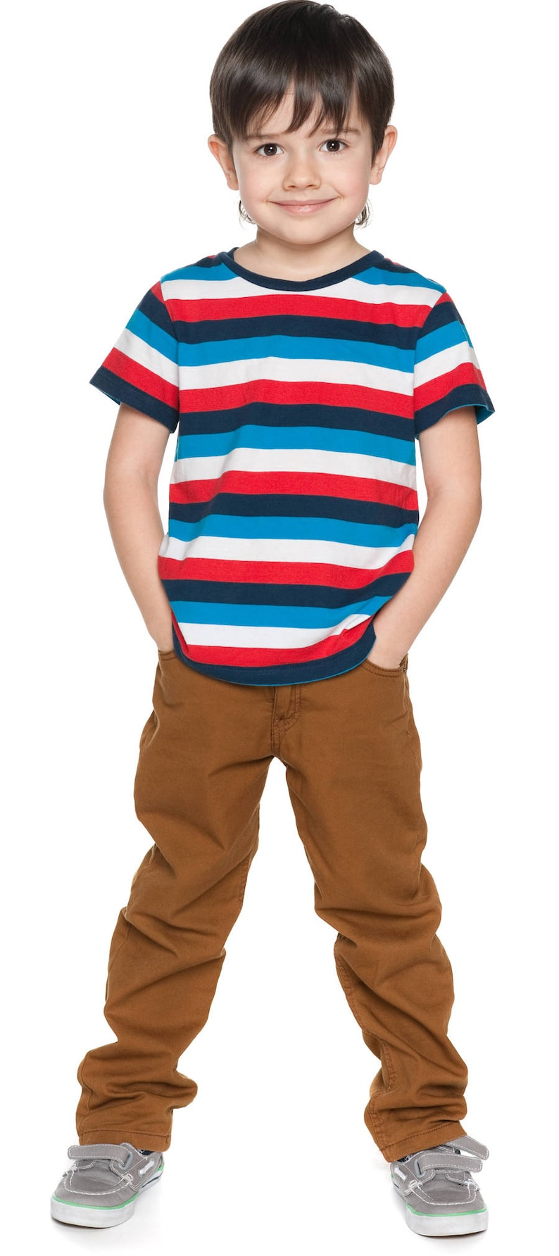
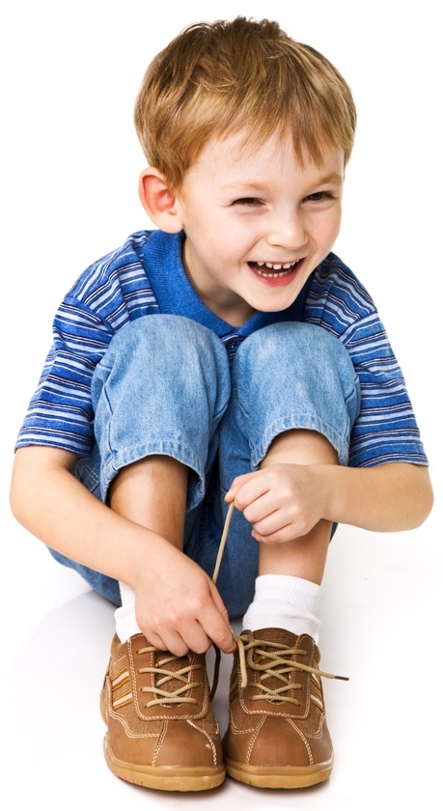
I am wearing a T-shirt and a hat.
I am wearing a T-shirt and trousers.
I am wearing a T-shirt and a jacket.
I am wearing socks and shoes.

Slide 8
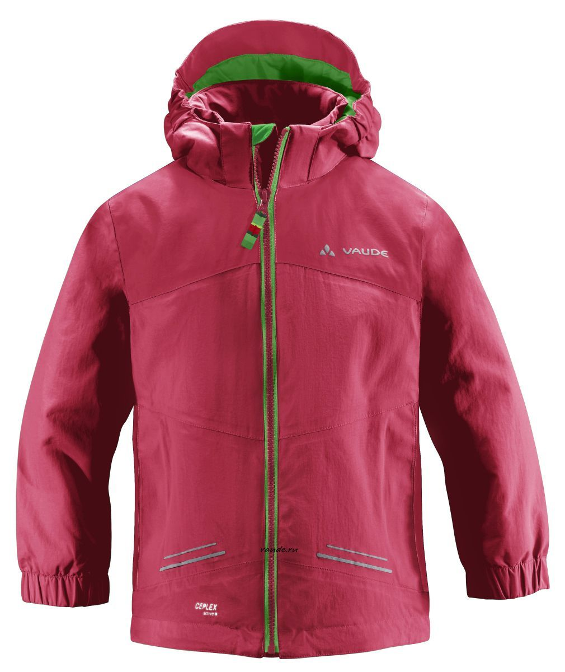
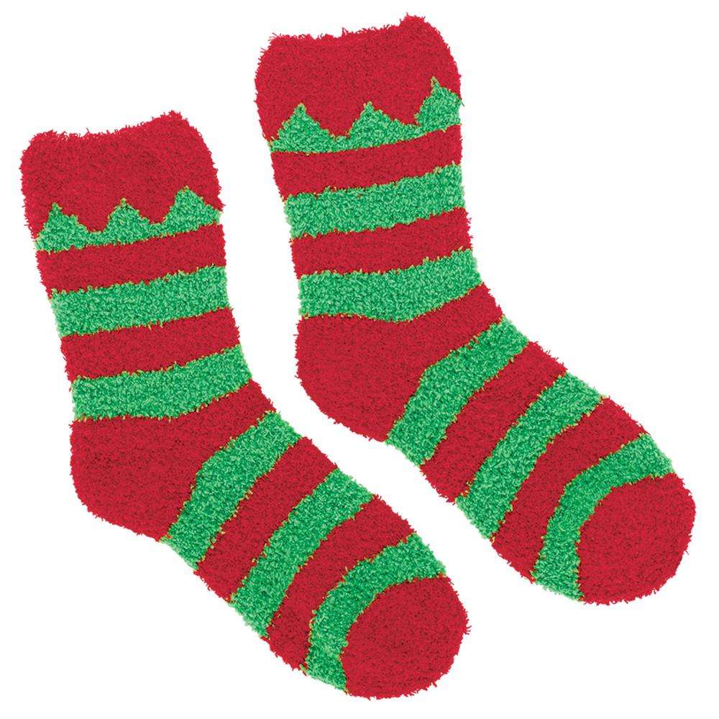
Write it!
s h e s o
a t h
t a j c k e
s c k s o

Slide 9
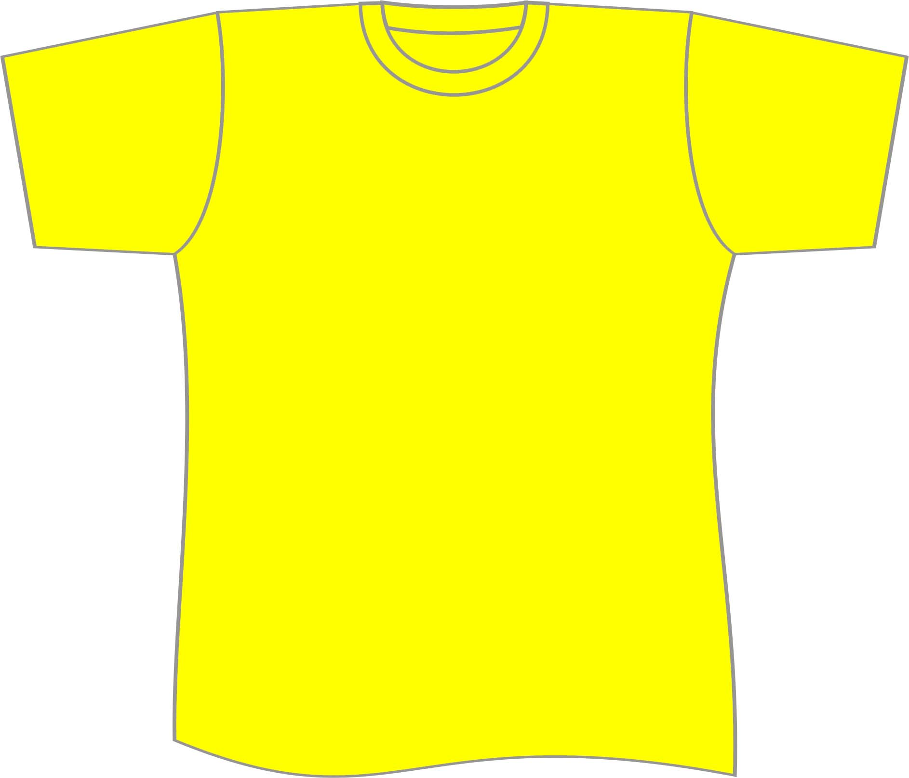
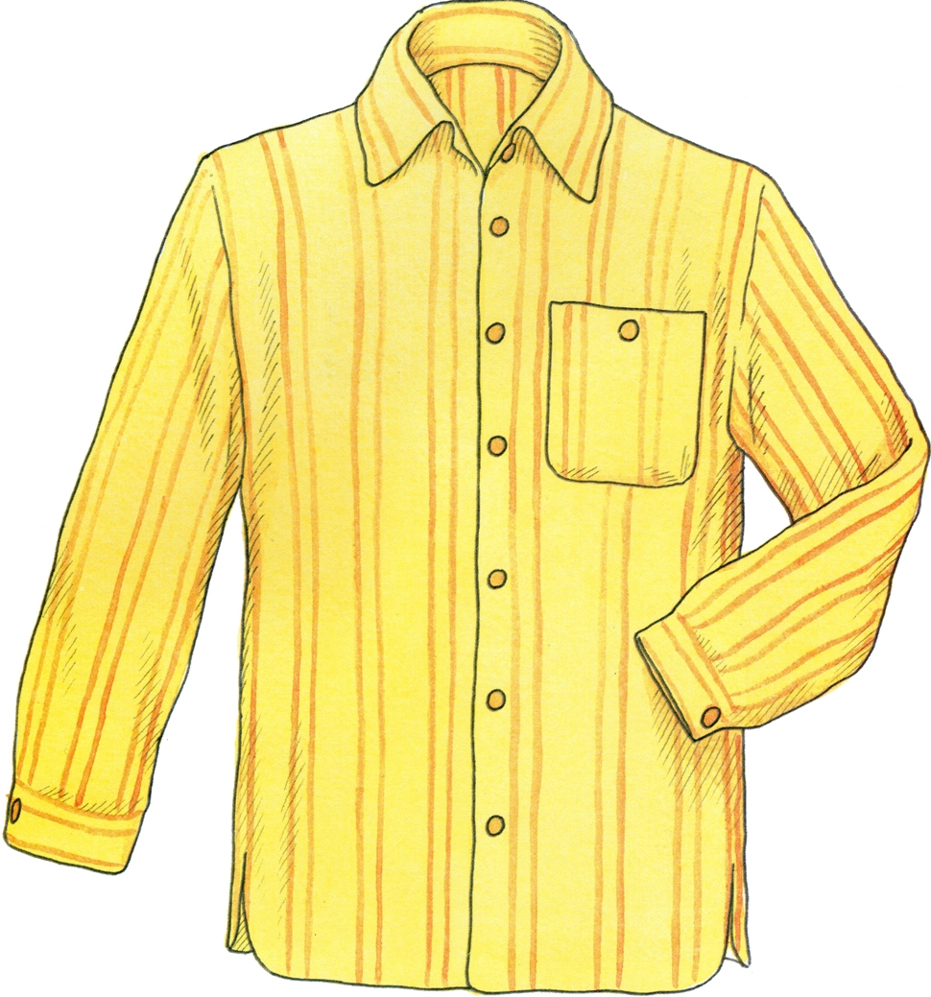
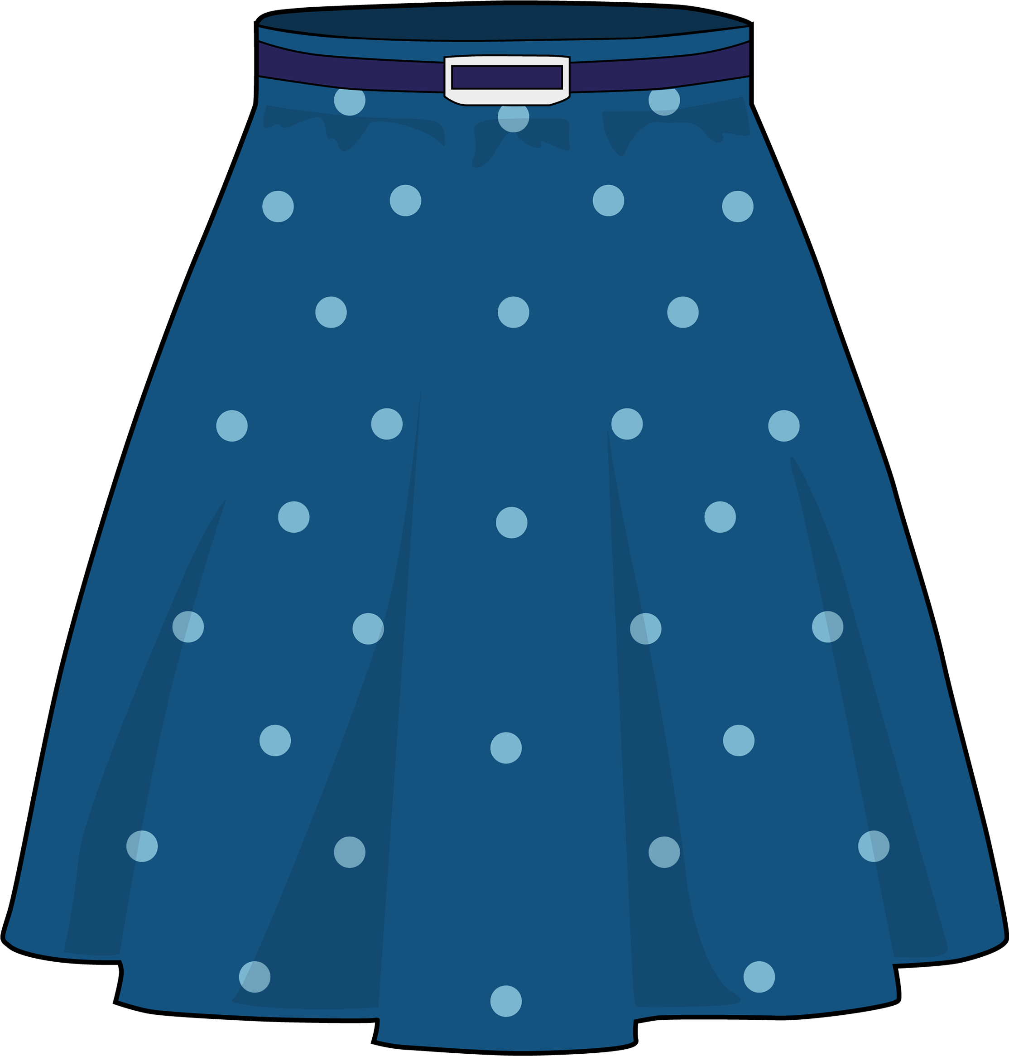
Write it!
t s i k r
s i t r h T-
r o u e s r t s
s h t i r

Slide 10
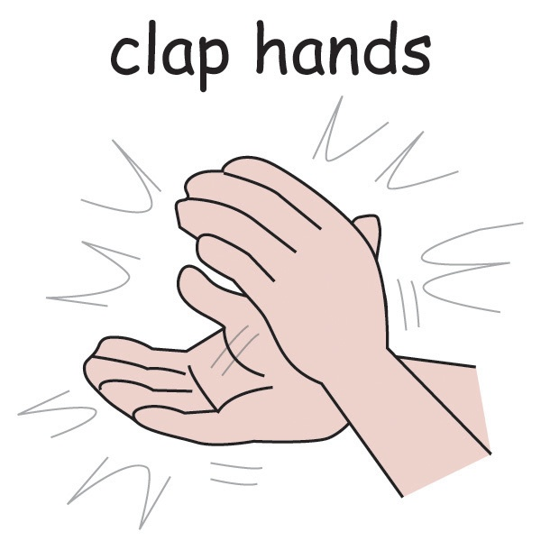
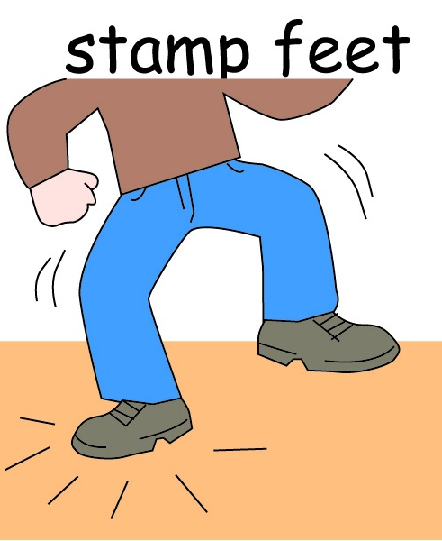
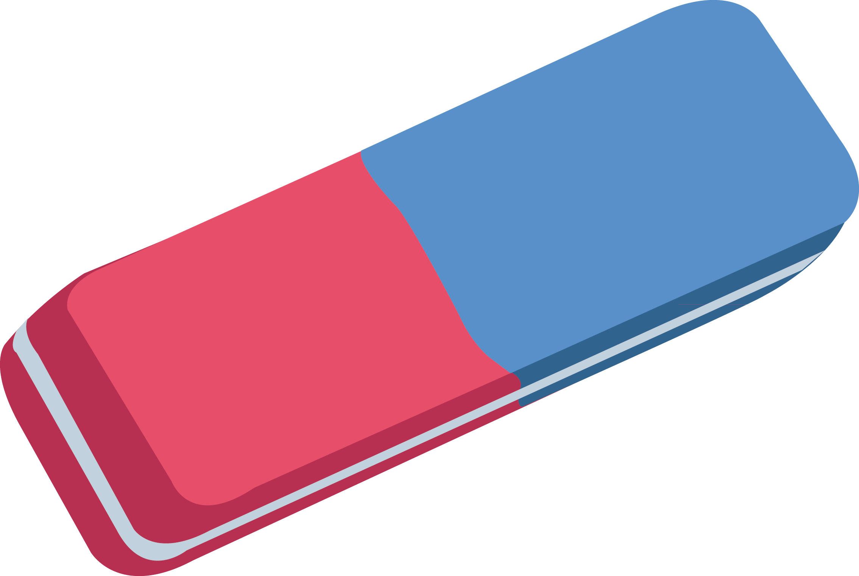
Listen!

Slide 11
Speak!
What are you wearing?
.
I’m wearing a shirt, trousers
and a hat.
Are you a pirate?
Y
Yes, I am.

Slide 12
SAY IT!
Hi! My name is Sue.
I’m from Great Britain.
Look at me! I’m wearing… and …

Slide 13
SAY IT!
Hi! My name is Ann.
I’m from Egypt.
Look at me! I’m wearing… and …

Slide 14
SAY IT!
Hello! My name is Bill.
I’m from Canada.
Look at me! I’m wearing… and …

Slide 15
SAY IT!
wearing
shoes
I’m
and
socks
shoes
and
wearing
trousers
I’m
a hat
and
I’m
a dress
wearing

Slide 16
SAY IT!
wearing
a jacket
I’m
and
shoes
shirt
and
wearing
a skirt
I’m
a hat
and
I’m
a dress
wearing

Slide 17
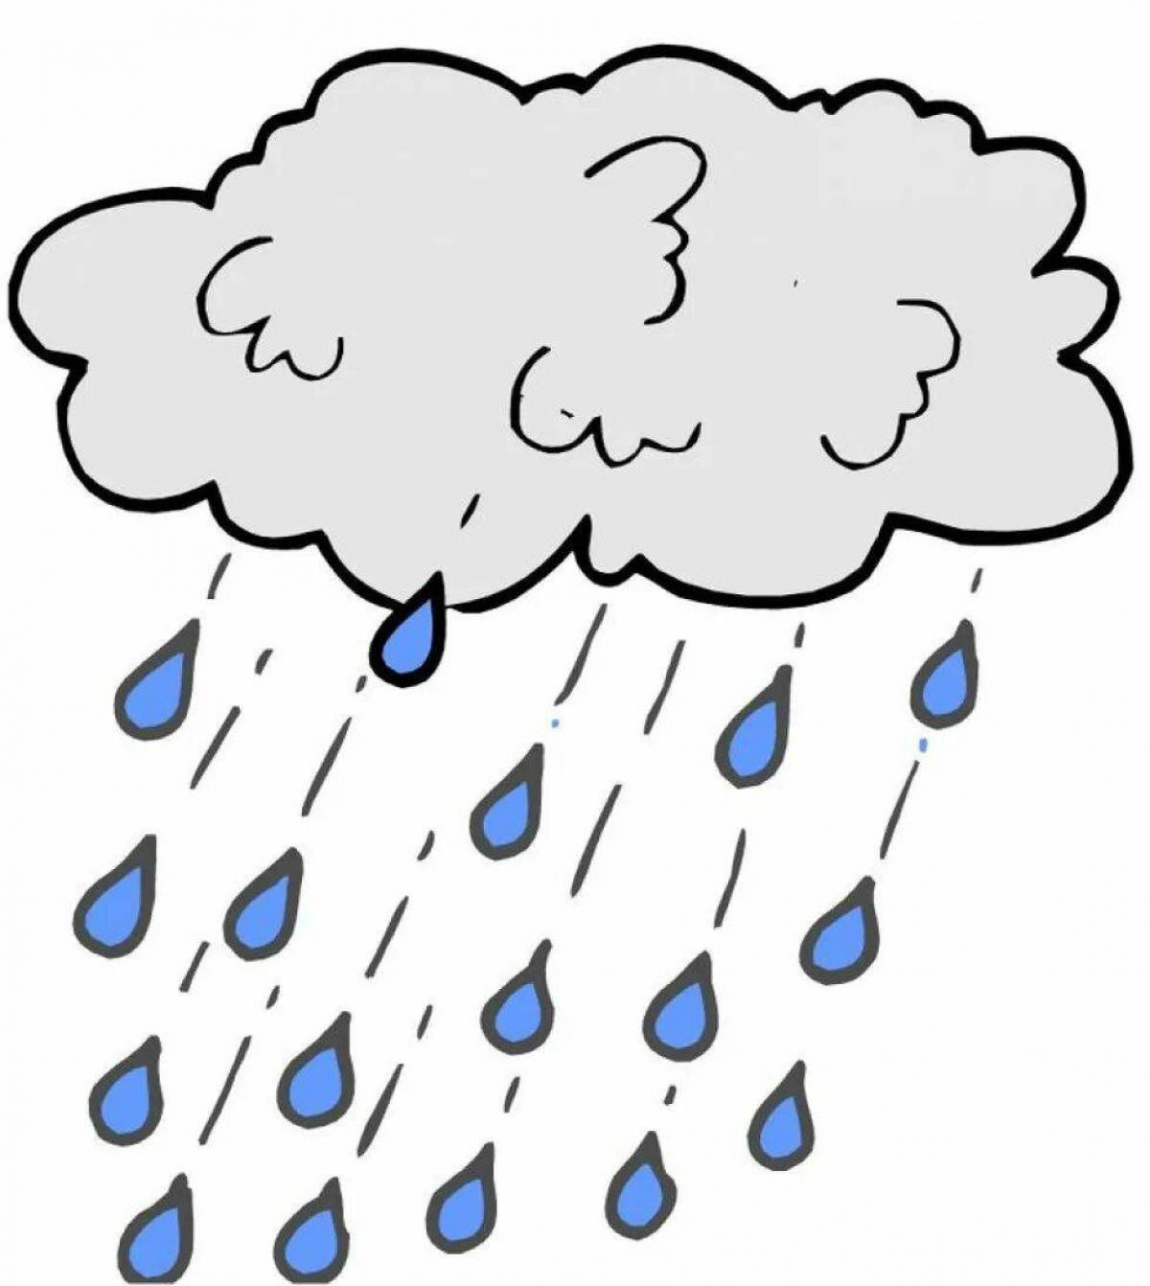
READ
cold
a jacket, a hat, trousers
hot
a shirt, a T-shirt, shorts
wet
a jacket, boots, a hat

Slide 18
Let’s play together!
https://wordwall.net/ru/resource/58391596/english/what-are-you-wearing-i-am-wearing-liz-is-wearing-im

