Slide 1
ЗАГОЛОВОК
Stories from far away
Grade 4
Teacher Vasilyeva T.

Slide 2
Phonics

Slide 3
Fill in the letters. Explain the meaning
wo _ _ d str_ _m
fi _ ld _ h_ oting st_ _
g_ _ ss bran_ _
gr_ _ nd n_st
campf_ _e l_ _f – lea_es

Slide 4
What story is this? Is it real?
How many characters are there in the story? What are they?
Where did it happen?
What tense is used in this story?

Slide 6
Order the sentences. Check.
Once upon a time, some monkeys were playing.
One of the monkeys ran up a tree and saw a bird’s nest on a branch.
Inside there were three beautiful blue eggs.
‘Yummy! I like eggs,’ said the monkey, and put out his hand.
‘Stop! Please don’t take my eggs!’
The monkey decided to be kind and he didn’t take the eggs.
‘Thank you!’ said the mother bird.

Slide 7
The next day, the monkeys were playing in the long grass.
Nearby, watching them, was a hungry leopard.
Yummy! thought the leopard. I like eating monkeys!
The mother bird was flying above. She saw the monkeys and the leopard and called, ‘Be careful! There’s a leopard. Run and hide!’
The monkey and his friends ran and hid.
The leopard had nothing to eat for lunch.
‘Thank you!’ he said, and they both smiled.

Slide 8
True / false
 | Sentences | T/F | +/-
1 | Once upon a time, some monkeys were playing.
2 | One of the monkeys ran up a tree, and through the stars he saw a bird’s nest on a branch.
3 | Inside there were five beautiful blue eggs.
4 | The mother bird flew into the tree and called, ‘Stop! Please take my eggs!’
5 | The monkey decided to be kind and he didn’t take the eggs.
6 | The next day, the monkeys were playing in the long grass.
7 | The mother bird saw the monkeys and the leopard and called, ‘Be careful! There’s a leopard. Run and jump!’
8 | The leopard had a lot of food to eat for lunch.

Slide 9
True / false. Check the answers
 | Sentences | T/F | +/-
1 | Once upon a time, some monkeys were playing. | T
2 | One of the monkeys ran up a tree, and through the stars he saw a bird’s nest on a branch. | F
3 | Inside there were five beautiful blue eggs. | F
4 | The mother bird flew into the tree and called, ‘Stop! Please take my eggs!’ | F
5 | The monkey decided to be kind and he didn’t take the eggs. | T
6 | The next day, the monkeys were playing in the long grass. | T
7 | The mother bird saw the monkeys and the leopard and called, ‘Be careful! There’s a leopard. Run and jump!’ | F
8 | The leopard had a lot of food to eat for lunch. | F

Slide 10
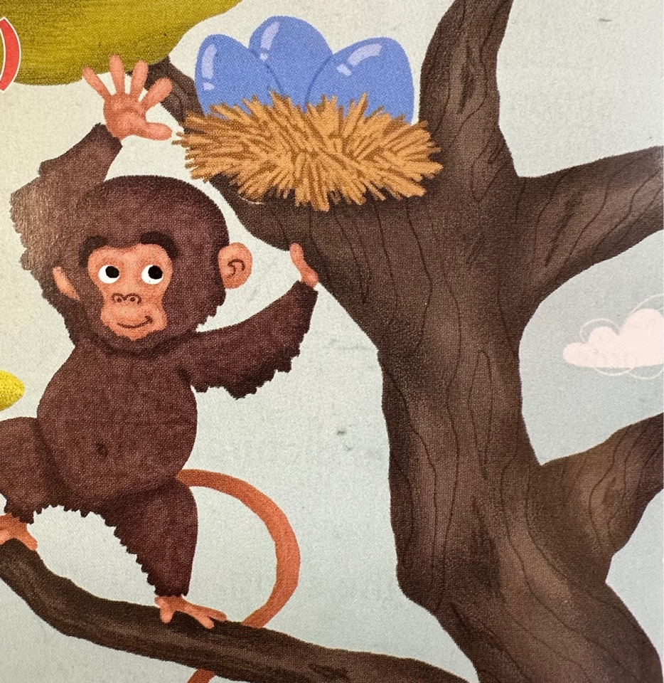
Answer the questions
What was the monkey doing?
Where did he see a nest?
Where was the mother bird? How did she feel when she saw the monkey?
Why didn’t monkey eat the eggs?
Where was the leopard the next day ?
What was his plan?
Who helped the monkeys?
What is the message of the story?

Slide 11
Proverbs
A friend in need is a friend indeed.
Друг познается в беде.
You only get when you give.
Долг платежом красен.
A true friend is the best possession.
Дружба дороже денег.

Slide 12
What is your favourite character of the story? Why?
Describe this character:
How it looks like
Its character and feelings
What happened one day

