Slide 1


Slide 2
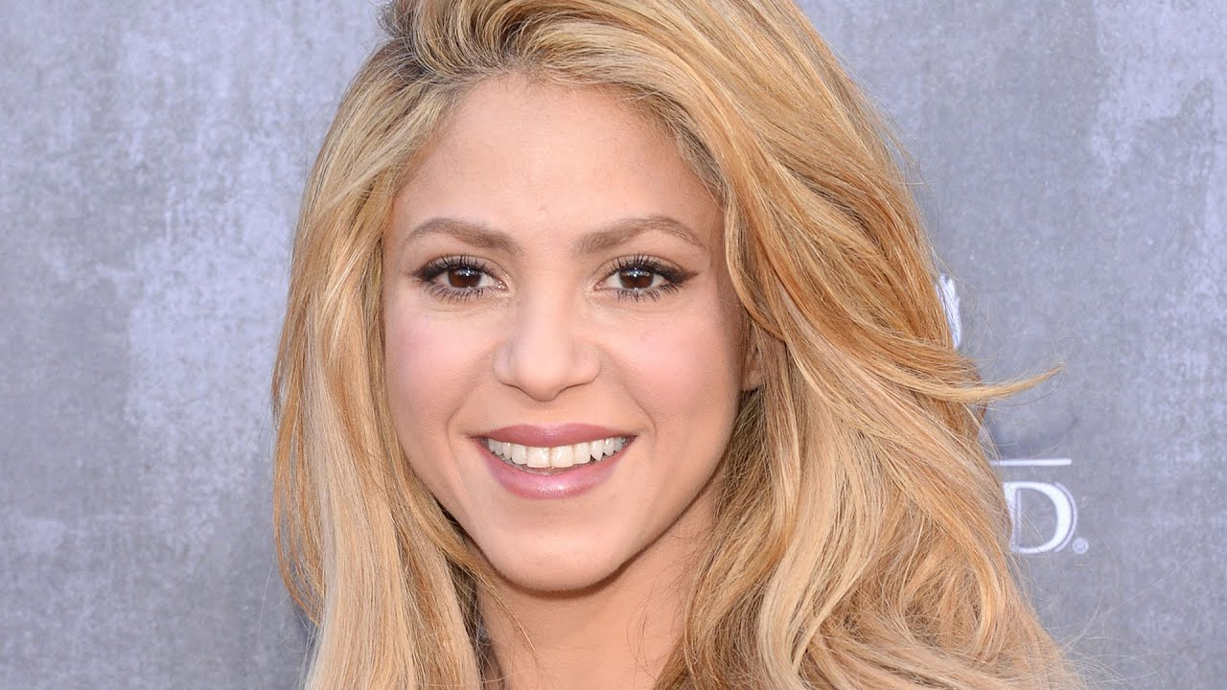
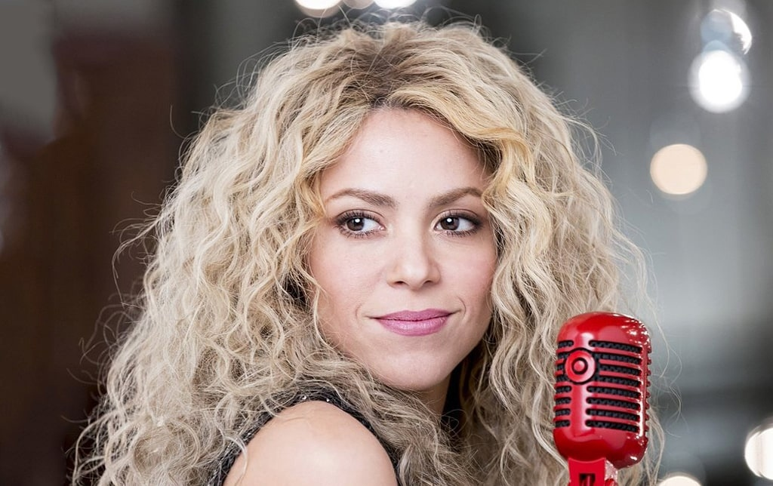
Famous people
Open your books on page 60,please!

Slide 3
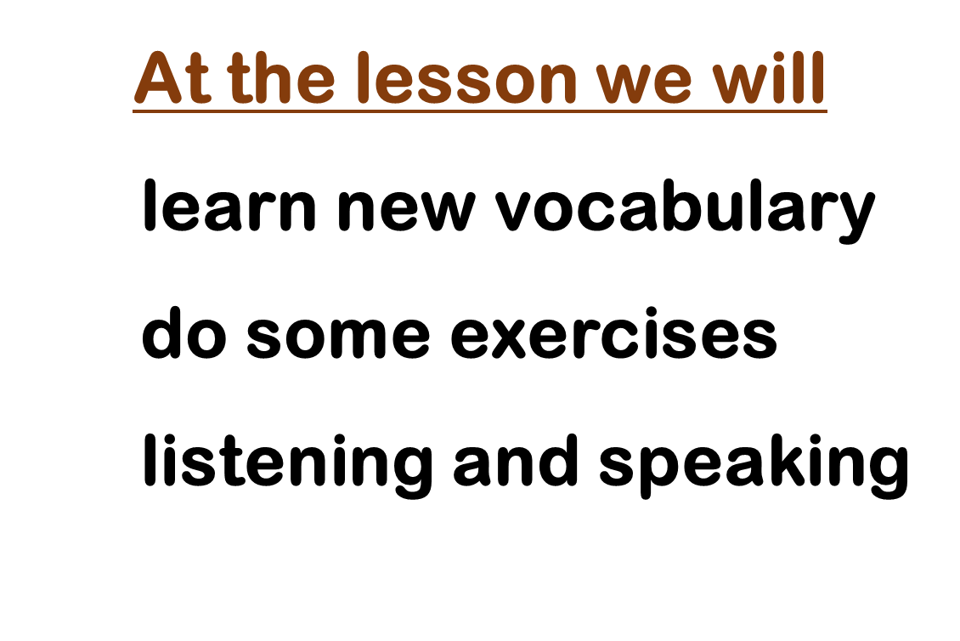


Slide 4
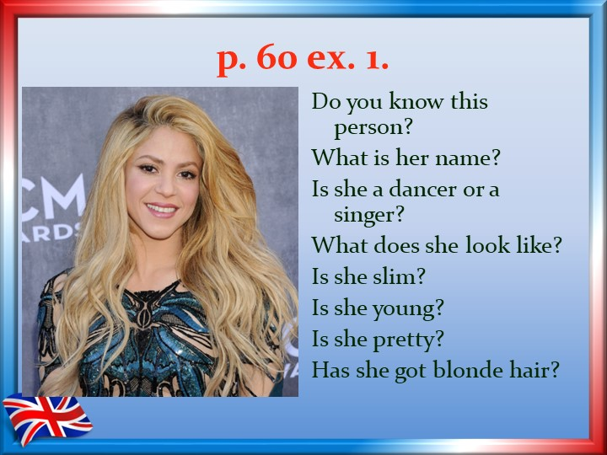


Slide 5
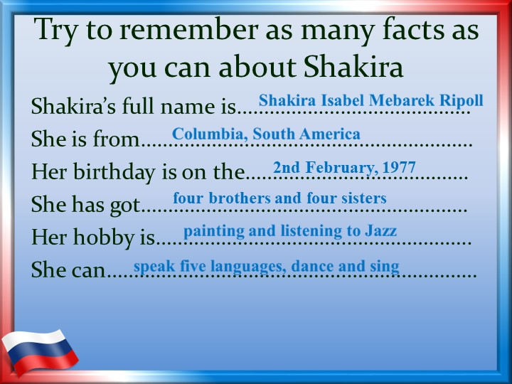

Slide 6
p.60 ex.5
Listen and match the people to their hobbies. What’s your hobby?
People Hobbies
1.Ann A.football
2. Tony B.painting
3.Pat C.computer games
4.Bill D.cooking
5.Laura E.playing the guitar
F.singing
G.dancing

Slide 7
People Hobbies
1.Ann singing F
2.Tony cooking D
3.Pat painting B
4.Bill playing the guitar E
5.Laura dancing G

Slide 8
  Homework
  SB стр.60 составить устный рассказ о любимых известных людях по образцу из упр.3 стр.60
  WB стр.29 упр.1

Slide 9
Now I
Know about Shakira
Can describe famous people
It was difficult to talk about appearance

Slide 10








How are you feeling?

