Slide 1
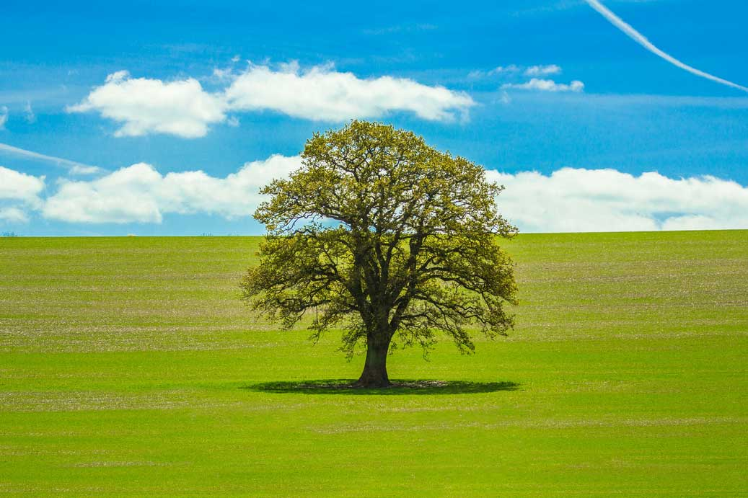
What’s this?
It’s a tree.

Slide 2
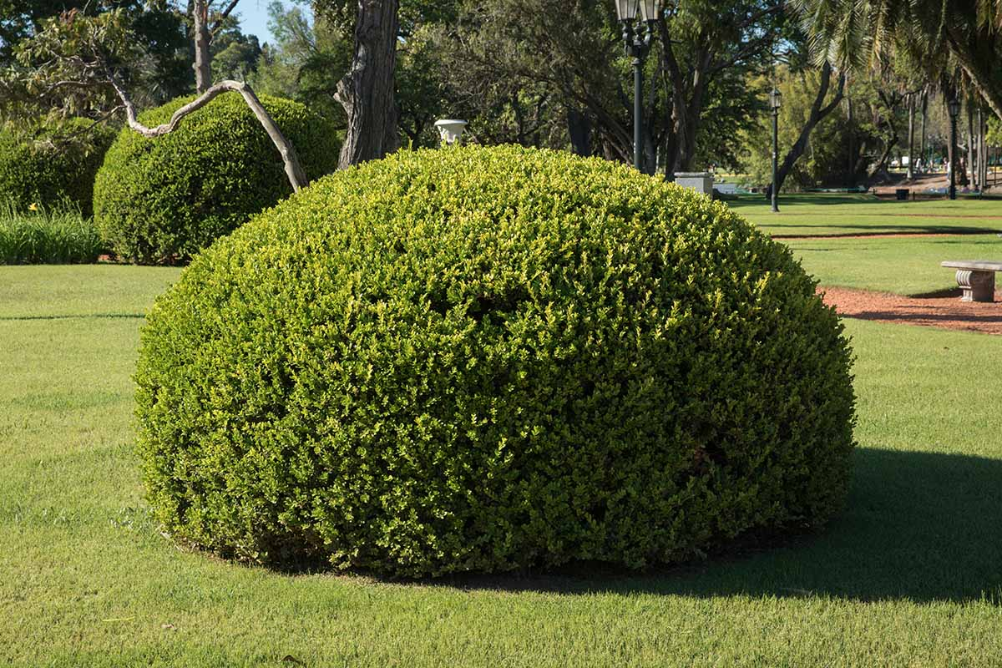
Is this a tree?
No, it’s a bush.

Slide 3
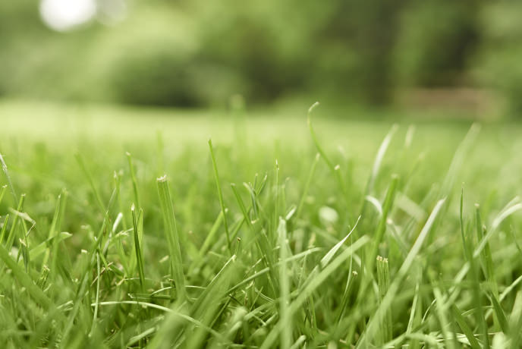
Is this a bush?
No, this is grass.

Slide 4
tree
bush
grass

Slide 5
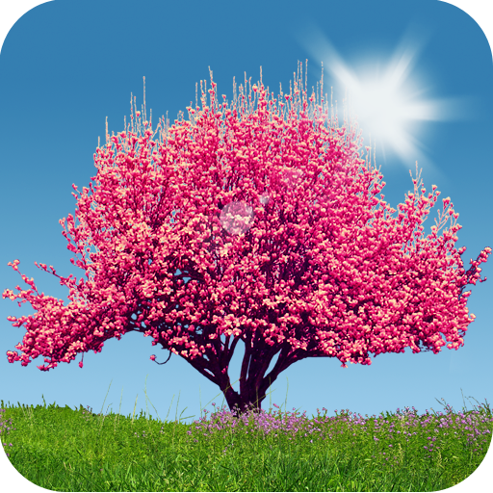
What’s this?
It’s a tree.

Slide 6
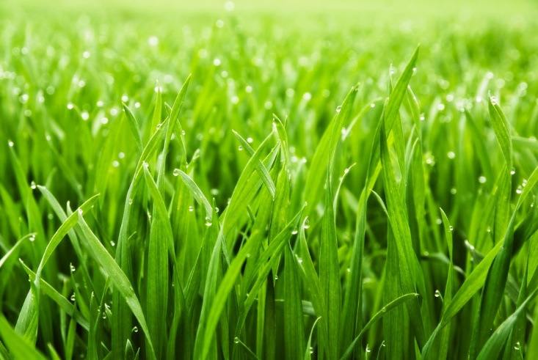
What’s this?
This is grass.

Slide 7
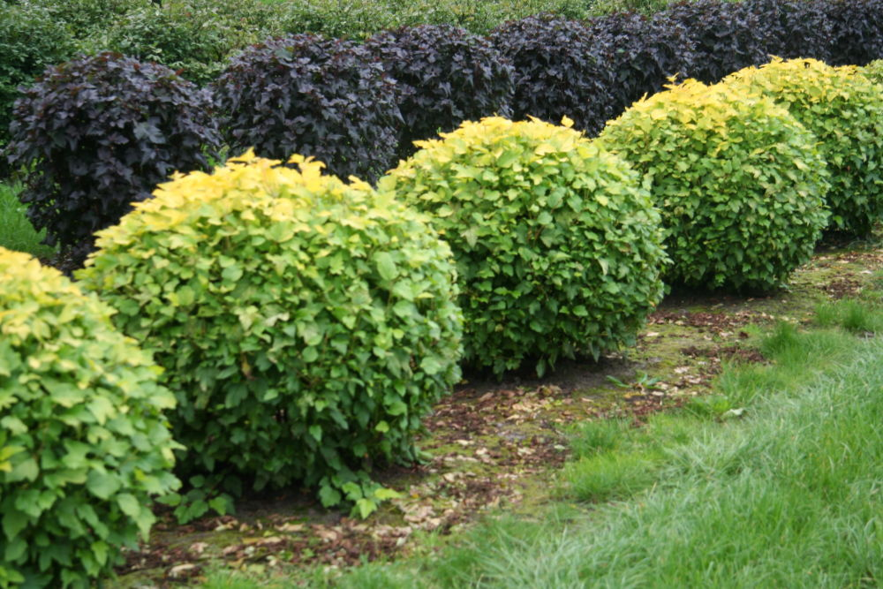
What are these?
They are bushes.

Slide 8
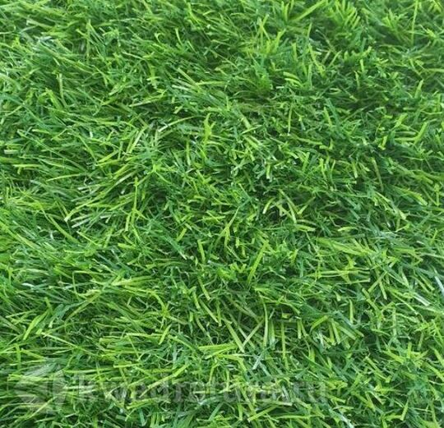
What’s this?
This is grass.

Slide 9
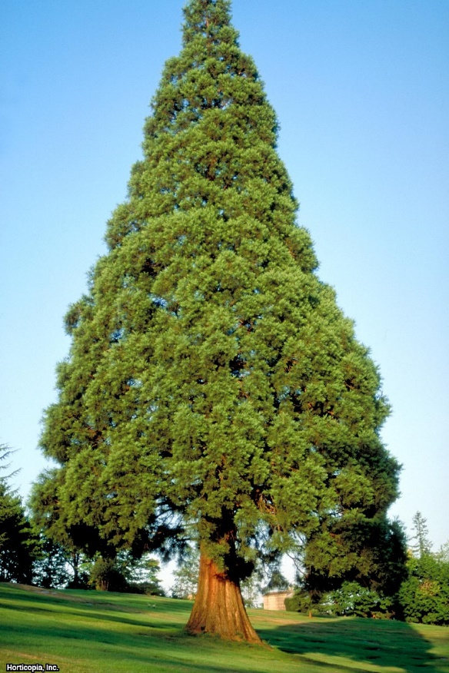
What’s this?
It’s a tree.

Slide 10
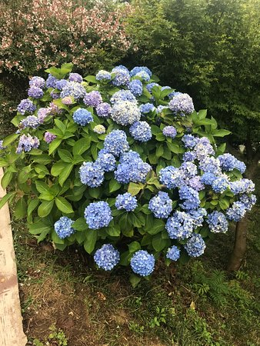
What’s this?
It’s a bush.

Slide 11
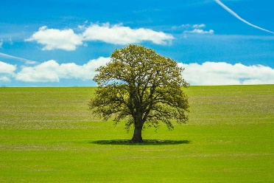

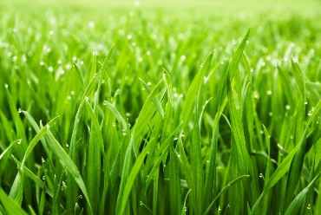
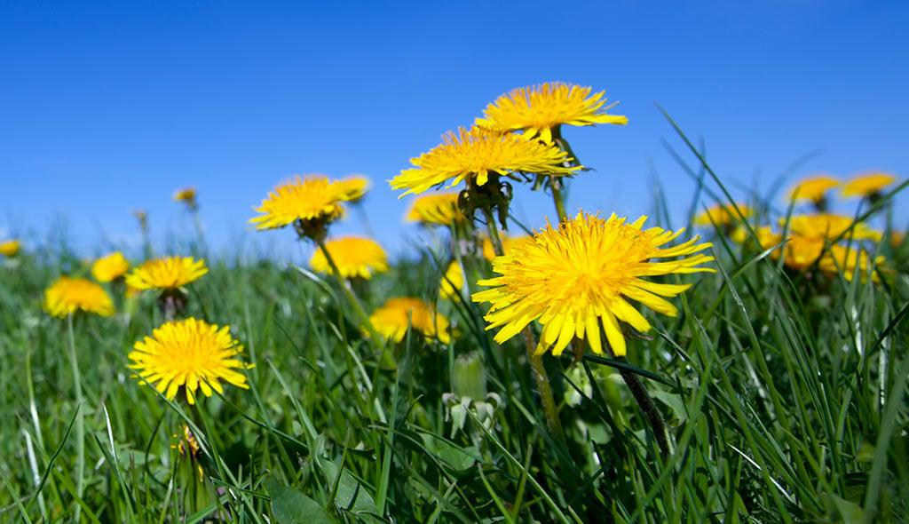
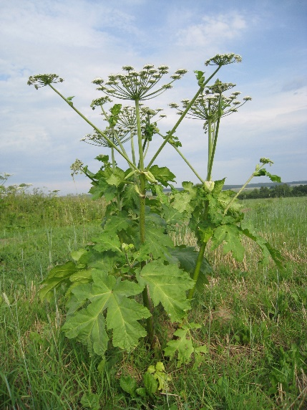
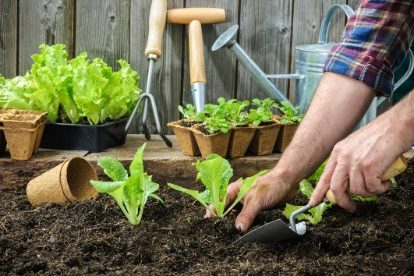
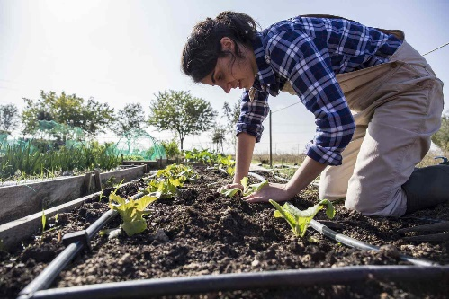
Plants
Wild
Cultivated

Slide 12
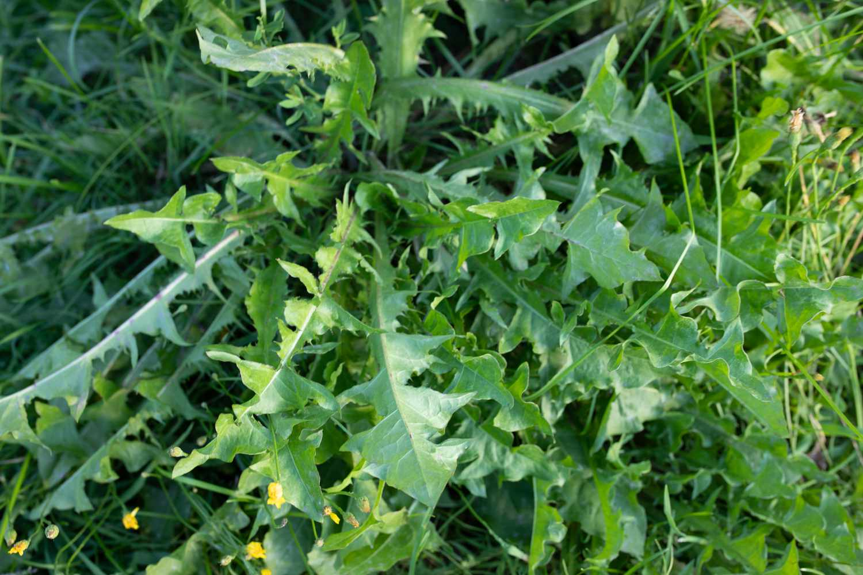
Wild or cultivated?
Wild

Slide 13
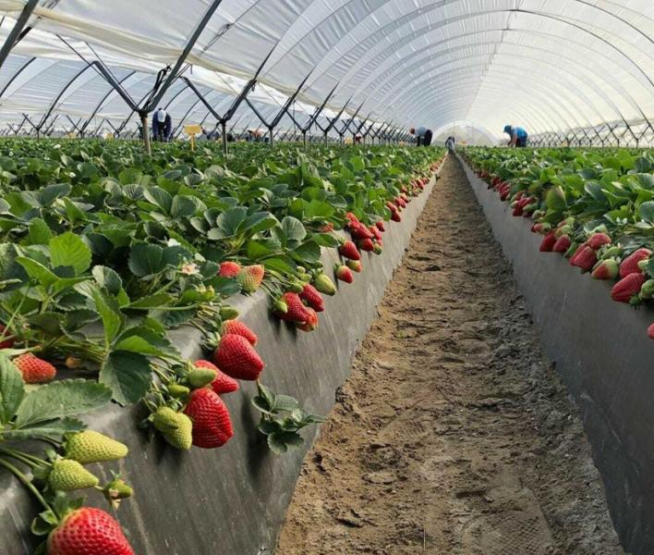
Wild or cultivated?
Cultivated

Slide 14
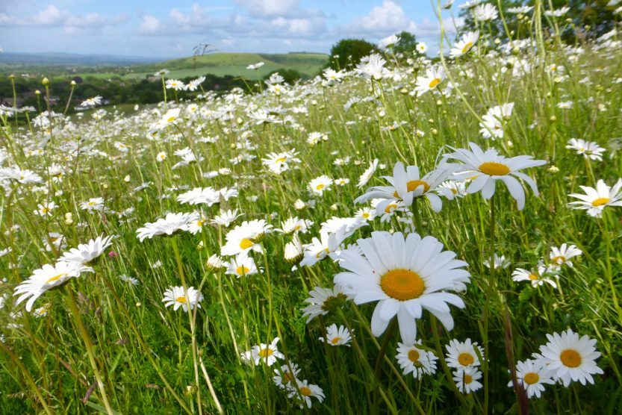
Wild or cultivated?
Wild

Slide 15
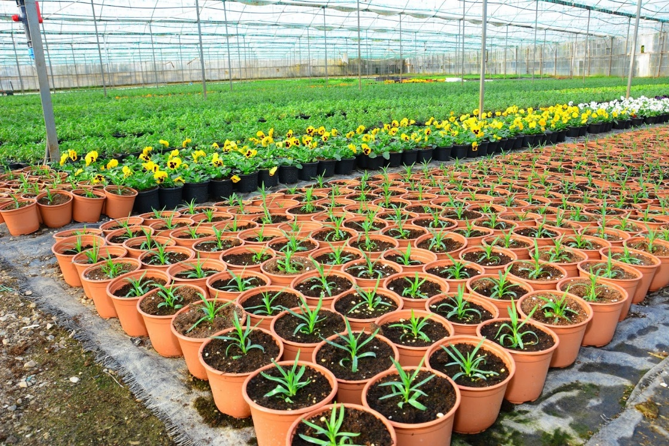
Wild or cultivated?
Cultivated

Slide 16
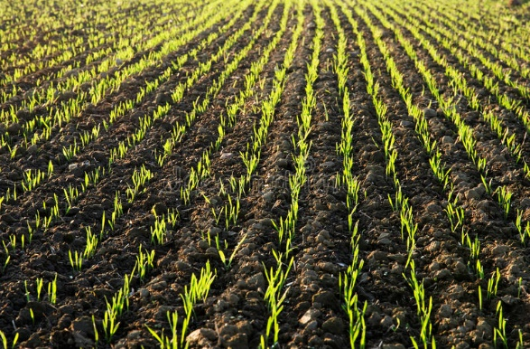
Wild or cultivated?
Cultivated

Slide 17
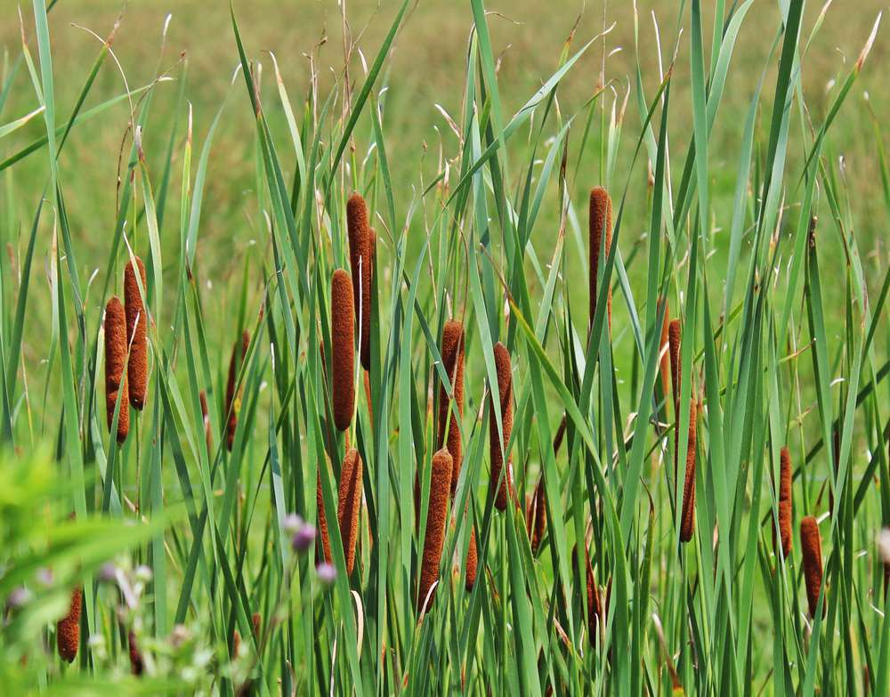
Wild or cultivated?
Wild

Slide 18
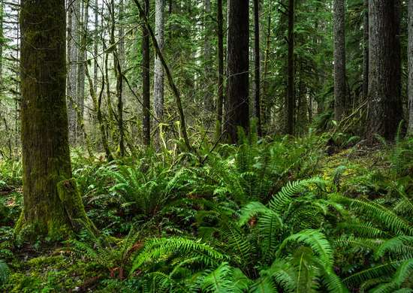
Wild or cultivated?
Wild

Slide 19
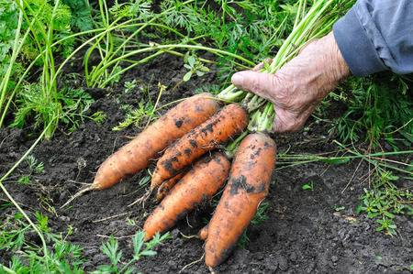
Wild or cultivated?
Cultivated

Slide 20
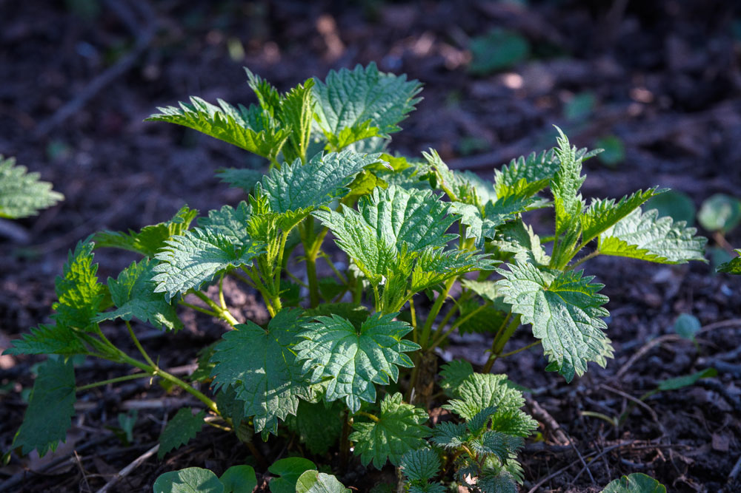
Wild or cultivated?
Wild

