Slide 1
The Paralympic Games

Slide 2
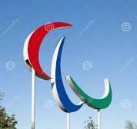
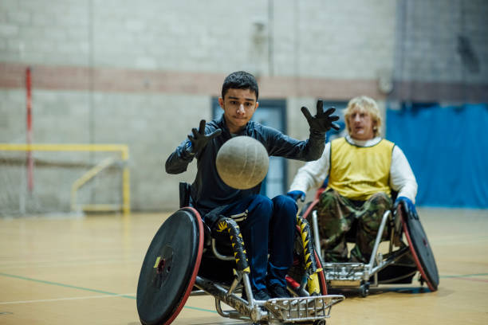
The Paralympic Games
people with physical disabilities
have a lot of different competitions
wheelchair rugby
sitting volleyball
net
ball
court
hit the ball
win
prizes
medals
practice

Slide 3

ex.1 Listen to an interview with Martha Dirksen
about a Paralympic sport.
What sport does she do?
1.
2.
wheelchair
basketball
wheelchair
tennis
3.
wheelchair
rugby

Slide 4





Ex. 2 Listen again and read the sentences.
Are they right or wrong?
Martha often has tennis practice. -
2. She wants to take part
in the Paralympic Games one day.-
3. Martha thinks it’s hard to play wheelchair
tennis. -
4. Tennis players move their wheelchairs fast
and hit the balls.-
5. David Wagner often wins his games. -
almost every day
dreams of being
difficult
quickly
has lots of medals

Slide 5
1. Martha is | ____________ years old.
2. Her court is | near her ____________ .
3. David Wagner is from | the ____________ .
4. Martha usually has breakfast | at ___________ o’clock.
5. She has tennis practice | __________ days a week.
6. Martha has competitions | at the ___________ .
eleven
Ex. 3 Listen again
and complete
the table.
You can use only
one word.
Write the numbers
in words.
school
USA
eight
four
weekends

Slide 6
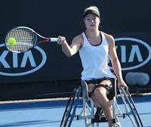
Ex.4 What do you know about Martha now?

Slide 7
Was it easy or
difficult to listen
to the interview?
Choose and underline
your variant.
Very easy easy quite quite difficult very
easy difficult difficult

