Slide 1
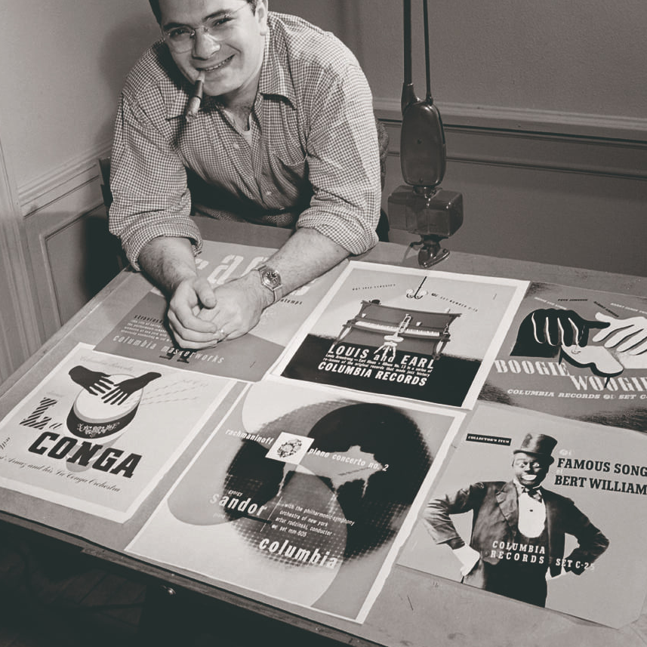
Ministry of Education of the Moscow Region Branch of the State Educational Institution of Higher Education of the Moscow Region "State Social and Humanitarian University" in the town of Zaraysk - Zaraysk Pedagogical College
Steinweiss
Student:
Doschenko E.I.
Group: 41 «B»
Specialty: 44.02.02
Teacher: Minaeva R.V.
Zaraysk, 2024
Notes:
Alex Steinweiss

Slide 2
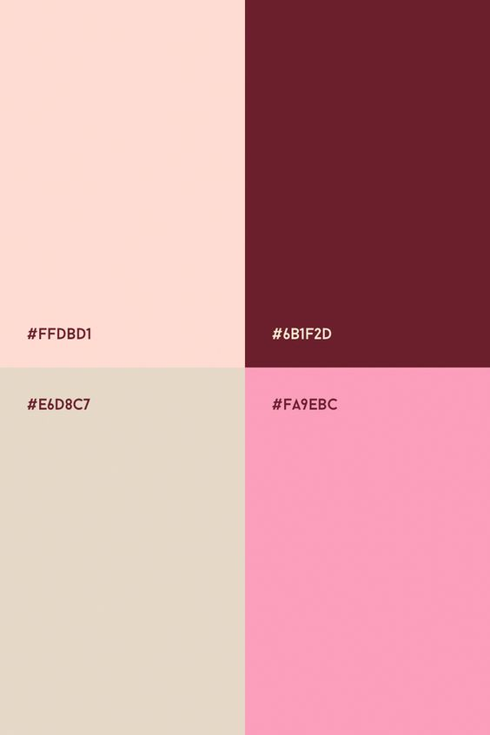
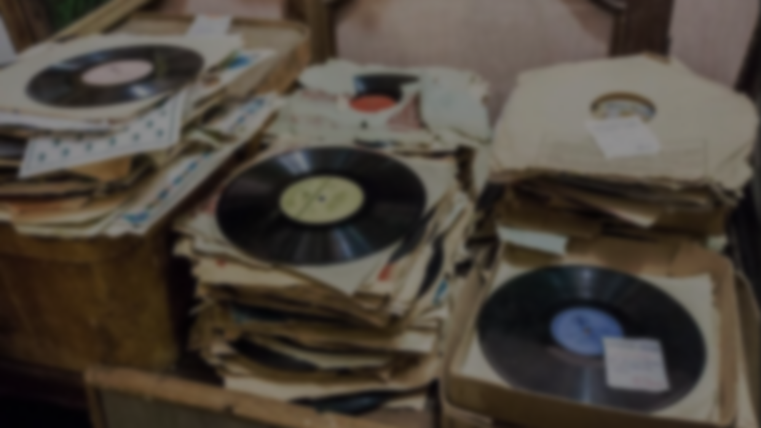
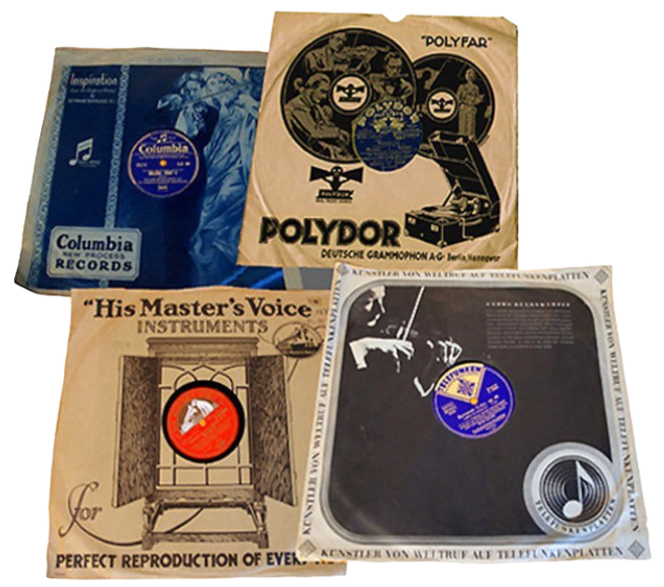
Before music records were packaged in simple brown paper sleeves.

Slide 3
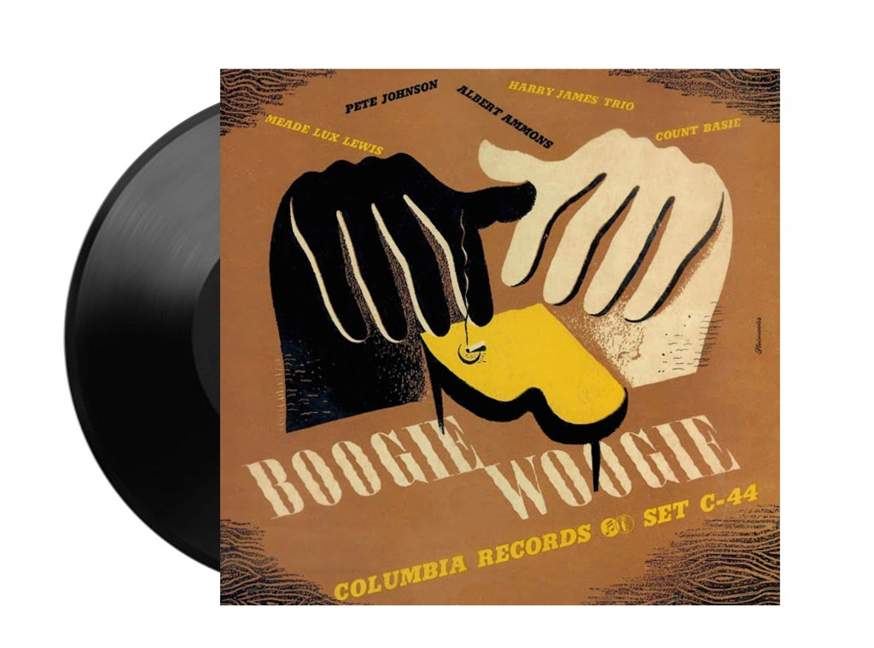
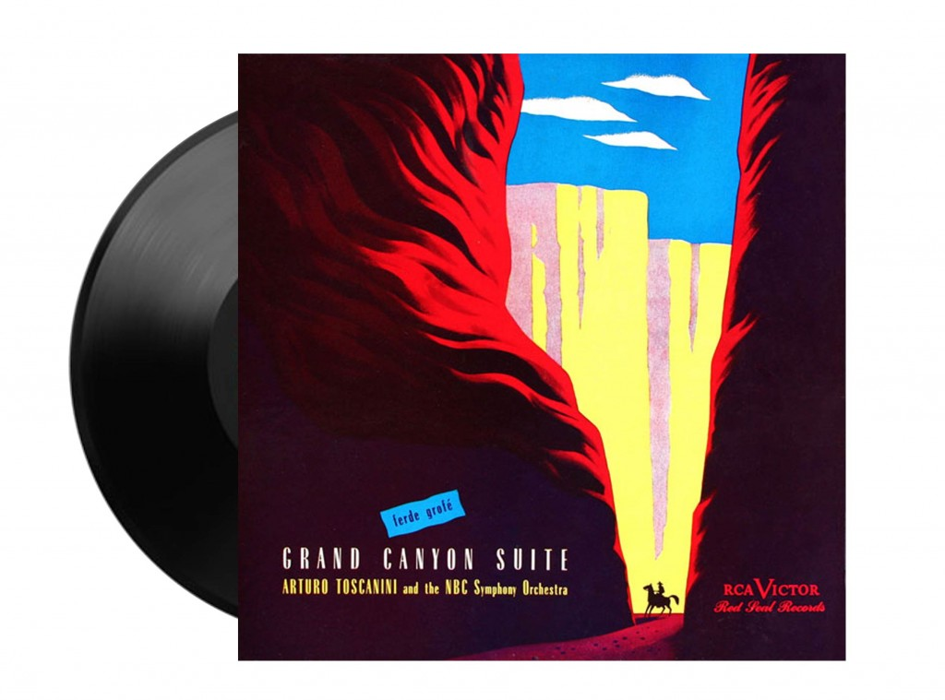
Packaging idea

Slide 4
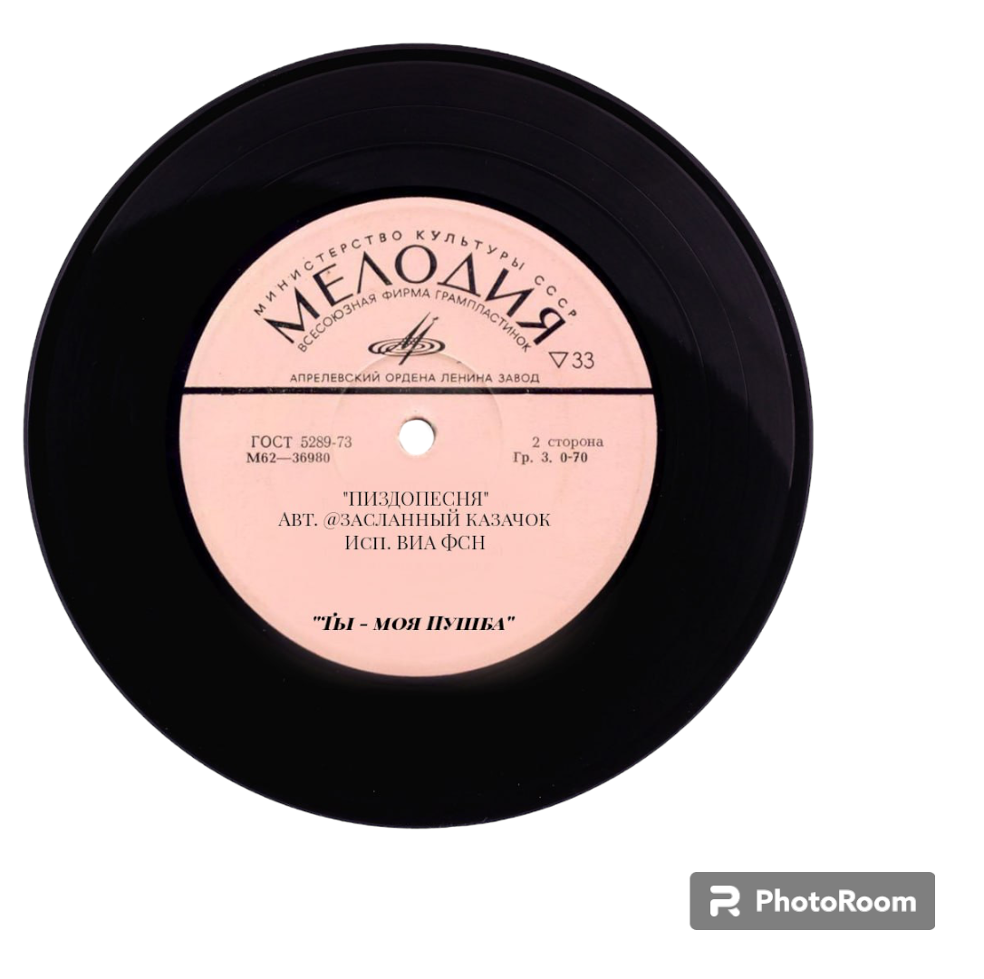
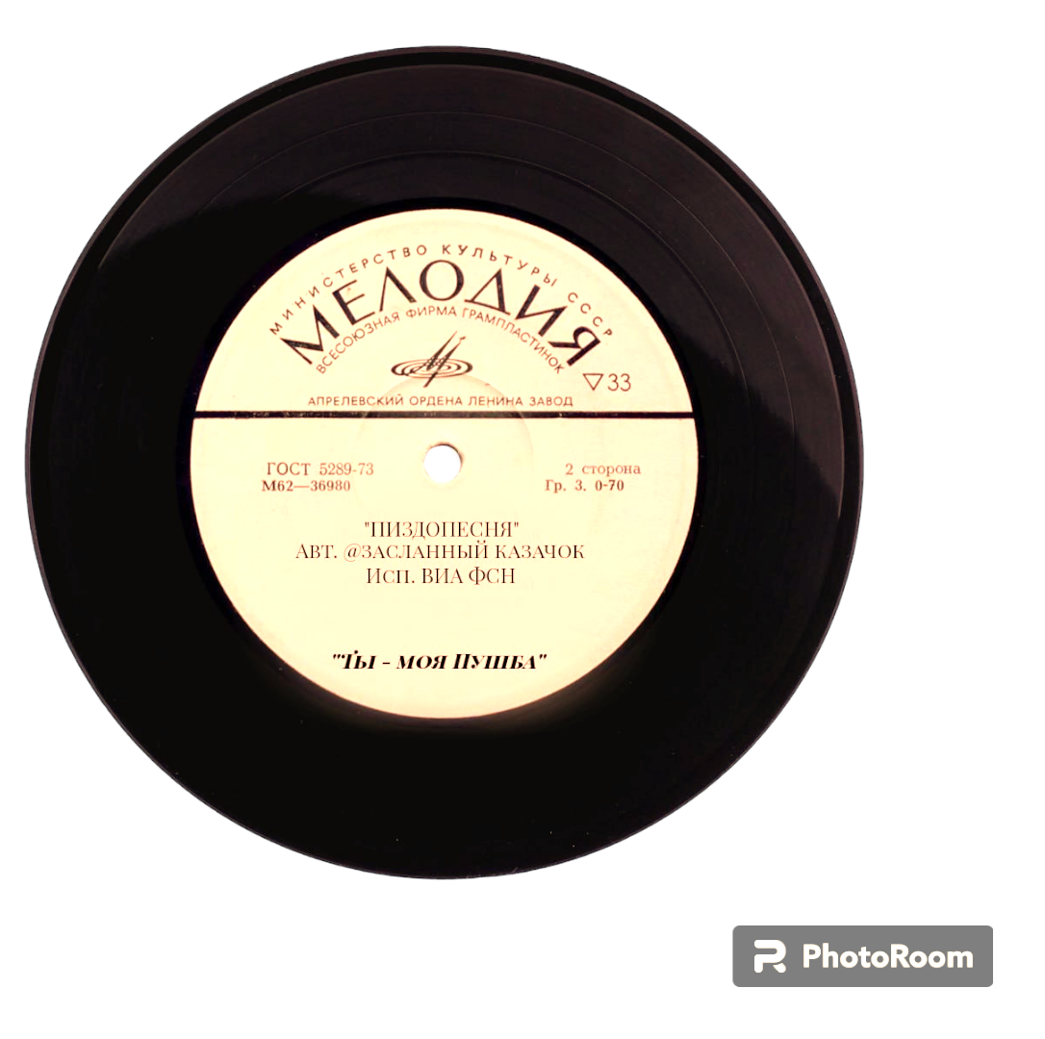
Record sales growth

Slide 5
Columbia Records

Slide 6
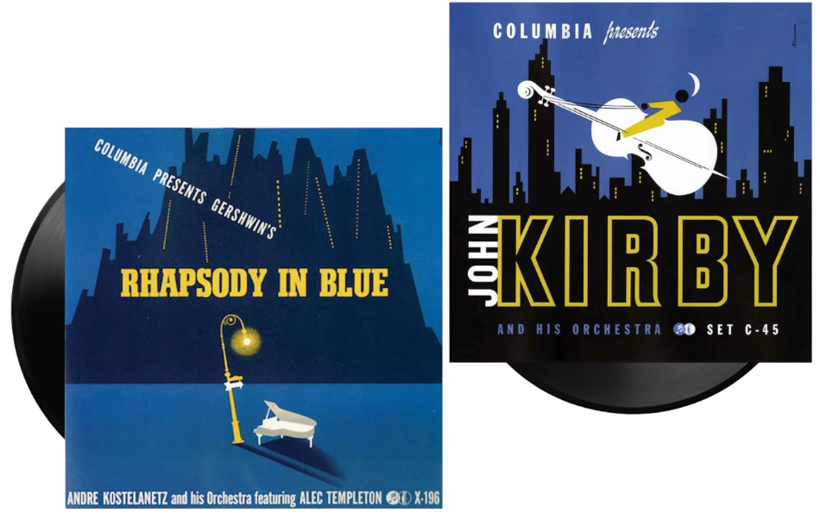
These were mini posters, mini stories about musical works in
the tradition of French and German graphic design of the 1930s
the tradition of French and German graphic design of the 1930s

Slide 7
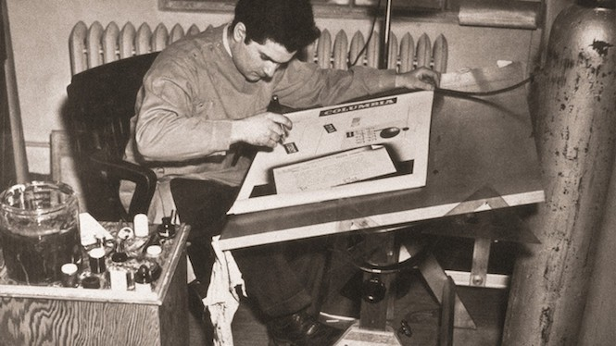
Steinweiss Scrawl

Slide 8
Computerization

Slide 9
Contributions by Alex Steinweiss

Slide 10
Fill in the missing words in the sentences.
Previously, music records were packaged in _______________ _______________.
Working in ________________________, he not only wrote fonts by hand and created his own font, Steinweiss Scrawl.
His idea of ______________________________________ was a huge success.
simple brown
paper sleeves
the “pre-computer era”
creating colorful images on packaging
Click here to check

Slide 11
Read the following statements. Answer the truth (T), a false (F) and doesn’t said (DS).
1) | From 1939 to 1945 he worked for New York Records. | _______
2) | With the development of printing processes, recording companies increasingly began to prefer photographs | _______
3) | 13. In the 50s, Alex Steinweiss left the company and took up writing. | _______
4) | His idea of creating vibrant images on packaging was a huge success. | _______
5) | Album sales increased by 800 percent thanks to new packaging | _______
F
T
F
T

Slide 12
Connect the beginning of the proverb with its end
1. In the 50s, Alex Steinweiss |  | on packaging was a huge success.
2. Working in the “pre-computer era”, |  | he worked for Columbia Records.
3. Alex Steinweiss is unique |  | in that he created more than just advertising packaging.
4. From 1939 to 1945 |  | left the company and took up his own creativity.
5. His idea of creating vibrant images |  | he not only wrote fonts by hand and created his own font, Steinweiss Scrawl.

Slide 13
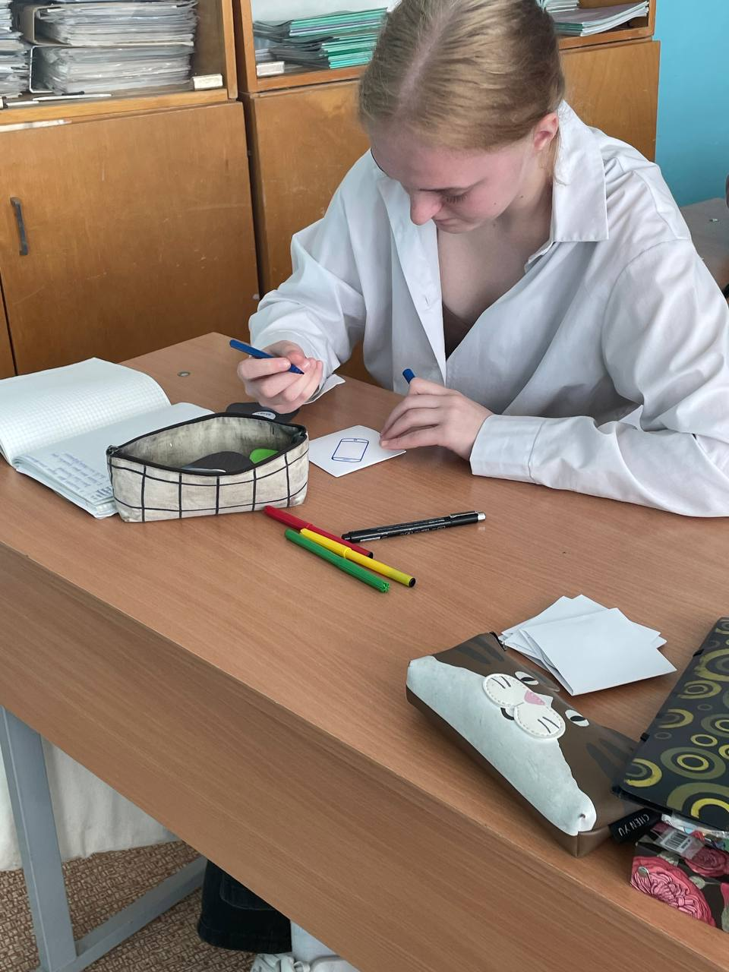
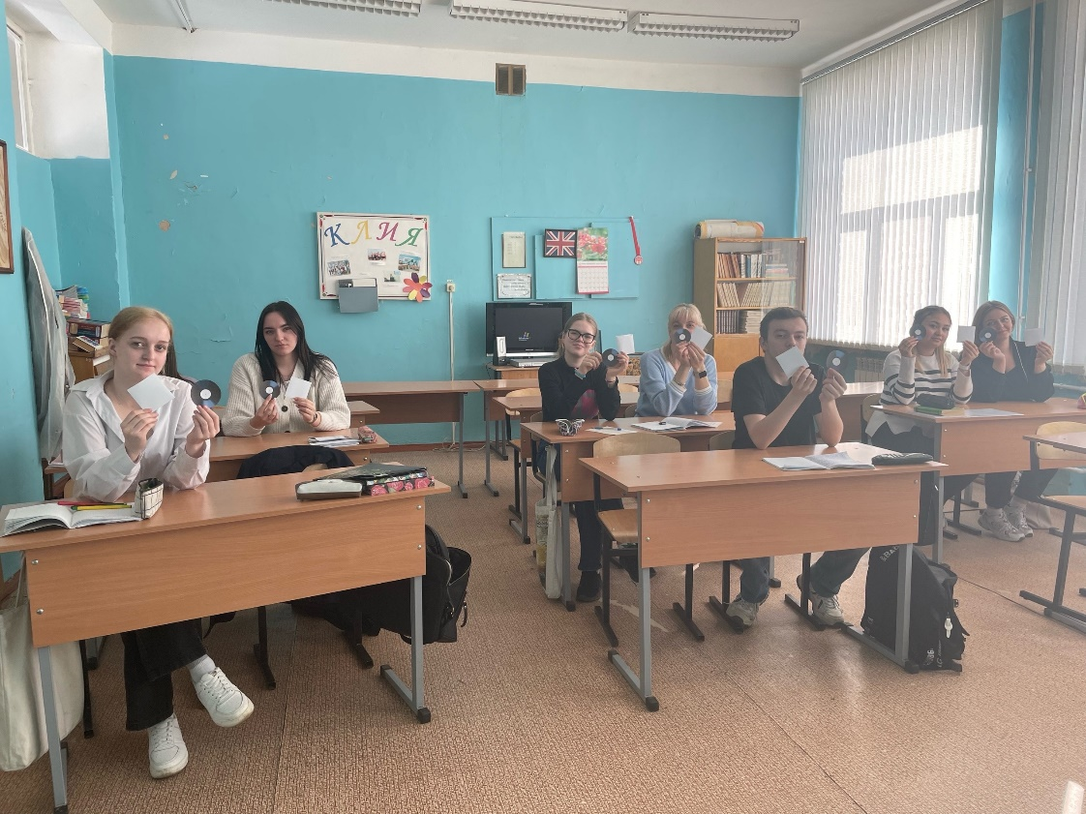
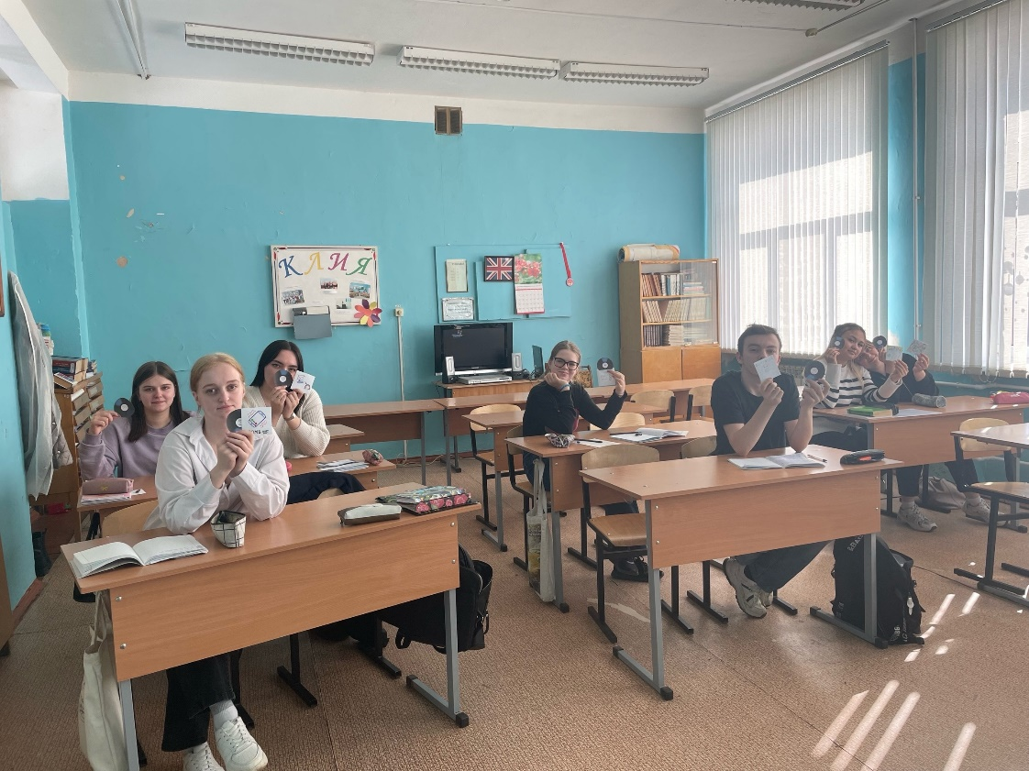
Create your own design for music record packaging

Slide 14
Thank you for your attention!

Slide 15
Bibliography
http://www.lafrimeuse.com/ru/aleks-stejnvejs-ili-kak-graficheskij-dizajner-perevernul-muzykalnyj-mir/
https://deziiign.ru/project/529b9d6e825c49dcaeee4b377df24f4b
https://trendymen.ru/lifestyle/media/45310/

