Slide 1
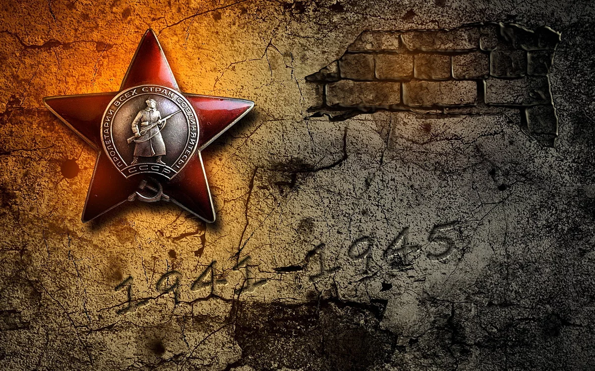
We Remember,
We Are Proud,
We Inherit!
(Slide 11).
Natalya Ignatenko
Komsomolsk-na-Amure.
(Slide 11).
(

Slide 2
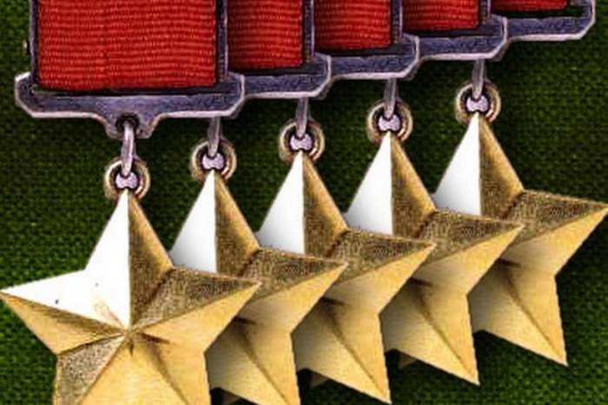
Citizens of Komsomolsk-na-Amure – Heroes of the Soviet Union

Slide 3
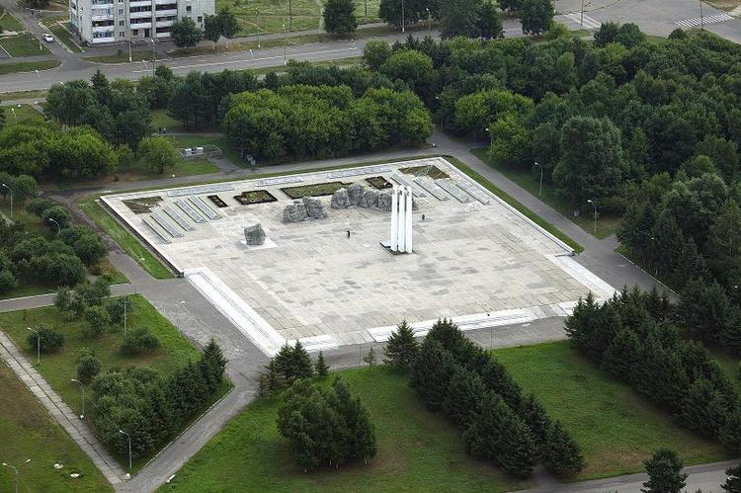
Contribution of citizens of Komsomolsk-na-Amure
to the Victory
More than forty thousand citizens of Komsomolsk went to the front in 1941. Over five thousand of them perished on the battlefields.
Eighteen men were awarded the title of Hero of The Soviet Union.
To commemorate their heroic deeds the Memorial Complex was erected.
Our memory is alive not only in the stone but in our hearts.
Nobody is forgotten, nothing is forgotten.

Slide 4
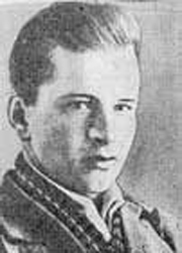
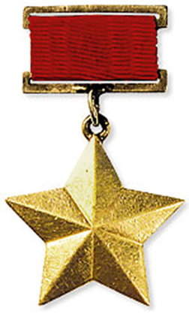
Dikopoltsev Evgeniy Aleksandrovich
23.11.1923 - 17.10.1943
Evgeniy was born in the village of Troitskoye Khabarovsk Region in the family of peasants. He finished school №1 which now bears his name.
In October 1943, during the crossing of the Dnieper, while pulling the ends of the cable he was seriously wounded by the explosion of the enemy’s artillery shell. Losing consciousness, he connected the ends of the damaged cable with his teeth providing the link with the headquarter even after his death. Yevgeny was only twenty.-two.

Slide 5
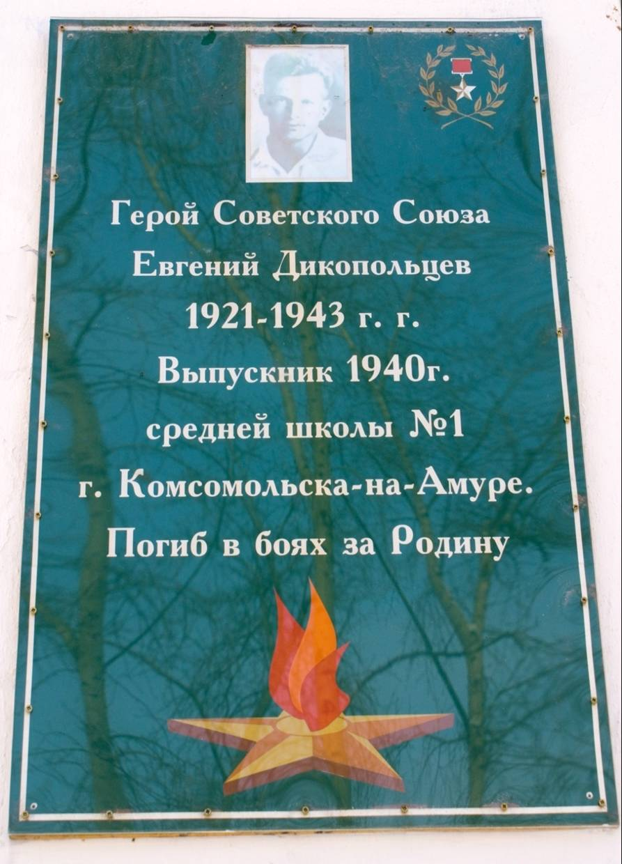
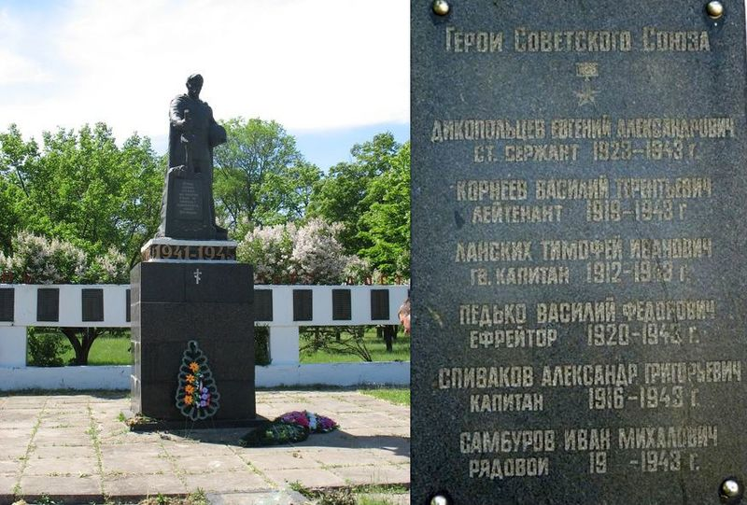
The memorial board on the building of the Pedagogical University, Kirov Street,(former school №1) where Yevgeny studied
The bed of honor, the village of Radanskoуe, Ukraine, where Yevgeny Dikopoltsev was buried

Slide 6
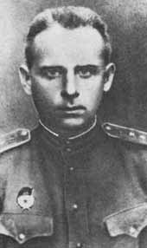
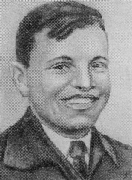
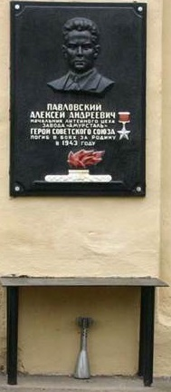
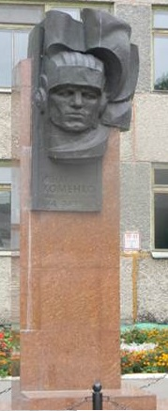
Khomenko Ignat Stepanovich
Pavlovskiy Aleksey Andreevich
Commander of the amphibious battalion. With his solders he captured and defended height 177 for two days.
Being in besiegement Pavlovskiy destroyed 17 German tanks and died heroically…
He was a mechanic-driver of the tank SAU-122. In November 1943 during the battle for the town of Cherkassk, Ignat rammed two artillery guns, being in the damaged tank which didn’t have artillery shells
The memorial plaque on the building of the Amurmetal plant where Alexey Pavlovskiy worked before the war broke out.
The monument to Khomenko Ignat in front of the building of school №4, where he studied. The school bears his name.
School №4

Slide 7
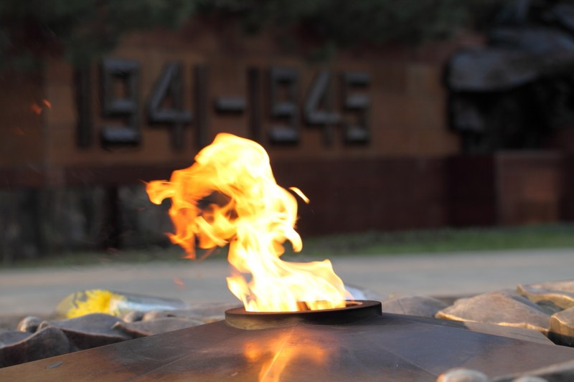
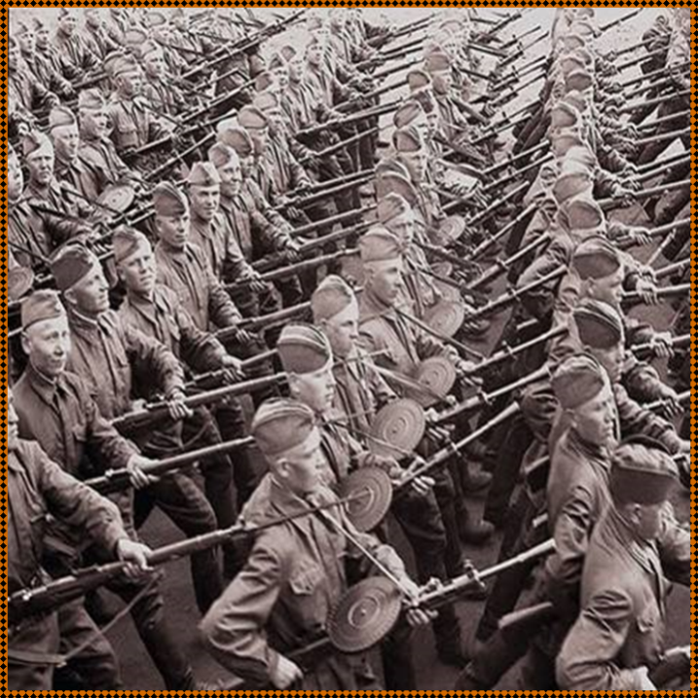
We will never forget you…
More than 40000 citizens of Komsomolsk-na-Amure went to the front in 1941…
Over 5000 of them perished on the battlefields.
28000 people were awarded orders and medals.
18 men were awarded the title of Hero of the Soviet Union.

Slide 8
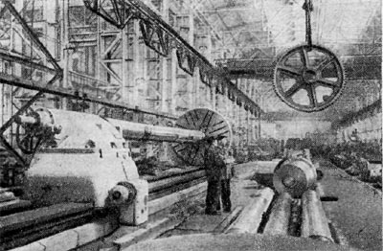
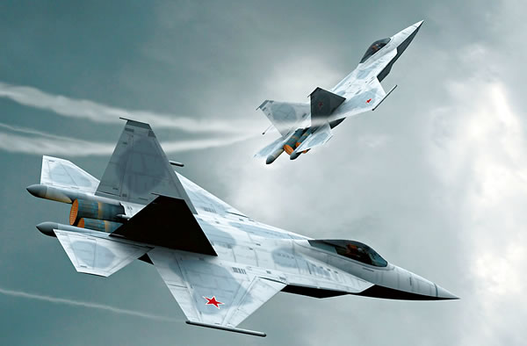
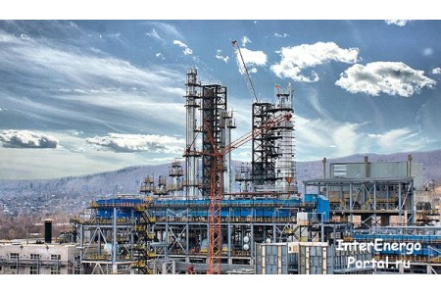
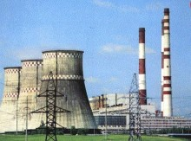
The plants of Komsomols-na-Amure contributed much to the victory. The Shipbuilding plant made aircraft carriers and battle cruisers.
The aircraft plant made 2700 fighters “IL-4” which bombed German troops.
It also made artillery shells and aircraft bombs.
The “Amurstal” plant melted steel for the other plants.

Slide 9
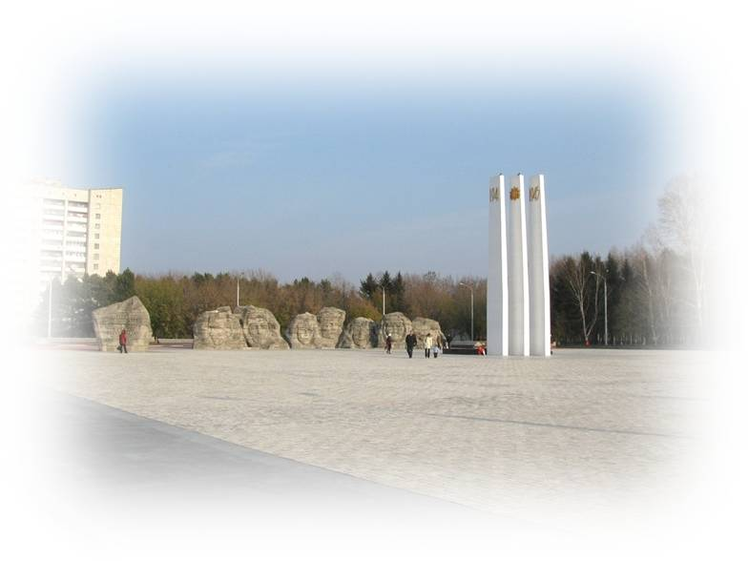
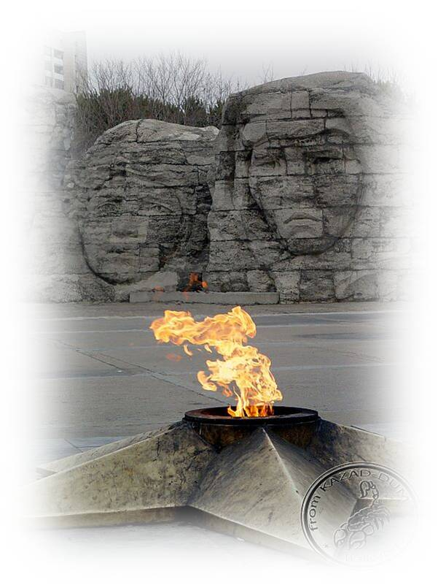
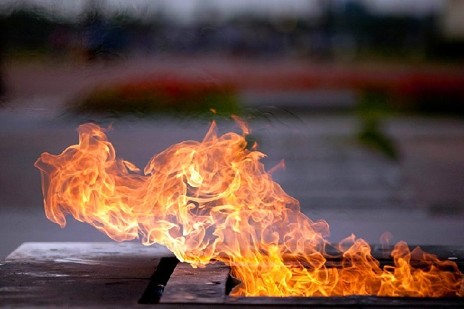
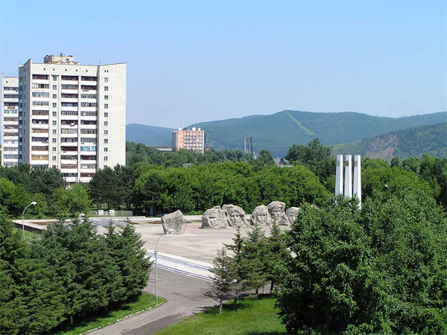
To commemorate those who will never come back from the battle fields of the World War II, the Memorial Complex to the citizens of Komsomolsk was erected in 1972. The design of sculptors from Leningrad N. Ivleva and S. Nikolin won the competition.
In one part of the Complex you can see three pylons, symbolizing soldiers’ bayonets. You can see the dates “1941” and “1945” on two of them and the Order of the Great Patriotic War on the third one.

Slide 10
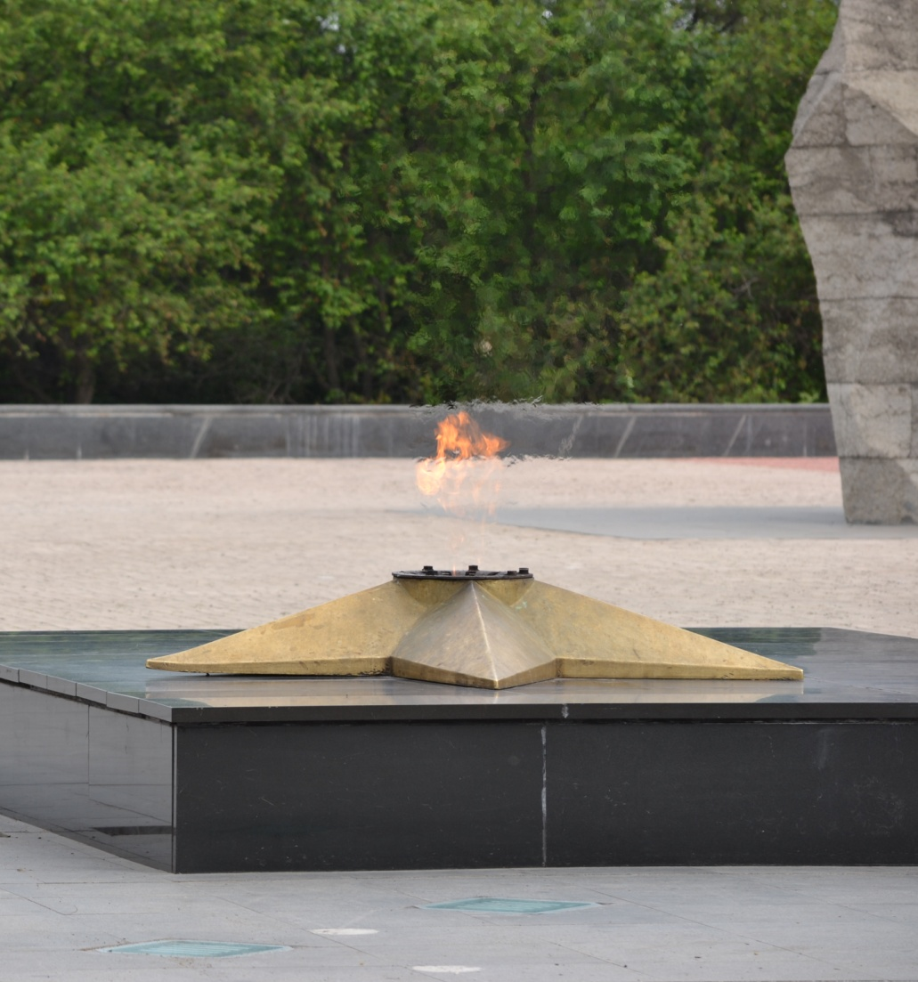
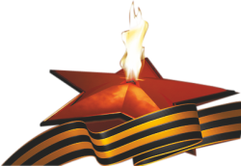
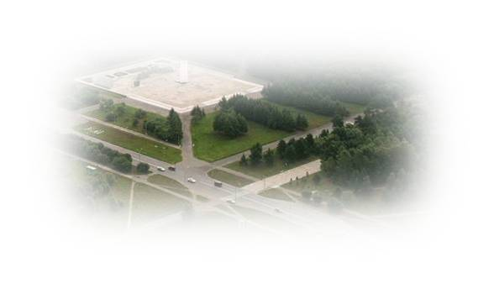
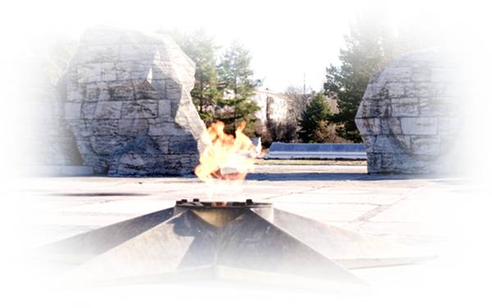
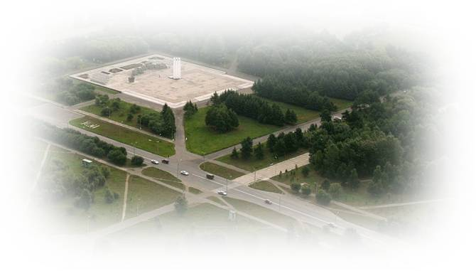
The second part of the complex is a five-pointed star in the middle where the eternal flame burns in memory of those who gave their lives for freedom and independence of our country.
The star was made of brass at the Shipbuilding plant.
The fire was lit on May 9, 1975, to celebrate the 30th anniversary of the victory over fascism. A torch with fire flame, taken from open-hearth furnace of the "Amurstal" plant was delivered by a Hero of Socialist Labor V.G.Vinogradov.

Slide 11
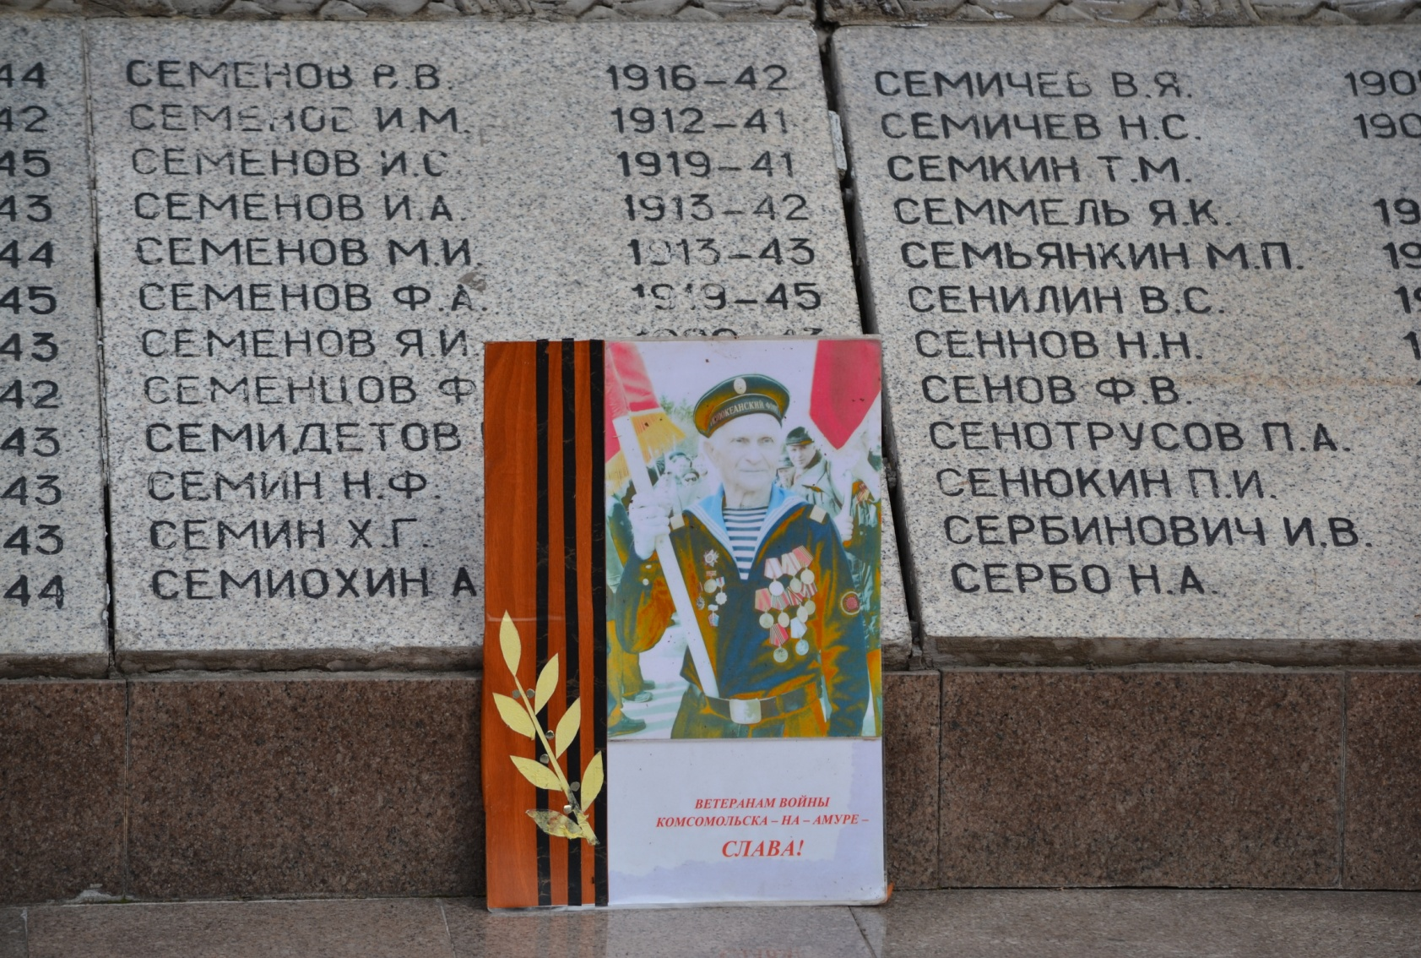
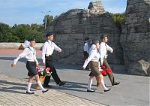
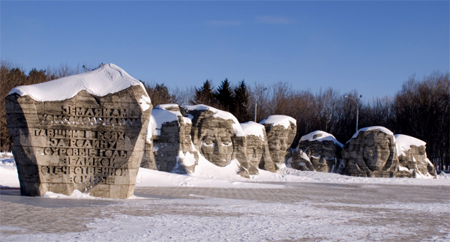
Post №1 in Komsomolsk-na-Amure
The town schools compete to serve at Post №1. Only best schools have the right to do it. The senior students of School № 23 annually serve here and are proud of it. We mustn’t forget those people who gave their lives to make our lives happy.
The carved faces of soldiers representing different nationalities and different kinds of troops surround the Complex

Slide 12
Questions
1.How many citizens of Komsomolsk participated in the Great Patriotic War?
2.How many citizens of Komsomolsk were awarded with the title “Hero of the USSR” for the heroic actions in the Great Patriotic War?
3.What was the contribution of the city industrial enterprises to the victory over fascists?
4. What heroic actions were made by Y.Dikopoltsev,I/Khomenko, A.Pavlovskiy?
5.Who are the sculptors of the Memorial Complex?
6.When was it opened?
7.Did any of your relatives participate in the Great Patriotic War?
8. Who took part in the march of the immortal regiment and is going to continue to participate in it?
9. Does your family keep frontline stories, letters, awards?
1
Notes:
пиирррррр

