Slide 1
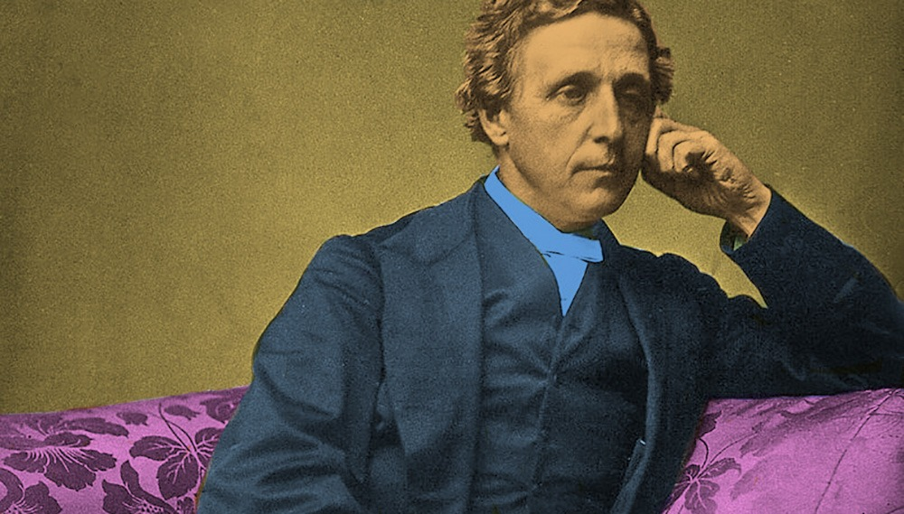
Lewis Carroll

Slide 2
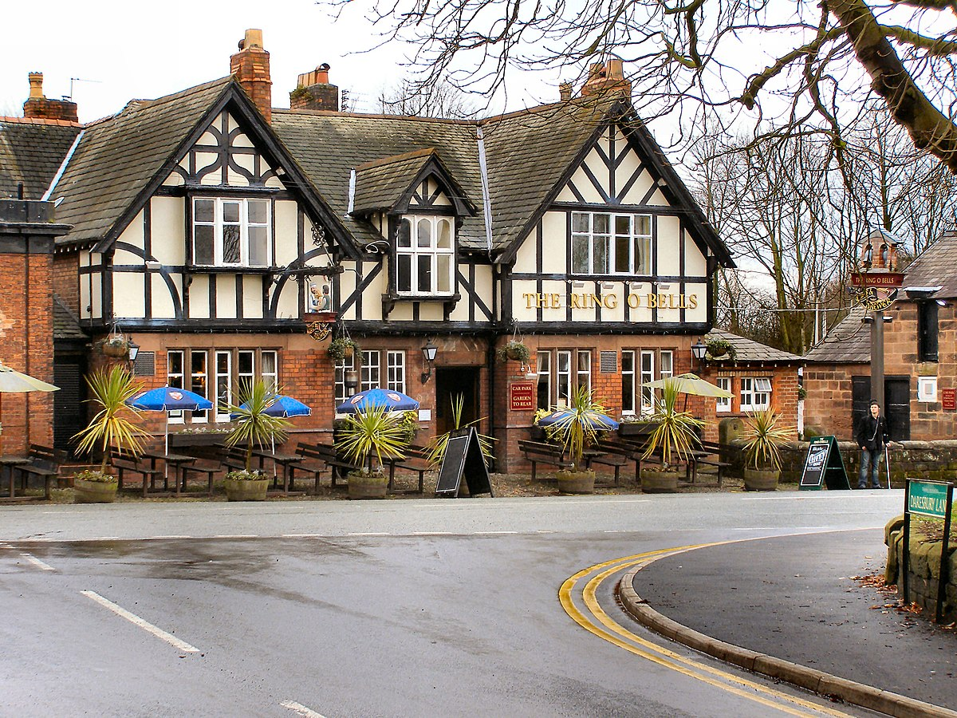
Lewis Carroll is a nickname of Charles Lutwidge Dodgson. He was born in Daresbury in Cheshire, England on 27th January, 1832. He had three younger brothers and seven sisters.

Slide 3
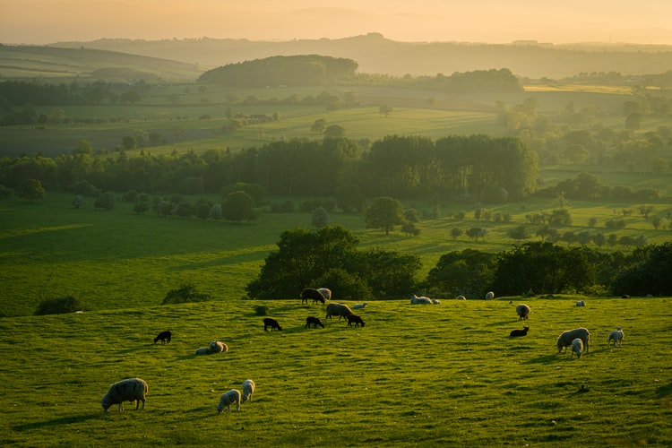
When he was eleven, the family moved to a
small village in Yorkshire. Charles did magic tricks, made puppet shows and wrote poems to entertain his brothers and sisters.

Slide 4
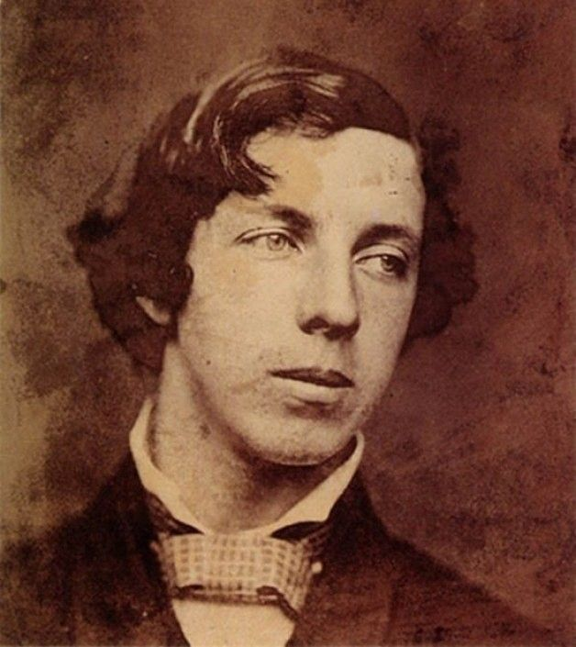
Charles Dodgson went to Rugby school and then to Oxford University’s Christ Church college to study Mathematics and Classics. In 1855 he became a teacher of Maths at Christ Church. He spent most of his life there and never married.

Slide 5
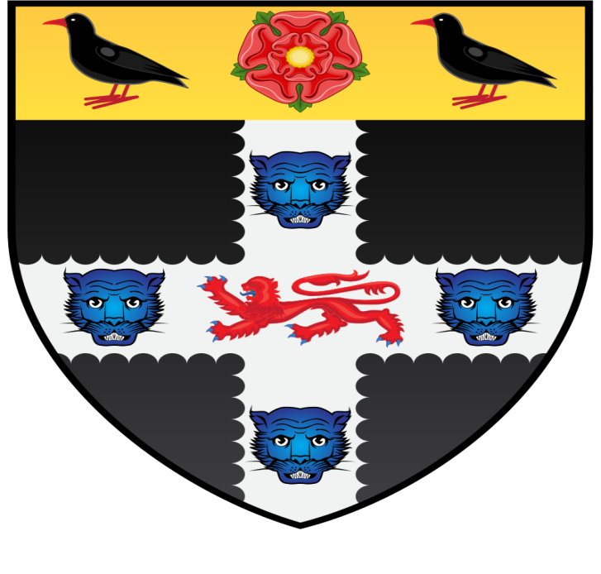
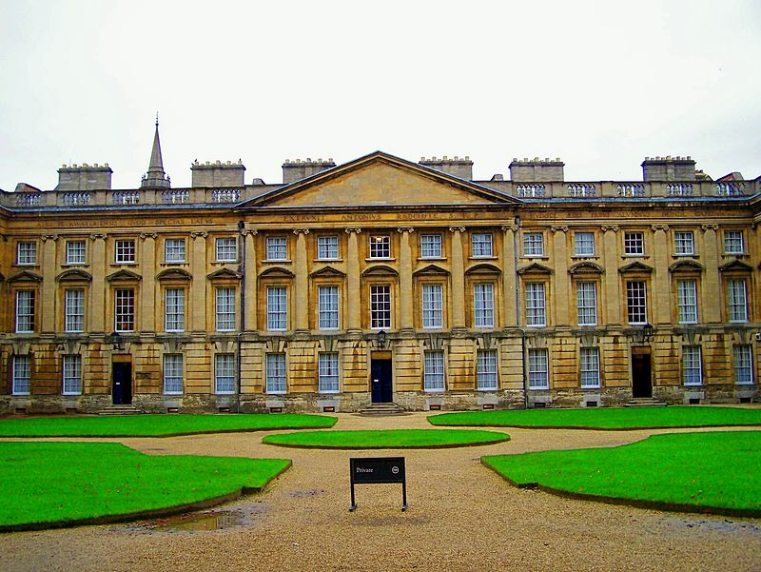
Christ Church College

Slide 6
Charles liked to photograph children. One girl, who he often photographed, was Alice Liddell, a daughter of the dean at Christ Church. He spent much time with the dean’s children and told them different stories.

Slide 8
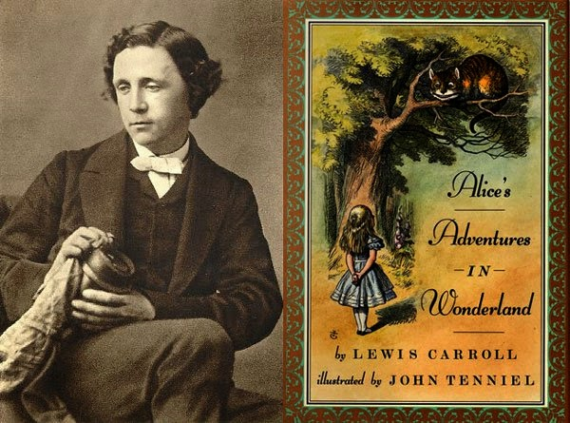
So, his famous books “Alice’s Adventures in Wonderland” (1865) and “Through the Looking Glass” (1871) appeared.

Slide 9
These books became very popular, and Charles Dodgson wrote several other stories and various funny poems.

Slide 10
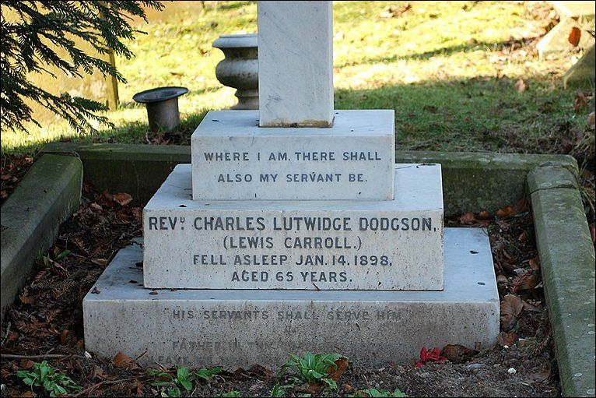
Lewis Carroll, a famous British children’s writer, died in Guildford, Surrey, England on
14th January 1898.

