Slide 1
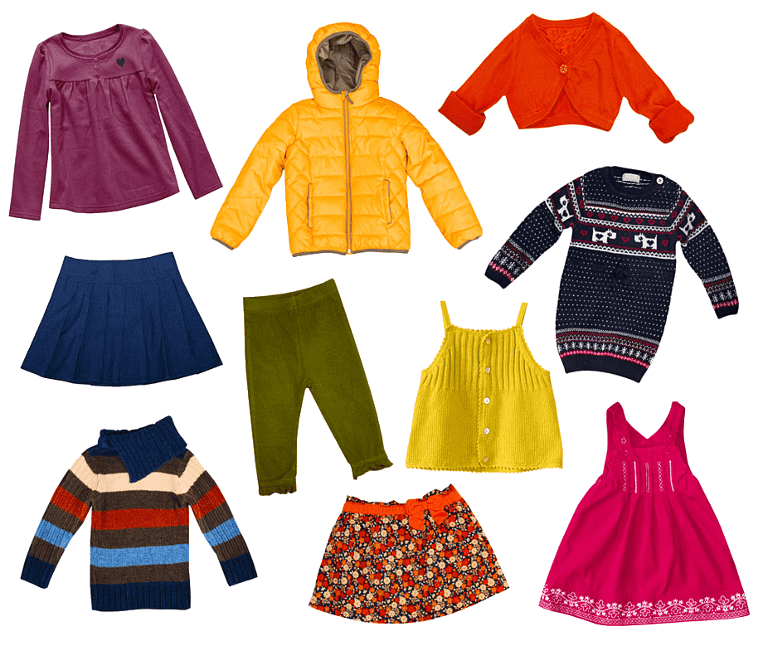
O
F
S
H
A
I
N

Slide 2
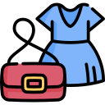
Урок английского языка по теме
«Мода. Одежда» («Fashion. Clothes»)
Учитель английского языка
Абольянина А.П. [269-216-430]

Slide 3
1. colourful a) поношенный
2. tight b) расклешённый
3. glamorous c) водоотталкивающий
4. baggy d) облегающий
5. flared e) цветной, пёстрый
6. worn f) стильный
7. waterproof g) роскошный
8. stylish h) мешковатый

Slide 4
Keys:
1 - e), 2 - d), 3 - g), 4 - h),
5 - b), 6 - a), 7 - c), 8 – f)

Slide 5
Can I help you?
Does it fit?
Is it my colour?
Does this skirt go with this blouse?
It suits you.
Do you need another size?
It’s too big on me.
Would you like to try it on?
I’ll take it.
Sure, it’s no problem.
It’s a bit small.
Do you like it?
Do you have these jeans in a larger size?
I’ll have a look.
Can I pay by card?
I’m just looking, thanks.
How much is it?
What make do you prefer?
Where is the fitting room?
How will you pay?
What size are you?

Slide 6
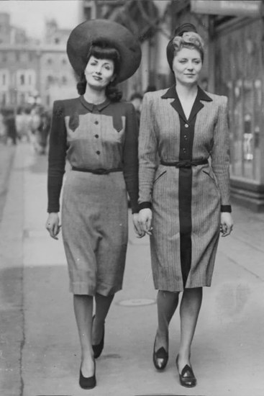
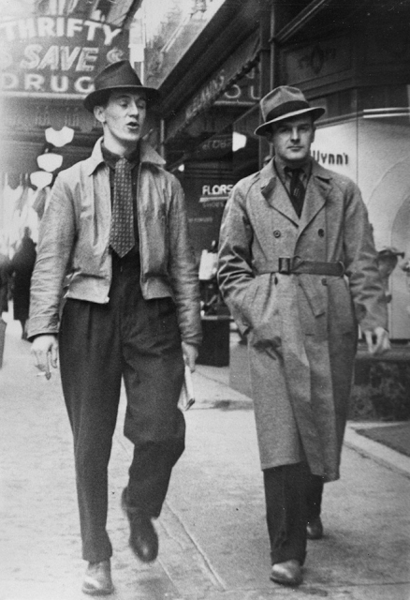
Fashion 30-s – 40-s

Slide 7
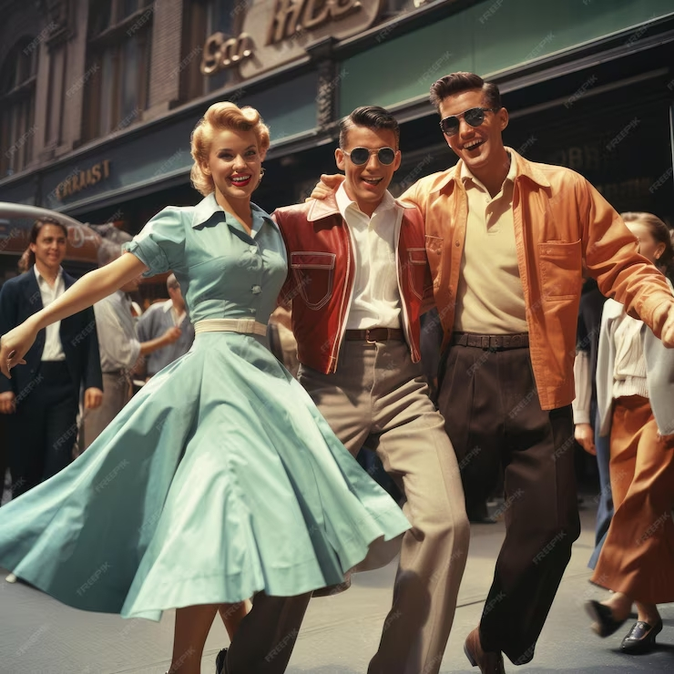
Fashion 50-s

Slide 8
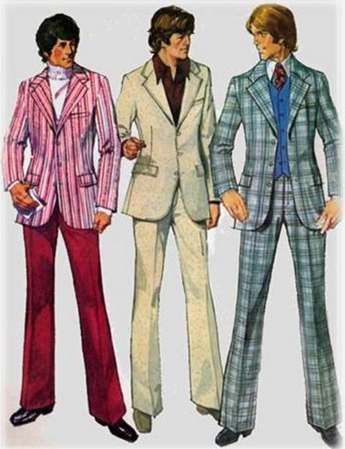
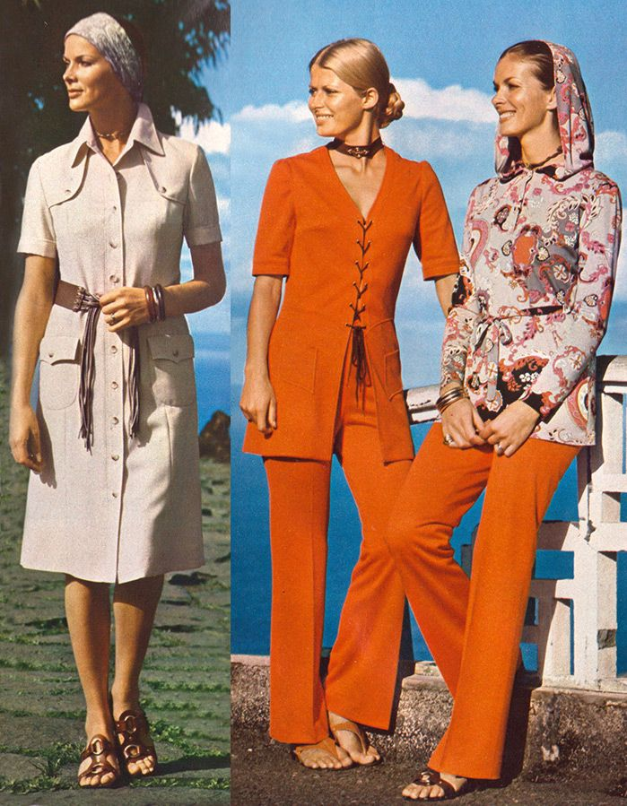
Fashion 60-s – 70-s

Slide 9
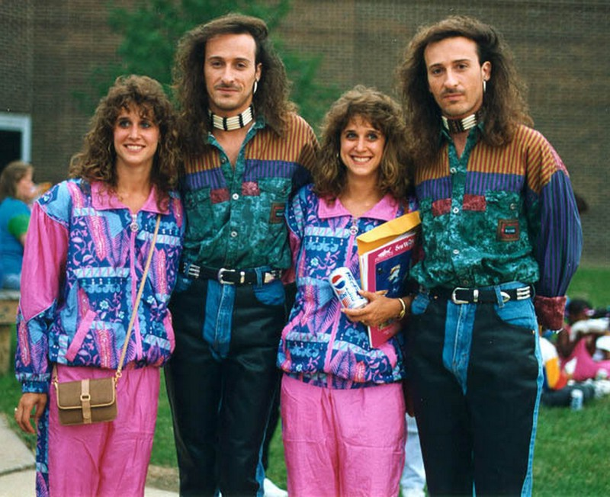
Fashion 80-s – 90-s

Slide 10
T-shirts
American troops (войска) copied the idea and started calling them “T-shirts” because of their T shape. In the mid-1950s, rock star Elvis Presley shocked the world by wearing the T-shirt on TV.
By the 1960s, T-shirts had conquered (завоевали) the world. Sports teams, clubs and rock bands were all using colours and logos on their “tees” to be noticed.
They tell others what we like, where we have been, the things we’ve done, the competitions we’ve won.
T-shirts started as underwear (нижнее белье). During the First World War, European soldiers wore them underneath (под) their uniform to keep warm.
Today T-shirts are worn in every corner of the world. Babies, kids, teenagers, adults and old people wear them.

Slide 11
Keys:
d), a), b), e), c)

Slide 12
Thank you for attention

