Slide 1
Quiz

Slide 2
Rules
1) warming-up
2) who/what
3) google search
4) the neural network
5) guess the country
6) final round
Notes:
В квизе будет 6 раундов. По 8 вопросов в каждом раунде

Slide 3
Rules
1question- 0,5-1,5 points
write answers in response forms( spelling)
mustn’t use gadgets
time-20-40 sec
Notes:
За каждый вопрос можно заработать от 0.5 до 1.5 баллов. Ответы записываются на бланках и сдаются. Обращать внимание на правильность написания слов. На обдумывание дается от 20 до 40 секунд. Не пользоваться телефонами.

Slide 4
1 ROUND. Warming-up-30 sec
Notes:
На каждый вопрос по 30 секунд

Slide 5
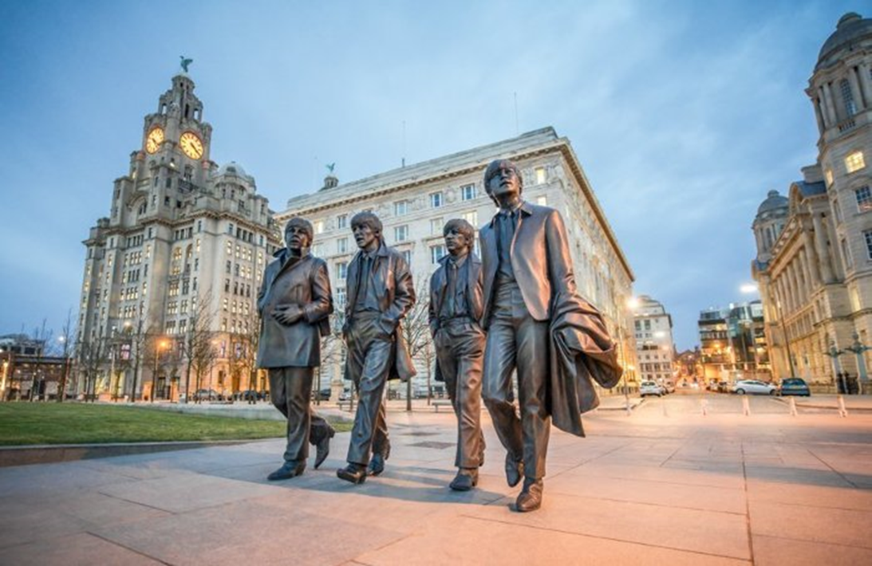
1.Guess the city

Slide 6
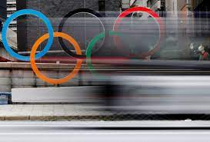
2.Continue …
Faster.Higer. Stronger.-

Slide 7
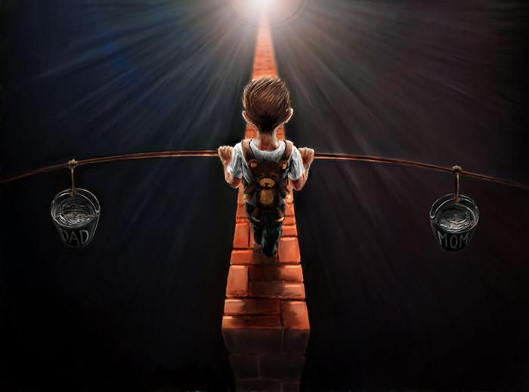
3 What is written?
The painting by the Polish artist Sebastian Pytka
The Divorce
Notes:
Что написано на ведрах

Slide 8
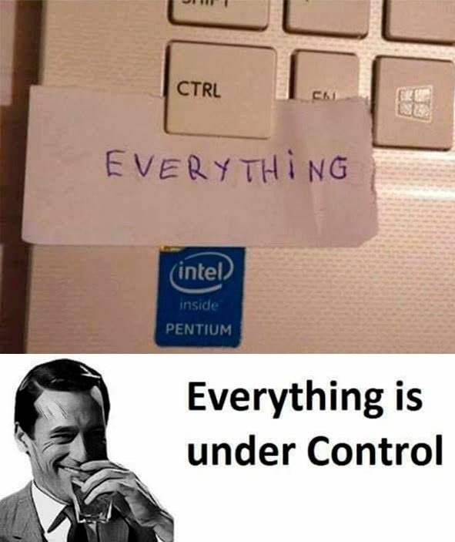
4. Continue the famous phrase

Slide 9
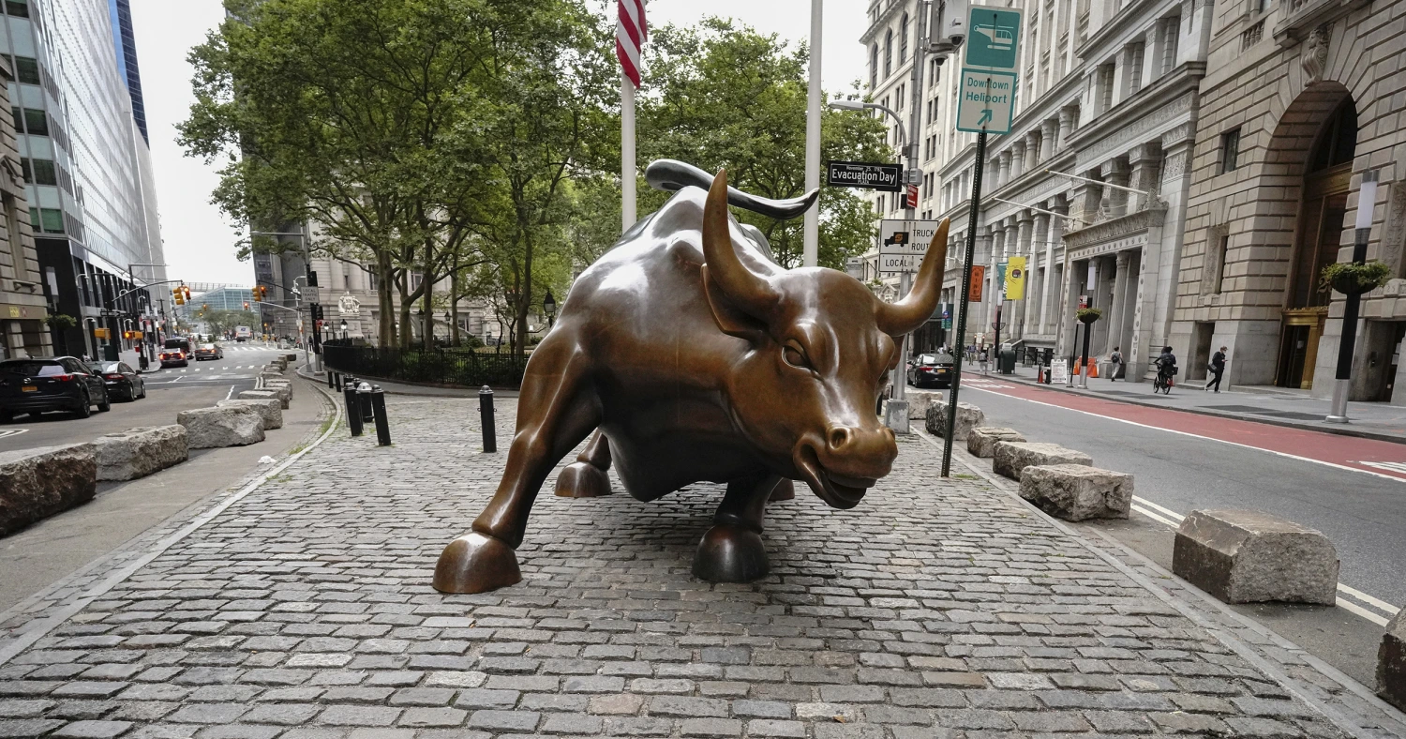
5. Where is situated?

Slide 10
6. Continue the joke
-Have you read any of Shakespeare’s play?
-Only two of them.
-Which one?
-…. …

Slide 11
7. Who is the author ?( Rus. poet)
I loved you -- and love it may yet be
Deep in my soul. It might still smoulder there.
But do not trouble your dear heart for me
I would not want to make you shed a tear
I loved you -- Helplessly Hopelessly
Timidity and longing plagued my mind
I loved you so tenderly so truly
God grant that you may such another find

Slide 12
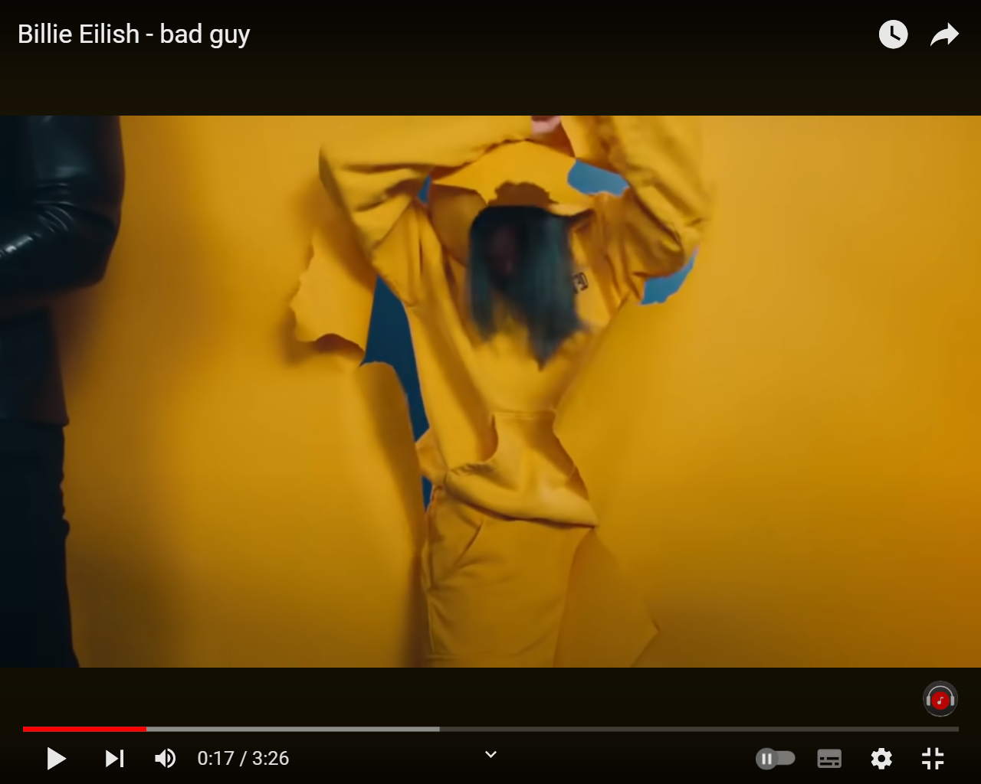
8. Guess the singer-0,5/song-0,5
Notes:
Угадывают только по скрин-шоту

Slide 13
Answers

Slide 14
1.Liverpool city
The only musical city in England listed as a UNESCO World Heritage Site. Many famous musicians were born here, including The Beatles.

Slide 15
2.The Olympic Motto
Faster.Higer. Stronger.- Together
The Olympic motto CITIUS, ALTIUS, FORTIUS – FASTER, HIGHER, STRONGER has inspired and motivated generations of Olympic athletes over the years.
BUT has changed
The renewed motto of the Olympic Games was officially announced on July 20th by the International Olympic Committee.

Slide 16
2.

Slide 17
4. Definition of ‘under one’s control’ means everything is going well, there are no problems.

Slide 18
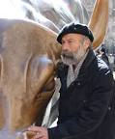
5. Bull of Wall Street or the Bowling Green Bull
Bronze sculpture that stands on Broadway in New York City. The symbol of financial optimism and prosperity. Charging Bull is a popular tourist destination that symbolizing Wall Street and the Financial District.
The sculpture was created by Italian artist Arturo Di Modica 1987.

Slide 19
6. Continue the joke
*-Have you read any of Shakespeare’s play?
*-Only two of them.
*-Which one?
*-Romeo and Juliet

Slide 20
7. А.С. Пушкин
Я вас любил: любовь еще, быть может,
В душе моей угасла не совсем;
Но пусть она вас больше не тревожит;
Я не хочу печалить вас ничем.
Я вас любил безмолвно, безнадежно,
То робостью, то ревностью томим;
Я вас любил так искренно, так нежно,
Как дай вам бог любимой быть другим.

Slide 21
8.Billie Eilish - Bad Guy
The song topped the charts in Australia, Canada, New Zealand, Norway and Russia, became the second in Ireland, Malaysia, Sweden, the United Kingdom
https://www.youtube.com/watch?v=DyDfgMOUjCI&ab_channel=BillieEilishVEVO
Notes:
Можно пройти по ссылке

Slide 22
2 Round . Who? What? 20*3=60sec
Notes:
Работа в этом раунде следующая. Должны отгадать про кого или про что, используя 3 подсказки. Если угадали с первой подсказки получают 1.5 балла, со второго- 1 балл, с третьего-0,5. Время по 20 секунд на каждую попытку. Ответы сдают после попыток сразу же. После третьей попытки открываются ответы

Slide 23
Example
1.5 -He was born on the 9th of March

Slide 24
Example
1.0 -He died at age of 34

Slide 25
Example
0.5 -The first cosmonaut

Slide 26
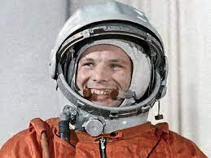

Slide 27
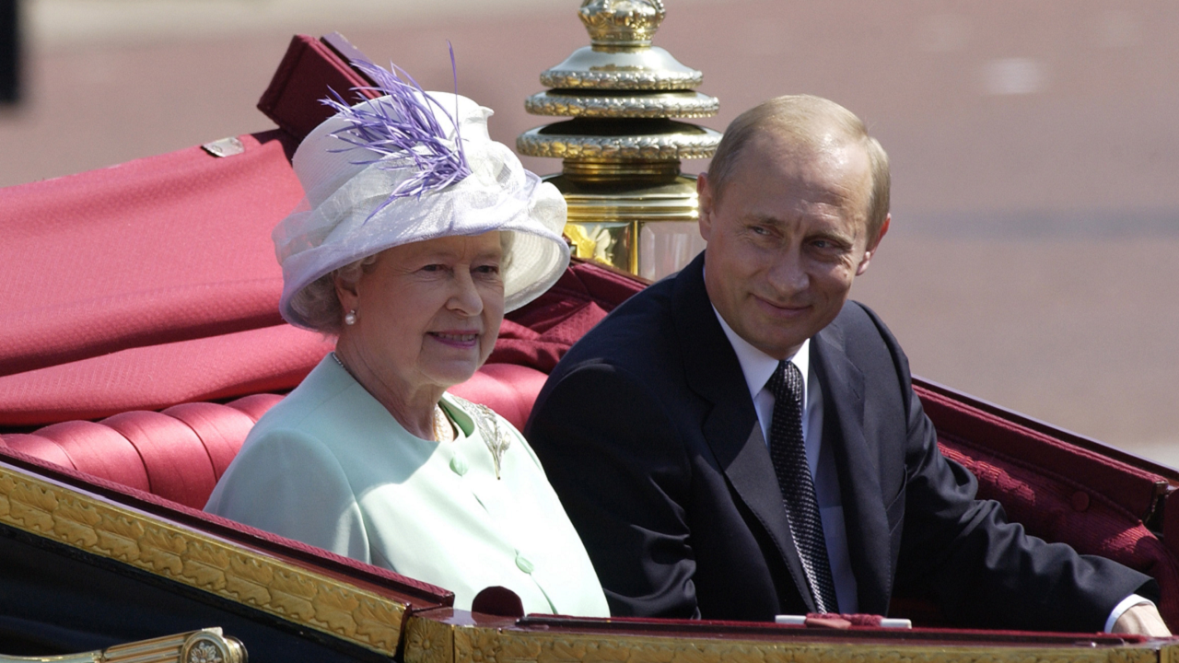
1.5 Who sits nearby Putin?

Slide 28
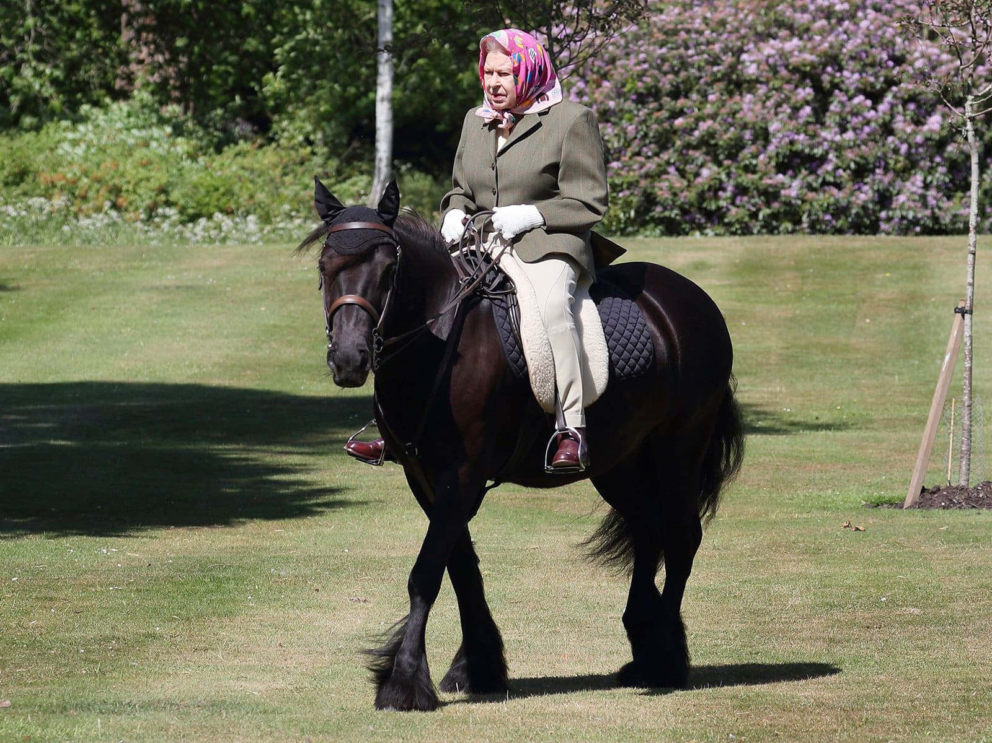
1.Who is on the horse?

Slide 29
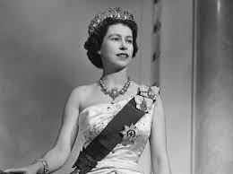
0,5. Who is young?

Slide 30
1. Elizabeth II

Slide 31
1,5. Who
He was a pioneer in a manufacturing using the assembly line

Slide 32
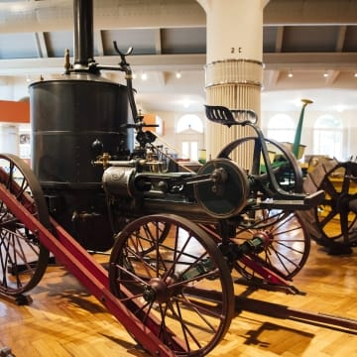
1. Who
Не designed and built his first steam engine in 1878, when he was only 15 years old!

Slide 33
0,5. Who
Founder of F… Motor Company

Slide 34
2. Henry Ford(1863-1947)industrial and business magnate
He was a pioneer in a manufacturing using the assembly line
Не designed and built his first steam engine in 1878, when he was only 15 years old!
Founder of Ford Motor Company

Slide 35
1,5. Who is he?
His mother named him … after looking at a Da Vinci painting.

Slide 36
1.Who is he?
He once got the award for "Worst Actor."

Slide 37
0,5.Who is he?
.
He rose to fame with his role in Titanic.

Slide 38
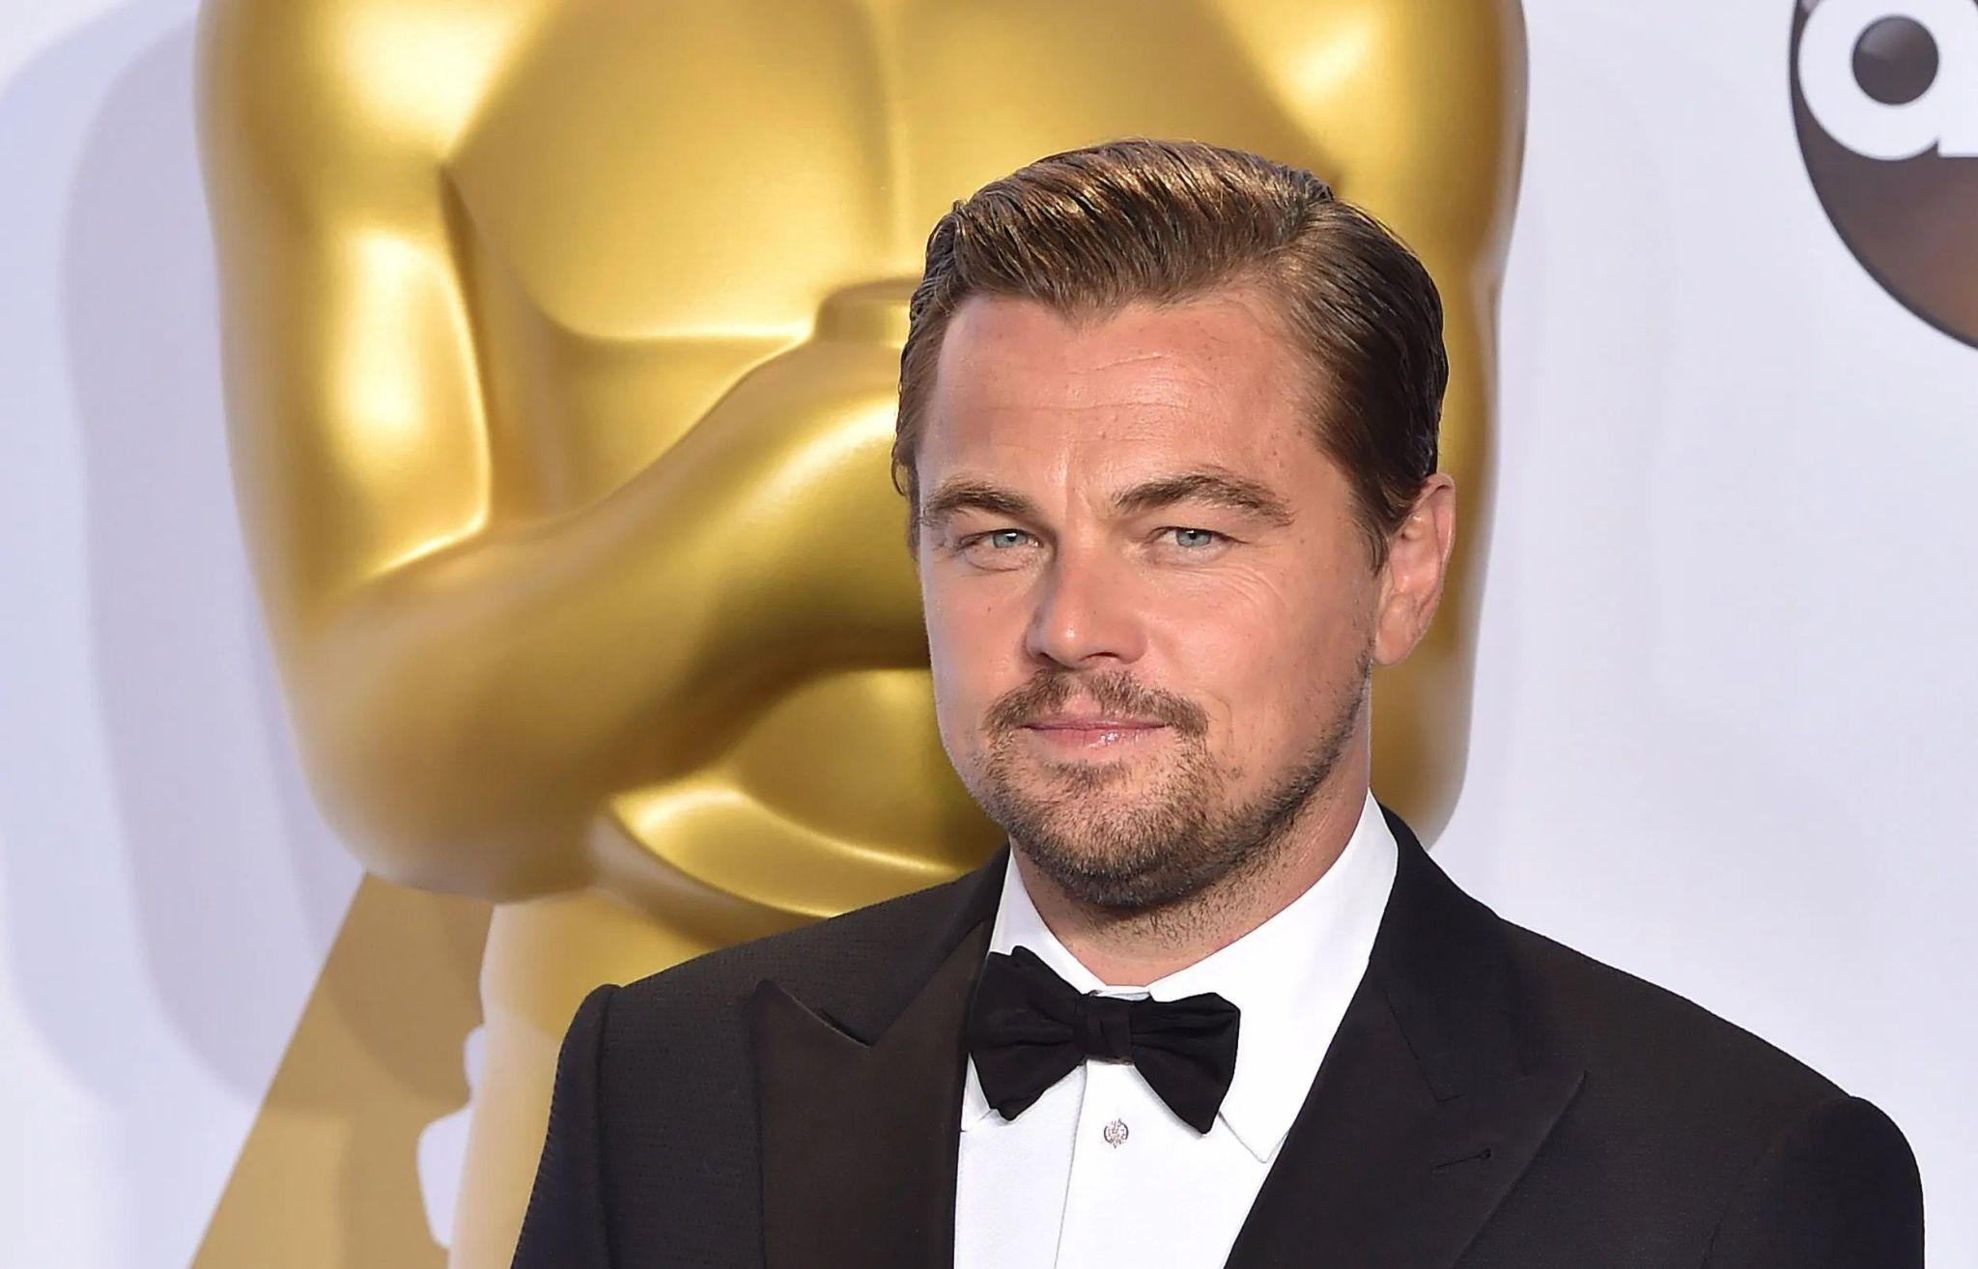
3.Leonardo DiCaprio
His mother named him Leonardo after looking at a Da Vinci painting
He once got the award for "Worst Actor."- The Beach
He rose to fame with his role in Titanic.

Slide 39
1,5. What
It said that IT was invented around 476 BC in China and was called Cuju

Slide 40
4. Football/Soccer
It said that IT was invented around 476 BC in China and was called Cuju
Do you know that only 2 countries in the world call IT and IT? The two countries are America and Canada
*Did you know that the biggest stadium in the world is stadium is located in North Korea? With a seating capacity of 1,14,000

Slide 41
1,5. What сountry?
3.3 times more sheep than people live in IT.

Slide 42
1. What сountry?
It’s name come from the Latin phrase
«Terra … Incognito» (Unknown Southern Land).

Slide 43
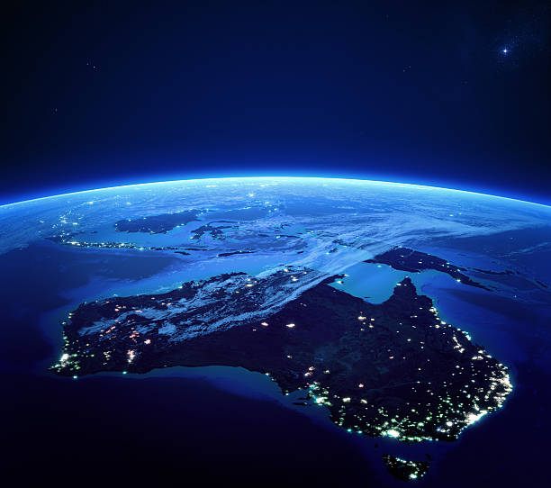
0,5. What сountry?
*

Slide 44
5. Australia
3.3 times more sheep than people live in IT.
It’s name come from the Latin phrase «Terra Australis Incognito» (Unknown Southern Land).

Slide 45
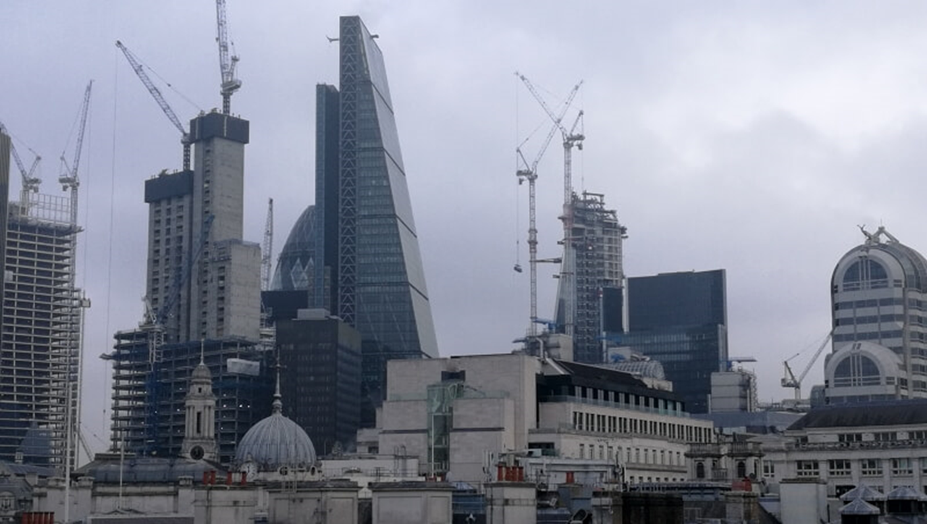
1,5. What city

Slide 46
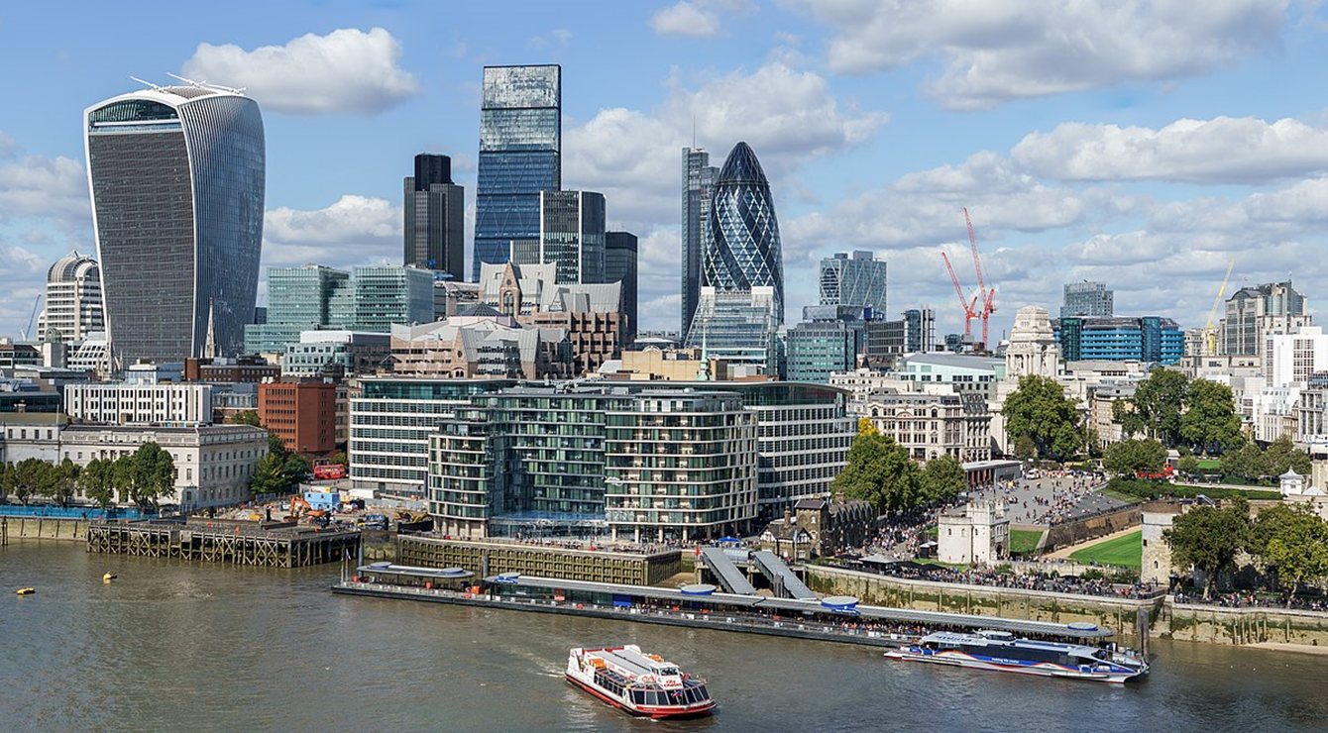
6. What city

Slide 47
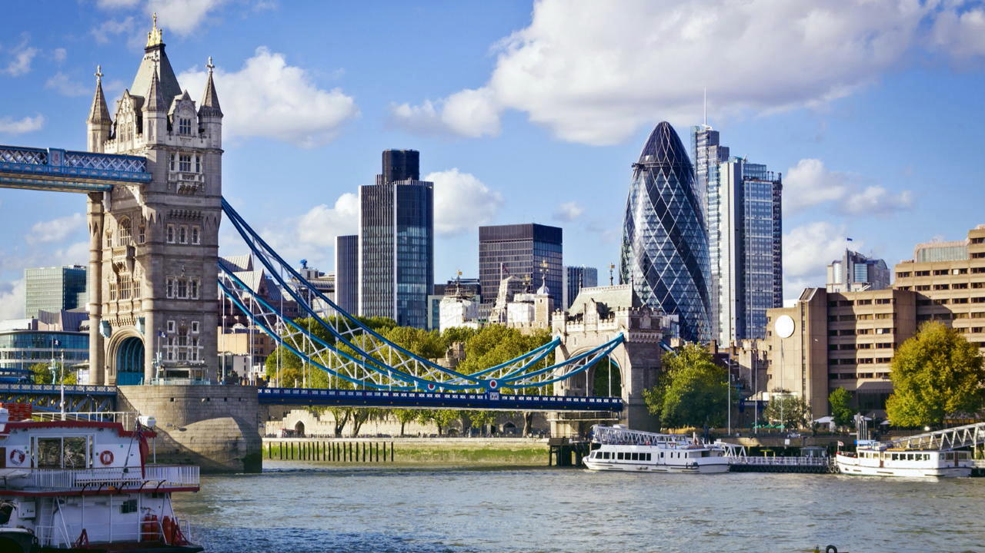
1. What city

Slide 48
0,5.London

Slide 49
1,5. What
The original name for IT was flutterby.

Slide 50
1. What
Actually have four wings, not two

Slide 51
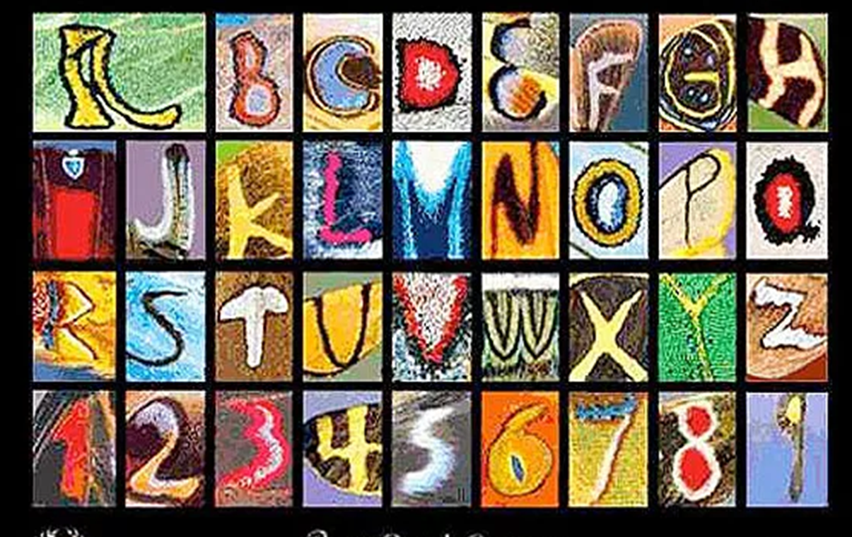
0,5. What
Kjell Bloch Sandved
has created an alphabet
entirely out of IT wings

Slide 52
7.Butterfly

Slide 53
1.5.What cartoon

Slide 54
1.What cartoon

Slide 55
0,5.What cartoon

Slide 56
8.Soul (2021)

Slide 57
Round 3 -Google search-30sec
Notes:
Часто мы обращаемся к Гугл за той или иной информацией По трем объяснениям должны отгадать.

Slide 58
Example
meeting with Elizabeth II
2 daughters Galina and Elena
first flight to space

Slide 60
1
cowboy hat
the largest in the U.S.
Mexico

Slide 61
2.
2.
New York City
colossus statue
holds a torch in raised right hand

Slide 62
3.
a popular tourist attraction worldwide
is packed with the world’s most famous people
all figures are made 2% larger than the person really Is

Slide 63
4
travelling around the world
breeds of domestic animals and varieties of plants
Is there God?

Slide 64
5.
how to play football better
Argentina
tattoos of his mother’s face

Slide 65
6.
to read about murders
facts about poisons
the success of «Ten little niggers»

Slide 66
7.
one of the London’s most popular attractions
has 32 capsules
was opened in 2000

Slide 67
was founded by Larry Page and Sergey Brin on September 4, 1998
Slogan-Don’t be evil
search everything and find

Slide 68
Answers

Slide 69
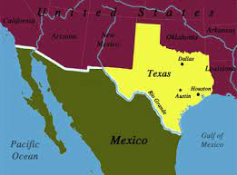
1.Texas
cowboy hat
the largest in the U.S.
Mexico

Slide 70
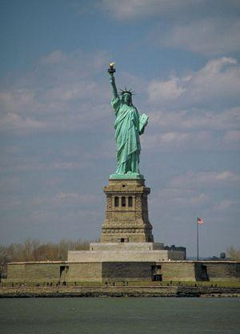
2. Statue of Liberty
New York City
colossus statue
holds a torch in raised right hand

Slide 71
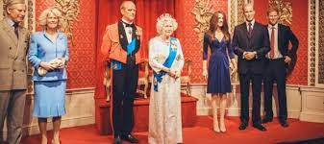
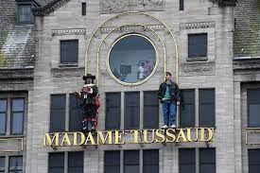
3. Madame Tussauds Museum
a popular tourist attraction worldwide
is packed with the world’s most famous people
all figures are made 2% larger than the person really Is

Slide 72
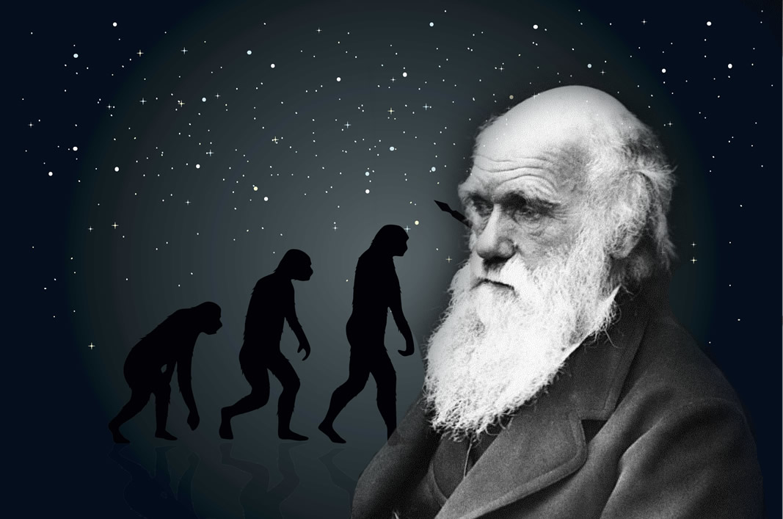
4. Charles Darwin
travelling around the world
breeds of domestic animals and varieties of plants
Is there God?

Slide 73
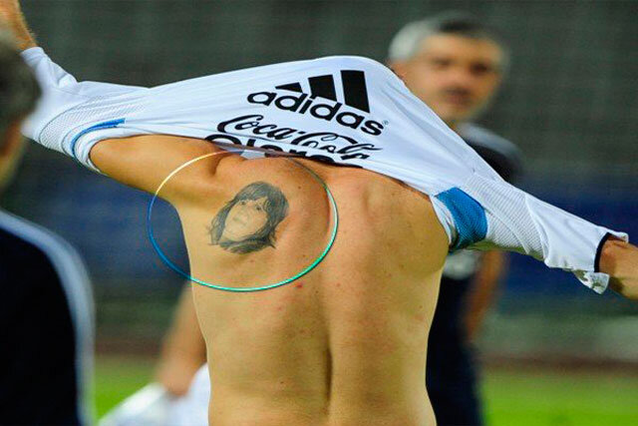
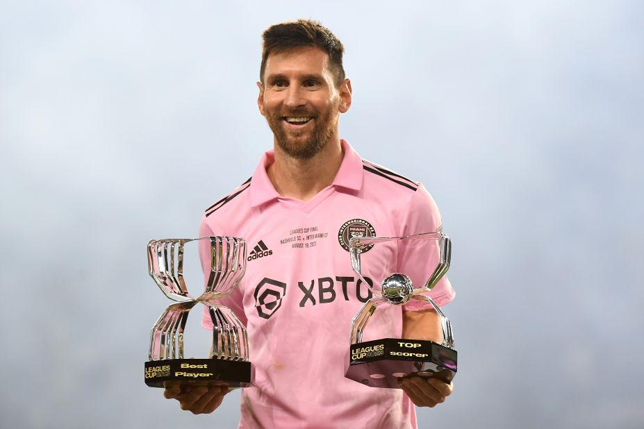
5. Lionel Messi
how to play football better
Argentina
tattoos of his mother’s face

Slide 74
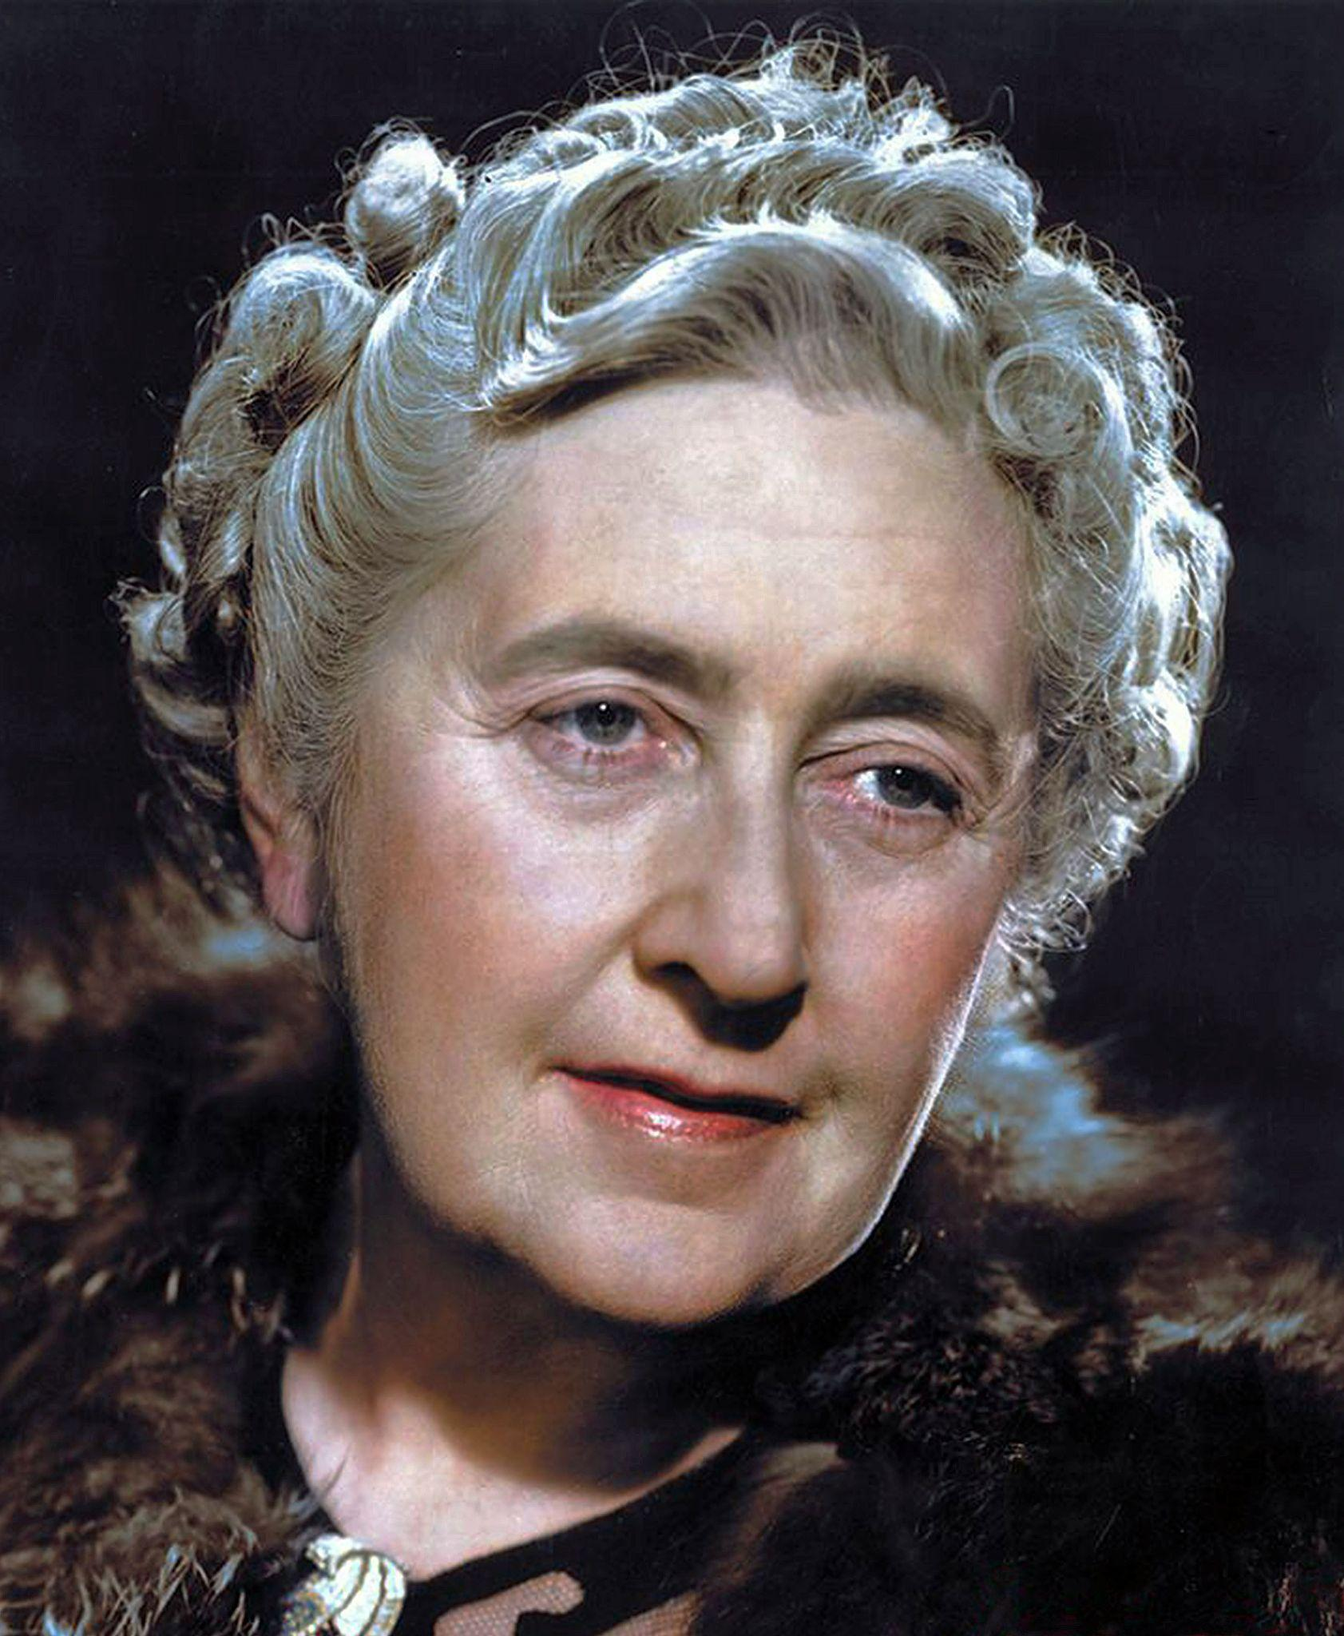
6. Agatha Christie
To read about murder
Facts about poisons
The success of «Ten little niggers»

Slide 75
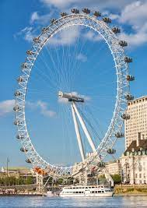
7. London Eye
one of the London’s most popular attractions
has 32 capsules
was opened in 2000

Slide 76
was founded by Larry Page and Sergey Brin on September 4, 1998
Slogan-Don’t be evil
search everything and find

Slide 77
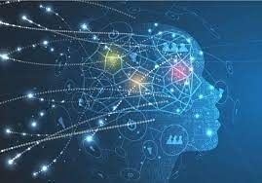
4 Round
The Neural network30 sec
Notes:
Будут предложены знакомые фразы, либо идиомы нарисованные нейросетью

Slide 78
1.Guess the Idiom

Slide 79
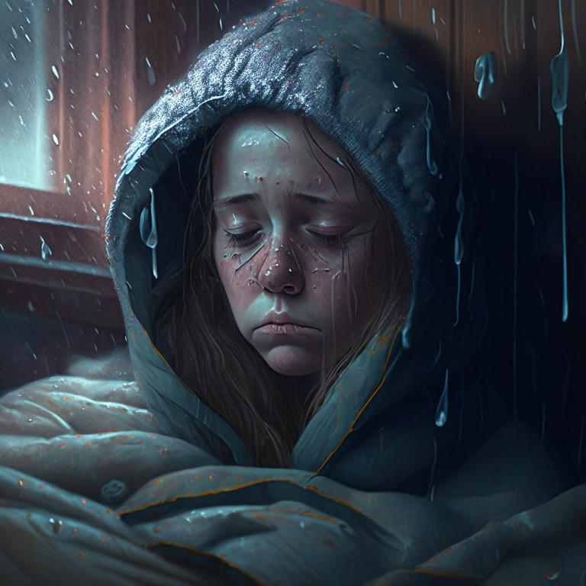
2.Guess the Idiom

Slide 80
3.Guess the Phrase

Slide 81
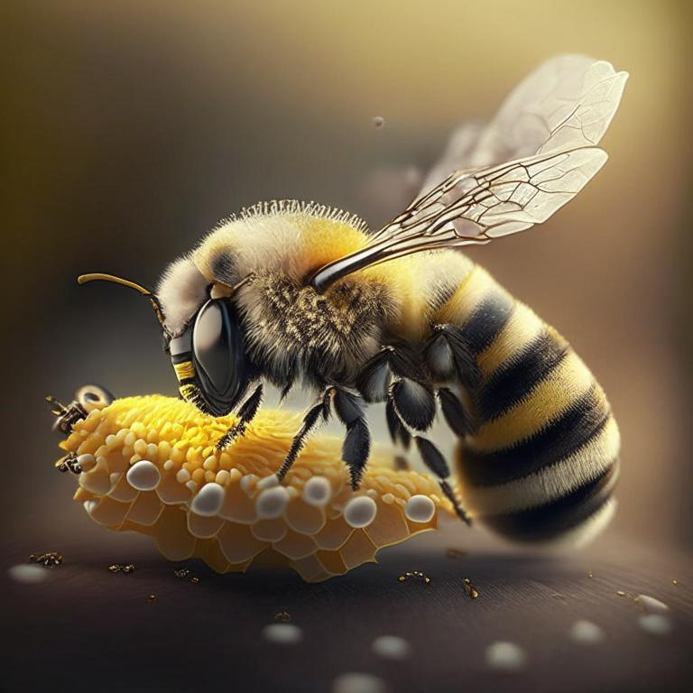
4.Guess the Idiom

Slide 82
6.Guess the Phrase

Slide 83
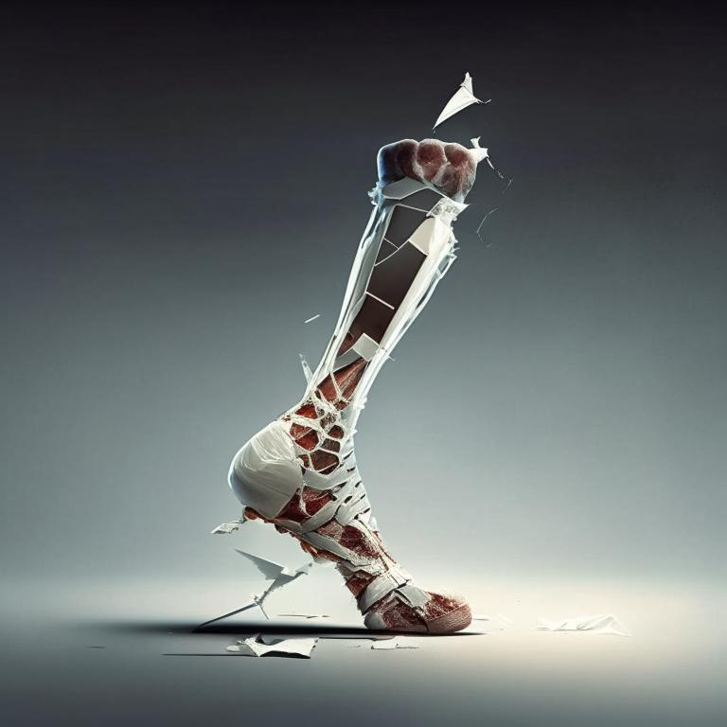
7.Guess the Idiom

Slide 84
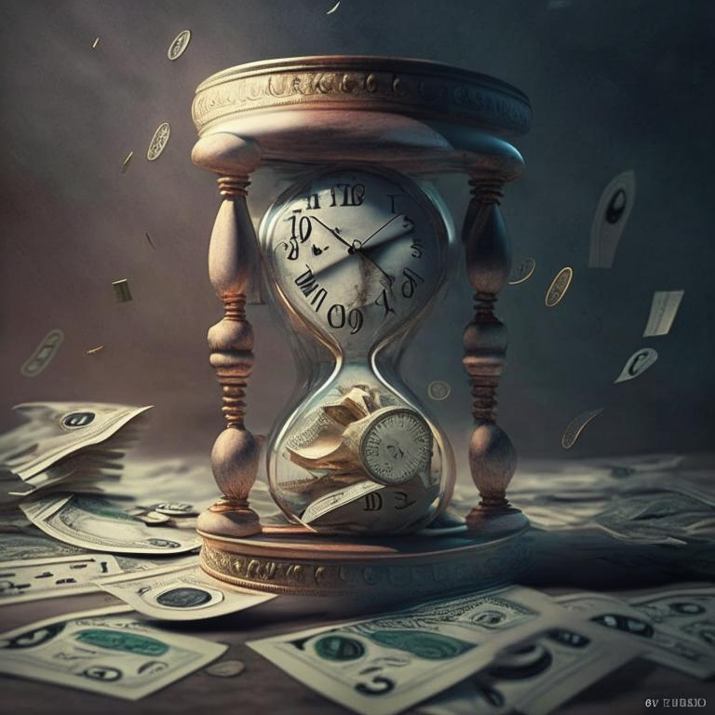
8.Guess the Phrase

Slide 86
BUTTERFLIES IN THE STOMACH

Slide 87
Under the weather

Slide 88
Take it easy

Slide 89
AS BUSY AS A BEE

Slide 90
Never give up

Slide 91
I love you

Slide 92
Break a leg

Slide 93
Time is money

Slide 94
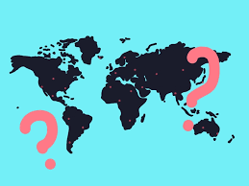
5 Round. Guess the country-30 sec
Notes:
Угадать страну по контуру и по картинке внутри контура. Облегчается раунд тем, что страны будут в алфавитном порядке

Slide 95
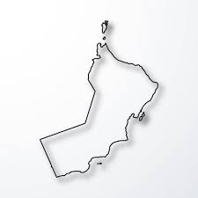
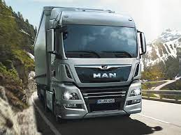
Example
OMAN

Slide 96
Belarus
Dominica
Georgia
Mongolia
….
Uzbekistan
Notes:
Образец алфавитного порядка

Slide 97
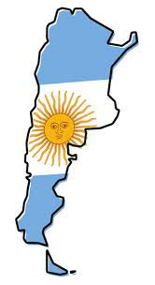
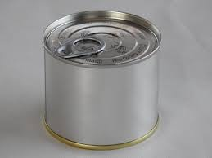
1.

Slide 98
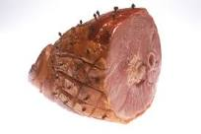
2.

Slide 99
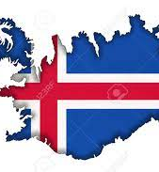
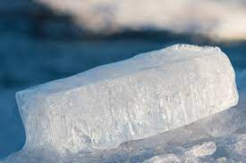
3.

Slide 100
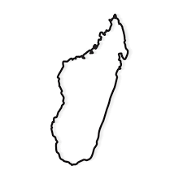
4.

Slide 101
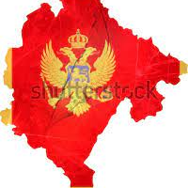
5.

Slide 102
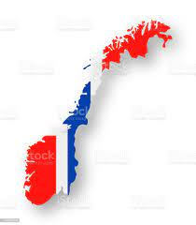
6.

Slide 103
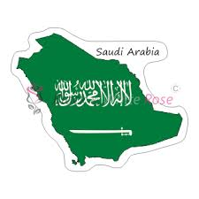
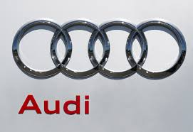
7.

Slide 104
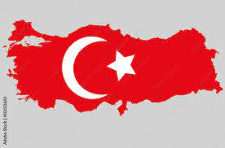
8.

Slide 105
Answers

Slide 106
ArgenTINa.

Slide 107
2. BaHAMas

Slide 108
3. ICEland

Slide 109
4. MadagasCAR

Slide 110
5. MonTENegro ( Черногория).

Slide 111
6. NorWAY

Slide 112
7.The Kingdom of Saudi Arabia

Slide 113
8. Turkey

Slide 114
Final-crossword-40 sec

Slide 115
 |  |  |  | N
 |  |  |  | l
 |  |  |  | s
 |  |  |  | h
Notes:
Раздаются готовые шаблоны кроссворда

Slide 116
Example
 |  | M | A | R | C | H |  |  |  | +2
 |  |  |  |  |  |  |  |  |  | 0
 | R | A | I | N |  |  |  |  |  | -2
 |  |  |  | l |  |  |  |  |  | 0
 |  |  |  |  |  |  |  |  |  | 0
 |  |  |  | s |  |  |  |  |  | 0
 |  |  |  | S | T | O | R | M |  | 1
Notes:
Если уверены в ответе –ставят галку и получают не один балл, а два/ Если не уверены, можно галку не ставить/ Но если поставили галку и ответ окажется неверным. то сразу минус 2 балла. 0баллов -если не знают ответа. По вертикали получиться слово. За которое тоже можно делать ставки.

Slide 117
1.Guess the music group
IT has produced many well-known hits
like “Bohemian Rhapsody”,
“We Will Rock You”,
“We Are the Champions”

Slide 118
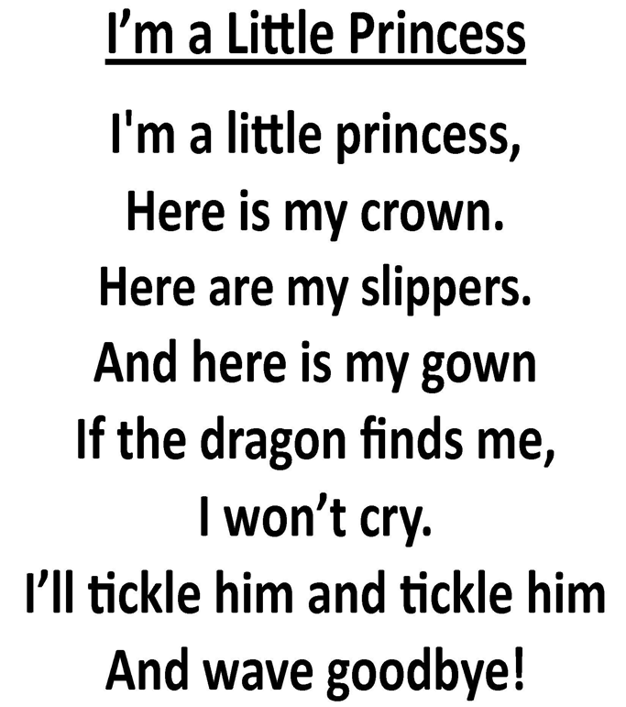
2.Itty Bitty Rhyme: I'm a Little Princess …
What word is missing?

Slide 119
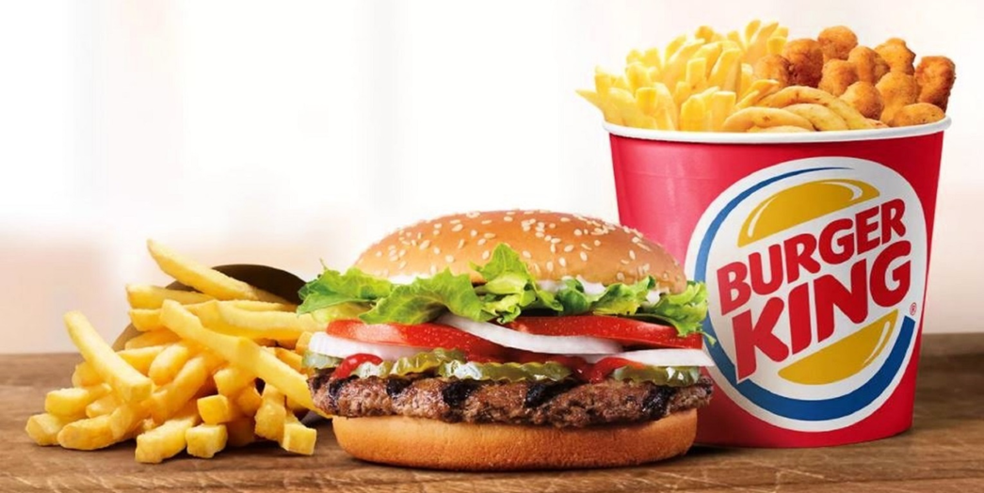
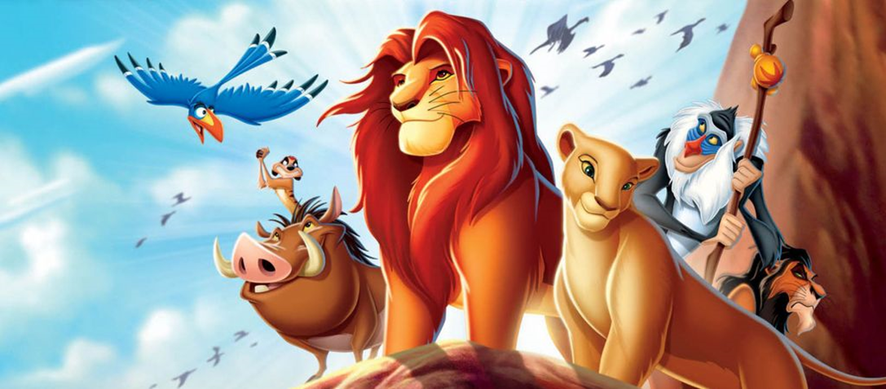
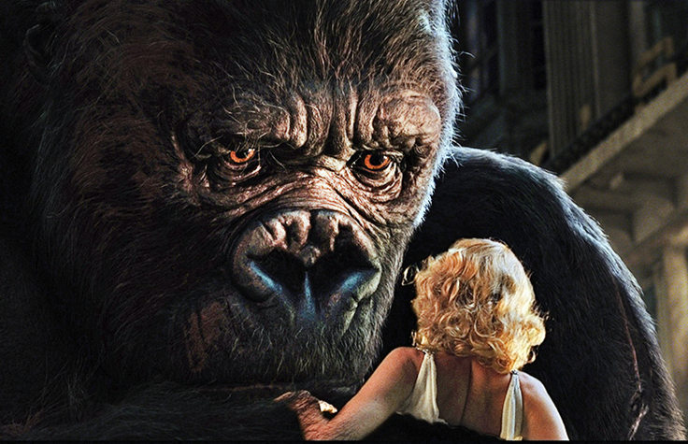
3.What do these pictures have in common?

Slide 120
4.
During the Second World War, IT functioned as the Capital of Six Countries

Slide 121
5.
The ants will get it and learn to read and get too smart and knowledge is power,but power corrupts so they'll turn evil and take over the world.
Notes:
Где такая табличка?

Slide 122
6. Who stands nearby Kevin? ( “Home alone-2”-Hotel Plaza)
Notes:
Здесь нужно предупредить, что нужно писать не фамилию, а должность

Slide 123
7. Who is he?
Notes:
Мужчина в женском образе

Slide 124
Answers

Slide 125
1.Queen
A British rock band that achieved widespread fame in the mid-1970s, and one of the most successful bands in the history of rock music

Slide 126
2.Itty Bitty Rhyme: I'm a Little Princess …

Slide 127
3. King

Slide 128
4. London
During the Second World War, IT functioned as the Capital of Six Countries
Governments displaced by the Nazi regime took up residence in London during the second world war – so the city was the seat of government of six countries at the same time.
France, Poland, Holland, Belgium and Norway and, of course, the United Kingdom.

Slide 129
3. 3

Slide 131
7. Prince Harry
Prince Henry, Duke of Sussex is a member of the British royal family, son of King Charles III and Princess Diana, brother of Prince William. Grandson of Queen Elizabeth II.

Slide 132
 |  | q | u | e | e | n
c | r | o | w | n
 | k | i | n | g
 |  |  |  | l | o | n | d | o | n
 |  |  | l | i | b | r | a | r | y
 | p | r | e | s | i | d | e | n | t
 |  |  |  | h | a | r | r | y

