Slide 1
School 10 History
English teacher
Andreiko Irina Petrovna
School 10
Krasnodar Region, Kushchevsky District
Krasnoe 2024
Notes:
1

Slide 2
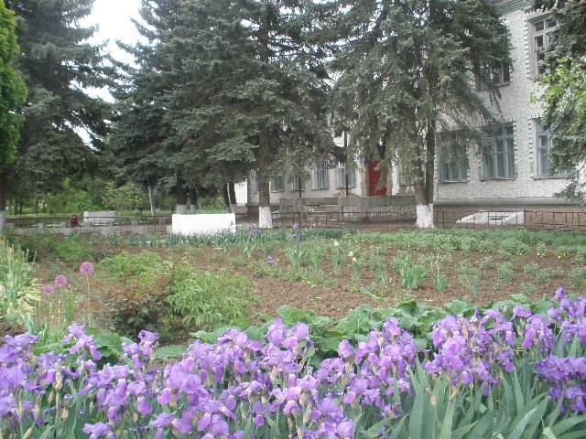
School 10 named by Troshev G.N.
Notes:
2

Slide 3
I think we should know our past, which in turn allows us to understand our present. Studying history is important to understand the various changes that have taken place over the years. It helps us to see how different societies and cultures have evolved and changed over time

Slide 4
The Beginning…
Notes:
4

Slide 5
Students Help to Build the School
Notes:
5

Slide 6
Main Building of Our School
Notes:
6

Slide 7
School Opening Day (October 1968)
School teachers: Foroponov I.A., Girina V.M., Korol A.G., Sulg E.P., Mantsyzova T.I., Yurchik V.K., Pridacha S.I., Persan H.G., Shapovalova A.F., Glushko N.F.
In the center Vsevolod Georgievich Polyansky - the director of the state farm Krasnoe
Notes:
7

Slide 8
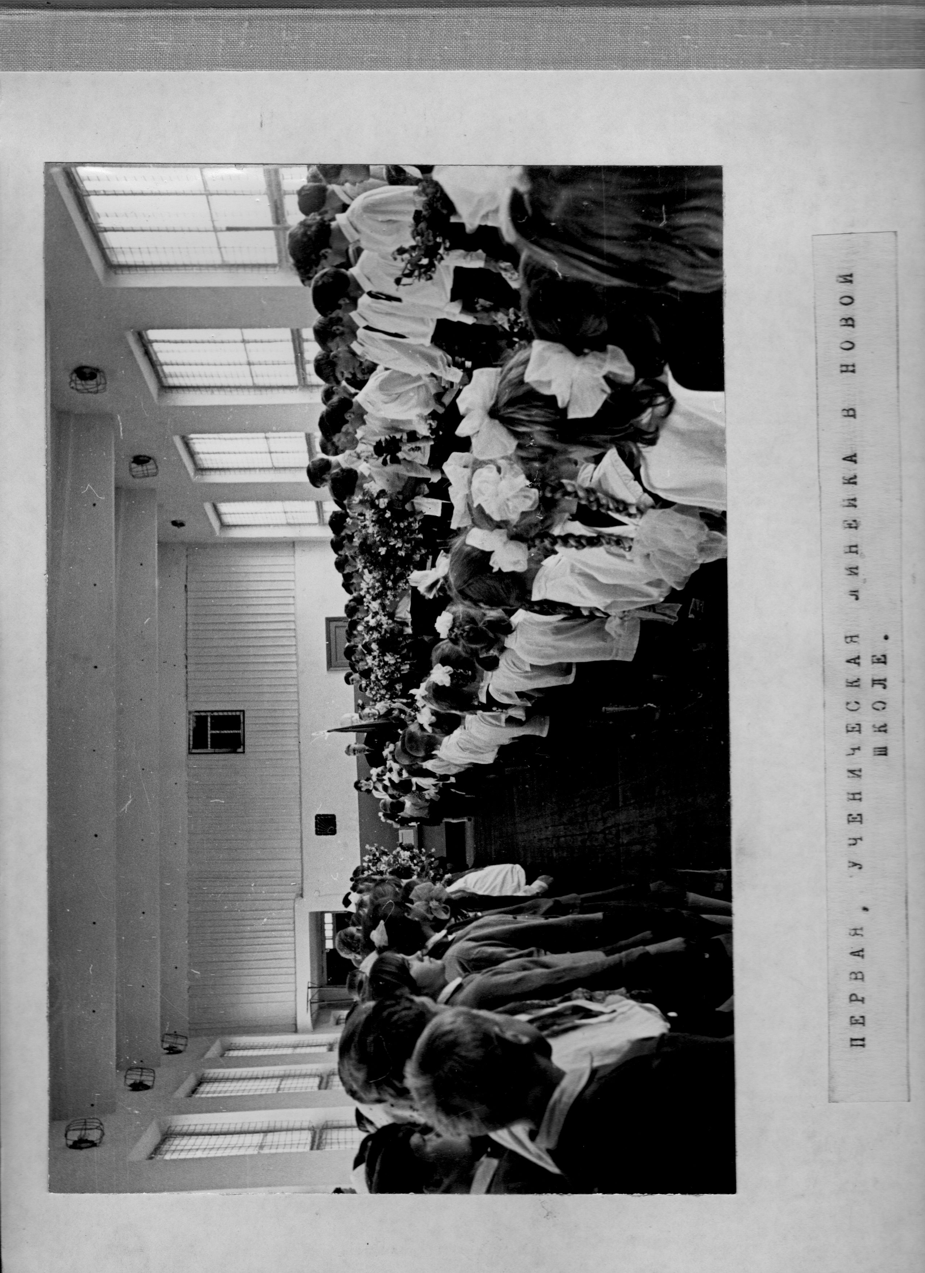
First Student Meeting at Our New School
Notes:
8

Slide 9
The 1st of May Celebration
Notes:
9

Slide 10
Sports Festival
Notes:
10

Slide 11
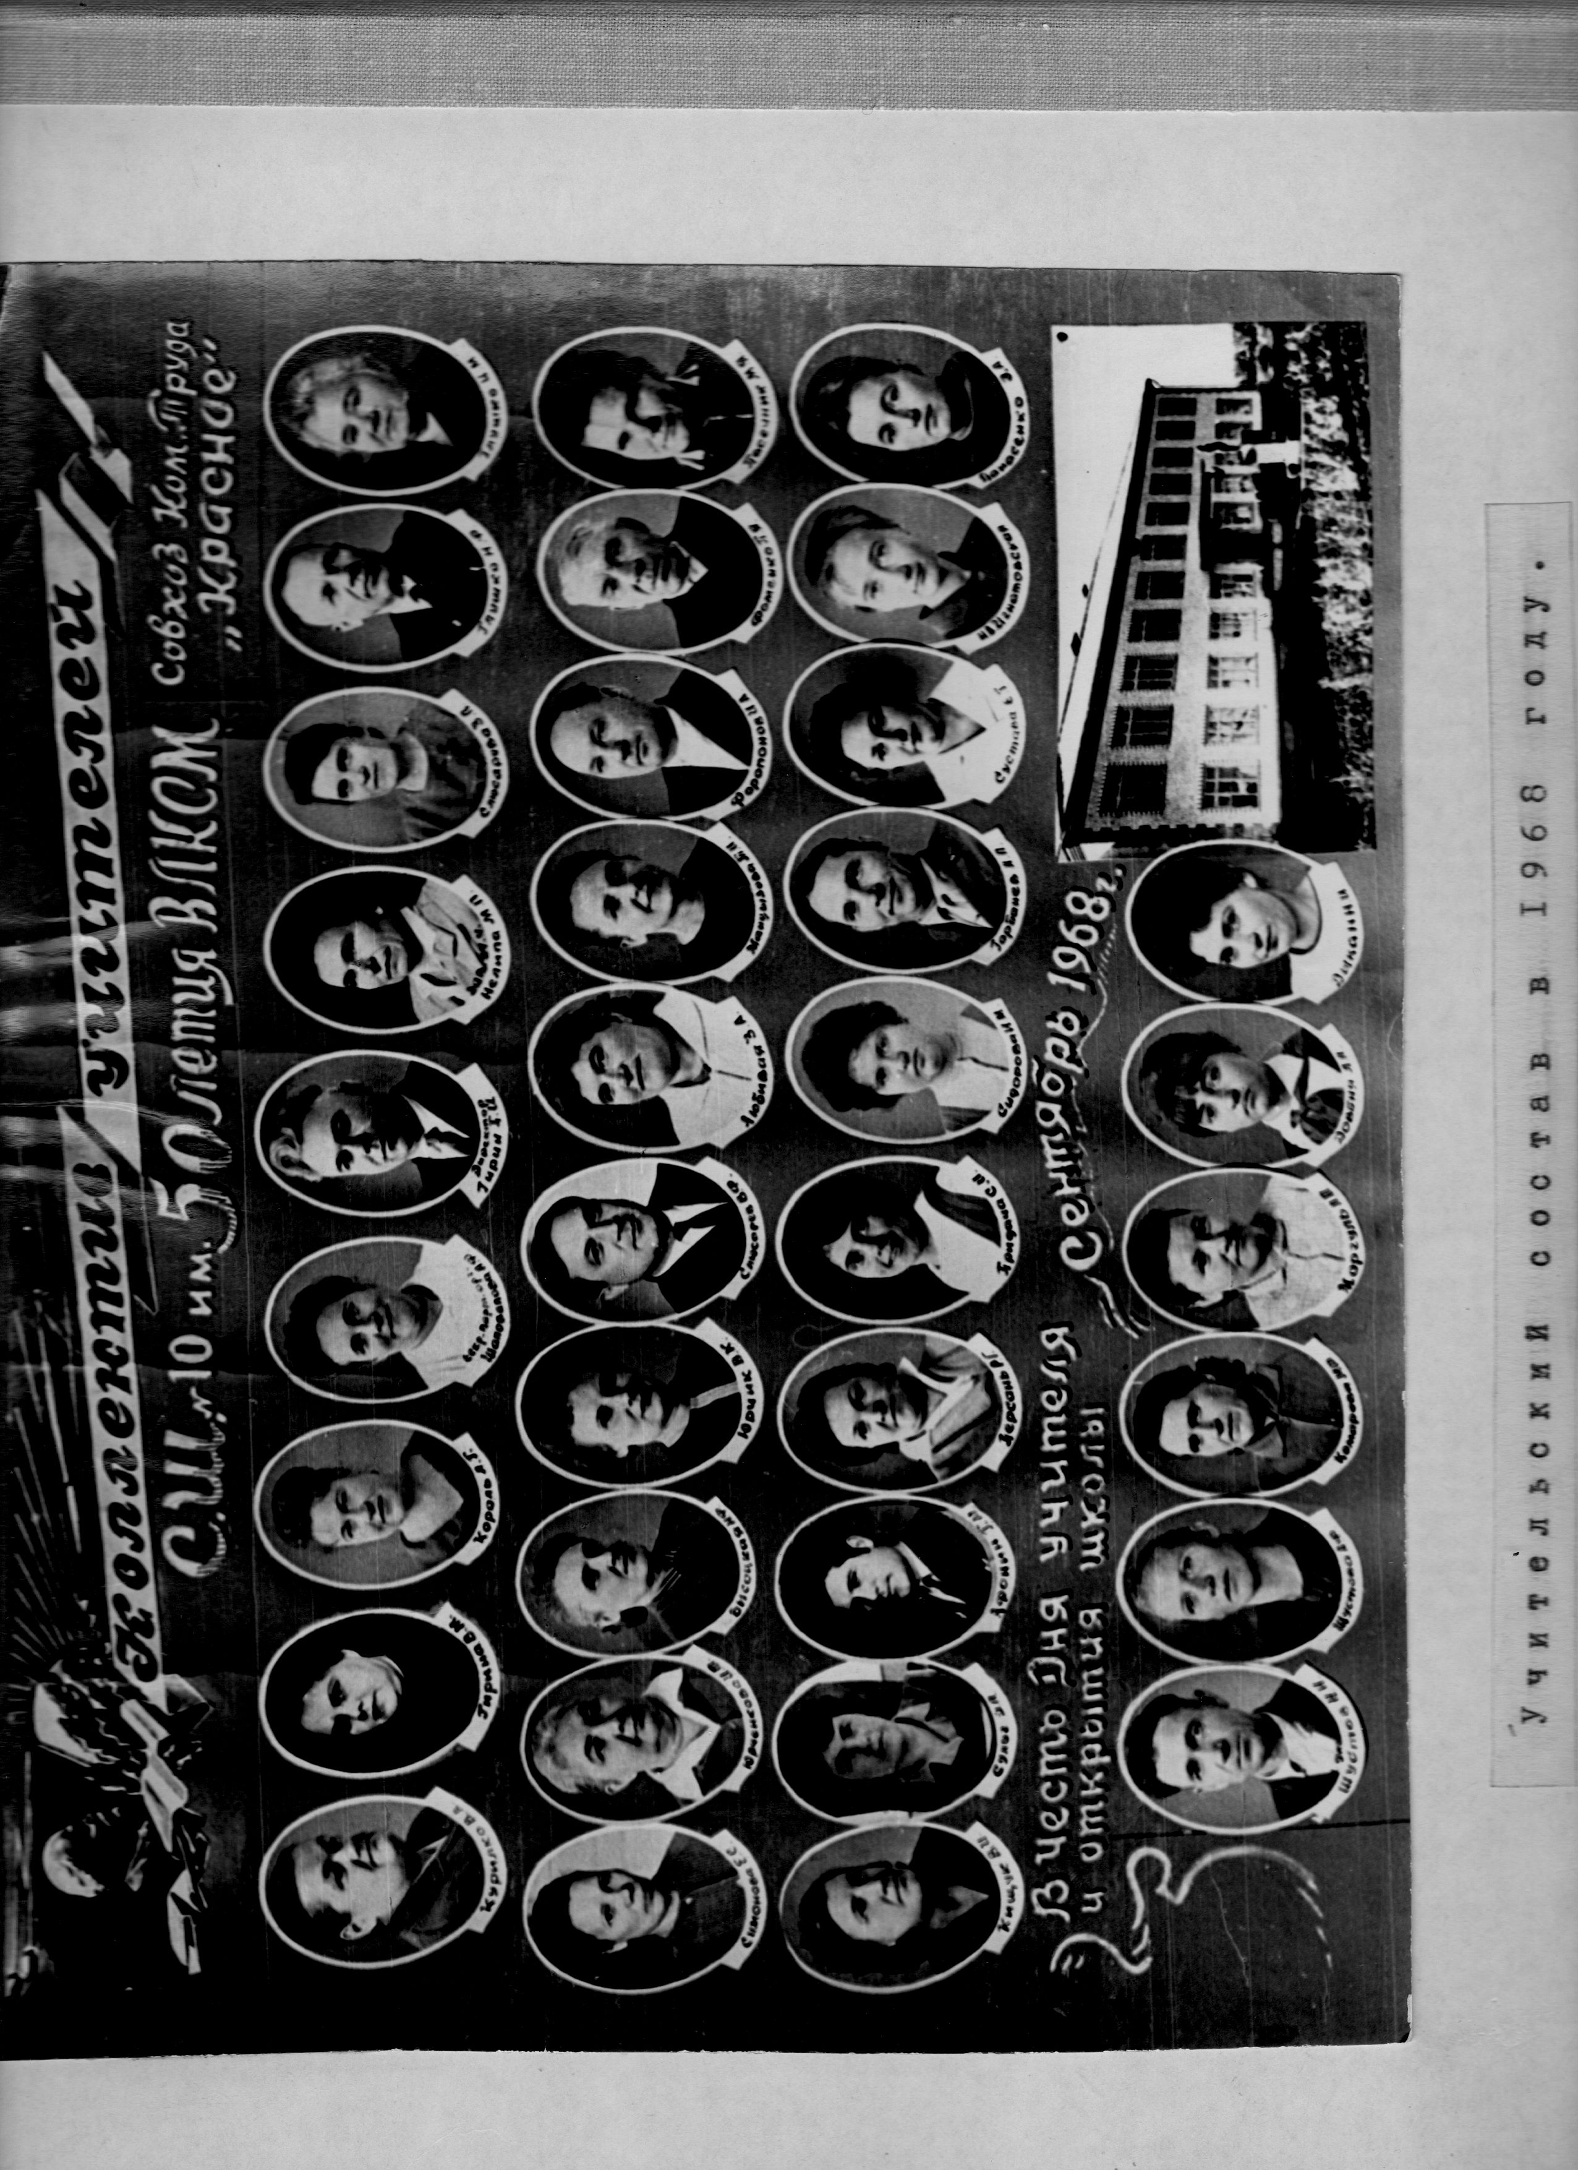
School 10 Teachers
Notes:
11

Slide 12
School 10 Teachers
Notes:
12

Slide 13
Tinkering Club
Notes:
13

Slide 14
Aviation Modeling Club
Notes:
14

Slide 15
Gardeners
Popular Professions in Our Area
Mechanics
Notes:
15

Slide 16
Students Work as Gardeners and Mechanics
Notes:
16

Slide 17
Students Brigade
(1968)
Notes:
17

Slide 18
Students and Their Masters
Notes:
18

Slide 19
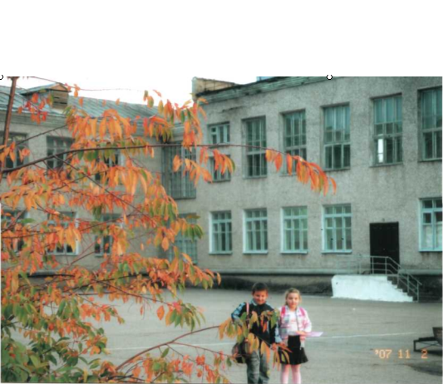
Our school is 56, but it continues teaching and educating children. Our school is the best!

Slide 20
