Slide 1
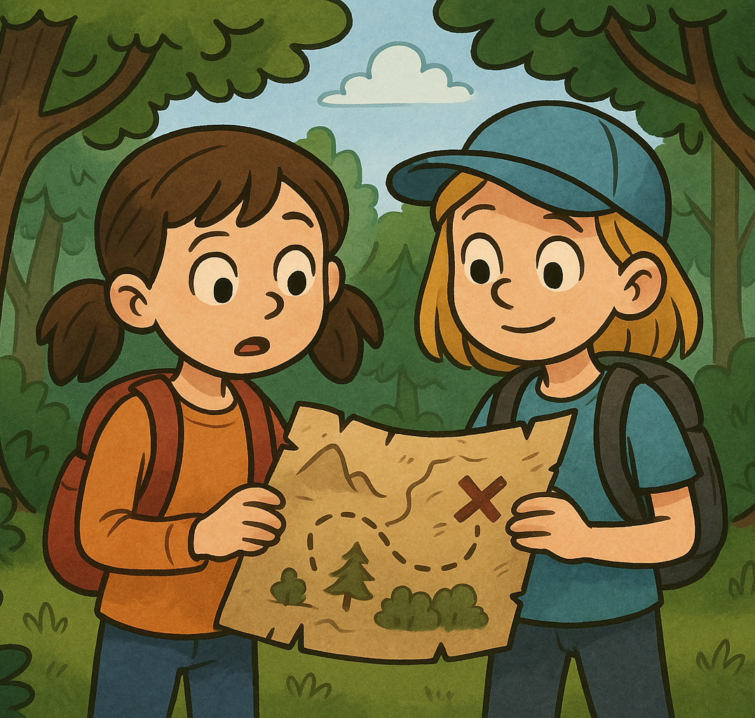
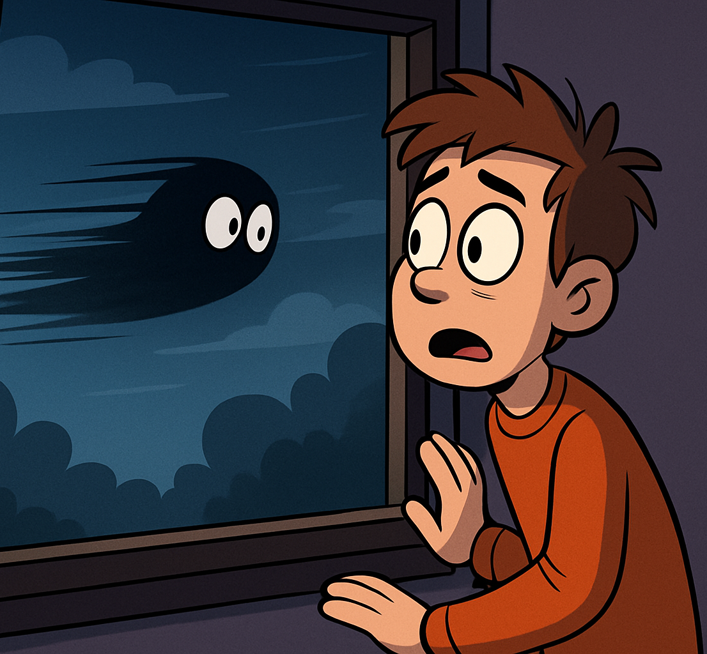
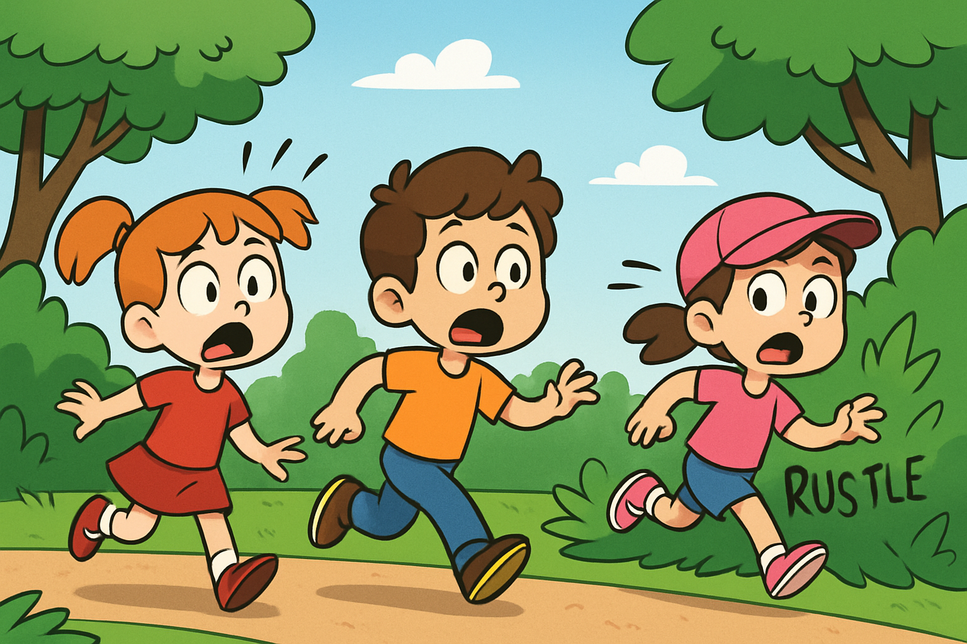
Read the three short stories. Match them to the pictures. Then complete each story with the correct Past Simple verb.
1
2
3
A. One evening, Tom ______________ (see) something behind the window. It ______________ (move) quickly and ________ (not make) sound. Picture ___
B. Mila and her friend _____________ (find) an old map in the attic. They ____________ (decide) to follow it. They _______________ (go) into the woods the next day. Picture ___
C. The kids _____________ (hear) a noise in the bushes. They _______________ (look around) and ___________ (run) away. Picture ___

Slide 2

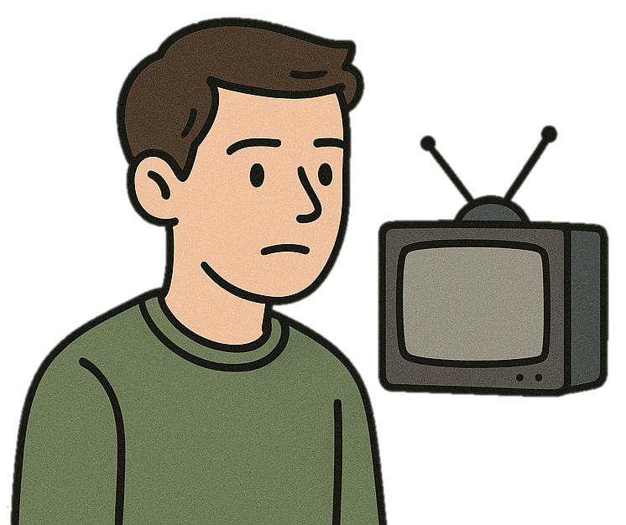
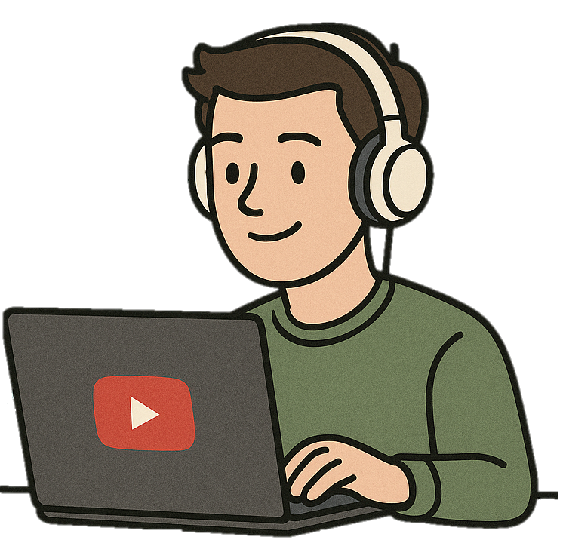
I didn’t use to watch YouTube.
But now I usually watch YouTube.

Slide 3
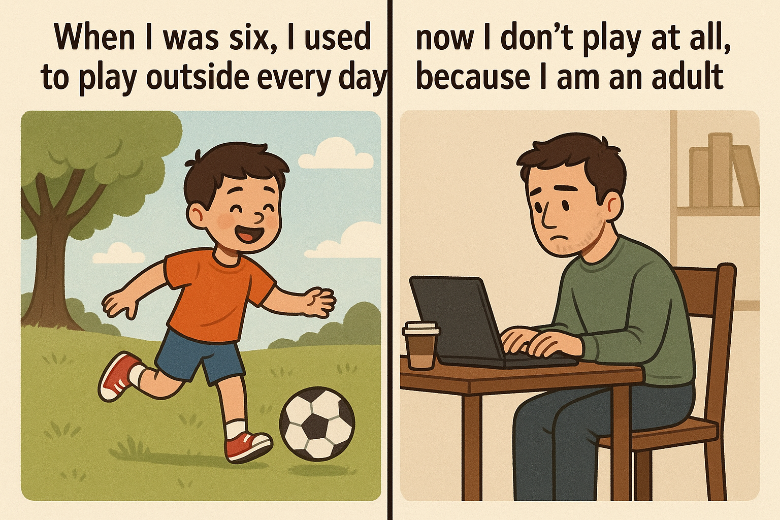
When I was six, I used to play outside every day.
But now I don’t play at all, because I am an adult.

Slide 4
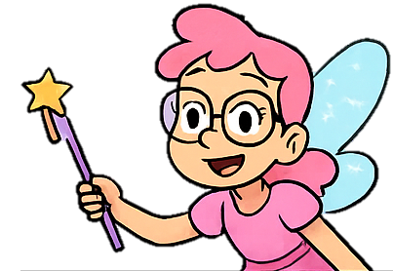
used to = действие, которое происходило раньше регулярно, но больше не происходит.
Тип предложения | Пример
✅ Утвердительное | I used to play with toys.
❌ Отрицательное | I didn’t use to play computer games.
❓ Вопрос | Did you use to read comics?

Slide 5
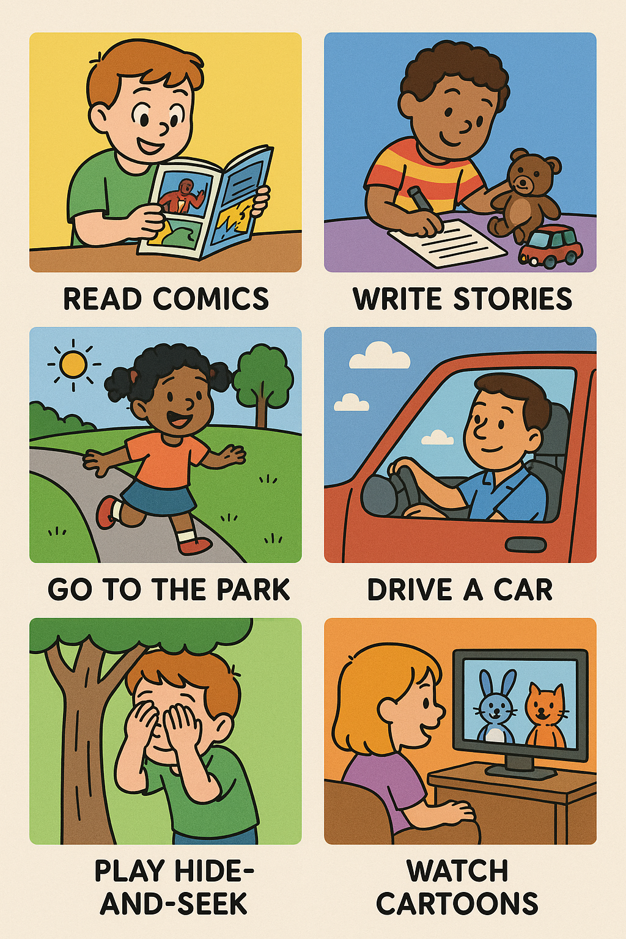
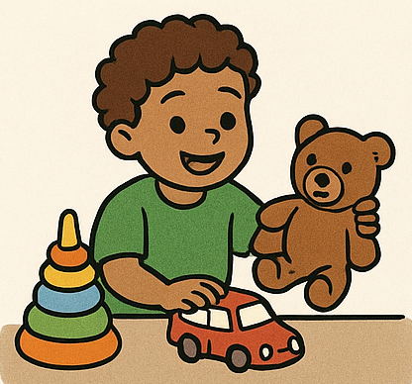
What did/didn’t you use to do when you were six?
read comics
write stories
play with toys
go to the park
When I was six, I used to …..
When I was six, I didn’t use to ….
play hide-and-seek
watch cartoons
drive a car

Slide 6
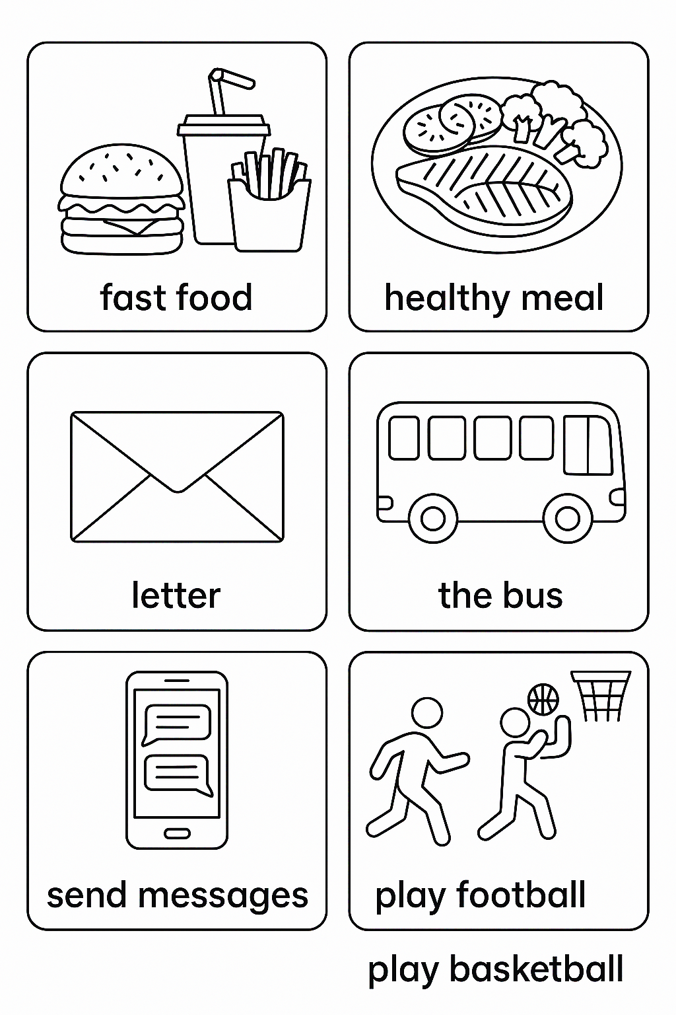
I used to ______, but now I ______.
Then (eat)
Now (cook)

Slide 7

I used to ______, but now I ______.
Then
Now (send)

Slide 8
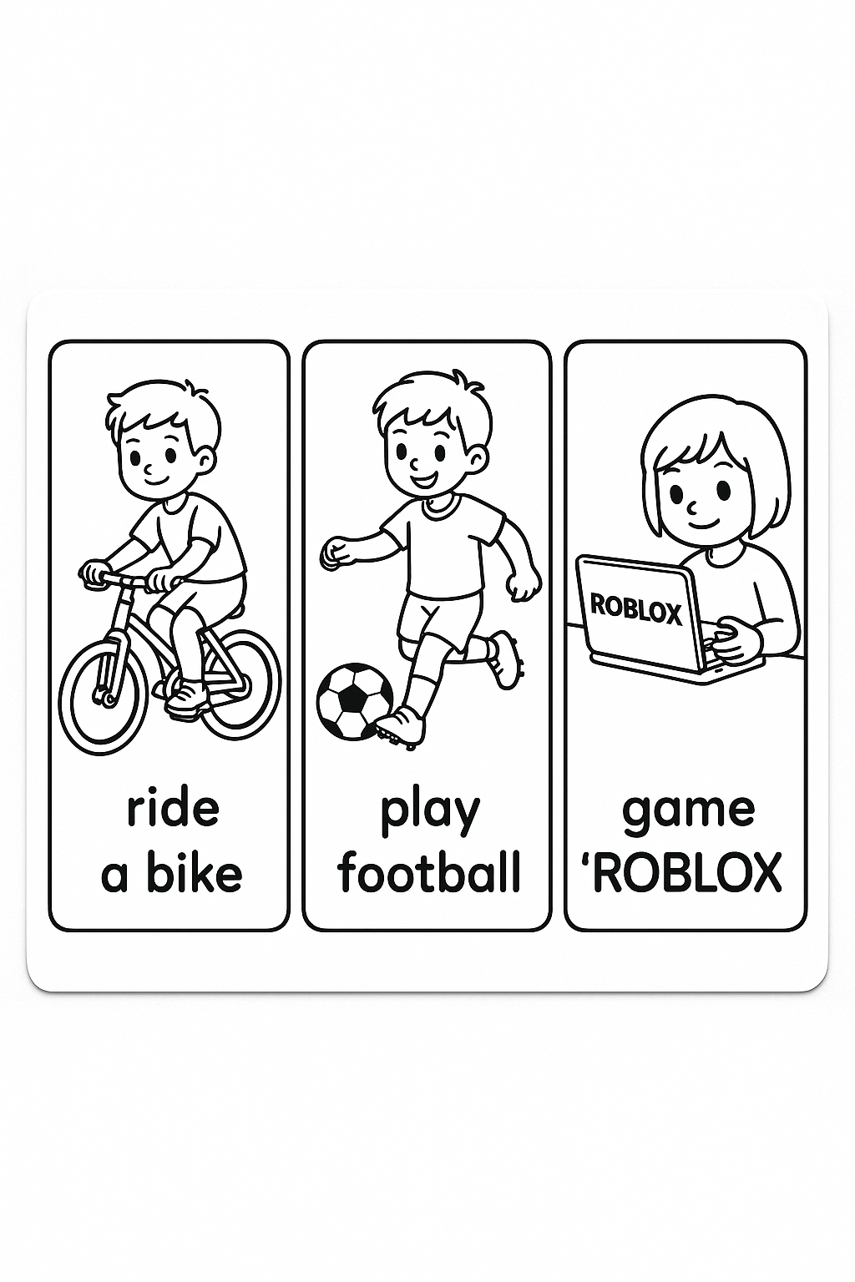
I used to ______, but now I ______.
Then
Now

Slide 9
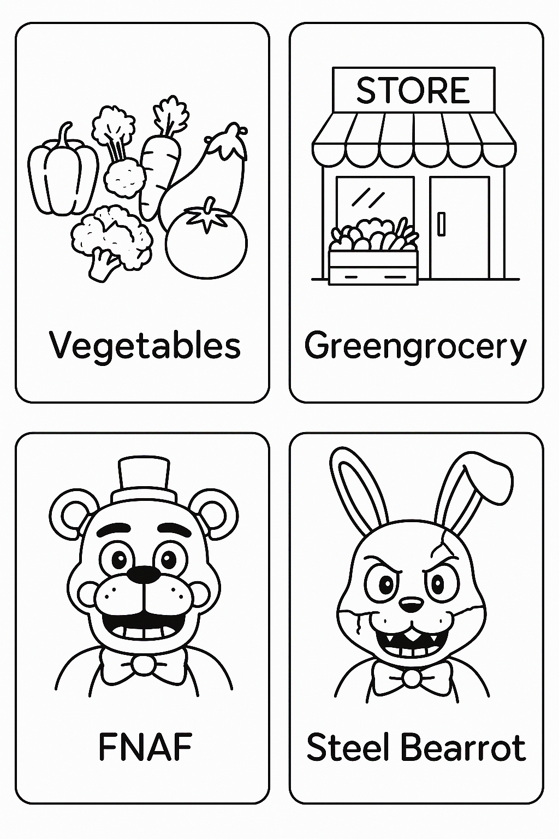
I used to ______, but now I ______.
Then (hate)
Now (buy)

Slide 10
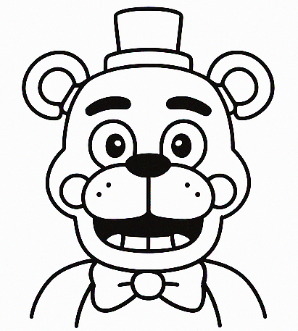
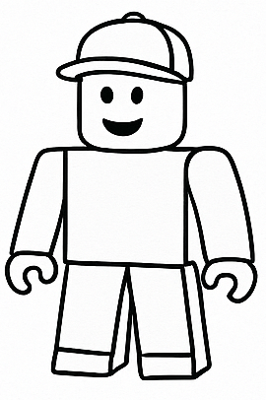
I used to ______, but now I ______.
Then
Now

Slide 11
I used to ______, but now I ______.
Then (ride)
Now (take)

Slide 12
Complete the sentences with USED TO or the PRESENT FORM.
I _____________________ (read) fairy tales when I was 6.
We ____________________ (not go) to the library every day.
My brother _________________ (believe) in monsters.
I _________________ (love) stories about detectives when I was young.
My parents __________________ (not like) scary books.
I ________________ (watch) cartoons every morning when I was younger.

Slide 13
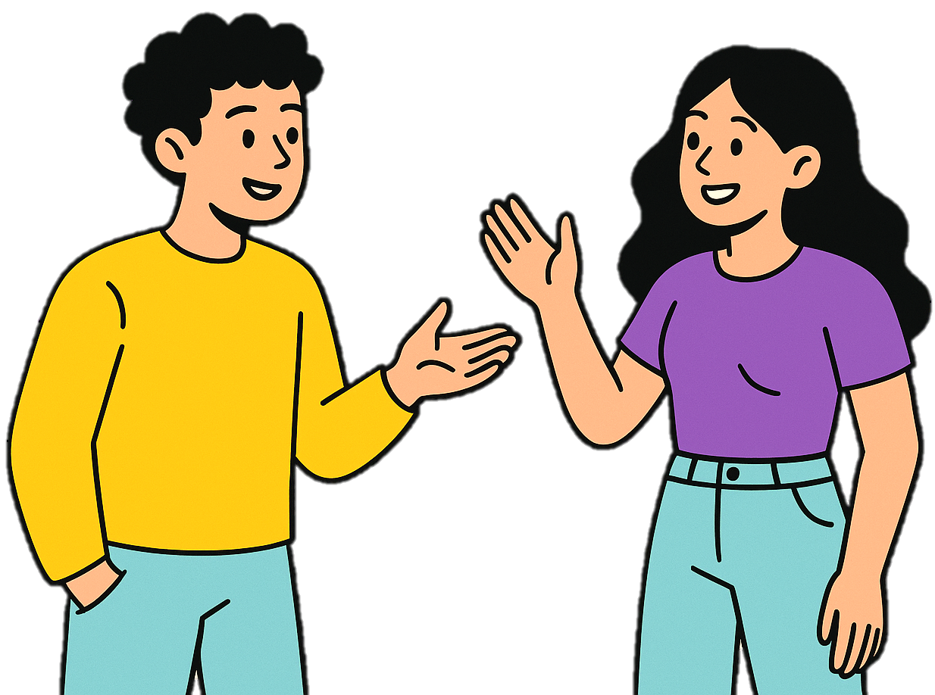
Choose the emoji!
What new grammar did we learn today?
What can you say using “used to”?
Was it easy or difficult for you? Why?
😊
😕
👍
👎

Slide 14
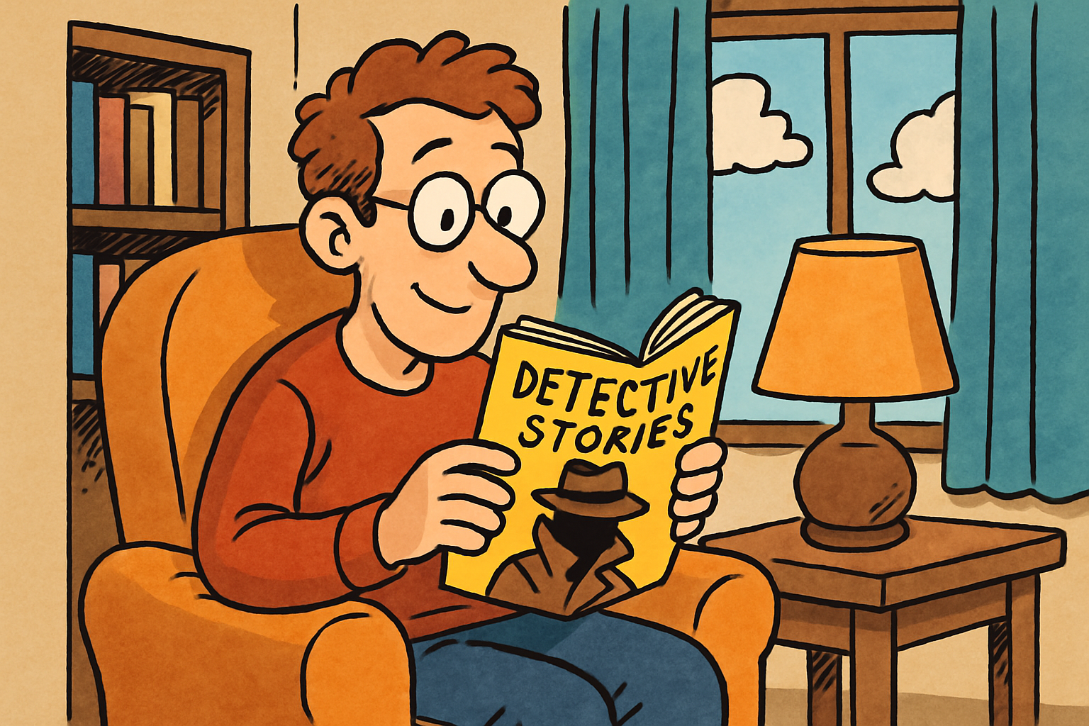
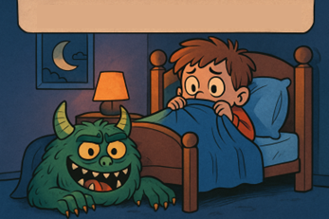
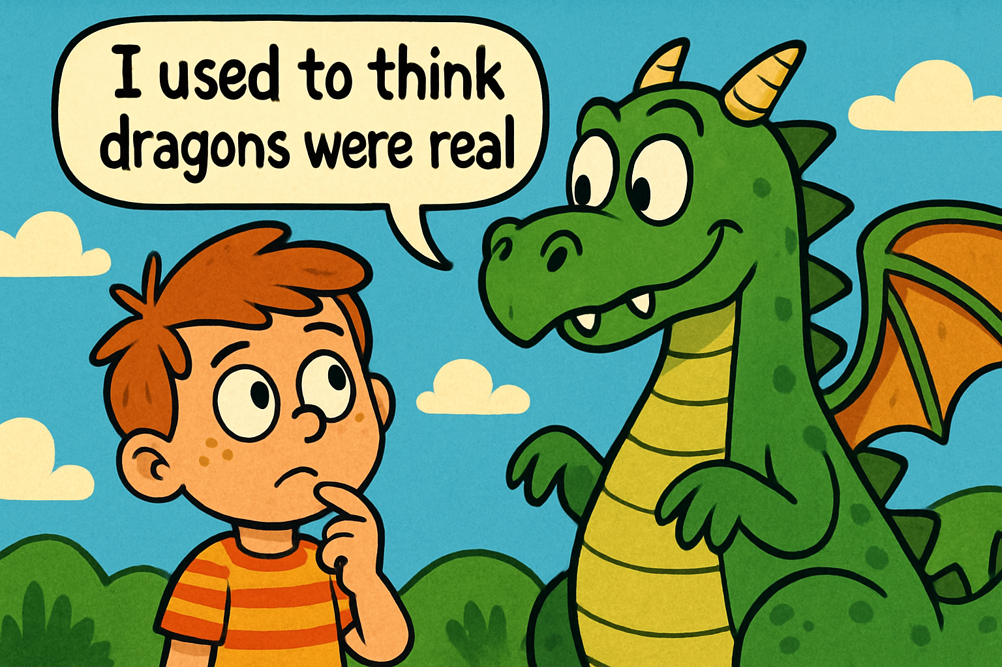
Homework
Look at the pictures and write 1–2 sentences about what each person used to do. Be creative!

