Slide 1
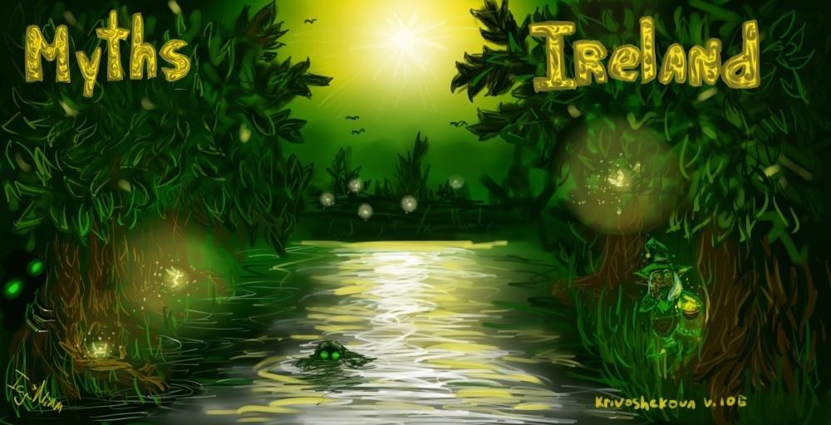

Slide 2
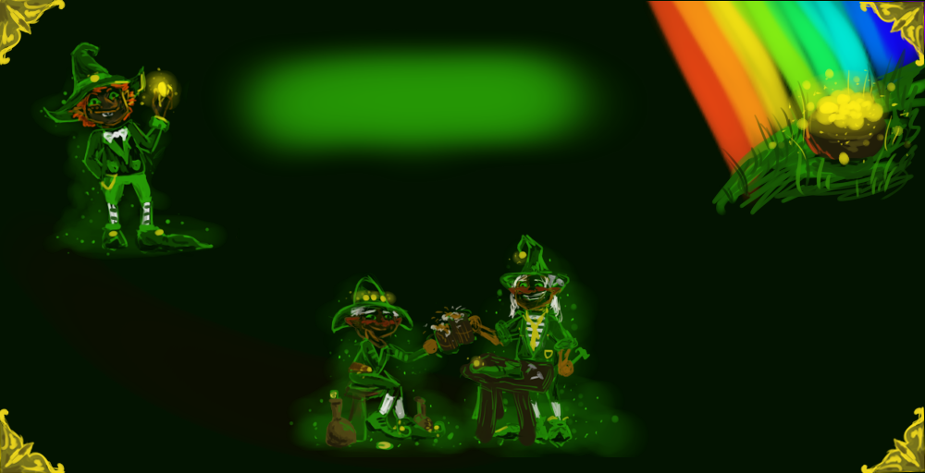
Мarch, 17 in Ireland is celebrated the day of St. Patrick. It's a fun holiday, with green beer, with painted faces in the colors of the Irish flag - and they dance a lot , of course. Irish people like their best symbol of this holiday – magic people, LEPRECHAUNS.
Leprechaun are only man in Celtic mythology, and they wear a beard. Some say, they live an average of 300 – 1000 years but no one knows. The older leprechaun is the more harmful it is to make dirty tricks.
The closest relatives of leprechauns are klurakans . But klurakans always drink too much, make scandals, steal and at night ride pets. They live in wine cellars.

Slide 3
Leprechauns
Leprechaun - the character of Irish folklore, traditionally portrayed as a small, stocky man dressed in a green suit and hat. . They are often drunk a lot, but it does not affect their shoemaker’s skills
They also make shoes for fairies. But no one has had a chance to catch the leprechaun at work . They always could be seen in one left shoe. Leprechauns’ duties included searching and storing of ancient treasures.
Leprechaunts were great hunters of treasures. Each family had a pot of gold coins, buried in the ground. Only the rainbow could point at the place of the treasures, but only the owner of gold coin could find it.

