Slide 1
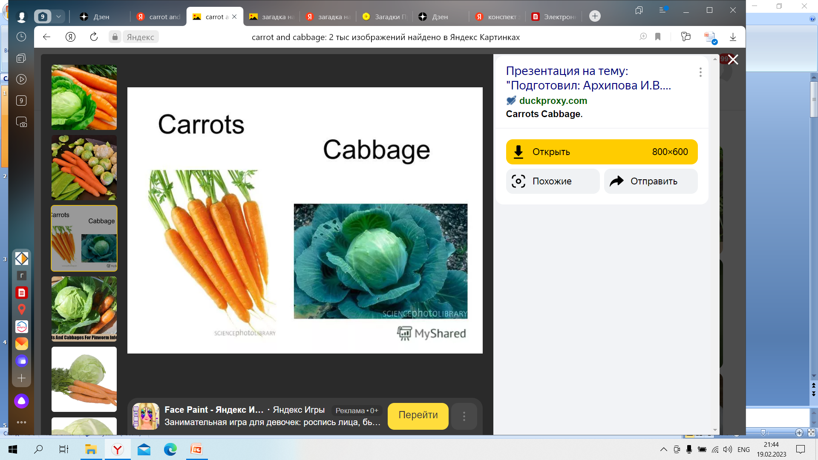
In winter it is white,
In summer it is grey,
It likes
Who is it? (Кто это?)

Slide 2
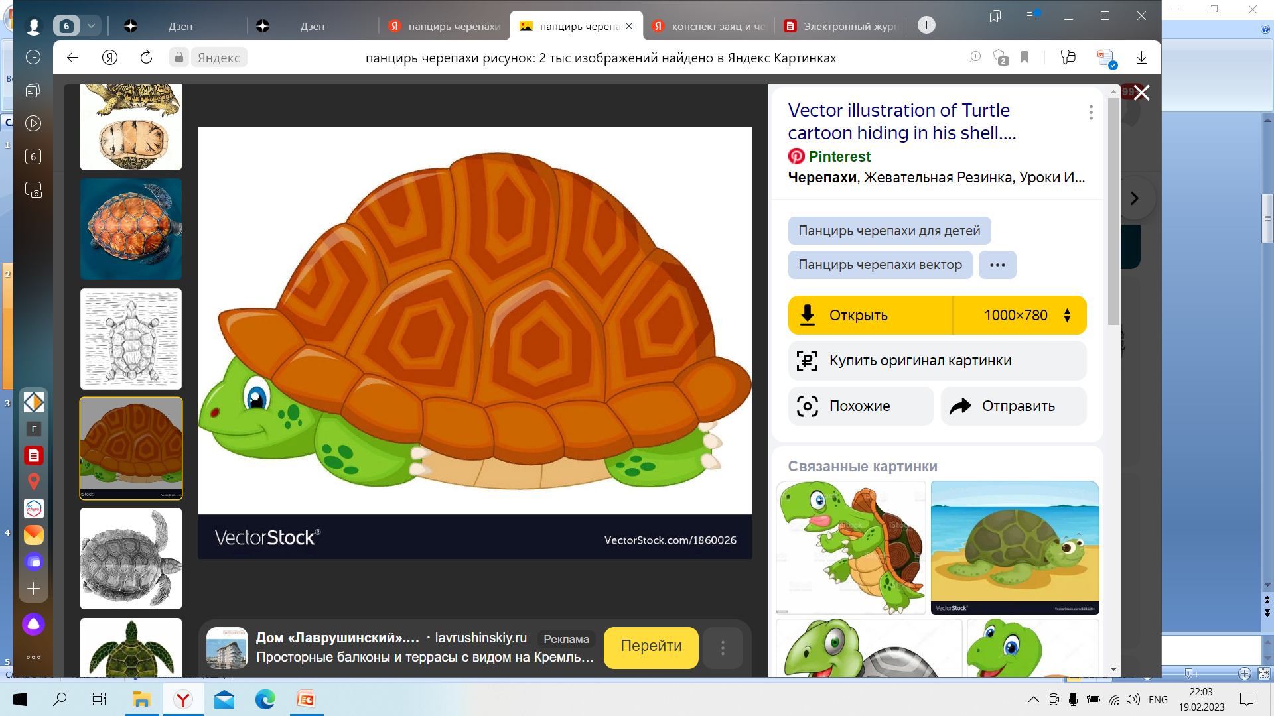
I have four legs and a tail.
I have no teeth.
I can swim and dive underwater.
I carry my house around with me.
I am a…

Slide 3
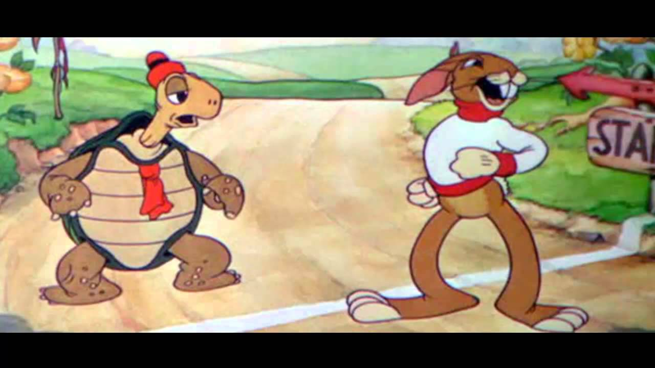
The Hare and the Tortoise.

Slide 4
Let’s make a plan of our lesson.
read, speak, learn, get
1 _______________ new words
2._______________ the text
3._______________ new information
4._______________ about the text

Slide 5
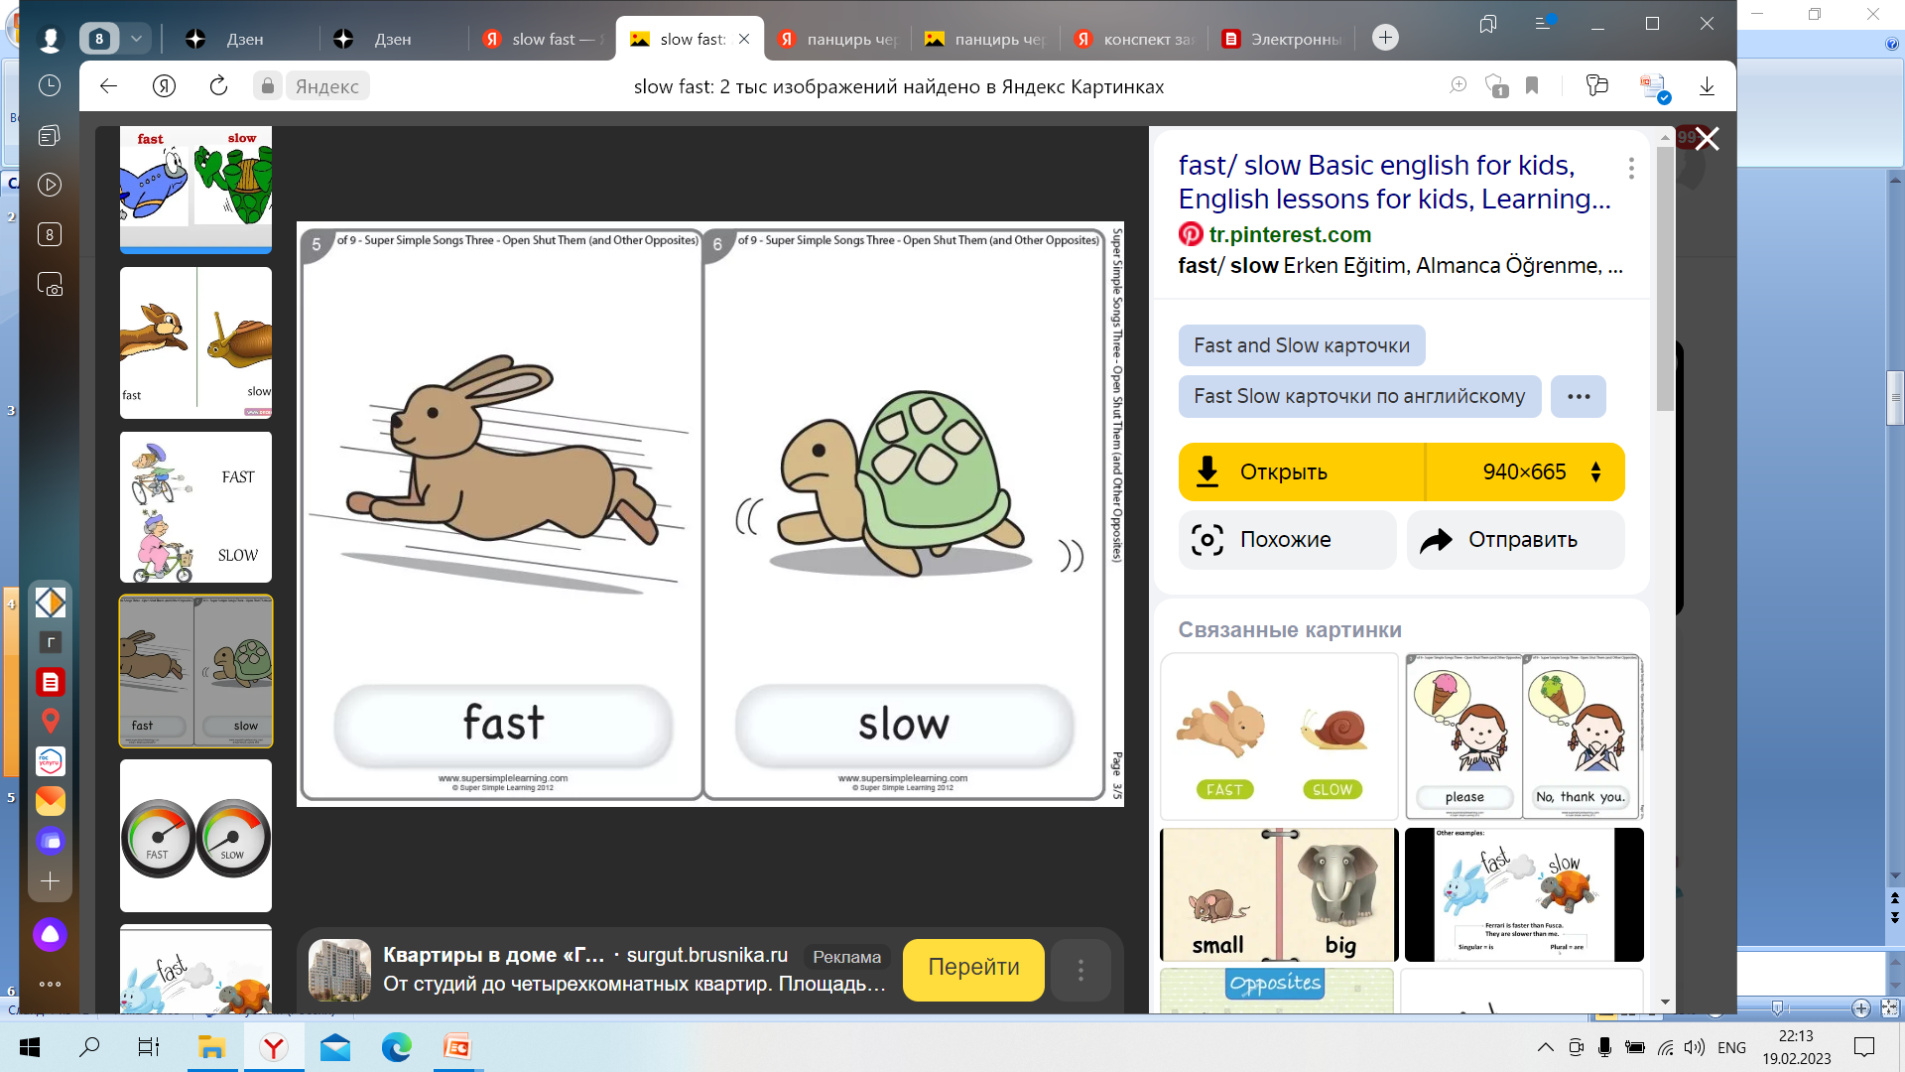

Slide 6

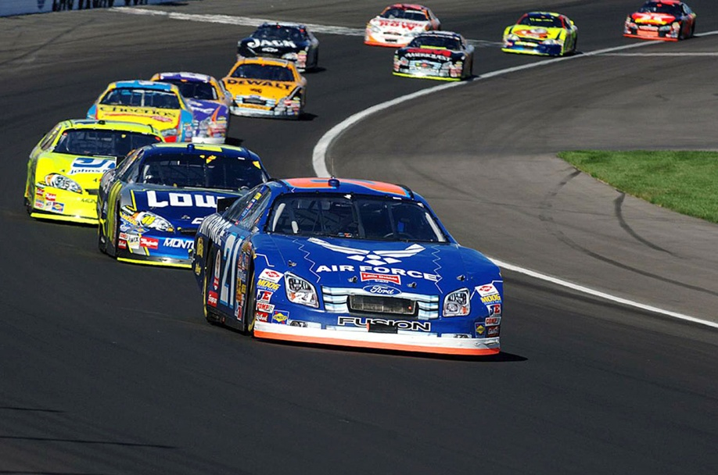
laugh
tired
race

Slide 7
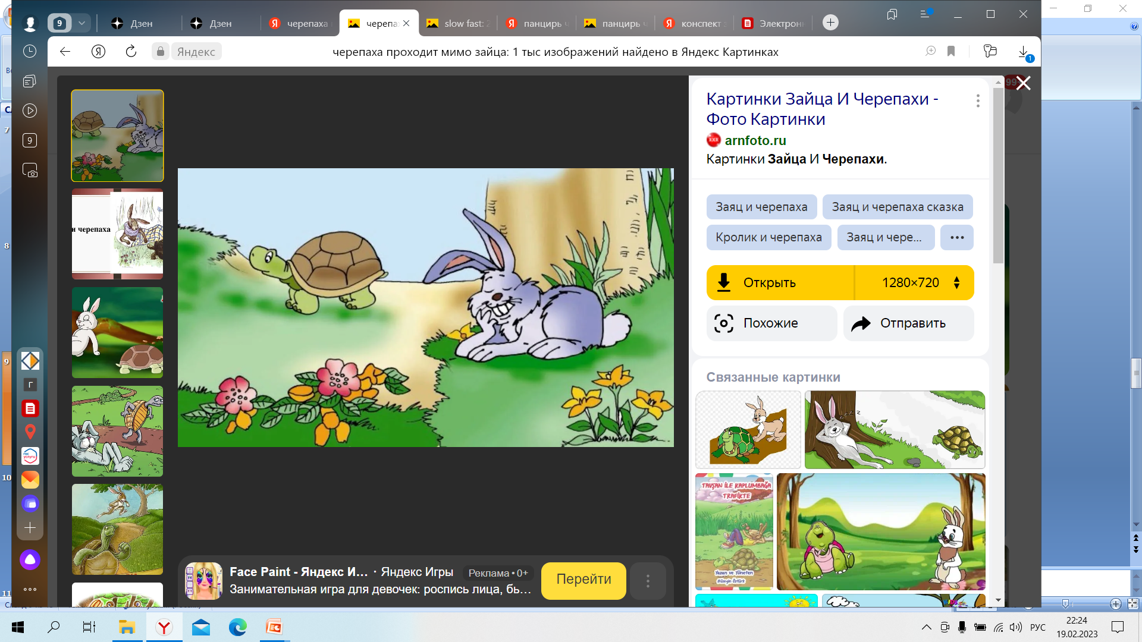
The tortoise passed the sleeping hare
I can rest

Slide 8
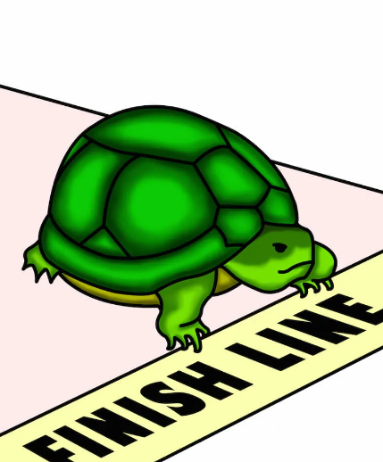
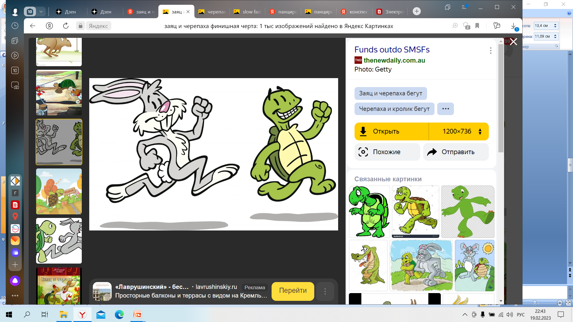

Slide 9
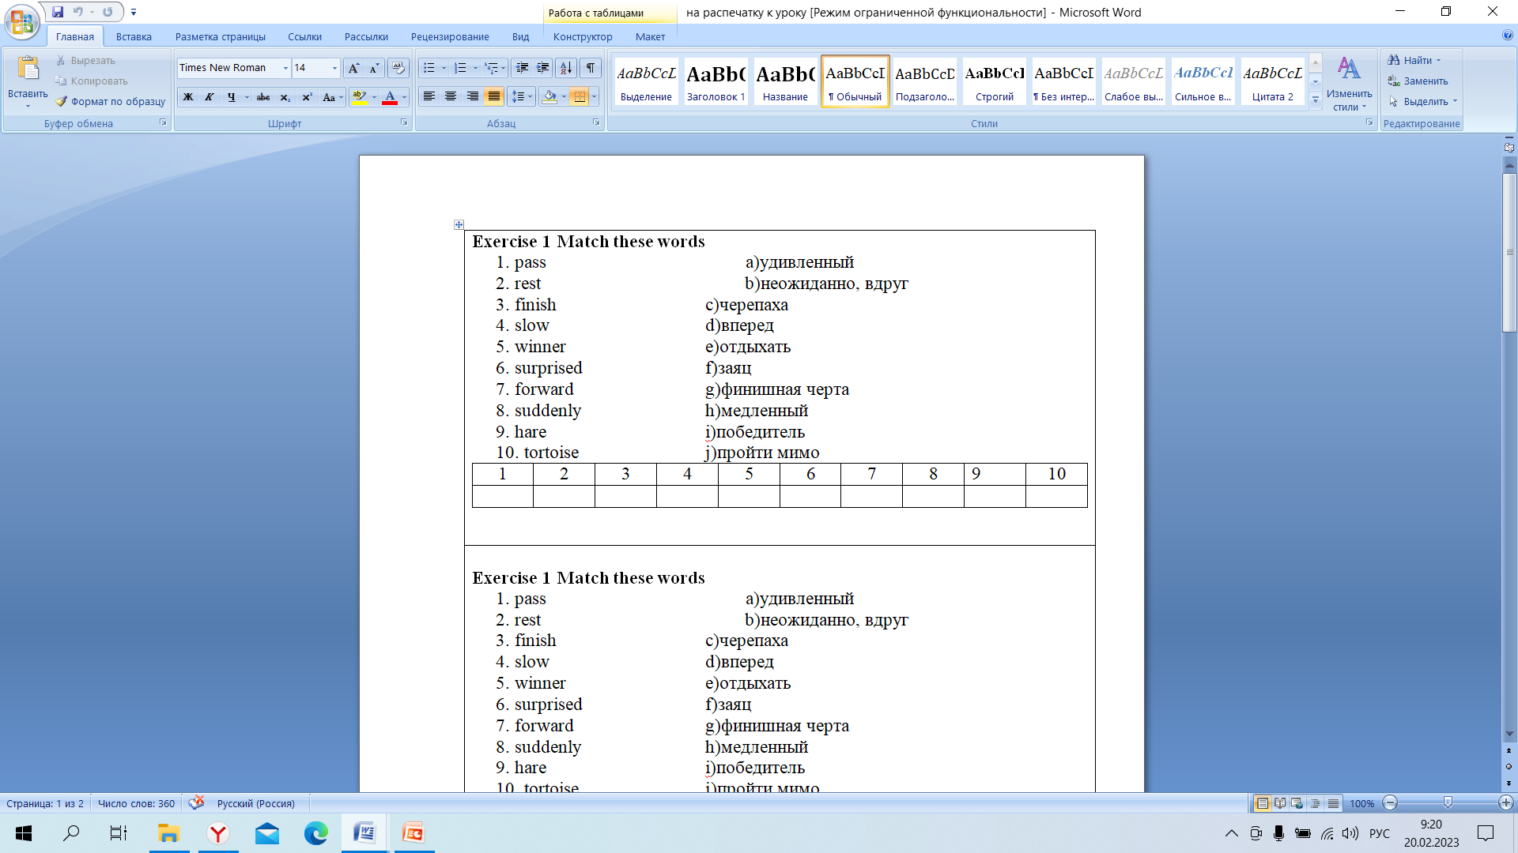
Exercise 1 Match these words
1. pass a)удивленный
2. rest b)неожиданно, вдруг
3. finish c)черепаха
4. slow d)вперед
5. winner e)отдыхать
6. surprised f)заяц
7. forward g)финишная черта
8. suddenly h)медленный
9. hare i)победитель
10. tortoise j)пройти мимо

Slide 10
Past Simple (Прошедшее простое время)
Прошедшее простое время правильных глаголов образуется путем прибавления
– ed к начальной форме смыслового глагола.
work+ ed = worked
laugh + ed= laughed
play + ed = played
pass + ed = passed
I played a game.

Slide 11
Read the verbs
laugh — laughed
pass — passed
surprise — surprised
open — opened
start — started
learn — learned
jump — jumped
look — looked

Slide 12
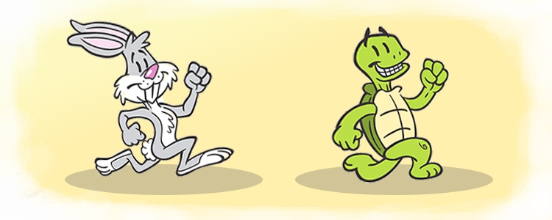
Read and match
A) and the hare was very hot.
B) because he was so slow.
C) the hare jumped forward.
1 The hare always laughed at the tortoise
2 When they started the race,
3 It was a very hot day

Slide 13
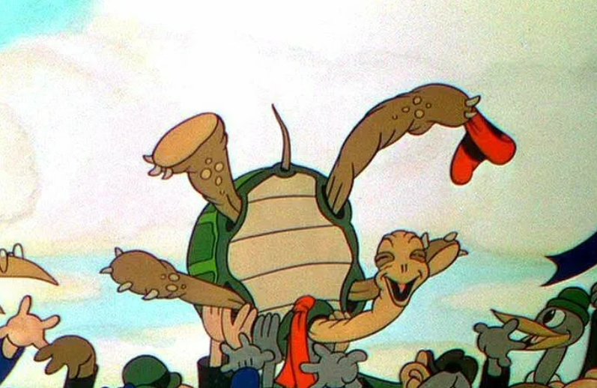
Which is the best moral for the Hare?
Don’t sleep when you run.
Don’t laugh too much.
Don’t be slow.
The winner takes all.
The slower you go the faster you get.

Slide 14
Homework.
SB ex.1 p. 91 retell the text (пересказ текста), revise the rule (повторить правило)

