Slide 1
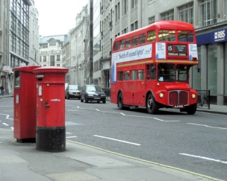
A bus tour around…

Slide 2
Цели урока:
Познавательный аспект: знакомство со столицей Великобритании и её достопримечательностями.
Развивающий аспект – развитие способности к догадке, коммуникабельности, способности осуществлять репродуктивные и продуктивные речевые действия.
Воспитательный аспект – воспитание уважительного толерантного отношения к чужой культуре.

Slide 3
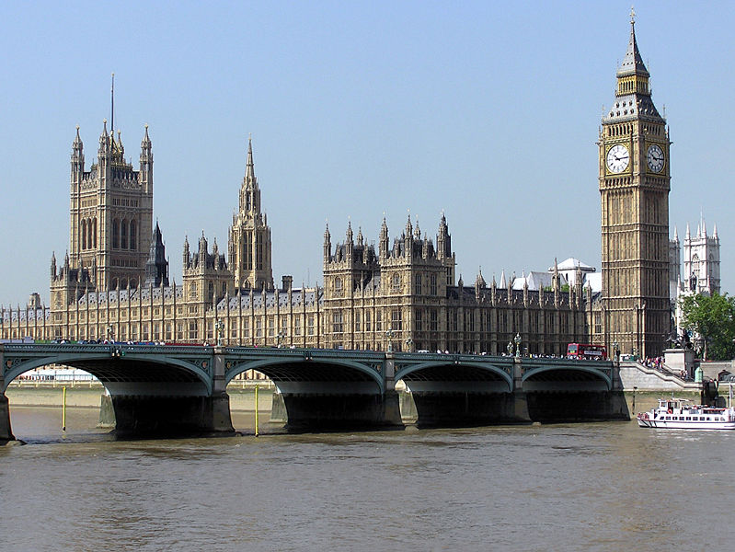
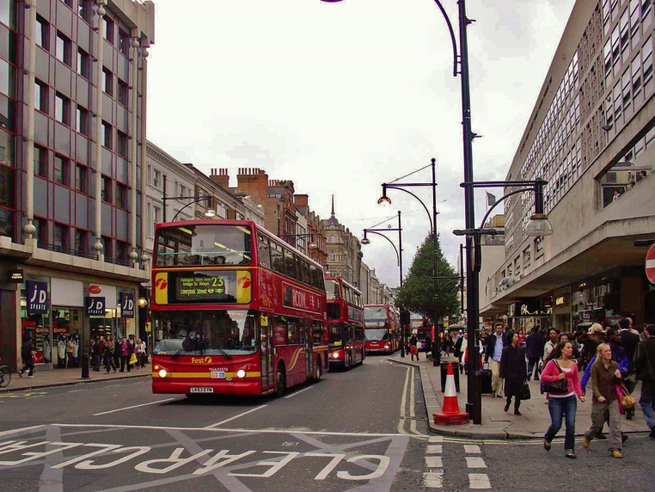
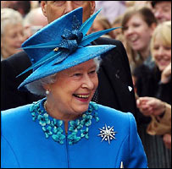
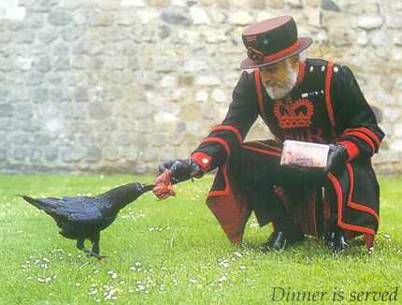

Slide 4
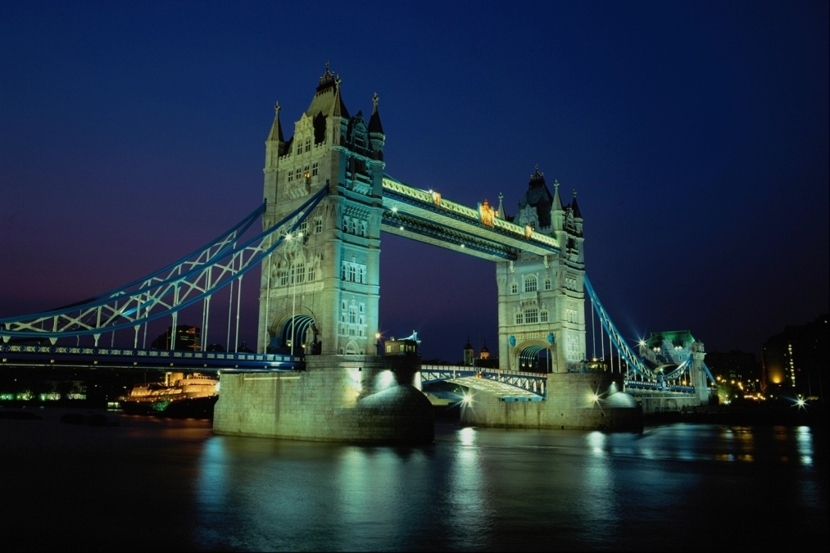
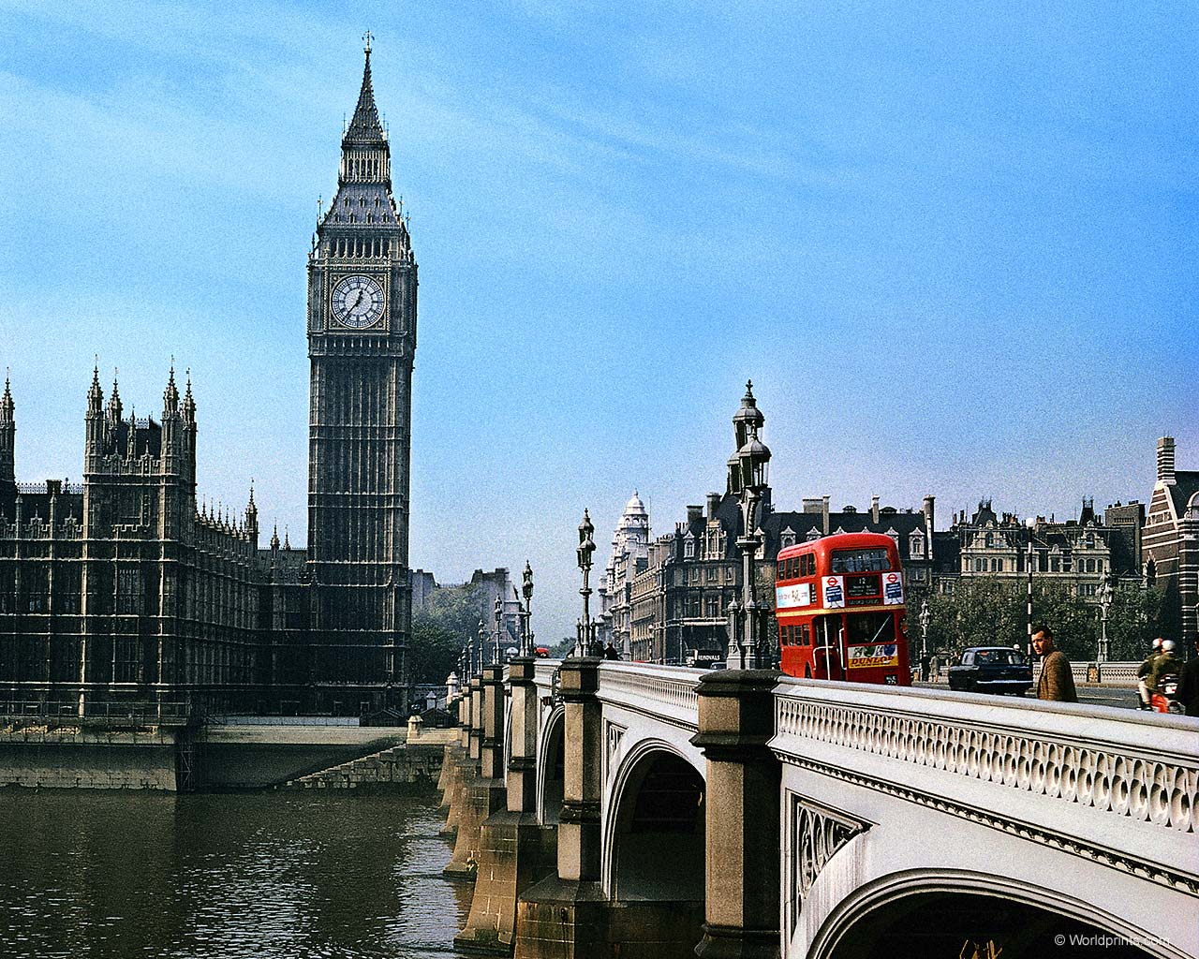
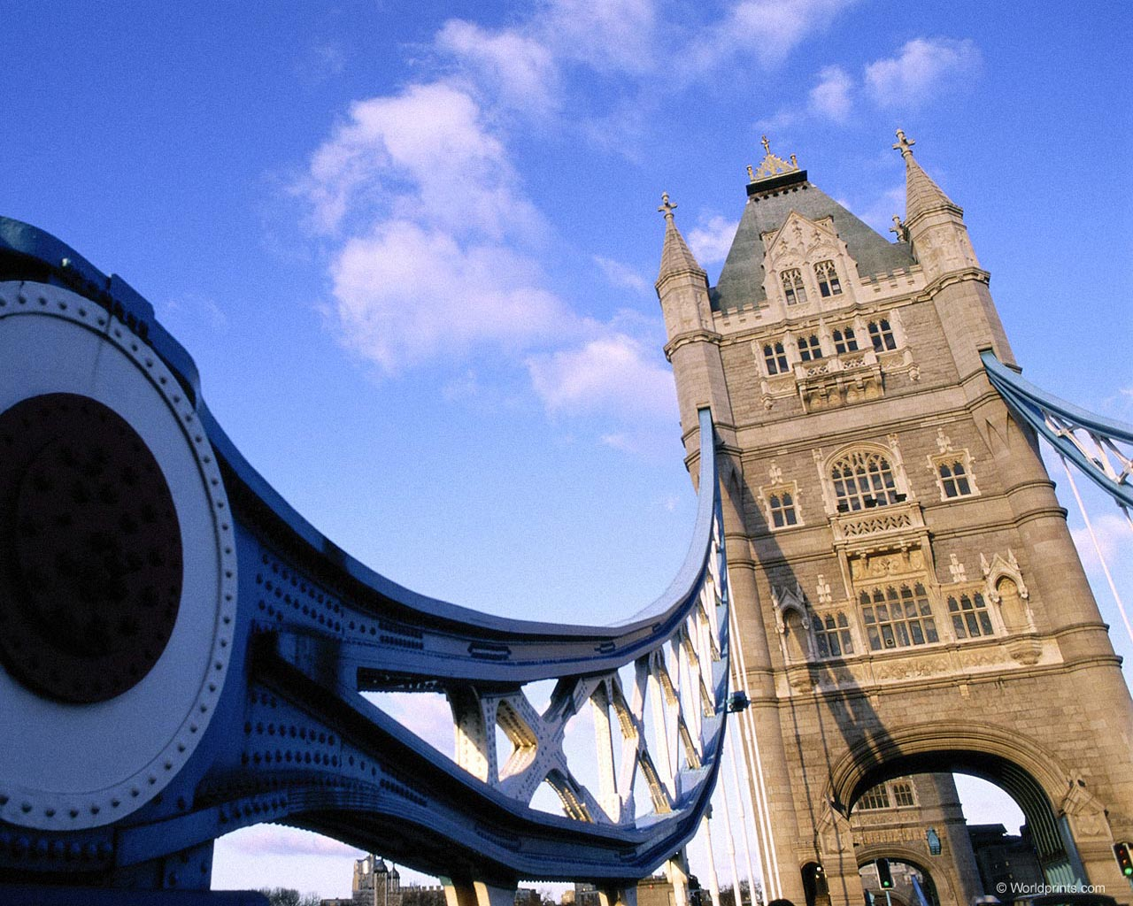
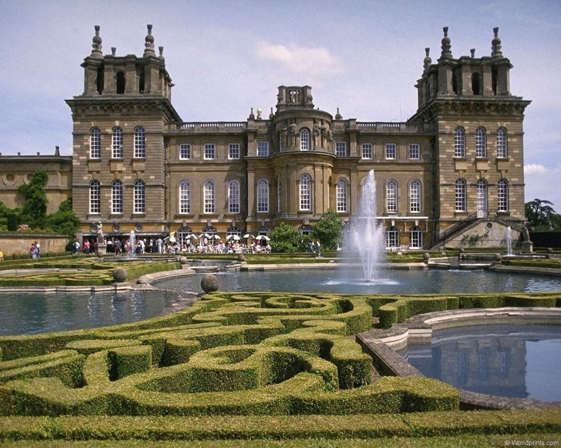
LONDON
London, the capital of Great Britain

Slide 5
London
The Tower of London
Trafalgar Square
Buckingham Palace
Westminster Abbey
The Houses of Parliament
Big Ben
Tower Bridge
St. Paul’s Cathedral
The National Gallery
The Thames
The British Museum

Slide 6
- Лондон
- собор Св. Павла
- река Темза
- Букингемский дворец
-Тауэр
- Здание парламента
- Биг Бен
- Вестминстерское аббатство
- Трафальгарская площадь
- Национальная галерея
Тауэрский мост
Британский музей
- Trafalgar Square
- The National Gallery
- The Tower of London
- Westminster Abbey
- The Houses of Parliament
- Big Ben
- St. Paul’s Cathedral
- Buckingham Palace
Tower Bridge
The British Museum
- London
- The Thames

Slide 7
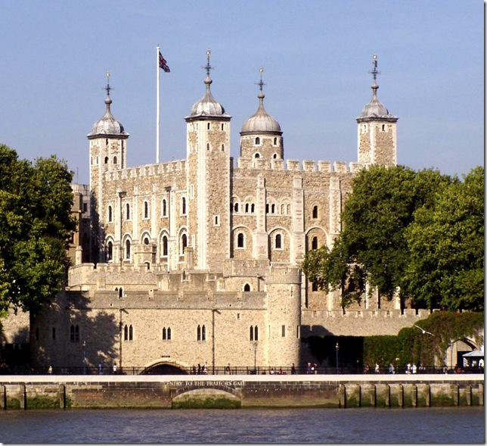
TOWER OF LONDON
The Tower of London
It was a fortress, a palace and a prison. Now it is a museum.

Slide 8
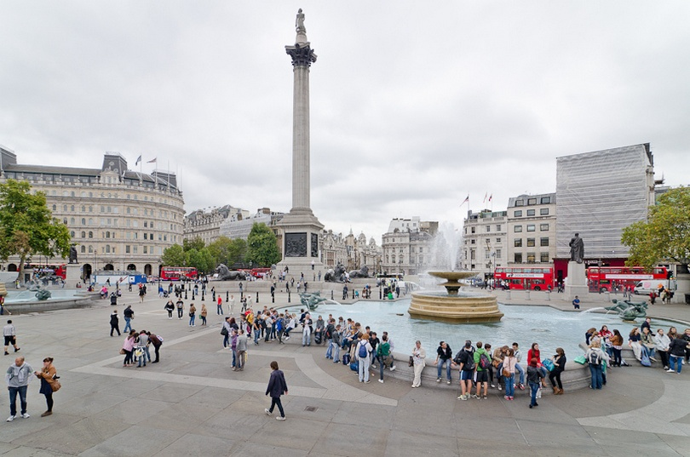
Trafalgar Square
is the heart of London
In the middle of the square you can see Nelson's Column.

Slide 9
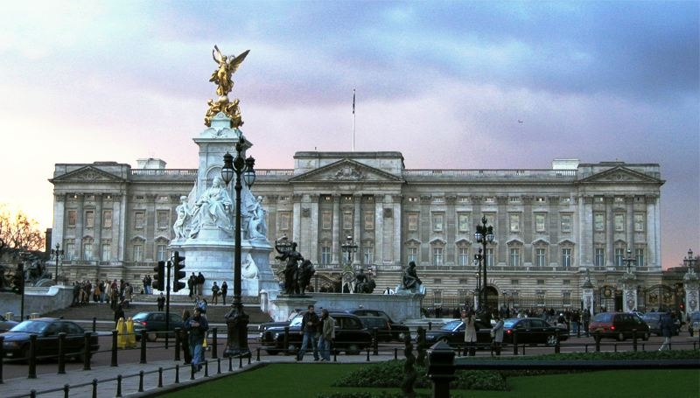
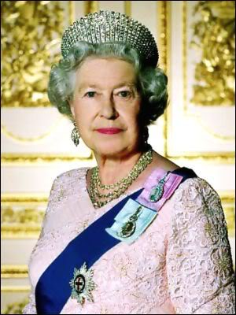
Buckingham Palace
Buckingham Palace
London home of Queen Elizabeth II

Slide 10
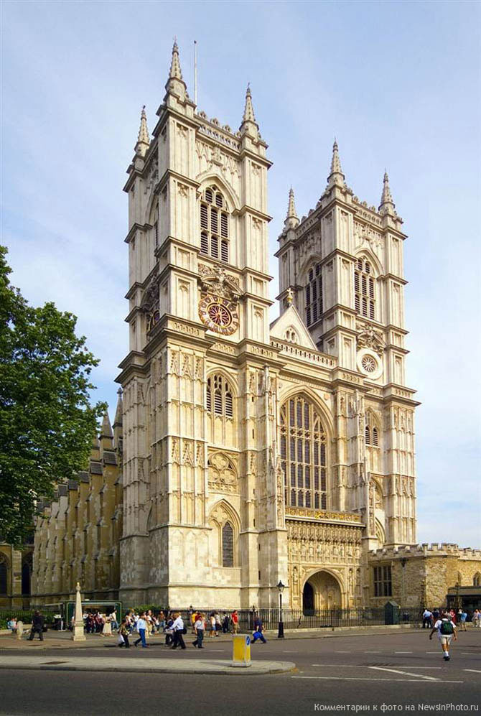
WESTMINSTER ABBEY
It is a royal church..
English kings and queens were crowned here.

Slide 11
The Houses of Parliament
It is the building in which the members of the British parliament meet.

Slide 12
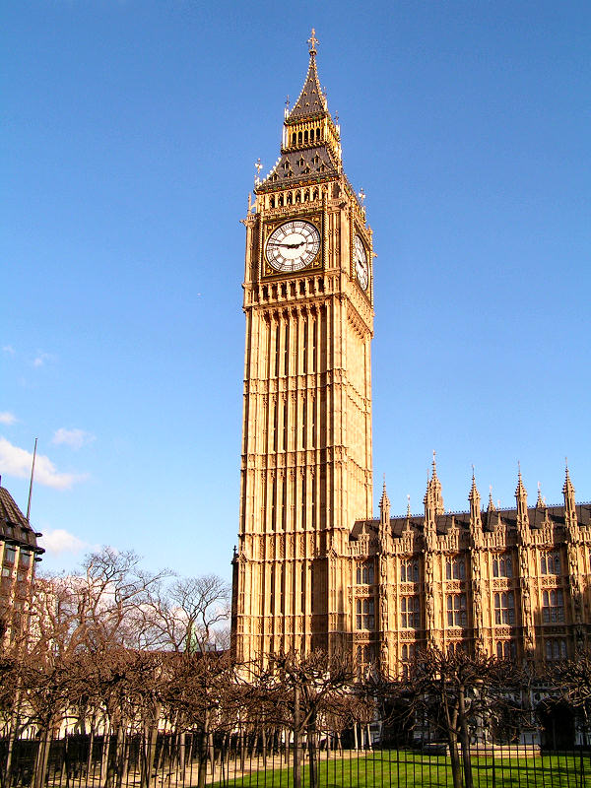
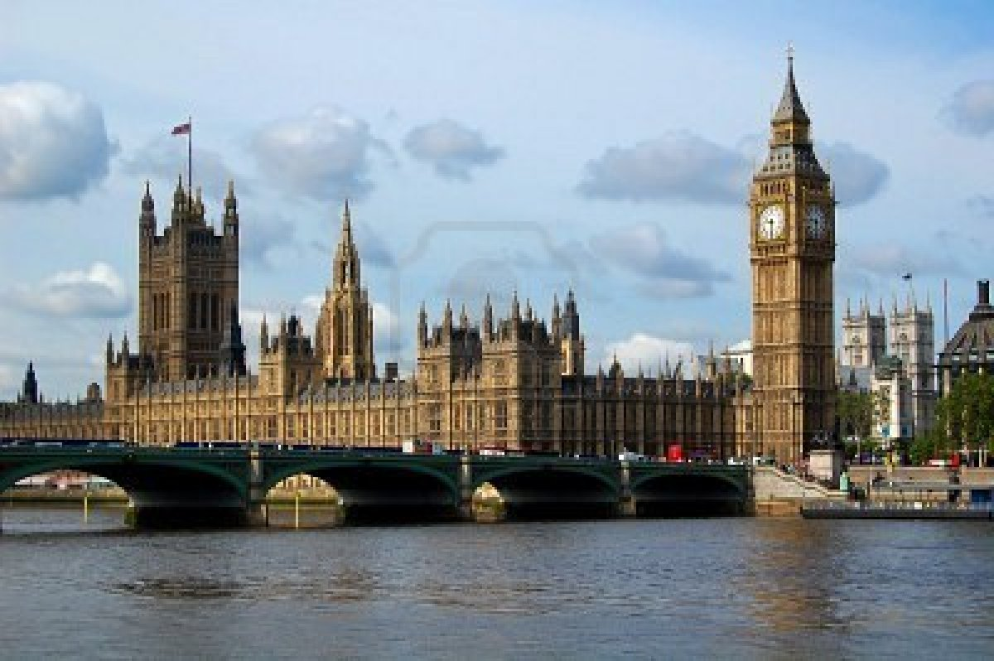
Big Ben,
the big clock tower, is the symbol of London.

Slide 13
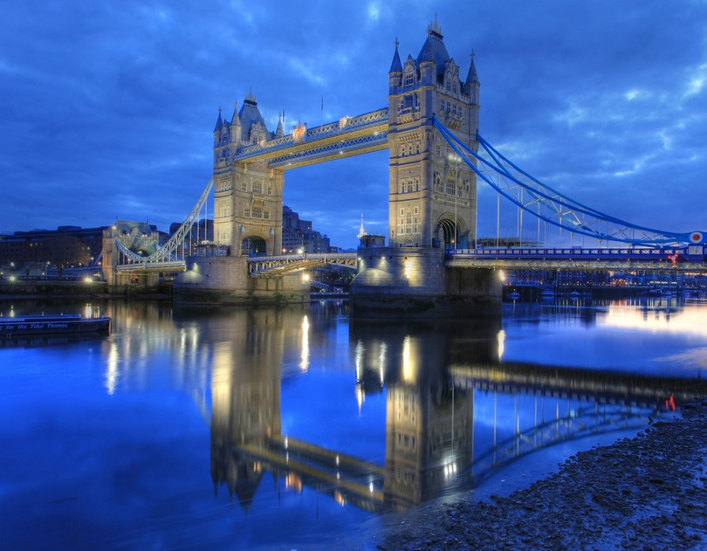
Tower Bridge
A bridge which crosses the river Thames.
It opens when a big ship comes.

Slide 14
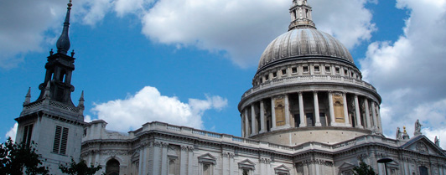
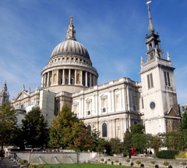
St. Paul’s Cathedral
Is the greatest
of English
churches.

Slide 15
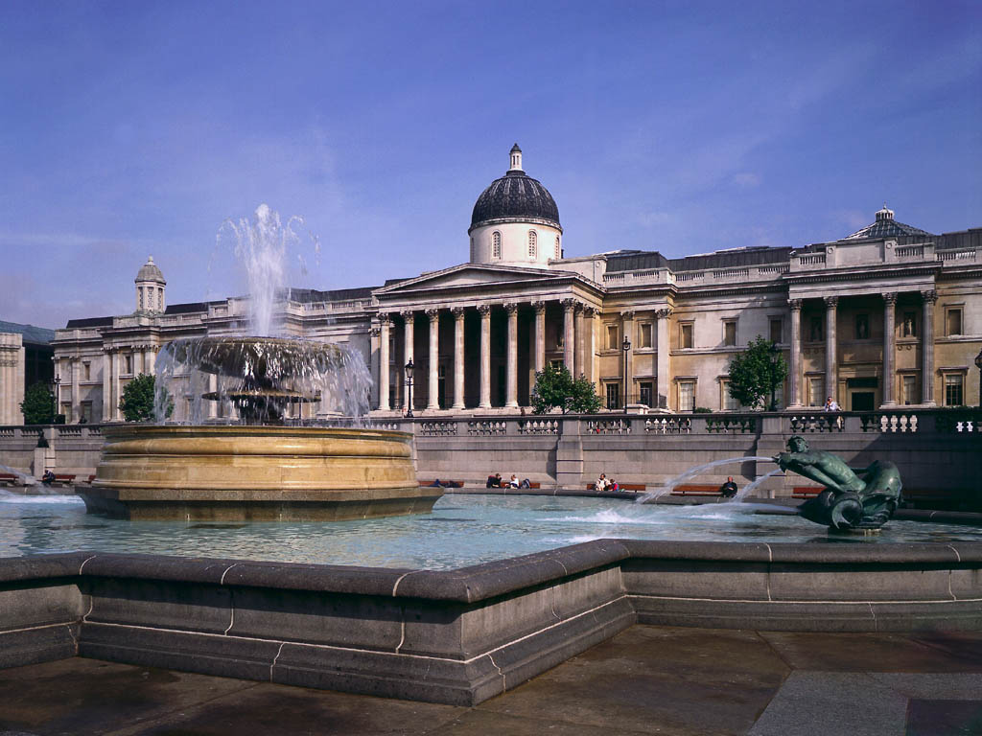
The National Gallery
It is the home of the most important collection of historical paintings.

Slide 16
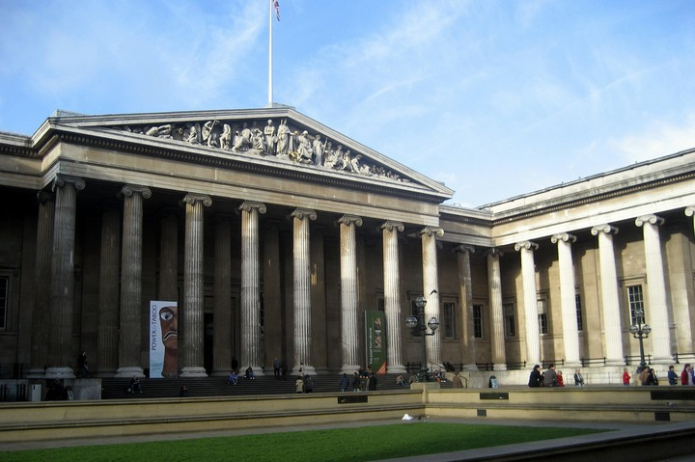
The British Museum
is the biggest museum in London and one of the biggest museums in the world.

Slide 17
Up, down, up, down
Which is the way to London Town?
Where? Where?
Up in the air
Close your еyes
And you are there.

Slide 18
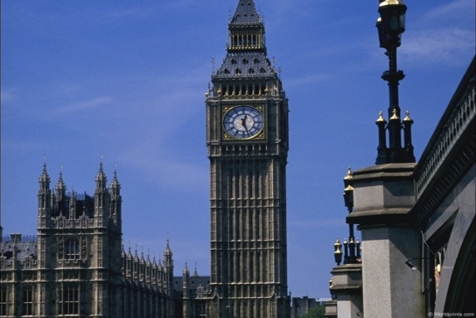
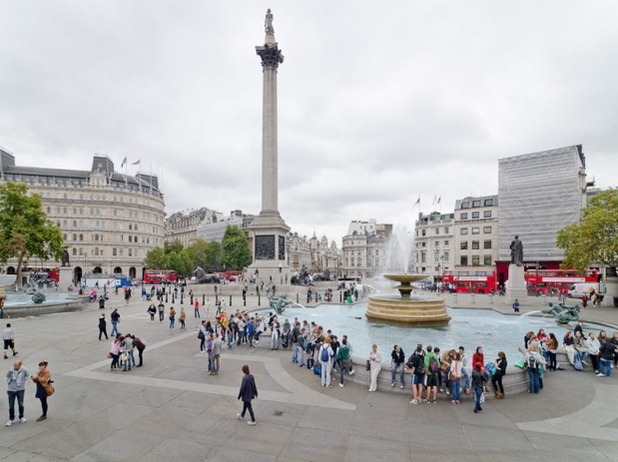
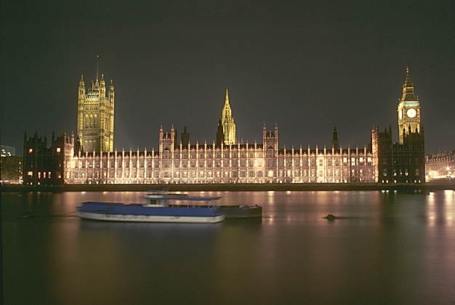
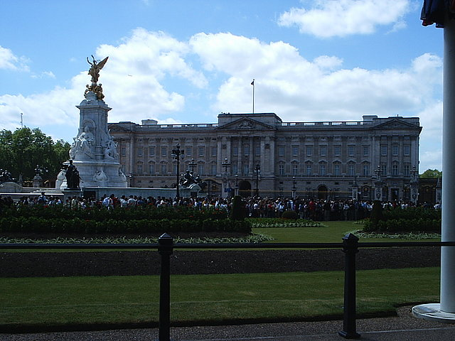
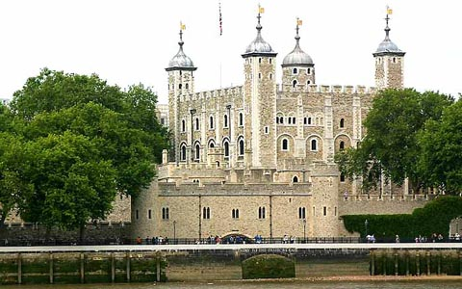
a) Trafalgar Square b) Big Ben c) The Tower of London d) Buckingham Palace e) The Houses of Parliament f) Tower Bridge
1
3
2
4
6
5

Slide 19
2
3
1
Tower Bridge
Trafalgar Square
Big Ben
The Houses of Parliament
Buckingham Palace
The Tower of London
6
4
5

Slide 20
Match the columns
The Tower of London was…
Big Ben is…
Trafalgar Square is …
Westminster Abbey is…
Buckingham Palace is…
The National Gallery is …
The British Museum is…
St. Paul’s Cathedral is …
1. a large square, a traditional place for meetings.
2. the Queen’s residence.
3. the biggest museum in London and one of the biggest museums in the world.
4. a fortress, a royal palace and a prison.
5. the greatest of English churches.
6. the symbol of London.
7. a royal church.
8. a rich art gallery.

Slide 21
Put in the missing words
London is the 1)... of Great Britain. It is a very 2)… city. It was founded about two thousand 3)… ago. London is one of the most 4)… and interesting 5)… in Europe. There are many places to visit in London. There are a lot of 6)…., art 7)…, cinemas, 8)… and parks in London.
cities, capital, museums, years, old, galleries, beautiful, theatres

Slide 22
Check yourself
London is the 1)capital of Great Britain. It is a very 2)old city. It was founded about two thousand 3)years go. London is one of the most 4)beautiful and interesting 5)cities in Europe. There are many places to visit in London. There are a lot of
6) museums, art 7) galleries, cinemas, 8) theatres, and parks in London.

Slide 23
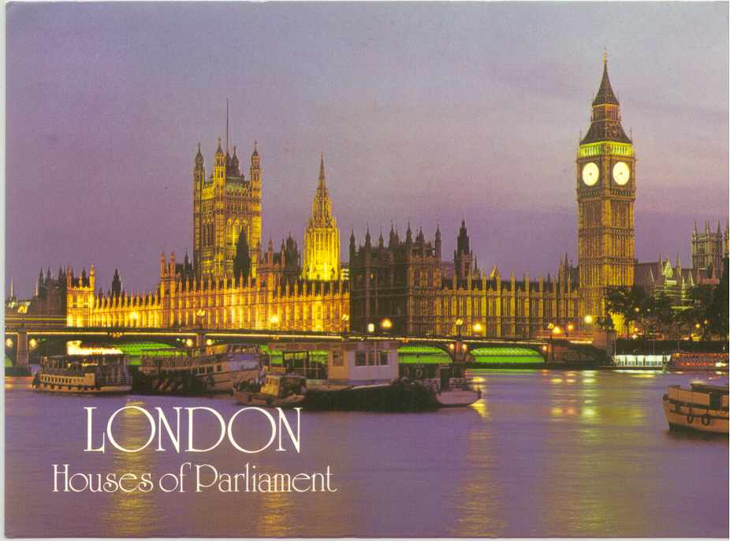
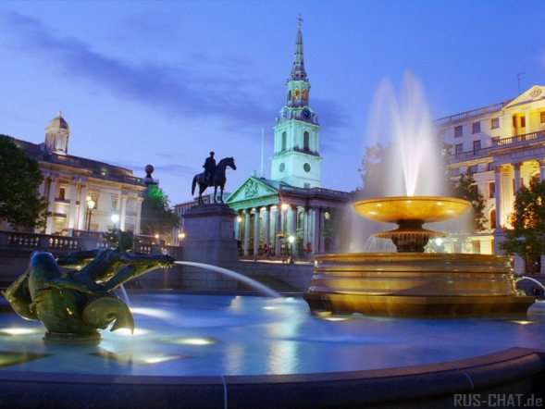
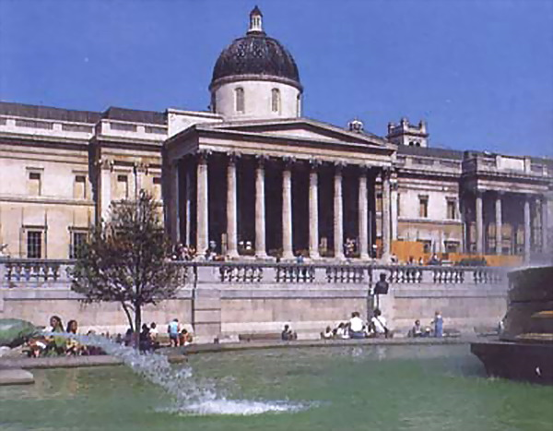
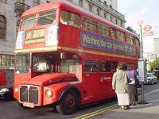
Dear -------------, I’m in London now. Yesterday I visited ----------------------------------------------------------------------. Also I’d like to visit --------------------------------------------------------------------. London is wonderful! I’m OK. See you soon!
------------

Slide 24
Finish the sentences
London is……
London is a very old……
In London there are a lot of ..….
The symbol of London is…….
Westminster Abbey is…….
The British Museum is……
Trafalgar Square is……
Buckingham Palace is……

Slide 25
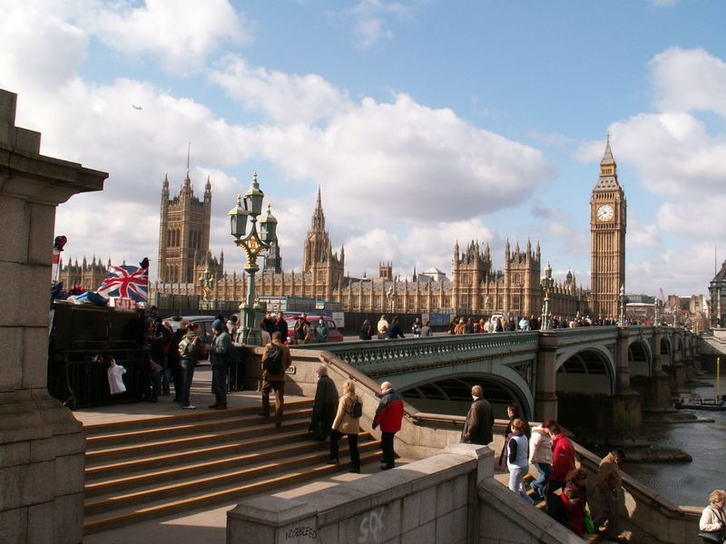
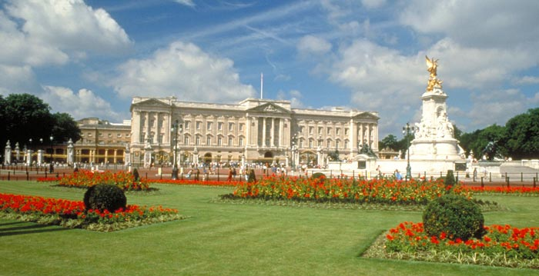
Good bye!

