Slide 1
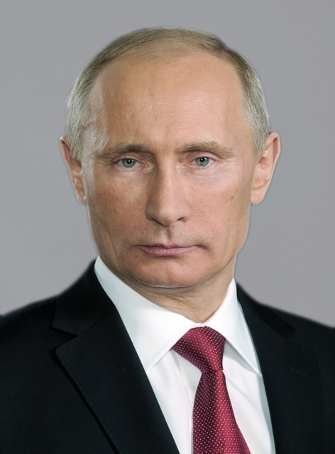
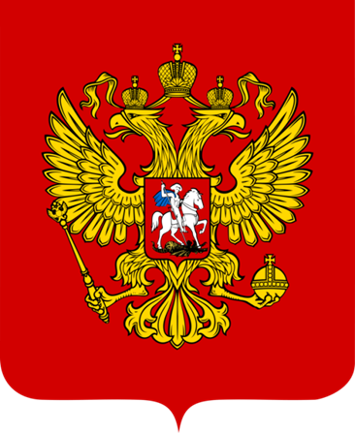
The National Symbols of the Russian Federation

Slide 2
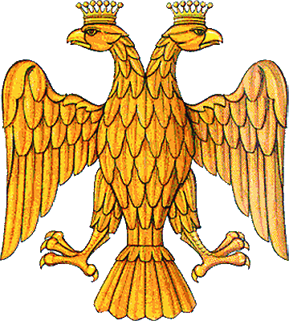
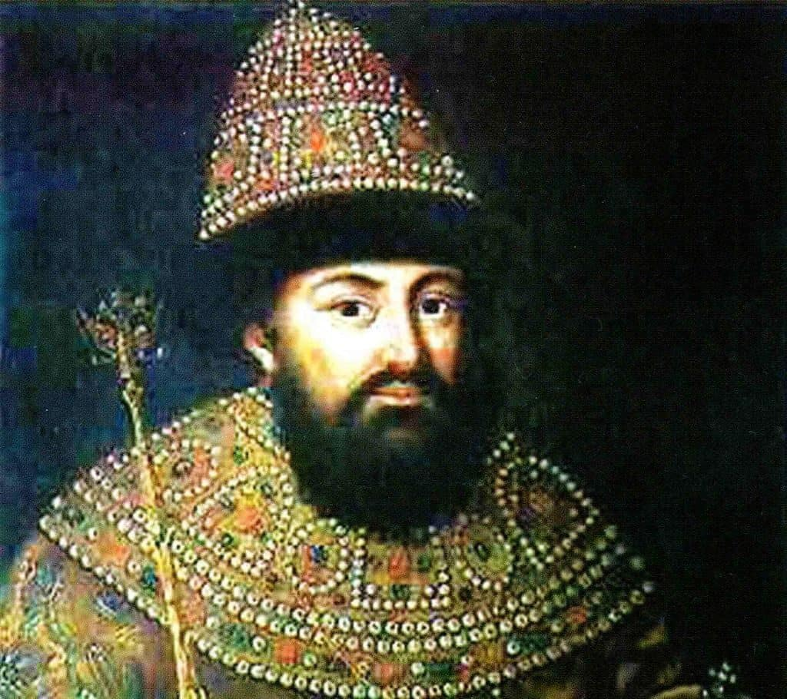
The Russian Coat of Arms
The double-headed Eagle serves as the Russian Coat of Arms since 15th century after the marriage of Ivan III of Russia and Sophia Paleologue, a niece of the last Byzantine emperor Constantine XI.

Slide 3
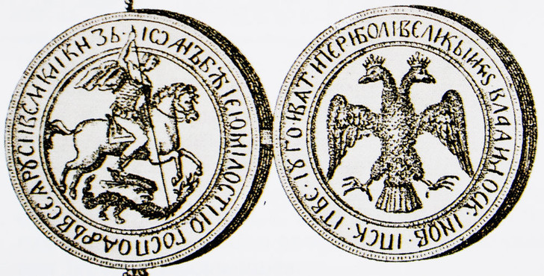
The double-headed eagle was placed on the national seal at the end of the XV century by Ivan III.

Slide 4
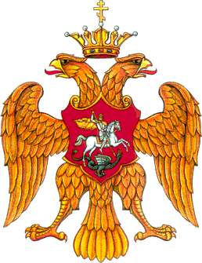
From the late 15th century the two-headed eagle appeared on the seals of the Moscow governor.
It supplemented the former Moscow coat of arms with the image of St. George the Conqueror.
This was a sign of Russia showing its belonging to Byzantium.

Slide 5
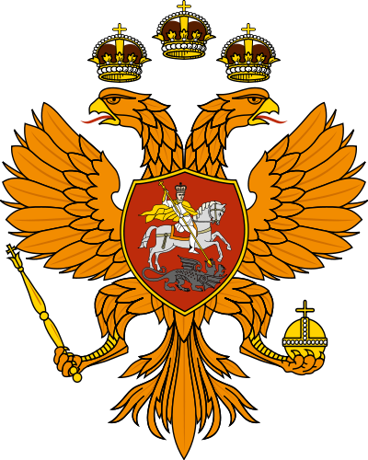
The first ruler of the Romanov dynasty – Mikhail Fedorovich – was elected by Zemsky Sobor in 1613. The two-headed eagle on his seal of 1625 got a third crown.
In the reign of Tsar Alexei Mikhailovich Romanov the eagle receives symbols of power: the scepter and the orb.

Slide 6
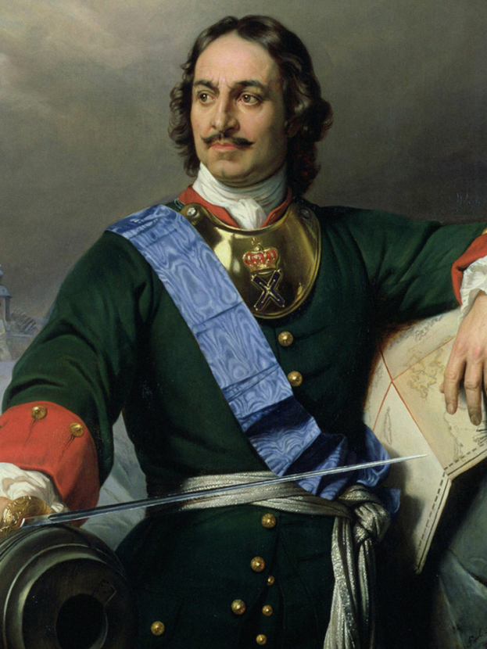
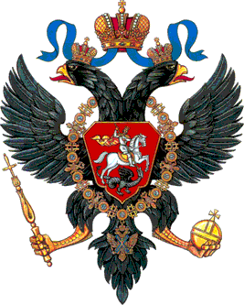
Under Peter I the eagle started to be coloured black, though it had always been golden. It was associated with the Northern War.
This is how Peter I decided to express the might and power of the Russian state.

Slide 7
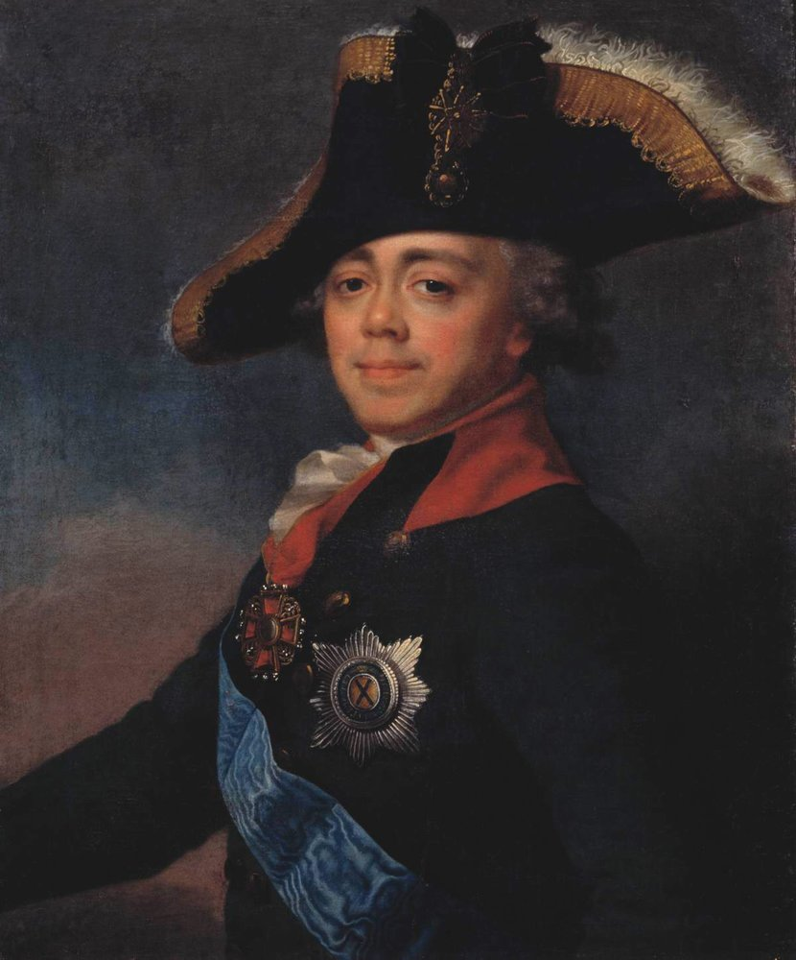
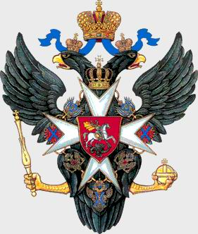
Pavel I (1796-1801) introduced some changes to the coat of arms during his rule.
The two-headed eagle became part of the imperial family in
the epoch of Pavel I.
The bright Maltese cross appeared on the eagle’s chest, with the Grand Master’s crown on top
of the cross.

Slide 8
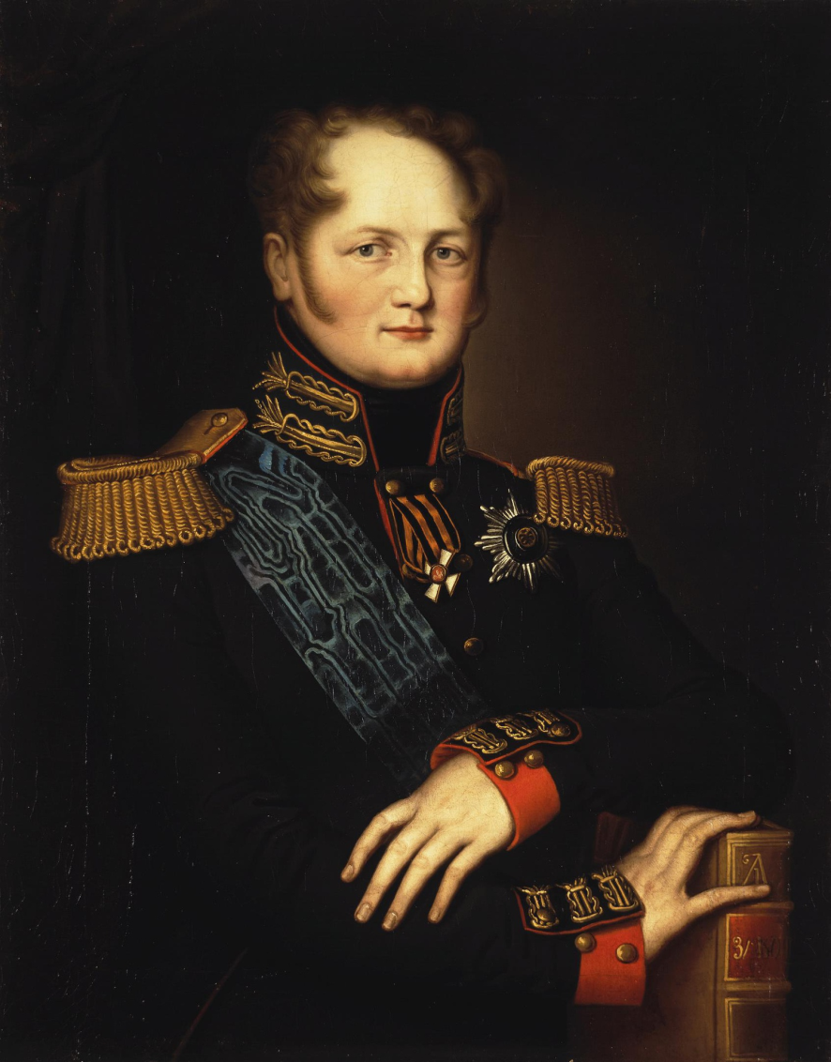
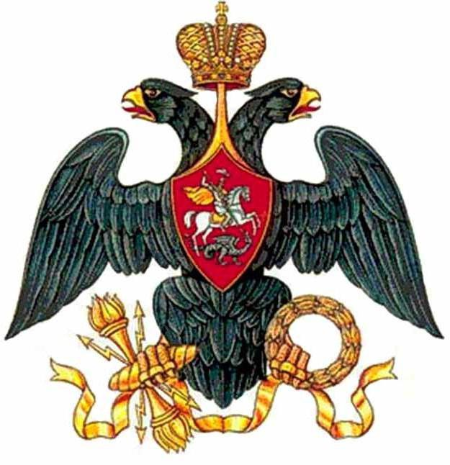
Alexander I (1801-1825) in his turn decided to cancel the Maltese cross.
Under his reign the eagle’s wings were spread apart and its feathers lowered.
One head of the eagle was tilted more than the other.
The eagle got new attributes in its paws: thunder arrows, a torch, and a laurel wreath.

Slide 9
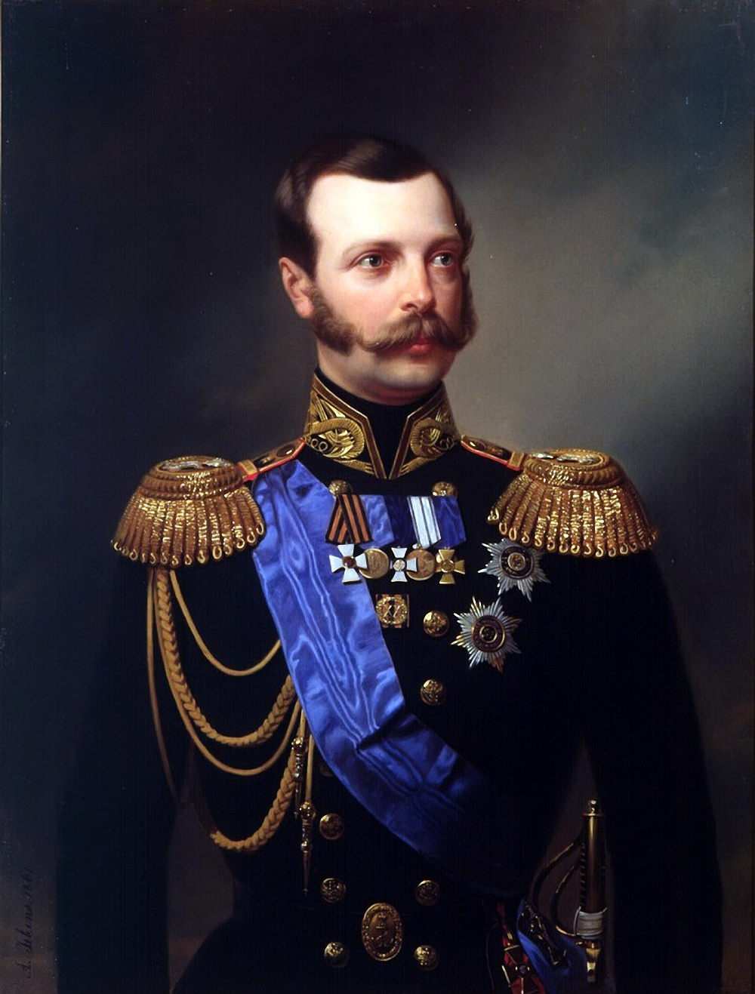
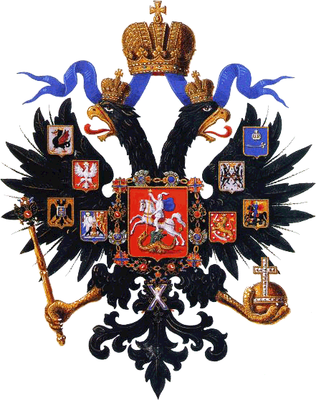
The big State Emblem was introduced by order of Alexander II (1855-1881) on April 11, 1857.
In the center of the coat of arms there was the French golden shield with the two-headed black eagle.

Slide 10
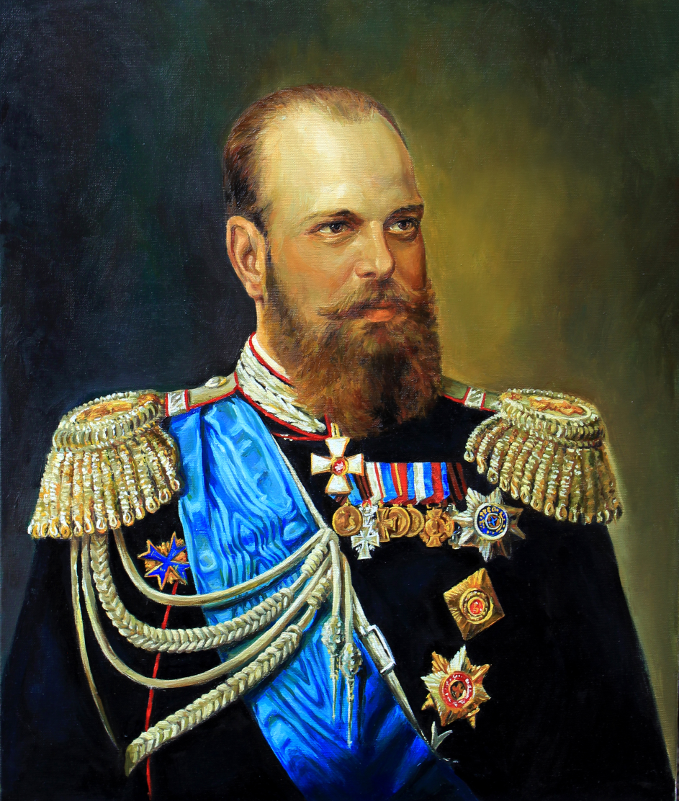
The Coat of Arms of the Russian Empire
Large coat of arms is commonly depicted with a black double-headed eagle in a Golden shield, which was crowned by two Imperial crowns.

Slide 11
July 20, 1920 approved a new version of the coat of arms. Finally, the new coat of arms was legalized by the Constitution of the RSFSR, adopted by the XII All-Russian Congress of Soviets on May 11 1925.

Slide 12
The State Emblem of the Soviet Union was adopted in 1923 and was used until the dissolution of the USSR in 1991.
The state emblem shows the traditional Soviet emblems of the Hammer and Sickle and the Red Star over a globe, and two wreaths of emmer wheat covered by "Workers of the world, unite!" in the official languages of the Soviet Republics, in the reverse order they were mentioned in the Soviet Constitution.

Slide 13
The Russian Coat of Arms
The Russian National Emblem is a golden DOUBLE – HEADED EAGLE with a horseman (St George) on a shield on the eagle’s breast with a red background. Above the two heads of the eagle, there is an historical crown.

