Slide 1
Презентация к уроку
английского языка по теме «Еда. Завтрак.»
5 класс

Slide 2


Slide 4


Slide 5
Match the countries with the names of food
    Hamburger Mexico
Taco India
Dumplings the USA
Curry Japan
Sushi Vietnam
Bibimbap China
Rice Noodles South Korea
Waffles Belgium
Sausages Switzerland
Paella Spain
Fondue Italy
Pizza Germany
Fish and chips England

Slide 6
Прочитайте текст и предложения после текста. Найдите верные True и неверные False предложения.
Breakfast in Russia is a very important meal because the weather is cold and we need to eat something warm and healthy to start the day.
Some people drink coffee for breakfast, but hot tea is more popular. There are lots of different kinds of bread to eat. Brown bread is very traditional in Russia. Bliny (pancakes), sausages and fried eggs are also typical things to eat for breakfast. Kasha (porridge) is also very popular, especially for children.
1. The weather in Russia is usually warm and rainy. (true/false)
2. People drink milk and juice for breakfast. (true/false)
3. Hot tea is very popular and more important drink. (true/false)
4. White bread is very traditional in Russia. (true/false)
5. Children like to eat kasha for breakfast. (true/false)

Slide 7


Slide 8
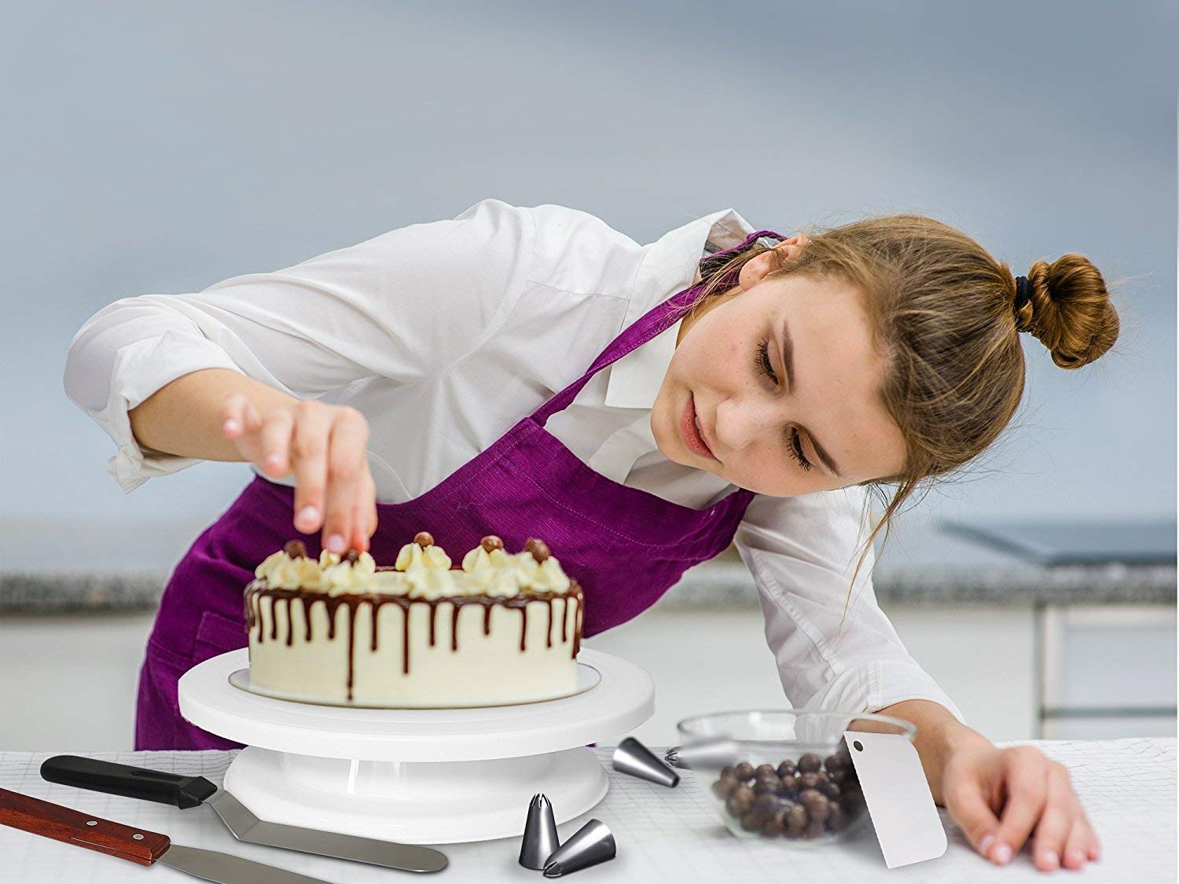

Slide 9


Slide 10


Slide 11
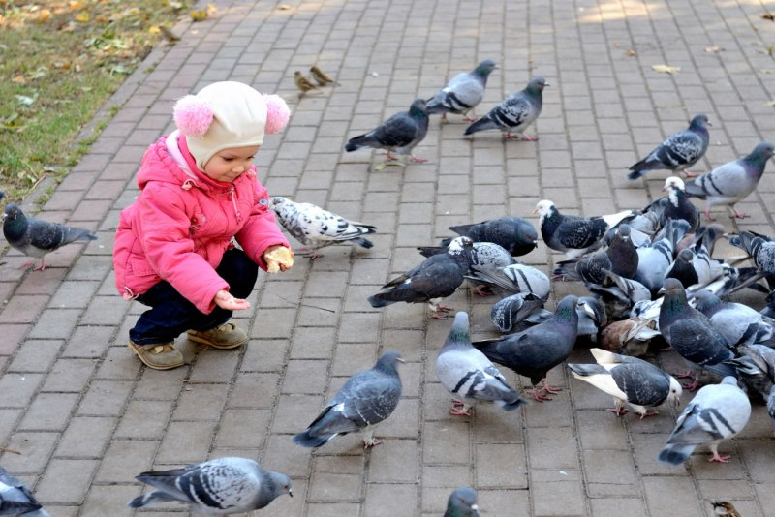

Slide 12
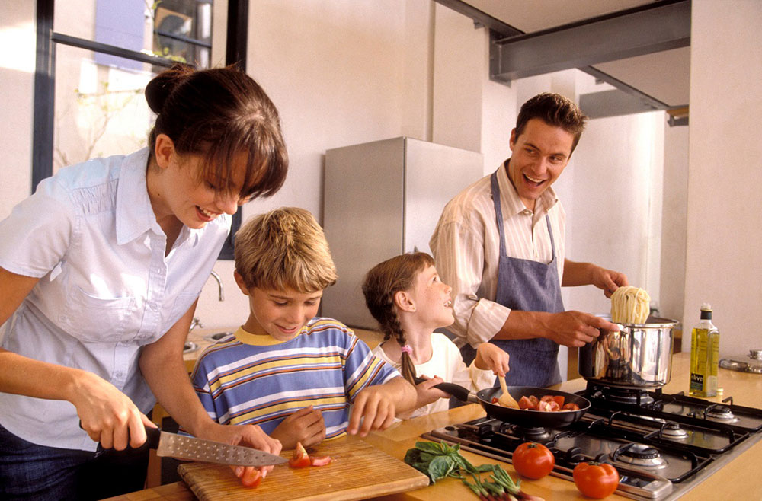

Slide 13


Slide 14
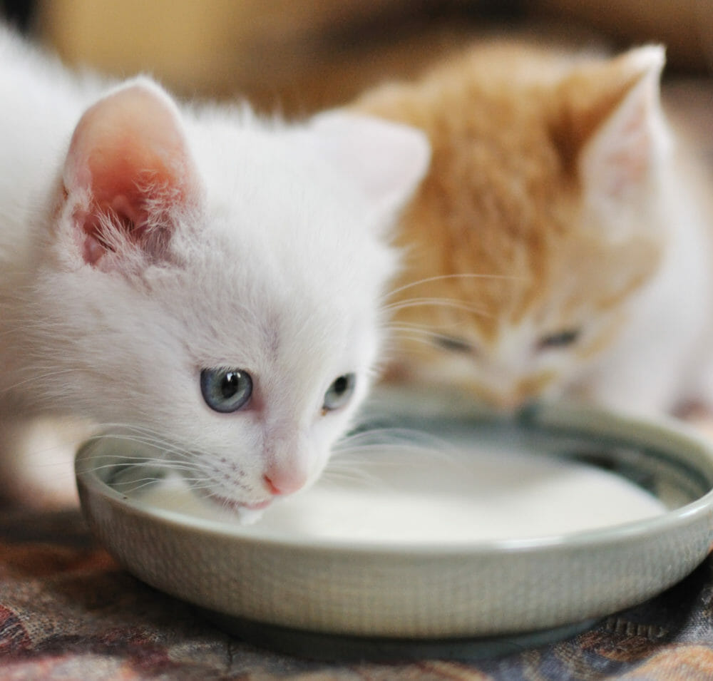

Slide 15


Slide 16
