Slide 1
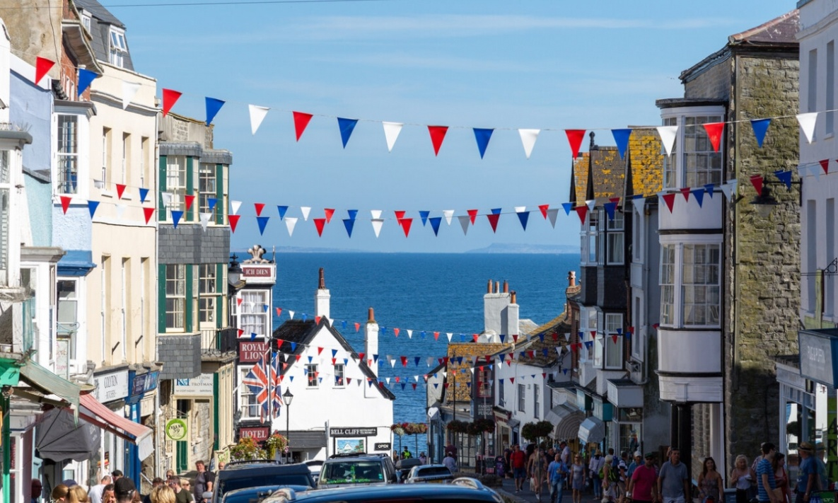
The Queen's Platinum Jubilee
Учитель английского языка: Свистун К.А.

Slide 2
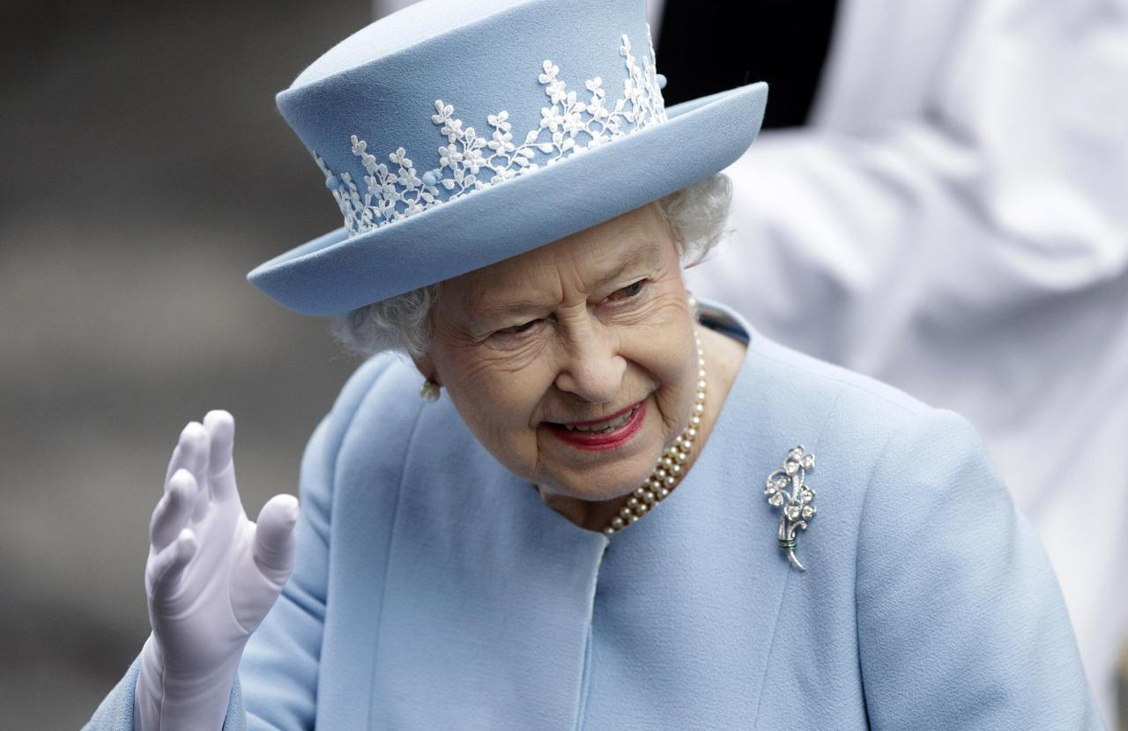
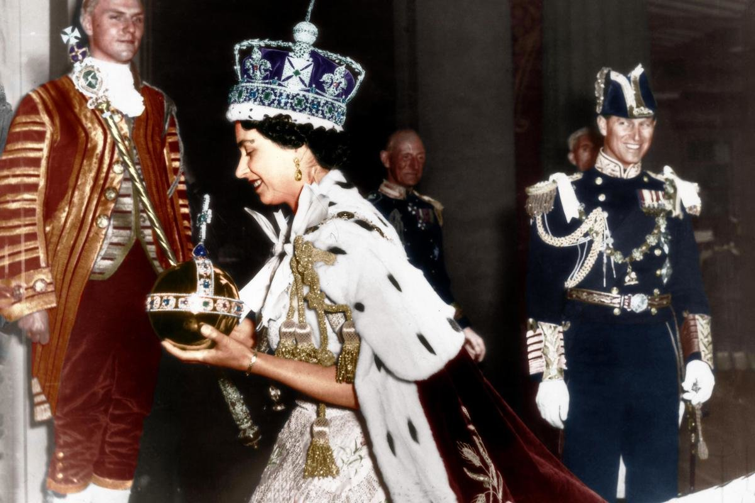

Slide 3
Topic: The Queen's Platinum Jubilee
Aims:
To help students to talk about the Queen’s platinum jubilee;
To develop students’ listening skils;
To develop students’ reading skills;
To develop students’ speaking skills.

Slide 4
Celebrations.
Anniversary [ænɪˈvɜːsərɪ] юбилей, годовщина
Party [ˈpɑːtɪ] вечеринка
Carnival [ˈkɑːnɪvəl] карнавал
Parade [pəˈreɪd] парад
Wedding [ˈwedɪŋ] свадьба, венчание

Slide 5
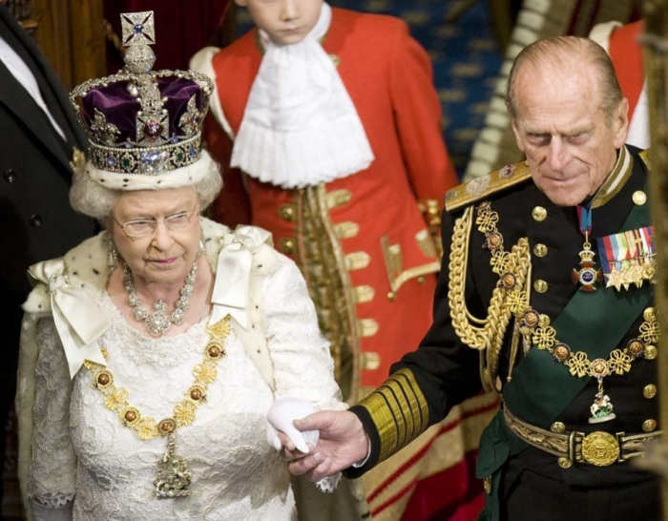
Royal [ˈrɔɪəl] королевский, царский

Slide 6
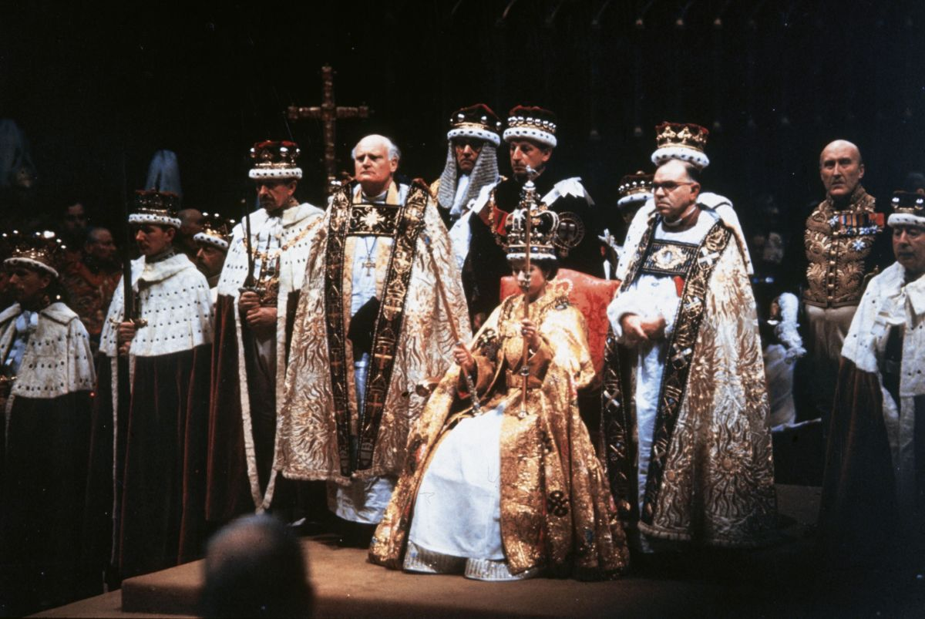
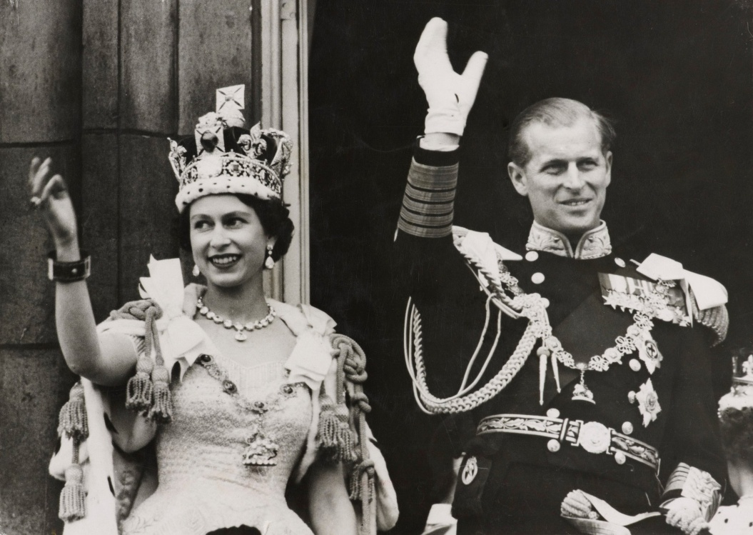
Crown [kraʊn] корона
To crown [kraʊn] короновать
Crowned [kraʊnd] коронованный
Coronation [kɒrəˈneɪʃn] коронация

Slide 7
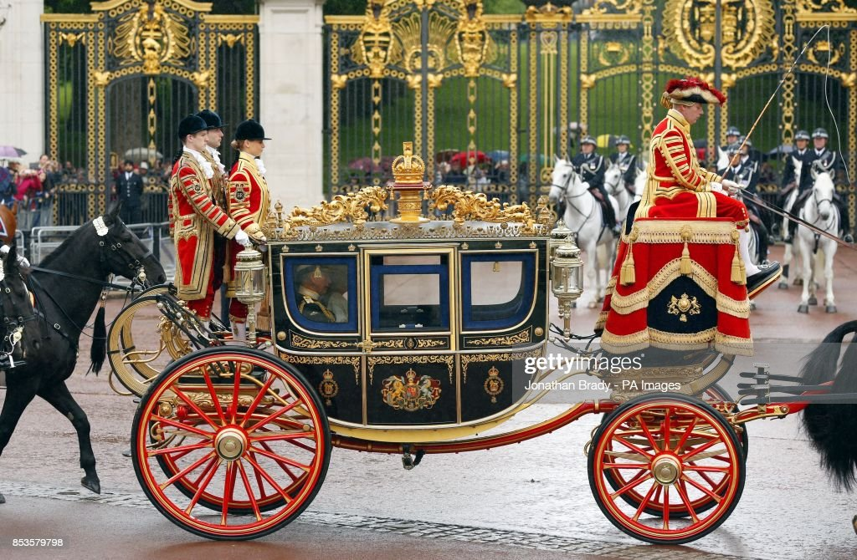
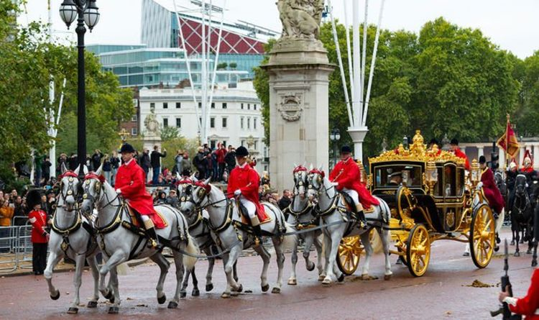
a carriage [ˈkærɪʤ] карета

Slide 8
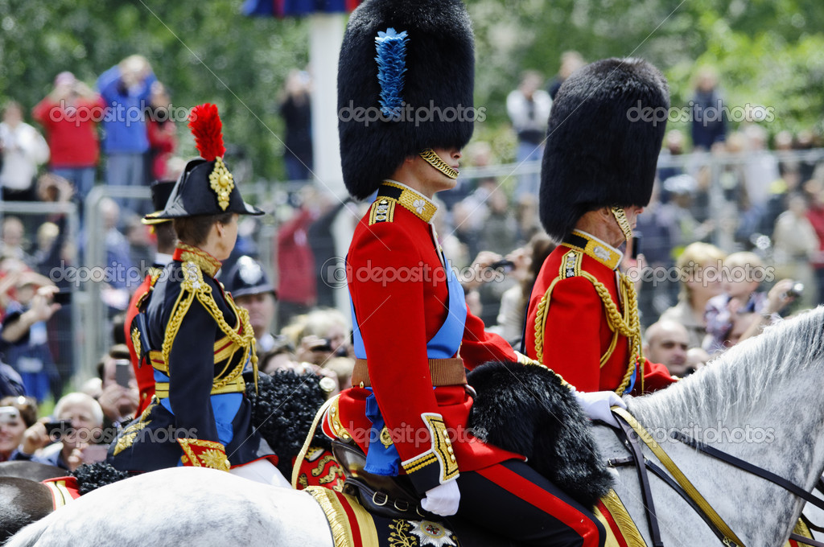
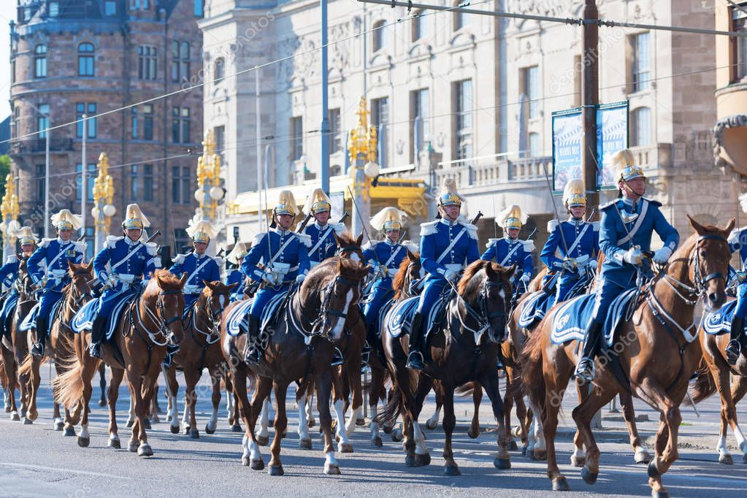
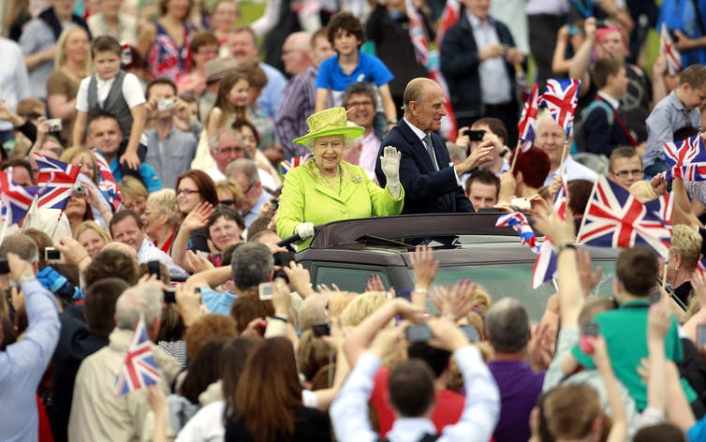
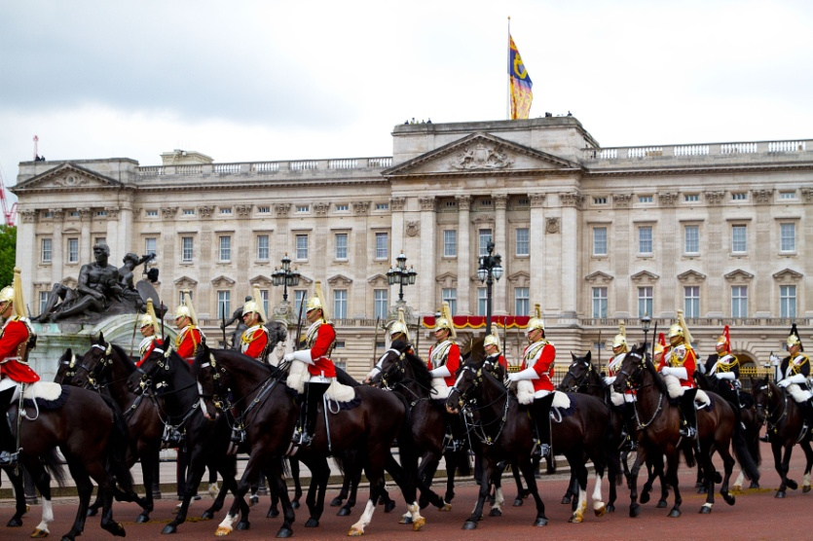
Parade [pəˈreɪd] парад

Slide 9
Homework:
Write a paragraph about any anniversaries or events you have celebrated recently (10-12 sentences).
p.86 ex. 8

