Slide 3
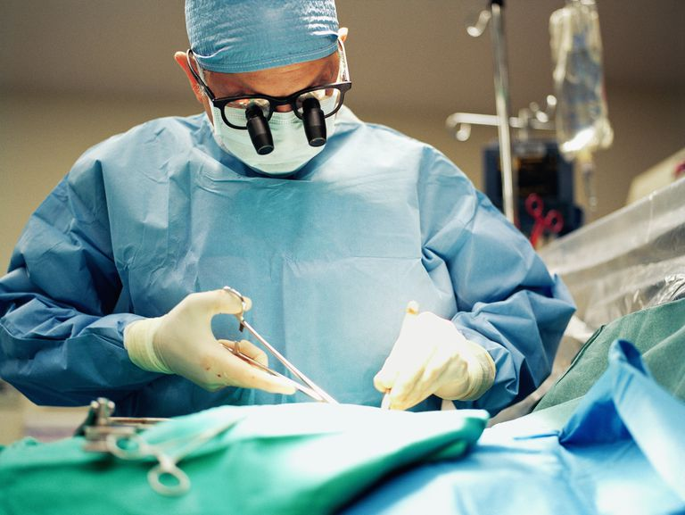

Slide 4
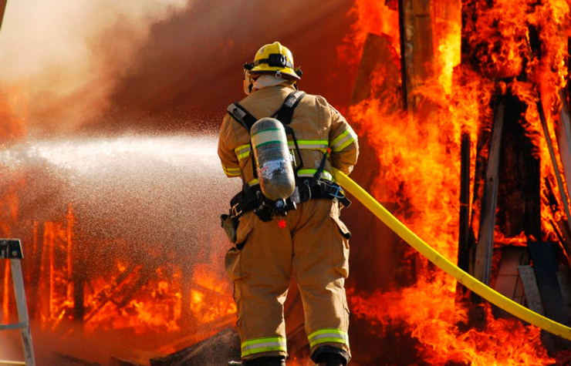

Slide 5
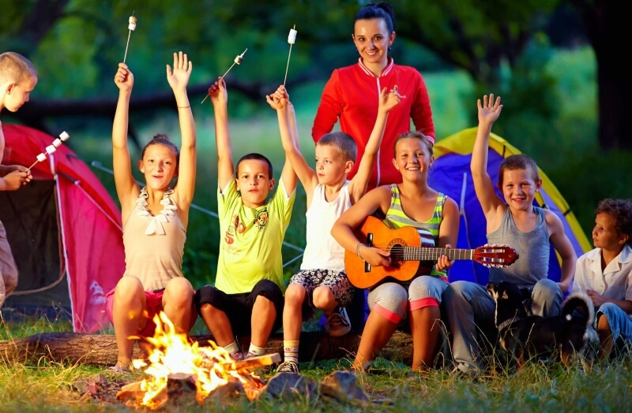

Slide 6
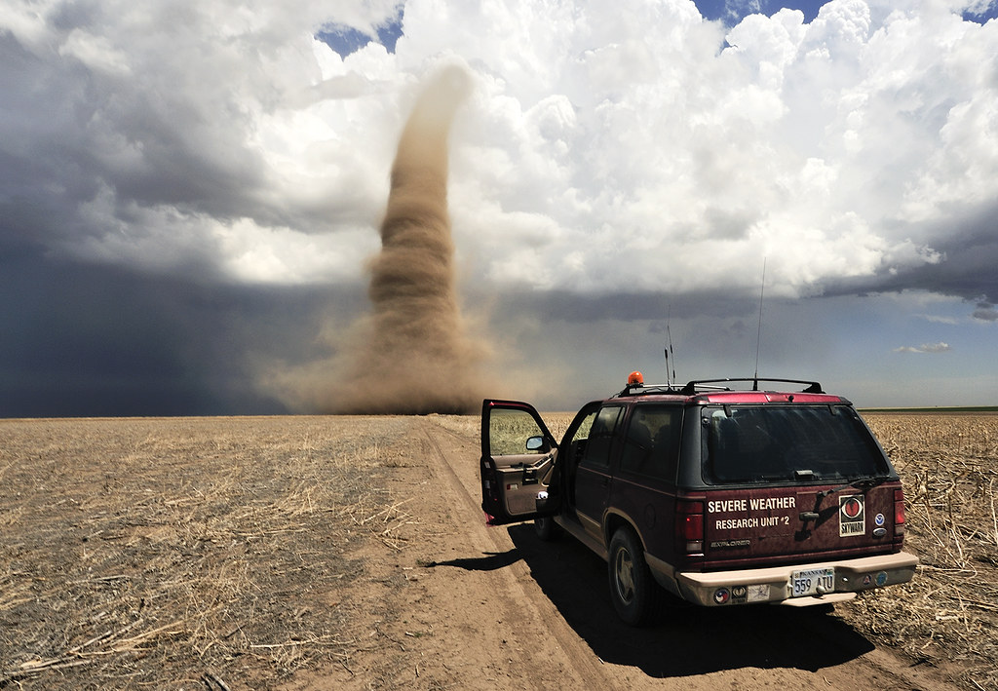

Slide 7
VOCABULARY Suffixes: -er, -or, -ist, -ian, -ant
He spent the day with an important -ian.
It isn’t easy being a – er.
Would you like to be a – ist ?
I’d love to be a – or for a day!
There are also some jobs available on university campuses, such as a research
–ant or a teaching –ant.

Slide 8
Choose a suitable job for these teens!
I want to do a job where I can write. I love writing and giving opinions. I don’t want to sit at a desk all day. I want to be with people and ask them questions.

Slide 9
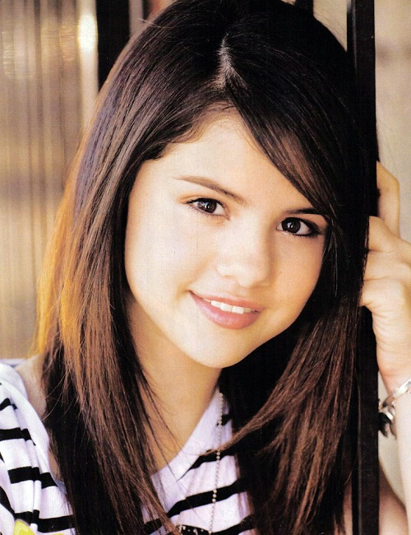
Choose a suitable job for these teens!
I want to create things. I’d really like to draw pictures of clothes that people can wear, and then try to make them. I think that would be awesome!

Slide 10
Choose a suitable job for these teens!
I like being outside. I’m quite strong and I don’t mind lifting heavy weights. I’d like to do a job where I’m helping to make something useful and beautiful.

Slide 11
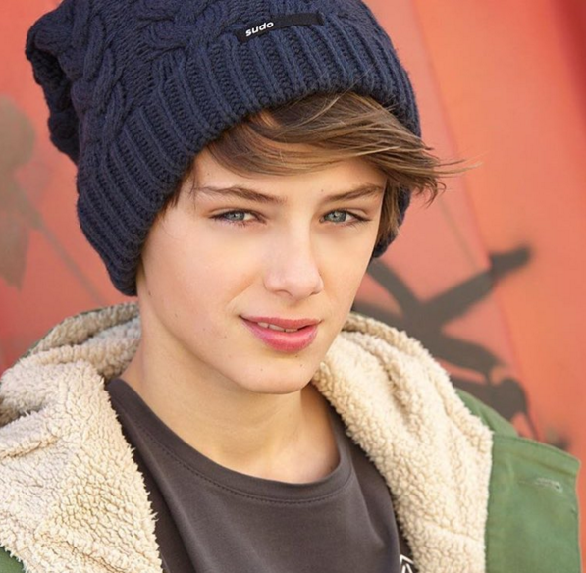
Choose a suitable job for these teens!
I want to work with people and I’d like to help them. I prefer working in a team and I don’t mind being in dangerous situations.

Slide 12
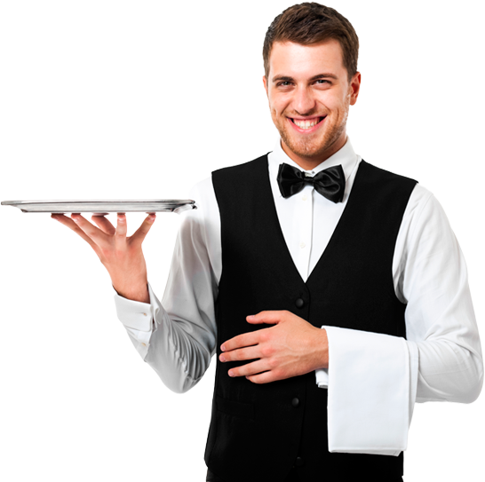
What do you have to do to get the job?

Slide 14
1. Look for adverts on the Internet or in some newspapers

Slide 15
2. Apply for a job.

Slide 16
3. Have a job interview.

Slide 17
Complete the formal phrases needed to apply for a job in a hotel.
1. I am writing to ______ for the ______ of receptionist.
2. My _______ ________ greeting guests and answering calls.
3. I _____ _____ to be responsible and reliable.
4. I would be very _____ for the ______ to visit your hotel and _______ my application in ______.
5. I look forward to ______ from you soon.

Slide 18
Complete the formal phrases needed to apply for a job in a hotel.
1. I am writing to apply for the position of receptionist.
2. My responsibilities included greeting guests and answering calls.
3. I consider myself to be hard-working, responsible and reliable.
4. I would be very grateful for the opportunity to visit your hotel and discuss my application in person.
5. I look forward to hearing from you soon.

Slide 21
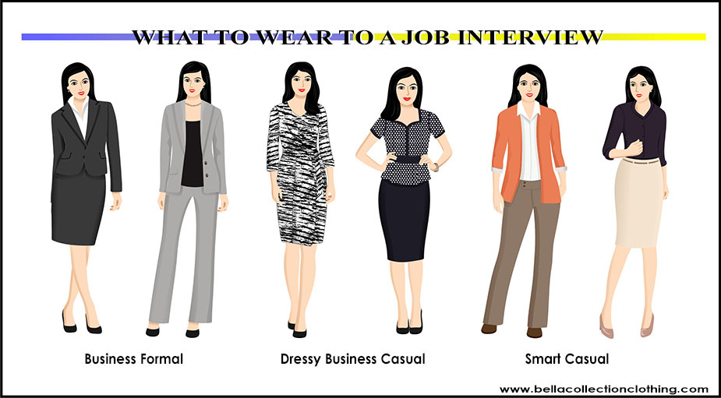

Slide 22
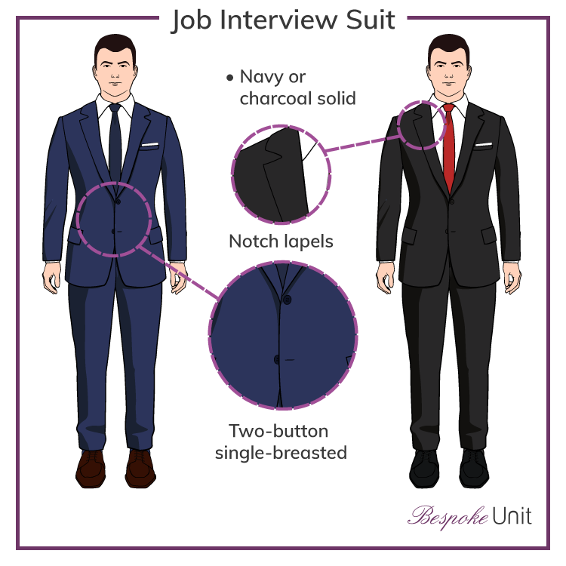

Slide 23
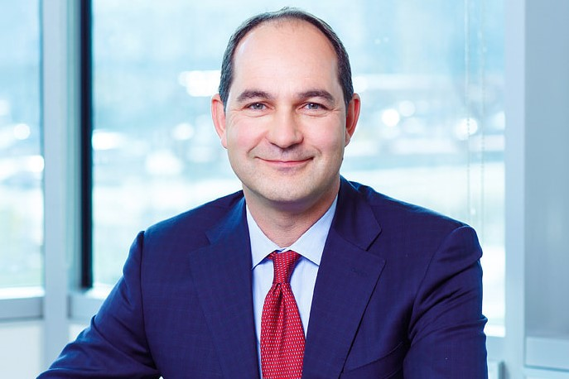
Get ideas If you were an employer, which person would you offer a job and why?

Slide 24
In your opinion, which three qualities are generally most important at work?
Flexible
Responsible
Hard-working
Friendly
Sociable
Honest
Patient
Physically fit
Reliable
In any job, it’s important to be …., …. and …..

Slide 25
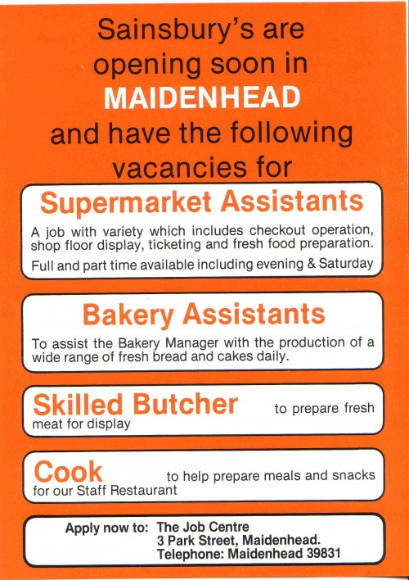
What job is the interview for?

Slide 26
Which qualities did Simon mention?
Qualities needed for jobs:
* сonfident * flexible
* persistent * polite
* enthusiastic * reliable
* creative * responsible
* sociable * hard-working
* energetic * ambitious
* honest * helpful
* friendly * physically fit

Slide 27
Order the words to make sentences. Listen again and check each other.
1. for I’m a looking part-time to job pay help university for.
2. you why think do you’ll a be shop assistant good?
3. have you do experience any this in type work of?
4. if offer we you job the, can when start you?

Slide 28
THANKS FOR YOUR HARD WORK!

