Slide 1
Important Inventions grade 4 teacher T. Vasilyeva

Slide 2
Plan of the lesson
Vocabulary
Speak about inventions and gadgets
True/false
Answer the questions
Grammar
Group work (speaking)

Slide 3
What is the most important invention? Why?
Keyboard | Internet | Wifi | Telephone | Penicillin
Tablet | Alphabet | TV | Wheel | X-ray
Computer | Magnifying glass | Remote control | Games console | Computer mouse
Printing | Radio | Cars | Numbers | Space inventions

Slide 4
True / False
People printed the first books by hand.
They used ink and a pencil called a quill, which they made from a feather.
They wrote on material, which they made from animal fur.
It took years to make one book.
A technology called pressing changed how people made books.
Johannes Gutenberg invented a printing machine.
This invention could make lots of books quickly.
It reduced the cost of the books.
More people were able to buy books and so more people learned to listen.

Slide 5
True / False
People wrote the first books by hand.
They used ink and a pencil called a quill, which they made from a feather.
They wrote on material, which they made from animal skins.
It took years to make one book.
A technology called printing changed how people made books.
Johannes Gutenberg invented a pressing machine.
This invention could make lots of books quickly.
It reduced the cost of the books.
More people were able to buy books and so more people learned to read.

Slide 6
Order the sentences
Number
 | They also drew pictures and coloured them with paint.
 | With the invention of audio technology, people didn’t need to read books. They could listen to them.
 | We can buy books on the Internet.
 | People made the first books by hand.
 | Now we can read books on an e-reader, a tablet or a smartphone.
 | With digital technology, it’s quicker to write a book.
 | Johannes Gutenberg invented a printing machine.

Slide 7
Number
2 | They also drew pictures and coloured them with paint.
4 | With the invention of audio technology, people didn’t need to read books. They could listen to them.
6 | We can buy books on the Internet.
1 | People made the first books by hand.
5 | Now we can read books on an e-reader, a tablet or a smartphone.
7 | With digital technology, it’s quicker to write a book.
3 | Johannes Gutenberg invented a printing machine.

Slide 8
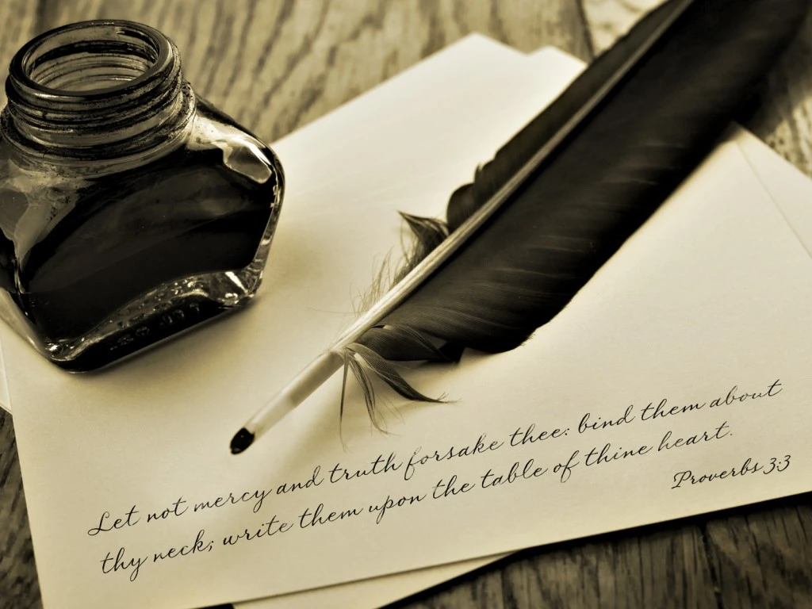

Slide 14
Open the brackets
Johannes Guttenberg ……………… (invent) the printing machine many years ago. It ………………..(take) years to make one book.
What …………you …………….. (do) now? – I …………………..(listen) to the music. – But I don’t hear any music! – Look! I …………………….(use) my earphones!
Many years ago books ………………(be) very expensive because people ……………….. (make) them by hand.
I ………………(use) my tablet every day. I …………………(look for) some information in the Internet and my brother ………………….. (download) music.

Slide 15
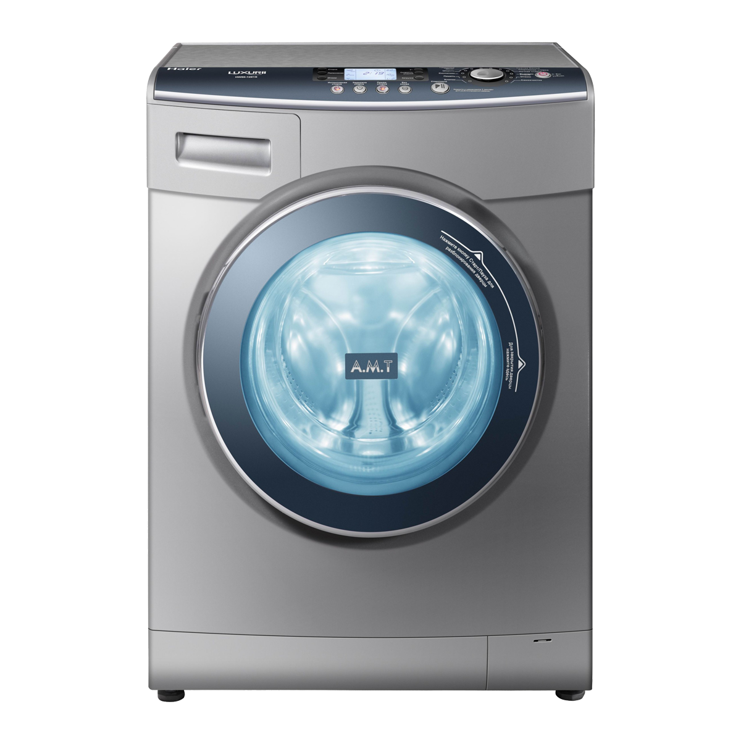
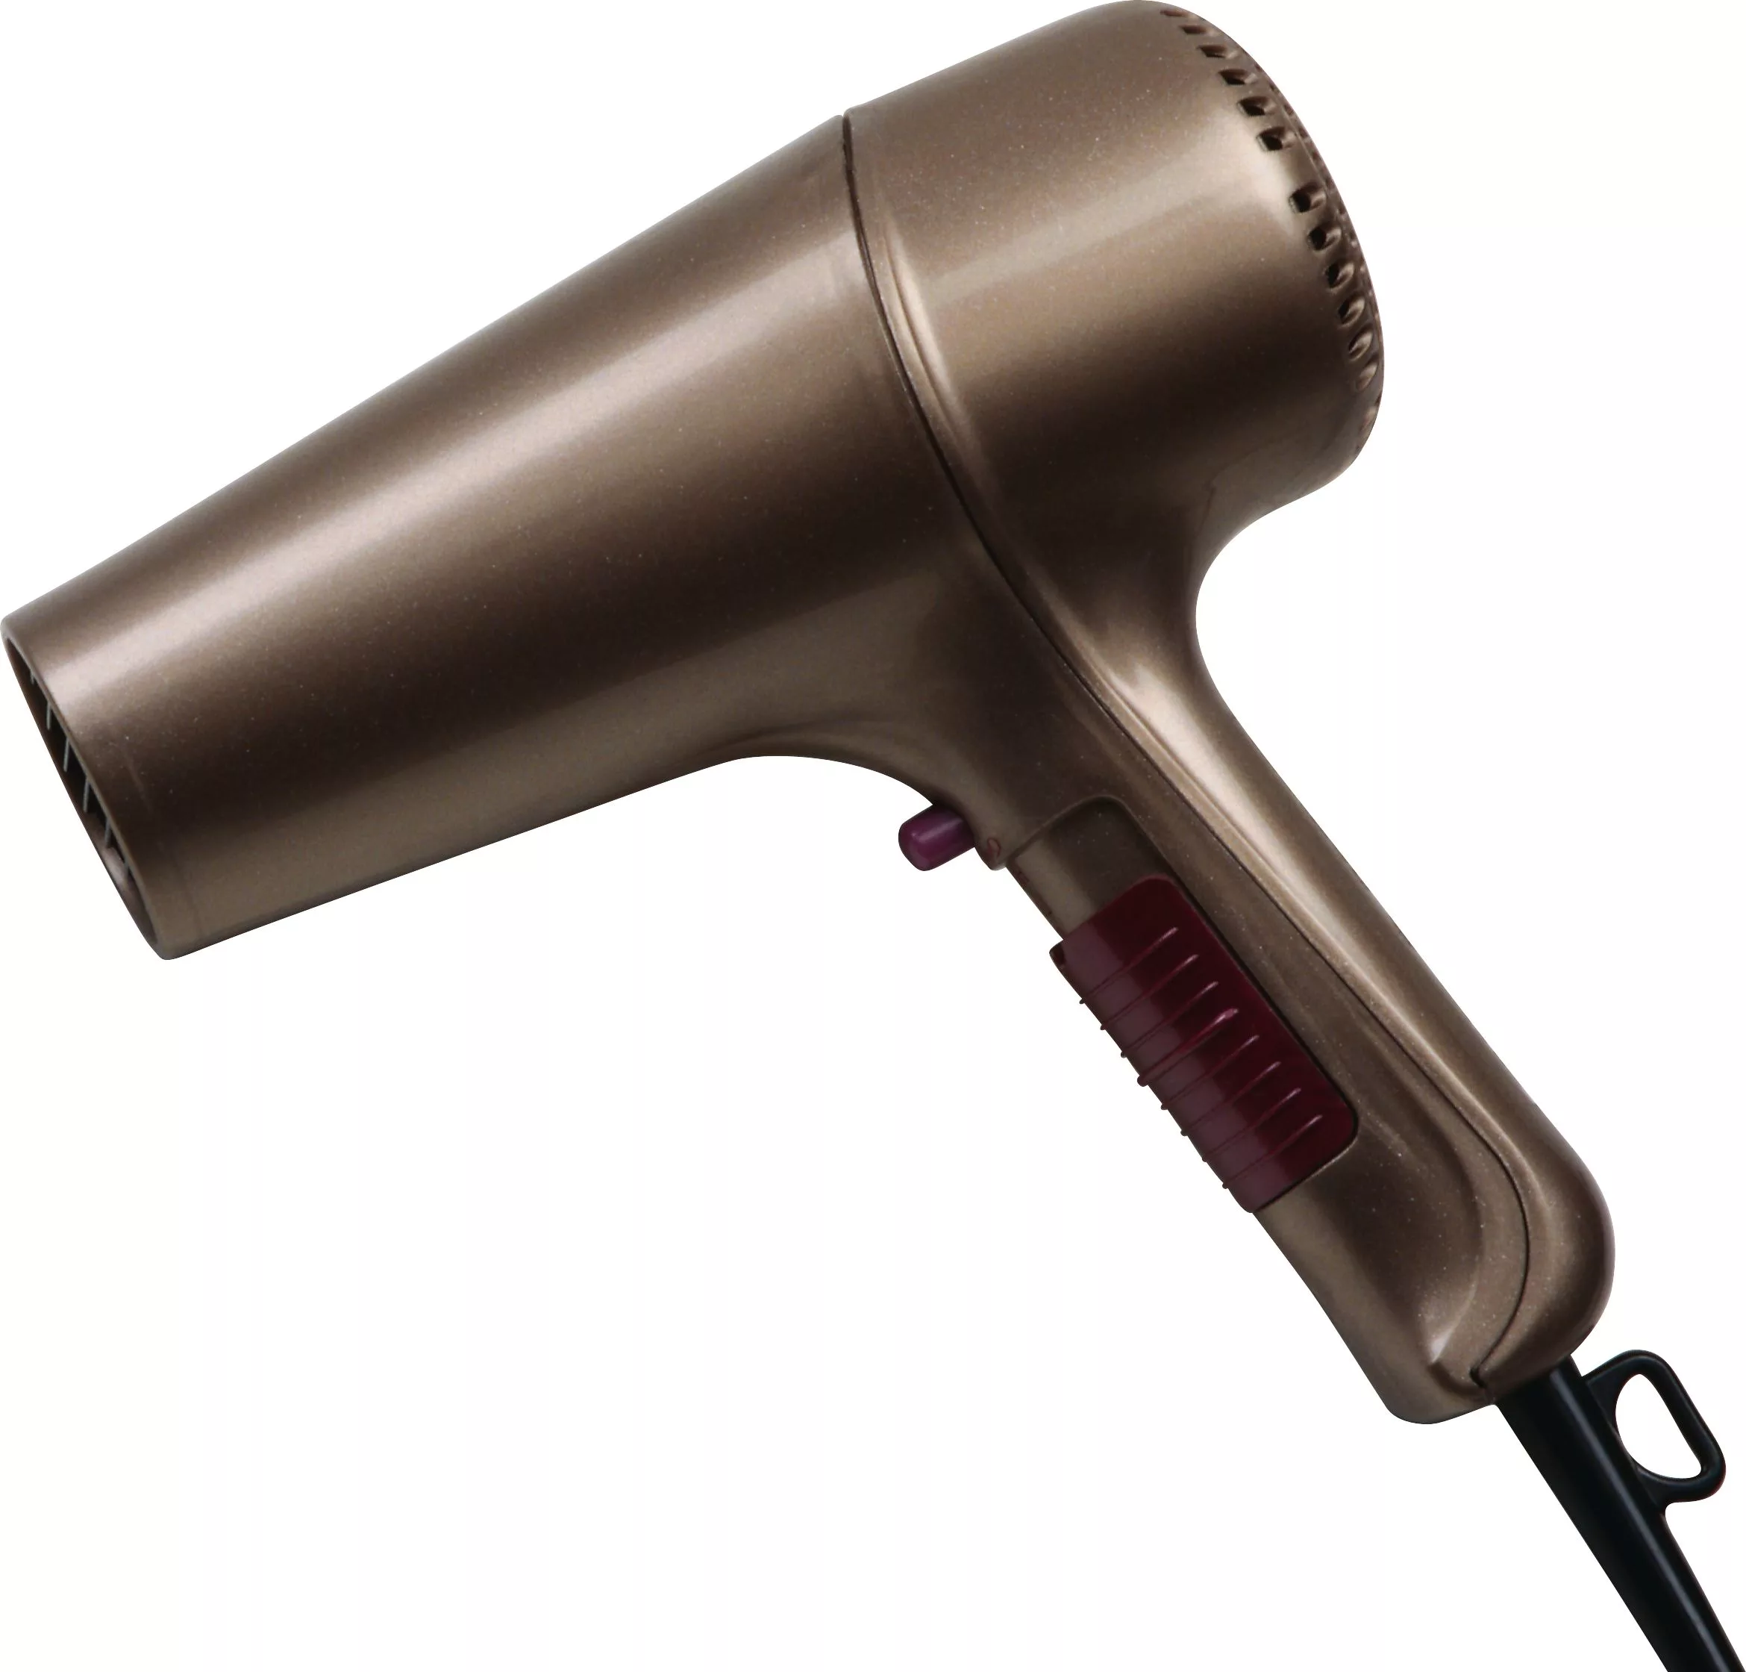
Fill in: Which / who / where
A washing machine is a thing …………..
we use to wash clothes
A hair drier is something …………we use to dry hair

Slide 16
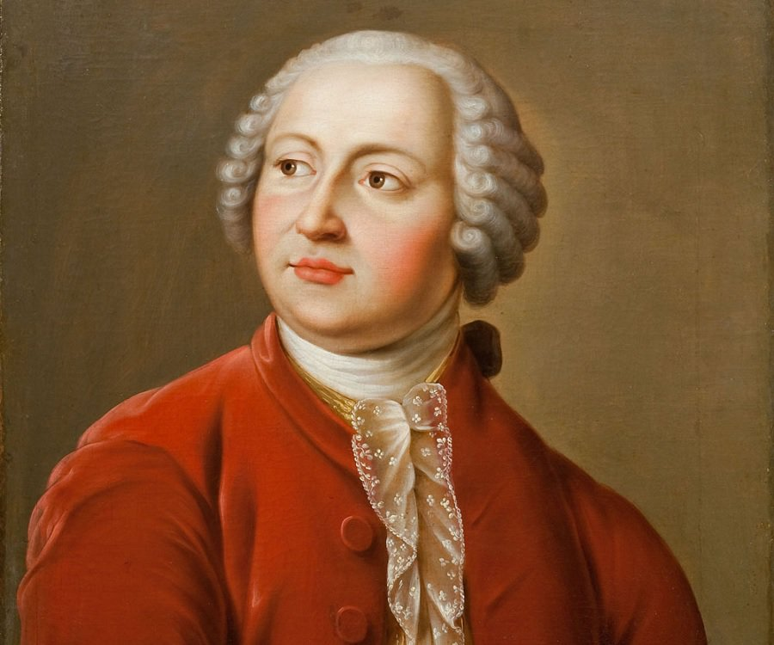
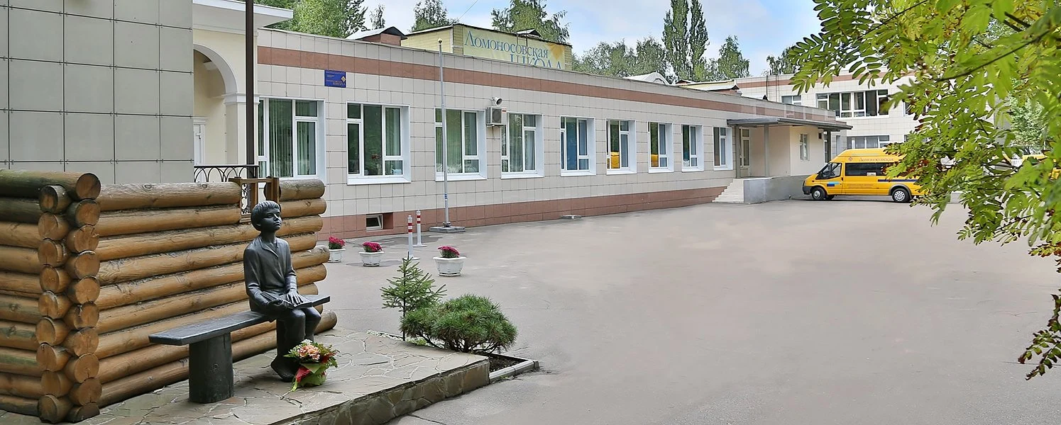
Fill in: Which / who / where
Lomonosov is a scientist ………….. gave his name to our school.
Mozhayskoe Avenue is the street ……………..you can see our school.

Slide 17
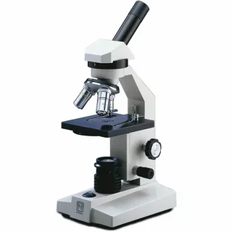
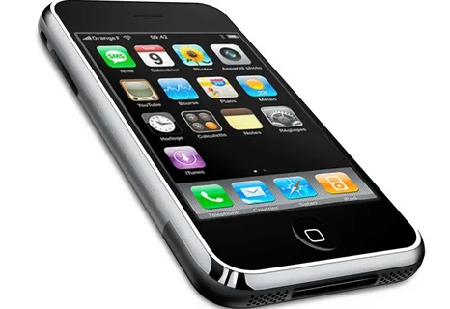
Fill in: Which / who / where
A mobile phone is some thing …………. we use to call people.
A microscope is a thing ________ we use to see small things.

Slide 18
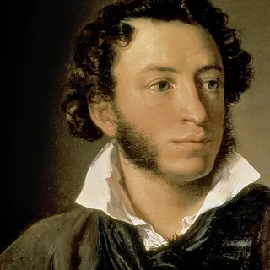
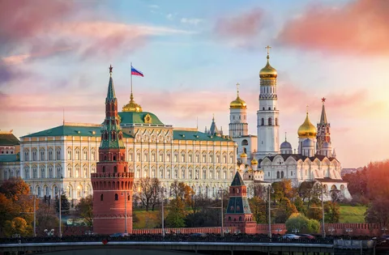
Fill in: Which / who / where
Pushkin is a person ………….. wrote “ Golden Fish”.
Kremlin is a place ……………..the president of Russia works.

Slide 19
Guess the word. Make your own riddle
School is the place where we can use it.
The students are people who can read it.
It’s a thing which is important for learning.
It can be different colours, big and small, thin and thick.
We use it at daytime or with the lamp. You shouldn’t use it lying in bed – it’s bed for your eyes.
It is an important invention because…

